Slide 1
Automated knowledge base construction 1. Introduction
Simon Razniewski
Summer term 2022

Slide 2
Outline
Introducing each other
Course organization
What, Why, How
Lab 1

Slide 3
Simon Razniewski
Senior Researcher at MPII, Department 5
Heading “Knowledge Base Construction and Quality” area
Background
Assistant professor FU Bozen-Bolzano, Italy, 2014-2017
PhD FU Bozen-Bolzano, 2014
Diplom at TU Dresden, 2010
Research areas:
Logics, databases, Semantic Web
More recently IR, (applied) NLP, ML, …
Research focus: Knowledge base construction and quality
Analyzing what knowledge bases know, and what they don’t
Commonsense knowledge base construction

Slide 4
Tutorial teachers
Hiba Arnaout
Shrestha Ghosh
Sneha Singhania
Tuan-Phong Nguyen
Doctoral researchers at D5, MPII
Knowledge base construction, question answering, knowledge coverage, commonsense knowledge, …

Slide 5
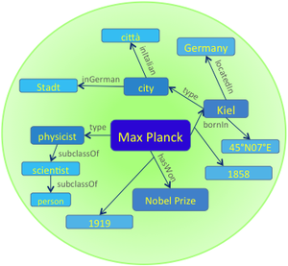
Department 5
Department 5: Database and information systems
Knowledge discovery: extracting, organizing, searching, exploring and ranking facts from structured, semi-structured, textual and multimodal information sources
Knowledge Base
Earliest prominent machine-generated knowledge base (2007)
Contains more than 10 million entities and more than 120 million facts
Gerhard Weikum 259th most cited computer scientist worldwide
Notes:
Source: http://www.guide2research.com/scientists/

Slide 6
And you?
Course of study
Preknowledge
…
Comments?
https://tinyurl.com/4xpk8enh

Slide 7
Outline
Introducing each other
Course organization
What, Why, How
Lab 1

Slide 8
Learning outcomes
Knowledge
What AKBC is about (“What”)
What AKBC is good for (“Why”)
What main tasks and challenges in AKBC are
What common approaches to problems in AKBC are (“How”)
Skills
Analyze potentials and limitations of AKBC approaches
Learn to choose right source and method for right task
Implement simple solutions for main problems in AKBC
Scraping, typing, linking, …
Abilities
Build your own AKBC pipeline for a problem
→ Very practical focus!

Slide 9
Prerequisites
Basic concepts of ML
We won’t go deep
Python programming
Essential
Still time to learn
Helpful but not required
Basic notions of information retrieval (IRDM?)
Computational linguistics (SNLP?)

Slide 10
Formal organization
Credit points: 6, hours: 180 (!)
Registration
Subscribe to the mailing list https://groups.google.com/g/akbc2022/
Register in HISPOS until 4.7. for the exam
When?
Lecture: Wednesday 12:15-13:45
Lab: Wednesday 16:15-17:45
How to pass this course?
8 small practical assignments
Pass/fail
To be admitted to exam, pass at least 6
Oral exam

Slide 11
Assignments
Published on lecture day (Wednesday)
Due Monday 23:59 the week after
Labs are there to start solving the assignments
Discussing assignments together is allowed, but each student must write their own solution
No sharing of code!
Plagiarism = course failed for both
Avoid triangular plagiarism = cite sources
“Approach for NER adapted from stackoverflow.com/how-to-…”
Libraries that solve core tasks not allowed
In doubt ask..
Weekly assignments are evil!?
Established psychological “trick” to help you learn and pass!

Slide 12
Assignment content
Coding
4 assignments are in competition format
Crisp input/output problem specification
“From the first sentence of Wikipedia, extract the type of an entity”
Labelled training/test data set
Unseen (hidden) evaluation dataset
To avoid overfitting
Ranked list by a standard metric, e.g., precision or F1-score
But pass/fail does not depend on rank

Slide 13
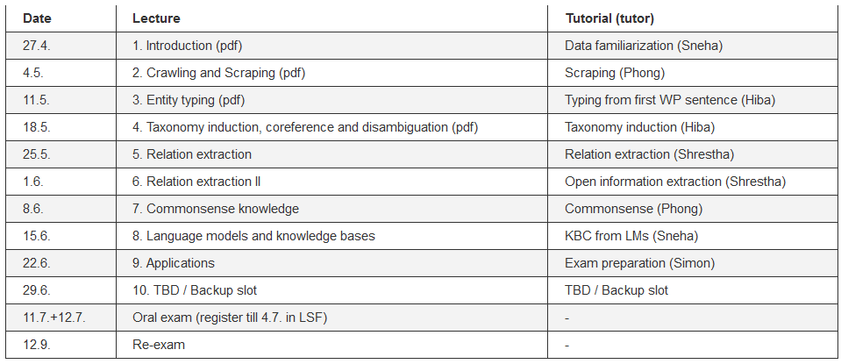
Schedule

Slide 14
Outline
Introducing each other
Course organization
What, Why, How
Lab 1

Slide 15
3. Introduction to AKBC
Motivation
Terminology
Topics
Construction techniques
Applications
Past, present and future

Slide 16
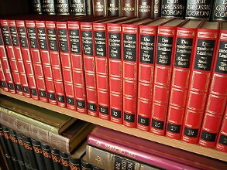
I. Motivation

Slide 17
https://en.wikipedia.org/wiki/Max_Planck_Institute_for_Informatics
https://www.wikidata.org/wiki/Q565400

Slide 18
What for?
One central hub for interlanguage interlinking of 100+ Wikipedia editions
Your AI chatbot wants to know where MPII, MIT and KAIST are located? → structured query
A library wants to distinguish which of the 100+ literary John Smiths wrote “A description of New England”? → Wikidata ID

Slide 19
Samples of advanced queries
Who discovered the most planets: http://tinyurl.com/y7rldyqc
Distribution of places ending with “-weiler” in Germany: https://w.wiki/67o
Living relatives of Louis XIV of France: https://w.wiki/549E

Slide 20
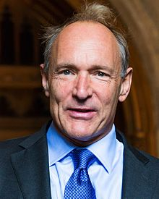
The Semantic Web
Term coined by Tim Berners-Lee for a machine-readable Web
Web content originally from humans for humans
→ Make machines read human language, or make humans write machine-readable structured data?

Slide 21
3. Introduction to AKBC
Motivation
Terminology
Topics
Construction techniques
Applications
Past, present and future

Slide 22
Facts (triples) and their constituents
Entities: Objects about which statements can be made Paris; Trump; Irony
Property/predicate/relation/attribute: What can be said locatedIn(entity, location), worksAt(person, organization), antonymOf(term, term)
Fact/statement/claim/triple: Core building block of KBs <Paris, locatedIn, France>
General form:
<subject, predicate, object>
<s, p, o>

Slide 23
Subjects and objects
Machine-generated identifiers
Wikidata: Q4262, Q67245
Canonical name strings
DBpedia, YAGO: “John_Smith_(politician)”
Internationalized resource identifier (IRI)
Semantic web: http://dbpedia.org/resource/Max_Planck
General phrases
TupleKB: <industry, grow over, past few decade>
Literals: Attribute values that are no entities
www.mpi-inf.mpg.de
Often with units: 1.63m; 54.85° N
Same for predicates, sometimes canonicalized, sometimes just text

Slide 24
Classes and class hierarchies
Classes/types: Allow to group similar entities Presidents, nouns, Greek gods
Type/property hierarchy: Tree-like hierarchy among types/properties (cf. inheritance in object-oriented programming) <Town, subclassOf, Administrative_unit>

Slide 25
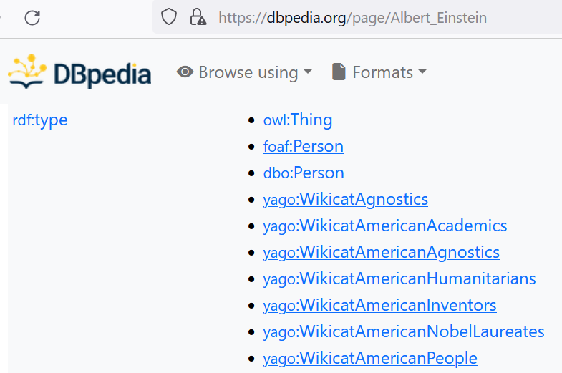
Classes

Slide 26
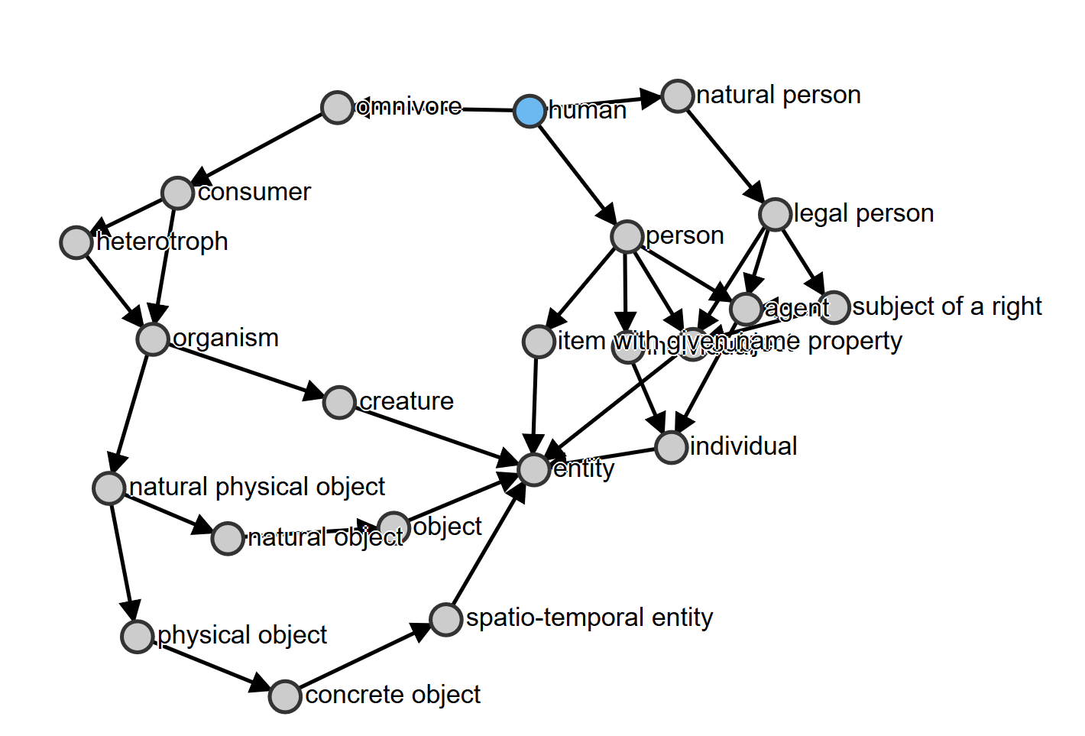
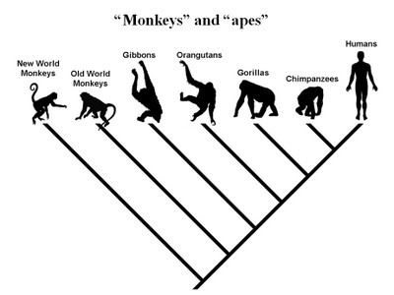
Taxonomies
https://angryloki.github.io/wikidata-graph-builder/?property=P279&item=Q5

Slide 27
Knowledge base: Definition
A knowledge base (KB) is a collection of structured data about entities and relations with the following characteristics:
Content: The KB contains entities and their semantic types for a given domain of interest. Additionally, attributes of entities (including numeric and string literals) and relationships between entities are captured.
Schema and Scale: Unlike a conventional database, there is often no pre- determined relational schema where all knowledge has to fit into a static set of relations. If fixed, longitudinal evolution must allow ad-hoc additions where the set of types and relations may grow to ten or hundred thousands.
Open Coverage: New entities and facts emerge and get covered in new web sources at high rate. Therefore, we have to view KB construction and maintenance as a “never-ending” task, following an open world assumption and acknowledging the high pace of real-world changes.
[Weikum et al., FnT 2021]

Slide 28
3. Introduction to AKBC
Motivation
Terminology
Topics
Construction techniques
Applications
Past, present and future

Slide 29
Common topics of knowledge bases
Lexical knowledge
<shout, isA, verb>
<shout, subformOf, communicate>
Instance knowledge (“Encyclopedic KBs”):
<Paris, capitalOf, France>
<MPII, foundedIn, 1988>
<Angela Merkel, major, Physics>
Class knowledge (“Commonsense”):
<Pizza, is, tasty>
<Elephant, color, grey>
<turnOnPC, requires, power>

Slide 30
Lexical KBs
WordNet (1995)
FrameNet (1998)
(Wiktionary (2002))
SenticNet (2010)
…

Slide 31
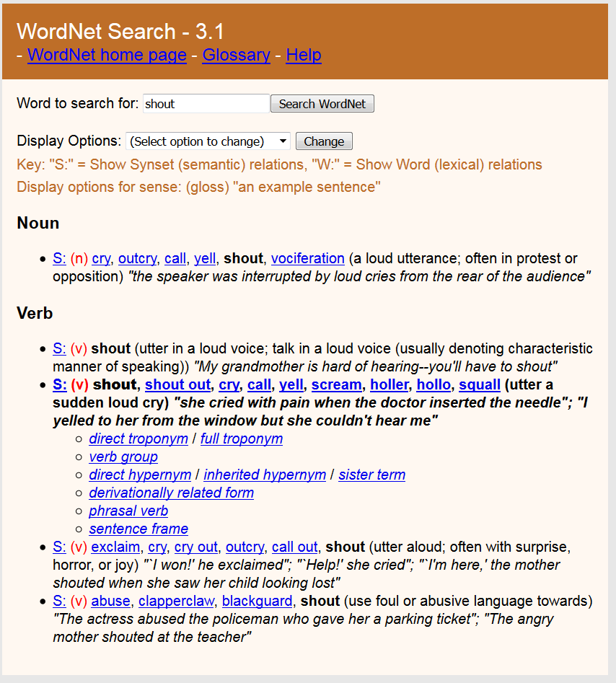

Slide 32
FrameNet
Example Frame – “Revenge”: Because of some injury to something-or-someone important to an avenger (maybe himself), the avenger inflicts a punishment on the offender. The offender is the person responsible for the injury.
Frame elements:
avenger, offender, injury, injured_party, punishment.
Invoking terms:
Nouns: revenge, vengeance, reprisal, retaliation
Verbs: avenge, revenge, retaliate (against), get back (at), get even (with), pay back
Adjectives: vengeful, vindictive

Slide 33
Encyclopedic KBs (“Instance-oriented KBs”)
Cyc (1984)
YAGO (2007)*
DBpedia (2007)
Wikidata (2012)
* developed at MPII

Slide 34
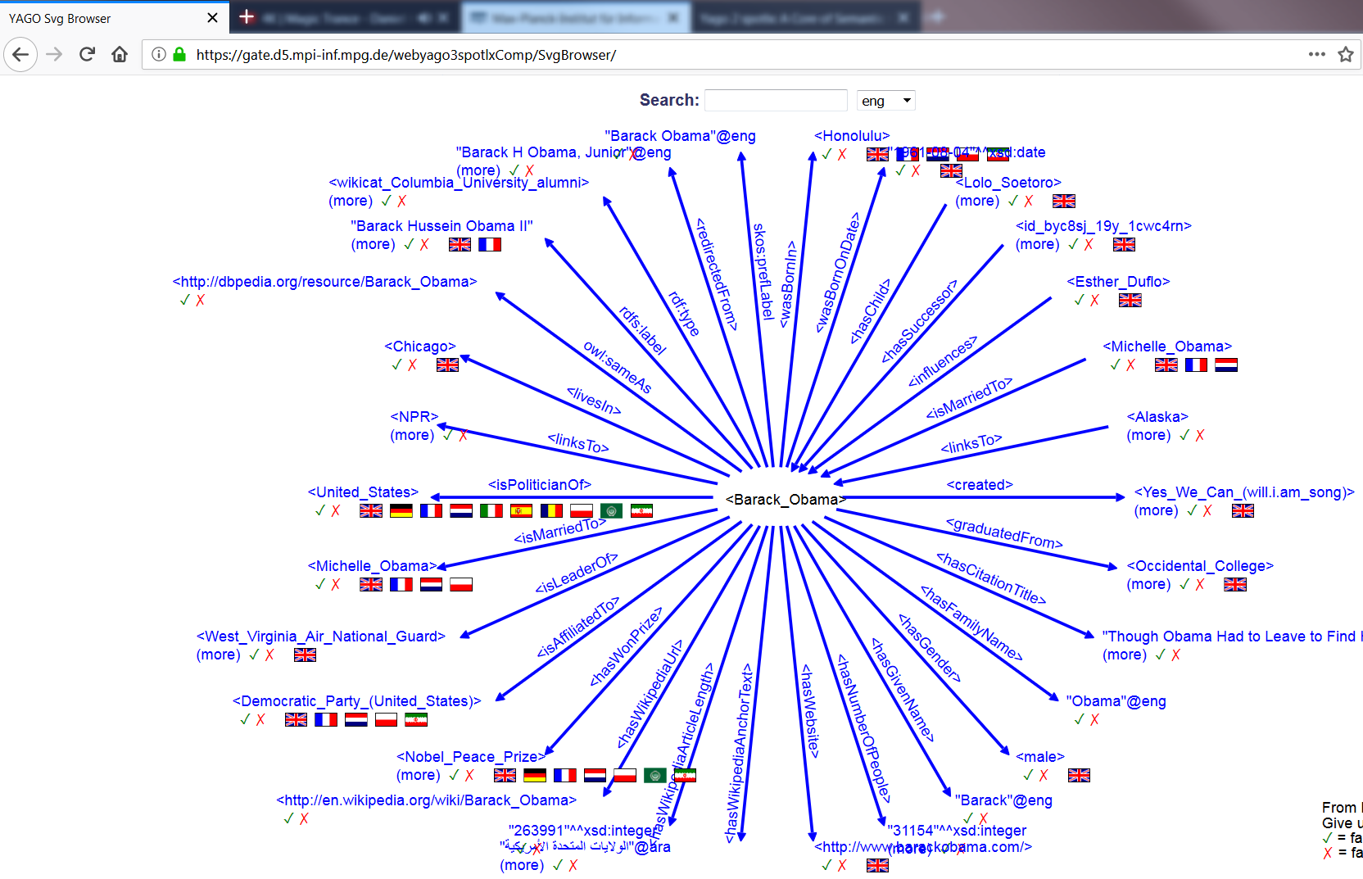

Slide 35
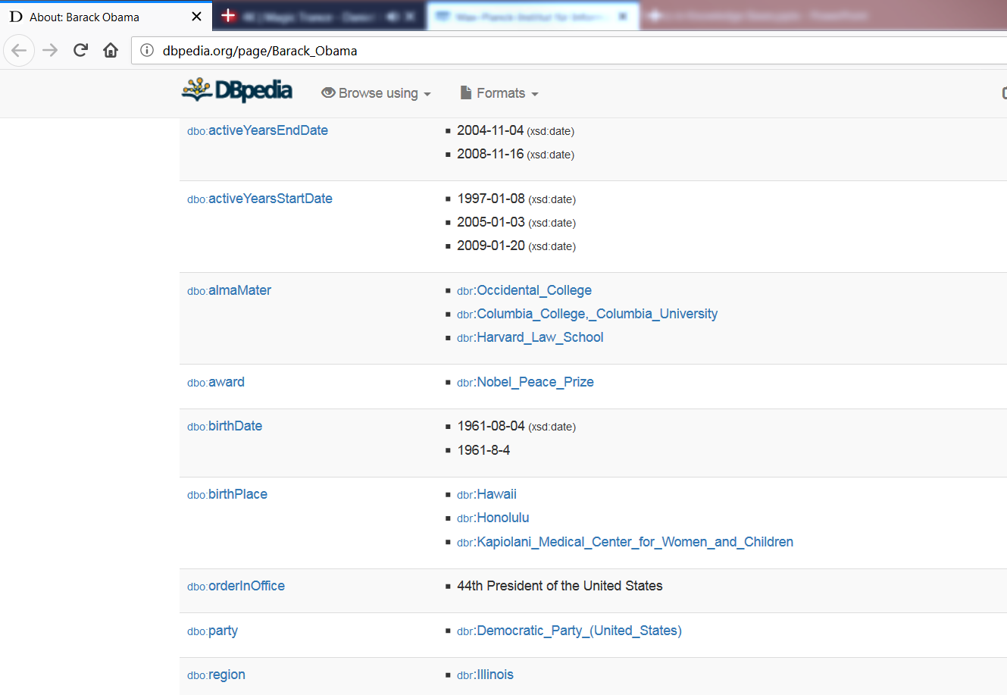

Slide 36
Commonsense KBs (class-oriented)
Cyc (1984)
ConceptNet (1999)
TupleKB (2017)
Quasimodo (2019)*
Ascent (2021)*
* Developed at MPII

Slide 37
ConceptNet

Slide 38
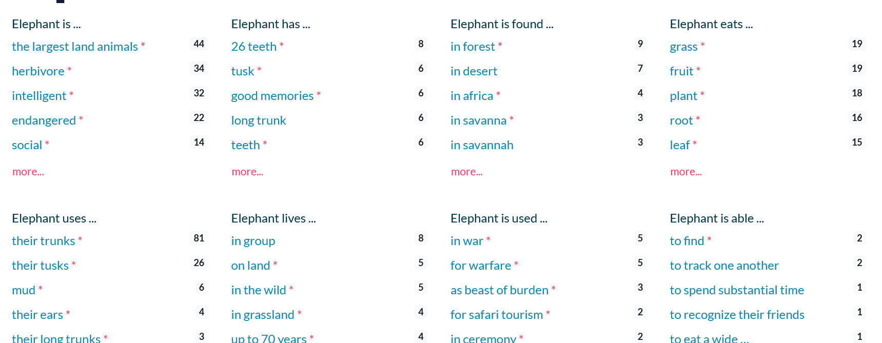

Slide 39
3. Introduction to AKBC
Motivation
Terminology
Topics
Construction techniques
Applications
Past, present and future

Slide 40
How to build KBs?

Slide 41
Possible approaches
Humans (CYC, ConceptNet, Wikidata)
Structured extraction (YAGO, DBpedia)
Text extraction (NELL, Textrunner)
Constraints and pattern mining
Our focus

Slide 42
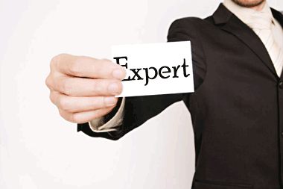
A. Humans: Experts
Potentially best quality
Difficult to scale
CYC: “In 1986, Doug Lenat estimated the effort to complete the KB to be 250,000 rules and 350 man-years of effort.”

Slide 43
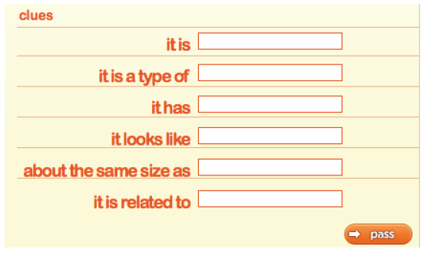
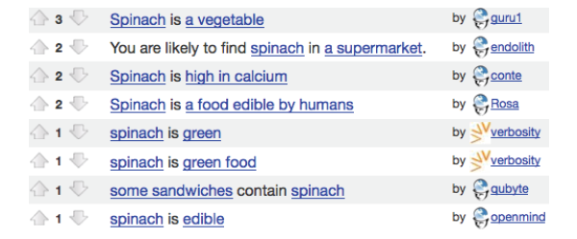
Humans: Crowdsourcing/Gamification
Make work fun (?)

Slide 44
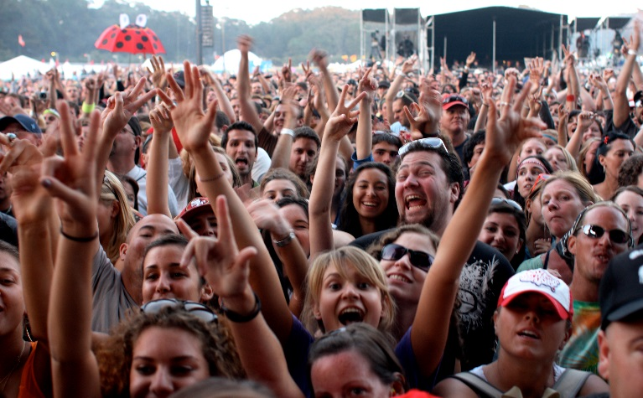
Humans: Volunteers
Wikidata: 18k active users
Intrinsic motivation achieves great things
Broad expertise, compared with selected experts or paid crowdsourcing
https://www.wikidata.org/wiki/Wikidata:Database_reports/List_of_properties/all

Slide 45
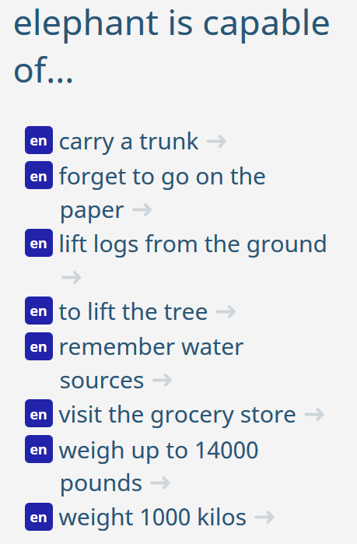
Humans: Challenges
ConceptNet:
Common knowledge, normalization
Crowdsourcing: Quality assurance
Wikidata: Modelling and agreement
E.g., ethnicity, notable_work, …
Multilingual concept alignment

Slide 46
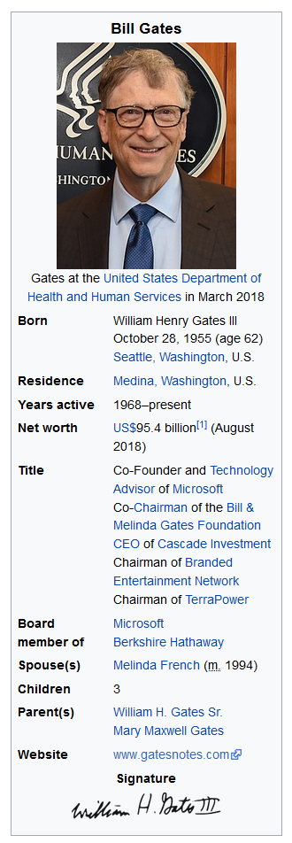
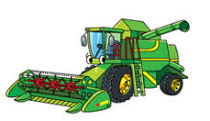
B. Structured extraction
Wikipedia already provides structured data
All we need to do is harvest…

Slide 47
Work done?
Noise
Canonicalization of entities and predicates
Usage of category system
Examples: YAGO, DBpedia

Slide 48
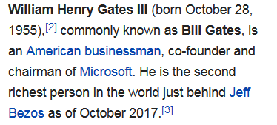
C. Text extraction
In principle most powerful
No need for humans
No restriction to Wikipedia existence
In practice big noise challenges
Many pipeline steps
Named-entity recognition, named-entity disambiguation, relation extraction, relation canonicalization, extraction consolidation, ..
Examples: NELL, Textrunner

Slide 49
Text extraction demo (relations part)
https://www.rosette.com/capability/relationship-extraction/#try-the-demo
Merkel is of German and Polish descent. Her paternal grandfather, Ludwik Kasner, was a German policeman of Polish ethnicity, who had taken part in Poland's struggle for independence in the early 20th century.[22] He married Merkel's grandmother Margarethe, a German from Berlin, and relocated to her hometown where he worked in the police. In 1930, they Germanized the Polish name Kaźmierczak to Kasner.[23][24][25][26] Merkel's maternal grandparents were the Danzig politician Willi Jentzsch, and Gertrud Alma née Drange, a daughter of the city clerk of Elbing (now Elbląg, Poland) Emil Drange. Since the mid 1990s, Merkel has publicly mentioned her Polish heritage on several occasions and described herself as a quarter Polish, but her Polish roots became better known as a result of a 2013 biography.
In 1968, Merkel joined the Free German Youth (FDJ), the official communist youth movement sponsored by the ruling Marxist–Leninist Socialist Unity Party of Germany.[30][31][32] Membership was nominally voluntary, but those who did not join found it difficult to gain admission to higher education.[33] She did not participate in the secular coming of age ceremony Jugendweihe, however, which was common in East Germany. Instead, she was confirmed.[34] During this time, she participated in several compulsory courses on Marxism-Leninism with her grades only being regarded as "sufficient".

Slide 50
D. Constraints
Databases
Key, foreign key, range, …
Knowledge bases:
Events start earlier than they end
Every human must have two parents
Mayors of cities must be humans
The parent of a person’s sibling is the person’s parent
Can be used to…
… reject KB modifications
… indicate missing information
… infer new facts
But reality is messy..

Slide 51
3. Introduction to AKBC
Motivation
Terminology
Topics
Construction techniques
Applications
Past, present and future

Slide 52
What KBs are good for
Master data
Data mining
Search enhancements
Question answering
Language generation
Entity linking
Learning more knowledge
….

Slide 53
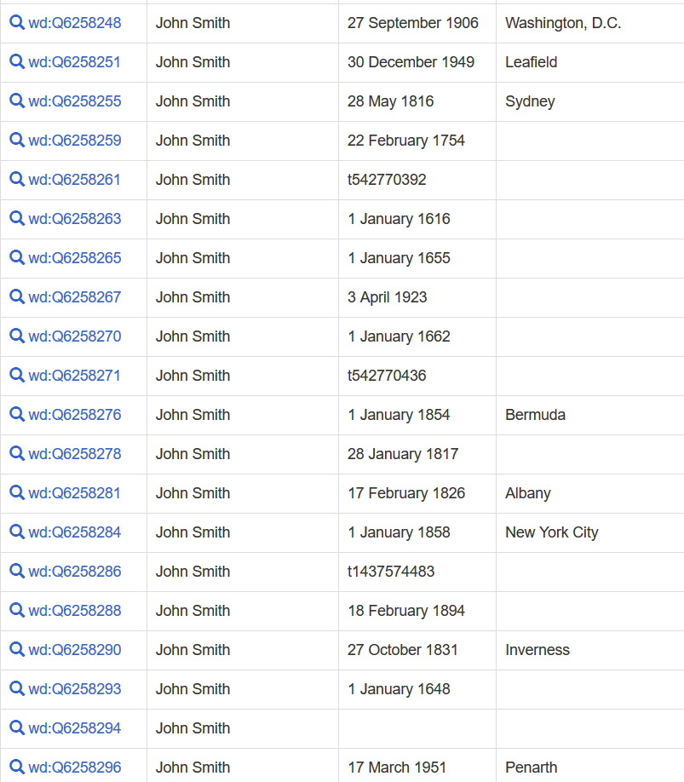
Master data (1)
(300 more)
https://w.wiki/A4Z

Slide 54
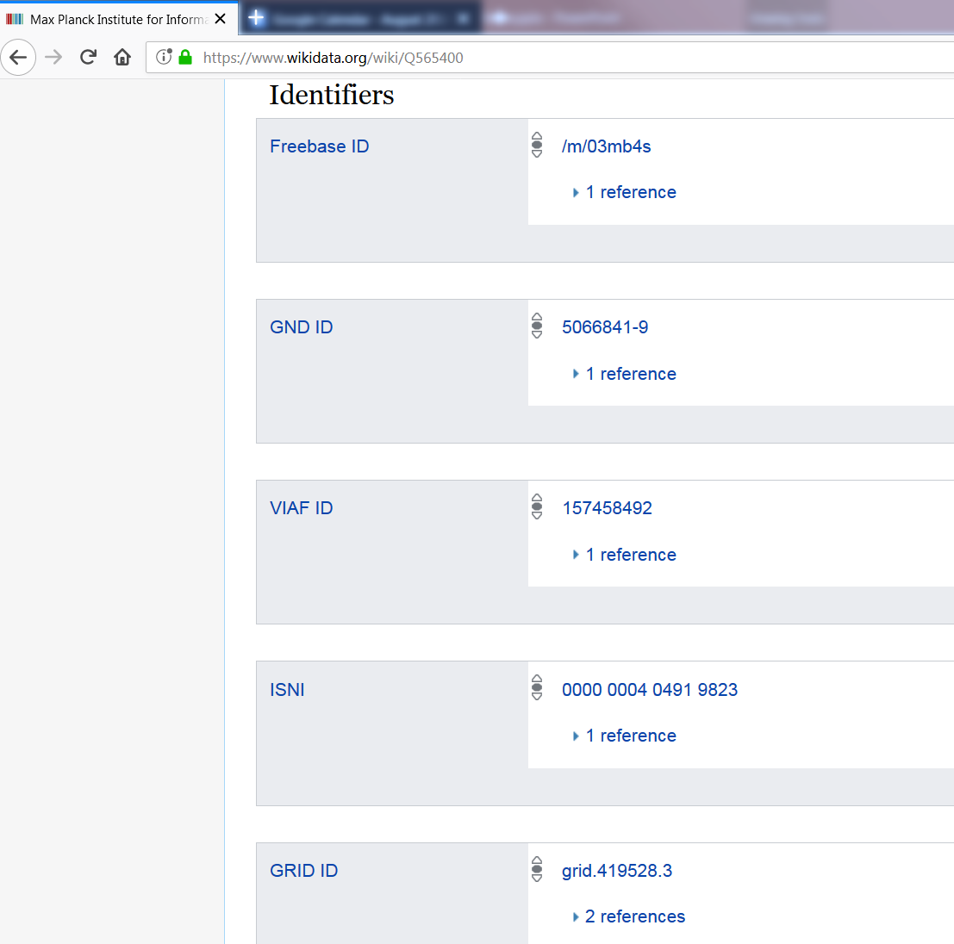
Master data (2)
Relevant for:
- Museums
- Libraries
- Scientific publications
….

Slide 55
Data mining
Use input facts to extract patterns that allow to predict new facts
isCitizenOf(John, France) → livesIn(John, France)
Various approaches based on association rule mining and latent models

Slide 56
Entity linking
https://opentapioca.org/
Notes:
[[Angela]] met [[Donald]] and together they discussed about [[Vladimir]]
Associated Press writer Julie Pace contributed from Washington. She knows Obama and lives in Berlin.

Slide 57
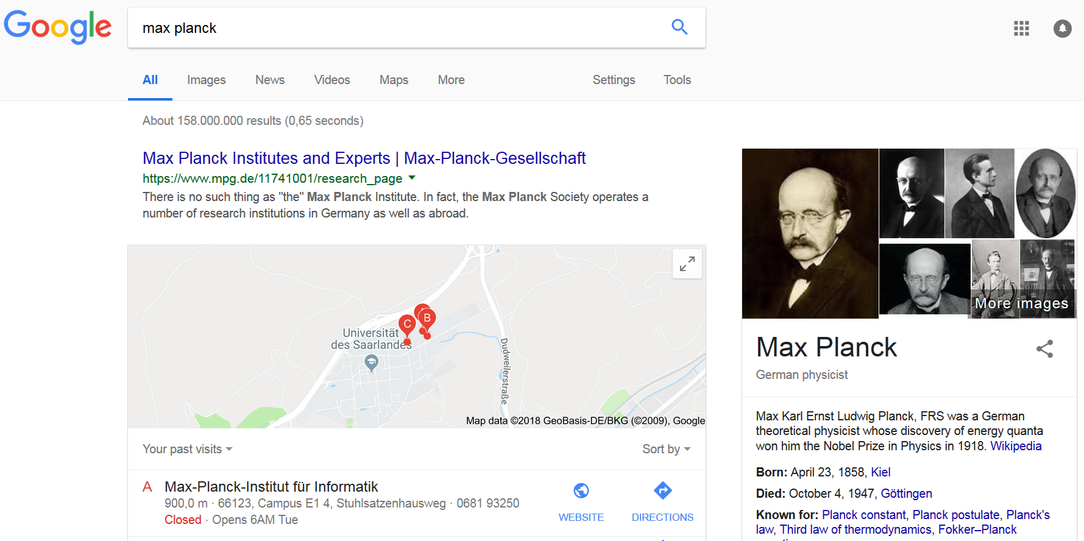
Search enhancements

Slide 58
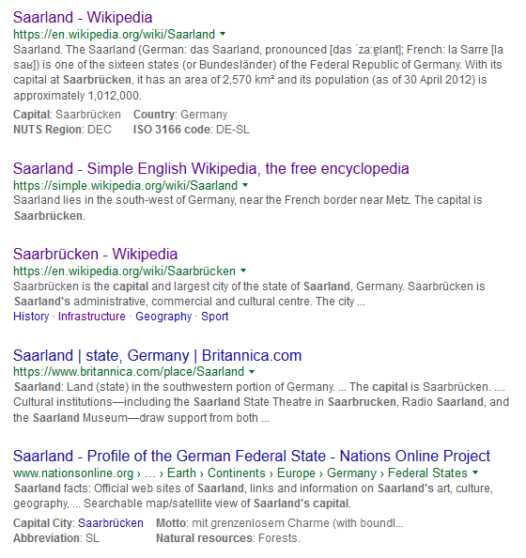
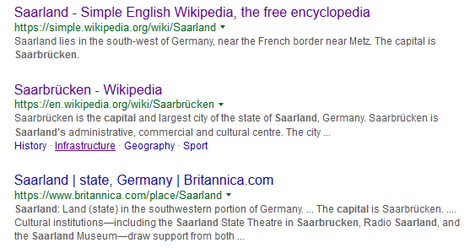
Question answering
What is the capital of the Saarland?
Try yourself:
When was Trump born?
What is the nickname of Ronaldo?
Who invented the light bulb?
Notes:
Google launched 1998 (1995 other name)

Slide 59
Question answering (2)
Knowledge bases key component in question answering systems
E.g., IBM Watson
AllenAI science challenge: Computers currently in 8th grade
Knowledge acquisition still major bottleneck

Slide 60
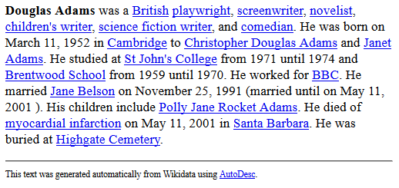
Language generation
Wikipedia in world’s most spoken language: 1/10 as many articles as English Wikipedia
World’s fourth most spoken language: 1/100
→ Wikidata intended to help resource-poor languages
https://tools.wmflabs.org/autodesc?q=9021&lang=&mode=long&links=reasonator&redlinks=reasonator&format=html
Notes:
First Chinese, fourth Hindi

Slide 61
3. Introduction to AKBC
Motivation
Terminology
Topics
Construction techniques
Applications
Past, present and future

Slide 62
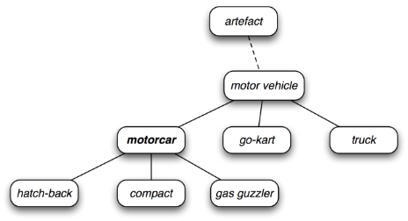
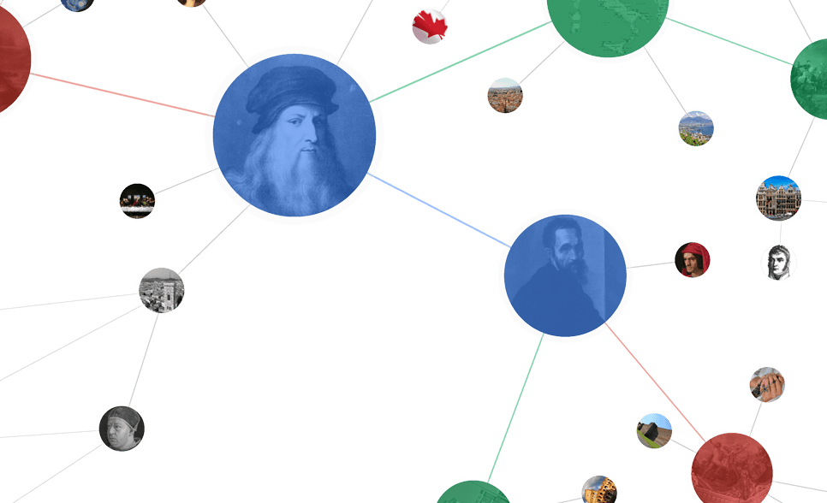
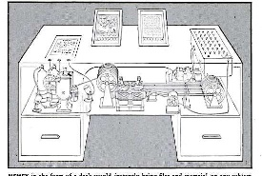
Past
Cyc
(#$relationAllExists
#$biologicalMother
#$ChordataPhylum
#$FemaleAnimal)
Knowledge Graph
(collaborative)
Memex
(1945)
1984
2001
2007
2012
2018

Slide 63
Present
KBs at most major tech companies and beyond
Google, Microsoft, Alibaba, Bloomberg, …
Feb 2018: $125 million investment by Microsoft cofounder Paul Allen into non-profit research on common sense knowledge extraction and reasoning
Research: Major part of NLP conferences taken up by IE/AKBC research

Slide 64
Future
?

Slide 65
Outline
Introducing each other
Course organization
What, Why, How
Lab 1

Slide 66
Lab 1
Information extraction where from?
Actual web crawling nontrivial
Wikipedia a popular high-quality resource
Learn/practice text manipulation, perform some simple analyses, get to know KB querying

Slide 67
Take home
Knowledge base construction builds machine-readable structured content from unstructured/semistructured inputs
Structured data is relevant for a range of knowledge-intensive tasks
Next week: Crawling and scraping

