Slide 1
Automated knowledge base construction 3. Entity Typing
Simon Razniewski
Summer term 2022
Notes:
Interactive:
11: NER
28: Planet type features
32: Cascaded NER
68: Classical Hearst patterns
77: Spacy code run

Slide 2
Varia
Scraping: How to deal with new websites?
Pattern/statement duality / iterative seed-based pattern and statement discovery (Section 6.2.2.1 in FnT 2001, in detail in lecture 5)
Spot known statements in new websites to learn extraction patterns
Use known extraction patterns to extract new relations
Iterate
Zero-shot structure learning (last part of Section 9.5.2.3 in FnT 2021)
Learn fundamental patterns of semi-structured statement expression in websites
Allows domain transfer (e.g., education to movies)
Lockard, Colin, et al. "ZeroShotCeres: Zero-Shot Relation Extraction from Semi-Structured Webpages." ACL 2020.

Slide 3
Entity typing: Motivation
Einstein: Scientist, Physicist, Nobel prize winner
Dudweiler: Village, location, municipality
RCH₂OH: chemical formula, psychoactive substance
Entities are the basic block of KBs
Types often most salient info about entities
Types help to
Organize entities
Power search applications
Direct and constrain fact extraction →

Slide 4
Inputs
Semi-Structured Data
(Infoboxes, Tables, Lists …)
Text Documents
& Web Pages
Conversations
& Behavior
Premium Sources
(Wikipedia, IMDB, …)
Web collections
(Web crawls)
High-Quality Text
(News Articles, Wikipedia …)
Difficult Text
(Books,
Interviews …)
Online Forums
& Social Media
Queries & Clicks
Rules & Patterns
Logical
Inference
Statistical
Inference
NLP
Tools
Deep
Learning
Methods
Entity Names, Aliases & Classes
Entities in
Taxonomy
Rules &
Constraint
Relational
Statements
Canonicalized
Statements
Outputs

Slide 5
Types and fact extraction
In 1905, Einstein discovered special relativity.
In Zürich, Einstein discovered special relativity.
dateOfDiscovery(special_relativity, 1905)
placeOfDiscovery(special_relativity, Zürich)
After three years in Westmore College, Mary moved to Eastless Academy.
After three years in Software Corp., Mary moved to Hardware Inc.
After three years in Corporate Finance, Mary moved to Controlling.
-> studiedAt? workedFor? fieldOfWork?

Slide 6
Outline
Named-entity recognition and classification
Problem
Interpretable rule-based NERC
Neural NERC
Extractive typing
Use cases
spaCy
WebIsALOD
Entyfi

Slide 7
Person Organization

Slide 8
Classes/Types
[1996]

Slide 9
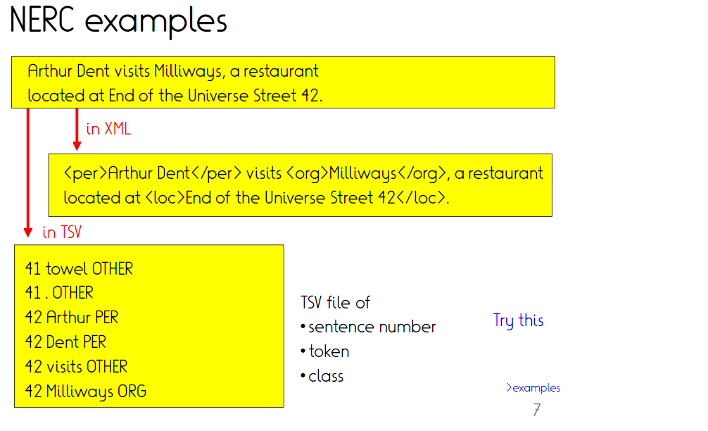
Notes:
“Other” to say that token is not an entity

Slide 11
She took the bus from Saarland University
Saarland University has 25 Bachelor programs

Slide 12
Outline
Named-entity recognition and classification
Problem
Interpretable rule-based NERC
Neural NERC
Extractive typing
Use cases
spaCy
WebIsALOD
Entyfi

Slide 16
Notes:
Opposite: Common name/noun

Slide 18
Dudweiler, Landsweiler, Wellesweiler -> LOC

Slide 21
[1995]
https://gate.ac.uk/
Notes:
Rb = adverb

Slide 29
1. Find a NERC rule for each annotation
2. Merge two rules by replacing a feature by a more general feature
3. Merge two rules by dropping a feature
4. Remove redundant rules
5. Repeat

Slide 30
Notes:
(s.|y.) = (says|yells)

Slide 31
Outline
Named-entity recognition and classification
Problem
Interpretable rule-based NERC
Neural NERC
Extractive typing
Use cases
spaCy
WebIsALOD
Entyfi

Slide 32
Neural NERC
Problem well suited for machine learning
Few to moderately many output labels
Well-scoped problem (typically small context sufficient)
Realistic to acquire sufficient training data

Slide 33
Not-yet neural ML for NERC
Rule mining is actually a machine learning paradigm
Instead of rule mining, can plug any favourite ML technique
Nearest neighbor
Regression
(Pre-trained) neural nets

Slide 34
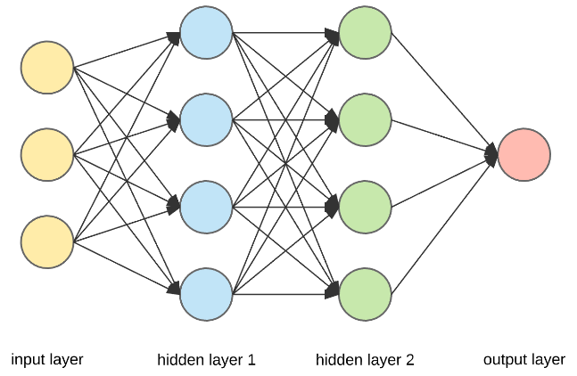
Excursus: Neural language models (LMs)
Huge multi-layer neural networks self-trained on large corpora, later fine-tuned to a variety of tasks
Huge: Only recently became trainable (e.g., GPT-3: 175B parameters)
Self-training: Require no further human labels - predict randomly masked words, or sentence order on existing texts
Fine-tuning to applications: Can be transferred to a range of text-related tasks with relatively few labelled samples
Popular instances: ELMo, BERT, GPT, T5
The lion chased the zebra.
The lion chased the [?].
[?] = zebra

Slide 35
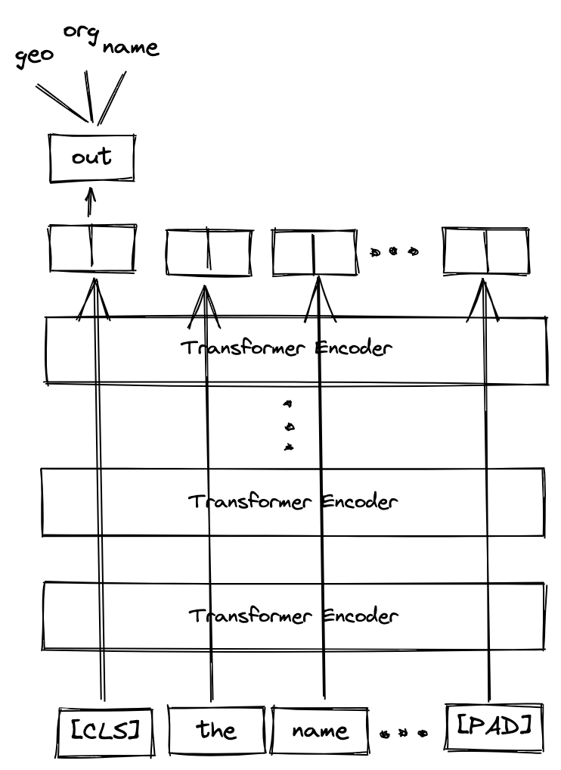
Pre-trained neural LMs for NERC
Notes:
CLS = special token for Classification

Slide 36
Pre-trained neural LMs for NERC
B = beginning
I = inside
O = outside
https://towardsdatascience.com/named-entity-recognition-with-bert-in-pytorch-a454405e0b6a

Slide 37
Examples
https://demo.allennlp.org/named-entity-recognition/named-entity-recognition
https://huggingface.co/dslim/bert-base-NER?text=My+name+is+Wolfgang+and+I+live+in+Berlin

Slide 38
Automated training data creation
Manual training data possible, but we love automation
Wiki markup provides disambiguation from surface forms to Wiki entities
“The [Max Planck Society | MPG] was founded in 1911 as the Kaiser Wilhelm Society for basic research.”
“[Monopotassium glutamate | MPG] is used to enhance the taste of …”
Wiki categories provide type-like information about entities
Max Planck Society → Scientific organization, Research units, …
Monopotassium glutamate → Flavor enhancers, Potassium compounds, E-number additives, …
Idea: Train a supervised classifier that predicts categories from mention context
“The MPG was founded in 1911 as the Kaiser Wilhelm Society for basic research.” → Scientific organization, Research units
“MPG is used to enhance the taste of…” → Flavor enhancers, Potassium compounds, E-number additives
~> Weak labels/distant supervision

Slide 39
Pre-trained neural nets

Slide 40
Outline
Named-entity recognition and classification
Problem
Features
Rule-based
Distance-based
Extractive typing
Use cases
spaCy
WebIsALOD
Entyfi

Slide 41
Limitations of NERC
Classification limited by target set
Traditionally 5-20
Lately up to 10k types
Still inherently limited by target set
Single mentions often provide limited context
Extraction may consider larger text corpus

Slide 42
Examples – Types beyond typical inventories
Notes:
HOMR = Simpson episode
Monson = Doctor
Moe = bartender, unlicensed physician
Homer = idiot

Slide 45
[Marti Hearst, 1992]

Slide 48
https://www.google.com/search?client=firefox-b-d&q=%22cities+such+as%22
https://en.wikipedia.org/w/index.php?search=%22cities+such+as%22&title=Special%3ASearch&go=Go&ns0=1

Slide 53
Notes:
Optional, point forward to taxonomy construction

Slide 55
Outline
Named-entity recognition and classification
Problem
Features
Rule-based
Distance-based
Extractive typing
Use cases
spaCy
WebIsALOD
Entyfi

Slide 56
Use case 1: Classification: spaCy
https://spacy.io/api/annotation#named-entities
Trained on OntoNotes 5 dataset
18 types
Few frequent ones (person, location, geopolitical entity, ..)
http://localhost:8888/notebooks/IE-course/spacy-NER.ipynb
Notes:
Nationalities or religious or political groups

Slide 57
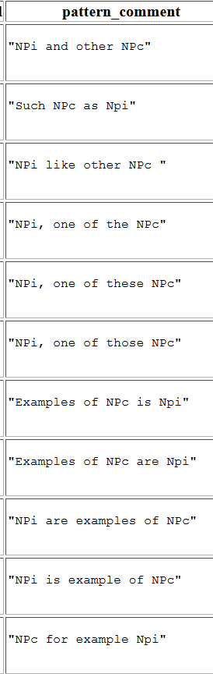
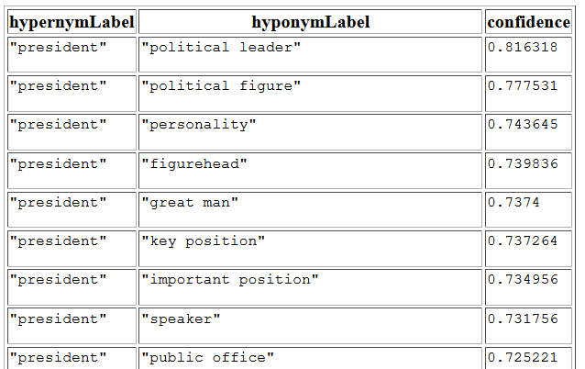
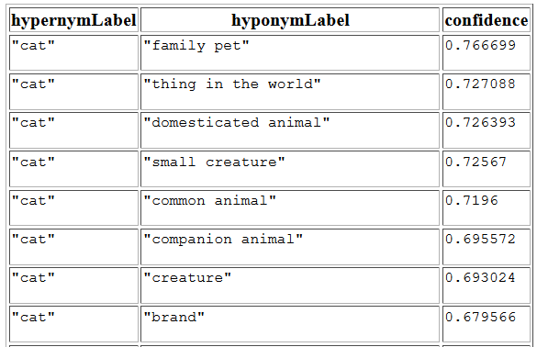
Use case 2: Extraction: WebIsALOD
Huge dataset (400m) of noisy isA-edges extracted from general web crawl (CommonCrawl) via 58 Hearst-style patterns
[http://webisa.webdatacommons.org]

Slide 58
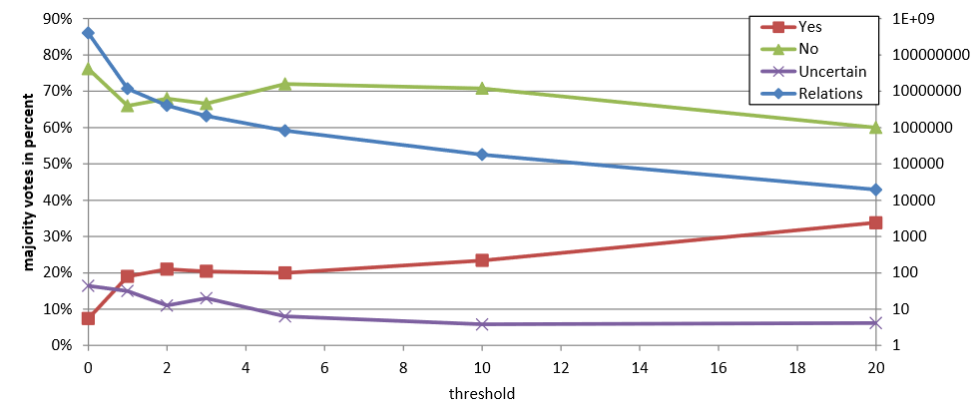
WebIsALOD - Noise
Pure application of 58 patterns
75% of results are considered wrong by human annotators
Thresholding by source and pattern frequency helps little

Slide 59
WebIsALOD – supervised scoring
RandomForest trained on 400 instances
Features:
Frequency of matches
#distinct patterns
#distinct domains
Binary feature per pattern
Hypernym/hyponym length, modifier existence
Min/max/avg token distance in source
ROC AUC 0.72-0.83

Slide 60
Data access
http://webisa.webdatacommons.org/sparql
PREFIX isa: <http://webisa.webdatacommons.org/concept/>
PREFIX isaont: <http://webisa.webdatacommons.org/ontology#>
SELECT ?hyponymLabel ?confidence
WHERE{
GRAPH ?g {
isa:_frankfurt_ skos:broader ?hyponym.
}
?hyponym rdfs:label ?hyponymLabel.
?g isaont:hasConfidence ?confidence.
}
ORDER BY DESC(?confidence)
Lowercase!
Notes:
obama, trump -> lowercase works, uppercase not

Slide 61
Use case 3: Joint system: Entyfi
Existing approaches overfit to Wikipedia, or assume huge corpora
Fiction and fantasy as archetypes of long-tail universes where Wikipedia has insufficient coverage
[Chu et al., WSDM 2020]

Slide 62
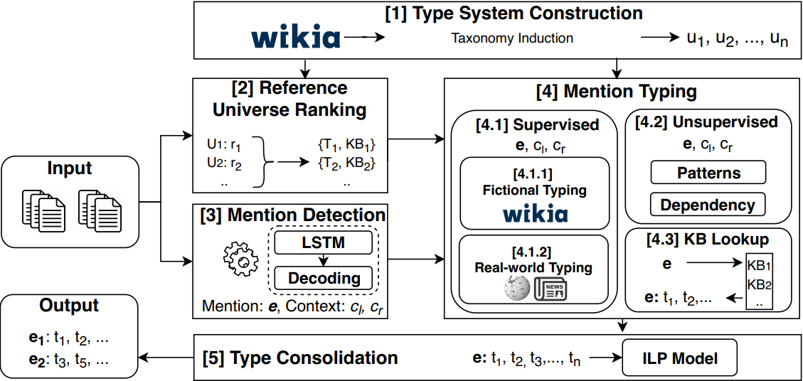
Entify - Overview

Slide 63
Entify – 1. Type system construction
Scrape categories and subcategory relations from 200 diverse Wikia universes
Clean extracted data to derive coherent taxonomies
Remove meta-categories
Remove unsuited relations
Forward reference: more details next lecture

Slide 64
Entify – 2. Type system ranking
Demo:
First example LoTR+GoT
The Maya god of rain, one of the most important deities in the Mayan pantheon Panon. Chaac was often described as having four divine aspects or incarnations, connected to the four cardinal directions and colored green, red, white, and black respectively. In some Maya traditions there were also many demigods, also known as Chaacob, who served the great god Chaac and often appeared to humans as dwarves or giants, like Ebxywz.
https://d5demos.mpi-inf.mpg.de/entyfi/
(runtime → run 1, 4, 5)

Slide 65
Entify – 4.1 – supervised typing
Existing Wikipedia models: 112 or 10331 types
[Eunsol Choi, Omer Levy, Yejin Choi, and Luke Zettlemoyer. Ultra-fine entity typing. In ACL, 2018]
[Sonse Shimaoka, Pontus Stenetorp, Kentaro Inui, and Sebastian Riedel. Neural architectures for fine-grained entity type classification. In EACL, 2017]
Attentive neural architectures on 16-words span around mention
Trained via disambiguated links and categories in Wikia reference universes

Slide 66
Entify – 4.2/4.3 – Unsupervised+lookup
Unsupervised typing:
36 Hearst patterns
Dependency parses
King Robert was the ruler of Dragonstone Castle
Lookups:
Fiction frequenly creates mashups and reuses previous ideas
Freya not only in “Edda”, but also in “Nibelungen”
Lookups as practical way to obtain candidates

Slide 67
Entify – 5. Consolidation
Most typing modules are noisy
Top-level hard constraints
Location and living_thing exclude each other
Soft correlations
Dwarves are frequently axe-wielders, rarely archers
Secret agents are usually middle-aged singles
Consolidation across multiple mentions
Gondor decided to join the war.
Frodo joined the ranks of Gondor.
ILP encodes hard constraints and rewards for respecting correlations

Slide 68
Lab 3
Input: First sentence from Wikipedia
Task: Extract/predict the Wikidata types
Automated evaluation on unseen evaluation data
Precision/recall/F1
Macro (per row), micro (per prediction/ground truth type instance)
Full match or headword only (British writer/English writer)
How good is a method? Random baseline
Hints:
Consider data distribution – max bang per buck?
Target labels do not always match text

Slide 69
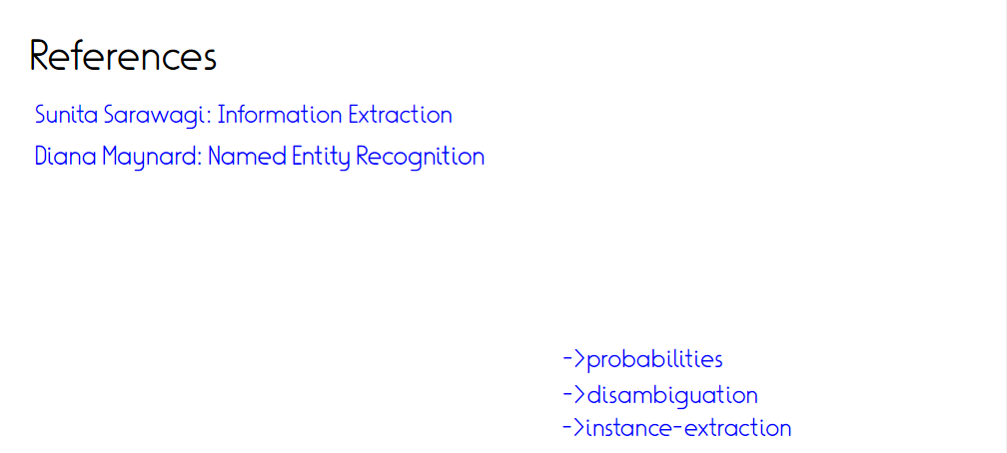
Sven Hertling and Heiko Paulheim. WebIsALOD: Providing Hypernymy Relations extracted from the Web as Linked Open Data, ISWC 2017
Chu et al., ENTYFI: Entity Typing in Fictional Texts, WSDM 2020
Slides adapted from Fabian Suchanek

Slide 70
Take home
NERC major AKBC task
Entity types a core piece of knowledge
Types help in relation extraction
Classification vs. extraction
Rules for classification
Pre-trained neural architectures
Hearst patterns for extraction
Next week: Organizing types in taxonomies, entity coreference and disambiguation

