Slide 1
Automated knowledge base construction 9. Applications
Simon Razniewski
Summer term 2022

Slide 2
Outline
Academic projects
Scraping and Harvesting
Pattern-based text extraction and OpenIE
Industrial Knowledge Bases
Knowledge Base Question Answering
Semantic Web

Slide 3
DBpedia (2007)
Large-scale Wikipedia infobox+category scraping
Manually designed mappings to consolidate synonymous attributes
See lecture/assignment 2
Multilingual
No persistent IDs
For long considered the “core” of Semantic Web (see later)
Data access
Per entity: http://dbpedia.org/page/Max_Planck_Institute_for_Informatics
SPARQL endpoint:
http://dbpedia.org/snorql/?query=SELECT+%3Fitem+WHERE+%7B%0D%0A%3Fitem+dbo%3AalmaMater+dbr%3ASaarland_University%0D%0A%7D
Data dumps
https://wiki.dbpedia.org/develop/datasets
https://wiki.dbpedia.org/downloads-2016-10
Notes:
(think of Bradley -> Chelsea Manning, Alphabet -> Google)

Slide 4
YAGO (2007)
Precision-oriented Wikipedia infobox+category extraction
Subset of 76 important relations, cleaning steps (>95% precision)
Much focus on type extraction from categories
“French writers” → “Writer” + “French person”
WordNet disambiguation and linking
Data access
Per-entity access: https://yago-knowledge.org/graph/Elvis_Presley
SPARQL access: https://yago-knowledge.org/sparql
Data dumps: https://www.mpi-inf.mpg.de/departments/databases-and-information-systems/research/yago-naga/yago/downloads/

Slide 5
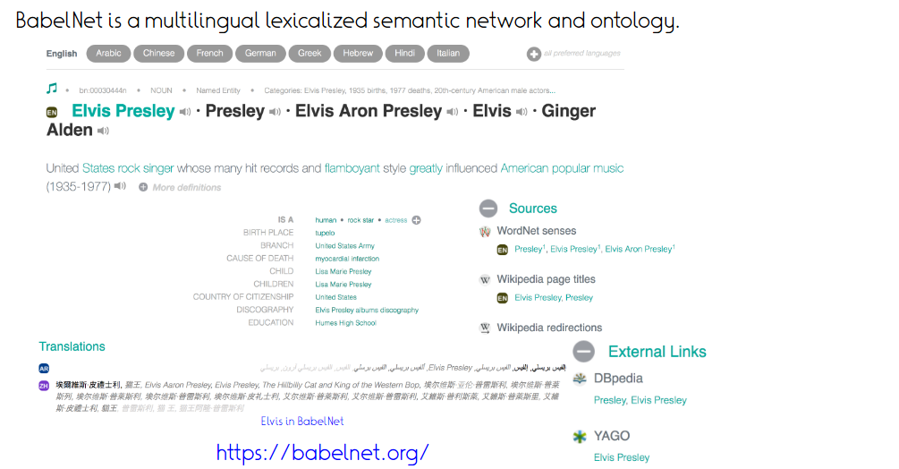
BabelNet (2012)
http://babelfy.org/
Focus on general terms, sense disambiguation, instead of named entities
Notes:
“Wednesday is the day of the AKBC lecture”

Slide 6
Wikidata (2012)
Largely supersedes YAGO and DBpedia
Not itself built using AKBC techniques
Community generally disapproves of automated extraction
Isolated projects, e.g. https://github.com/google/sling
https://www.wikidata.org/wiki/User:Anders-sandholm
Nonetheless highly important for AKBC
Disambiguation reference
Training data source (distant supervision)
Data access:
SPARQL: https://w.wiki/DKU
Individual entities: https://www.wikidata.org/wiki/Q565400
JSON: https://www.wikidata.org/wiki/Special:EntityData/Q565400.json
Dumps: https://www.wikidata.org/wiki/Wikidata:Database_download
~65 GB zipped

Slide 7
Outline
Academic projects
Scraping and Harvesting
Pattern-based text extraction and OpenIE
Industrial Knowledge Bases
Knowledge Base Question Answering
Semantic Web

Slide 8
(2010)
327 manually designed relations each with a few curated training examples
http://rtw.ml.cmu.edu/rtw/
Sales point: Continuous nature of extraction and learning
Notes:
Actually open the link

Slide 10
ReVerb/OpenIE 4.0
Knowledge base built using open information extraction
5 billion extractions from general web crawls
https://openie.allenai.org/
(see OIE lecture)

Slide 11
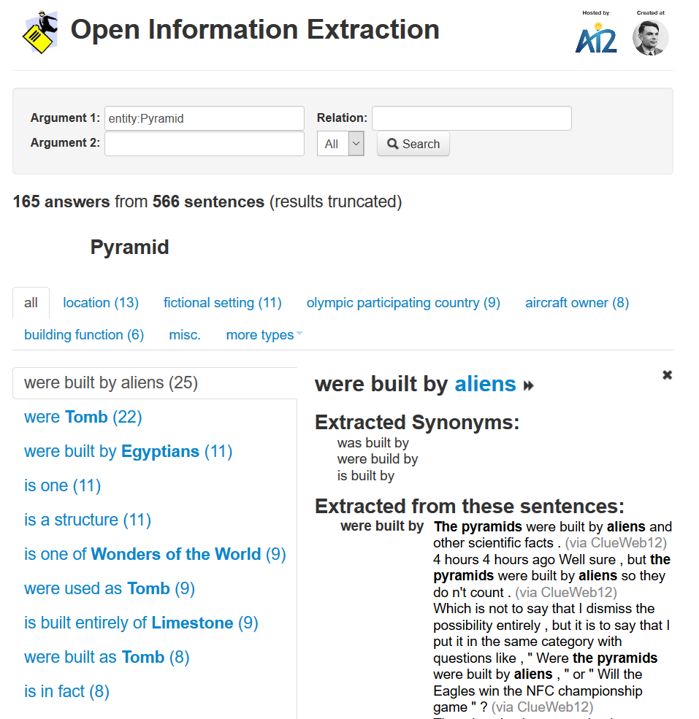

Slide 12
Outline
Academic projects
Scraping and Harvesting
Pattern-based text extraction and OpenIE
Industrial Knowledge Bases
Knowledge Base Question Answering
Semantic Web

Slide 13
Industrial projects
- Baidu

Slide 14
Google Knowledge Vault (2014)
Ambitious project combining text extraction, semistructured extraction, and predictive models
Apparently not in use (successors?)
[Dong, Xin, et al. "Knowledge vault: A web-scale approach to probabilistic knowledge fusion, KDD 2014]

Slide 15
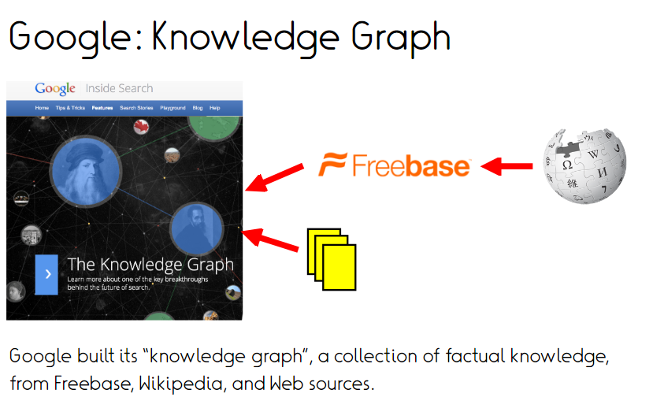
(since ~2012)
https://developers.google.com/knowledge-graph

Slide 16
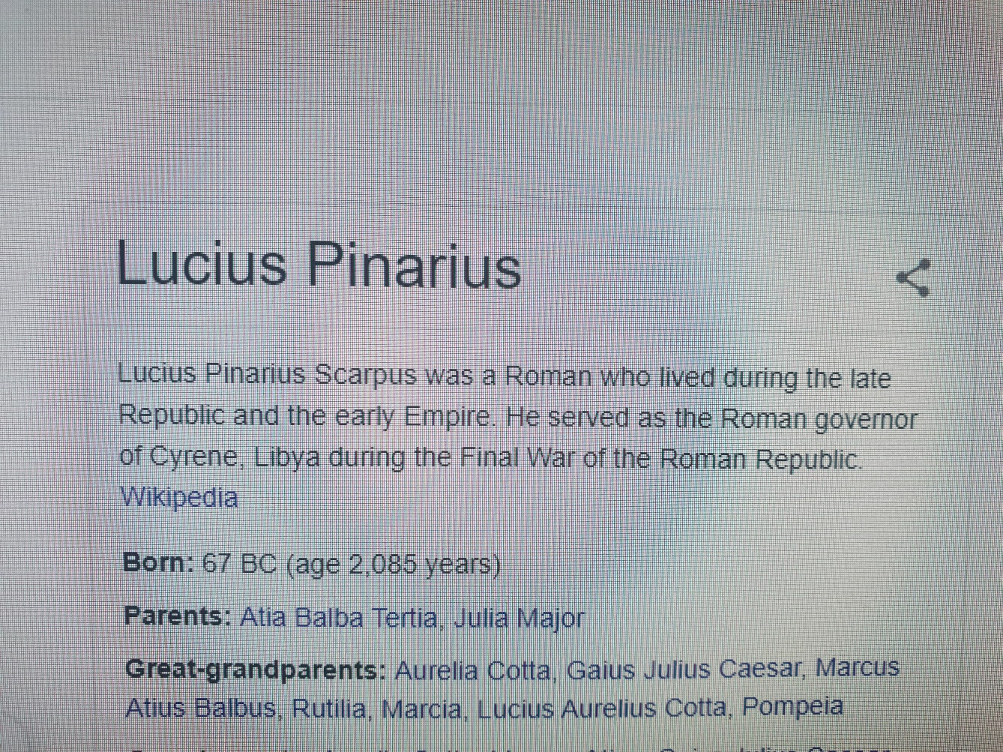
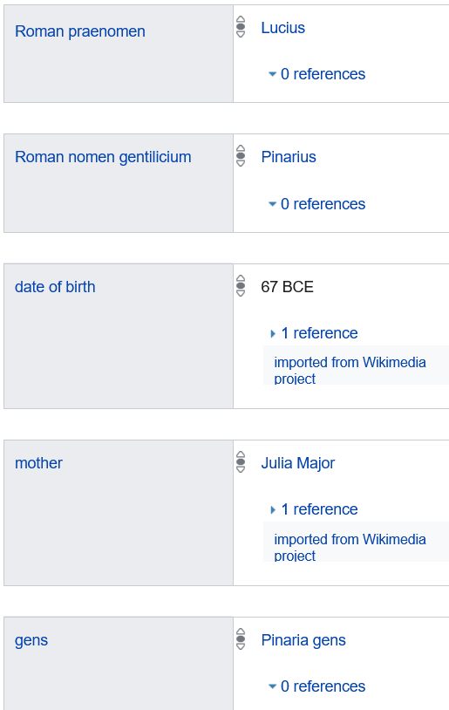
https://www.reddit.com/r/wikipedia/comments/dg6pnl/the_death_date_of_lucius_pinarius_wasnt_added_so/

Slide 17
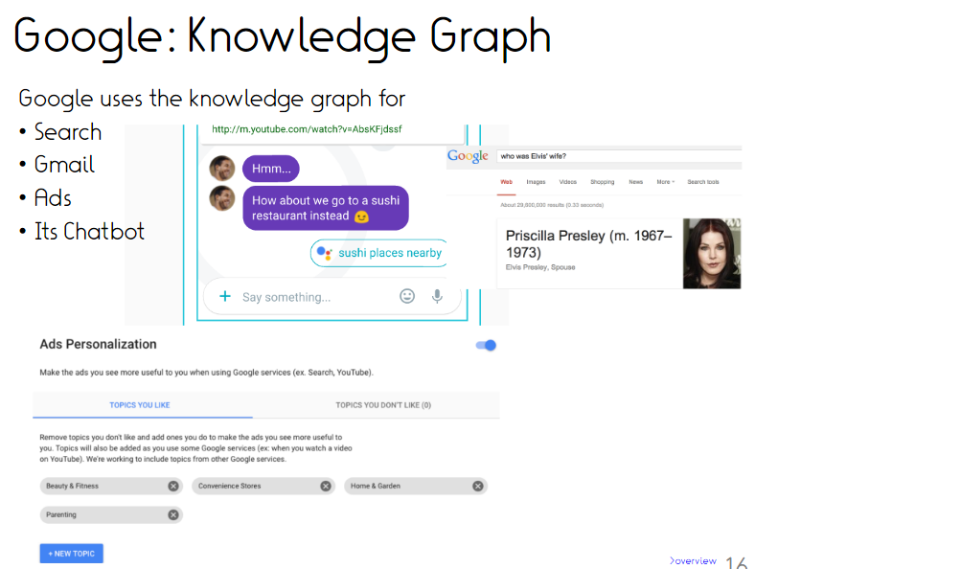

Slide 19
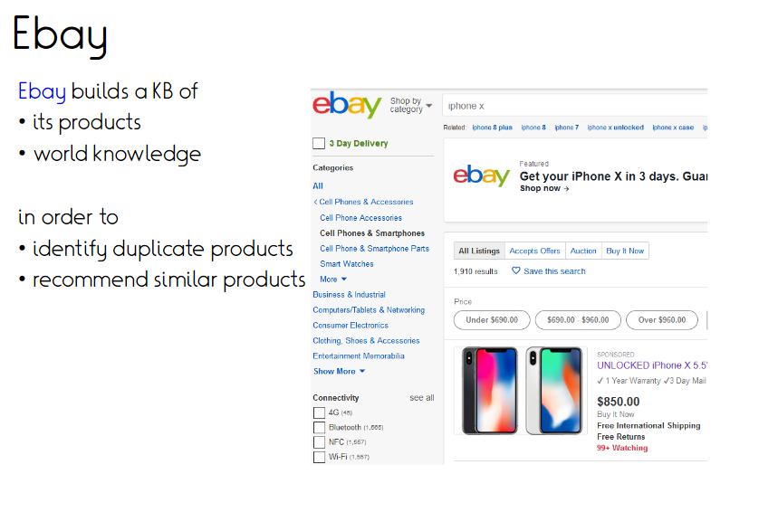
[Noy, Natasha, et al. "Industry-scale Knowledge Graphs: Lessons and Challenges." Queue 17.2 (2019): 20]

Slide 22
Watson outperformed the 74-fold human winner in the Jeopardy quiz show

Slide 24
Baidu
Non-English languages traditionally underrepresented
Open (academic) solutions:
Zhishi.me: Chinese-language equivalent of DBpedia
Based on Baidu Baike, Hudong Baike, Chinese Wikipedia
Xlore: English-Chinese alignment KB
Baidu has apparently three internal knowledge graphs
https://www.mdpi.com/2071-1050/10/9/3245/htm
Huawei building a knowledge graph?
https://www.huawei.com/en/press-events/news/2019/9/atlas-series-products-cloud-services-all-scenario-ai-solutions

Slide 25
Outline
Academic projects
Scraping and Harvesting
Pattern-based text extraction and OpenIE
Industrial Knowledge Bases
Knowledge Base Question Answering
Semantic Web

Slide 26
Evaluation
Lecture:
https://tinyurl.com/akbclec
Lab
https://tinyurl.com/akbclab
Tutor: Write “all”
If individual comments into text fields

Slide 27
Outline
Scraping and Harvesting
DBpedia, Yago, BabelNet, (Wikidata)
Pattern-based text extraction and OpenIE
NELL and ReVerb
Industrial Knowledge Bases
Knowledge Base Question Answering
Semantic Web

Slide 28
Question answering: Vital for information access
Direct answers to questions
Saves time and effort
Natural in voice UI

Slide 29
Question answering: Vital for information access

Slide 30
Approaches to question answering
Traditional IR-style approach: Match question with text phrases in documents
“What is the capital of Belgium”
“Brussels is the capital of Belgium”
Works only for simple questions
Misses additional conditions
Google, Siri, Echo et al.
Precision much more important than recall
Answer origin needs to be debuggable/explainable
→ Question answering from structured sources much preferred

Slide 31
Question answering is a hot topic
QA over knowledge graphs [Abujabal et al. 2018]
Reading comprehension QA [Reddy et al. 2018]
Visual and multimodal QA [Lu et al. 2016]
Community QA [Hoogeveen et al. 2018]
Passage retrieval and sentence selection [Shen et al. 2018]
Non-factoid: Causal, procedural, ...

Slide 32
QA over Knowledge Graphs
Which Oscar nominations did Nolan receive?
Director
Inception
Male
gender
type
directed
<ChristopherNolan, gender, Male>
<ChristopherNolan, type, Director>
<ChristopherNolan, directed, Inception>
<ChristopherNolan, nominatedFor, BestDirector>
<BestDirector, type, AcademyAward>
<ChristopherNolan, birthDate, 30 July 1970>
ChristopherNolan
nominatedFor
birthDate
30 July 1970
BestDirector
type
AcademyAward
Notes:
Main challenge: mapping

Slide 33
QA over Knowledge Graphs
Which Oscar nominations did Nolan receive?
<ChristopherNolan, gender, Male>
<ChristopherNolan, type, Director>
<ChristopherNolan, directed, Inception>
<ChristopherNolan, nominatedFor, BestDirector>
<BestDirector, type, AcademyAward>
<ChristopherNolan, birthDate, 30 July 1970>
ChristopherNolan
nominatedFor
SELECT ?ANS
WHERE {
ChristopherNolan nominatedFor ?ANS .
?ANS type AcademyAward }
SPARQL
?ANS
type
AcademyAward
BestDirector

Slide 34
Generalizing QA
If we can answer:
What are the Oscar award nominations of Nolan?
Then we should be able to answer:
What are the Cannes award nominations of Ryan Coogler?
Which Oscar award nominations did Nolan receive?
Same syntax!
Same semantics!

Slide 35
Template-based Question Answering
Interpretable
Question Who is Inception’s director? | Question template Who is <NOUN1>’s <NOUN2>?
Query ?ANS director Inception | Query template ?ANS <PRED1> <ENT1>
1 SPARQL triple pattern
Notes:
Introduce templates

Slide 36
Template-based Question Answering
Who is Libya’s president?
Who is Messi’s manager?
Generalizes to new domains
Question Who is Inception’s director? | Question template Who is <NOUN1>’s <NOUN2>?
Query ?ANS director Inception | Query template ?ANS <PRED1> <ENT1>
1 SPARQL triple pattern

Slide 37
Template-based Question Answering
Generalizes to new domains
Question Who plays the role of Cobb in Inception? | Question template Who <VERB> <DT> <NOUN> <DT> <NOUN> <PREP> <NOUN>?
Query ?ANS playsIn Inception ?ANS role Cobb | Query template ?ANS <PRED1> <ENT1> ?ANS <PRED2> <ENT2>
2 SPARQL triple patterns

Slide 38
Challenges with templates
Hand-crafted by experts (Fader et al. 2014; Unger et al. 2013)
Low coverage
Solution: Learn templates
Question templates
Query templates
Slot alignments

Slide 39
Dependency-parse-based question templates
Question: What are the Oscar award nominations of Nolan?
Dependency parse
Question template (labeled nodes and edges)
Notes:
We know parts of speech - nouns, verbs, adjectives - DP: POS + relations between them
nsubj: nominal subject, cop: copula, det: determiner, nmod: nominal modifier, case: prepositions, postpositions and other case markers
https://web.stanford.edu/~jurafsky/slp3/13.pdf ; https://nlp.stanford.edu/software/dependencies_manual.pdf

Slide 40
Graphical query templates
Query: ChristopherNolan nominatedFor ?VAR .
?VAR awardTitle ?ANS .
?ANS type AcademyAward
Graphical Query Query template
ChristopherNolan
nominatedFor
?VAR
ENT
PRED1
?VAR
awardTitle
PRED2
AcademyAward
type
?ANS
TYPE
type
?ANS
Notes:
Introduce templates

Slide 41
Key task: Slot Alignments
ENT
PRED1
?VAR
PRED2
?ANS
type
TYPE

Slide 42
Template-based question answering
New question
Match
Train
Template-based answering
No answer found
Match
Template
bank
Question-Query log
Similarity-based answering
QA pairs
User feedback on answers
Generalize
Add

Slide 43
Training template-based QA
Collecting question-query pairs difficult
Start with question-answer pairs instead
Create queries by distant supervision
Generalize to create slot-aligned templates

Slide 44
Distant supervision from Q-A pairs
Question: What are the Oscar award nominations of Nolan?
Answer: Best Director
Retain shortest path between question and answer entities
Retain answer type information
AcademyAward
type
BestDirector
awardTitle
ChristopherNolan
nominatedFor
Award

Slide 45
Distant supervision from Q-A pairs
Question: What are the Oscar award nominations of Nolan?
Answer: Best Director
Query: ChristopherNolan nominatedFor ?VAR .
?VAR awardTitle ?ANS .
?ANS Type AcademyAward
AcademyAward
type
?ANS
awardTitle
ChristopherNolan
nominatedFor
?VAR

Slide 46
Question-schema alignment
Question n-grams
what nominations
oscar nominations
oscar award
nominations of
oscar
what are
oscar award nominations
nominations
award
award nominations
KB schema
nominatedFor
awardTitle
AcademyAward
Notes:
Why do we do this? To get aligned question-query pairs, which to generalize to templates.

Slide 47
Create Candidate Alignments
Bipartite graph with edge weights (Yahya et al. 2012)
Weights from lexicons L_{P} and L_{T} (Abujabal et al. 2017, Berant and Liang 2013)
what nominations
oscar nominations
oscar award
nominations of
oscar
0.5
0.9
what are
oscar award nominations
nominations
award
award nominations
0.7
nominatedFor
awardTitle
AcademyAward

Slide 48
Create Candidate Alignments
Phrase | KG Predicate | Weight
nominee for | nominatedFor | 0.8
nominations of | nominatedFor | 0.9
oscar nominations | nominatedFor | 0.5
Phrase | KG Type | Weight
Academy Award | AcademyAward | 0.9
Oscar | AcademyAward | 0.7
Oscar Award | AcademyAward | 0.8
what nominations
oscar nominations
oscar award
nominations of
oscar
0.5
0.9
what are
oscar award nominations
nominations
award
award nominations
0.7
nominatedFor
awardTitle
AcademyAward
Notes:
Predicate and type lexicons

Slide 49
Optimal Mapping via ILP
Best alignment of items with Integer Linear Program (ILP)
At least/at most constraints
Type coherence
what nominations
oscar nominations
oscar award
nominations of
oscar
0.5
0.9
what are
oscar award nominations
nominations
award
award nominations
0.7
nominatedFor
awardTitle
AcademyAward

Slide 50
Optimal Mapping via ILP
Best alignment of items with Integer Linear Program (ILP)
At least/at most constraints
Type coherence
nominations of
oscar
award
nominatedFor
awardTitle
AcademyAward

Slide 51
Apply Alignment to Question-Query
AcademyAward
type
ChristopherNolan
nominatedFor
?VAR
awardTitle
?ANS
Notes:
Now we have a training pair. Can generalize it with variables.

Slide 52
Answering with templates
New question: What are the Cannes award nominations of Ryan Coogler?
Template
bank
Match

Slide 53
Instantiating Queries
What are the Cannes award nominations of Ryan Coogler?
Question template 1
Question template 2
...
Query template 1
Query template 2
...
Query 1
Query 2
...
RyanCoogler nominated ?VAR .
?VAR awardTitle ?ANS .
?ANS Type CannesAward
Rank queries with learning to rank and execute best query
RyanCoogler awarded ?VAR .
?VAR awardTitle ?ANS .
?ANS Type GoldenGlobe

Slide 54
Closing the Loop with User Feedback
So far, assumed all answers were correct: Pseudo-relevance
Pseudo-relevance degrades quality
Users provide feedback on answers
Question: Which Oscar nominations did Nolan receive?
Answer: Best Director
User:
Positive feedback:
Learn new template from question-query
Add new question-query to log
Update learning-to-rank model

Slide 55
Outline
Academic projects
Scraping and Harvesting
Pattern-based text extraction and OpenIE
Industrial Knowledge Bases
Knowledge Base Question Answering
Semantic Web

Slide 56
We can do AKBC – what now?

Slide 61
Reminder: RDF

Slide 69
RDF and RDFS vocabularies

Slide 75
https://www.wikidata.org/wiki/Special:EntityData/Q565400.rdf

Slide 76
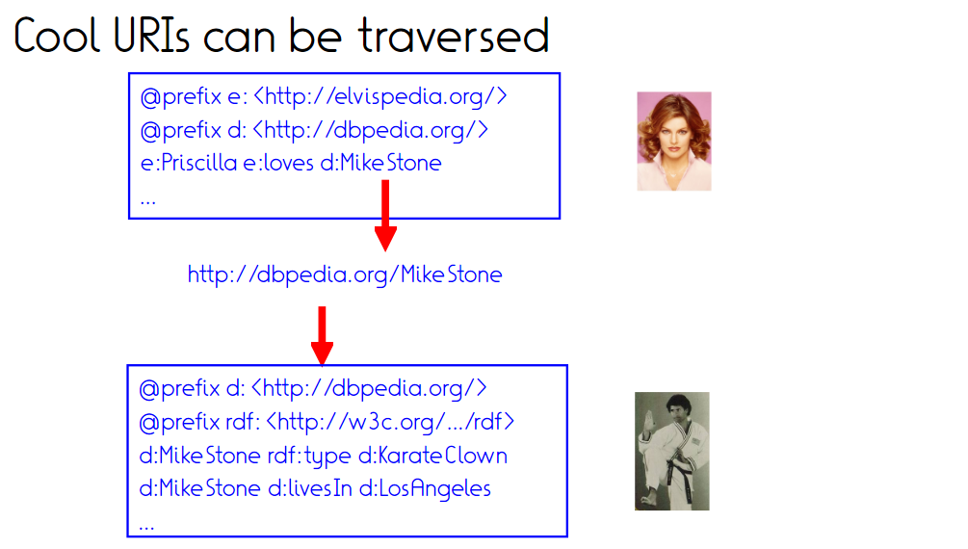

Slide 78
Interlinking on the Semantic Web

Slide 80
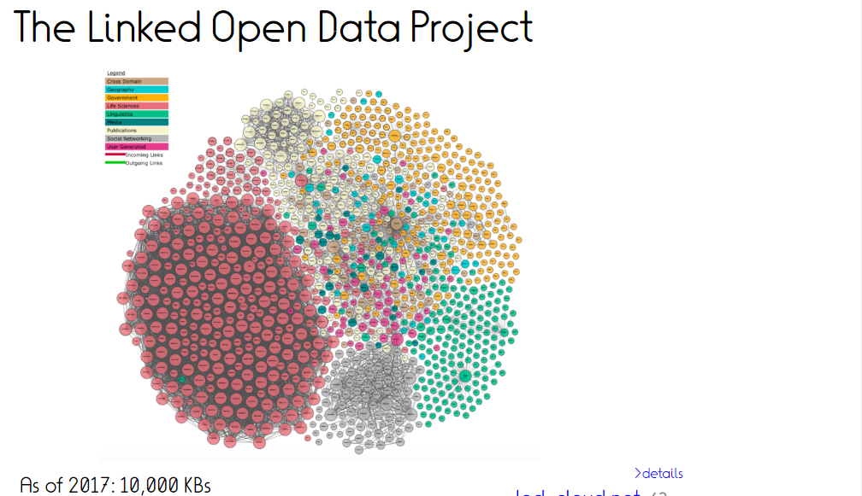

Slide 83
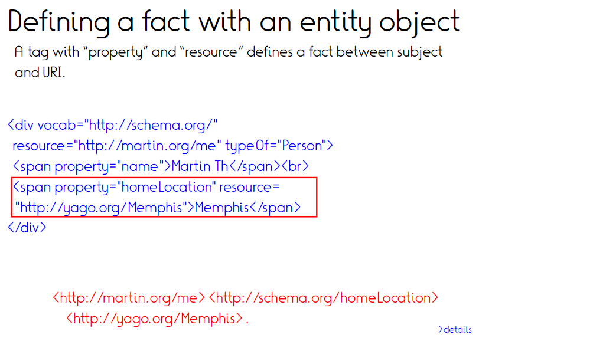
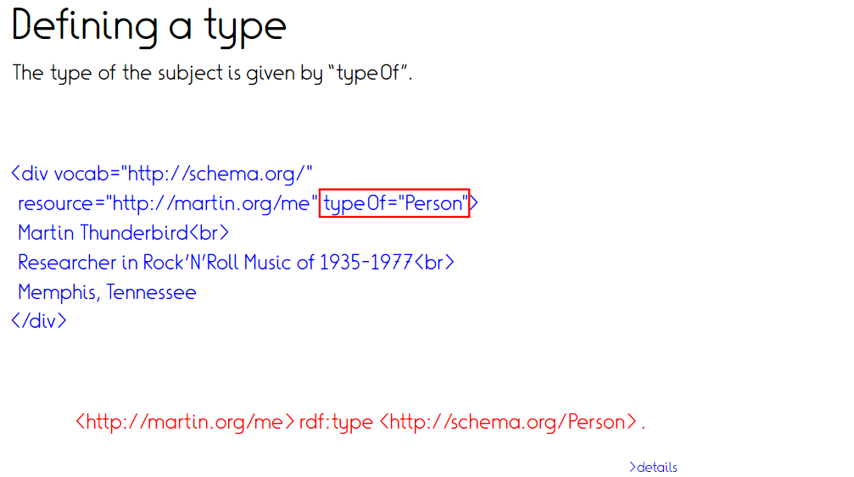

Slide 84
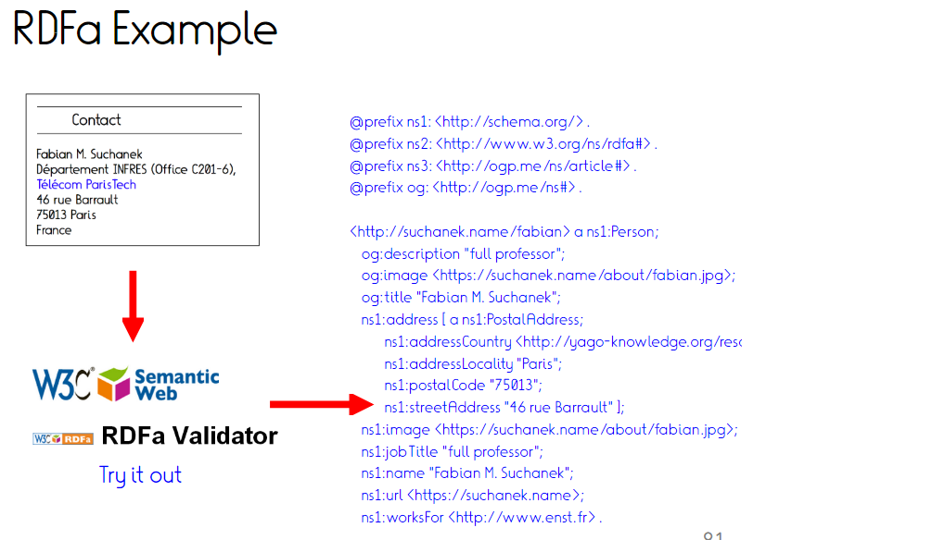
https://suchanek.name/index.html#contact

Slide 85
JSON-LD

Slide 87
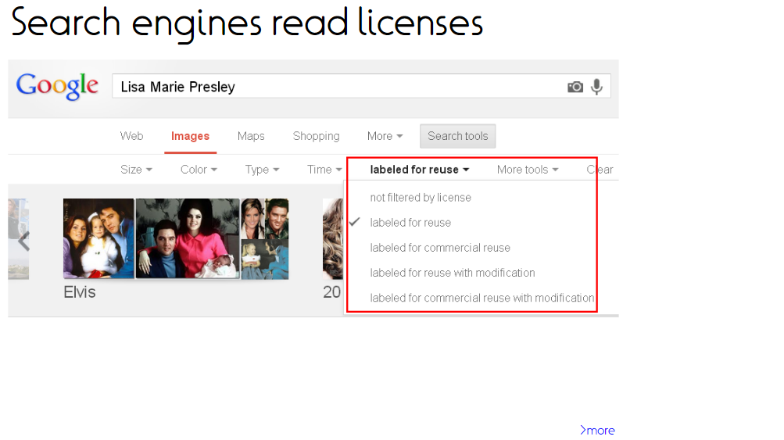

Slide 91
References
Selected references
Further reading
qa.mpi-inf.mpg.de
Slides
Adapted from Fabian Suchanek and Rishiraj Saha Roy

Slide 92
Assignment 9
No assignment ☺
Tutorial today: Exam questions

Slide 93
Take home
AKBC important tool for building structured knowledge
Wikipedia popular resource
Free text extraction harder but possible
KBs in widespread use in tech companies
Actual methods guarded secrets
Source of data not always known
Signature application: Question answering
Challenge: From unstructured user question to structured KB query
Semantic web: Vision of interlinked and machine-readable internet
Schema reuse essential for (simple) machine-readability

