Slide 1
Interactive Reflection Editing
SIGGRAPH Asia 2009
Friday, 18 December, 2009, Yokohama, Japan
Tobias Ritschel Makoto Okabe Thorsten Thormählen Hans-Peter Seidel
Max-Planck-Institut Informatik
Notes:
Thanks for the introduction, welcome to my talk

Slide 2
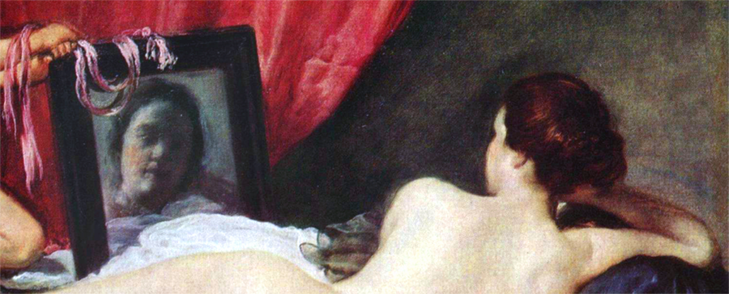
Motivation
Edited reflection
Physical reflection
The Rokeby Venus (before 1651, detail)
Diego Velasquez (1599-1660)
View direction
Notes:
This work is inspired by the way artists have dealt with reflections for centuries.
While rendering software deals with physically correct reflections, artists are not restricted by physics.
If it is useful to convey an artistic message, artists draw unphysical reflections.
This painting is a famous example for non-physical reflections, as verified by Braham in 1976, the reflections in this painting are physically incorrect.
Starting from a physical view direction (click) a physical reflection direction can be computed (click), however, this is not the direction the artist used to convey a message (click).
In this talk, we present a system to allow such interactions for 3d rendering.

Slide 3
Motivation
Notes:
Here we reproduced the scene setting in 3d graphics.
A user can manipulate the reflection to achieve the similar artistic manipulation as Velasquez in his painting.

Slide 4
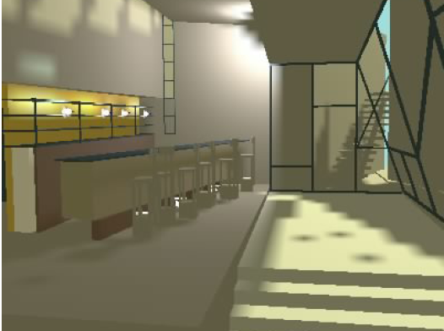
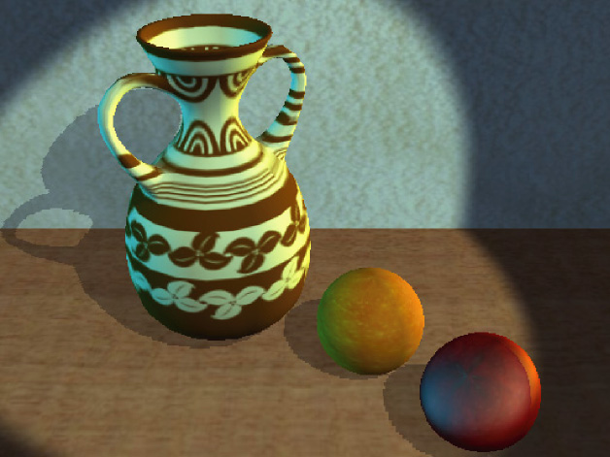
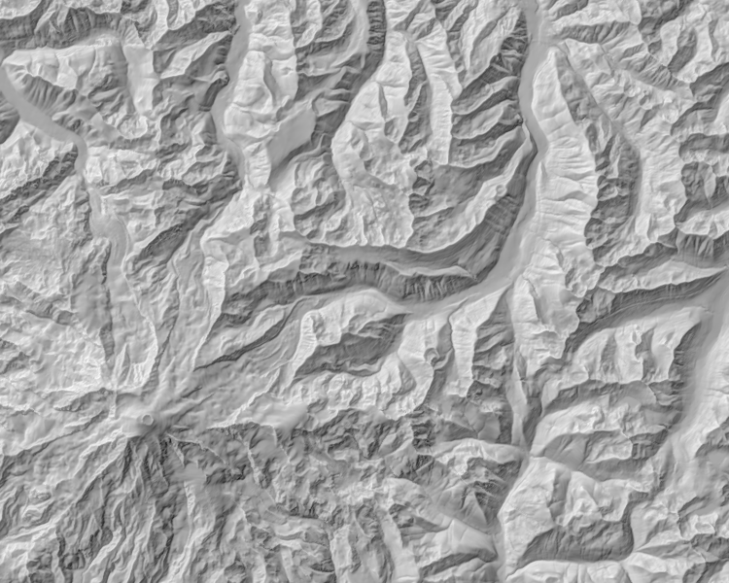
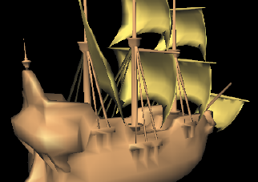
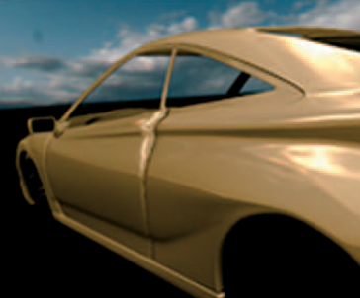
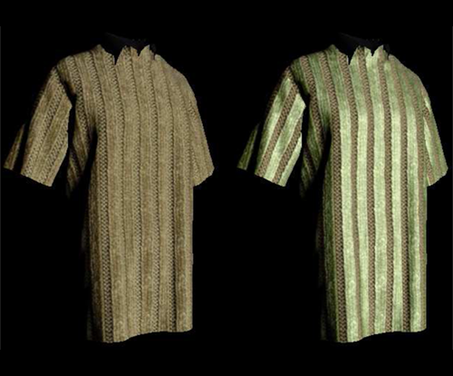
Previous Work
Light painting
Schöneman et al. 1993
Poulin et al. 1997
Pellacini et al. 2007
Obert et al. 2008
Lighting optimization
Shacked and Lischinski 2001
Rusinkiewicz et al. 2008
Appearance editing
Colbert et al. 2006
Kautz et al. 2007
Anjyo et al. 2003
Todo et al. 2004
Notes:
Interaction with light and materials to realize artistic goals has been considered by the following previous work:
One option to control scene lighting is by painting light onto the surface.
However, the view-dependent nature of reflections, is in our opinion better addressed by drag & drop and deformation than by painting.
Optimal placement of lights to convey information was also considered in previous work, but reflections were not addressed in such systems.
Besides editing the light, editing materials via textures or BTFs was considered by Colbert et al. and Kautz et al.
Those methods control how light reflects and in theory could be used for reflection edits as well, but control via a BRDF is prohibitively tedious.
Control of highlights, was addressed in a system by Anjyo et al., that was able to move light across the surface for comic shaders.

Slide 5
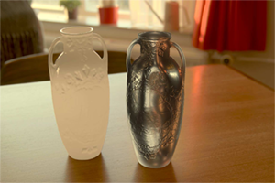
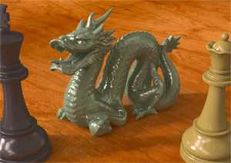
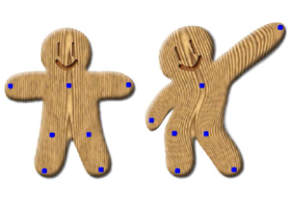
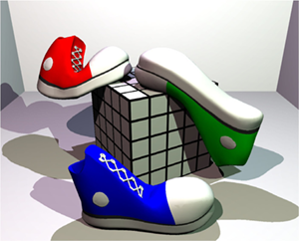
Previous Work
Reflection Perception
Fleming et al. 2003
Ramanarayana et al. 2005
Khan et al. 2006
Intuitive deformation
Igarashi et al. 2005
Müller et al. 2005
Schaefer et al. 2006
Sorkine and Alexa 2007
Inhouse Solutions
Unpublished
Build-your-own, using e.g. Kopra 2007
Notes:
The human difficulties when perceiving reflections were exposed by Khan et al. in a system that allowed material editing in single images.
Our system works by deforming the reflection on the surface, and our approach is based on a body of work that addressed surface deformation, especially moving least squares techniques.
It can be assumed by watching some movies or commercials, that besides research work, manipulation of shader code was used to perform reflection cheating by manual tweaking. However, no public source describes such an approach.

Slide 6
PHYSICAL LAWS
Viewer
View direction
Normal
Edited Reflection
Reflecting object
Physical Reflection
Reflected object
Notes:
We will start our exposition with a review how reflections work.
A viewer inside a scene (click), looks at an object (click) that reflects another object (click).
A view direction (click) is reflected at the surface normal (click) resulting in a reflection direction (click).
Our system is based on turning this reflection direction into an edited reflection direction (click).
To do so, we will introduce a system to define such a change, a user interface and how to propagate the change across a scene.

Slide 7
INTERACTION
Original
Edit 1
Edit 2
Notes:
Our interaction metaphor allows for two kinds of edits.
(click) Assume an original image, where a viewer is looking at a red point on a reflecting surface that reflects a green point on the reflected object.
The first kind of edit works by redefining where a reflected position appears on the reflecting object (click).
This is done by moving the red point via drag and drop (click).
The second kind of edit works in the opposite way: The red handle remains fixed, but the location that reflects, the green point, is dragged (click).
We call the red and green points reflection constraints and a combination of such reflection constraints a reflection edit.

Slide 8
INterpolation
Schaefer et al. 2006 interpolate
rotation / translation of
pixels
in 2D.
We interpolate
rotations of
reflection directions
on a 3D surface.
Notes:
Moving around single points and editing their reflections is simple.
It is more difficult however, to propagate a deformation from such points over the surface in an intuitive way.
We use Moving Least Squares deformation as introduced by Schaefer et al. in 2006 to perform such a task.
While they interpolate translations and rotations for 2D pixels, our system propagates edits as rotations of reflection directions across a 3D surface.
Their method can be used with some minor modifications, and works as follows …

Slide 9
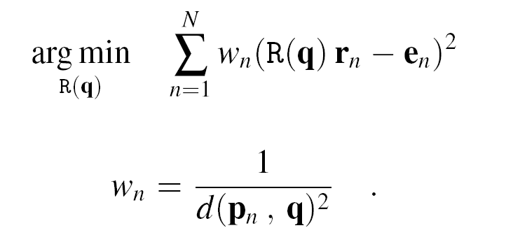
INterpolation
Number of
constraints
Original ray n
Edited ray n
Weight n
Position in
question
Transformation
Edit position n
Distance
(Euclidean or geodesic)
Notes:
Propagation of a deformation across a domain, is cast into a minimization problem.
For a surface point q (click) in question, we will try to find a transformation R-at-q (click), that minimizes the following for n reflection constraints (click).
We want to be edited rays e (click) to be very similar to transformed original rays r (click).
As we have multiple constraints that need to blend, they are weighted by w (click).
The weight for one constraint should be very high if its very close and also it should be smooth.
One-over-the-distance of the constraint position p-n and the point in question q has this smooth, interpolating property.

Slide 10
INterpolation
Enforcing rotation
Weight n
Reflection n
Edited reflection n
Notes:
A solution to this problem is just a weighted combination (click) of edits and reflections, followed by an orthonormalization (click) to guarantee a rotation matrix.

Slide 11
GPU Implementation
Solve R(q) per fragment q under all constraints using a GPU
24.5 megapixels / s on a Nvida GeForce 8800 GTX
Notes:
Using deferred shading, we know the world space position q of every pixel.
We evaluate the closed form solution R-at-q at every q in a fragment program.
We can evaluate 24 million such solutions on a somewhat old GPU, or in other words: a 1-megapixel image with reflection editing has approximatly 24 fps.

Slide 12
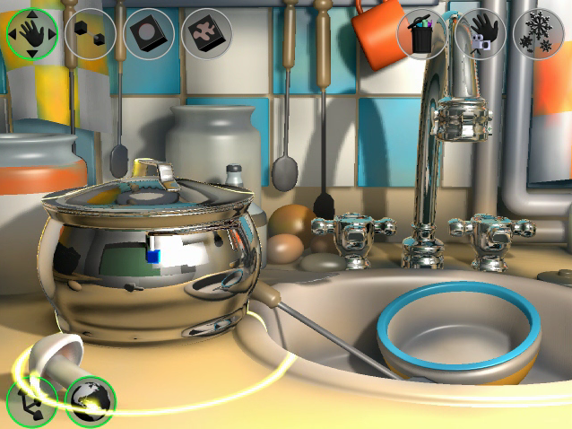
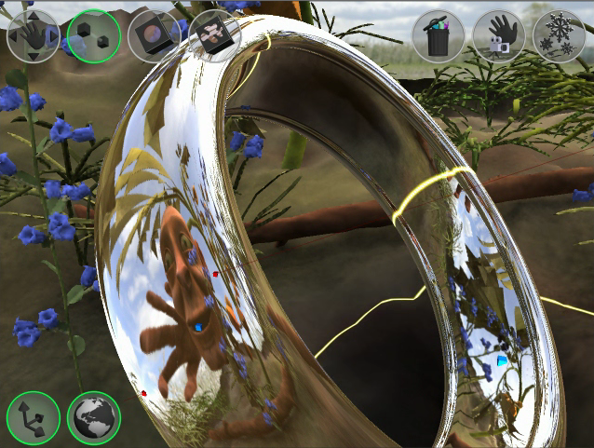
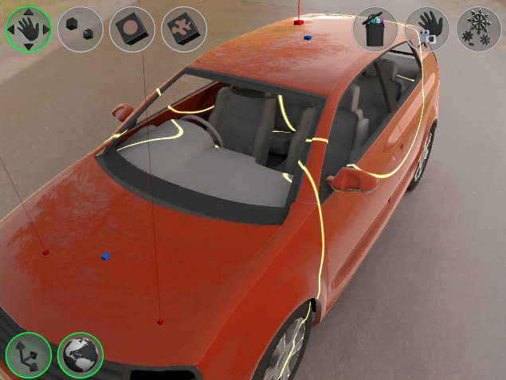
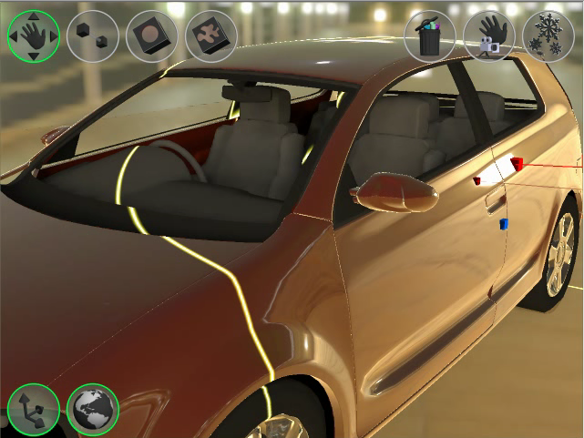
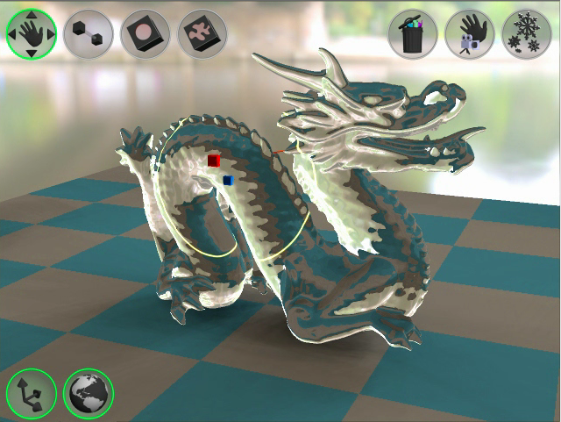
Applications
Reflection edit: Kitchen
Reflection edit: Ring
Reflection edit: Car
Highlight Editing
Refraction Editing
Notes:
There are numerous applications for a system like this: Besides reflection editing, we show editing of highlights and refractions as well.

Slide 13
Car
Notes:
Say it’s a car

Slide 14
Kitchen
Notes:
Say it’s a kitchen

Slide 15
Ring
Notes:
Say it’s a ring

Slide 16
Highlight Edit
Notes:
Say we edit highlights

Slide 17
Refraction Edit
Notes:
Man, look-it: refractions.

Slide 18
Keyframed Animation
Notes:
Man, look-it: refractions.

Slide 19
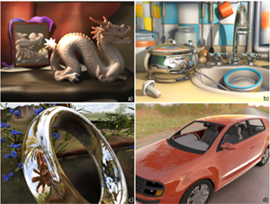
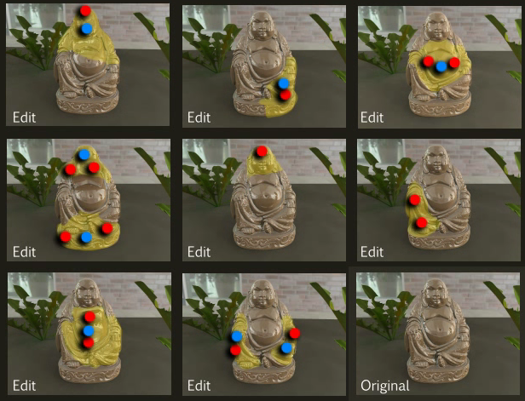
User Study
Study 1: Task performance
Study 2: Visual quality
Notes:
To evaluate our system, we performed two user studies:
A first study evaluates user task performance when using the system, (click) a second study evaluates visual quality of our results.

Slide 20
Task performance
16 novice users
Task: “Reproduce this example result image we made” performed in
2:22 minutes for “Rokeby Dragon”
4:04 minutes for “Kitchen”
2:00 minutes for “Highlight”
Notes:
To evaluate task performance, we asked 16 subjects to reproduce the reflection edits we presented them.
After a short introduction and some trials we timed their performance on each task.
It took them only a few minutes in each scene, to perform the task.
Nobody failed.
Furthermore, all aspects reported to feel that this is the right tool to perform such a task.

Slide 21
Visual Quality
Notes:
In a second study, we wanted to evaluate, if reflections that are edited at the same time: can look plausible and yet are strong enough to convey an artistic goal.
To do so, we performed 8 edits of similar strength on this object and asked participants if they can spot the original reflections.
Thereafter, we asked them to map textual descriptions of the edit to the images.

Slide 22
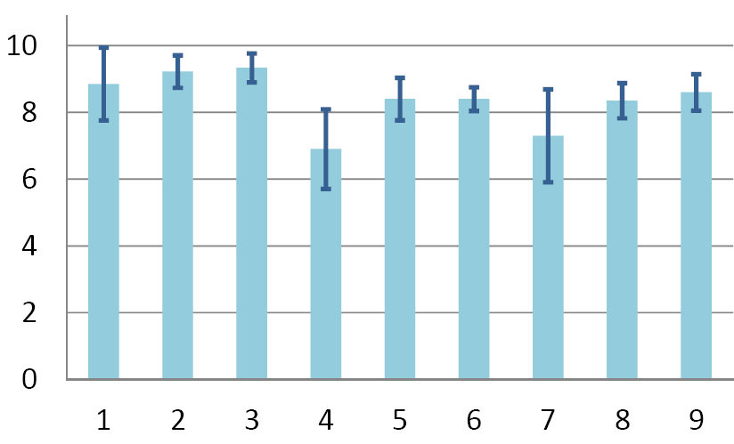
Visual Quality
Result:
Users consider non-physical reflections plausible for
significant and meaningful edits.
Original
Average score
Edits
Edits
Notes:
We found that they are not able to tell apart physical correct and edited reflections.
Some un-physical edits even achieved higher scores than the original.
At the same time, most people were able to map textual descriptions to the images, which shows that our edits were significant.

Slide 23
Future Work
Problem: Can do unpleasant and unrealistic edits
Solution: Restrict to pleasant and realistic edits. How?
Problem: Bending rays is not possible
Solution: Allow it. Mostly a UI problem.
Problem: Limitation to reflections
Solution: Try for other phenomena such as shadows, bounces, or caustics
Notes:
Wrapping up, in future work we would like to address the following limitations.
The system doesn’t prevent users from doing unpleasant and not plausible edits.
We observed some high level indicator when an edit works and when not.
Automating these would improve usability of the system.
Currently, rays can not be bend, but an improved UI and underlying rendering would allow to do so.
Furthermore, an extension to shadows, bounces and caustics is an interesting avenue of future research.

Slide 24
Conclusion
You saw a system, that …
… allows to edit rendered reflections as artists did for centuries.
… is easy to use and implement and runs in real-time.
… was evaluated in a user-study.
You can test it at the Digital Bazaar A60
Notes:
In conclusion, this talk proposed a system to edit reflections in 3d renderings in the way artistst did for many centuries.
The system is easy to implement and runs in real time.
A user study evaluated, that it can do artistically significant edits that look physically plausible.

Slide 25
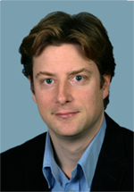
Thank you!
Acknowledgemens
Max-Planck Center for Visual Computing and Communication
BMBF-FKZ01IMC01
Anthonny Dick
Martin Fuchs
Carsten Stoll
Kaleigh Smith
Study participants
Funding
Voice-over
Internal Review
Internal Review
Internal Review
Patience
Notes:
We would like to thank the following people and would be happy to answer your question.
Thank you!

Slide 26
Surface Details

Slide 27
LafortunE

Slide 28
Cheating

