Slide 1
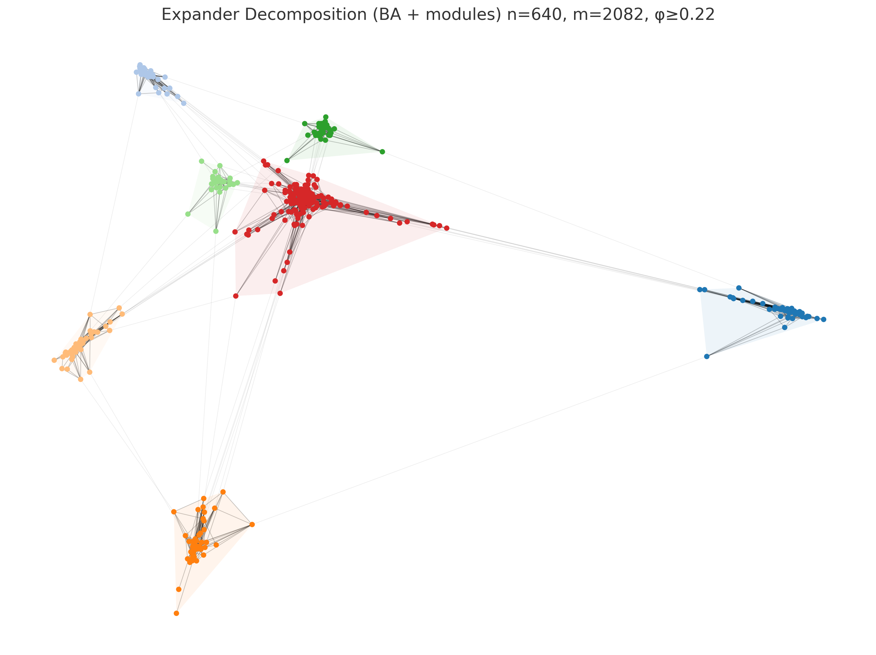
Lecture 1:
Expander Decomposition
Thatchaphol Saranurak
U of Michigan
August 18, 2025
ADFOCS

Slide 2
Part 0
Setting expectation

Slide 3
Expanders in TCS:
There are 2 main different regimes of expanders in TCS
Tailor-made expanders
  Strong expansion
  Non-trivial to even construct explicitly.
Expanders in the wild
  Weaker expansion
  Can find everywhere

Slide 4
Tailor-made expanders
Goal: Explicit construction of extremely strong expanders
Key objects:
  Ramanujan expanders
  Lossless expanders, monotone expanders, more
  High dimensional expanders
Main applications:
  Coding theory
  Pseudo-randomness (extractors, condensers, dispersers)
  PCP construction
  Sampling algorithms

Slide 5
Expanders in the wild
Goal: Find and use expanding subsets in an arbitrary graph
Key objects:
  Expander Decomposition
  Expander Hierarchies
Main applications:
  Graph theory (grid minor theorem, edge disjoint paths)
  Graph algorithms (max flow, mincut, sparsifiers, oblivious routing)
  Dynamic / Fault-tolerant data structures (connectivity, distance)
  This series is about expanders in this regime

Slide 6
Topics for 5 lectures
Lecture 1 Expander decomposition
Lecture 2,3 Two types of expanding hierarchies
Lecture 4,5 Overview of whole area

Slide 7
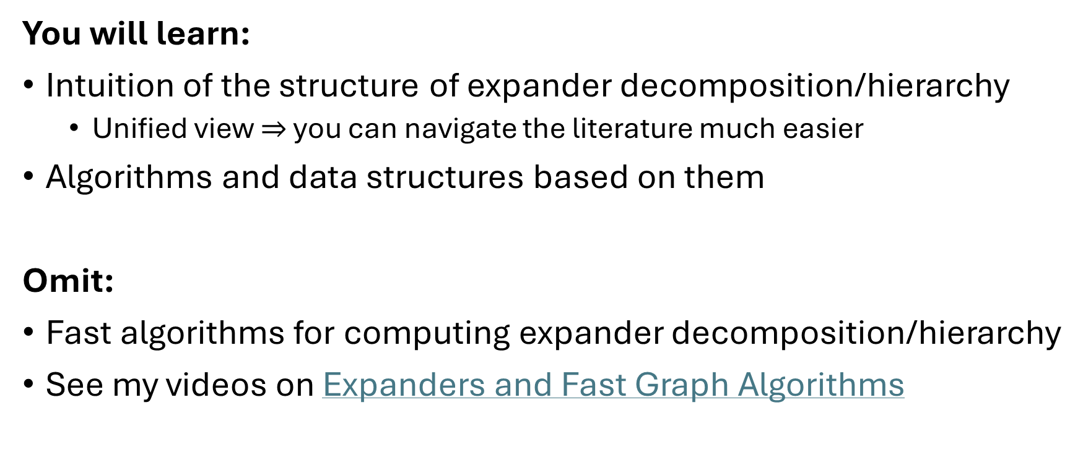
Expectation
You will learn:
Intuition of the structure of expander decomposition/hierarchy
  Unified view $⇒$ you can navigate the literature much easier
Algorithms and data structures based on them
Omit:
Fast algorithms for computing expander decomposition/hierarchy
See my videos on Expanders and Fast Graph Algorithms

Slide 8
Part 1
Basic Definitions

Slide 9



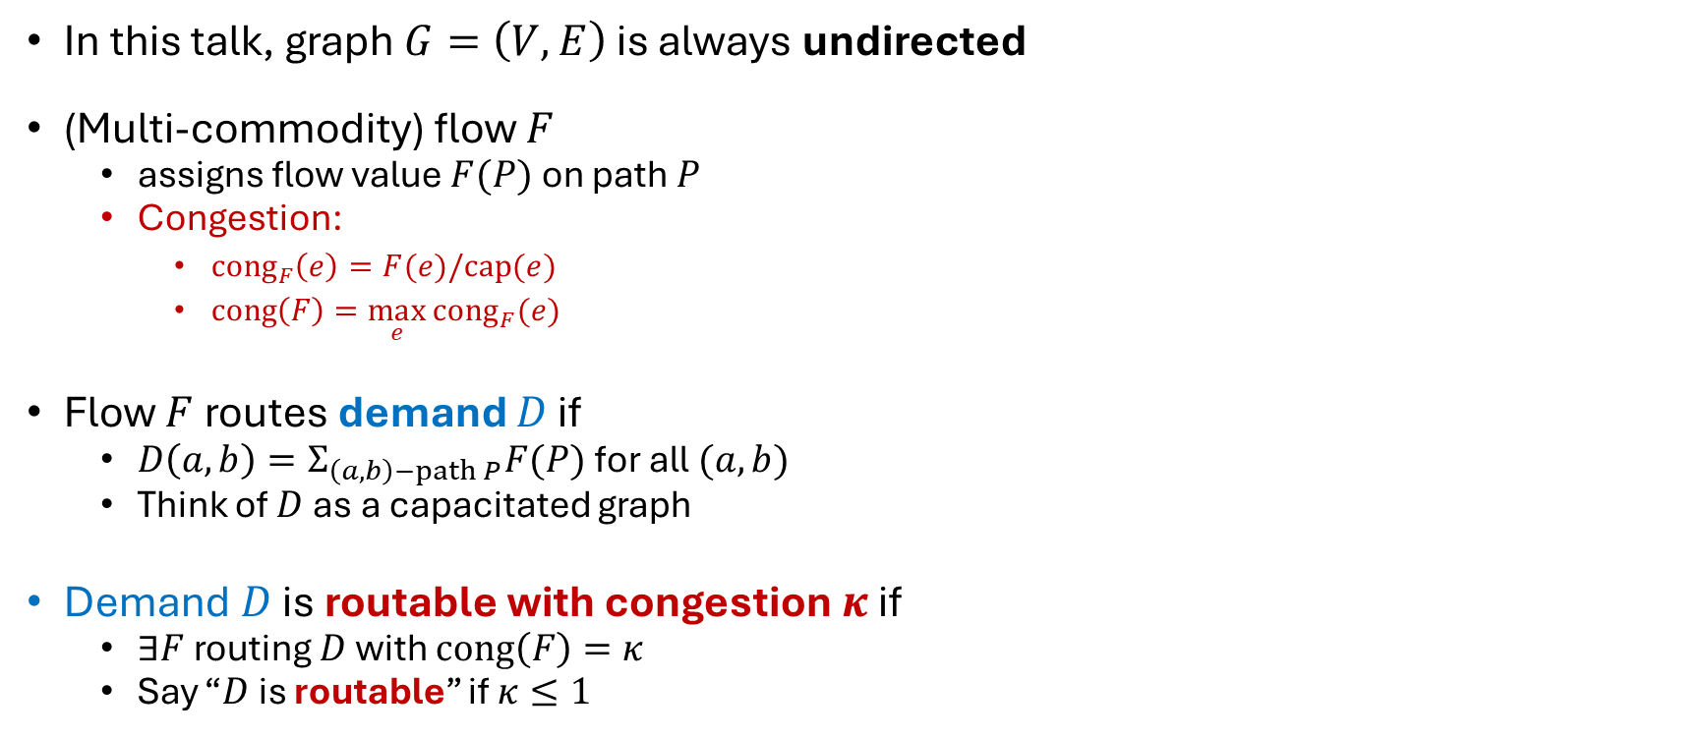
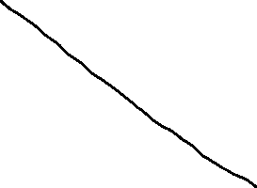


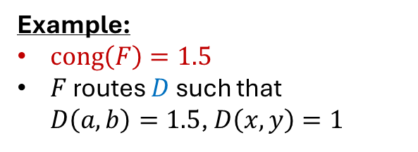
Flow and Demands
In this talk, graph $G=\left(V,E\right)$ is always undirected
(Multi-commodity) flow $F$
  assigns flow value $F(P)$ on path $P$
  Congestion:
    ${cong}_{F}\left(e\right)=F(e)/cap(e)$
    $cong\left(F\right)=\max_{e}{{cong}_{F}(e)}$
Flow $F$ routes demand $D$ if
  $D\left(a,b\right)=Σ_{\left(a,b\right)−path P}F(P)$ for all $(a,b)$
  Think of $D$ as a capacitated graph
Demand $D$ is routable with congestion $κ$ if
  $∃F$ routing $D$ with $cong\left(F\right)=κ$
  Say “$D$ is routable” if $κ≤1$
Example:
$cong\left(F\right)=1.5$
$F$ routes $D$ such that
$D\left(a,b\right)=1.5$, $D\left(x,y\right)=1$

Slide 10





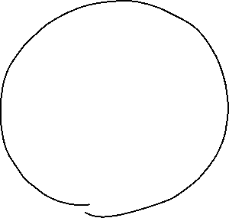

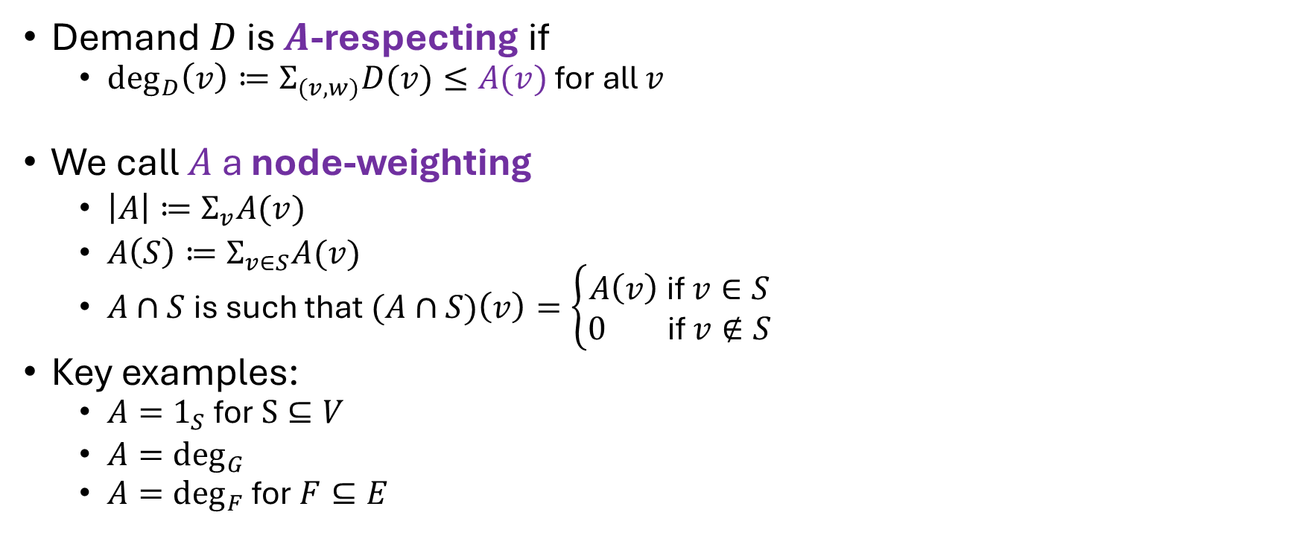
Node-Weighting
Demand $D$ is $A$-respecting if
  $\deg_{D}\left(v\right)≔Σ_{(v,w)}D(v)≤A(v)$ for all $v$
We call $A$ a node-weighting
  $\left|A\right|≔Σ_{v}A(v)$
  $A\left(S\right)≔Σ_{v∈S}A(v)$
  $A∩S$is such that $(A∩S)\left(v\right)=\left\{\begin{aligned}A\left(v\right) \text{if} v∈S \\ 0 \text{if} v∉S\end{aligned}\right.$
Key examples:
  $A=1_{S}$ for $S⊆V$
  $A=\deg_{G}$
  $A=\deg_{F}$ for $F⊆E$

Slide 11
Part 2
Expansion
Two equivalent ways to think about expansion

Slide 12

Flow and Cut Expansions: Informal
$A$ is flow-expanding in $G$ if
  can route flow between $A$ with low congestion
$A$ is cut-expanding in $G$ if
  No bottleneck cut preventing routing flow between $A$ with low congestion

Slide 13
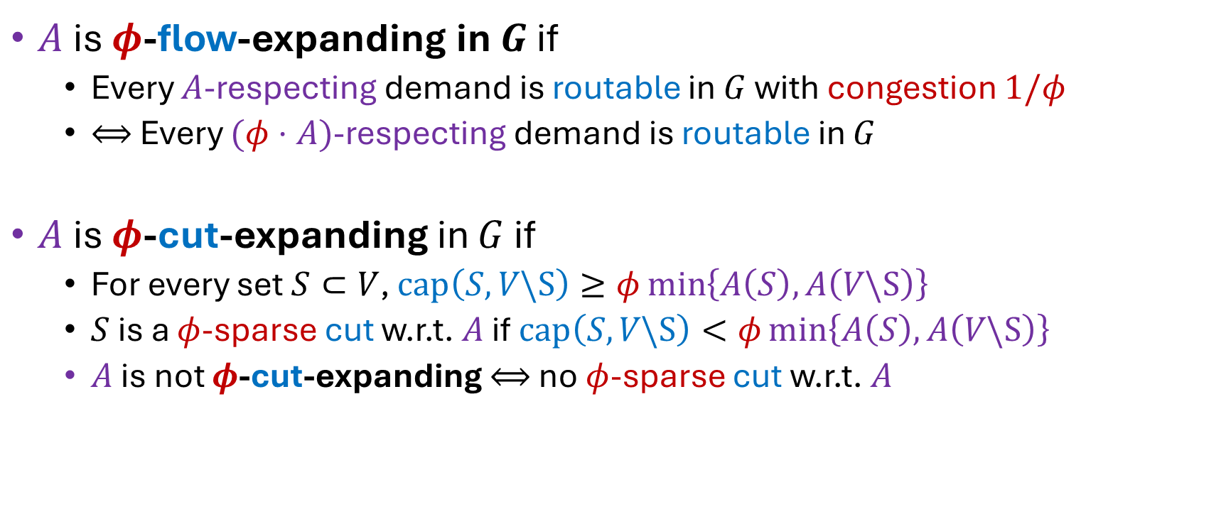


Flow and Cut Expansions: Formal
$A$ is $φ$-flow-expanding in $G$ if
  Every $A$-respecting demand is routable in $G$ with congestion $1/φ$
  $⟺$ Every $(φ⋅A)$-respecting demand is routable in $G$
$A$ is $φ$-cut-expanding in $G$ if
  For every set $S⊂V$, $cap\left(S,V\backslash S\right)≥φ\min\left\{A\left(S\right),A\left(V\backslash S\right)\right\}$
  $S$ is a $φ$-sparse cut w.r.t. $A$ if $cap\left(S,V\backslash S\right)<φ\min\left\{A\left(S\right),A\left(V\backslash S\right)\right\}$
  $A$ is not $φ$-cut-expanding $⟺$ no $φ$-sparse cut w.r.t. $A$

Slide 14
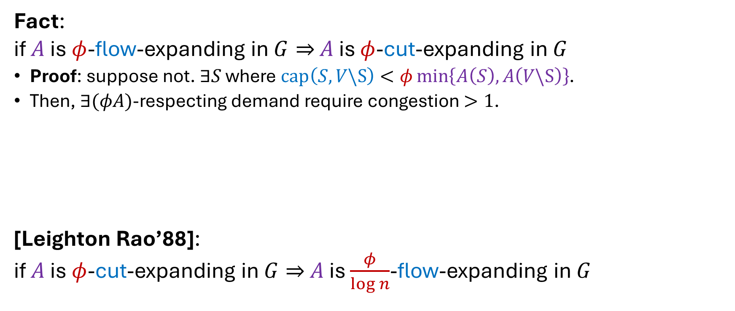
Flow and Cut Expansions: Equivalence
Fact:
if $A$ is $φ$-flow-expanding in $G⇒$ $A$ is $φ$-cut-expanding in $G$
Proof: suppose not. $∃S$ where $cap\left(S,V\backslash S\right)<φ\min\left\{A\left(S\right),A\left(V\backslash S\right)\right\}$.
Then, $∃(φA)$-respecting demand require congestion $>1$.
[Leighton Rao’88]:
if $A$ is $φ$-cut-expanding in $G⇒$ $A$ is $\frac{φ}{\log{n}}$-flow-expanding in $G$

Slide 15
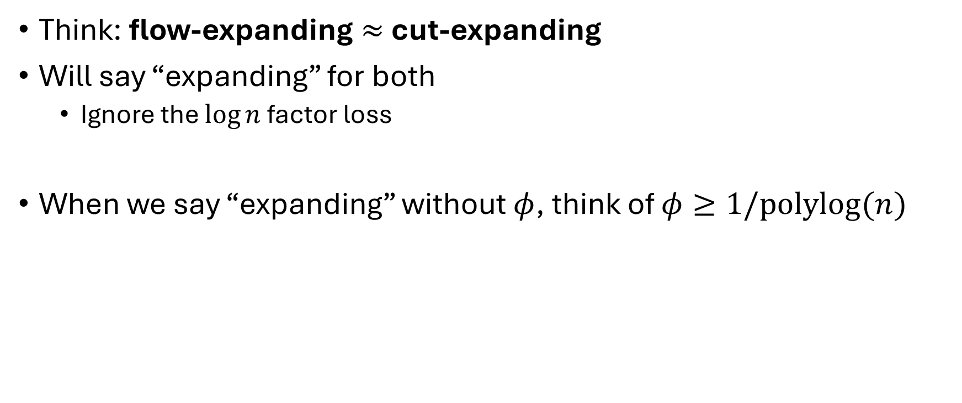
“Expanding”
Think: flow-expanding $≈$ cut-expanding
Will say “expanding” for both
  Ignore the $\log{n}$ factor loss
When we say “expanding” without $φ$, think of $φ≥1/polylog(n)$

Slide 16
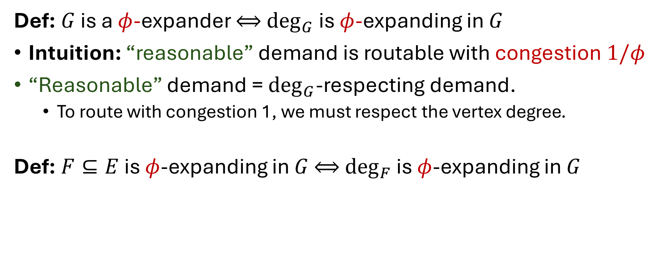
Expanders and Expanding Edge Sets
Def: $G$ is a $φ$-expander $⟺$ $\deg_{G}$ is $φ$-expanding in $G$
Intuition: “reasonable” demand is routable with congestion $1/φ$
“Reasonable” demand = $\deg_{G}$-respecting demand.
  To route with congestion 1, we must respect the vertex degree.
Def: $F⊆E$ is $φ$-expanding in $G$ $⟺$ $\deg_{F}$ is $φ$-expanding in $G$

Slide 17
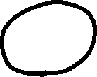

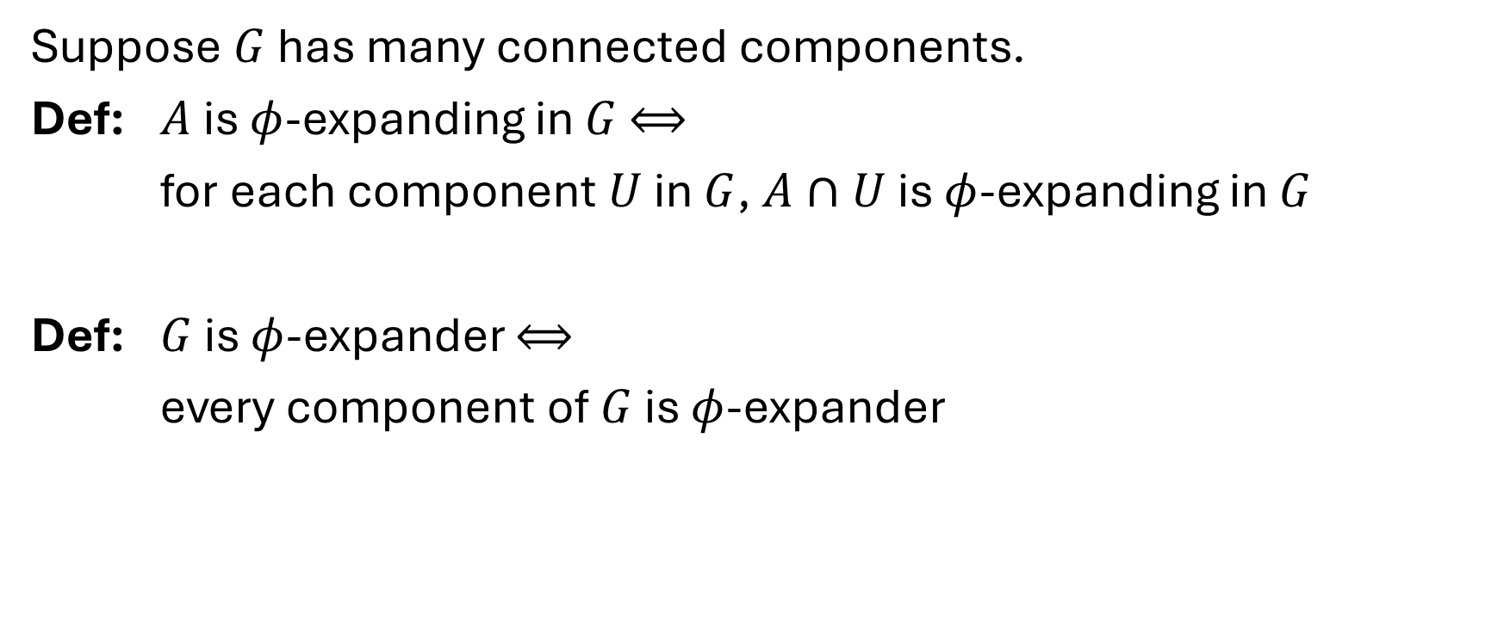


When $G$ has many connected components
Suppose $G$ has many connected components.
Def: $A$ is $φ$-expanding in $G$ $⟺$
for each component $U$ in $G$, $A∩U$ is $φ$-expanding in $G$
Def: $G$ is $φ$-expander $⟺$
every component of $G$ is $φ$-expander

Slide 18















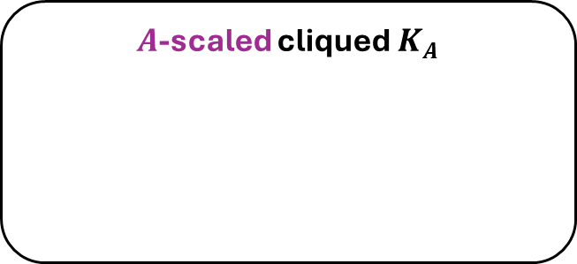




Quiz: which one is an expander?
Clique
Single vertex
Star
Hypercube
Disjoint cliques
Empty graphs
$A$-scaled cliqued $K_{A}$
$cap\left(u,v\right)=\frac{A\left(u\right)A\left(v\right)}{A(V)}$
$$\deg_{K_{A}}{=}A$$
Dumbbell
Path

Slide 19




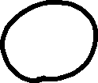





Quiz: which set is expanding?

Slide 20
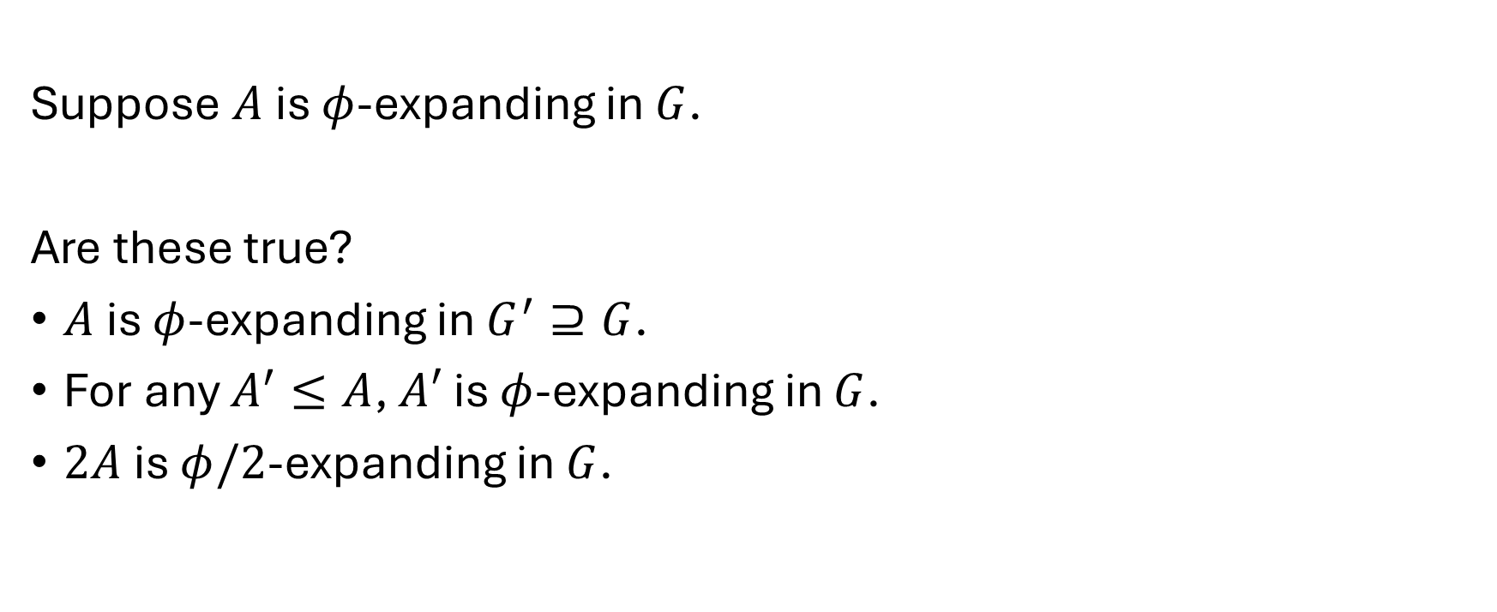
Quiz
Suppose $A$ is $φ$-expanding in $G$.
Are these true?
$A$ is $φ$-expanding in $G^{′}⊇G$.
For any $A^{′}≤A$, $A′$ is $φ$-expanding in $G$.
$2A$ is $φ/2$-expanding in $G$.

Slide 21
Part 3
Algorithms on Expanders

Slide 22
Expanders are Algorithmic Friendly
Problems usually become easy on expanders
You will see many examples in this series.

Slide 23
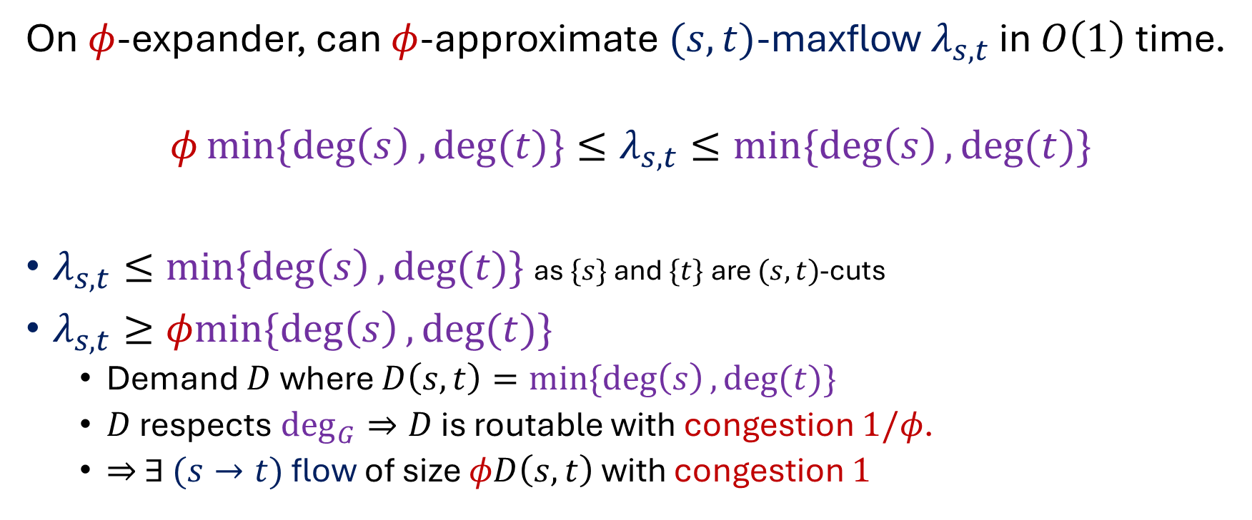
Example: Approx Max Flow on Expanders
On $φ$-expander, can $φ$-approximate $(s,t)$-maxflow $λ_{s,t}$ in $O\left(1\right)$ time.
$$φmin\{\deg\left(s\right),\deg{(t)\}}{≤λ_{s,t}≤min\{\deg\left(s\right),\deg{(t)\}}}$$
$λ_{s,t}≤min\{\deg\left(s\right),\deg{(t)\}}$ as $\{s\}$ and $\{t\}$ are $(s,t)$-cuts
$λ_{s,t}≥φmin\{\deg\left(s\right),\deg{(t)\}}$
  Demand $D$where $D\left(s,t\right)=min\{\deg\left(s\right),\deg{(t)\}}$
  $D$ respects $\deg_{G}⇒D$ is routable with congestion $1/φ$.
  $⇒$ $∃$ $(s→t)$ flow of size $φD\left(s,t\right)$ with congestion $1$

Slide 24
Part 4
Expander Decomposition

Slide 25

Motivation
$G$ might not be an expander, but…
We can make $G$ a $φ$-expander after removing $≈φ$ fraction of edges

Slide 26
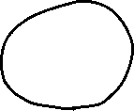




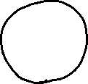
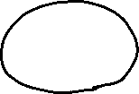
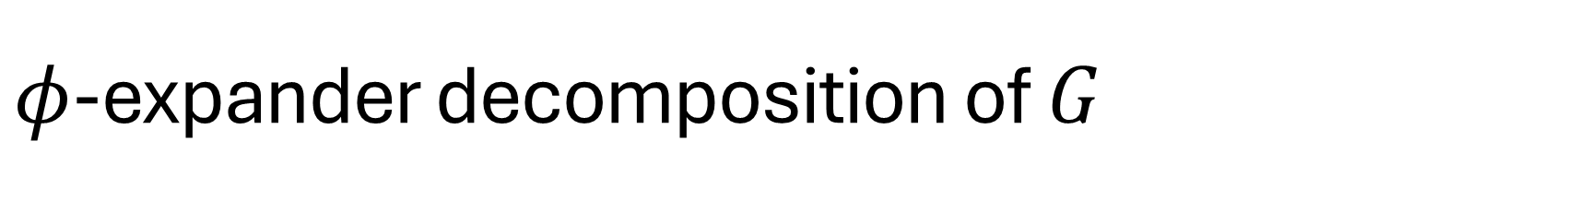



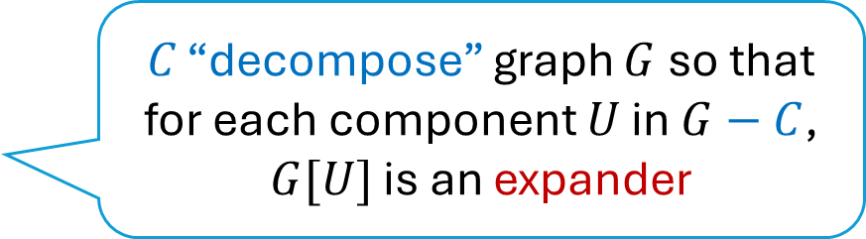
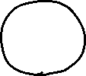

$φ$-expander decomposition of $G$
Theorem: Given $G=\left(V,E\right),φ$, there exists $C⊆E$
$\left|C\right|≤(φ\log{n})⋅m$
$\deg_{G}$ is $φ$-expanding in $G−C$.
So, $G−C$ is a $φ$-expander
$C$ “decompose” graph $G$ so that
for each component $U$ in $G−C$,
$G[U]$ is an expander

Slide 27







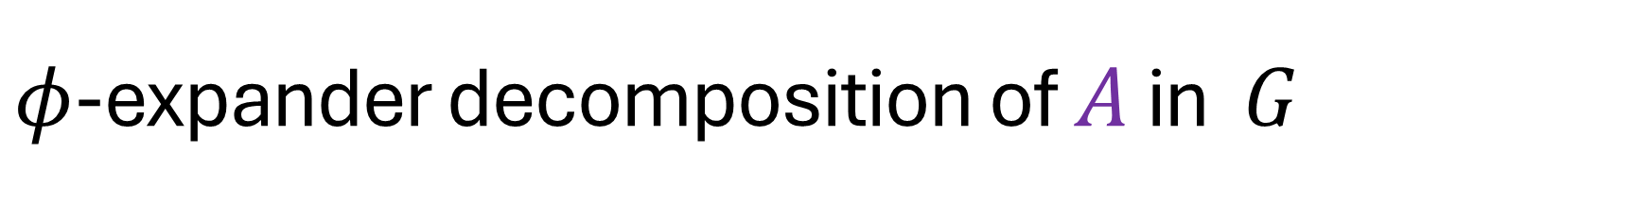






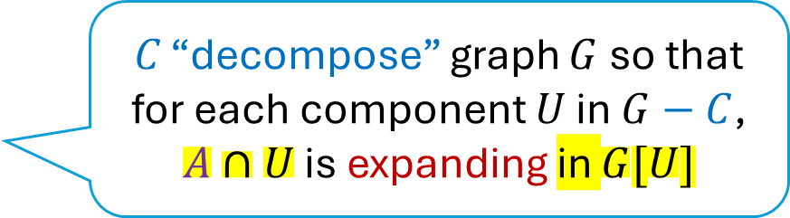
$φ$-expander decomposition of $A$ in $G$
Theorem: Given $G=\left(V,E\right), A,φ$, there exists $C⊆E$
$\left|C\right|≤(φ\log{n})⋅|A|$
$A$ is $φ$-expanding in $G−C$
$C$ “decompose” graph $G$ so that
for each component $U$ in $G−C$,
$A∩U$ is expanding in $G[U]$

Slide 28

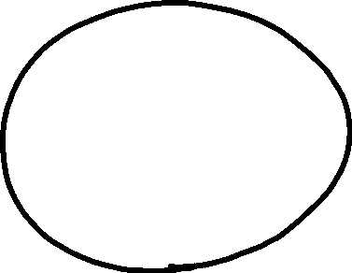
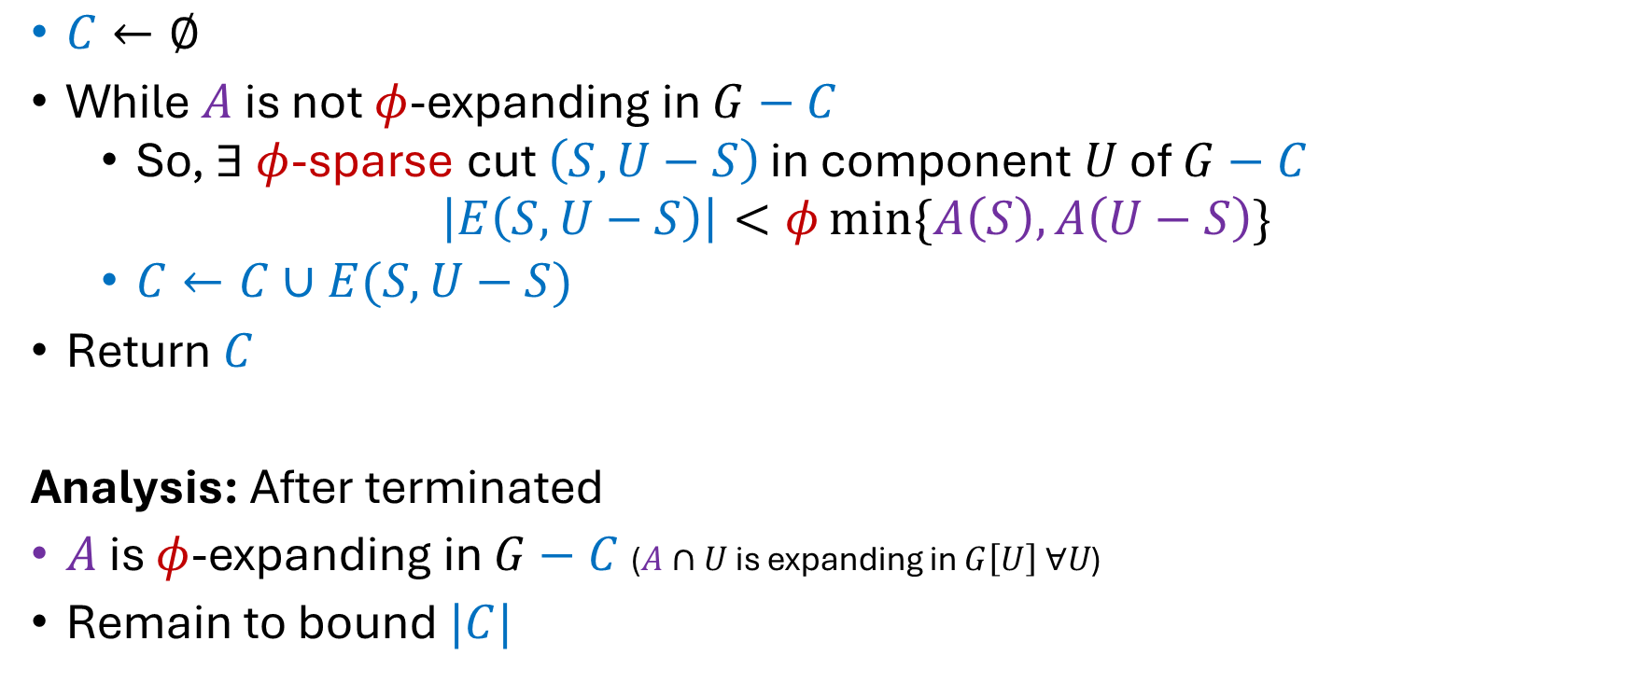
Algorithm
$C←∅$
While $A$ is not $φ$-expanding in $G−C$
  So, $∃$ $φ$-sparse cut $\left(S,U−S\right)$ in component $U$ of $G−C$
  $\left|E\left(S,U−S\right)\right|<φ\min{\{A\left(S\right),A\left(U−S\right)\}}$
  $C←C∪E(S,U−S)$
Return $C$
Analysis: After terminated
$A$ is $φ$-expanding in $G−C$ ($A∩U$ is expanding in $G\left[U\right] ∀U$)
Remain to bound $|C|$

Slide 29

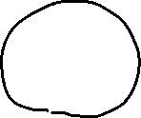
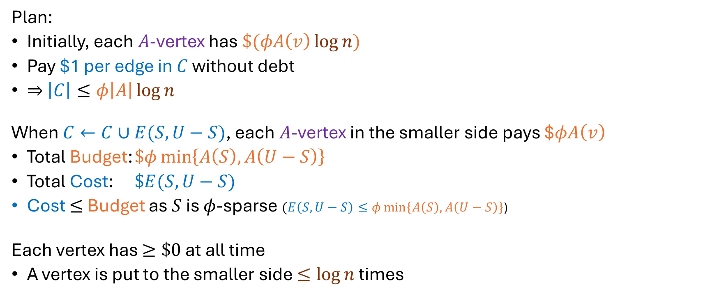

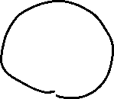
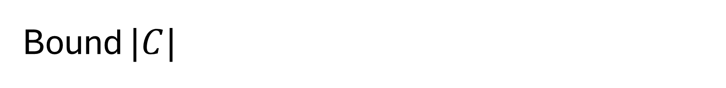
Bound $|C|$
Plan:
Initially, each $A$-vertex has $\$(φA\left(v\right)\log{n})$
Pay $1 per edge in $C$ without debt
$⇒$ $\left|C\right|≤φ\left|A\right|\log{n}$
When $C←C∪E(S,U−S)$, each $A$-vertex in the smaller side pays $$φA\left(v\right)$
Total Budget: $\$φ\min\left\{A\left(S\right),A\left(U−S\right)\right\}$
Total Cost: $\$E(S,U−S)$
Cost $≤$ Budget as $S$ is $φ$-sparse $(E\left(S,U−S\right)≤φ\min\left\{A\left(S\right),A\left(U−S\right)\right\}$)
Each vertex has $≥\$0$ at all time
A vertex is put to the smaller side $≤\log{n}$ times

Slide 30

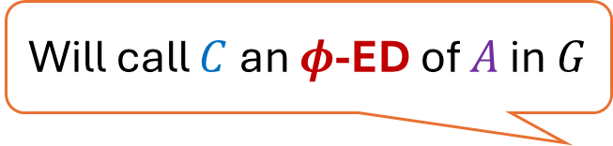





$φ$-expander decomposition of $A$ in $G$
Theorem: Given $G=\left(V,E\right), A,φ$, there exists $C⊆E$
$\left|C\right|≤(φ\log{n})⋅|A|$
$A$ is $φ$-expanding in $G−C$
Will call $C$ an $φ$-ED of $A$ in $G$

Slide 31



$φ$-expander decomposition of $G$
Theorem: Given $G=\left(V,E\right), φ$, there exists $C⊆E$
$\left|C\right|≤(φ\log{n})⋅m$
$\deg_{G}$ is $φ$-expanding in $G−C$.
Will call $C$ an $φ$-ED of $G$

Slide 32
Part 5
Repeated Expander Decomposition

Slide 33

Repeated Expander Decomposition
Idea:
Compute an expander decomposition $C$ of $G$.
Then, recurse on the graph induced by $C$.

Slide 34

Repeated Expander Decomposition
Theorem: Given $G=(V,E)$, can partition $E$
Each part induces a $(\frac{1}{4log{n}})$-expander
Each vertex is in $≤\log{n}$ expanders

Slide 35

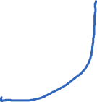

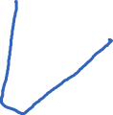
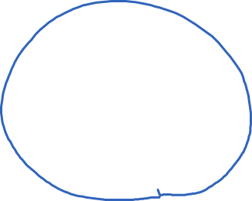


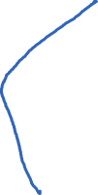
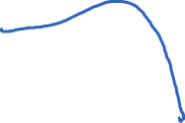
Repeated Expander Decomposition
$(\frac{1}{4logn})$-expander
$C_{1}$ is $1/4logn$-ED of $G$
$$|C_{1}|≤\frac{m}{2}$$

Slide 36

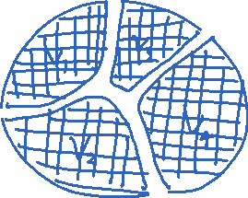

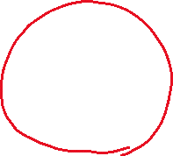
Repeated Expander Decomposition
Expander decomposition
$(\frac{1}{4logn})$-expander
Graph induced by $C_{1}$
$≤\frac{m}{2}$ edges

Slide 37
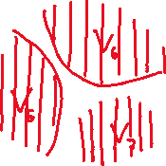



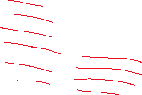



Repeated Expander Decomposition
$(\frac{1}{4logn})$-expander
$(\frac{1}{4logn})$-expander
$C_{2}$ is $1/4logn$-ED of $G$
$$|C_{2}|≤\frac{m}{4}$$

Slide 38


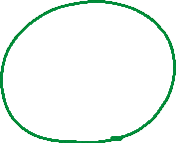

Repeated Expander Decomposition
$(\frac{1}{4logn})$-expander
$(\frac{1}{4logn})$-expander
$≤\frac{m}{4}$ edges

Slide 39











Repeated Expander Decomposition
$(\frac{1}{4logn})$-expander
$(\frac{1}{4logn})$-expander
$(\frac{1}{4logn})$-expander
$$G_{2}$$
$$G_{3}$$
$$G_{\log{n}}$$
$$G_{1}$$

Slide 40
Repeated Expander Decomposition
Theorem: Given $G=(V,E)$, can partition $E$
Each part induces a $(\frac{1}{4log{n}})$-expander
Each vertex is in $≤\log{n}$ expanders
$(\frac{1}{4logn})$-expander
$(\frac{1}{4logn})$-expander
$(\frac{1}{4logn})$-expander
$$G_{2}$$
$$G_{3}$$
$$G_{\log{n}}$$
$$G_{1}$$

Slide 41
Part 6
Application of Expander Decomposition: Edge Sparsifier

Slide 42

Edge Sparsifiers for Cuts
Input: graph $G=(V,E)$
Output: weighted graph $H=(V,E^{′})$
$H$ has $\tilde{O}(n)$ weighted edges
$w_{G}\left(S,V−S\right)≈_{1+ε}w_{H}\left(S,V−S\right)$ $∀S⊂V$

Slide 43


Sparsifier of $φ$-Expanders: Degree-Sampling
Linear-Time Algo: for each $e=(u,v)$
Put edge $e$ into $H$ with prob $p_{e}=\min{\{1,}\frac{100\log{n}}{ε^{2}φmin\left\{\deg_{G}{u},\deg_{G}{v}\right\}}\}$
Set weight of $e$ to $1/p_{e}$
Correctness:
$\left|E\left(H\right)\right|=\tilde{O}(n/ε^{2}φ)$
  Assign each edge to the lower degree endpoint.
  Each vertex $u$ is assigned $≤\deg{u}$ edges, each of which is sampled with rate $≈1/\deg{u}$
$(1+ε)$-approximation
  This works as long as $p_{(u,v)}=\min{\{1,}\frac{100\log{n}}{ε^{2}λ_{u,v}}\}$[Fung Hariharan Harvey Panirahi]
  We knew $λ_{u,v}≥φmin\left\{\deg_{G}{u},\deg_{G}{v}\right\}$ on $φ$-expander

Slide 44


Sparsifier on General Graphs
Algo:
${\left\{X_{i}\right\}}_{i}←$ repeated $(1/4log{n})$-expander decomposition of $G$
For each expander $X_{i}$, ${\tilde{X}}_{i}←$degree-sampling$(X_{i})$
Return $H=∪_{i}{\tilde{X}}_{i}$
Size: $\left|E\left(H\right)\right|=\tilde{O}(n/ε^{2})$
Approximation: union of sparsifiers is a sparsifier of the union
Let $G=G_{1}∪G_{2}$. Let ${\tilde{G}}_{1},{\tilde{G}}_{2}$ be $α$-sparsifier of $G_{1},G_{2}$.
Then, $\tilde{G}={\tilde{G}}_{1}∪{\tilde{G}}_{2}$ is $α$-sparsifier of $G$

Slide 45

Sparsifier on General Graphs
Algo:
${\left\{X_{i}\right\}}_{i}←$ repeated $(1/4log{n})$-expander decomposition of $G$
For each expander $X_{i}$, ${\tilde{X}}_{i}←$degree-sampling$(X_{i})$
Return $H=∪_{i}{\tilde{X}}_{i}$
Comment on this approach:
First construction of “spectral sparsifiers” by [Spielman-Teng’04]
Dynamic algorithm $⇒$ $ℓ_{2}$-IPM for max flow in $\tilde{O}(m+n^{1.5})$ time

Slide 46
Part 7
Boundary-Linked Expander Decomposition

Slide 47


Recall: $φ$-expander decomposition of $A$ in $G$
Theorem: Given $G=\left(V,E\right), A,φ$, there exists $C⊆E$
$\left|C\right|≤(φ\log{n})⋅|A|$
$A$ is $φ$-expanding in $G−C$
Will call $C$ an $φ$-ED of $A$ in $G$

Slide 48




Boundary-linked $φ$-expander decomposition of $A$ in $G$
Theorem: Given $G=(V,E)$, $A$, $φ≤1/4\log{n}$, there exists $C⊆E$
$\left|C\right|≤(2φ\log{n})⋅|A|$
$A+\deg_{C}$ is $φ$-expanding in $G−C$
for each component $U$ in $G−C$,
$A∩U+∂_{G}U$ is expanding in $G[U]$

Slide 49

Algorithm
$C←∅$
While $A^{′}=A+\deg_{C}$ is not $φ$-expanding in $G−C$
  So, $∃$ $φ$-sparse cut $\left(S,U−S\right)$ in component $U$ of $G−C$
  $\left|E\left(S,U−S\right)\right|<φ\min{\{A′\left(S\right),A′\left(U−S\right)\}}$
  $C←C∪E(S,U−S)$
Return $C$
Analysis: After terminated
$A′$ is $φ$-expanding in $G−C$ ($A′∩U$ is expanding in $G\left[U\right] ∀U$)
Remain to bound $|C|$

Slide 50


Bound $|C|$: Plan
Initially, each $A$-vertex has $\$(2φA\left(v\right)\log{n})$
Without debt
  Pay $1 per edge in $C⇒$ $\left|C\right|≤2φ\left|A\right|\log{n}$
  Maintain Invariant “Each $A′$-vertex $v$ has $\$(2φA′\left(v\right)\log{|U_{v}|})$”
    $U_{v}$ is the component in $G−C$ containing $v$”

Slide 51





Bound $|C|$: Payment scheme
When $C←C∪E(S,U−S)$, each $A′$-vertex in the smaller side pays $$2φA′\left(v\right)$
Total Budget: $\$2φ\min\left\{A′\left(S\right),A′\left(U−S\right)\right\}$
Total Cost: $\$2E(S,U−S)$
  $\$E(S,U−S)$for new edges in $C$
  $\$2φ\left|A_{new}^{′}\right|\log{U}$ to maintain invariant
    $\left|A_{new}^{′}\right|=2|E\left(S,U−S\right)|$ as edges has two endpoints
    $φ≤1/4\log{n}$
    So, $\$2φ\left|A_{new}^{′}\right|\log{U}≤\$E(S,U−S)$
Cost $≤$ Budget as $S$ is $φ$-sparse $(E\left(S,U−S\right)≤φ\min\left\{A′\left(S\right),A′\left(U−S\right)\right\}$)
Observe: Invariant is maintained

Slide 52

Boundary-linked $φ$-expander decomposition of $A$ in $G$
Theorem: Given $G=(V,E)$, $A$, $φ≤1/4\log{n}$, there exists $C⊆E$
$\left|C\right|≤(2φ\log{n})⋅|A|$
$A+\deg_{C}$ is $φ$-expanding in $G−C$

Slide 53
Part 8
Application of Boundary-Linked Expander Decomposition:
Vertex Sparsifiers

Slide 54

Vertex Sparsifiers: Informal
Given a huge graph $G$ and a node weighting $A$.
Informal Goal:
Compress $G$ to size $≈|A|$
Preserve routability of all $A$-respecting demands

Slide 55


Vertex Sparsifiers
Given a huge graph $G$ and a node weighting $A$.
Goal: find $H$ s.t. for every $A$-respecting demand $D$
$D$ is routable in $G$ ⇒ $D$ is routable in 𝐻
$D$ is routable in $H$ ⇒ $D$ is routable in $G$ with congestion $q=4 log⁡n$
$|E(H)|=O(\left|A\right|)$
Exercise: Preserve mincuts between all subsets.
for any $U⊆V$,
For all $X,Y⊆U$,
$${mincut}_{G}\left(X,Y\right)≤{mincut}_{H}\left(X,Y\right)≤q⋅{mincut}_{G}\left(X,Y\right)$$
$\left|E\left(H\right)\right|=O\left(\deg_{G}{(U)}\log^{2}{n}\right)$

Slide 56









Construction [Chuzhoy’12]
Theorem: Given $G$, $A$, $φ≤1/4\log{n}$, there is $C⊆E$
$\left|C\right|≤(2φ\log{n})⋅|A|$
$A+\deg_{C}$ is $φ$-expanding in $G−C$
Find $C$ where $A+\deg_{C}$ is $(φ=1/4\log{n})$-expanding in $G−C$
For each $A$-vertex $v$, add edge $\left(v,v^{′}\right)$ with capacity $A(v)$.
$H←$ contract each component of $G−C$
Size: $\left|E\left(H\right)\right|≤\left|A\right|+\left|C\right|=O\left(\left|A\right|\right)$.
Next: show that $H$ preserves routability
Think:
$v′$ represents $v$.

Slide 57














Routable in $G⇒$ Routable in $H$
Let $D$ be an $A$-respecting demand.
Suppose $F_{G}$ routes $D$ in $G$ with congestion 1
Goal: Construct $F_{H}$ routing $D$ in $H$ with congestion 1
$D$ respects $A$
$⇒$ Dummy edges $\left(v,v^{′}\right)$ have congestion $≤1$
Contraction never increases congestion.

Slide 58







Routable in $H⇒$ Routable in $G$ with low congestion
Let $D$ be an $A$-respecting demand.
Suppose $F_{H}$ routes $D$ in $H$ with congestion 1
Goal: Construct $F_{G}$ routing $D$ in $G$ with congestion $q=4\log{n}$
For each component $U$ in $G−C$
$F_{H}$ induces demand $D_{U}$
$D_{U}$ respects $\left(A+\deg_{C}\right)∩U$
  which is $(1/4\log{n})$-expanding in $G[U]$
$D_{U}$ is routable in $G[U]$ with congestion $4\log{n}$
$F_{G}←$ concatenate flow in $G$ on each $U$

Slide 59
Vertex Sparsifiers
Given a huge graph $G$ and a node weighting $A$.
Goal: find $H$ s.t. for every $A$-respecting demand $D$
$D$ is routable in $G$ ⇒ $D$ is routable in 𝐻
$D$ is routable in $H$ ⇒ $D$ is routable in $G$ with congestion $q=4 log⁡n$
$|E(H)|=O(\left|A\right|)$

Slide 60
Summary

Slide 61

What we learned
Flow expansion $≈$Cut-expansion
Easy algorithms on expanders
  Approx max flow from degree
Expander decomposition
  Repeated expander decomposition
    Application: edge sparsifiers for cuts
  Boundary-linked expander decomposition
    Application: vertex sparsifiers for flow

Slide 62
Boundary-linked $φ$-expander decomposition of $A$ in $G$
Theorem: Given $G=(V,E)$, $A$, $φ≤1/4\log{n}$, there exists $C⊆E$
$\left|C\right|≤(2φ\log{n})⋅|A|$
$A+\deg_{C}$ is $φ$-expanding in $G−C$

Slide 63
Repeated Expander Decomposition
Theorem: Given $G=(V,E)$, can partition $E$
Each part induces a $(\frac{1}{4log{n}})$-expander
Each vertex is in $≤\log{n}$ expanders
$(\frac{1}{4logn})$-expander
$(\frac{1}{4logn})$-expander
$(\frac{1}{4logn})$-expander
$$G_{2}$$
$$G_{3}$$
$$G_{\log{n}}$$
$$G_{1}$$

