Slide 1
Lecture 2:
Separator-Expanding Hierarchies
Thatchaphol Saranurak
U of Michigan
August 18, 2025
ADFOCS

Slide 2
Plan
Connectivity Oracles under Edge Faults [Patraşcu Thorup’07]
Oracle construction on expanders
Separator-expanding hierarchy
Oracle construction on general graphs

Slide 3
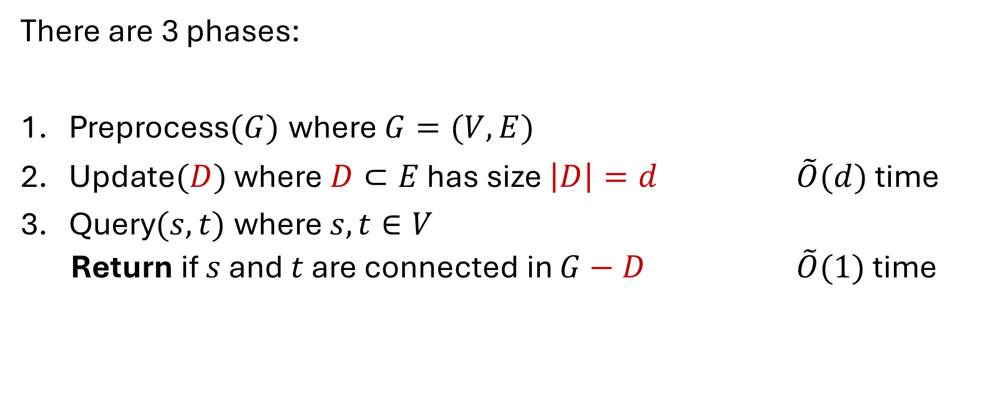
Connectivity Oracles under Edge Faults
There are 3 phases:
Preprocess$(G)$ where $G=(V,E)$
Update$(D)$ where$D⊂E$ has size $\left|D\right|=d$ $\tilde{O}(d)$ time
Query$(s,t)$ where $s,t∈V$
  Return if $s$ and $t$ are connected in $G−D$ $\tilde{O}(1)$ time

Slide 4

Part 1
Warm-Up:
Oracle Construction on Expanders where $(s,t)$ are fixed.

Slide 5











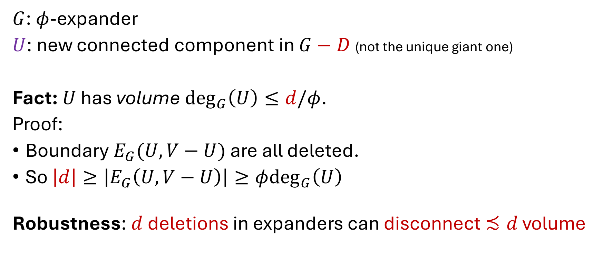
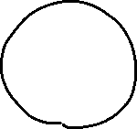

Robustness of Expanders
$G$: $φ$-expander
$U$: new connected component in $G−D$ (not the unique giant one)
Fact: $U$ has volume $\deg_{G}\left(U\right)≤d/φ$.
Proof:
Boundary $E_{G}(U,V−U)$ are all deleted.
So $\left|d\right|≥\left|E_{G}\left(U,V−U\right)\right|≥φ\deg_{G}\left(U\right)$
Robustness: $d$ deletions in expanders can disconnect $≾d$ volume

Slide 6






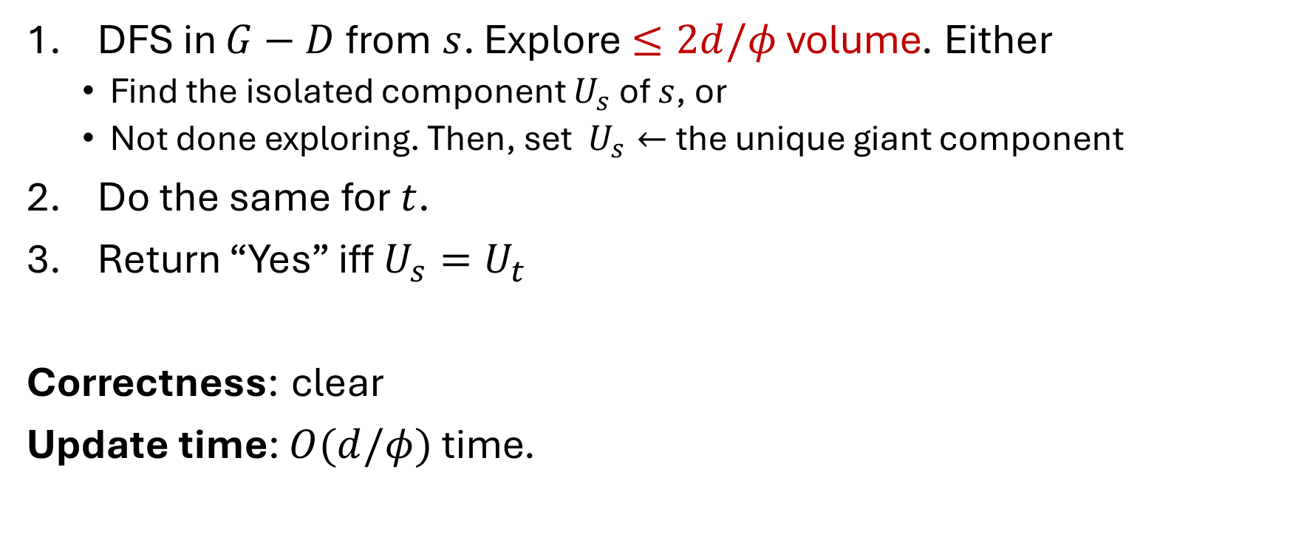


Oracle on $φ$-Expanders. Fixed $s,t$
DFS in $G−D$ from $s$. Explore $≤2d/φ$ volume. Either
  Find the isolated component $U_{s}$ of $s$, or
  Not done exploring. Then, set $U_{s}←$ the unique giant component
Do the same for $t$.
Return “Yes” iff $U_{s}=U_{t}$
Correctness: clear
Update time: $O(d/φ)$ time.

Slide 7
Part 2
Oracle Construction on Expanders

Slide 8
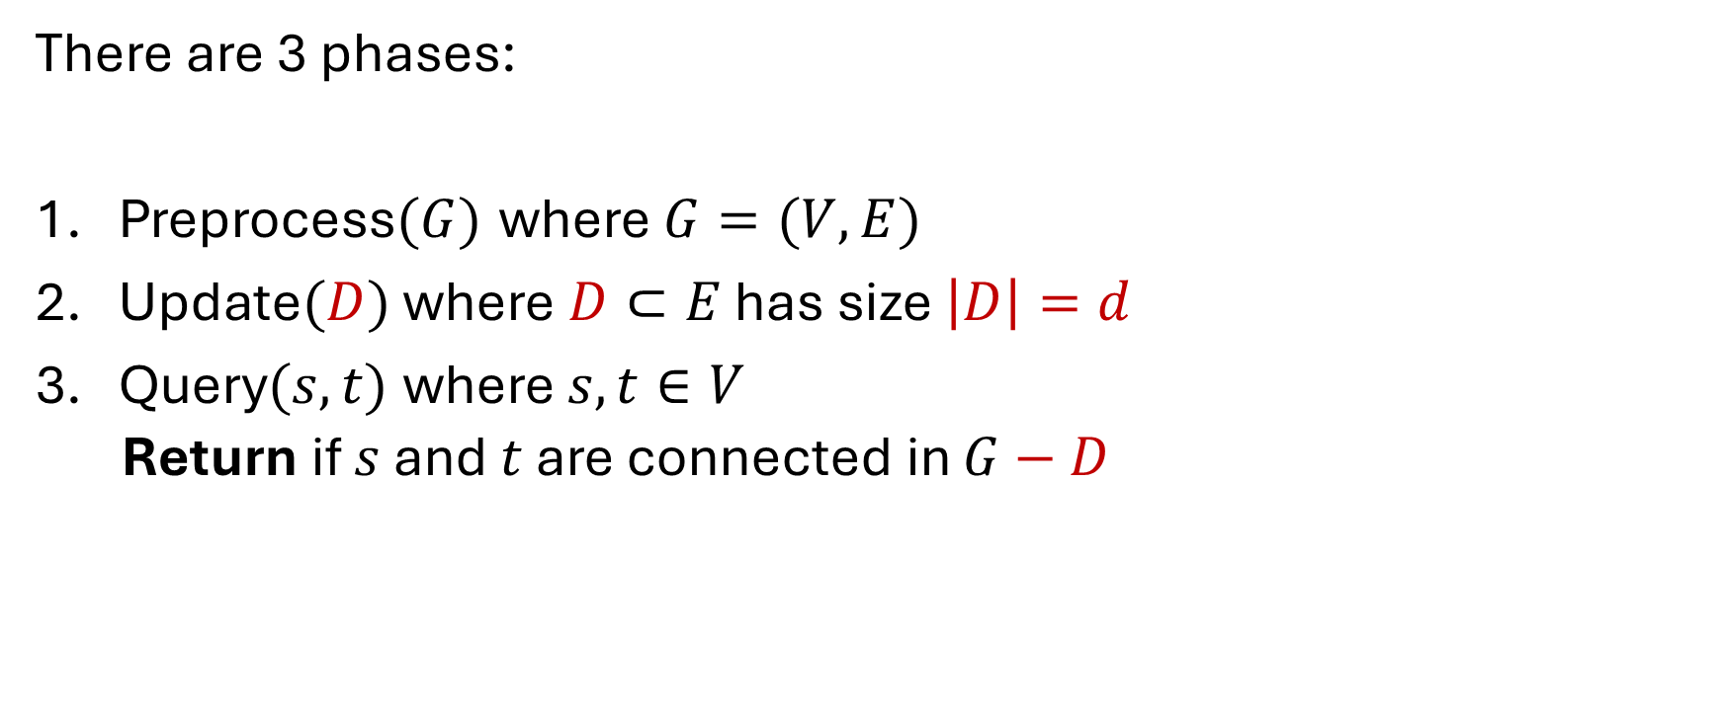
Connectivity Oracles under Edge Faults
There are 3 phases:
Preprocess$(G)$ where $G=(V,E)$
Update$(D)$ where$D⊂E$ has size $\left|D\right|=d$
Query$(s,t)$ where $s,t∈V$
  Return if $s$ and $t$ are connected in $G−D$

Slide 9
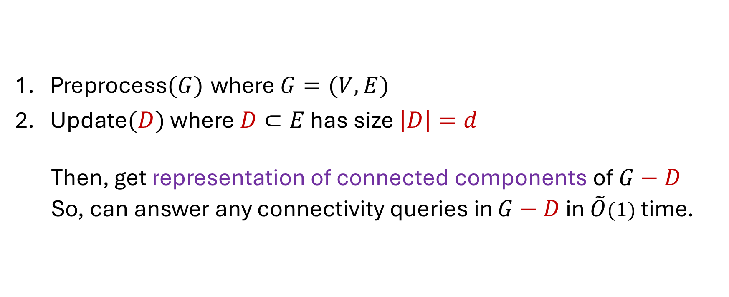
Connectivity Oracles under Edge Faults
Preprocess$(G)$ where $G=(V,E)$
Update$(D)$ where$D⊂E$ has size $\left|D\right|=d$
  Then, get representation of connected components of $G−D$
  So, can answer any connectivity queries in $G−D$ in $\tilde{O}(1)$ time.

Slide 10
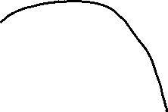
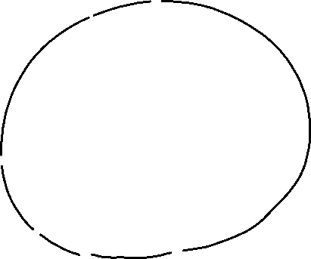
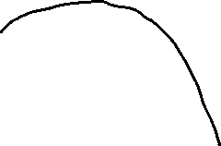




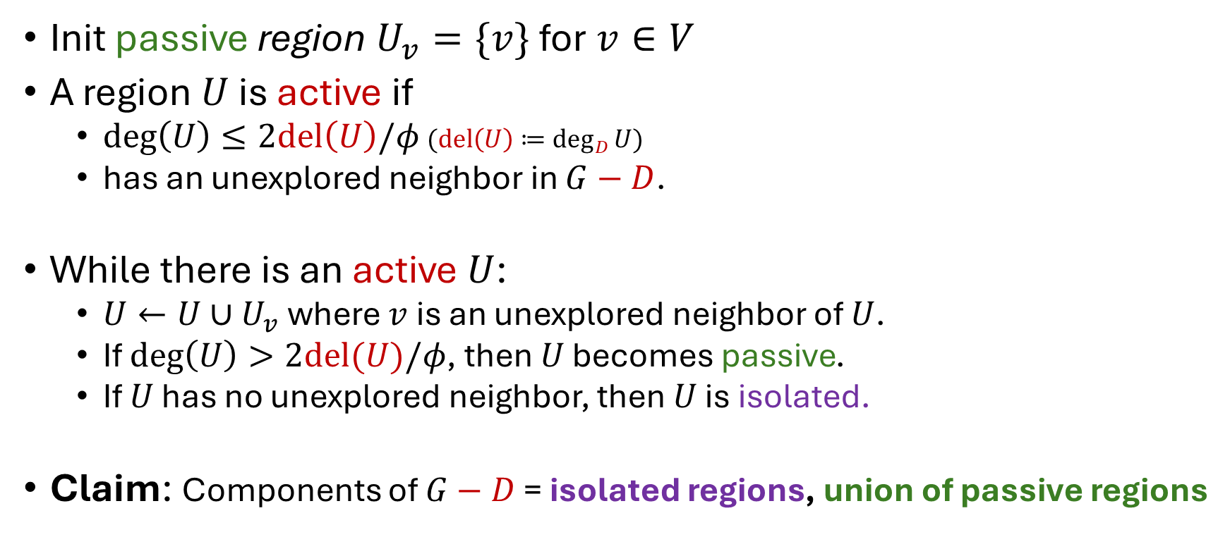

Oracle on $φ$-Expanders
Init passive region $U_{v}=\{v\}$ for $v∈V$
A region $U$ is active if
  $deg\left(U\right)≤2del\left(U\right)/φ$ $(del\left(U\right)≔\deg_{D}{U})$
  has an unexplored neighbor in $G−D$.
While there is an active $U$:
  $U←U∪U_{v}$ where $v$ is an unexplored neighbor of $U$.
  If $deg\left(U\right)>2del(U)/φ$, then $U$ becomes passive.
  If $U$ has no unexplored neighbor, then $U$ is isolated.
Claim: Components of $G−D$ = isolated regions, union of passive regions

Slide 11

Oracle on $φ$-Expanders
Init passive region $U_{v}=\{v\}$ for $v∈V$
A region $U$ is active if
  $deg\left(U\right)≤2del\left(U\right)/φ$ $(del\left(U\right)≔\deg_{D}{U})$
  has an unexplored neighbor in $G−D$.
While there is an active $U$:
  $U←U∪U_{v}$ where $v$ is an unexplored neighbor of $U$.
  If $deg\left(U\right)>2del(U)/φ$, then $U$ becomes passive.
  If $U$ has no unexplored neighbor, then $U$ is isolated.
Claim: Components of $G−D$ = isolated regions, union of passive regions

Slide 12

Oracle on $φ$-Expanders
Init passive region $U_{v}=\{v\}$ for $v∈V$
A region $U$ is active if
  $deg\left(U\right)≤2del\left(U\right)/φ$ $(del\left(U\right)≔\deg_{D}{U})$
  has an unexplored neighbor in $G−D$.
While there is an active $U$:
  $U←U∪U_{v}$ where $v$ is an unexplored neighbor of $U$.
  If $deg\left(U\right)>2del(U)/φ$, then $U$ becomes passive.
  If $U$ has no unexplored neighbor, then $U$ is isolated.
Claim: Components of $G−D$ = isolated regions, union of passive regions

Slide 13



Oracle on $φ$-Expanders
Init passive region $U_{v}=\{v\}$ for $v∈V$
A region $U$ is active if
  $deg\left(U\right)≤2del\left(U\right)/φ$ $(del\left(U\right)≔\deg_{D}{U})$
  has an unexplored neighbor in $G−D$.
While there is an active $U$:
  $U←U∪U_{v}$ where $v$ is an unexplored neighbor of $U$.
  If $deg\left(U\right)>2del(U)/φ$, then $U$ becomes passive.
  If $U$ has no unexplored neighbor, then $U$ is isolated.
Claim: Components of $G−D$ = isolated regions, union of passive regions

Slide 14


Oracle on $φ$-Expanders
Init passive region $U_{v}=\{v\}$ for $v∈V$
A region $U$ is active if
  $deg\left(U\right)≤2del\left(U\right)/φ$ $(del\left(U\right)≔\deg_{D}{U})$
  has an unexplored neighbor in $G−D$.
While there is an active $U$:
  $U←U∪U_{v}$ where $v$ is an unexplored neighbor of $U$.
  If $deg\left(U\right)>2del(U)/φ$, then $U$ becomes passive.
  If $U$ has no unexplored neighbor, then $U$ is isolated.
Claim: Components of $G−D$ = isolated regions, union of passive regions

Slide 15





Oracle on $φ$-Expanders
Init passive region $U_{v}=\{v\}$ for $v∈V$
A region $U$ is active if
  $deg\left(U\right)≤2del\left(U\right)/φ$ $(del\left(U\right)≔\deg_{D}{U})$
  has an unexplored neighbor in $G−D$.
While there is an active $U$:
  $U←U∪U_{v}$ where $v$ is an unexplored neighbor of $U$.
  If $deg\left(U\right)>2del(U)/φ$, then $U$ becomes passive.
  If $U$ has no unexplored neighbor, then $U$ is isolated.
Claim: Components of $G−D$ = isolated regions, union of passive regions

Slide 16








Oracle on $φ$-Expanders
Init passive region $U_{v}=\{v\}$ for $v∈V$
A region $U$ is active if
  $deg\left(U\right)≤2del\left(U\right)/φ$ $(del\left(U\right)≔\deg_{D}{U})$
  has an unexplored neighbor in $G−D$.
While there is an active $U$:
  $U←U∪U_{v}$ where $v$ is an unexplored neighbor of $U$.
  If $deg\left(U\right)>2del(U)/φ$, then $U$ becomes passive.
  If $U$ has no unexplored neighbor, then $U$ is isolated.
Claim: Components of $G−D$ = isolated regions, union of passive regions

Slide 17

Oracle on $φ$-Expanders
Init passive region $U_{v}=\{v\}$ for $v∈V$
A region $U$ is active if
  $deg\left(U\right)≤2del\left(U\right)/φ$ $(del\left(U\right)≔\deg_{D}{U})$
  has an unexplored neighbor in $G−D$.
While there is an active $U$:
  $U←U∪U_{v}$ where $v$ is an unexplored neighbor of $U$.
  If $deg\left(U\right)>2del(U)/φ$, then $U$ becomes passive.
  If $U$ has no unexplored neighbor, then $U$ is isolated.
Claim: Components of $G−D$ = isolated regions, union of passive regions

Slide 18

Oracle on $φ$-Expanders
Init passive region $U_{v}=\{v\}$ for $v∈V$
A region $U$ is active if
  $deg\left(U\right)≤2del\left(U\right)/φ$ $(del\left(U\right)≔\deg_{D}{U})$
  has an unexplored neighbor in $G−D$.
While there is an active $U$:
  $U←U∪U_{v}$ where $v$ is an unexplored neighbor of $U$.
  If $deg\left(U\right)>2del(U)/φ$, then $U$ becomes passive.
  If $U$ has no unexplored neighbor, then $U$ is isolated.
Claim: Components of $G−D$ = isolated regions, union of passive regions

Slide 19


Oracle on $φ$-Expanders
Init passive region $U_{v}=\{v\}$ for $v∈V$
A region $U$ is active if
  $deg\left(U\right)≤2del\left(U\right)/φ$ $(del\left(U\right)≔\deg_{D}{U})$
  has an unexplored neighbor in $G−D$.
While there is an active $U$:
  $U←U∪U_{v}$ where $v$ is an unexplored neighbor of $U$.
  If $deg\left(U\right)>2del(U)/φ$, then $U$ becomes passive.
  If $U$ has no unexplored neighbor, then $U$ is isolated.
Claim: Components of $G−D$ = isolated regions, union of passive regions

Slide 20




Oracle on $φ$-Expanders
Init passive region $U_{v}=\{v\}$ for $v∈V$
A region $U$ is active if
  $deg\left(U\right)≤2del\left(U\right)/φ$ $(del\left(U\right)≔\deg_{D}{U})$
  has an unexplored neighbor in $G−D$.
While there is an active $U$:
  $U←U∪U_{v}$ where $v$ is an unexplored neighbor of $U$.
  If $deg\left(U\right)>2del(U)/φ$, then $U$ becomes passive.
  If $U$ has no unexplored neighbor, then $U$ is isolated.
Claim: Components of $G−D$ = isolated regions, union of passive regions

Slide 21

Oracle on $φ$-Expanders
Init passive region $U_{v}=\{v\}$ for $v∈V$
A region $U$ is active if
  $deg\left(U\right)≤2del\left(U\right)/φ$ $(del\left(U\right)≔\deg_{D}{U})$
  has an unexplored neighbor in $G−D$.
While there is an active $U$:
  $U←U∪U_{v}$ where $v$ is an unexplored neighbor of $U$.
  If $deg\left(U\right)>2del(U)/φ$, then $U$ becomes passive.
  If $U$ has no unexplored neighbor, then $U$ is isolated.
Claim: Components of $G−D$ = isolated regions, union of passive regions

Slide 22
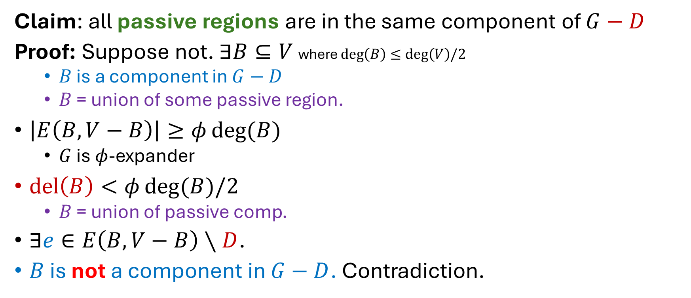
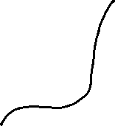
Correctness
Claim: all passive regions are in the same component of $G−D$
Proof: Suppose not. $∃B⊆V$ where $deg\left(B\right)≤deg\left(V\right)/2$
  $B$ is a component in $G−D$
  $B$ = union of some passive region.
$\left|E\left(B,V−B\right)\right|≥φ\deg{(B)}$
  $G$ is $φ$-expander
$del\left(B\right)<φ\deg{(B)/2}$
  $B$ = union of passive comp.
$∃e∈E\left(B,V−B\right)∖D$.
$B$ is not a component in $G−D$. Contradiction.

Slide 23
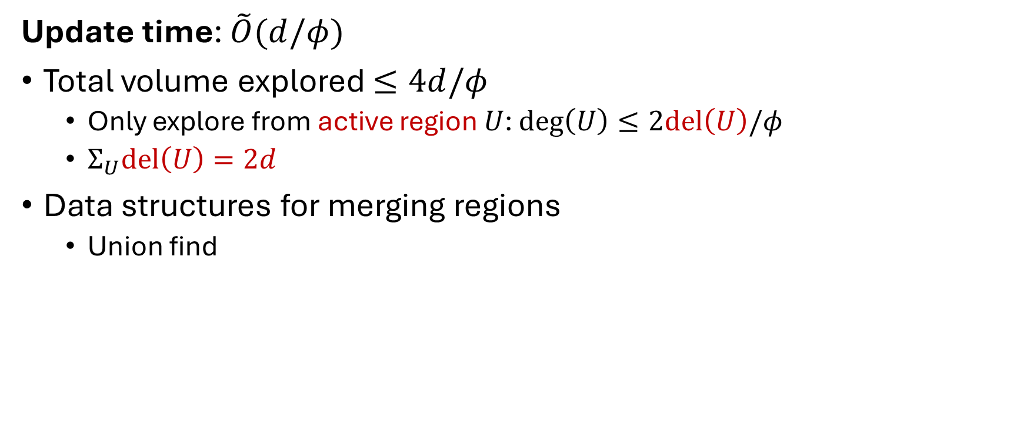
Update Time
Update time: $\tilde{O}(d/φ)$
Total volume explored $≤4d/φ$
  Only explore from active region $U$: $deg\left(U\right)≤2del\left(U\right)/φ$
  $Σ_{U}del\left(U\right)=2d$
Data structures for merging regions
  Union find

Slide 24

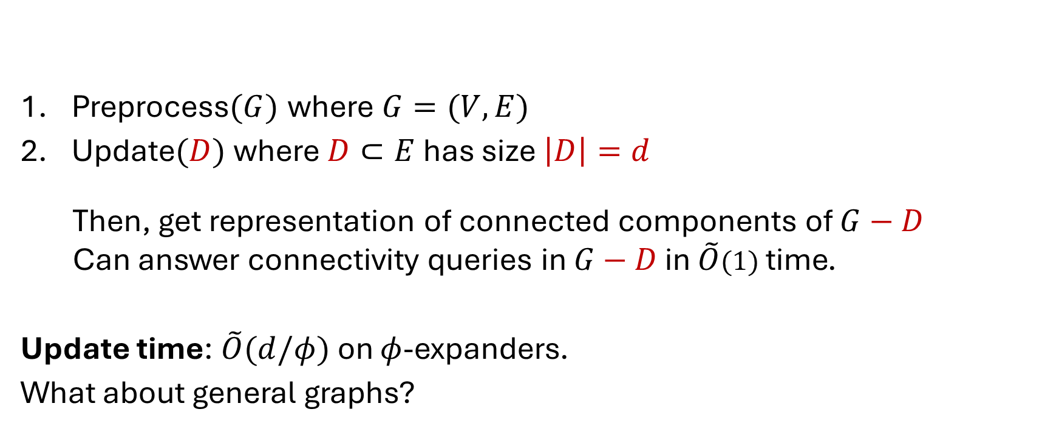
Connectivity Oracles under Edge Faults
Preprocess$(G)$ where $G=(V,E)$
Update$(D)$ where$D⊂E$ has size $\left|D\right|=d$
  Then, get representation of connected components of $G−D$
  Can answer connectivity queries in $G−D$ in $\tilde{O}(1)$ time.
Update time: $\tilde{O}(d/φ)$ on $φ$-expanders.
What about general graphs?

Slide 25
Plan
Expanding Balanced Separator
Separator-Expanding Hierarchy
Connectivity Oracles on General Graphs

Slide 26
Part 2
Expanding Balanced Separator

Slide 27



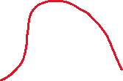


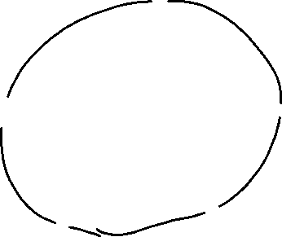

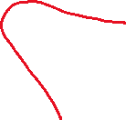
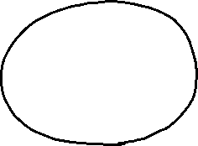
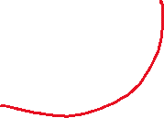

Expanding Balanced Separator
Theorem: every graph $G$ contains an edge set $F⊆E$ such that
$F$ is $1/4$-expanding in $G$
each component $C$ in $G−F$ has $≤n/2$ vertices.

Slide 28






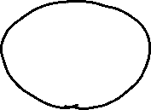
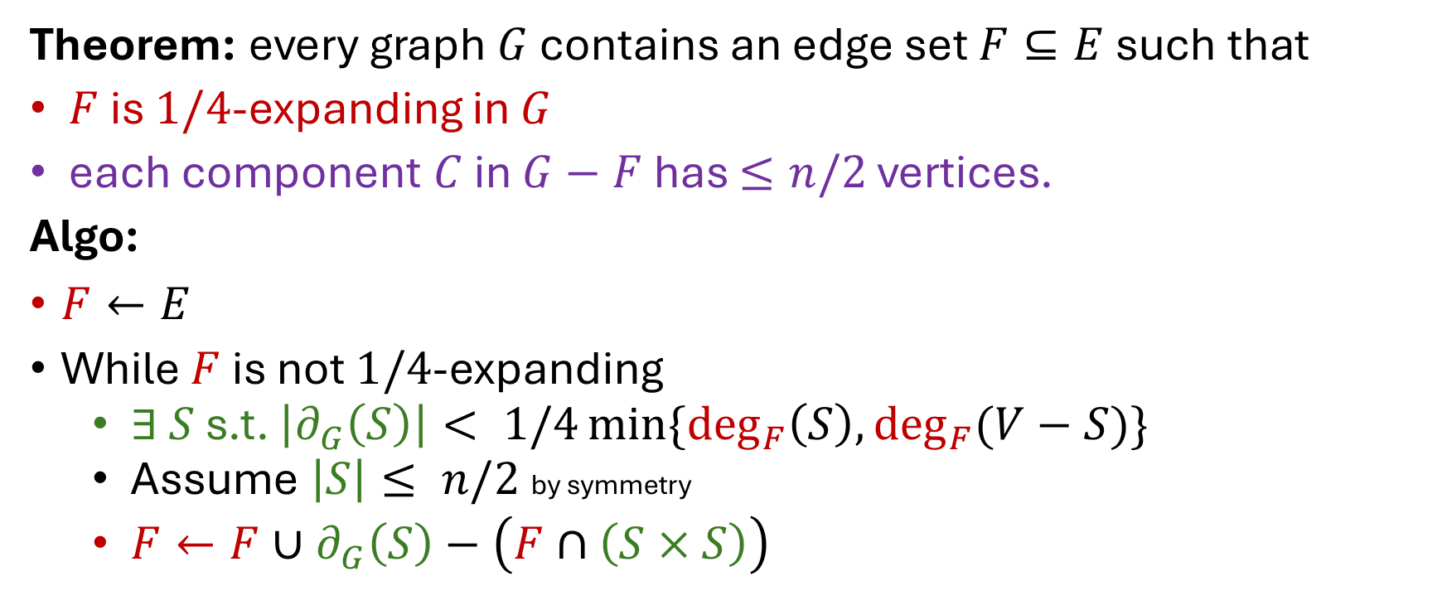
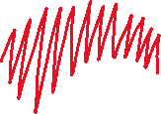
Expanding Balanced Separator: Construction
Theorem: every graph $G$ contains an edge set $F⊆E$ such that
$F$ is $1/4$-expanding in $G$
each component $C$ in $G−F$ has $≤n/2$ vertices.
Algo:
$F←E$
While $F$ is not $1/4$-expanding
  ∃ $S$ s.t. $\left|∂_{G}\left(S\right)\right|< 1/4\min{\{\deg_{F}\left(S\right),\deg_{F}(V−S)\}}$
  Assume $\left|S\right|≤ n/2$ by symmetry
  $F←F∪∂_{G}\left(S\right)−\left(F∩\left(S×S\right)\right)$

Slide 29


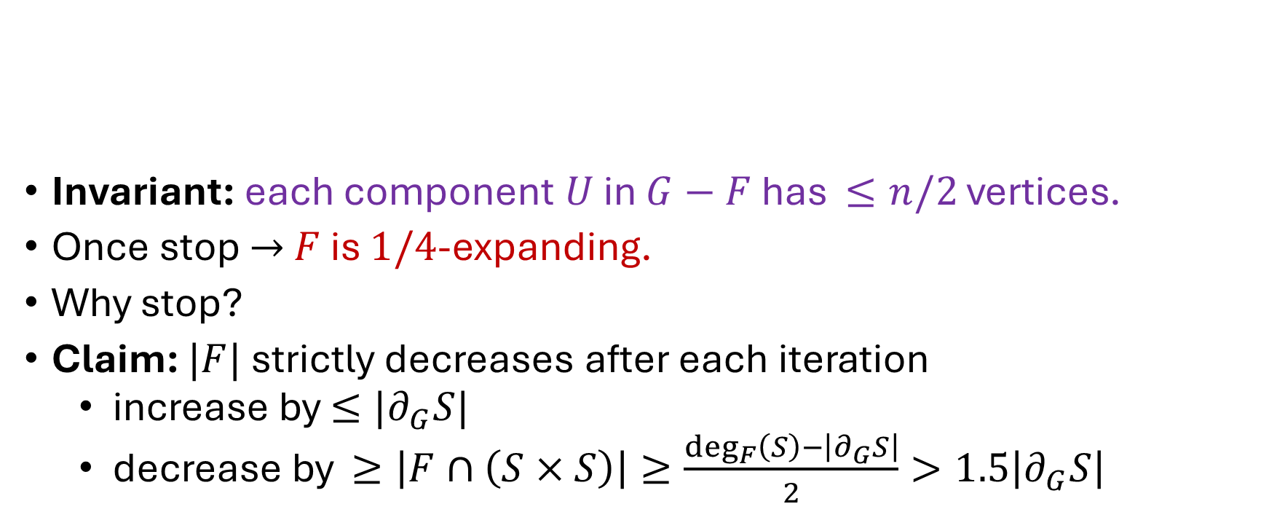
Expanding Balanced Separators: Proof
Invariant: each component $U$ in $G−F$ has $≤n/2$ vertices.
Once stop $→$ $F$ is $1/4$-expanding.
Why stop?
Claim: $|F|$ strictly decreases after each iteration
  increase by $≤|∂_{G}S|$
  decrease by $≥\left|F∩\left(S×S\right)\right|≥\frac{\deg_{F}\left(S\right)−\left|∂_{G}S\right|}{2}>1.5\left|∂_{G}S\right|$

Slide 30

Expanding Balanced Separator
Theorem: for every $G$, $∃$ edge set $F⊆E$ such that
$F$ is $1/4$-expanding in $G$
each component $U$ in $G−F$ has $≤n/2$ vertices.

Slide 31
Part 3
Separator-Expanding Hierarchy

Slide 32








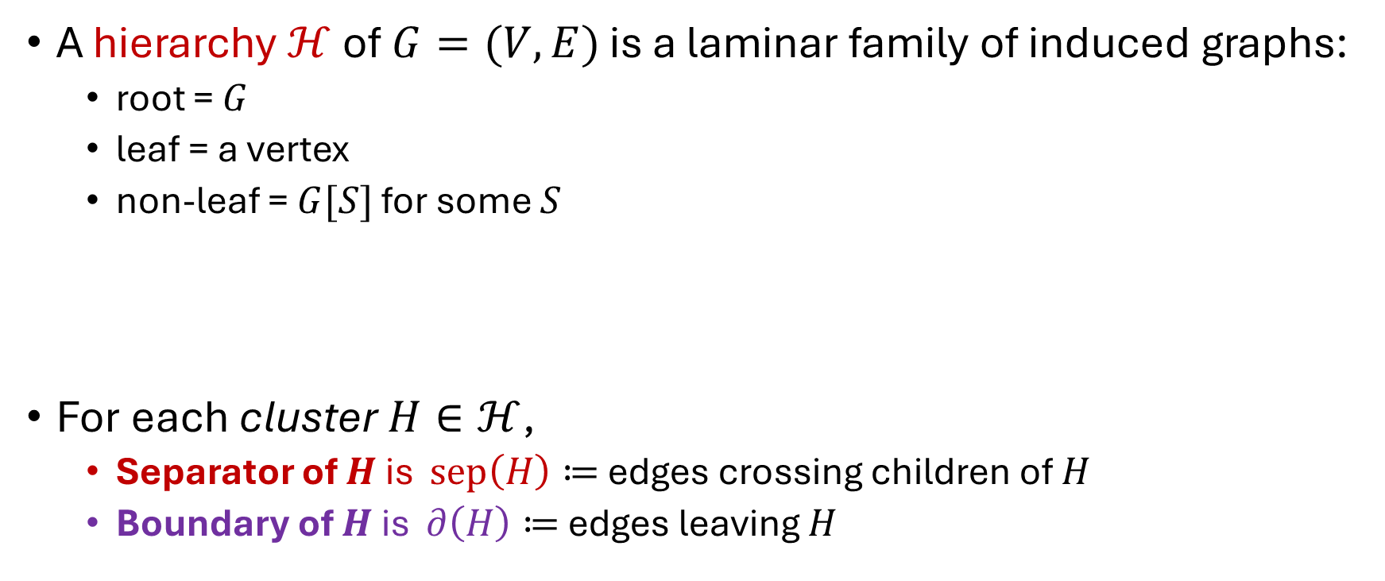







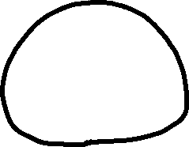




Hierarchy
A hierarchy $ℋ$ of $G=(V,E)$ is a laminar family of induced graphs:
  root = $G$
  leaf = a vertex
  non-leaf = $G[S]$ for some $S$
For each cluster $H∈ℋ$,
  Separator of $H$ is $sep\left(H\right)≔$ edges crossing children of $H$
  Boundary of $H$ is $∂\left(H\right)≔$ edges leaving $H$

Slide 33




Separator-Expanding Hierarchy
Def: a $φ$-separator-expanding $(φ$-SE) hierarchy of $G=(V,E)$ is
a hierarchy $ℋ$ of $G$ where, for each cluster $H∈ℋ$,
$sep(H)$ is $φ$-expanding in $H$.

Slide 34




Separator-Expanding Hierarchy: Partition View
Def: a $φ$-separator-expanding $(φ$-SE) hierarchy of $G=(V,E)$ is
a partition $E_{0},…,E_{ℓ}$ of $E$ s.t.
$E_{i}$ is $φ$-expanding in $G−E_{>i}$

Slide 35
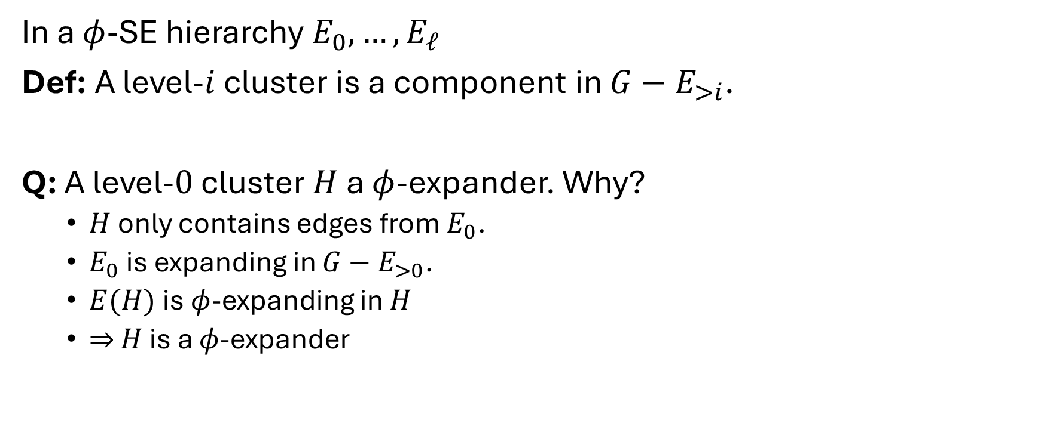
Quiz
In a $φ$-SE hierarchy $E_{0},…,E_{ℓ}$
Def: A level-$i$ cluster is a component in $G−E_{>i}$.
Q: A level-$0$ cluster $H$ a $φ$-expander. Why?
  $H$ only contains edges from $E_{0}$.
  $E_{0}$ is expanding in $G−E_{>0}$.
  $E(H)$ is $φ$-expanding in $H$
  $⇒$ $H$ is a $φ$-expander

Slide 36

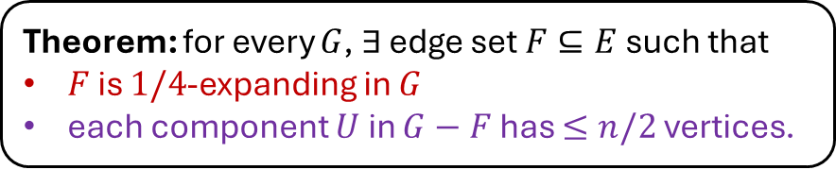
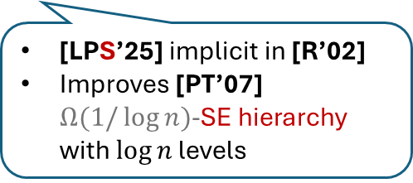
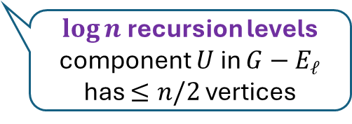
Construction
Theorem: for every $G$, $∃$ edge set $F⊆E$ such that
$F$ is $1/4$-expanding in $G$
each component $U$ in $G−F$ has $≤n/2$ vertices.
Thm: Every graph has $¼$-SE hierarchy with $\log{n}$ levels
Algo:
$E_{ℓ}←¼$-expanding balanced separator.
Recurse on each component $U$ of $G−E_{ℓ}$
[LPS’25] implicit in [R’02]
Improves [PT’07] $Ω(1/\log{n})$-SE hierarchy with $\log{n}$ levels
$\log{n}$ recursion levels
component $U$ in $G−E_{ℓ}$ has $≤n/2$ vertices

Slide 37




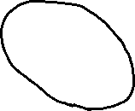











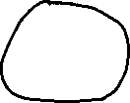


Summary
Thm: Every graph has $¼$-SE hierarchy with $\log{n}$ levels

Slide 38
Part 4
Oracle Construction on
General Graphs

Slide 39



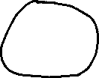




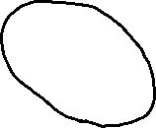

Bottom-Up Strategy
On a level-$i$ cluster $H_{≤i}$

Slide 40

Bottom-Up Strategy
On a level-$i$ cluster $H_{≤i}$
Consider deleted edges in $D∩H_{≤i}$.
Assume: components of children clusters of $H_{≤i}$ are updated.

Slide 41




















Bottom-Up Strategy
On a level-$i$ cluster $H_{≤i}$
Consider deleted edges in $D∩H_{≤i}$.
Assume: components of children clusters of $H_{≤i}$ are updated.
Task: update components of $H_{≤i}$ in $\tilde{O}\left(\left|D∩H_{≤i}\right|\right)$time.

Slide 42
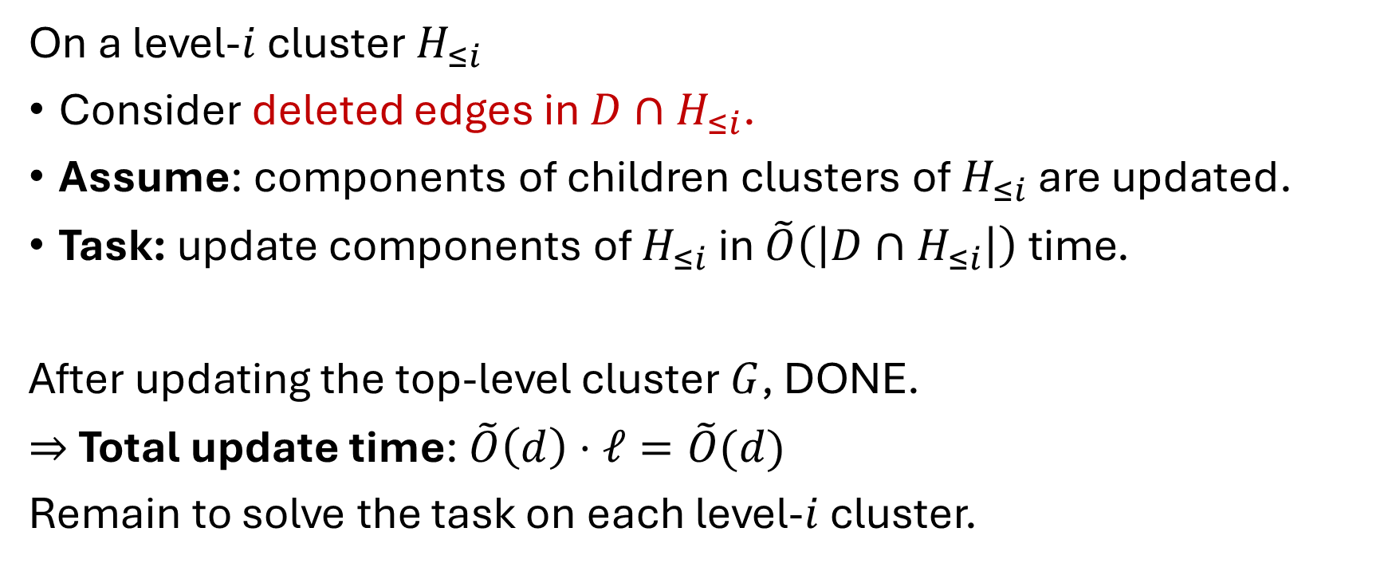


Bottom-Up Strategy
On a level-$i$ cluster $H_{≤i}$
Consider deleted edges in $D∩H_{≤i}$.
Assume: components of children clusters of $H_{≤i}$ are updated.
Task: update components of $H_{≤i}$ in $\tilde{O}\left(\left|D∩H_{≤i}\right|\right)$time.
After updating the top-level cluster $G$, DONE.
$⇒$ Total update time: $\tilde{O}\left(d\right)⋅ℓ=\tilde{O}(d)$
Remain to solve the task on each level-$i$ cluster.

Slide 43

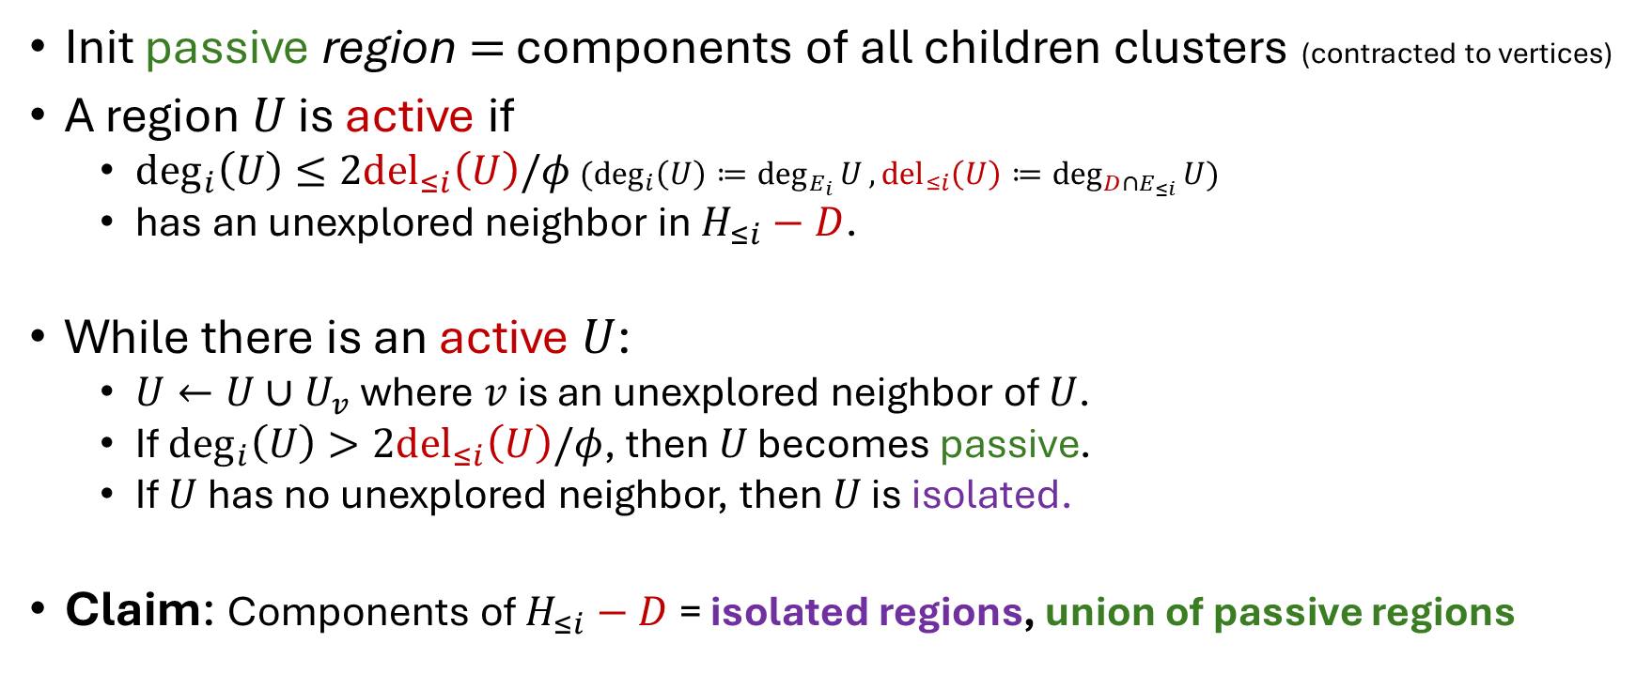
Oracle on Level-$i$ Cluster $H_{≤i}$
Init passive region $=$ components of all children clusters (contracted to vertices)
A region $U$ is active if
  $\deg_{i}\left(U\right)≤2{del}_{≤i}\left(U\right)/φ$ $(\deg_{i}\left(U\right)≔\deg_{E_{i}}{U}, {del}_{≤i}\left(U\right)≔\deg_{D∩E_{≤i}}{U})$
  has an unexplored neighbor in $H_{≤i}−D$.
While there is an active $U$:
  $U←U∪U_{v}$ where $v$ is an unexplored neighbor of $U$.
  If $\deg_{i}\left(U\right)>2{del}_{≤i}\left(U\right)/φ$, then $U$ becomes passive.
  If $U$ has no unexplored neighbor, then $U$ is isolated.
Claim: Components of $H_{≤i}−D$ = isolated regions, union of passive regions

Slide 44
Oracle on Level-$i$ Cluster $H_{≤i}$
Init passive region $=$ components of all children clusters (contracted to vertices)
A region $U$ is active if
  $\deg_{i}\left(U\right)≤2{del}_{≤i}\left(U\right)/φ$ $(\deg_{i}\left(U\right)≔\deg_{E_{i}}{U}, {del}_{≤i}\left(U\right)≔\deg_{D∩E_{≤i}}{U})$
  has an unexplored neighbor in $H_{≤i}−D$.
While there is an active $U$:
  $U←U∪U_{v}$ where $v$ is an unexplored neighbor of $U$.
  If $\deg_{i}\left(U\right)>2{del}_{≤i}\left(U\right)/φ$, then $U$ becomes passive.
  If $U$ has no unexplored neighbor, then $U$ is isolated.
Claim: Components of $H_{≤i}−D$ = isolated regions, union of passive regions

Slide 45
Oracle on Level-$i$ Cluster $H_{≤i}$
Init passive region $=$ components of all children clusters (contracted to vertices)
A region $U$ is active if
  $\deg_{i}\left(U\right)≤2{del}_{≤i}\left(U\right)/φ$ $(\deg_{i}\left(U\right)≔\deg_{E_{i}}{U}, {del}_{≤i}\left(U\right)≔\deg_{D∩E_{≤i}}{U})$
  has an unexplored neighbor in $H_{≤i}−D$.
While there is an active $U$:
  $U←U∪U_{v}$ where $v$ is an unexplored neighbor of $U$.
  If $\deg_{i}\left(U\right)>2{del}_{≤i}\left(U\right)/φ$, then $U$ becomes passive.
  If $U$ has no unexplored neighbor, then $U$ is isolated.
Claim: Components of $H_{≤i}−D$ = isolated regions, union of passive regions

Slide 46














Oracle on Level-$i$ Cluster $H_{≤i}$
Init passive region $=$ components of all children clusters (contracted to vertices)
A region $U$ is active if
  $\deg_{i}\left(U\right)≤2{del}_{≤i}\left(U\right)/φ$ $(\deg_{i}\left(U\right)≔\deg_{E_{i}}{U}, {del}_{≤i}\left(U\right)≔\deg_{D∩E_{≤i}}{U})$
  has an unexplored neighbor in $H_{≤i}−D$.
While there is an active $U$:
  $U←U∪U_{v}$ where $v$ is an unexplored neighbor of $U$.
  If $\deg_{i}\left(U\right)>2{del}_{≤i}\left(U\right)/φ$, then $U$ becomes passive.
  If $U$ has no unexplored neighbor, then $U$ is isolated.
Claim: Components of $H_{≤i}−D$ = isolated regions, union of passive regions

Slide 47


Oracle on Level-$i$ Cluster $H_{≤i}$
Init passive region $=$ components of all children clusters (contracted to vertices)
A region $U$ is active if
  $\deg_{i}\left(U\right)≤2{del}_{≤i}\left(U\right)/φ$ $(\deg_{i}\left(U\right)≔\deg_{E_{i}}{U}, {del}_{≤i}\left(U\right)≔\deg_{D∩E_{≤i}}{U})$
  has an unexplored neighbor in $H_{≤i}−D$.
While there is an active $U$:
  $U←U∪U_{v}$ where $v$ is an unexplored neighbor of $U$.
  If $\deg_{i}\left(U\right)>2{del}_{≤i}\left(U\right)/φ$, then $U$ becomes passive.
  If $U$ has no unexplored neighbor, then $U$ is isolated.
Claim: Components of $H_{≤i}−D$ = isolated regions, union of passive regions

Slide 48


Oracle on Level-$i$ Cluster $H_{≤i}$
Init passive region $=$ components of all children clusters (contracted to vertices)
A region $U$ is active if
  $\deg_{i}\left(U\right)≤2{del}_{≤i}\left(U\right)/φ$ $(\deg_{i}\left(U\right)≔\deg_{E_{i}}{U}, {del}_{≤i}\left(U\right)≔\deg_{D∩E_{≤i}}{U})$
  has an unexplored neighbor in $H_{≤i}−D$.
While there is an active $U$:
  $U←U∪U_{v}$ where $v$ is an unexplored neighbor of $U$.
  If $\deg_{i}\left(U\right)>2{del}_{≤i}\left(U\right)/φ$, then $U$ becomes passive.
  If $U$ has no unexplored neighbor, then $U$ is isolated.
Claim: Components of $H_{≤i}−D$ = isolated regions, union of passive regions

Slide 49
Oracle on Level-$i$ Cluster $H_{≤i}$
Init passive region $=$ components of all children clusters (contracted to vertices)
A region $U$ is active if
  $\deg_{i}\left(U\right)≤2{del}_{≤i}\left(U\right)/φ$ $(\deg_{i}\left(U\right)≔\deg_{E_{i}}{U}, {del}_{≤i}\left(U\right)≔\deg_{D∩E_{≤i}}{U})$
  has an unexplored neighbor in $H_{≤i}−D$.
While there is an active $U$:
  $U←U∪U_{v}$ where $v$ is an unexplored neighbor of $U$.
  If $\deg_{i}\left(U\right)>2{del}_{≤i}\left(U\right)/φ$, then $U$ becomes passive.
  If $U$ has no unexplored neighbor, then $U$ is isolated.
Claim: Components of $H_{≤i}−D$ = isolated regions, union of passive regions

Slide 50

Oracle on Level-$i$ Cluster $H_{≤i}$
Init passive region $=$ components of all children clusters (contracted to vertices)
A region $U$ is active if
  $\deg_{i}\left(U\right)≤2{del}_{≤i}\left(U\right)/φ$ $(\deg_{i}\left(U\right)≔\deg_{E_{i}}{U}, {del}_{≤i}\left(U\right)≔\deg_{D∩E_{≤i}}{U})$
  has an unexplored neighbor in $H_{≤i}−D$.
While there is an active $U$:
  $U←U∪U_{v}$ where $v$ is an unexplored neighbor of $U$.
  If $\deg_{i}\left(U\right)>2{del}_{≤i}\left(U\right)/φ$, then $U$ becomes passive.
  If $U$ has no unexplored neighbor, then $U$ is isolated.
Claim: Components of $H_{≤i}−D$ = isolated regions, union of passive regions

Slide 51

Oracle on Level-$i$ Cluster $H_{≤i}$
Init passive region $=$ components of all children clusters (contracted to vertices)
A region $U$ is active if
  $\deg_{i}\left(U\right)≤2{del}_{≤i}\left(U\right)/φ$ $(\deg_{i}\left(U\right)≔\deg_{E_{i}}{U}, {del}_{≤i}\left(U\right)≔\deg_{D∩E_{≤i}}{U})$
  has an unexplored neighbor in $H_{≤i}−D$.
While there is an active $U$:
  $U←U∪U_{v}$ where $v$ is an unexplored neighbor of $U$.
  If $\deg_{i}\left(U\right)>2{del}_{≤i}\left(U\right)/φ$, then $U$ becomes passive.
  If $U$ has no unexplored neighbor, then $U$ is isolated.
Claim: Components of $H_{≤i}−D$ = isolated regions, union of passive regions

Slide 52

Oracle on Level-$i$ Cluster $H_{≤i}$
Init passive region $=$ components of all children clusters (contracted to vertices)
A region $U$ is active if
  $\deg_{i}\left(U\right)≤2{del}_{≤i}\left(U\right)/φ$ $(\deg_{i}\left(U\right)≔\deg_{E_{i}}{U}, {del}_{≤i}\left(U\right)≔\deg_{D∩E_{≤i}}{U})$
  has an unexplored neighbor in $H_{≤i}−D$.
While there is an active $U$:
  $U←U∪U_{v}$ where $v$ is an unexplored neighbor of $U$.
  If $\deg_{i}\left(U\right)>2{del}_{≤i}\left(U\right)/φ$, then $U$ becomes passive.
  If $U$ has no unexplored neighbor, then $U$ is isolated.
Claim: Components of $H_{≤i}−D$ = isolated regions, union of passive regions

Slide 53












Correctness
Claim: all passive regions are in the same component of $H_{≤i}−D$
Proof: Suppose not. $∃B⊆H_{≤i}$ where $\deg_{i}\left(B\right)≤\deg_{i}\left(H_{≤i}\right)/2$
  $B$ is a component in $H_{≤i}−D$
  $B$ = union of some passive region.

Slide 54
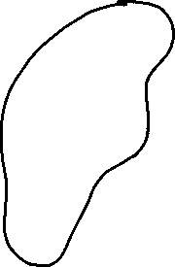
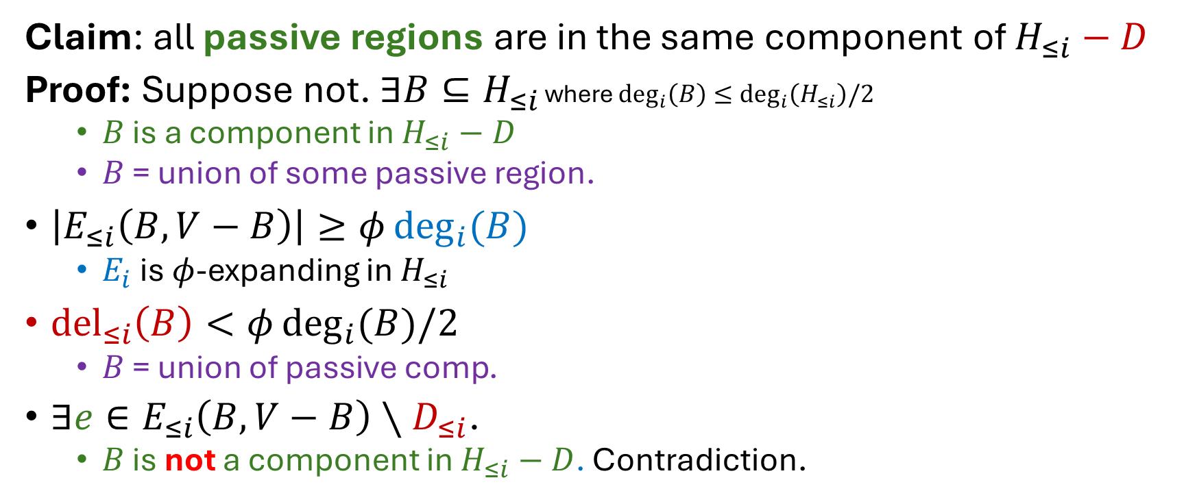
Correctness
Claim: all passive regions are in the same component of $H_{≤i}−D$
Proof: Suppose not. $∃B⊆H_{≤i}$ where $\deg_{i}\left(B\right)≤\deg_{i}\left(H_{≤i}\right)/2$
  $B$ is a component in $H_{≤i}−D$
  $B$ = union of some passive region.
$\left|E_{≤i}\left(B,V−B\right)\right|≥φ\deg_{i}{(B)}$
  $E_{i}$ is $φ$-expanding in $H_{≤i}$
${del}_{≤i}\left(B\right)<φ\deg_{i}{(B)/2}$
  $B$ = union of passive comp.
$∃e∈E_{≤i}\left(B,V−B\right)∖D_{≤i}$.
  $B$ is not a component in $H_{≤i}−D$. Contradiction.

Slide 55
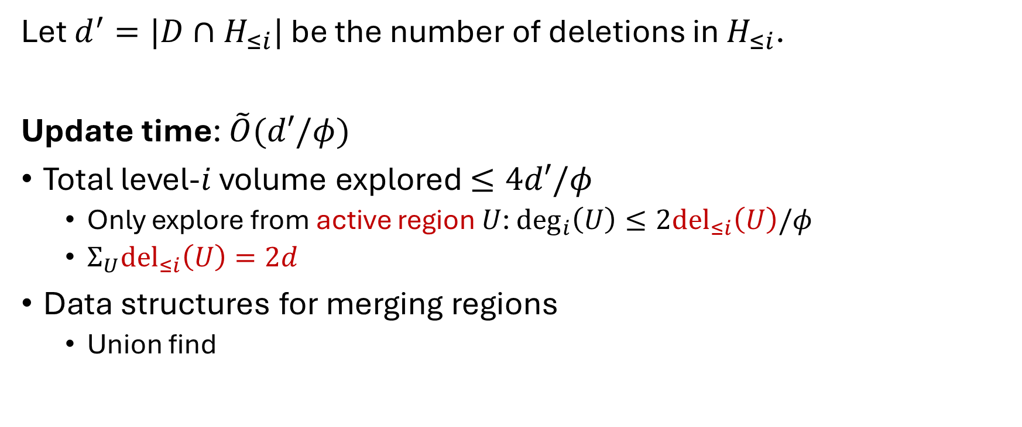

Update Time on Level-$i$ Cluster $H_{≤i}$
Let $d^{′}=|D∩H_{≤i}|$ be the number of deletions in $H_{≤i}$.
Update time: $\tilde{O}(d′/φ)$
Total level-$i$ volume explored $≤4d′/φ$
  Only explore from active region $U$: $\deg_{i}\left(U\right)≤2{del}_{≤i}\left(U\right)/φ$
  $Σ_{U}{del}_{≤i}\left(U\right)=2d$
Data structures for merging regions
  Union find

Slide 56
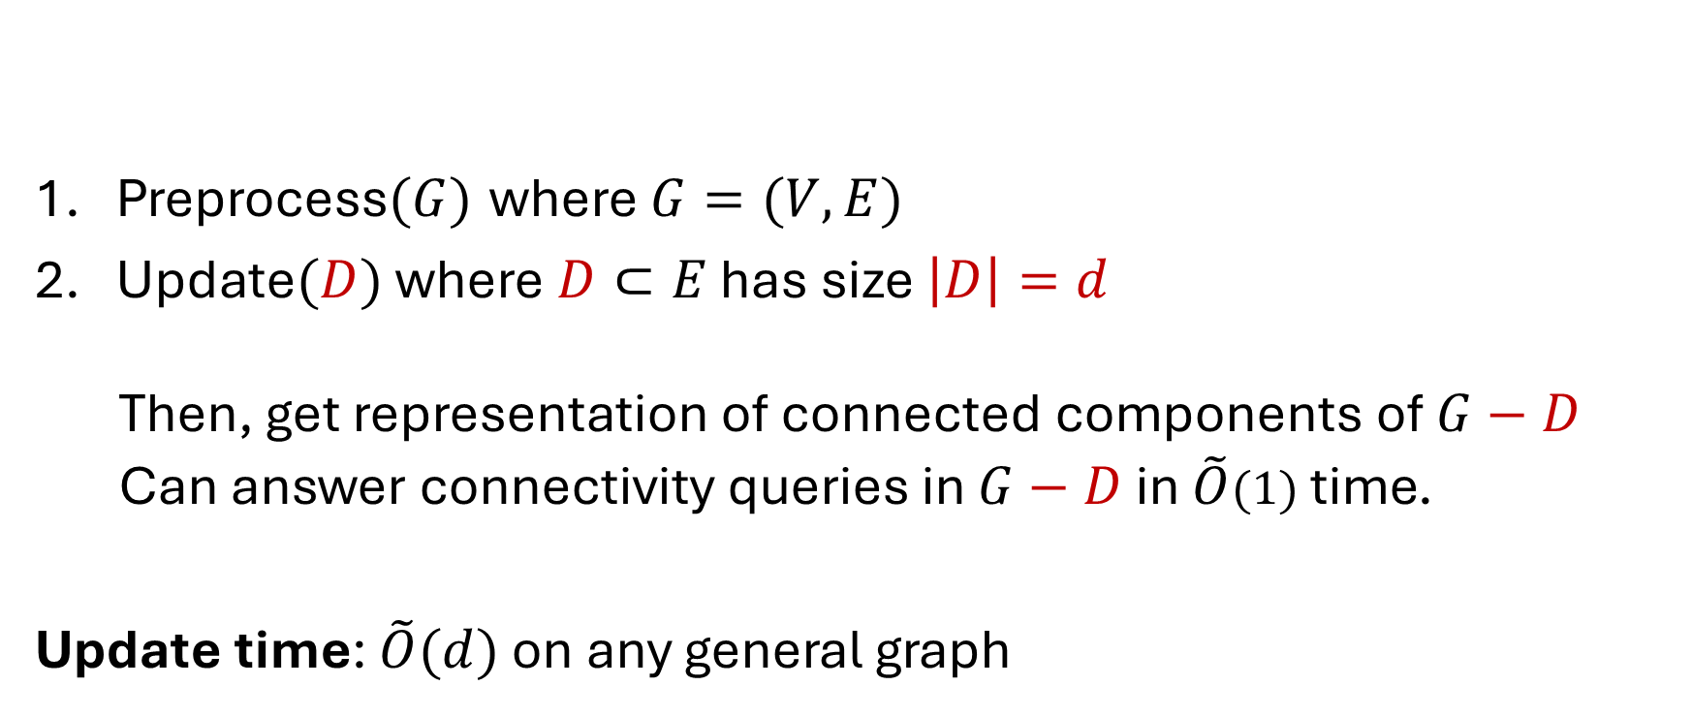
Connectivity Oracles under Edge Faults
Preprocess$(G)$ where $G=(V,E)$
Update$(D)$ where$D⊂E$ has size $\left|D\right|=d$
  Then, get representation of connected components of $G−D$
  Can answer connectivity queries in $G−D$ in $\tilde{O}(1)$ time.
Update time: $\tilde{O}(d)$ on any general graph

Slide 57
Summary

Slide 58
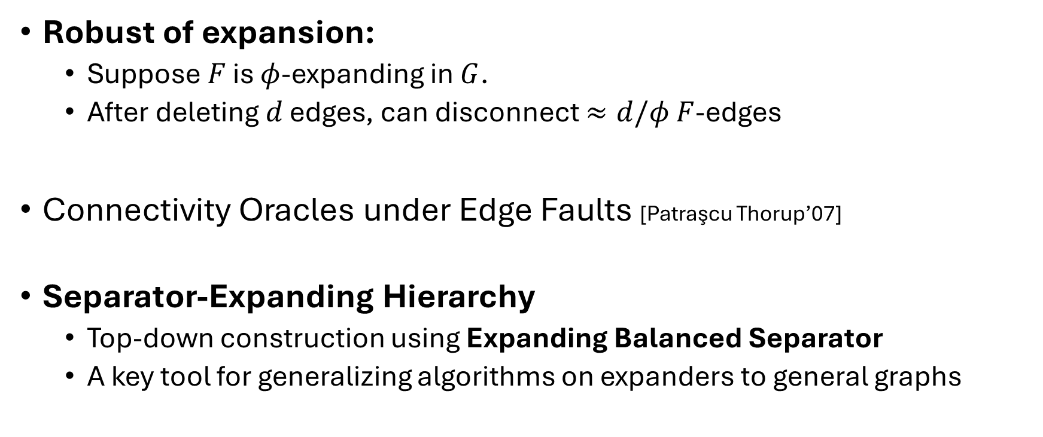
Summary
Robust of expansion:
  Suppose $F$ is $φ$-expanding in $G$.
  After deleting $d$ edges, can disconnect $≈d/φ$ $F$-edges
Connectivity Oracles under Edge Faults [Patraşcu Thorup’07]
Separator-Expanding Hierarchy
  Top-down construction using Expanding Balanced Separator
  A key tool for generalizing algorithms on expanders to general graphs

