Slide 1
Lecture 5
Overview of the Area
Thatchaphol Saranurak
U of Michigan
August 18, 2025
ADFOCS

Slide 2
Plan
History of expander decomposition and hierarchies
Recent developments in the last 10 years
Other central concepts in the area

Slide 3
Part 1
Early History

Slide 4
1980-2000: before first appearance
Areas that motivates expander decomposition and hierarchies
Approximate Sparsest Cuts and Multi Cuts
  Flow/cut characterization [Leighton Rao 88]
  Metric embedding [Linial Longdon Rabinonich 95]
Spectral graph theory
  Eigenvalue characterization: Cheeger’s Inequality [Alon Milman 85]
  Random-walk characterization: [Sinclair Jerrum 89]
Graph minor theory
  Disjoint path problem [Graph Minor XIII, Robertson Seymour 95]
Distributed algorithms
  Low diameter decomposition [Awerbuch Peleg 90] [Linial Saks 93]

Slide 5
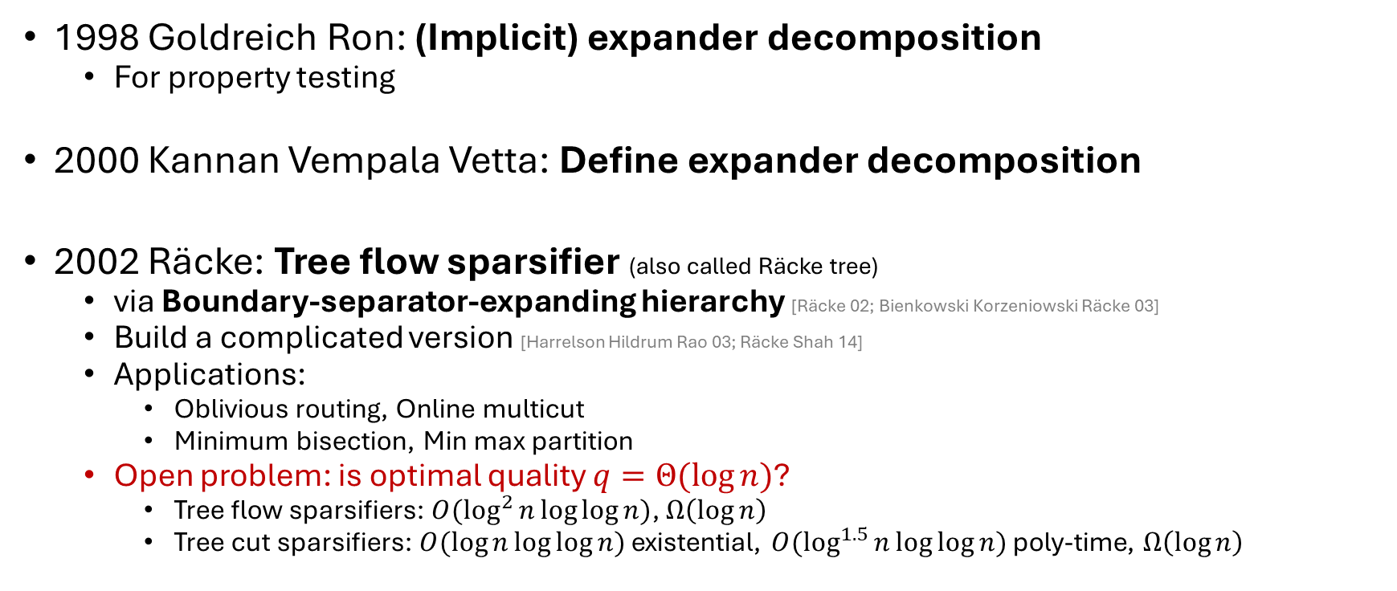
2000-2005: first appearance
1998 Goldreich Ron: (Implicit) expander decomposition
  For property testing
2000 Kannan Vempala Vetta: Define expander decomposition
2002 Räcke: Tree flow sparsifier (also called Räcke tree)
  via Boundary-separator-expanding hierarchy [Räcke 02; Bienkowski Korzeniowski Räcke 03]
  Build a complicated version [Harrelson Hildrum Rao 03; Räcke Shah 14]
  Applications:
    Oblivious routing, Online multicut
    Minimum bisection, Min max partition
  Open problem: is optimal quality $q=Θ(\log{n})$?
    Tree flow sparsifiers: $O(\log^{2}{n}\log{\log{n}})$, $Ω\left(\log{n}\right)$
    Tree cut sparsifiers: $O(\log{n}\log{\log{n}})$ existential, $O(\log^{1.5}{n}\log{\log{n}})$ poly-time, $Ω\left(\log{n}\right)$

Slide 6
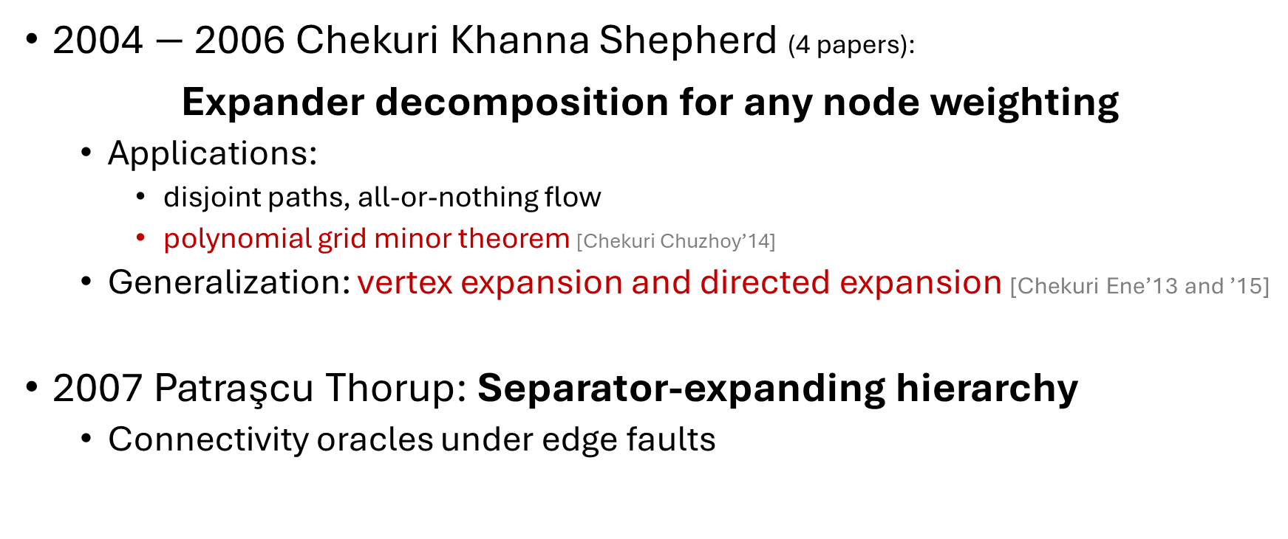
2000-2005: first appearance
2004 $−$ 2006 Chekuri Khanna Shepherd (4 papers):
Expander decomposition for any node weighting
  Applications:
    disjoint paths, all-or-nothing flow
    polynomial grid minor theorem [Chekuri Chuzhoy’14]
  Generalization: vertex expansion and directed expansion [Chekuri Ene’13 and ’15]
2007 Patraşcu Thorup: Separator-expanding hierarchy
  Connectivity oracles under edge faults

Slide 7
Before 2005
But these concepts were not formalized in a unified way.
Relationship between Räcke’s and PT’s hierarchies were not explicit documented anywhere… until 2025.
Expander decomposition, SE hierarchy, BSE hierarchy
already appeared in literature.
It was unclear why they are useful for very fast algorithms yet.

Slide 8
Central Concepts
Cut-matching Game

Slide 9
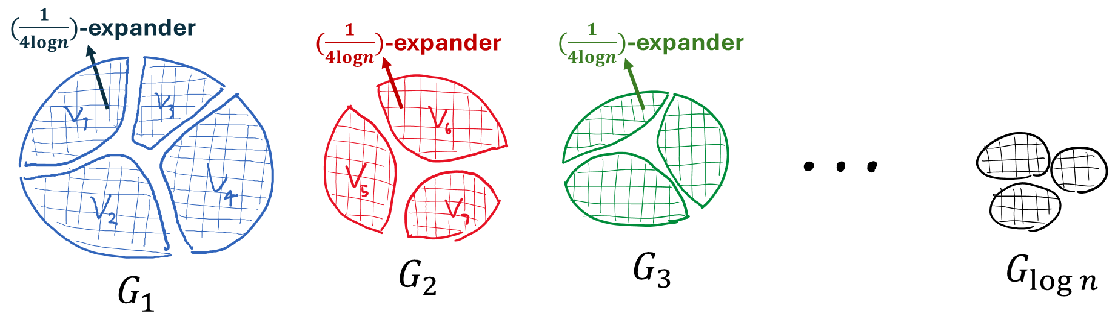
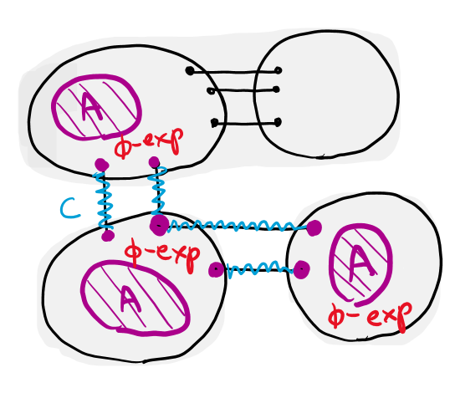
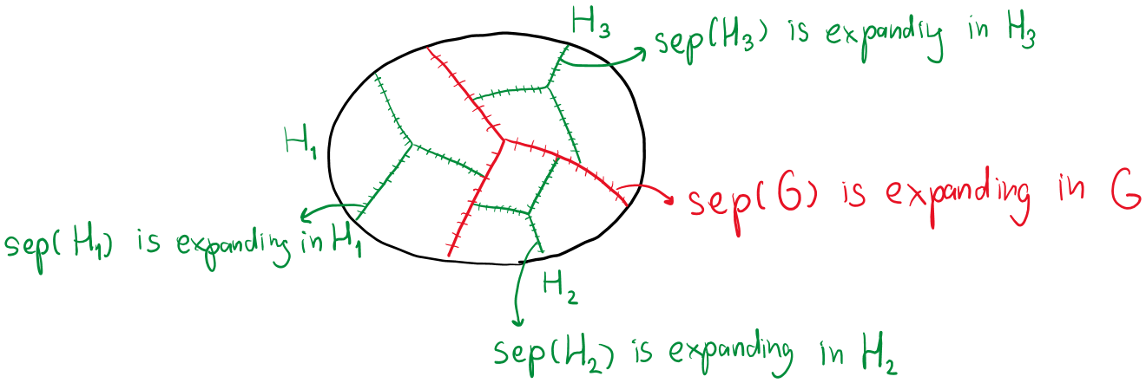
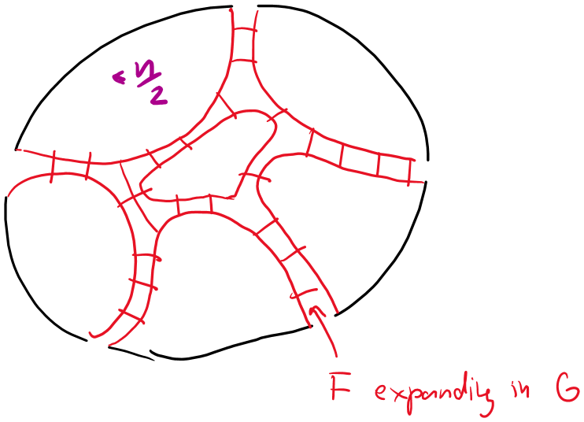
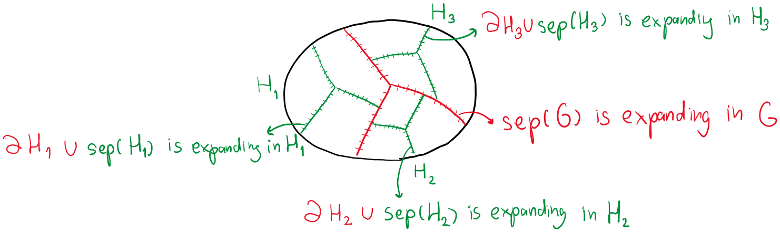
Recap key concepts
Expander Decomposition
Repeated Expander Decomposition
Boundary-linked version
Dynamic version
Separator-expanding (SE) Hierarchy
Cut Matching Game
Expanding Balanced Separator
Boundary-separator-expanding (BSE) Hierarchy

Slide 10
Cut-Matching Game
A process for building an expander
from few adversarial matchings

Slide 11
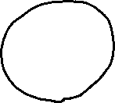
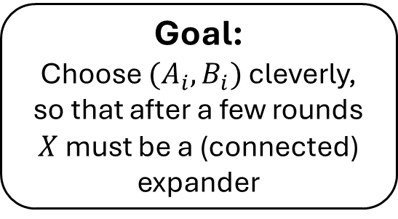
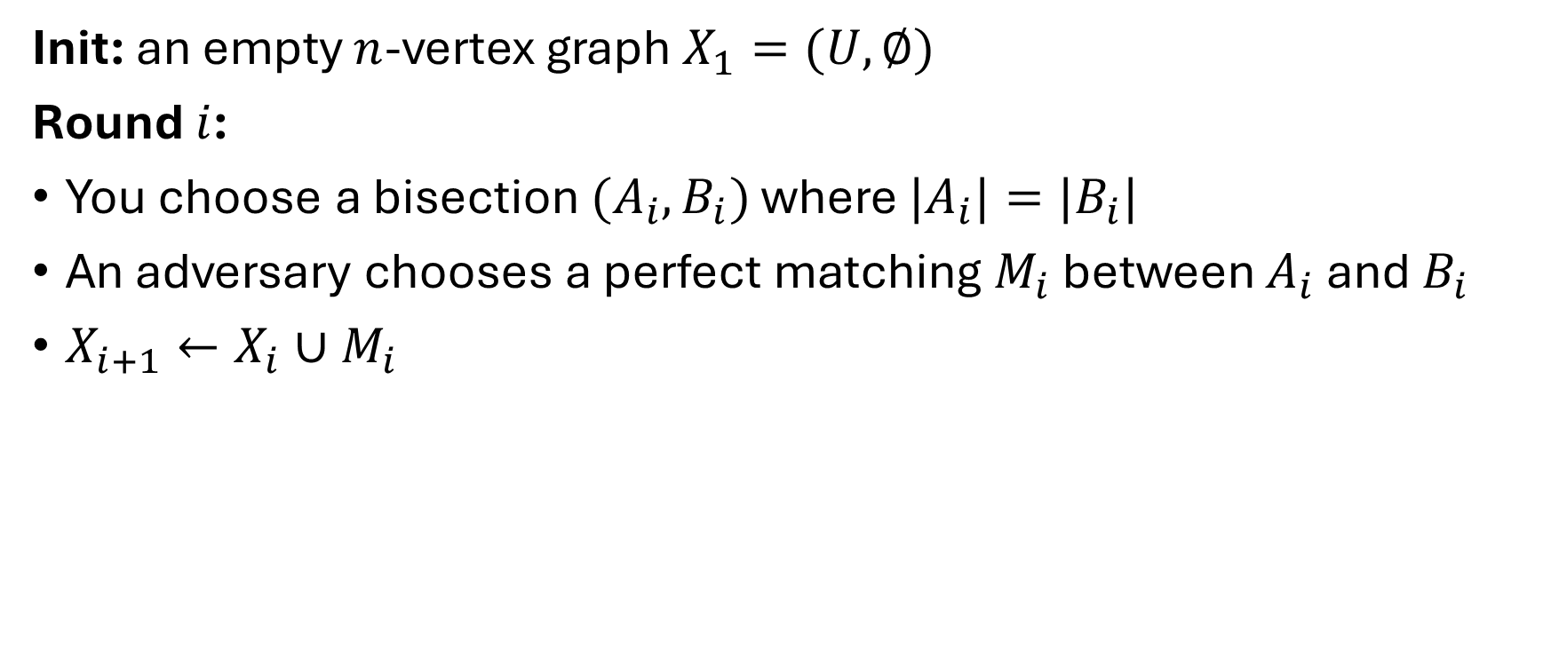
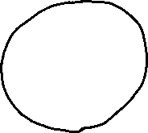
Cut-Matching Game
Init: an empty $n$-vertex graph $X_{1}=(U,∅)$
Round $i$:
You choose a bisection $(A_{i},B_{i})$ where $|A_{i}|=|B_{i}|$
An adversary chooses a perfect matching $M_{i}$ between $A_{i}$ and $B_{i}$
$X_{i+1}←X_{i}∪M_{i}$
Goal:
Choose $(A_{i},B_{i})$ cleverly,
so that after a few rounds
$X$ must be a (connected) expander

Slide 12
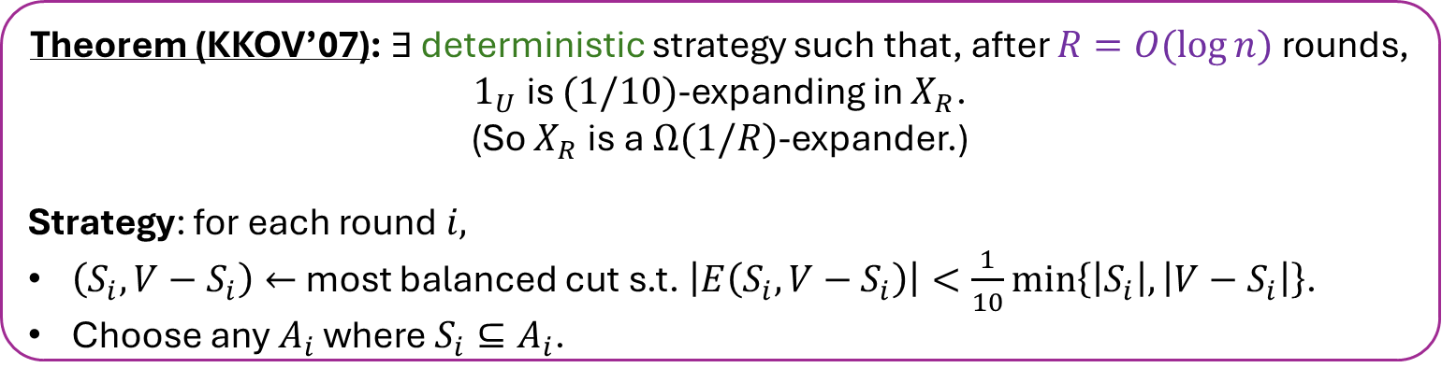
Cut-Matching Game
Init: an empty $n$-vertex graph $X_{1}=(U,∅)$
Round $i$:
You choose a bisection $(A_{i},B_{i})$ where $|A_{i}|=|B_{i}|$
An adversary chooses a perfect matching $M_{i}$ between $A_{i}$ and $B_{i}$
$X_{i+1}←X_{i}∪M_{i}$
Theorem (KKOV’07): $∃$ deterministic strategy such that, after $R=O(\log{n})$ rounds, $1_{U}$ is $(1/10)$-expanding in $X_{R}$.
(So $X_{R}$ is a $Ω(1/R)$-expander.)
Strategy: for each round $i,$
$\left(S_{i},V−S_{i}\right)←$ most balanced cut s.t. $\left|E\left(S_{i},V−S_{i}\right)\right|<\frac{1}{10}\min\left\{\left|S_{i}\right|,\left|V−S_{i}\right|\right\}$.
Choose any $A_{i}$ where $S_{i}⊆A_{i}$.
[KKOV]: Slow, “Chicken & Egg”
[KRV, OSVV]: Fast, Randomized

Slide 13
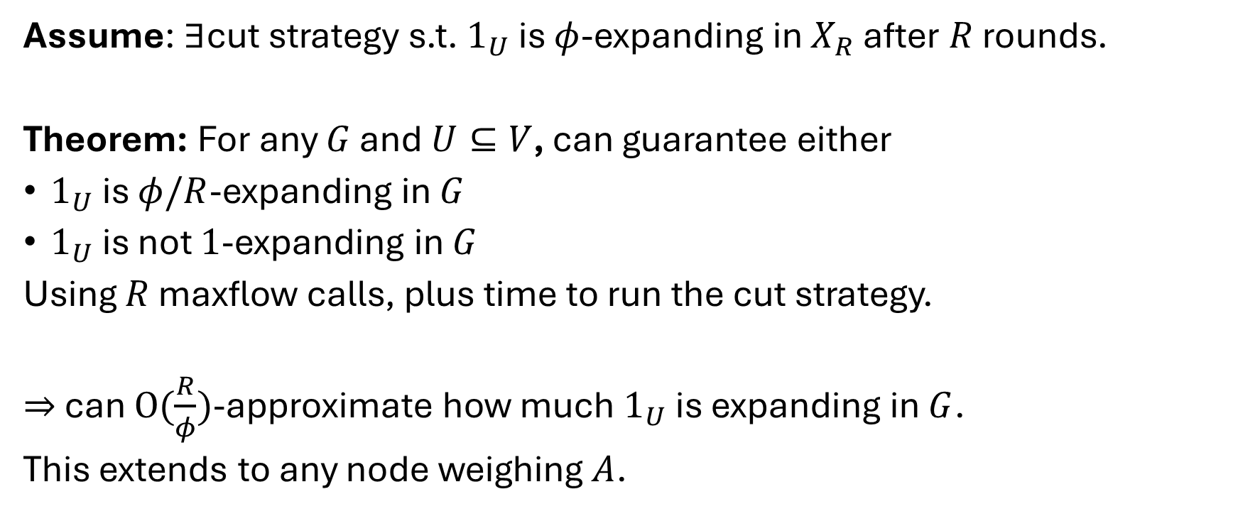
Approx Expansion via Cut-Matching Game
Assume: $∃$cut strategy s.t. $1_{U}$ is $φ$-expanding in $X_{R}$ after $R$ rounds.
Theorem: For any $G$ and $U⊆V$, can guarantee either
$1_{U}$ is $φ/R$-expanding in $G$
$1_{U}$ is not $1$-expanding in $G$
Using $R$ maxflow calls, plus time to run the cut strategy.
$⇒$ can $O(\frac{R}{φ})$-approximate how much $1_{U}$ is expanding in $G$.
This extends to any node weighing $A$.

Slide 14


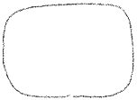
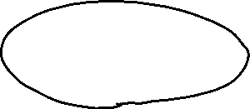


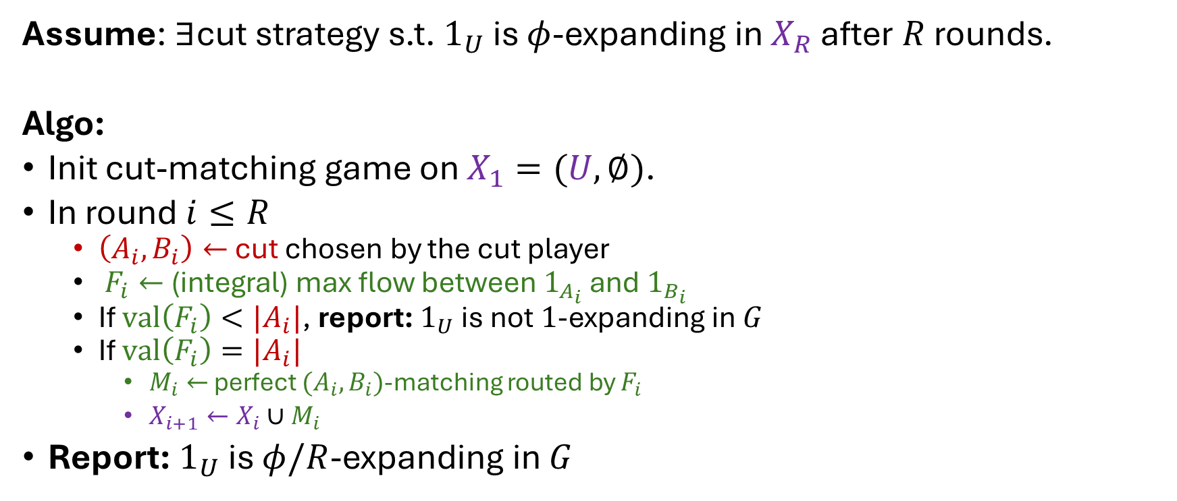



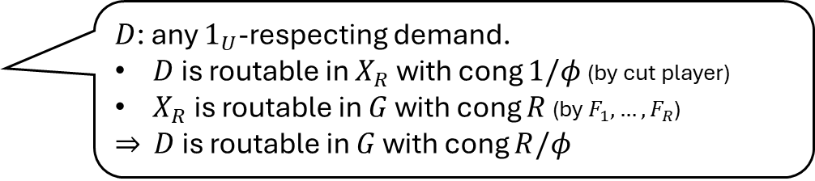
Approx Expansion via Cut-Matching Game
Assume: $∃$cut strategy s.t. $1_{U}$ is $φ$-expanding in $X_{R}$ after $R$ rounds.
Algo:
Init cut-matching game on $X_{1}=(U,∅)$.
In round $i≤R$
  $\left(A_{i},B_{i}\right)←$ cut chosen by the cut player
  $F_{i}←$ (integral) max flow between $1_{A_{i}}$ and $1_{B_{i}}$
  If $val\left(F_{i}\right)<|A_{i}|$, report: $1_{U}$ is not $1$-expanding in $G$
  If $val\left(F_{i}\right)=|A_{i}|$
    $M_{i}←$ perfect $(A_{i},B_{i})$-matching routed by $F_{i}$
    $X_{i+1}←X_{i}∪M_{i}$
Report: $1_{U}$ is $φ/R$-expanding in $G$
$D$: any $1_{U}$-respecting demand.
$D$ is routable in $X_{R}$ with cong $1/φ$ (by cut player)
$X_{R}$ is routable in $G$ with cong $R$ (by $F_{1},…,F_{R}$)
$⇒$ $D$ is routable in $G$ with cong $R/φ$

Slide 15
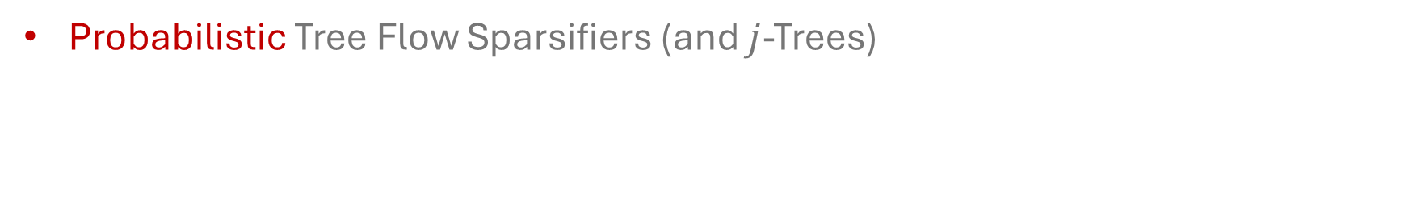
Central Concepts
Probabilistic Tree Flow Sparsifiers (and $j$-Trees)

Slide 16
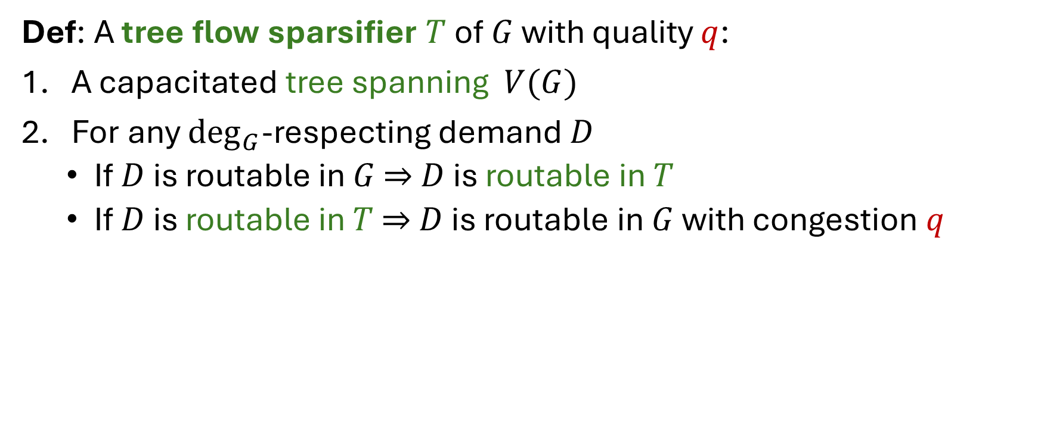
Recall: Tree Flow Sparsifiers
Def: A tree flow sparsifier $T$ of $G$ with quality $q$:
A capacitated tree spanning $V(G)$
For any $\deg_{G}$-respecting demand $D$
  If $D$ is routable in $G$ $⇒$ $D$ is routable in $T$
  If $D$ is routable in $T$ $⇒$ $D$ is routable in $G$ with congestion $q$

Slide 17
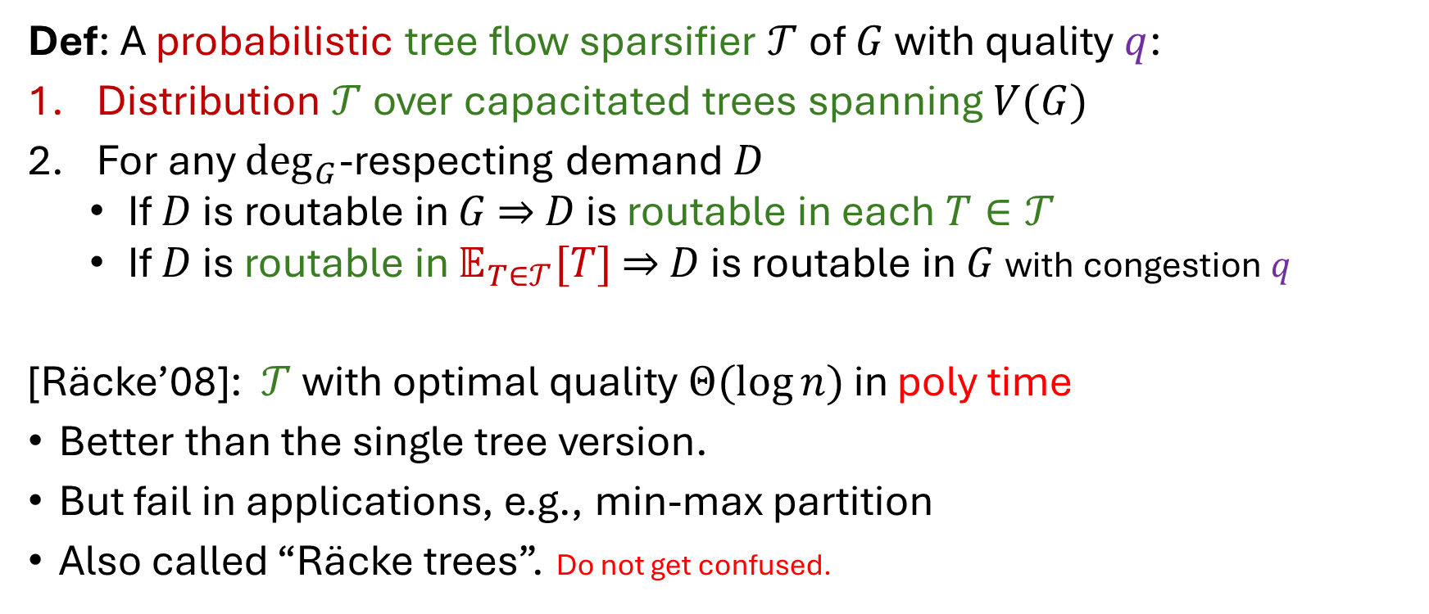
Probabilistic Tree Flow Sparsifiers
Def: A probabilistic tree flow sparsifier $𝒯$ of $G$ with quality $q$:
Distribution $𝒯$ over capacitated trees spanning $V(G)$
For any $\deg_{G}$-respecting demand $D$
  If $D$ is routable in $G$ $⇒$ $D$ is routable in each $T∈𝒯$
  If $D$ is routable in $𝔼_{T∈𝒯}[T]$ $⇒$ $D$ is routable in $G$ with congestion $q$
[Räcke’08]: $𝒯$ with optimal quality $Θ(\log{n})$ in poly time
Better than the single tree version.
But fail in applications, e.g., min-max partition
Also called “Räcke trees”. Do not get confused.

Slide 18

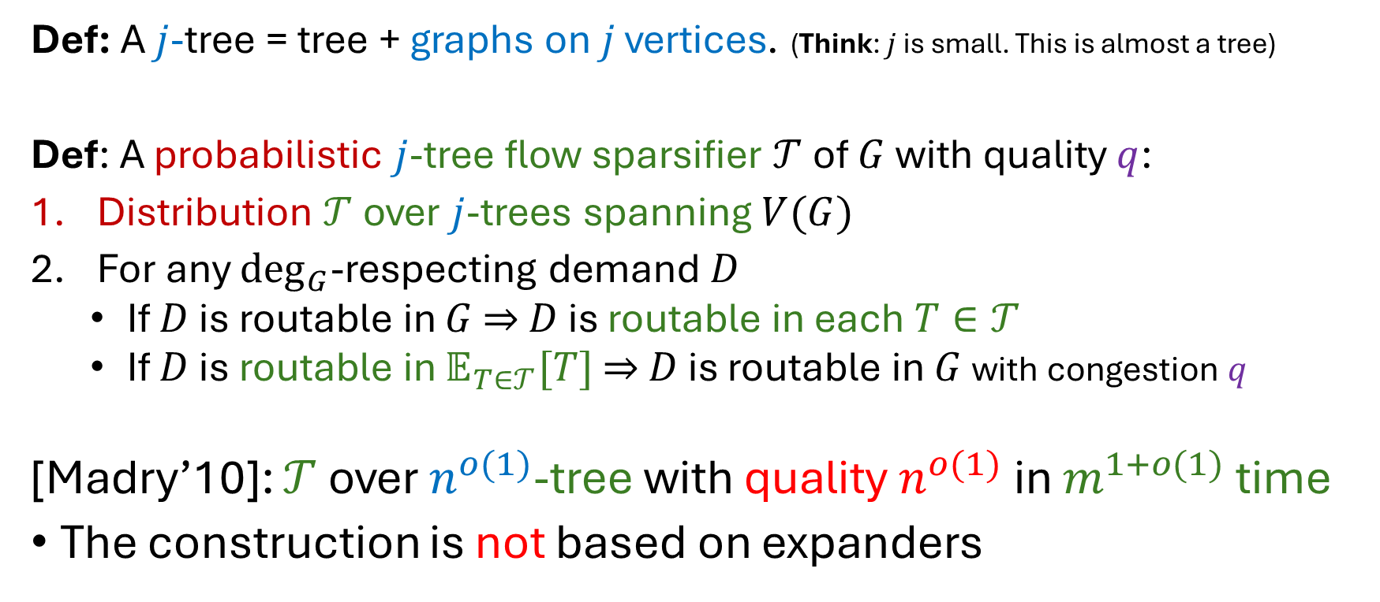
Probabilistic Almost-Tree Flow Sparsifiers
Def: A $j$-tree = tree + graphs on $j$ vertices. (Think: $j$ is small. This is almost a tree)
Def: A probabilistic $j$-tree flow sparsifier $𝒯$ of $G$ with quality $q$:
Distribution $𝒯$ over $j$-trees spanning $V(G)$
For any $\deg_{G}$-respecting demand $D$
  If $D$ is routable in $G$ $⇒$ $D$ is routable in each $T∈𝒯$
  If $D$ is routable in $𝔼_{T∈𝒯}[T]$ $⇒$ $D$ is routable in $G$ with congestion $q$
[Madry’10]: $𝒯$ over $n^{o(1)}$-tree with quality $n^{o(1)}$in $m^{1+o(1)}$ time
The construction is not based on expanders

Slide 19
Part 2
History: 2005-2015

Slide 20
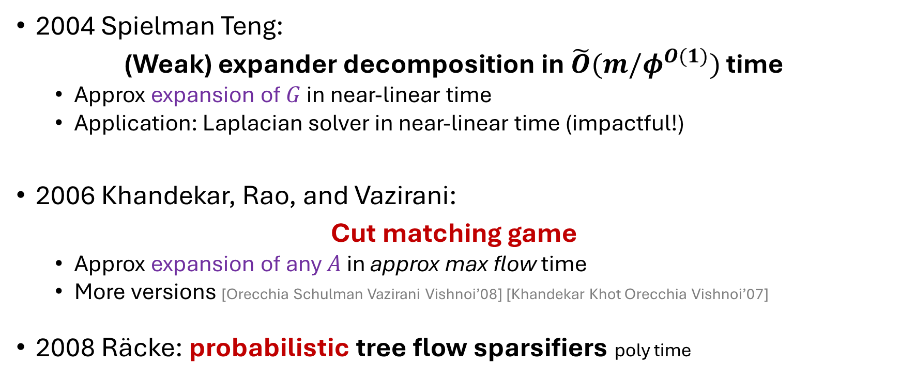
2005-2015: impact to fast algorithms
2004 Spielman Teng:
(Weak) expander decomposition in $\tilde{O}(m/φ^{O(1)})$ time
  Approx expansion of $G$ in near-linear time
  Application: Laplacian solver in near-linear time (impactful!)
2006 Khandekar, Rao, and Vazirani:
Cut matching game
  Approx expansion of any $A$ in approx max flow time
  More versions [Orecchia Schulman Vazirani Vishnoi’08] [Khandekar Khot Orecchia Vishnoi’07]
2008 Räcke: probabilistic tree flow sparsifiers poly time

Slide 21
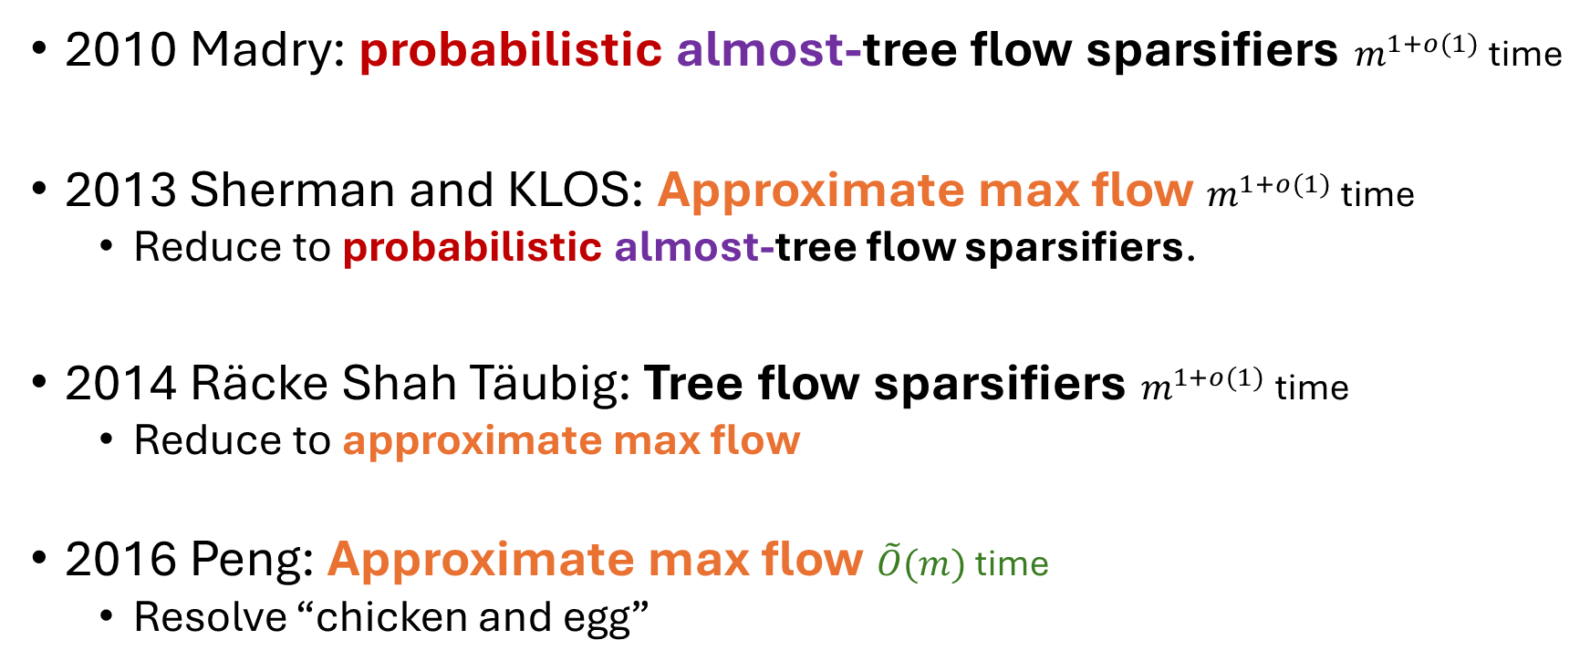
2005-2015: impact to fast algorithms
2010 Madry: probabilistic almost-tree flow sparsifiers $m^{1+o(1)}$ time
2013 Sherman and KLOS: Approximate max flow $m^{1+o(1)}$ time
  Reduce to probabilistic almost-tree flow sparsifiers.
2014 Räcke Shah Täubig: Tree flow sparsifiers $m^{1+o(1)}$ time
  Reduce to approximate max flow
2016 Peng: Approximate max flow $\tilde{O}(m)$ time
  Resolve “chicken and egg”

Slide 22
2005-2015: impact to fast algorithms
10 years after [Spielman Teng],
it was clear that expanders are very powerful for fast algorithms.

Slide 23
Part 3
Survey: 2015 - Now

Slide 24
Two dimensions of development
Expander-based techniques hugely extend in 2 dimensions
Across models of computation
Across notions of expansion

Slide 25
Part 3.1
Development across models of computation

Slide 26
Models of Computation
Static
Dynamic
Distributed

Slide 27
Models of Computation
Static
Dynamic
Distributed

Slide 28
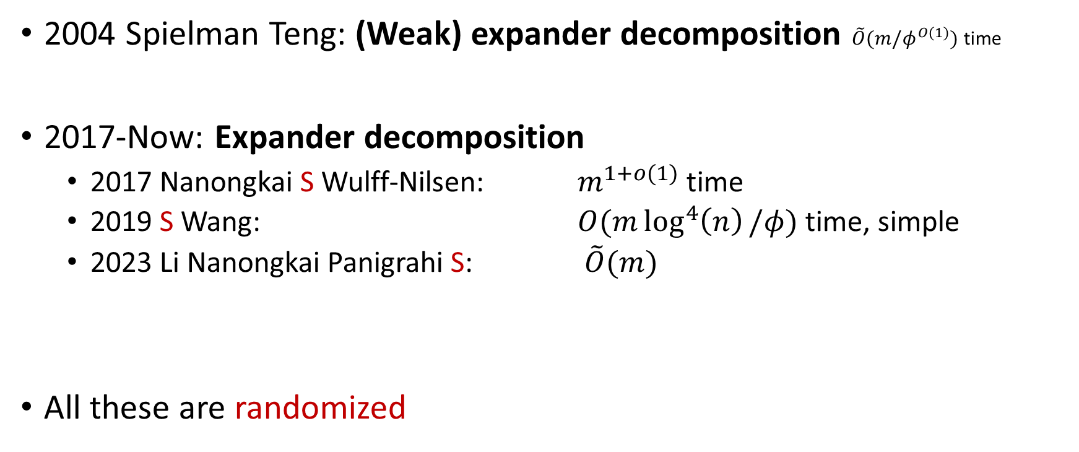
Static Core Objects: Faster
2004 Spielman Teng: (Weak) expander decomposition $\tilde{O}(m/φ^{O(1)})$ time
2017-Now: Expander decomposition
  2017 Nanongkai S Wulff-Nilsen: $m^{1+o(1)}$ time
  2019 S Wang: $O(m\log^{4}\left(n\right)/φ)$ time, simple
  2023 Li Nanongkai Panigrahi S: $\tilde{O}(m)$
All these are randomized

Slide 29
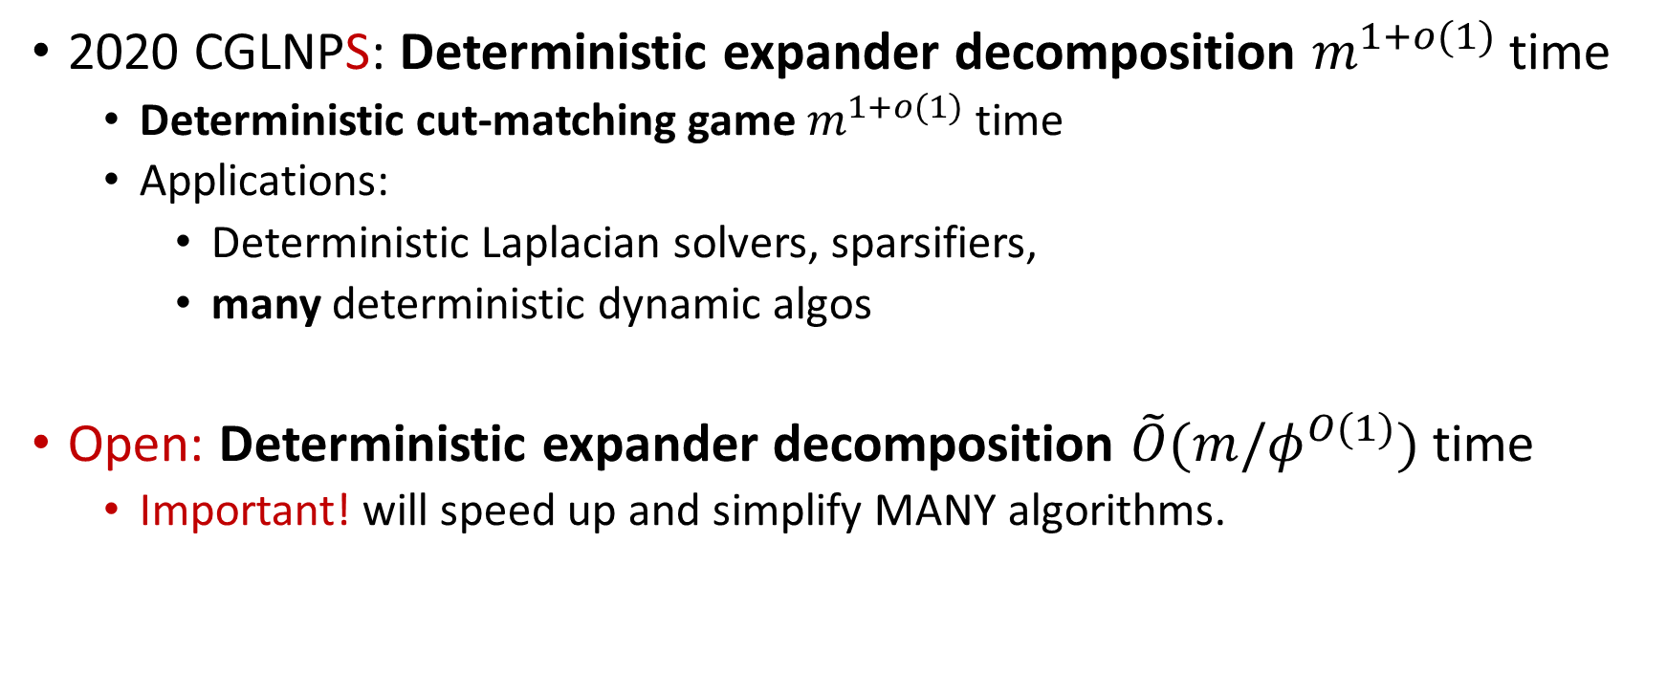
Static Core Objects: Deterministic
2020 CGLNPS: Deterministic expander decomposition $m^{1+o(1)}$ time
  Deterministic cut-matching game $m^{1+o(1)}$ time
  Applications:
    Deterministic Laplacian solvers, sparsifiers,
    many deterministic dynamic algos
Open: Deterministic expander decomposition $\tilde{O}(m/φ^{O(1)})$ time
  Important! will speed up and simplify MANY algorithms.
Notes:
2015 Kawarabayashi Thorup: $\tilde{O}(m)$ time, simple unweighted graphs
Bypass deterministic ED
2020 Li Panigrahi, Li $m^{1+o(1)}$ time, weighted graphs
Need deterministic ED
2025 Henzinger Li Rao Wang $\tilde{O}(m)$ time, weighted graphs

Slide 30
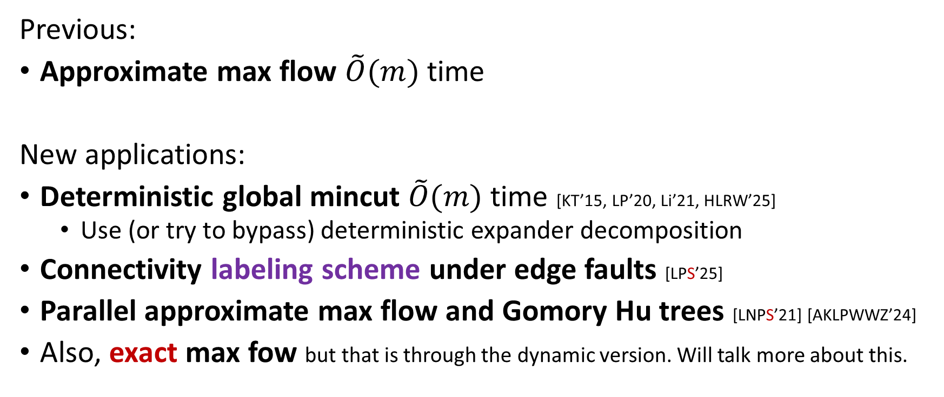
Applications in Static Setting
Previous:
Approximate max flow $\tilde{O}(m)$ time
New applications:
Deterministic global mincut $\tilde{O}(m)$ time [KT’15, LP’20, Li’21, HLRW’25]
  Use (or try to bypass) deterministic expander decomposition
Connectivity labeling scheme under edge faults [LPS’25]
Parallel approximate max flow and Gomory Hu trees [LNPS’21] [AKLPWWZ’24]
Also, exact max fow but that is through the dynamic version. Will talk more about this.

Slide 31
Models of Computation
Static
Dynamic
Distributed

Slide 32
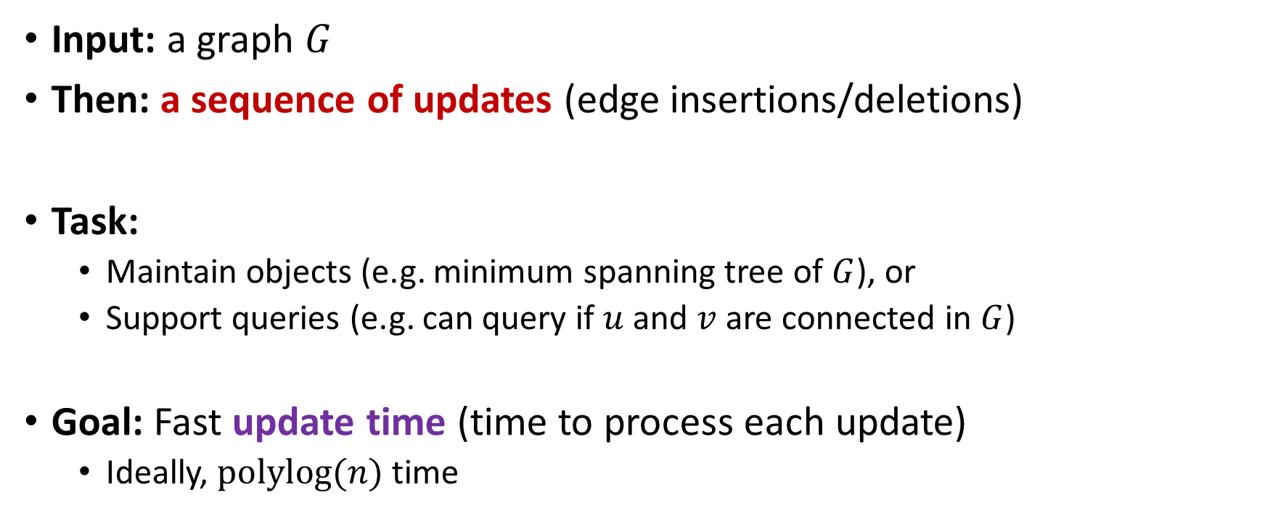
Dynamic Graph Problems
Input: a graph $G$
Then: a sequence of updates (edge insertions/deletions)
Task:
  Maintain objects (e.g. minimum spanning tree of $G$), or
  Support queries (e.g. can query if $u$ and $v$ are connected in $G$)
Goal: Fast update time (time to process each update)
  Ideally, $polylog(n)$ time

Slide 33
Dynamic Core Objects
2007: Exploit expanders for handling only one batch of updates
  [Patrascu Thorup]’s connectivity oracles
  But the dynamic setting has an online sequence of updates
2017 Nanongkai S Wulff-Nilsen: Dynamic Expanders Decomposition
2021 Goranci Räcke S Tan: Dynamic Tree Flow Sparsifiers
  Dynamic BSE-hierarchy
Last few years: Many uses of expanders in dynamic graphs
[SW’19] [CK’19] [CGLNPS’20] [BGS’20] [GRST’21] [CS’21] [BGS’21] [JS’21] [BKMNSS’22] [BBGNSSS’22] [LS’22] [GHNSTW'23] [JST’24] [EHL’25] [HLS’25] [CP’25]

Slide 34
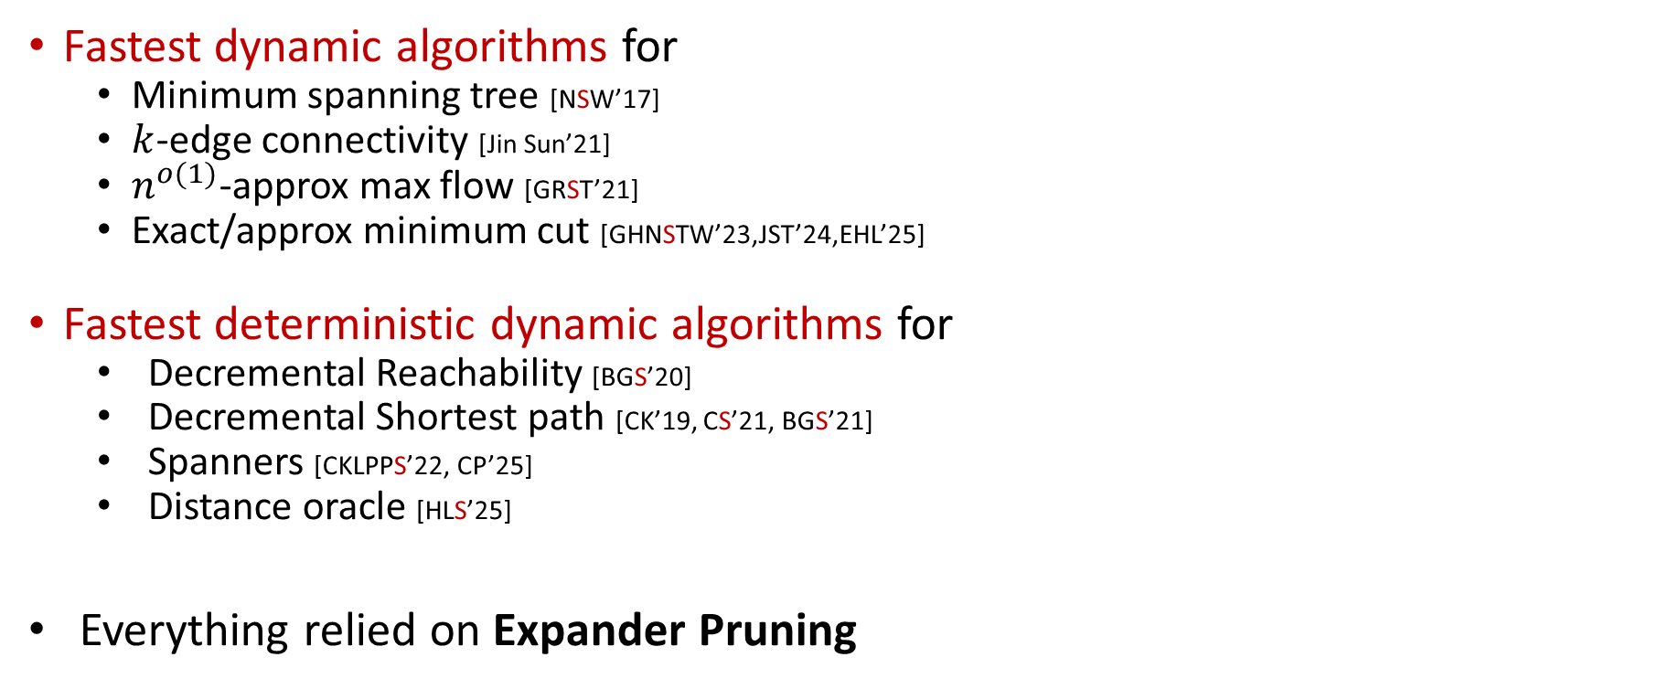
Applications in Dynamic Setting
Fastest dynamic algorithms for
  Minimum spanning tree [NSW’17]
  $k$-edge connectivity [Jin Sun’21]
  $n^{o(1)}$-approx max flow [GRST’21]
  Exact/approx minimum cut [GHNSTW’23,JST’24,EHL’25]
Fastest deterministic dynamic algorithms for
  Decremental Reachability [BGS’20]
  Decremental Shortest path [CK’19, CS’21, BGS’21]
  Spanners [CKLPPS’22, CP’25]
  Distance oracle [HLS’25]
Everything relied on Expander Pruning

Slide 35
Central Concepts
Expander Pruning

Slide 36




Intuition: Expanders are Robust under updates.
Non-expanders
Expanders
Sparse cut!
No sparse cut!
Delete
Delete
$$C_{1}$$
$$C_{2}$$
$$C_{1}$$
$$C_{2}$$
Very small change!
Big change!

Slide 37

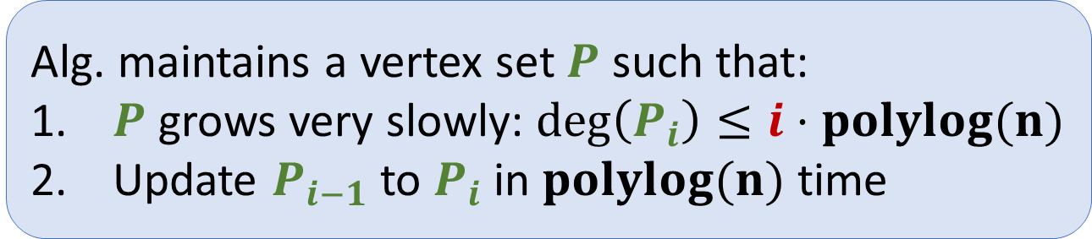










Expander Pruning [NSW’17] [SW’19] [MPS’25]
$G_{i}\left[V−P_{i}\right]$ remains an expander
$$P_{i}$$
$$P_{k}$$
$$P_{1}$$
$$P_{2}$$
$G_{0}$: expander
$$G_{1}=G_{0}−e_{1}$$
$$G_{2}=G_{1}+e_{2}$$
$$G_{i}=G_{i−1}−e_{i}$$
$$G_{k}=G_{k−1}−e_{k}$$
Alg. maintains a vertex set $P$ such that:
$P$ grows very slowly: $deg\left(P_{i}\right)≤i⋅polylog(n)$
Update $P_{i−1}$ to $P_{i}$in $polylog(n)$ time
where $k≤m/n^{o(1)}$

Slide 38


Expander Pruning [NSW’17] [SW’19]
$G_{i}\left[V−P_{i}\right]$remains an expander
$$P_{i}$$
$$P_{k}$$
$$P_{1}$$
$$P_{2}$$
$G_{0}$: expander
$$G_{1}=G_{0}−e_{1}$$
$$G_{2}=G_{1}+e_{2}$$
$$G_{i}=G_{i−1}−e_{i}$$
$$G_{k}=G_{k−1}−e_{k}$$
Each update can only cause “small problem”.
The remaining part is still an expander.

Slide 39
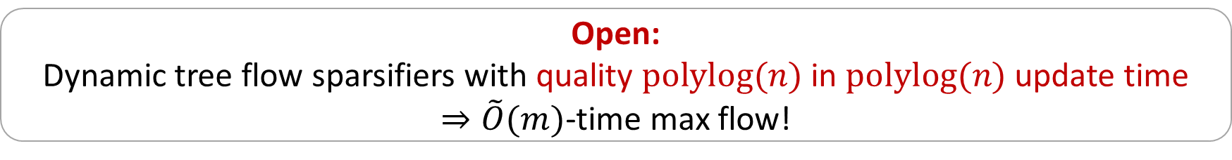
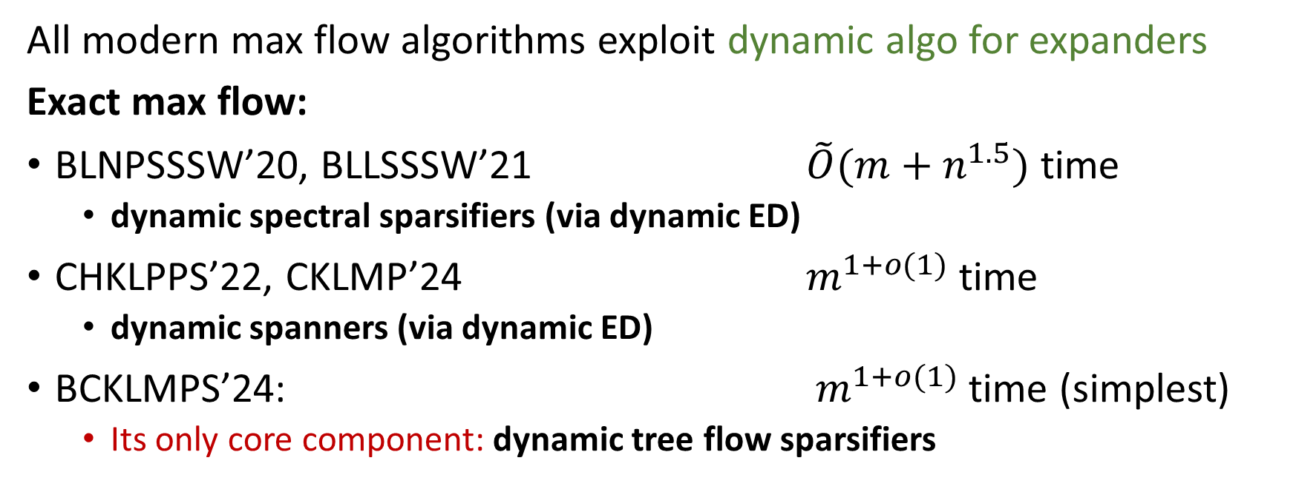
More Applications:
Dynamic Expanders for Exact Max Flow
All modern max flow algorithms exploit dynamic algo for expanders
Exact max flow:
BLNPSSSW’20, BLLSSSW’21 $\tilde{O}(m+n^{1.5})$ time
  dynamic spectral sparsifiers (via dynamic ED)
CHKLPPS’22, CKLMP’24 $m^{1+o(1)}$time
  dynamic spanners (via dynamic ED)
BCKLMPS’24: $m^{1+o(1)}$time (simplest)
  Its only core component: dynamic tree flow sparsifiers
Open:
Dynamic tree flow sparsifiers with quality $polylog(n)$ in $polylog(n)$ update time
$⇒\tilde{O}(m)$-time max flow!

Slide 40
Models of Computation
Static
Dynamic
Distributed

Slide 41

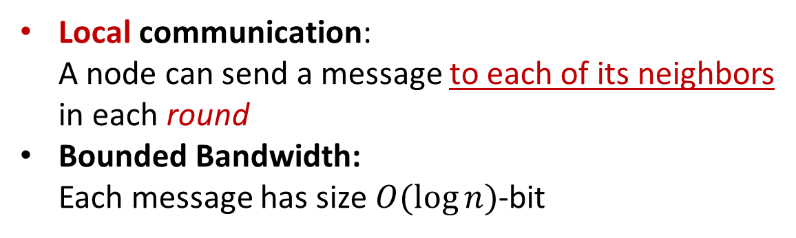
Distributed Model: CONGEST
Local communication:
A node can send a message to each of its neighbors
in each round
Bounded Bandwidth:
Each message has size $O(\log{n})$-bit
2
$\log{n}$ bits
1
4
Goal:
Compute something about the underlying network
Minimize the number of rounds
3

Slide 42
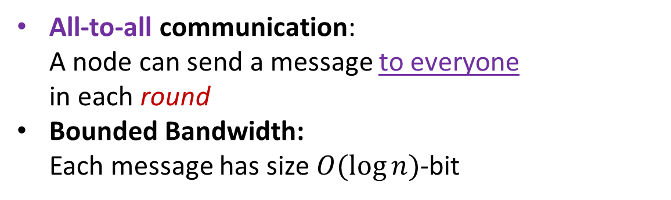
Distributed Model: CONGESTED CLIQUE
Stronger model than CONGEST
All-to-all communication:
A node can send a message to everyone
in each round
Bounded Bandwidth:
Each message has size $O(\log{n})$-bit
2
$\log{n}$ bits
1
4
Goal:
Compute something about the underlying network
Minimize the number of rounds
3

Slide 43
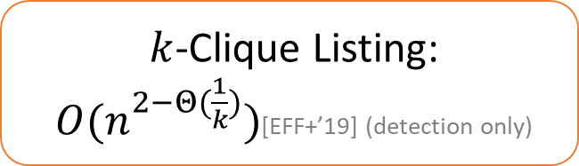
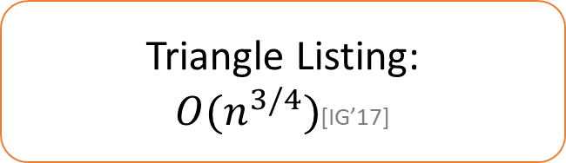
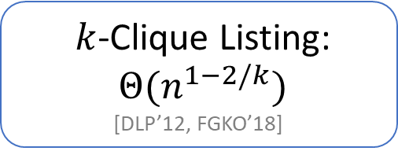
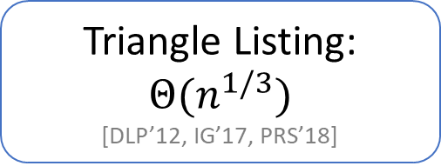
Without Expander Decomposition
CONGEST
CONGESTED CLIQUE
Triangle Listing:
$O(n^{3/4})$[IG’17]
Triangle Listing:
$Θ(n^{1/3})$
[DLP’12, IG’17, PRS’18]
$k$-Clique Listing:
$O(n^{2−Θ(\frac{1}{k})})$[EFF+’19] (detection only)
$k$-Clique Listing:
$Θ(n^{1−2/k})$
[DLP’12, FGKO’18]

Slide 44
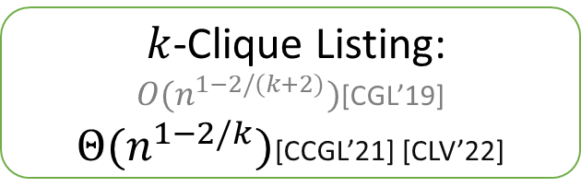
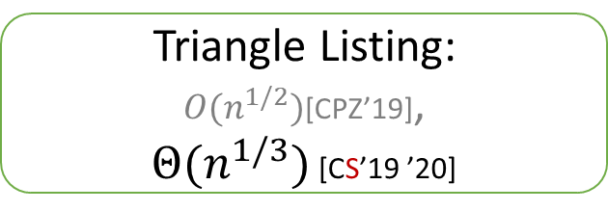

Using Expander Decomposition and Expander Routing
Will define soon!
CONGESTED CLIQUE
CONGEST
Triangle Listing:
$O(n^{1/2})$[CPZ’19],
$Θ(n^{1/3})$ [CS’19 ’20]
Triangle Listing:
$Θ(n^{1/3})$
[DLP’12, IG’17, PRS’18]
$k$-Clique Listing:
$O(n^{1−2/(k+2)})$[CGL’19]
$Θ(n^{1−2/k})$[CCGL’21] [CLV’22]
$k$-Clique Listing:
$Θ(n^{1−2/k})$
[DLP’12, FGKO’18]

Slide 45
Bypassing Locality
CONGEST model
CONGESTED CLIQUE model
Expander Decomposition & Routing
can transfer strong results
from CONGESTED CLIQUE (without locality constraint)
to CONGEST (with locality constraint)

Slide 46
Central Concepts
Expander Routing

Slide 47




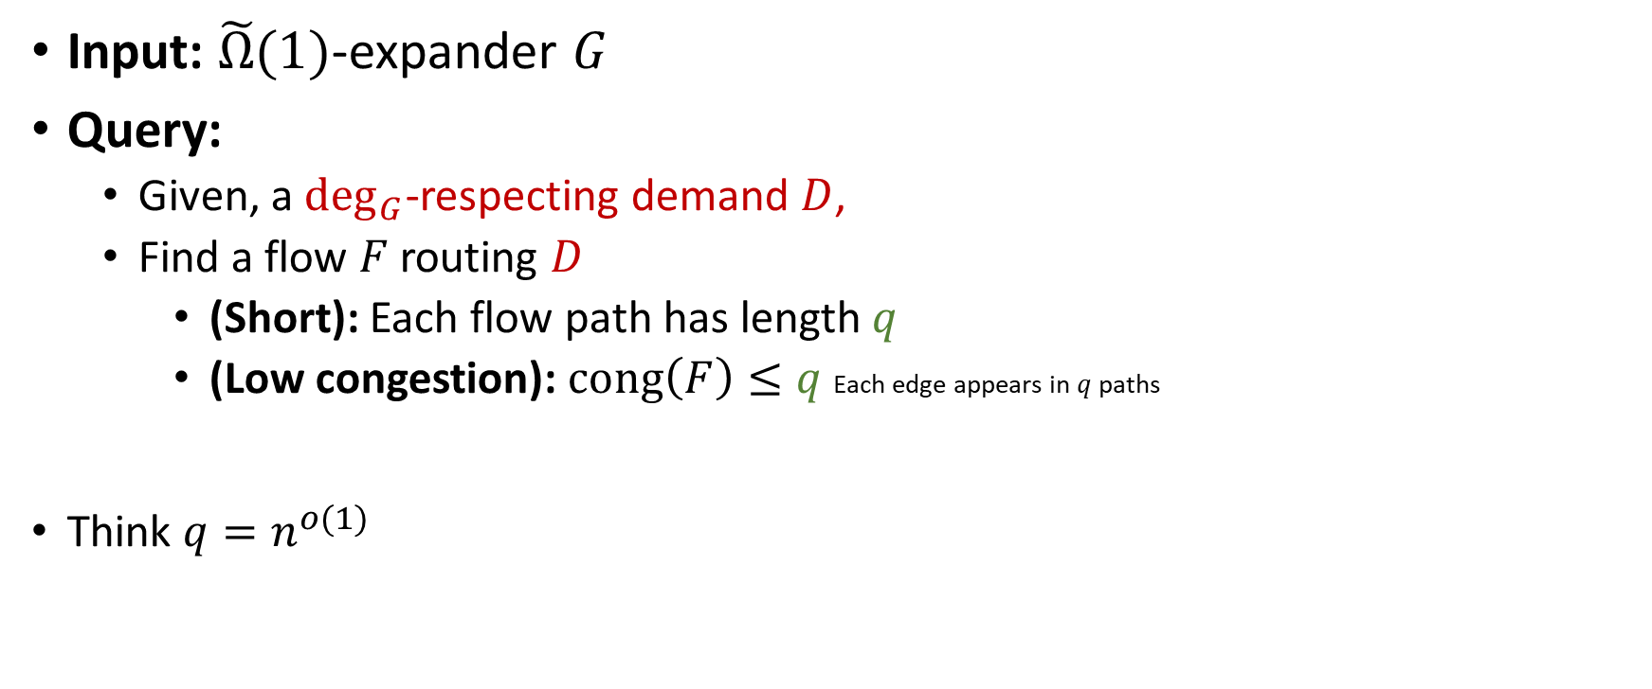




Expander Routing with quality $q$
Input: $\tilde{Ω}(1)$-expander $G$
Query:
  Given, a $\deg_{G}$-respecting demand $D$,
  Find a flow $F$ routing $D$
    (Short): Each flow path has length $q$
    (Low congestion): $cong\left(F\right)≤q$ Each edge appears in $q$ paths
Think $q=n^{o(1)}$

Slide 48
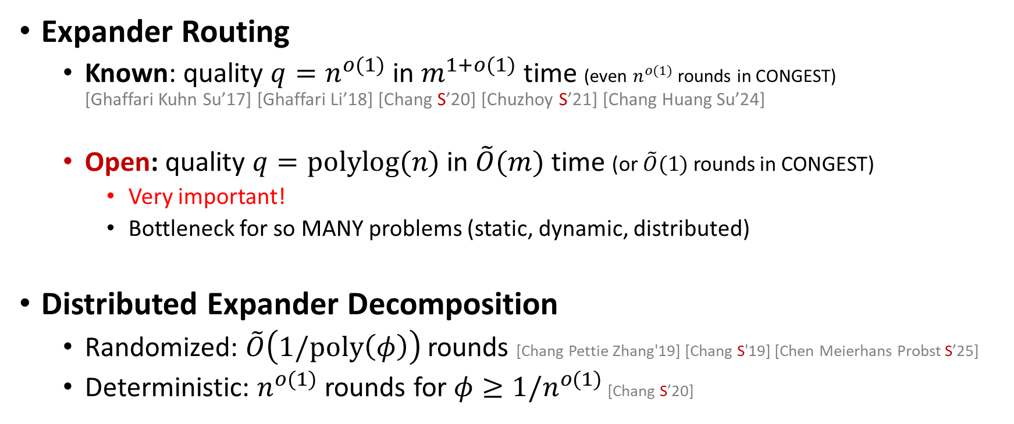
Survey: Distributed Expander-based Algorithms
Expander Routing
  Known: quality $q=n^{o(1)}$ in $m^{1+o(1)}$ time (even $n^{o(1)}$ rounds in CONGEST)
  [Ghaffari Kuhn Su’17] [Ghaffari Li’18] [Chang S’20] [Chuzhoy S’21] [Chang Huang Su’24]
  Open: quality $q=polylog(n)$ in $\tilde{O}(m)$ time (or $\tilde{O}(1)$ rounds in CONGEST)
    Very important!
    Bottleneck for so MANY problems (static, dynamic, distributed)
Distributed Expander Decomposition
  Randomized: $\tilde{O}\left(1/poly\left(φ\right)\right)$ rounds [Chang Pettie Zhang'19] [Chang S'19] [Chen Meierhans Probst S’25]
  Deterministic: $n^{o(1)}$ rounds for $φ≥1/n^{o(1)}$ [Chang S’20]

Slide 49
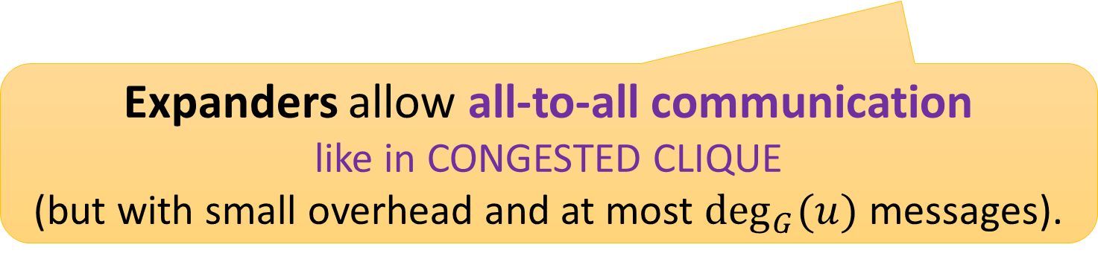
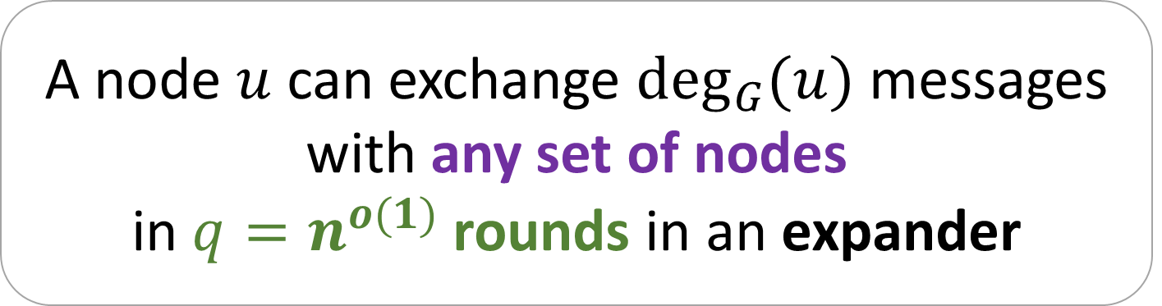
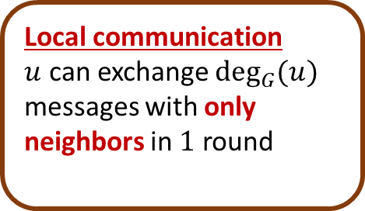
Why Expander Routing is Useful in CONGEST?
A node $u$ can exchange $\deg_{G}{(u)}$ messages with any set of nodes
in $q=n^{o(1)}$ rounds in an expander
Expanders allow all-to-all communication
like in CONGESTED CLIQUE
(but with small overhead and at most $\deg_{G}{(u)}$ messages).
Local communication
$u$ can exchange $\deg_{G}{(u)}$ messages with only neighbors in $1$ round

Slide 50
Part 3.2
Development across notions of expansion

Slide 51
Notions of Expansion
Vertex Expansion
Directed Expansion
Length-Constrained
Expansion
Unbreakability
Hybrid
Expansion

Slide 52
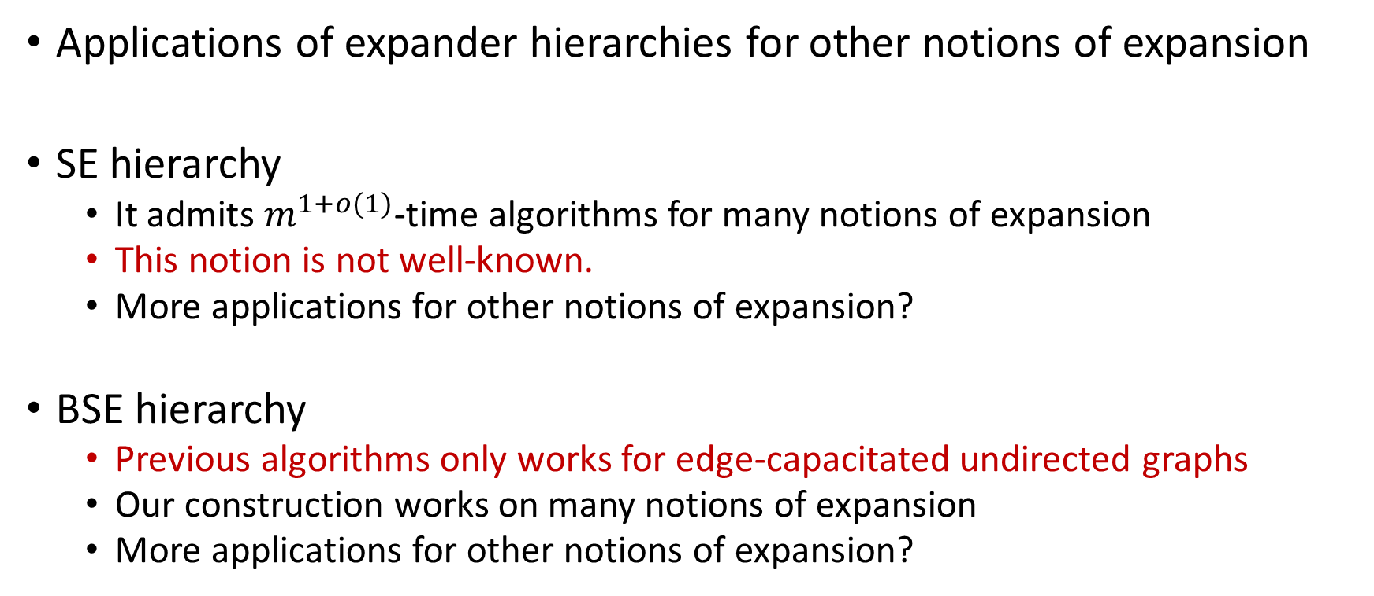
Promising Research Directions
Applications of expander hierarchies for other notions of expansion
SE hierarchy
  It admits $m^{1+o(1)}$-time algorithms for many notions of expansion
  This notion is not well-known.
  More applications for other notions of expansion?
BSE hierarchy
  Previous algorithms only works for edge-capacitated undirected graphs
  Our construction works on many notions of expansion
  More applications for other notions of expansion?

Slide 53
Notions of Expansion
Vertex Expansion
Directed Expansion
Length-Constrained
Expansion
Unbreakability
Hybrid
Expansion

Slide 54
Using Vertex Expander Decomp/Hierarchies
Using Expander Decomposition
Deterministic vertex connectivity [SY'22] [JNSY'25]
Using Expander hierarchies
Connectivity oracles under vertex faults [LS’22] [LY’24]
Connectivity labeling scheme under vertex faults [LPS’25]

Slide 55




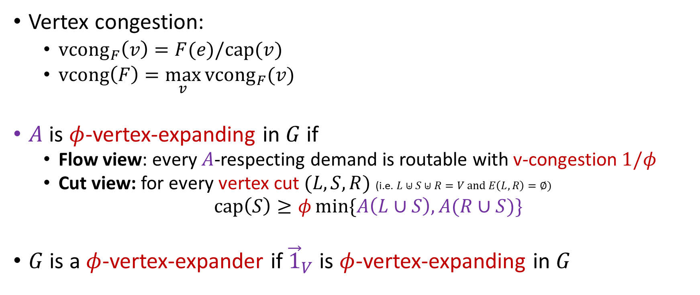
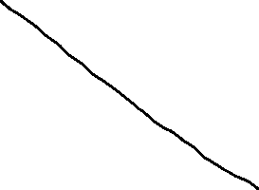




Vertex Expansion
Vertex congestion:
  ${vcong}_{F}\left(v\right)=F(e)/cap(v)$
  $vcong\left(F\right)=\max_{v}{{vcong}_{F}(v)}$
$A$ is $φ$-vertex-expanding in $G$ if
  Flow view: every $A$-respecting demand is routable with v-congestion $1/φ$
  Cut view: for every vertex cut $(L,S,R)$ (i.e. $L⊎S⊎R=V$ and $E\left(L,R\right)=∅$)
  $cap\left(S\right)≥φ\min{\{A\left(L∪S\right),A(R∪S)\}}$
$G$ is a $φ$-vertex-expander if ${\vec{1}}_{V}$ is $φ$-vertex-expanding in $G$
$vcong\left(F\right)=2.5$

Slide 56


Quiz: which ones are vertex expanders?
    Cliques
    Hypercubes
    Stars
    Paths

Slide 57

Vertex Expander Decomposition
$φ$-Expander decomposition of $G$: there is $C⊆V$ where
  Each component of $G−C$ is a $φ$-v-expander
  $\left|C\right|≤φn\log{n}$

Slide 58

Vertex Expander Hierarchy
Separator-expanding hierarchy: $∃$ partition $V_{0},…,V_{ℓ=O(\log{n})}$ of $V$
  ${\vec{1}}_{V_{i}}$ is $¼$-v-expanding in $G−V_{>i}$ for each $i$.
Not clear how to define
boundary-separator-expanding hierarchy

Slide 59
Notions of Expansion
Vertex Expansion
Directed Expansion
Length-Constrained
Expansion
Unbreakability
Hybrid
Expansion

Slide 60
Using Directed Expander Decomp/Hierarchies
Using Expander Decomposition
Decremental single-source reachability [BGS’20]
Using Expander Hierarchies
Combinatorial max flow [BBST’24, BBLST’25]
  Approach: just augmenting path
  Technical part: (100+ pages) 25 pages
  Use basic tools (Dijkstra, SCC, etc.) except expander decomposition
Fault-tolerant strong-connectivity preservers [HSW’25]

Slide 61



Directed Expansion
$A$ is $φ$-expanding in directed graph $G$ if
  Flow view: every $A$-respecting (symmetric) demand is routable with cong $1/φ$
  Cut view: for every cut $(S,V−S)$
  $cap\left(S,V−S)\right)≥φ\min{\{A\left(S\right),A(V−S)\}}$
$G$ is a $φ$-expander if $\deg_{G}$ is $φ$-expanding in $G$
  $\deg_{G}$ counts both in and out degree.
Exactly same notation as in the undirected case.

Slide 62

Directed Expander Decomposition
$φ$-Expander decomposition of $G$: there is $C⊆E$ where
  Each strong component of $G−C$ is a $φ$-expander
  $\left|C\right|≤φm\log{n}$

Slide 63

Directed Expander Hierarchies
Separator-expanding hierarchy: $∃$ partition $E_{0},…,E_{ℓ=O(\log{n})}$ of $V$
  $E_{i}$ is $¼$-expanding in $G−E_{>i}$ for each $i$.
BSE hierarchy: $∃$ partition $E_{0},…,E_{ℓ=O(\log{n})}$ of $V$
  $E_{≥i}$ is $Ω\left(1/\log{n}\right)$-expanding in $G−E_{>i}$ for each $i$.

Slide 64
Notions of Expansion
Vertex Expansion
Directed Expansion
Length-Constrained
Expansion
Unbreakability
Hybrid
Expansion

Slide 65



Flow Problems encompass many problems on graphs
Distance
($ℓ_{1}$)
Shortest paths
Transshipments
Steiner trees
LOCAL model
Distance & Congestion
($ℓ_{1} \& ℓ_{∞}$)
Min cost flow
Min-cost multi-commodity flow
Network design (e.g. $k$-ECSS)
CONGEST model
Congestion
($ℓ_{∞}$)
Max flow
Multi-commodity flow
Tree packing
CONGESTED CLIQUE model
Low diameter decomposition
since 1980, 100s of papers
Length-Constrained Expander decomp
since 2020
Expander decomposition
since 2000, 100s of papers
Graph Decomposition
key algorithmic technique

Slide 66

Using Length-Constrained Expander Decomp/Hierarchies
Universally optimal distributed algorithms [HRG’22]
Using flow shortcut (see Exercise 2) via expander hierarchies
Dynamic distance oracle [HLS’24]
  First deterministic: $O_{ε}(1)$-approx in $n^{ε}$ update time
$O_{ε}(1)$-approx Multi-commodity flow in $m^{1+ε}$ time [HHLRS’24]
Parallel $(1+ε)$-approx min-cost flow in $m^{1+o(1)}$ time [HJLSW’25]
Fault-tolerant distance oracles/labeling schemes [HLRS’26]
Approachable open problems: fault-tolerant roundtrip spanners

Slide 67


Flow and Embedding
2
2
Graphs are
  undirected, with edge-lengths, unit-capacity (for simplicity)
(Multi-commodity) flow $F$
  Congestion: $cong\left(F\right)=\max_{e}{F(e)}$
  Length: $len\left(F\right)=$ max total length in flow paths
1
2
1
1
5
Example:
$cong\left(F\right)=1.5$
$len\left(F\right)=$ 7

Slide 68





Length-Constrained Demands
Demand $D$ is $h$-LC if,
for each $D\left(a,b\right)>0$, ${dist}_{G}\left(a,b\right)≤h$

Slide 69









Length-Constrained Demands are Easier
$G$ is a path and $A=1_{V(G)}$
$A$ is not routable with congestion $<n/2$
$A$ is $4$-LC routable with length 4 and congestion $4$

Slide 70









LC-Expanders: Flow-based Definitions
Quiz:
Let $h,s=O\left(1\right)$ and $φ=Ω(1)$
Which is not $(h,s)$-LC $φ$-expander ?
Recall: $G$ is $φ$-expander $⇔$
$\deg_{G}$ is routable with congestion $1/φ$
$G$ is $(h,s)$-LC $φ$-expander $⇔$
$\deg_{G}$ is $h$-LC routable with length $hs$ and congestion $1/φ$
$A$ is $(h,s)$-LC $φ$-expanding $⇔$
$A$ is $h$-LC routable with length $hs$
and congestion $1/φ$

Slide 71

















Expander Decomposition
Theorem: Given $G=\left(V,E\right),A,φ$, there exists an $hs$-LC cut $C⊆E$
$A$ is $(h,s)$-LC $φ$-expanding in $G−C$.
$\left|C\right|≤(φn^{O\left(1/s\right)}\log{n})⋅|A|$
LC cut (i.e. length Increase)
$hs$-LC cut is
$$C:E→\left\{0,\frac{1}{hs},\frac{2}{hs}, …,1\right\}$$
Length in $G−C$
$${len}_{G−C}\left(e\right)={len}_{G}\left(e\right)+hs⋅C(e)$$
$C$ does not decompose graphs into connected components anymore!
But our notations work!

Slide 72
Notions of Expansion
Vertex Expansion
Directed Expansion
Length-Constrained
Expansion
Unbreakability
Hybrid
Expansion

Slide 73
Notions of Expansion
Vertex Expansion
Directed Expansion
Length-Constrained
Expansion
Unbreakability
Hybrid
Expansion

Slide 74
Summary

Slide 75
Recap key concepts
Expander Decomposition
Repeated Expander Decomposition
Boundary-linked version
Dynamic version
Separator-expanding (SE) Hierarchy
Cut Matching Game
Expanding Balanced Separator
Boundary-separator-expanding (BSE) Hierarchy

Slide 76
Expander Decomposition
Boundary-linked version
Repeated Expander Decomposition
Edge Sparsifier
Vertex Sparsifier
Fast
Flow / Cut / Distance
Algorithms
(undirected/directed
edge/vertex capacity)
Separator-expanding (SE) Hierarchy
Connectivity/Distance Oracles and Labeling Schemes
under Failures
Tree Flow Sparsifiers
Boundary-separator-expanding (BSE) Hierarchy
Flow Shortcuts

