Slide 1





Gradient Clock Synchronization
max_{{v,w}ϵE}|L_{v}-L_{w}| << max_{v,wϵV}|L_{v}-L_{w}|

Slide 2
Today: GCS Algorithm with log. Skew
Theorem
For any μ > θ-1, there is an algorithm such that
dH/dt ≤ dL/dt ≤ (1+μ)dH/dt
and the local skew is
O((u+μd) log_{σ} D),
where
σ = μ/(θ-1).

Slide 3
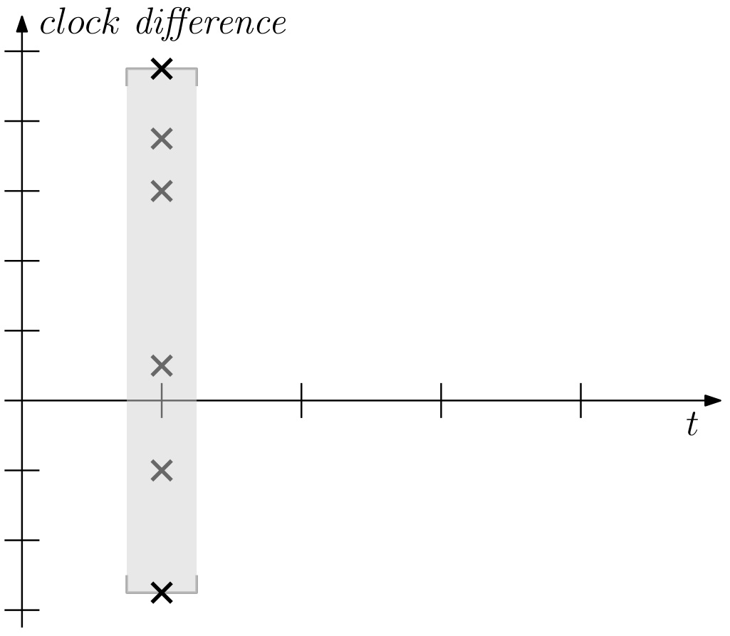
GCS: General Approach
repeat:
1. measure skews
(to neighbors)

Slide 4
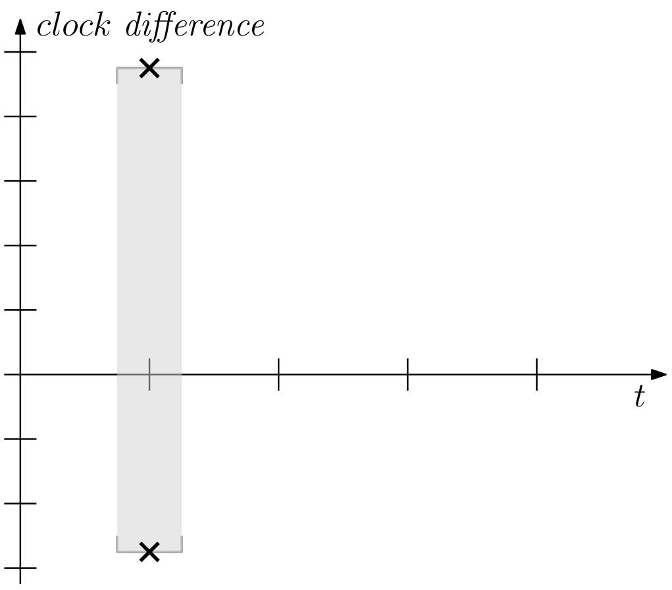
GCS: General Approach
repeat:
1. measure skews
(to neighbors)
2. determine range

Slide 5
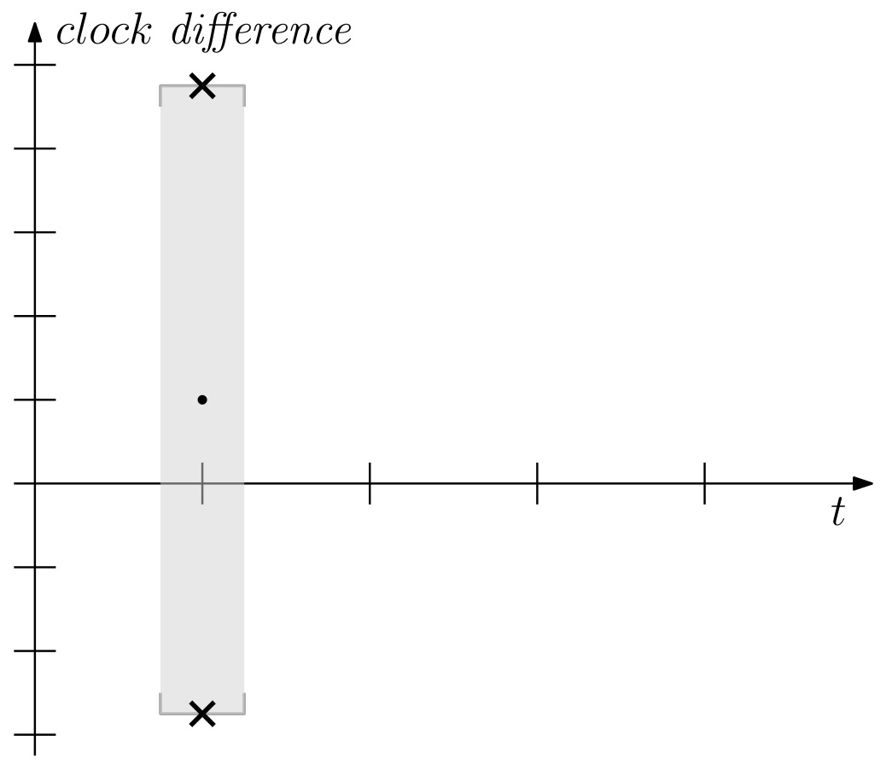
GCS: General Approach
repeat:
1. measure skews
(to neighbors)
2. determine range
3. find midpoint

Slide 6
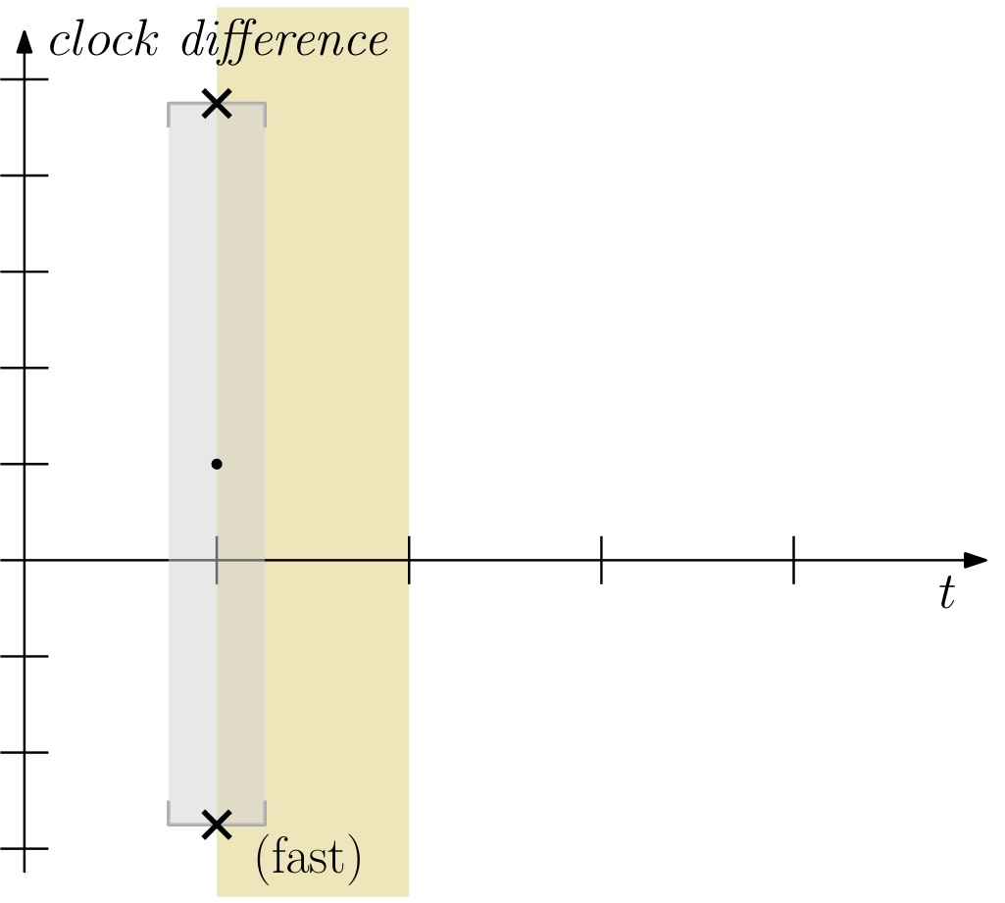
GCS: Naive Averaging Fails
repeat:
1. measure skews
(to neighbors)
2. determine range
3. find midpoint
4. if behind, run faster
(else like HW clock)

Slide 7
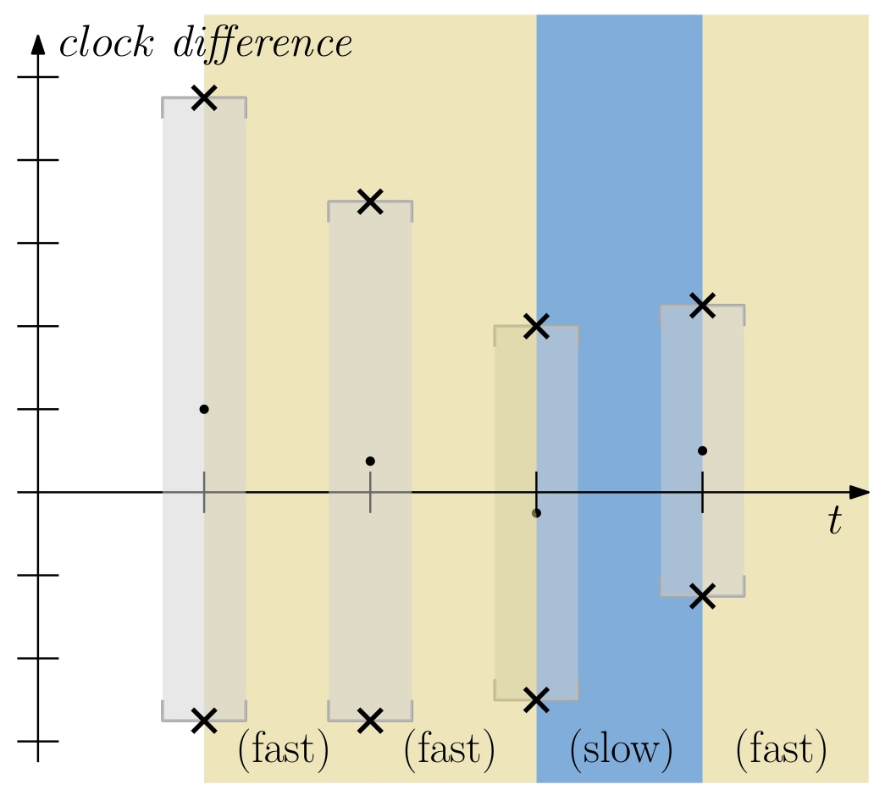
GCS: Naive Averaging Fails
repeat:
1. measure skews
(to neighbors)
2. determine range
3. find midpoint
4. if behind, run faster
(else like HW clock)

Slide 8
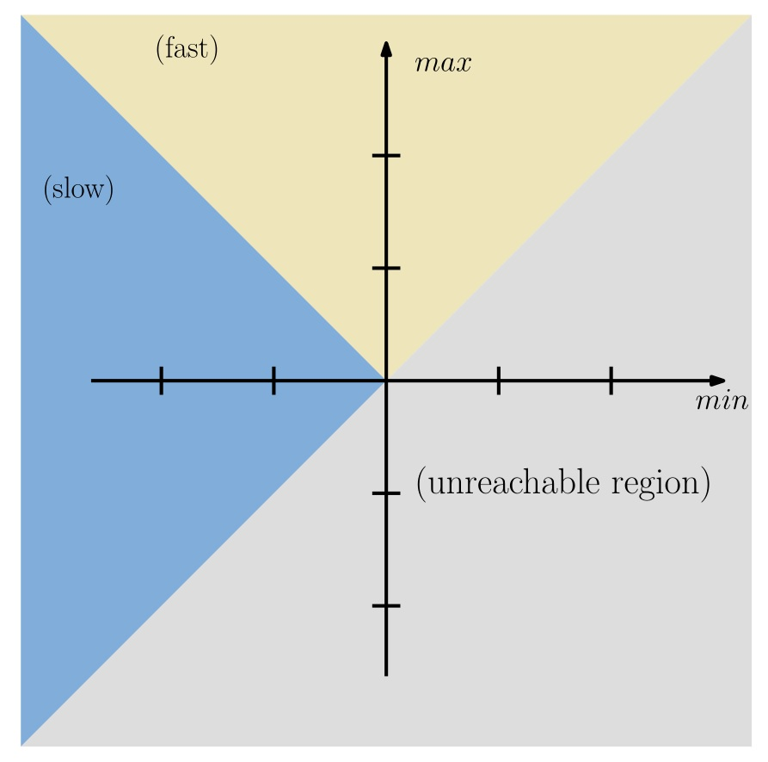
GCS: Naive Averaging Fails
repeat:
1. measure skews
(to neighbors)
2. determine range
3. find midpoint
4. if behind, run faster
(else like HW clock)

Slide 9
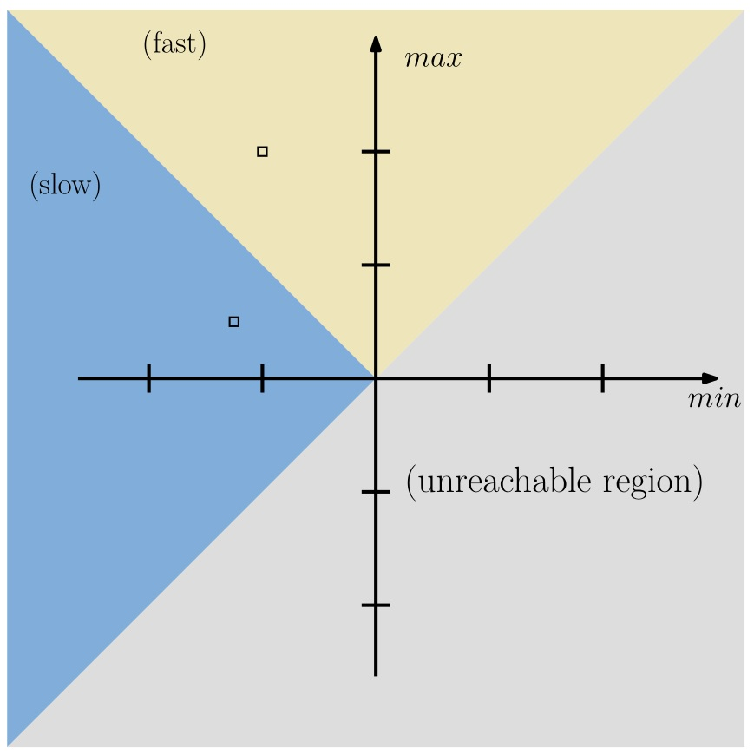
GCS: Naive Averaging Fails
repeat:
1. measure skews
(to neighbors)
2. determine range
3. find midpoint
4. if behind, run faster
(else like HW clock)

Slide 10
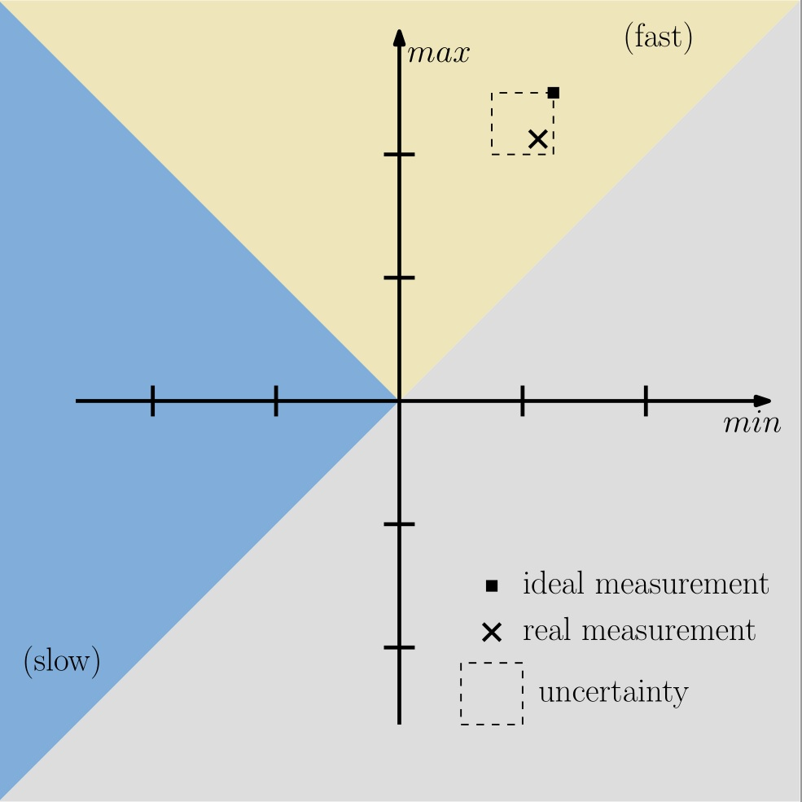
GCS: Naive Averaging Fails
problem:
Measurements
are not perfect!

Slide 11
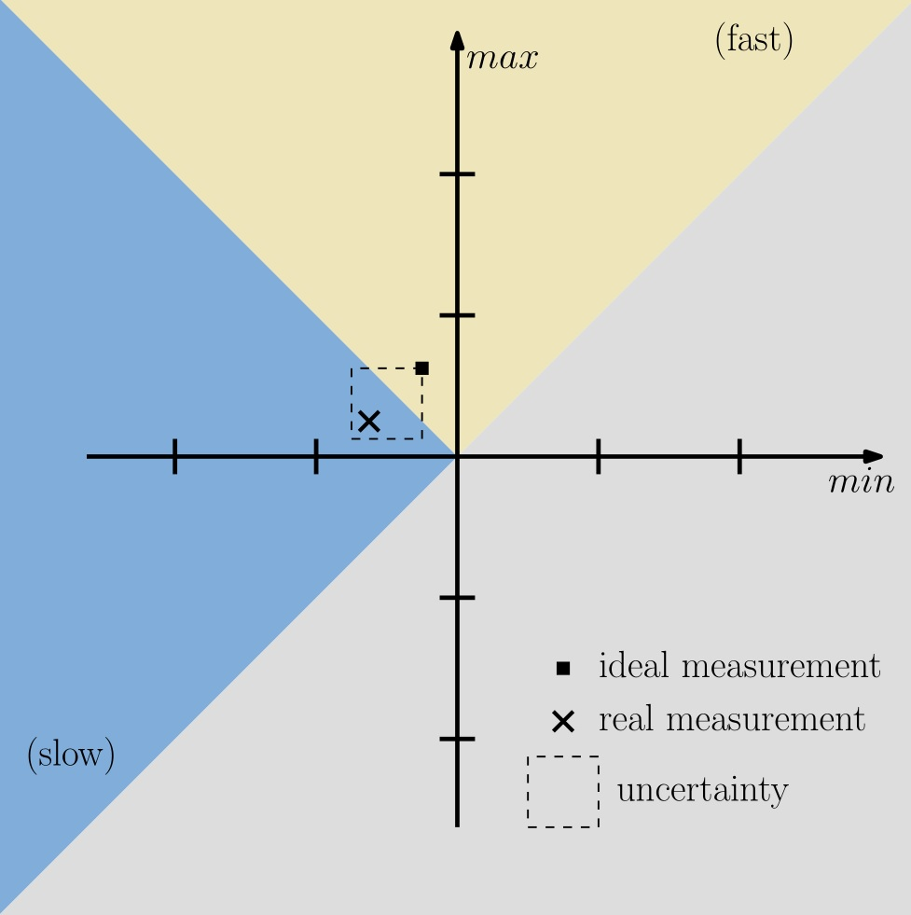
GCS: Naive Averaging Fails
problem:
Measurements
are not perfect!
This blurs the line
between fast and slow.

Slide 12
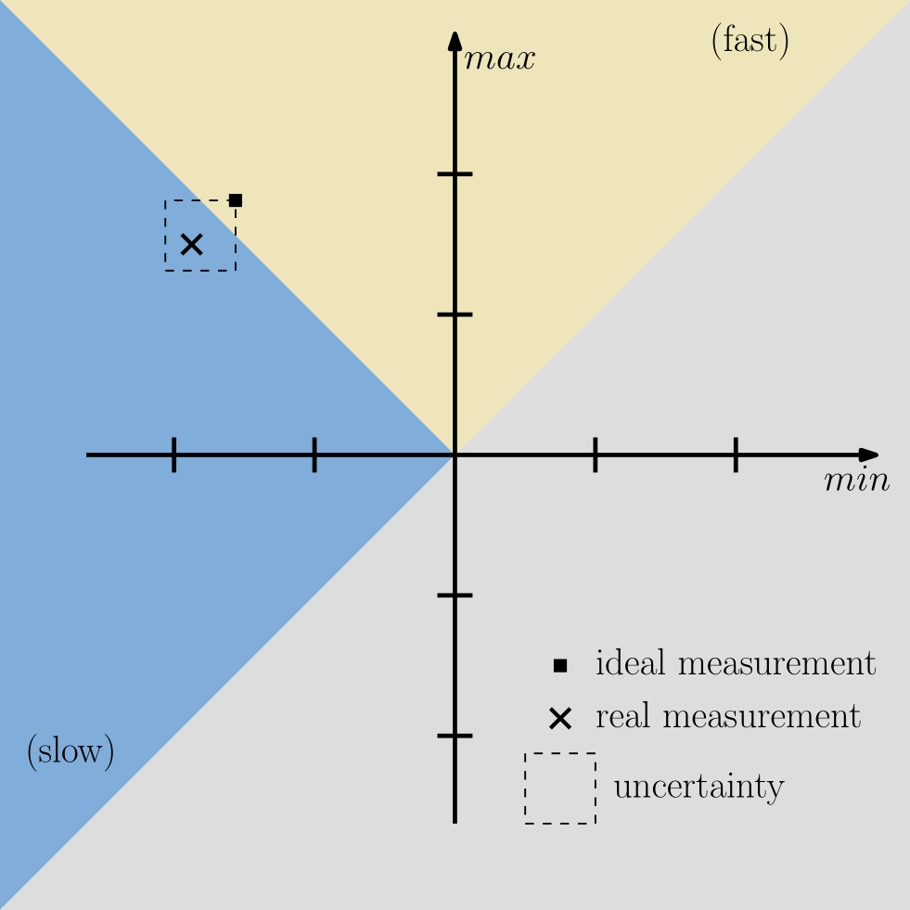
GCS: Naive Averaging Fails
problem:
Measurements
are not perfect!
This blurs the line
between fast and slow.
=> system might not
respond to build-up
of skew!

Slide 13
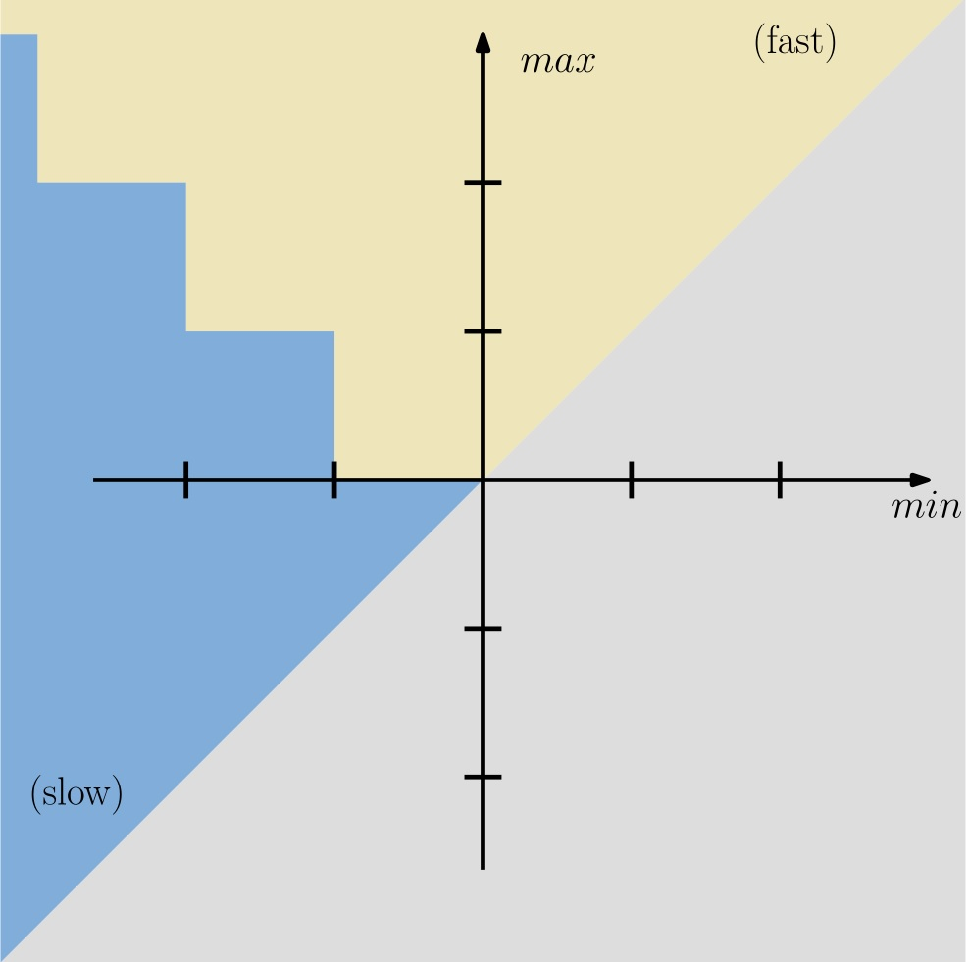
GCS Algorithm
idea:
discretize skews and
round conservatively
=> local & limited
response to skews

Slide 14
GCS Algorithm
aggressive averaging
idea:
discretize skews and
round conservatively
=> local & limited
response to skews

Slide 15
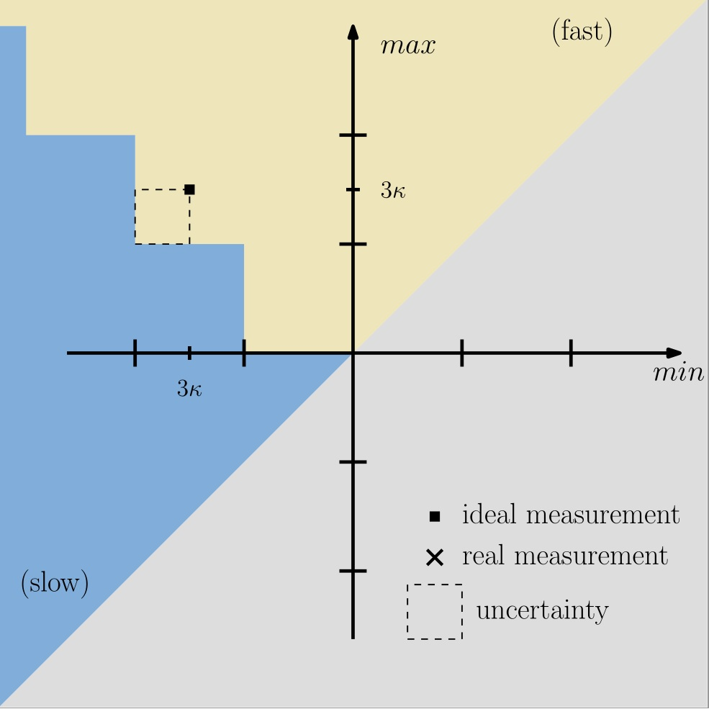
GCS Algorithm
aggressive averaging
idea:
discretize skews and
round conservatively
=> local & limited
response to skews

Slide 16
GCS Algorithm
conservative averaging
idea:
discretize skews and
round conservatively
=> local & limited
response to skews

Slide 17

GCS Algorithm
conservative averaging
idea:
discretize skews and
round conservatively
=> local & limited
response to skews

Slide 18
GCS Algorithm
idea:
discretize skews and
round conservatively
=> local & limited
response to skews
2κ = “height of stairs”
δ = side of square

Slide 19
Computing Clock Estimates
breakout session:
What‘s δ (asymptotically)?

Slide 20

GCS Analysis: Potential Function
Ψ_{v}^{s}(t) = max_{wϵV} {L_{w}(t) – L_{v}(t) – (2s – 1)κ dist(v,w)}
Ψ_{v}^{s}(t)
L_{w}(t)
L_{v}(t)

Slide 21
GCS Analysis: Potential Function
Ψ_{v}^{s}(t) = max_{wϵV} {L_{w}(t) – L_{v}(t) – (2s – 1)κ dist(v,w)}
leading node
Ψ_{v}^{s}(t)
L_{w}(t)
L_{v}(t)

Slide 22
GCS Analysis: Potential Function
Ψ_{v}^{s}(t) = max_{wϵV} {L_{w}(t) – L_{v}(t) – (2s – 1)κ dist(v,w)}
≤ (2s-1)κ
Ψ_{v}^{s}(t)
≥ (2s-1)κ
L_{w}(t)
L_{v}(t)

Slide 23
GCS Analysis: Potential Function
Ψ_{v}^{s}(t) = max_{wϵV} {L_{w}(t) – L_{v}(t) – (2s – 1)κ dist(v,w)}
- estimates are ≤ actual clock values
=> slow mode trigger holds for all leading nodes
≤ (2s-1)κ
Ψ_{v}^{s}(t)
≥ (2s-1)κ
L_{w}(t)
L_{v}(t)

Slide 24
GCS Analysis: Potential Function
Ψ_{v}^{s}(t) = max_{wϵV} {L_{w}(t) – L_{v}(t) – (2s – 1)κ dist(v,w)}
- estimates are ≤ actual clock values
=> slow mode trigger holds for all leading nodes
=> Ψ_{v}^{s}(t‘) ≤ Ψ_{v}^{s}(t) + θ(t‘ – t) – (L_{v}(t‘) – L_{v}(t))
≤ (2s-1)κ
Ψ_{v}^{s}(t)
≥ (2s-1)κ
L_{w}(t)
L_{v}(t)

Slide 25
GCS Analysis: Catching Up
Ψ_{v}^{s}(t) = max_{wϵV} {L_{w}(t) – L_{v}(t) – (2s – 1)κ dist(v,w)}
Ψ^{s}(t) = max_{vϵV} {Ψ_{v}^{s}(t)}
Lemma:
For times
t‘ ≥ t + Ψ^{s-1}(t)/μ
we have
L_{v}(t‘) - L_{v}(t) ≥ t‘ – t + Ψ_{v}^{s}(t).

Slide 26
GCS Analysis: Catching Up
Ψ_{v}^{s}(t) = max_{wϵV} {L_{w}(t) – L_{v}(t) – (2s – 1)κ dist(v,w)}
Ψ^{s}(t) = max_{vϵV} {Ψ_{v}^{s}(t)}
fix t and w that maximizes Ψ_{v}^{s}(t), and set
f_{x}(t‘) = L_{w}(t) + t‘ – t – L_{x}(t‘) – (2s – 2)κ dist(v,w)
f(t‘) = max_{xϵV} {f_{x}(t‘)}
L_{w}(t)
f (t)
L_{x}(t)
trailing node
L_{v}(t)

Slide 27
GCS Analysis: Catching Up
Ψ_{v}^{s}(t) = max_{wϵV} {L_{w}(t) – L_{v}(t) – (2s – 1)κ dist(v,w)}
Ψ^{s}(t) = max_{vϵV} {Ψ_{v}^{s}(t)}
fix t and w that maximizes Ψ_{v}^{s}(t), and set
f_{x}(t‘) = L_{w}(t) + t‘ – t – L_{x}(t‘) – (2s – 2)κ dist(v,w)
f(t‘) = max_{xϵV} {f_{x}(t‘)}
L_{w}(t)
f (t)
L_{x}(t)
L_{v}(t)

Slide 28
GCS Analysis: Catching Up
Ψ_{v}^{s}(t) = max_{wϵV} {L_{w}(t) – L_{v}(t) – (2s – 1)κ dist(v,w)}
Ψ^{s}(t) = max_{vϵV} {Ψ_{v}^{s}(t)}
fix t and w that maximizes Ψ_{v}^{s}(t), and set
f_{x}(t‘) = L_{w}(t) + t‘ – t – L_{x}(t‘) – (2s – 2)κ dist(v,w)
f(t‘) = max_{xϵV} {f_{x}(t‘)}
Ψ_{v}^{s}(t) ≤ f_{v}(t)
L_{w}(t)
f (t)
L_{x}(t)
L_{v}(t)

Slide 29
GCS Analysis: Catching Up
Ψ_{v}^{s}(t) = max_{wϵV} {L_{w}(t) – L_{v}(t) – (2s – 1)κ dist(v,w)}
Ψ^{s}(t) = max_{vϵV} {Ψ_{v}^{s}(t)}
fix t and w that maximizes Ψ_{v}^{s}(t), and set
f_{x}(t‘) = L_{w}(t) + t‘ – t – L_{x}(t‘) – (2s – 2)κ dist(v,w)
f(t‘) = max_{xϵV} {f_{x}(t‘)}
Ψ_{v}^{s}(t) ≤ f_{v}(t)
f(t‘) ≤ 0 => f_{v}(t‘) ≤ 0
=> L_{v}(t‘) – L_{v}(t) =
t‘ – t + f_{v}(t) ≥
t‘ – t + Ψ_{v}^{s}(t)
L_{w}(t)
f (t)
L_{x}(t)
L_{v}(t)

Slide 30
GCS Analysis: Catching Up
f_{x}(t‘) = L_{w}(t) + t‘ – t – L_{x}(t‘) – (2s – 2)κ dist(v,w)
f(t‘) = max_{xϵV} {f_{x}(t‘)}
sufficient to show:
t‘ ≥ t + Ψ^{s-1}(t)/μ
=> f(t‘) ≤ 0
L_{x}(t’)
f (t’)

Slide 31
GCS Analysis: Catching Up
f_{x}(t‘) = L_{w}(t) + t‘ – t – L_{x}(t‘) – (2s – 2)κ dist(v,w)
f(t‘) = max_{xϵV} {f_{x}(t‘)}
sufficient to show:
t‘ ≥ t + Ψ^{s-1}(t)/μ
=> f(t‘) ≤ 0
≤ (2s-2)κ
≥ (2s-2)κ
L_{x}(t’)
f (t’)

Slide 32
GCS Analysis: Catching Up
f_{x}(t‘) = L_{w}(t) + t‘ – t – L_{x}(t‘) – (2s – 2)κ dist(v,w)
f(t‘) = max_{xϵV} {f_{x}(t‘)}
sufficient to show:
t‘ ≥ t + Ψ^{s-1}(t)/μ
=> f(t‘) ≤ 0
≤ (2s-2)κ
≥ (2s-2)κ
L_{x}(t’)
f (t’)

Slide 33
GCS Analysis: Catching Up
f_{x}(t‘) = L_{w}(t) + t‘ – t – L_{x}(t‘) – (2s – 2)κ dist(v,w)
f(t‘) = max_{xϵV} {f_{x}(t‘)}
sufficient to show:
t‘ ≥ t + Ψ^{s-1}(t)/μ
=> f(t‘) ≤ 0
f(t) = max_{xϵV} {f_{x}(t)}
≤ max_{xϵV} {L_{w}(t) – L_{x}(t)
– (2s – 3)κ dist(x,w)}
≤ Ψ^{s-1}(t)
≤ (2s-2)κ
≥ (2s-2)κ
L_{x}(t’)
f (t’)

Slide 34
GCS Analysis: Catching Up
Ψ_{v}^{s}(t) = max_{wϵV} {L_{w}(t) – L_{v}(t) – (2s – 1)κ dist(v,w)}
Ψ^{s}(t) = max_{vϵV} {Ψ_{v}^{s}(t)}
Lemma:
For times
t‘ ≥ t + Ψ^{s-1}(t)/μ
we have
L_{v}(t‘) - L_{v}(t) ≥ t‘ – t + Ψ_{v}^{s}(t).

Slide 35
GCS Analysis: Local Skew Bound
Ψ_{v}^{s}(t) = max_{wϵV} {L_{w}(t) – L_{v}(t) – (2s – 1)κ dist(v,w)}
Ψ^{s}(t) = max_{vϵV} {Ψ_{v}^{s}(t)}
Lemma:
For times
t‘ ≥ t + Ψ^{s-1}(t)/μ
we have
L_{v}(t‘) - L_{v}(t) ≥ t‘ – t + Ψ_{v}^{s}(t).
Theorem:
Let G upper bound the global skew and Ψ¹(0) = 0. Then
Ψ^{s}(t) ≤ G/σ^{s-1}.

Slide 36
GCS Analysis: Proof of Local Skew Bound
Ψ¹(t) ≤ G(t) ≤ G = G/σ⁰

Slide 37
GCS Analysis: Proof of Local Skew Bound
Ψ¹(t) ≤ G(t) ≤ G = G/σ⁰
Recall:
Ψ_{v}^{s}(t‘) ≤ Ψ_{v}^{s}(t) + θ(t‘ – t) – (L_{v}(t‘) – L_{v}(t))

Slide 38
GCS Analysis: Proof of Local Skew Bound
Ψ¹(t) ≤ G(t) ≤ G = G/σ⁰
Recall:
Ψ_{v}^{s}(t‘) ≤ Ψ_{v}^{s}(t) + θ(t‘ – t) – (L_{v}(t‘) – L_{v}(t))
for t‘ ≤ G/(μσ^{s-1}):
Ψ_{v}^{s}(t‘) ≤ Ψ^{s}(0) + θ t‘ – (L_{v}(t‘) – L_{v}(0)) ≤ (θ – 1)t‘ ≤ G/σ^{s}

Slide 39
GCS Analysis: Proof of Local Skew Bound
Ψ¹(t) ≤ G(t) ≤ G = G/σ⁰
Recall:
Ψ_{v}^{s}(t‘) ≤ Ψ_{v}^{s}(t) + θ(t‘ – t) – (L_{v}(t‘) – L_{v}(t))
for t‘ ≤ G/(μσ^{s-1}):
Ψ_{v}^{s}(t‘) ≤ Ψ^{s}(0) + θ t‘ – (L_{v}(t‘) – L_{v}(0)) ≤ (θ – 1)t‘ ≤ G/σ^{s}
for t‘ > G/(μσ^{s-1}) set t = t‘ – G/(μσ^{s-1}) ≤ t‘ – Ψ^{s-1}(t)/μ

Slide 40
GCS Analysis: Proof of Local Skew Bound
Ψ¹(t) ≤ G(t) ≤ G = G/σ⁰
Recall:
Ψ_{v}^{s}(t‘) ≤ Ψ_{v}^{s}(t) + θ(t‘ – t) – (L_{v}(t‘) – L_{v}(t))
for t‘ ≤ G/(μσ^{s-2}):
Ψ_{v}^{s}(t‘) ≤ Ψ^{s}(0) + θ t‘ – (L_{v}(t‘) – L_{v}(0)) ≤ (θ – 1)t‘ ≤ G/σ^{s}
for t‘ > G/(μσ^{s-2}) set t = t‘– G/(μσ^{s-2}) ≤ t‘ – Ψ^{s-1}(t)/μ; thus
Ψ_{v}^{s}(t‘) ≤ Ψ_{v}^{s}(t) + θ(t‘ – t) – (L_{v}(t‘) – L_{v}(t))
≤ Ψ_{v}^{s}(t) + θ(t‘ – t) – (t‘ – t + Ψ_{v}^{s}(t))
= (θ – 1)(t‘ – t) = G/σ^{s-1}

Slide 41
GCS Analysis: Skew Bounds
Theorem:
Let G upper bound the global skew and Ψ¹(0) = 0. Then
Ψ^{s}(t) ≤ G/σ^{s-1}.

Slide 42
GCS Analysis: Skew Bounds
Theorem:
Let G upper bound the global skew and Ψ¹(0) = 0. Then
Ψ^{s}(t) ≤ G/σ^{s-1}.
=> L_{v}(t) – L_{w}(t) – (2log_{σ}(G/κ) – 1)κ dist(v,w) ≤ κ

Slide 43
GCS Analysis: Skew Bounds
Theorem:
Let G upper bound the global skew and Ψ¹(0) = 0. Then
Ψ^{s}(t) ≤ G/σ^{s-1}.
=> L_{v}(t) – L_{w}(t) – (2log_{σ}(G/κ) – 1)κ dist(v,w) ≤ κ
=> for {v,w} ϵ E: |L_{v}(t) – L_{w}(t)| ≤ 2κ (log_{σ}(G/κ) + 1)

Slide 44
GCS Analysis: Skew Bounds
Theorem:
Let G upper bound the global skew and Ψ¹(0) = 0. Then
Ψ^{s}(t) ≤ G/σ^{s-1}.
=> L_{v}(t) – L_{w}(t) – (2log_{σ}(G/κ) – 1)κ dist(v,w) ≤ κ
=> for {v,w} ϵ E: |L_{v}(t) – L_{w}(t)| ≤ 2κ (log_{σ}(G/κ) + 1)
Theorem:
If Ψ¹(0) = 0, then G ≤ σκD/(σ – 1) = (1 + 1/(σ –1))κD.

Slide 45
GCS Analysis: Skew Bounds
Theorem:
Let G upper bound the global skew and Ψ¹(0) = 0. Then
Ψ^{s}(t) ≤ G/σ^{s-1}.
=> L_{v}(t) – L_{w}(t) – (2log_{σ}(G/κ) – 1)κ dist(v,w) ≤ κ
=> for {v,w} ϵ E: |L_{v}(t) – L_{w}(t)| ≤ 2κ (log_{σ}(G/κ) + 1)
Theorem:
If Ψ¹(0) = 0, then G ≤ σκD/(σ – 1) = (1 + 1/(σ –1))κD.
for t‘ just after skew G has been exceeded:
Ψ_{v}¹(t‘) ≤ (θ – 1)(t‘ – max{0, t’ – G/μ}) ≤ G/σ ≤ κD/(σ – 1)

Slide 46
GCS Analysis: Skew Bounds
Theorem:
Let G upper bound the global skew and Ψ¹(0) = 0. Then
Ψ^{s}(t) ≤ G/σ^{s-1}.
=> L_{v}(t) – L_{w}(t) – (2log_{σ}(G/κ) – 1)κ dist(v,w) ≤ κ
=> for {v,w} ϵ E: |L_{v}(t) – L_{w}(t)| ≤ 2κ (log_{σ}(G/κ) + 1)
Theorem:
If Ψ¹(0) = 0, then G ≤ σκD/(σ – 1) = (1 + 1/(σ –1))κD.
for t‘ just after skew G has been exceeded:
Ψ_{v}¹(t‘) ≤ (θ – 1)(t‘ – max{0, t’ – G/μ}) ≤ G/σ ≤ κD/(σ – 1)
=> L_{v}(t’) – L_{w}(t’) – κD ≤ Ψ_{v}¹(t‘) ≤ κD/(σ – 1)

