Slide 1
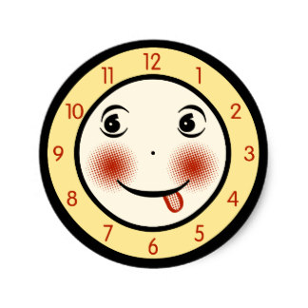
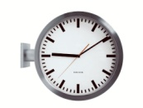
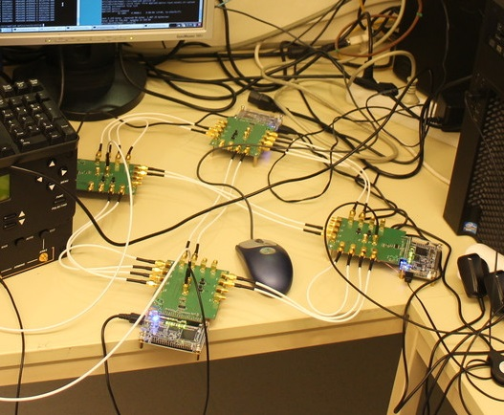
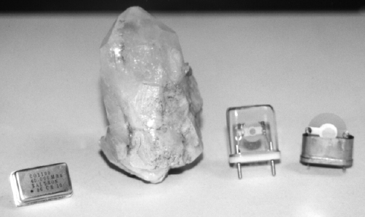
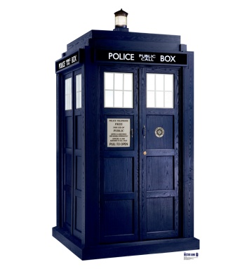
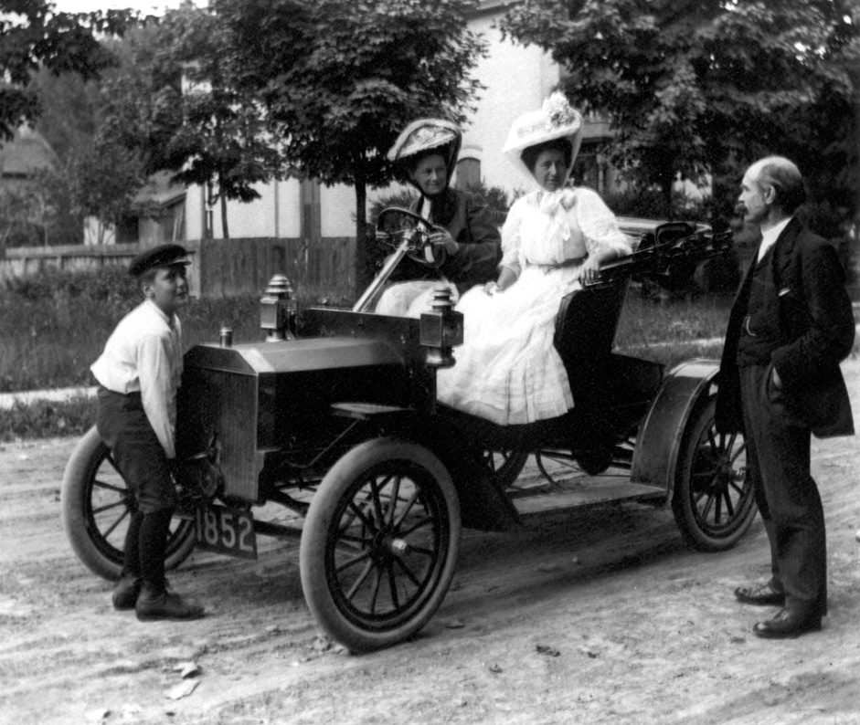
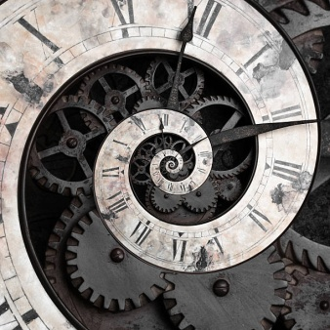
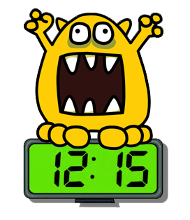
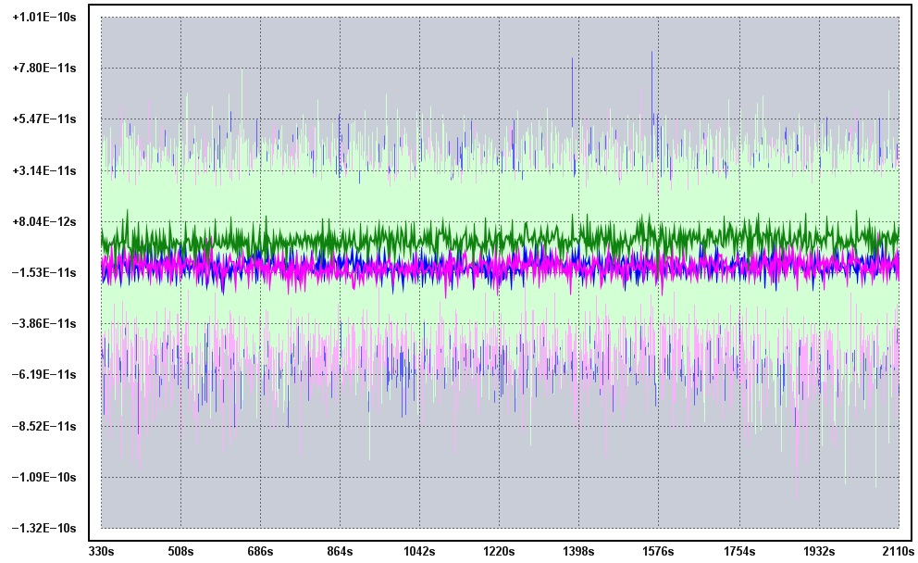
How to Clock Your Computer
Christoph Lenzen – MPI for Informatics
...or: What happens if you ask theoretical computer scientists about this and they do not abstract away the real-world challenges?
also starring: Moti Medina, Andreas Steininger, Danny Dolev, Ian Jones, Matthias Fuegger, Milos Krstic (and possibly Will Rosenbaum)

Slide 2
Today’s Menu
Why does this course exist?
2. What is this course about?
3. Who are you and what do you want?
- discussion in small groups
- sharing your findings with everyone
4. How will we run this course?
- your questions and input on this
5. Heads-up: What comes next?

Slide 3
Today’s Menu
Why does this course exist?
2. What is this course about?
3. Who are you and what do you want?
- discussion in small groups
- sharing your findings with everyone
4. How will we run this course?
- your questions and input on this
5. Heads-up: What comes next?

Slide 4
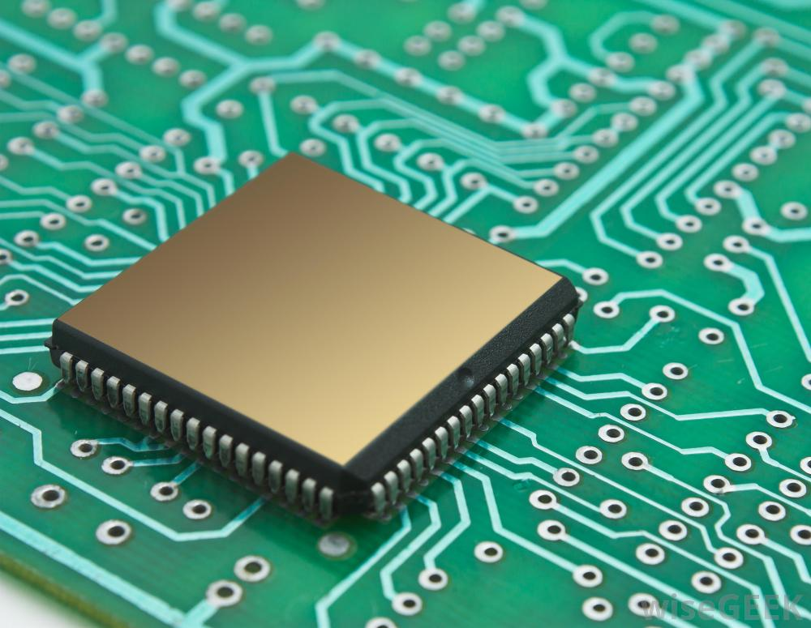
Chips are Distributed Systems
very large (> 10¹⁰ transistors)
-> fault-tolerance mandatory
very fast (> 10⁹ cycles/s)
-> communication “slow”
- highly concurrent/parallel
-> synchronous operation
We should treat them
as distributed systems!

Slide 5
Chips are Distributed Systems
very large (> 10¹⁰ transistors)
-> fault-tolerance mandatory
very fast (> 10⁹ cycles/s)
-> communication “slow”
- highly concurrent/parallel
-> synchronous operation
Fault-tolerant High-Precision
Clock Synchronization!

Slide 6
Clocking VLSI Circuits
cycle r−1
cycle r
cycle r+1
cycle r+2
store compute

Slide 7
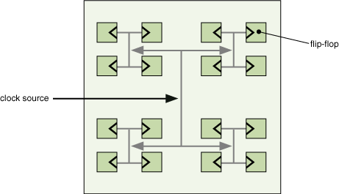
Clock Trees
clocked element
(e.g. register)
*disclaimer: real
product may not
actually be a tree
Distribute clock signal from single source!
+ very simple
+ recovers from any transient faults
+ ca. 20 ps = 2*10⁻¹¹ s precision (single chip)

Slide 8
Clock Trees: Scalability Issues
clock tree is single point of failure
-> components must be extremely reliable
tree dist./physical dist. = Ω(L) (L side length of chip)
-> max. difference of arrival times between adjacent gates grows linearly with L
-> clock frequency goes down with chip size

Slide 9
Clock Trees: Scalability Issues
clock tree is single point of failure
-> components must be extremely reliable
tree dist./physical dist. = Ω(L) (L side length of chip)
-> max. difference of arrival times between adjacent gates grows linearly with L
-> clock frequency goes down with chip size
countermeasure: use higher voltage and wider wires
-> electro-magnetic interference causes trouble and
strong currents induce large power consumption

Slide 10
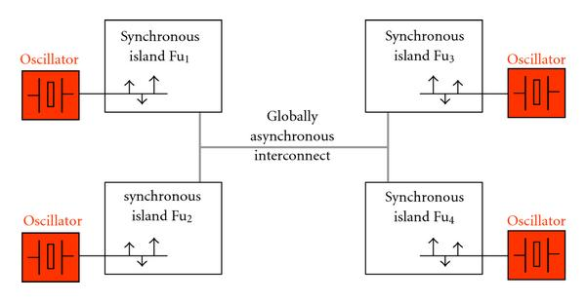
GALS: Globally Async., Locally Sync.
GALS: multiple separately clocked subsystems communicate asynchronously
+ removes some clock tree scalability issues
- asynchronous communication risks metastability
-> use of synchronizers, several clock cycles latency

Slide 11
What happens if we do
Computer Science
to it?

Slide 12
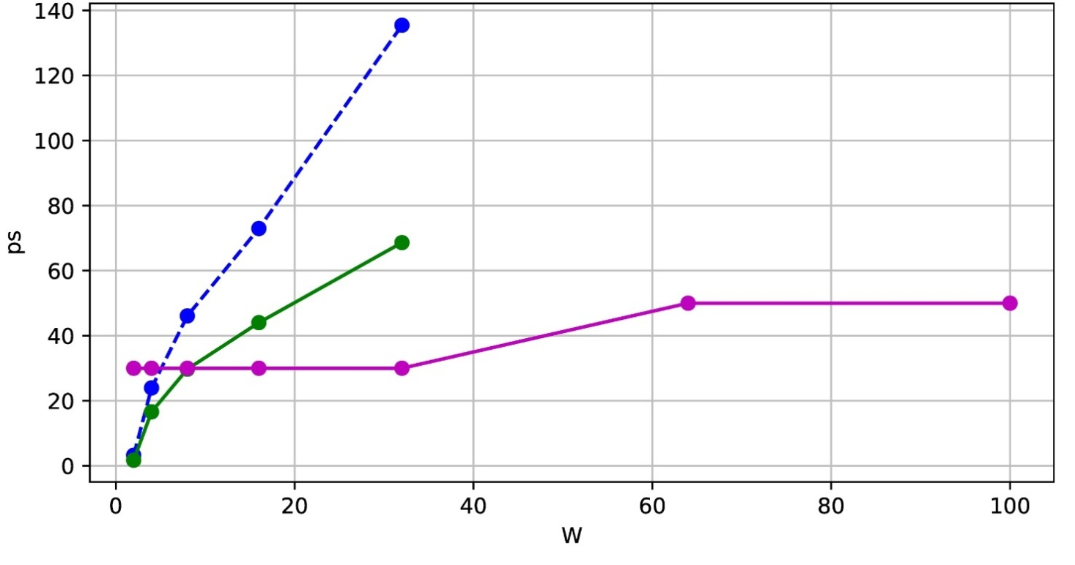
Scalable Clocking: Gradient Clock Sync
clock tree
clock tree
+ optimism
GCS
(worst-case
bound)
Synchronize along data flow!
=> bound skew between communicating components

Slide 13
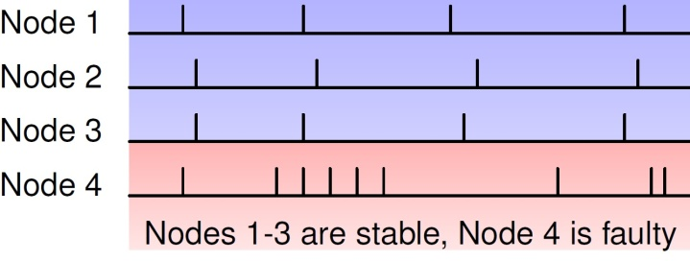
Fault-Tolerance
direction of
propagation
redundancy enables tolerating (worst-case!) faults
low-degree distribution networks needed

Slide 14
Innocent “Theory” Assumption
time
time difference can be
turned into a discrete number

Slide 15
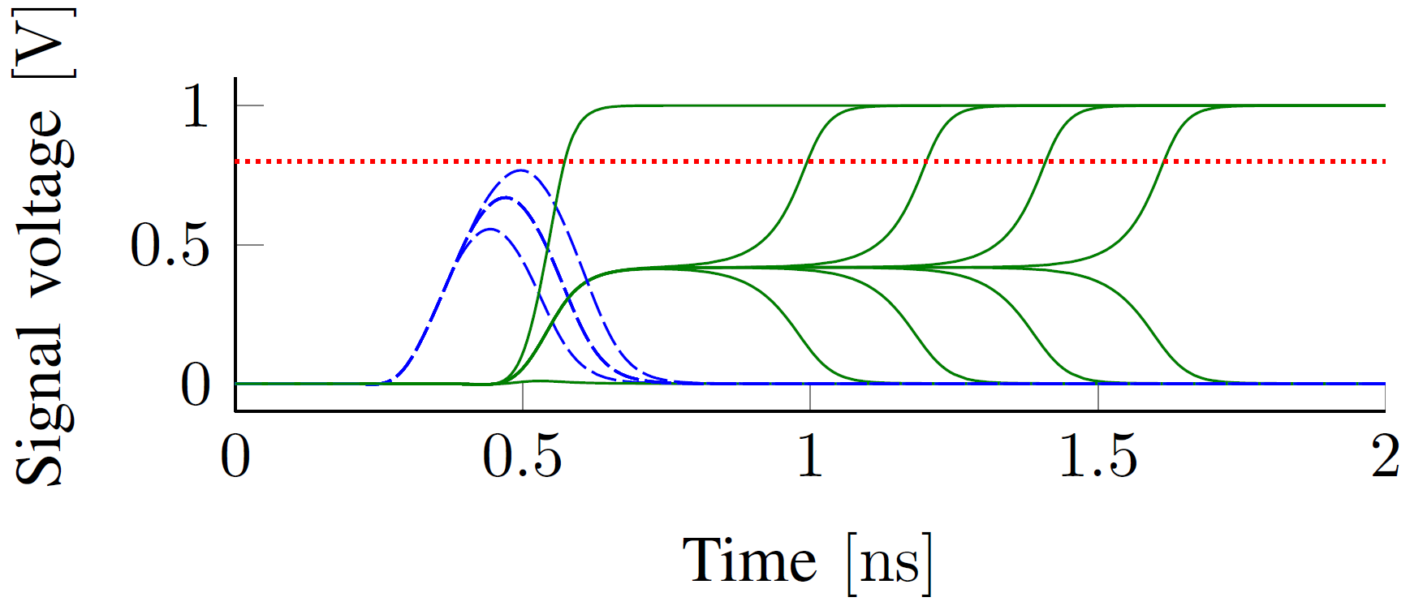
Metastability

Slide 16
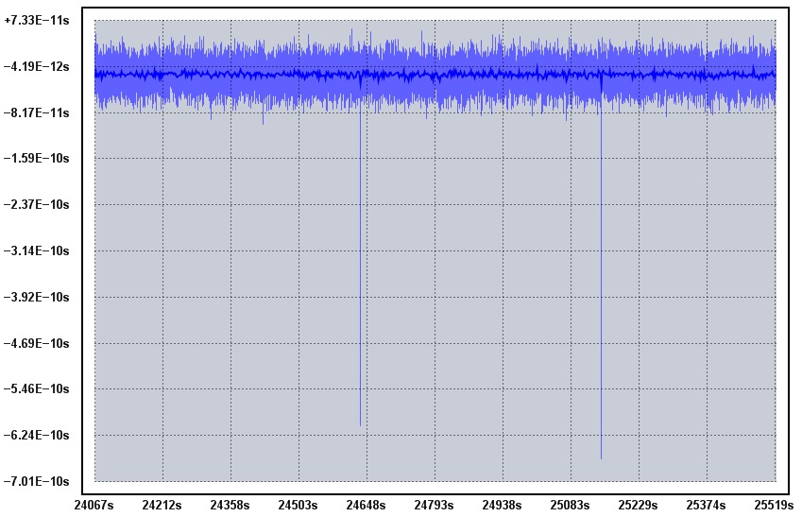
Metastability is Rare...
measurement
equipment
metastable
...unless your system runs at GHz speeds!

Slide 17
A “CS” Approach to Metastability
AND_{M} | 0 | 1 | M
0 | 0 | 0 | 0
1 | 0 | 1 | M
M | 0 | M | M
AND | 0 | 1
0 | 0 | 0
1 | 0 | 1
What can be computed “with” metastable inputs?
What is the complexity of such circuits?
Can we avoid synchronizers (and their latency)?

Slide 18
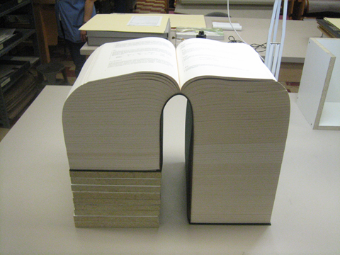
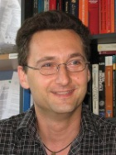
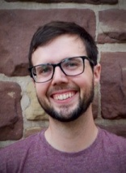
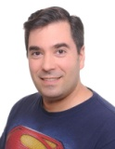
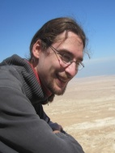
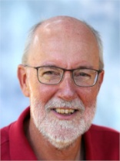
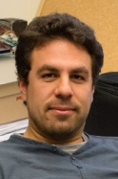
This, and more...
...is to become a book!

Slide 19
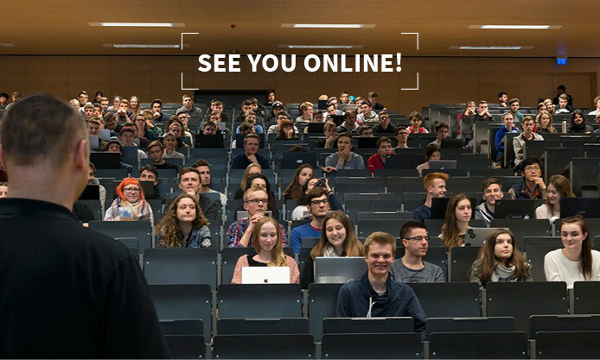
Treats
We intend to treat you to the
first ≈ 33.33% of its contents!

Slide 20
Today’s Menu
1. Why does this course exist?
2. What is this course about?
3. Who are you and what do you want?
- discussion in small groups
- sharing your findings with everyone
4. How will we run this course?
- your questions and input on this
5. Heads-up: What comes next?

Slide 21
Outlook
this course: clocking in the past & future from 40’s to 40’s
summer 2021: fault-tolerant clocking Byzantine faults & self-stabilization
winter 2021/22: handling metastability going beyond synchronizers

Slide 22
Outlook
this course: clocking in the past & future from 40’s to 40’s
summer 2021: fault-tolerant clocking Byzantine faults & self-stabilization
winter 2021/22: handling metastability going beyond synchronizers

Slide 23
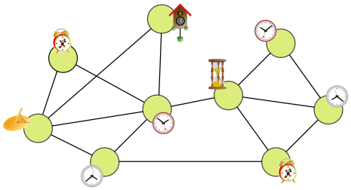
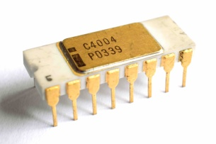
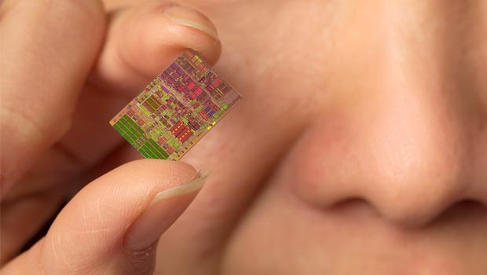
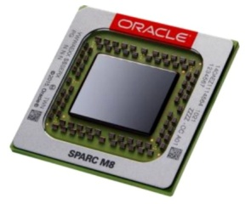
Warning: Contents May Advance Quickly
lectures | content | complexity
2-3 | overview | high-level fun
Ian Jones, Christoph Lenzen, and Andreas Steininger
1970
2000
2017
2030?

Slide 24
Warning: Contents May Advance Quickly
lectures | content | complexity
2-3 | overview | high-level fun
4-8 | clock trees (single clock island) | simple & small systems (≈1970)

Slide 25
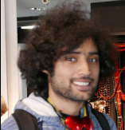
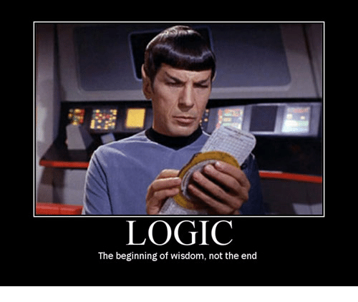
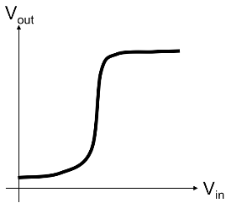
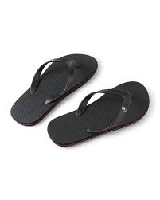
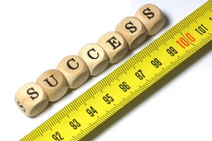
Crash Course on Digital Logic Design
“Logic is the beginning of wisdom...not the end” [Spock]
The digital abstraction and building block of circuits?
Circuits are mathematical objects with a strict math. Def.!
Basic memory cells AKA flip-flops
circuits + clock ≈ laptop’s CPU
what is a good circuit?
...and much more!
Don’t worry: examples will accompany us in this journey
Moti Medina and Shreyas Srinivas
Notes:
Shreyas Srinivas

Slide 26
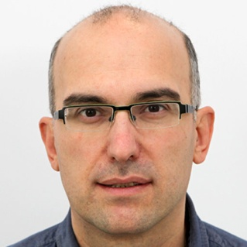
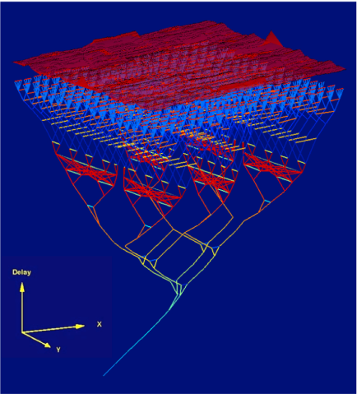
Clock Trees
What: Matthias Függer ? & Milos Krstic
- “good” clock distribution needed for efficient systems
- small skew (a.k.a. phase difference) => high frequencies
We will learn:
- how to translate a state machine into a circuit + timing constraints
- how to balance a clock tree
- how to determine feasible
clock frequency

Slide 27
Warning: Contents May Advance Quickly
lectures | content | complexity
2-3 | overview | high-level fun
4-8 | clock trees (single clock island) | simple & small systems (≈1970)
9-10 | Phase-Locked Loops (single clock island, but multiple frequency domains) | state-of-the-art systems (≈2000)

Slide 28
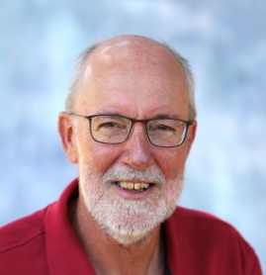
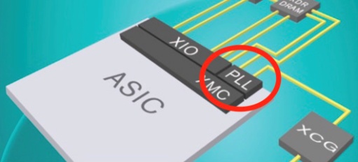
Phase Locked Loops
What: Ian W. Jones & Felipe Kuentzer
- PLL circuits are the gold standard for on-chip clocks
- they generate very stable high frequency clocks
We will learn:
- the basics of PLL designs – how and why they work so well
Future challenges:
- slow to respond computing demand changes
- large power-hungry modules

Slide 29
Warning: Contents May Advance Quickly
lectures | content | complexity
2-3 | overview | high-level fun
4-8 | clock trees (single clock island) | simple & small systems (≈1970)
9-10 | Phase-Locked Loops (single clock island, but multiple frequency domains) | state-of-the-art systems (≈2000)
11-14 | Globally Async. Locally Sync. (unsynchronized clock islands) | cutting edge systems (≈2017)

Slide 30
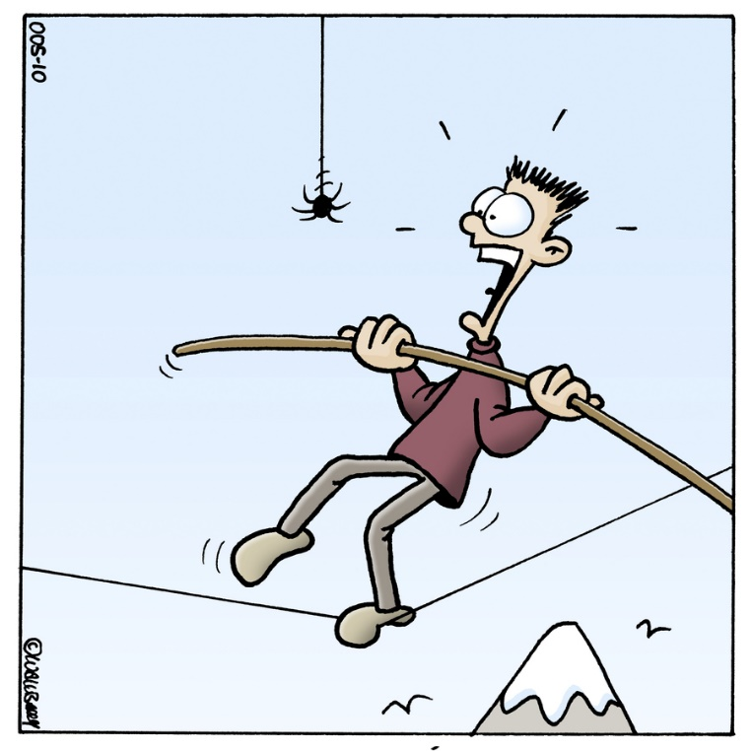
Andreas Steininger & Matthias Függer ?
Metastability
is a real cause of errors in digital circuits
causes out-of-spec operation strange effects
happens sporadically hard to track
is an issue at
every clock domain crossing
every interface
you will learn about
its nature, causes and effects in digital circuits
the calculation of its probability
mitigation techniques (synchronizers, handshakes,…)
©Toonpool.com

Slide 31
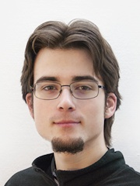
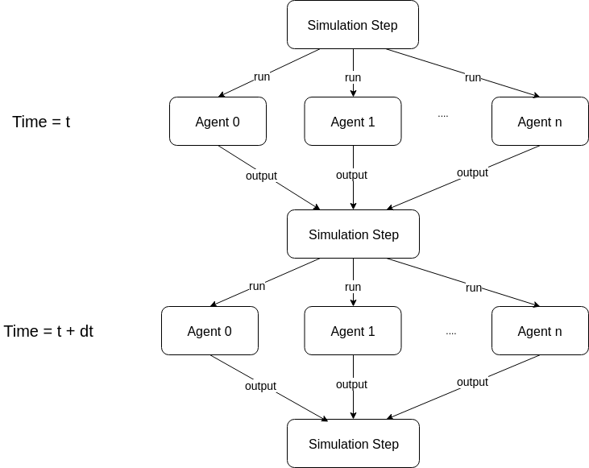
Network
Synchronizers
What... Christoph Lenzen ? & Ben Wiederhake
...if maintaing precise timing is just too hard?
We will learn:
- synchronous & asynchronous message passing models
- how to simulate synchrony in an asynchronous setting
- how to translate this into circuits
=> no need for single clock tree!

Slide 32
Warning: Contents May Advance Quickly
lectures | content | complexity
2-3 | overview | high-level fun
4-8 | clock trees (single clock island) | simple & small systems (≈1970)
9-10 | Phase-Locked Loops (single clock island, but multiple frequency domains) | state-of-the-art systems (≈2000)
11-14 | Globally Async. Locally Sync. (unsynchronized clock islands) | cutting edge systems (≈2017)
15-21 | Gradient Clock Synchronization (synchronized clock islands) | possible future systems (2030?)

Slide 33
Clock Synchronization
in Networks
What: Danny Dolev & Ian Jones
- synchronize clocks arranged in an (arbitrary) network
- hope for better scalability by using small, local clock trees
We will learn:
- simple algorithm achieves skew O(D) (D = network diam.)
- how to implement such an algorithm
- can‘t do better in the worst case
=> not better than clock trees?

Slide 34
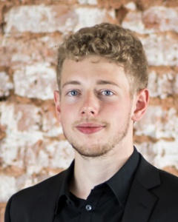
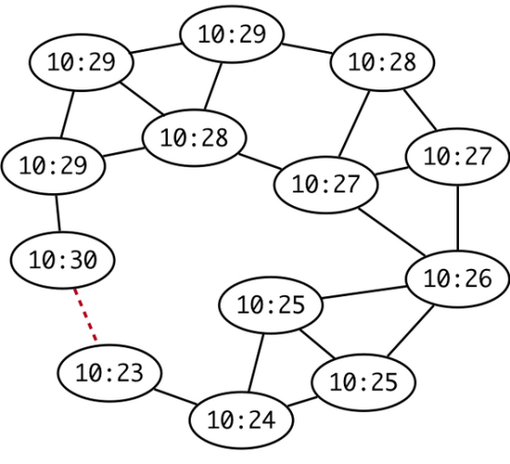
Gradient Clock
Synchronization
What: Christoph Lenzen & Johannes Bund
- study local skew: skew between adjacent clock domains
- this is what matters: distant domains hardly communicate
We will learn:
- simple algorithm achieves skew O(log D)
- how to implement the algorithm
- can‘t do better in the worst case...
...but clock trees can‘t achieve this at all
=> could be used to clock huge systems!

Slide 35
Today’s Menu
1. Why does this course exist?
2. What is this course about?
3. Who are you and what do you want?
- discussion in small groups
- sharing your findings with everyone
4. How will we run this course?
- your questions and input on this
5. Heads-up: What comes next?

Slide 36
Now
- ca. 10 minutes in small groups:
+ chat about what you expect and would like to get out of this course
+ implicit soundcheck for everyone
- ca. 20 minutes with everyone:
+ introduce yourself
+ share your ideas and expectations
+ questions & discussion

Slide 37
Now
discussion in breakout rooms until 11.30

Slide 38
Today’s Menu
1. Why does this course exist?
2. What is this course about?
3. Who are you and what do you want?
- discussion in small groups
- sharing your findings with everyone
4. How will we run this course?
- your questions and input on this
5. Heads-up: What comes next?

Slide 39
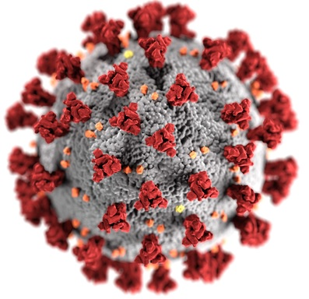
Our Expectations
+
matt.might.net/articles/phd-school-in-pictures/
+
=

Slide 40
Our Expectations of You
For each topic (i.e., between 2 and 4 lectures), study the reading assignment.
Write a short summary of the topic, including your thoughts and questions. 25% grade contribution
Attend* the sessions:
+ brief intro/overview by the lecturer
+ discuss and/or exercise in small groups
+ present results and discuss with everyone
+ 25% grade contribution from participation
After the lecture period is over, write a report on one of the topics. 50% grade contribution
*Recordings! Contact us in case of privacy concerns!

Slide 41
Questions?

Slide 42
Today’s Menu
1. Why does this course exist?
2. What is this course about?
3. Who are you and what do you want?
- discussion in small groups
- sharing your findings with everyone
4. How will we run this course?
- your questions and input on this
5. Heads-up: What comes next?

Slide 43
Thursday & Monday: Roadmap Spotlights
: poses increasingly difficult challenges
+
: collaborate to sketch solutions

Slide 44
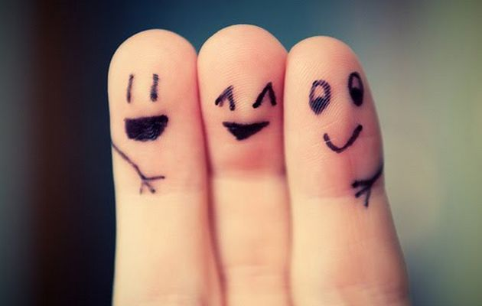
See You on Thursday!
Bring a friend!

