Slide 1
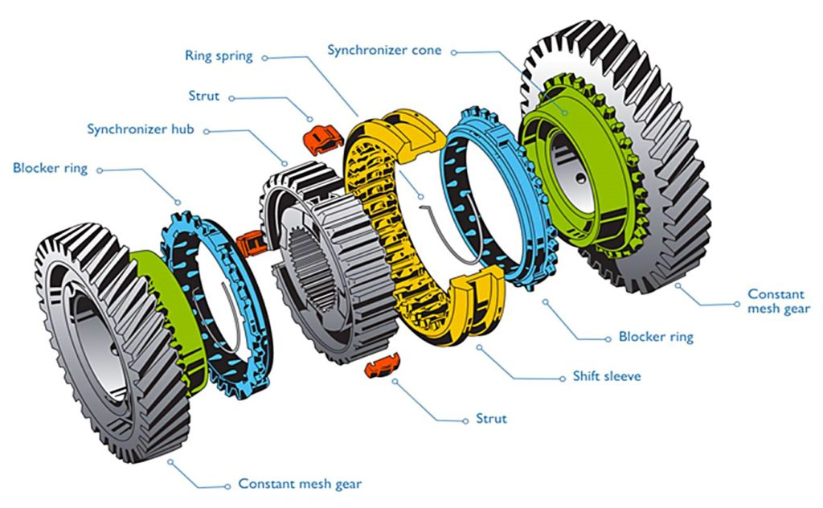
Simulating Synchronous Systems
...or: Synchronizers, the other Kind

Slide 2
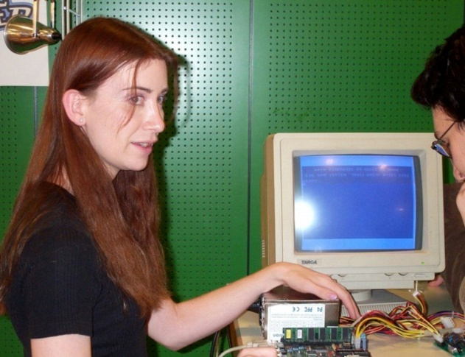
Some Oversimplified History
How to
Jeri – hardware developer
?
Bill – system architect

Slide 3
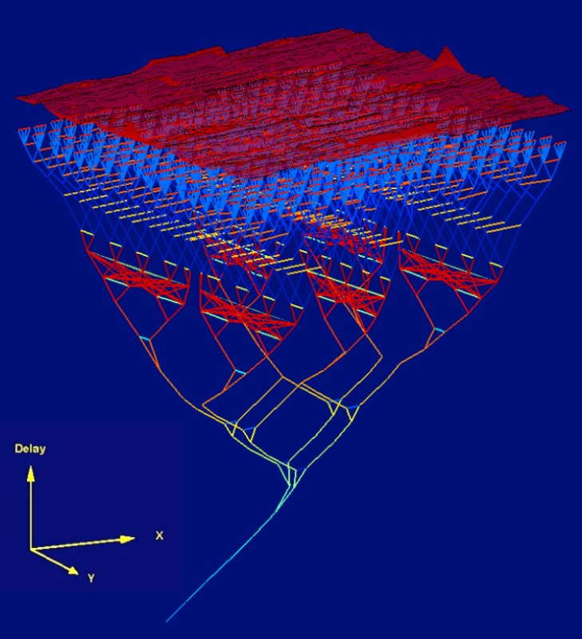
The Way Things Used to Be
Jeri – hardware developer
Bill – system architect

Slide 4
The Way Things Used to Be
Jeri – hardware developer
Bill – system architect

Slide 5
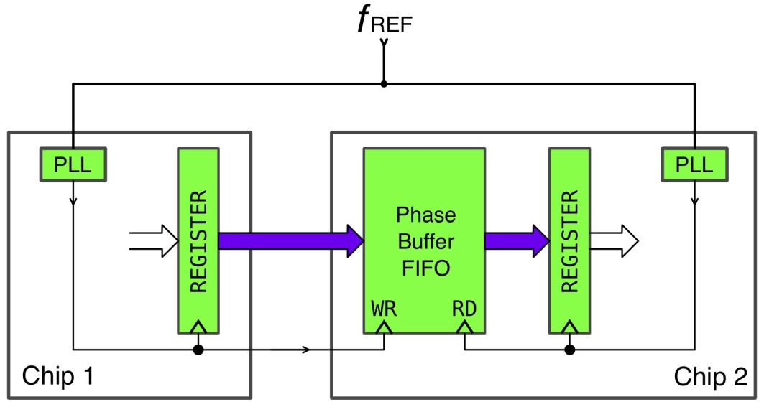
How Things Were Later
Jeri – hardware developer
Bill – system architect

Slide 6
How Things Were Later
Jeri – hardware developer
Bill – system architect

Slide 7
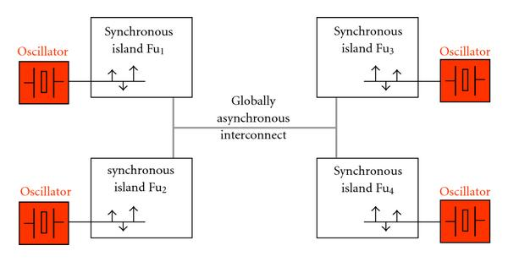
How Things Are Now
Jeri – hardware developer
+
Bill – system architect

Slide 8
Why Bill is Sad: Asynchrony
:
Message delivery is safe, but timing is not!
=> phase shifts cause non-deterministic executions!

Slide 9
Asynchrony is Bothersome
Example: constructing a BFS tree
1. Synchronous version:

Slide 10
Asynchrony is Bothersome
Example: constructing a BFS tree
1. Synchronous version:

Slide 11
Asynchrony is Bothersome
Example: constructing a BFS tree
1. Synchronous version:

Slide 12
Asynchrony is Bothersome
Example: constructing a BFS tree
1. Synchronous version:

Slide 13
Asynchrony is Bothersome
Example: constructing a BFS tree
2. Asynchronous version:

Slide 14
Asynchrony is Bothersome
Example: constructing a BFS tree
2. Asynchronous version:

Slide 15
Asynchrony is Bothersome
Example: constructing a BFS tree
2. Asynchronous version:

Slide 16
Asynchrony is Bothersome
Example: constructing a BFS tree
2. Asynchronous version:

Slide 17
Asynchrony is Bothersome
Example: constructing a BFS tree
2. Asynchronous version:

Slide 18
Asynchrony is Bothersome
Example: constructing a BFS tree
2. Asynchronous version:

Slide 19
Asynchrony is Bothersome
Example: constructing a BFS tree
2. Asynchronous version:

Slide 20
Asynchrony is Bothersome
Example: constructing a BFS tree
3. Asynchronous version (fixed, sort of):
0

Slide 21
Asynchrony is Bothersome
Example: constructing a BFS tree
3. Asynchronous version (fixed, sort of):
0
1

Slide 22
Asynchrony is Bothersome
Example: constructing a BFS tree
3. Asynchronous version (fixed, sort of):
1
0
1
2

Slide 23
Asynchrony is Bothersome
Example: constructing a BFS tree
3. Asynchronous version (fixed, sort of):
1
0
2
3
1
2

Slide 24
Asynchrony is Bothersome
Example: constructing a BFS tree
3. Asynchronous version (fixed, sort of):
1
4
0
2
3
1
2

Slide 25
Asynchrony is Bothersome
Example: constructing a BFS tree
3. Asynchronous version (fixed, sort of):
1
2
0
2
3
1
2

Slide 26
Asynchrony is Bothersome
Example: constructing a BFS tree
3. Asynchronous version (fixed, sort of):
1
2
What‘s the issue?
0
2
3
1
2

Slide 27
Why Bill is Sad: Asynchrony
...causes a range of problems:
- algorithms become (more) involved
=> design & implementation is (more) error-prone
- algorithms might become less efficient
- deciding when a task is complete might be difficult
- non-deterministic execution complicates testing and verification

Slide 28
Making Bill Happy: Synchronous Execution
Synchronous Message Passing (SMP):
In each round, each FSM in the network
1. updates its state and computes outoing messages,
2. sends these messages to its neighboring FSMs, and
3. receives the messages from its neighbors.
This eliminates all the listed problems!

Slide 29
How is this Different?
Where before we “saw” a single FSM, we now “see” a network of FSMs. We could still view the network as a single FSM updating a state vector of individual states and messages.
major advantages:
better modularization & mapping to clock domains

Slide 30
Example: Synchronous Restart
Special node receives START signal in unknown round, all nodes ought to RESTART in the same round shortly after that. Topology:
Exercise: design FSM for SMP algorithm:
- initial states s_{v,0} from (shared) state space S
- use “empty” 1-bit messages (i.e, Σ₀ = { ,1})
- Γ = Ω = {0,1} (whether to START resp. RESTART)
- locally count down while information propagates
- specify functions for state updates, messages sent, and when to RESTART
I
ͱ

