Slide 1
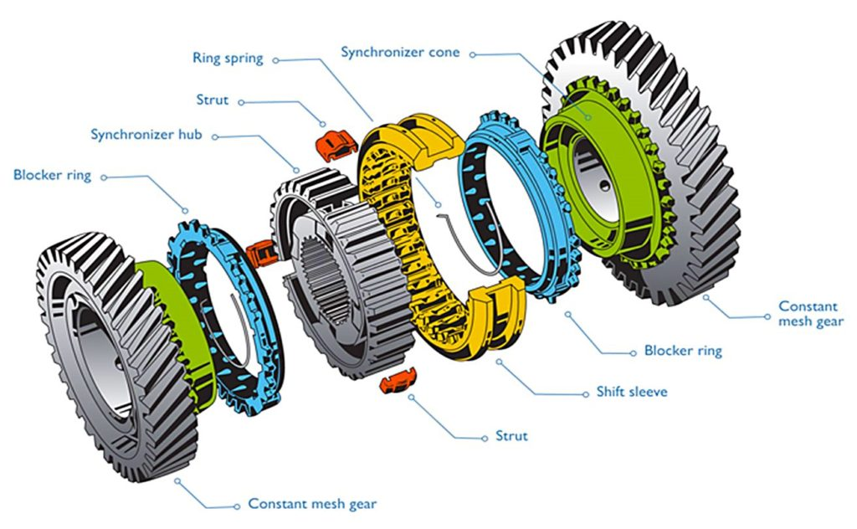
Simulating Synchronous Systems
...or: Synchronizers, the other Kind

Slide 2
Why Bill is Sad: Asynchrony
...causes a range of problems:
- algorithms become (more) involved
=> design & implementation is (more) error-prone
- algorithms might become less efficient
- deciding when a task is complete might be difficult
- non-deterministic execution complicates testing and verification

Slide 3
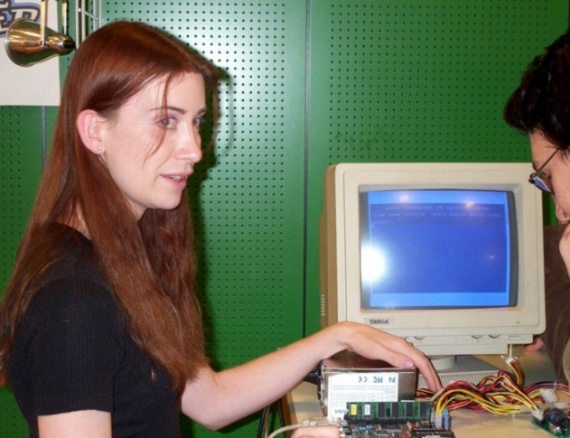
Making Bill Happy: Synchronous Execution
Synchronous Message Passing (SMP):
In each round, each FSM in the network
1. updates its state and computes outoing messages,
2. sends these messages to its neighboring FSMs, and
3. receives the messages from its neighbors.
...but: guaranteeing timing is too hard/inefficient!

Slide 4
How to Keep both Jeri and Bill Happy?
- do not try to guarantee timing
- but do guarantee the same behavior
=> simulate synchronous execution in an asynchronous system!
in other words: we‘ll fly a rocket without having one

Slide 5
What We Have and What We Want
Have:
- each network node has local FSM
- step triggered by event at some node: initialization, receiving some message, or receiving local input
- upon event: update state, send messages to neighbors, and generate local output
Want:
- each network node has local FSM
- execution in rounds: in each round, all nodes
+ update state, send messages, generate output
+ receive all neighbors‘ messages

Slide 6
Abstract Algorithm
“Simulate round i“ := update state, send messages (including “empty” ones!) labelled by round, compute local output
On initialization, simulate round 1.
Store all received messages and inputs, labeled by round and sender (i.e., corresponding port).
Once all round i-1 messages and input for round i are stored, simulate round i.
=> if round i is simulated, all computations etc. are correct if they were in round i-1
=> correctness follows by induction on rounds

Slide 7
Let’s be more Specific
Given: FSM of synchronous algorithm
- state space S
- initial state s_{v,0}
- message set Σ₀
- local input symbols Γ
- local output symbols Ω
- state transition function t: S x Σ₀^{deg(v)} x Γ → S
- output function o: S x Σ₀^{deg(v)} x Γ → Σ₀^{deg(v)} x Ω
Exercise: Specify the FSM of the simulation algorithm!

Slide 8
Let’s be even more Specific
Recall the synchronous restart problem:
Special node receives START signal in unknown round, all nodes ought to RESTART in the same round shortly after that. Topology:
Can you come up with a circuit implementation of the simulating algorithm?
- Σ₀ = Γ = Ω = {0,1} for simulated algorithm
- (re)use (sub)circuits of synchronous algorithm

Slide 9
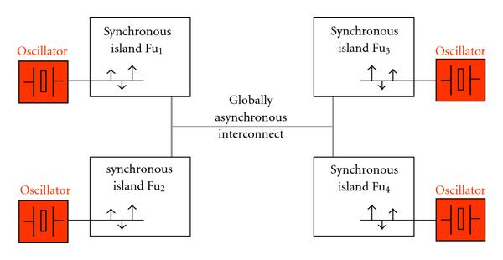
The Big Picture
We can clock a GALS system, enable safe communication, and simulate synchronous behavior to its users!
Why isn‘t it perfect?
- several clock cycles of communication latency
- bad if this dominates latency due to computation

