Slide 1
Spectral graph reduction for image and streaming video segmentation
Fabio Galasso¹ Margret Keuper² Thomas Brox² Bernt Schiele¹
¹ Max Planck Institute for Informatics
² University of Freiburg

Slide 2
Motivation
Image segmentation with graphs
Superpixel grouping ( prior / external information )
Smaller graph size
Reduce runtime
Reduce memory load
Image
Pixels
Pixel graph
Superpixel graph
Superpixels

Slide 3
Motivation
Image segmentation with graphs
Superpixel grouping ( prior / external information )
Smaller graph size
Reduce runtime
Reduce memory load
Image
Pixel graph
Superpixel graph

Slide 4
Motivation
Image segmentation with graphs
Why solutions will differ
superpixels may violate the true object boundaries
superpixels have different sizes
alter the balance, e.g. denominator in normalized cut
Spectral graph reduction
Preserve same solutions (equivalent graph reduction)
Image
Pixel graph
Superpixel graph

Slide 5
Motivation
Video segmentation with graphs
Superpixels
Higher-order graph ( edges connect multiple pixels )
Alter the balance ( different sizes )
Spectral graph reduction
Re-balance with higher-order models
Video
Superpixels
Superpixel graph

Slide 6
Motivation
Video segmentation with graphs
Higher-order features and performance
Video
Superpixels
Superpixel graph
Larger superpixel graph
Larger superpixels

Slide 7
Outline
Related work
Spectral graph reduction
Applications

Slide 8
Outline
Related work
Spectral graph reduction
Applications

Slide 9
Related work
Use of prior information
Biased and constrained spectral clustering [Maji et al. CVPR’11] [Eriksson et al. ICCV’07] [Yu and Shi NIPS’01]
this work : Constraints and efficiency
Efficiency
Representative points [Yan et al., KDD’09] [Chen and Cai, AAAI’11]
Sampled data points [Fowlkes et al., TPAMI’04]
this work: Grouping and equivalence
Equivalent graph reduction
(Normalized) Cut preservation [Rangapuram and Hein, AISTATS’12][Taylor CVPR’13]
this work:
Extension to spectral clustering
Re-balance with higher-order models

Slide 10
Outline
Related work
Spectral graph reduction
Applications

Slide 11
Outline
Related work
Spectral graph reduction
Equivalent graph reduction
( Re-balance with higher-order models )
Applications

Slide 12
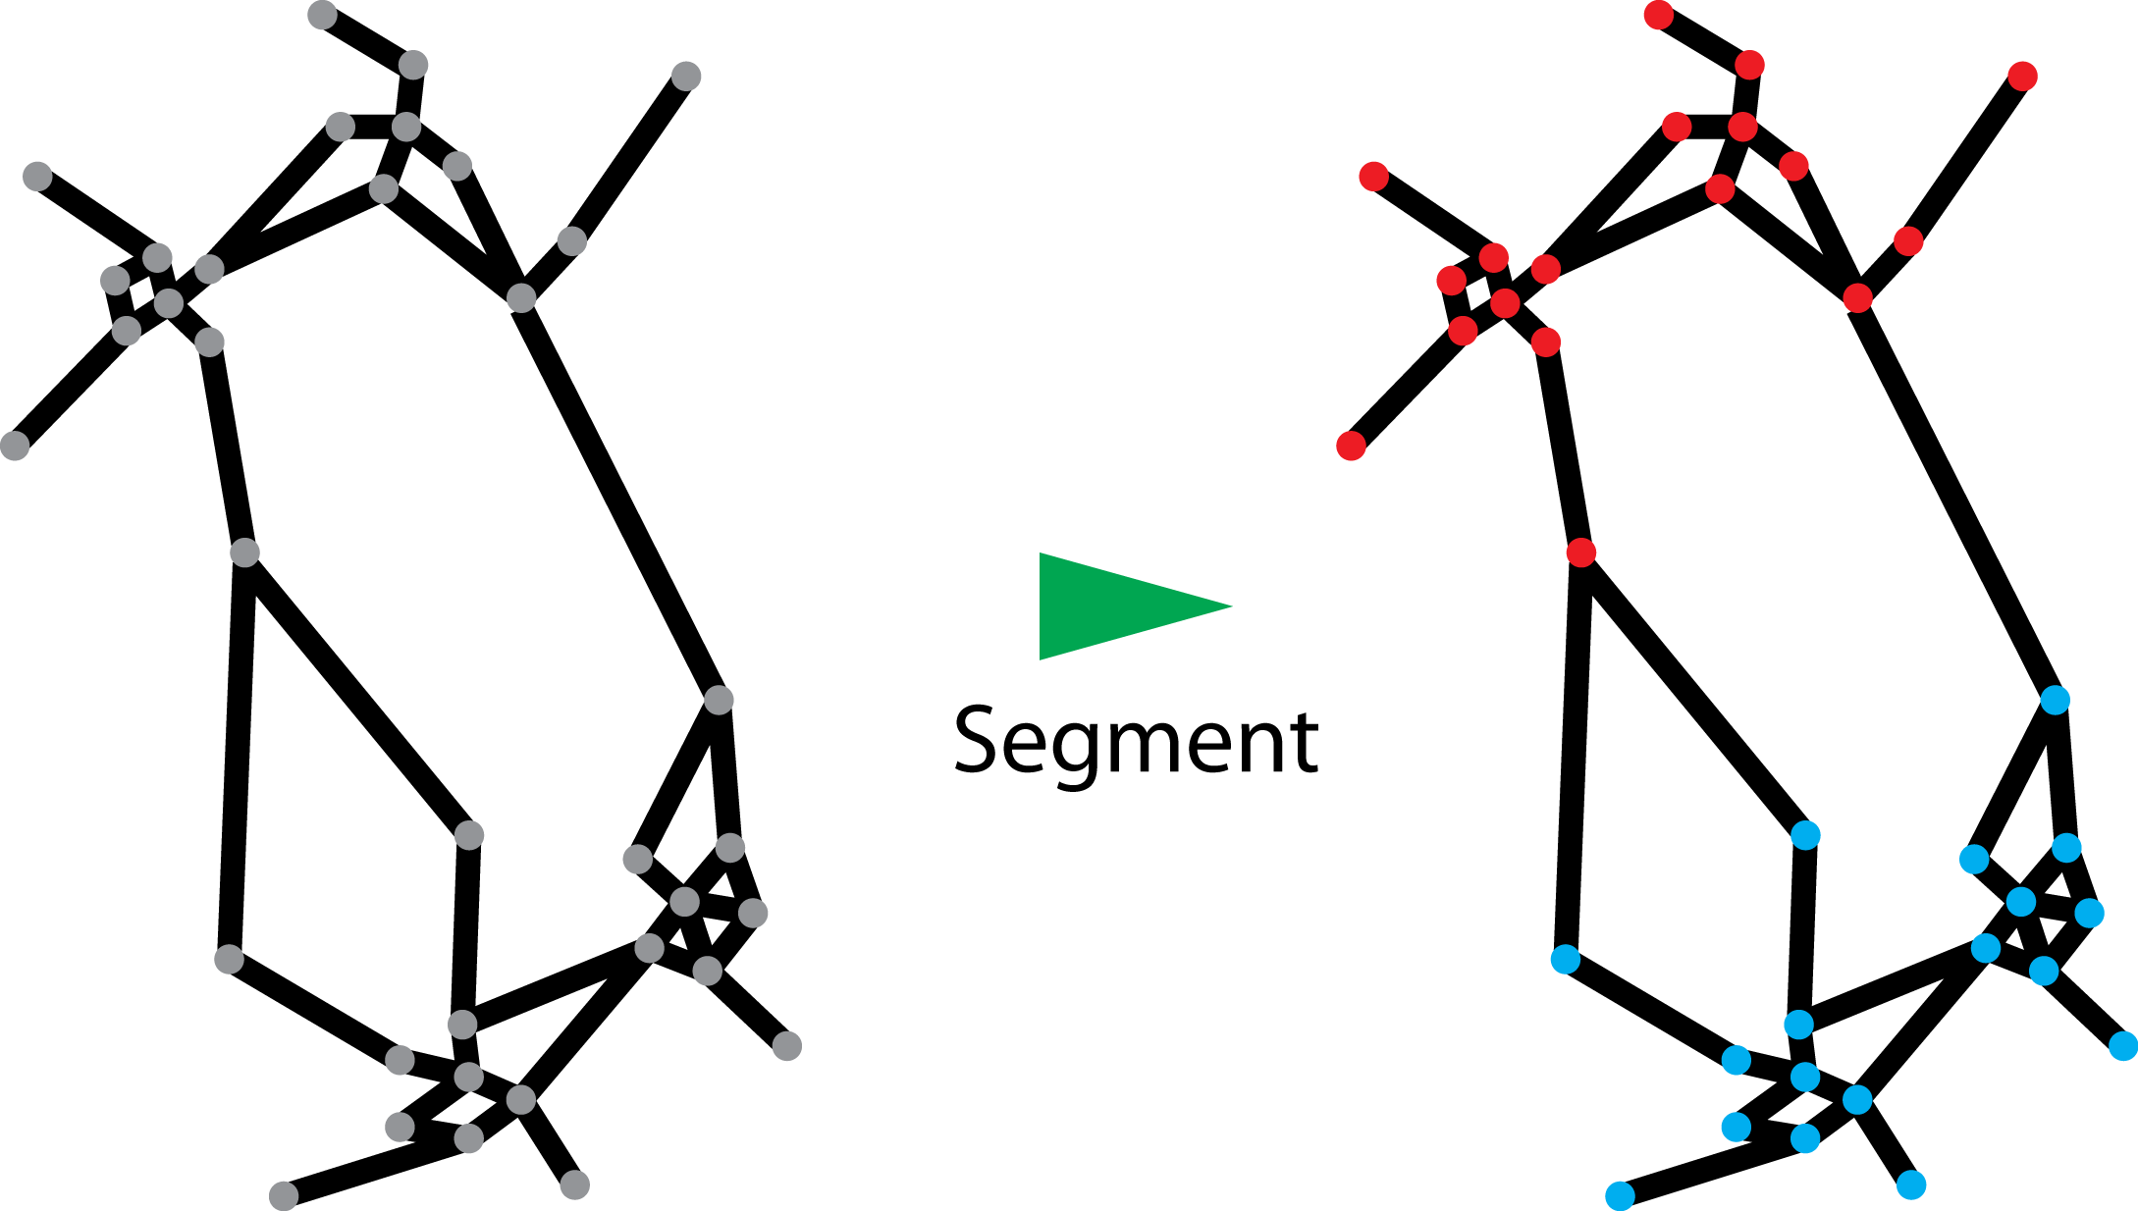
Segmentation
Cast as graph partitioning
Graph to represent image / video
Task: complete disjoint subgraphs
… label each node
Clustering algorithms
Normalized cut
Tight approximation [Bühler and Hein, ICML’09, NIPS’10]
Spectral clustering
State-of-the-art segmentation performance [Brox and Malik, ECCV’10] [Maire and Yu, ICCV’13] [Arbelaez et al. CVPR’14]
Provide balanced clusters

Slide 13
Segmentation

Slide 14
Proposed pipeline
Prior information (aka must-link constraints)
Main contribution: equivalent graph reduction (same solutions)
Normalized cut (NCut)
Spectral clustering (SC)

Slide 15
Proposed pipeline

Slide 16
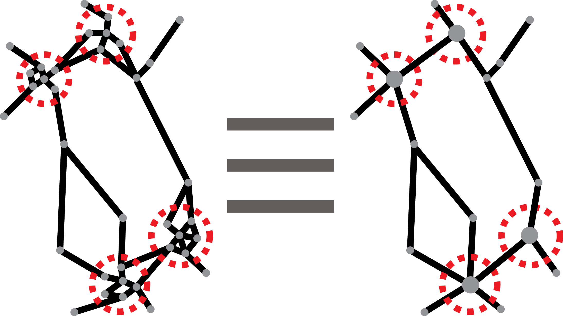
Equivalent graph reduction
Transform the graph
Groupings new nodes
Update weights
Prove NCut equivalence for [Rangapuram and Hein, EISTAT’12]
Prove SC equivalence for
provided clique-affinities
else Density Normalized Cut

Slide 17
Outline
Related work
Spectral graph reduction
Applications

Slide 18
Outline
Related work
Spectral graph reduction
Applications
Image segmentation
Video segmentation
Streaming video segmentation

Slide 19
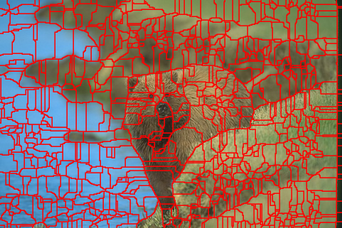
Application to image segmentation
gPb-owt-ucm [Arbelaez et al. TPAMI ’11]
Spectral Pb
Per-pixel affinity matrix
Computational bottleneck
Pre-group superpixels
Equivalent graph reduction
Same performance
2x runtime reduction
2x memory load reduction

Slide 20
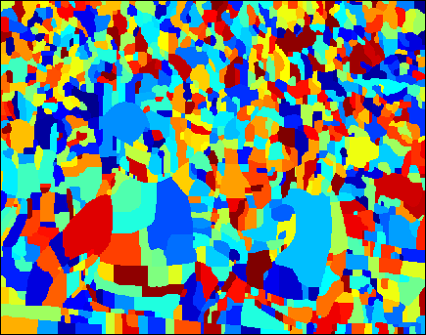
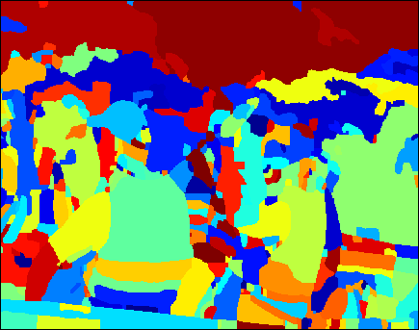
Application to video segmentation
Video segmentation algorithm [Galasso et al. ACCV’12]
Superpixels Graph Segmentation
We propose larger superpixels (SPX Lev.2)
Larger image patches
Higher-order features
Alter the balance
Re-balance with higher-order models
NCut
SC
SPX
SPX Lev.2

Slide 21
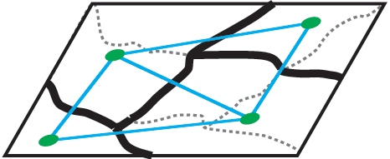
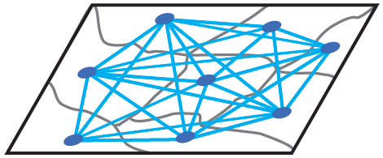
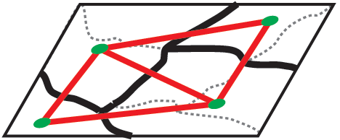
Application to video segmentation
Re-balance with higher-order models
SPX Lev.2 graph as higher-order term
Clique expansion to graph of SPX
Spectral reduction to graph of SPX Lev. 2
Direct re-balance
Preserve NCut
Preserve spectral clustering

Slide 22
Application to video segmentation
VSB100 [Galasso et al. ICCV’13]
Unified benchmark for video segmentation
100 HD videos
4 sets of human annotations
Metrics
Boundary precision-recall
Volume precision-recall (temporal consistency)
Notes:
Large enough
Heterogeneity:
natural images and animations
appearance, motion, object number and size
Multiple human GT’s at sparse frames
Address intrinsic segmentation “scale” ambiguity
Allows for temporal consistency
Desired:
Multiple GT’s
No degenerate cases
Coarse-to-fine and working regimes
Temporal consistency
Cast boundary detection as classification
Address temporal consistency
Classify optimally-assigned pixels
Normalized with theoretical lower-bound
Complementarity
Analysis: human, image and video segmentation, oracle
New features
Multiple human annotations
No degenerate cases
Working regimes
Leverage multiple human annotations
Consider hierarchical segmentations
Address degenerate segmentations
Address temporal consistency (VPR)
Similarly to boundary maps in Bpr, segments s from the machine segmentation regions S and segments g from the ground truth regions G are optimally assigned and the problem is then cast as classifying correctly segmented from wrongly segmented pixels, addressed in the precision-recall framework.
Angkorwat 126
Birds of paradise 122
Beachvolleyball 161
Buck 128
Rockclimbing 143

Slide 23
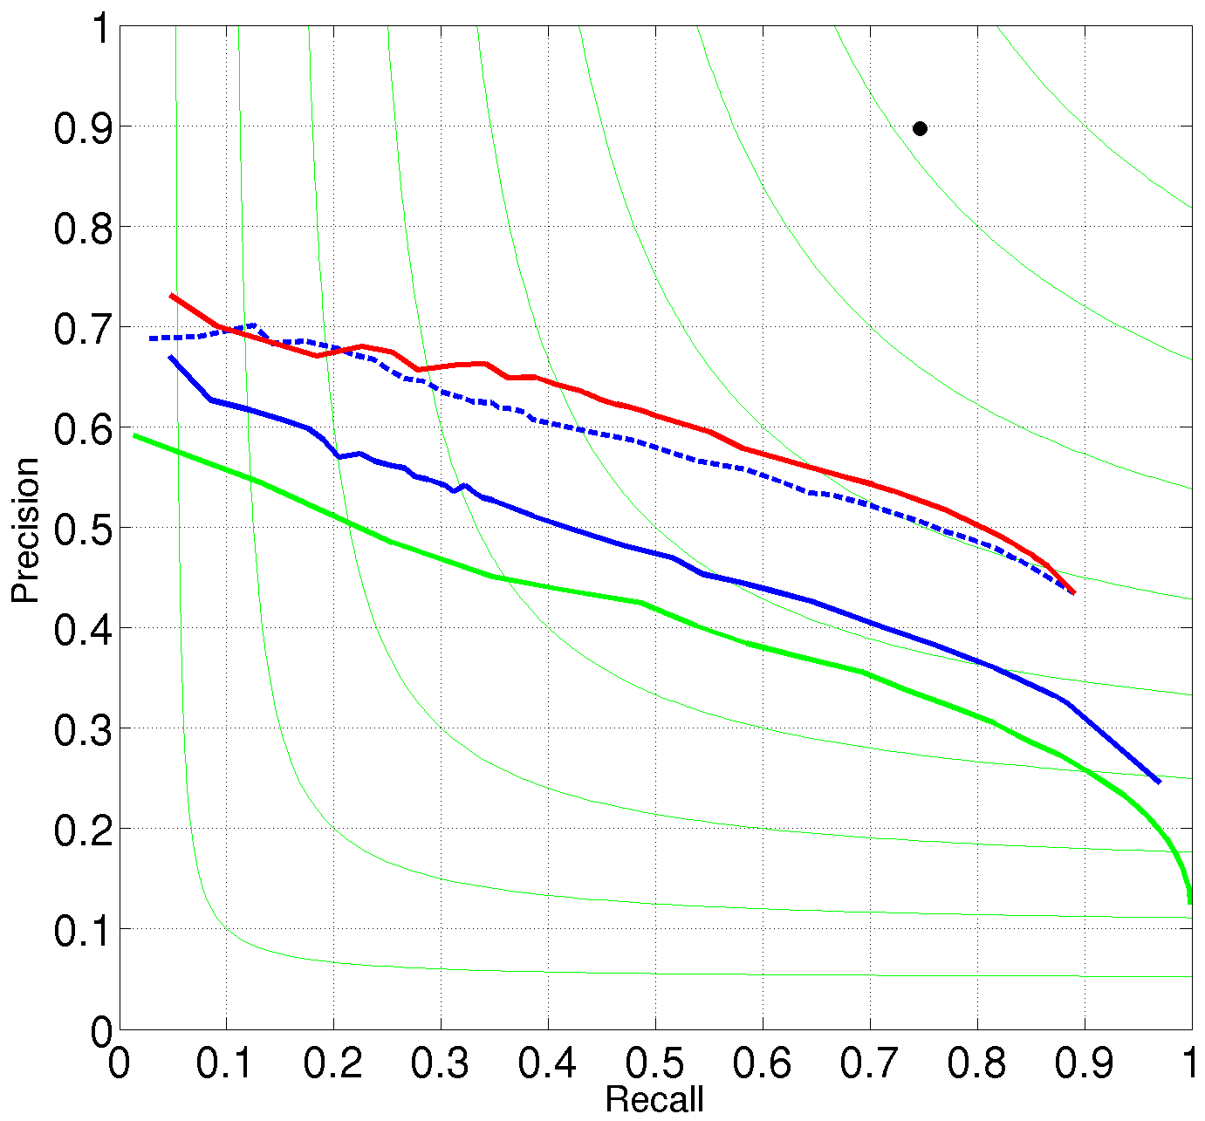
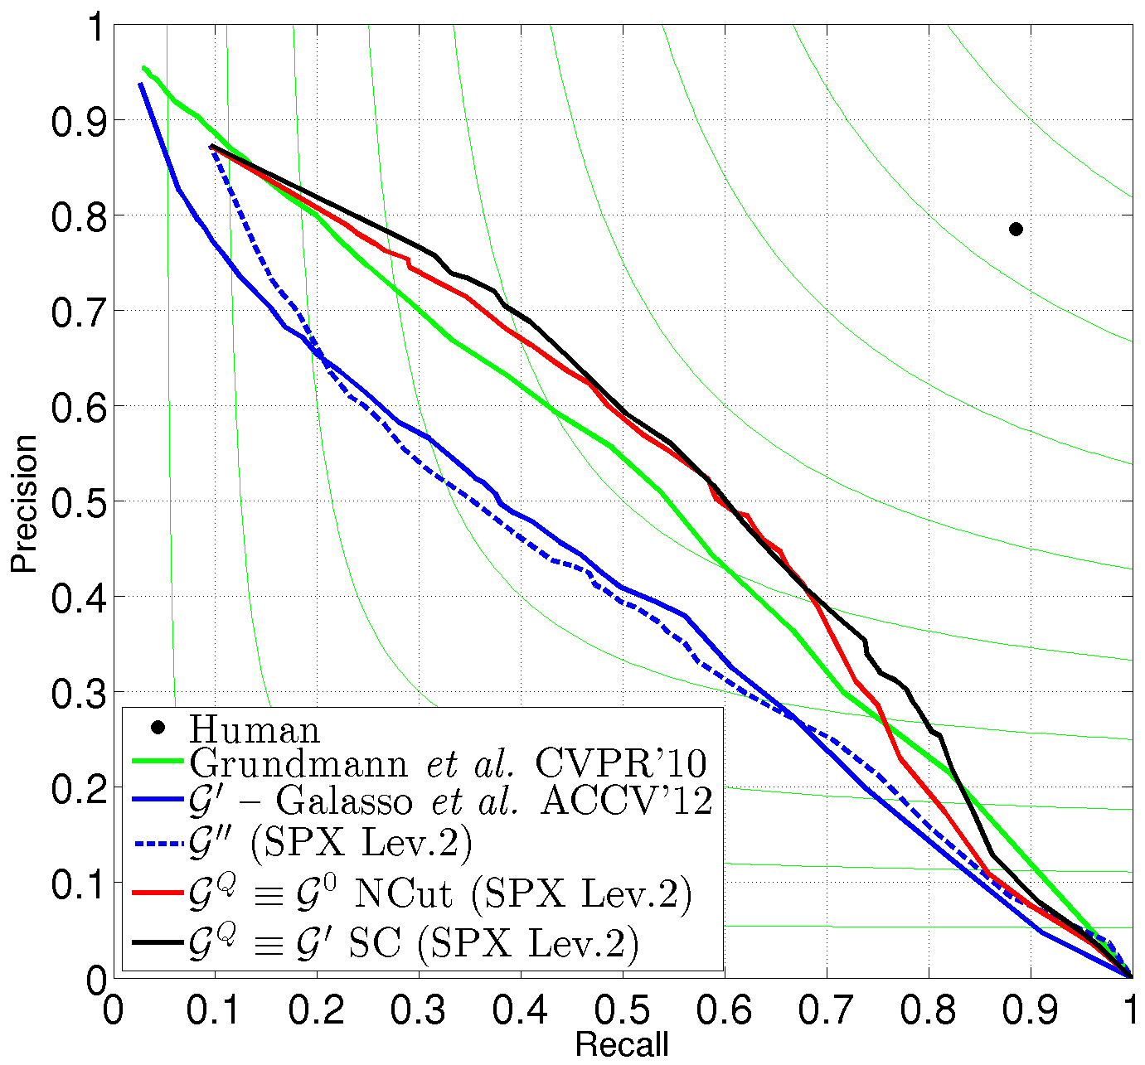
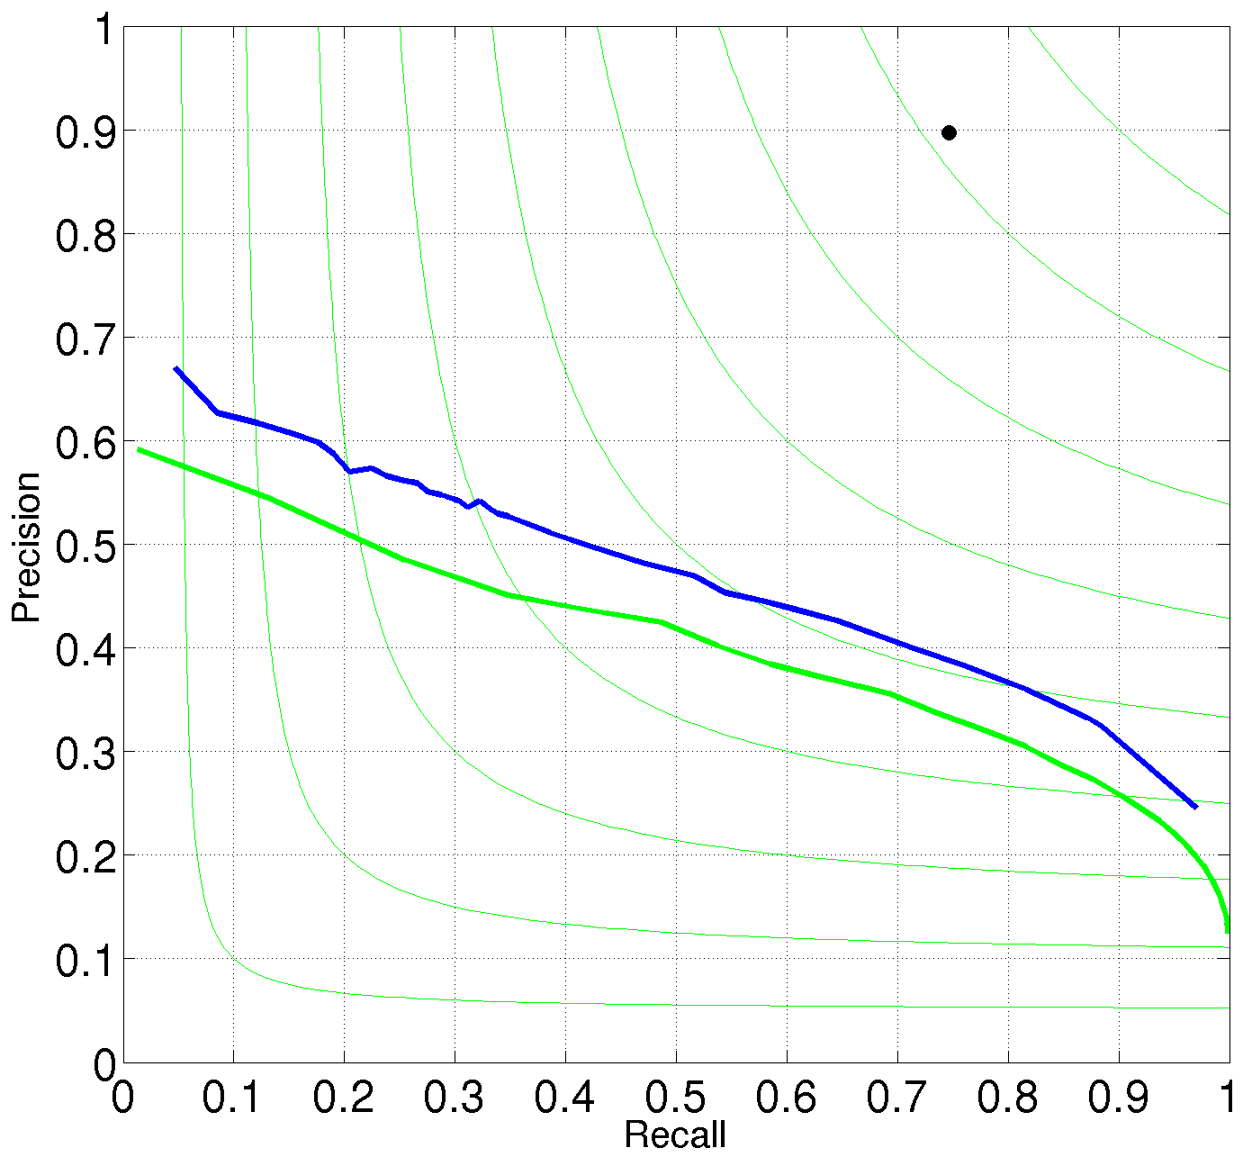
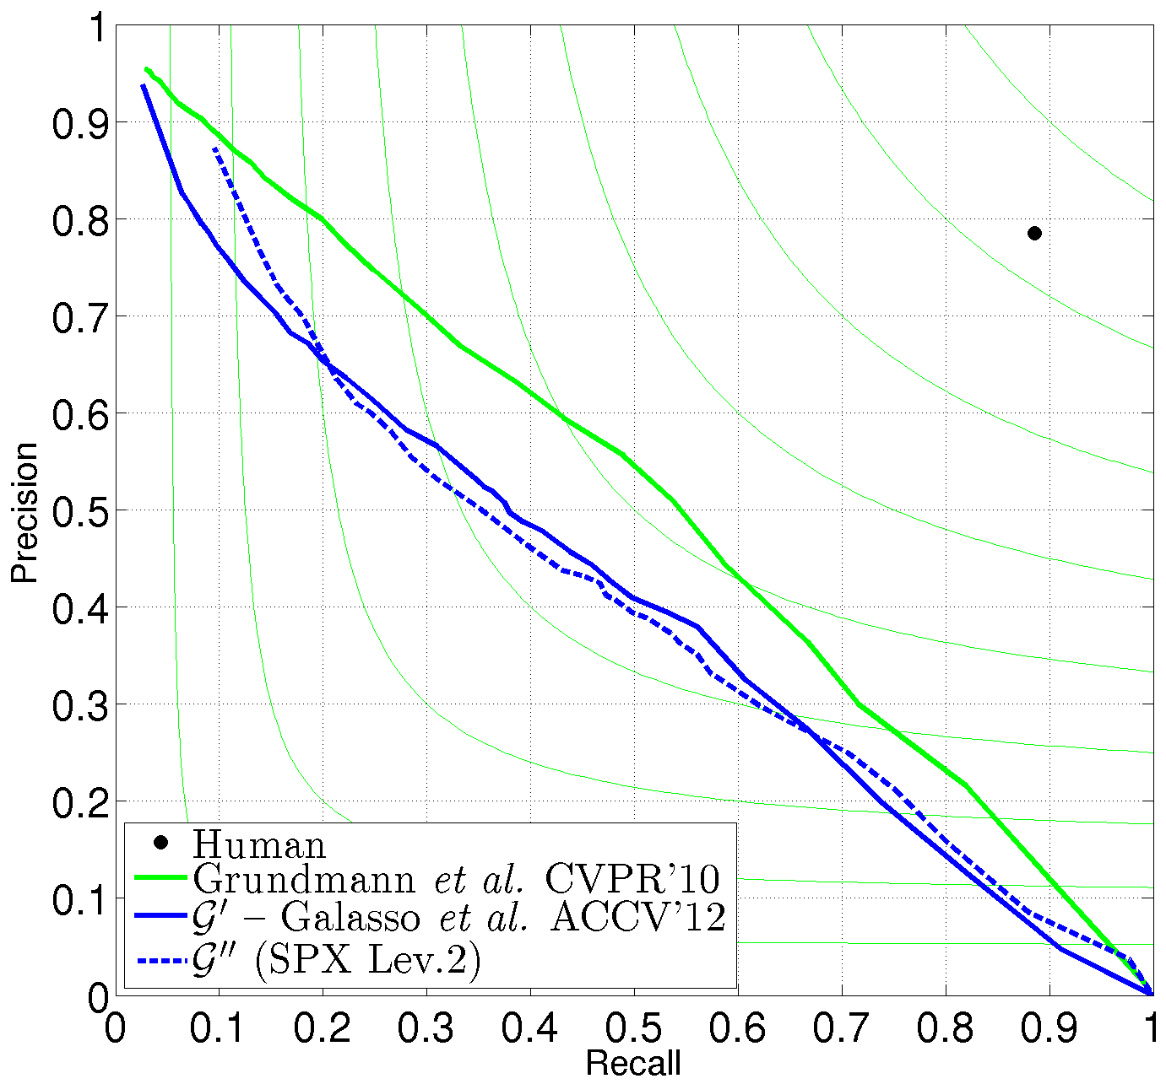
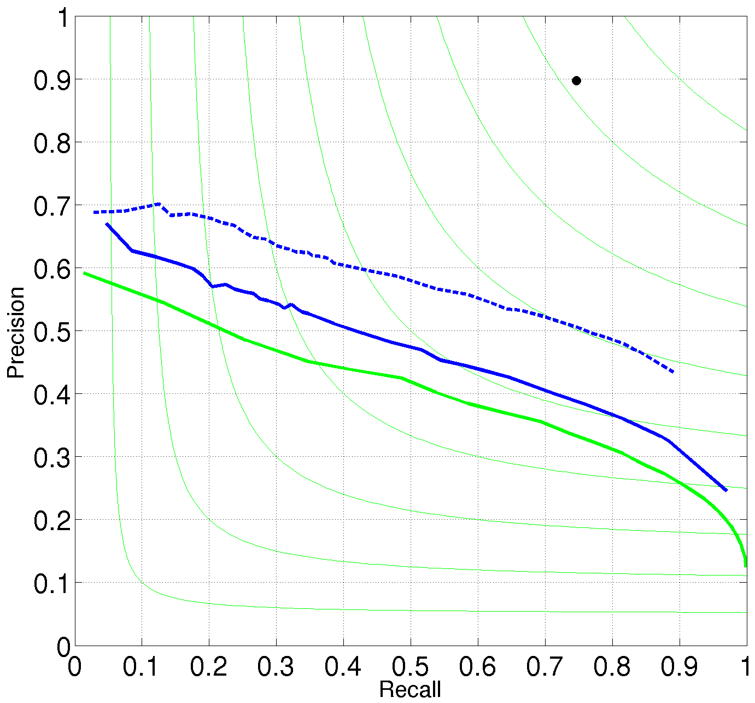
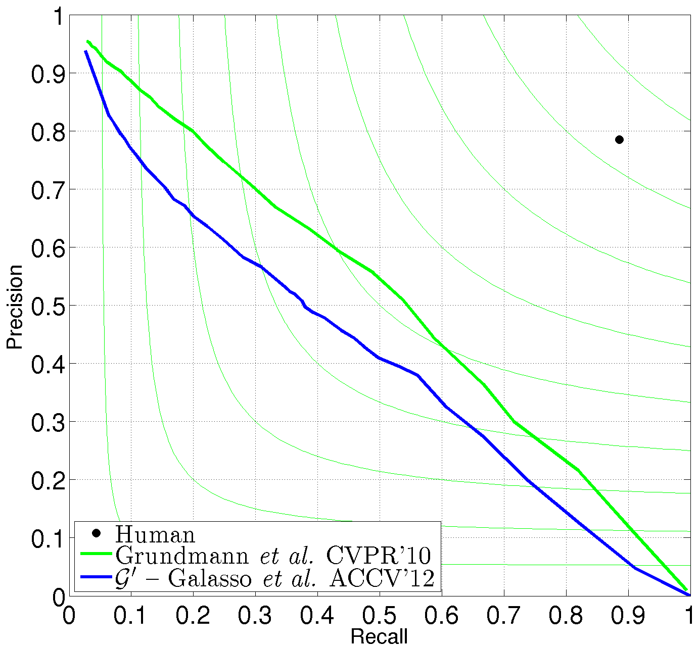
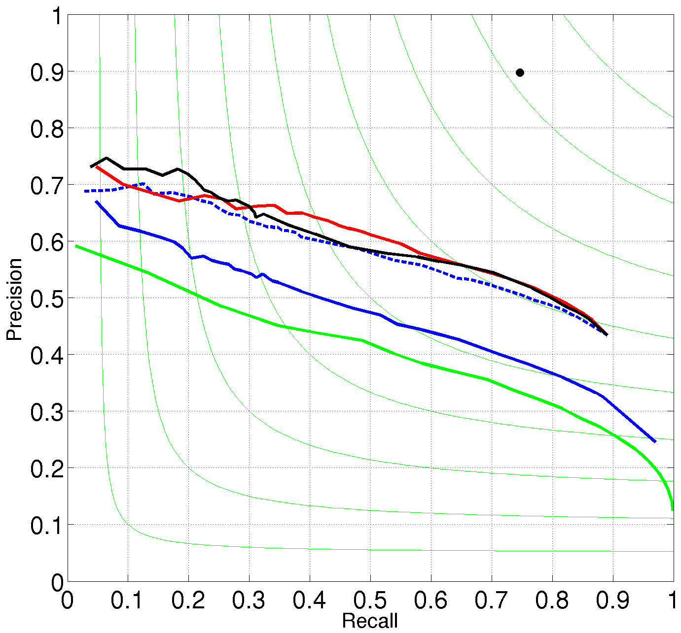
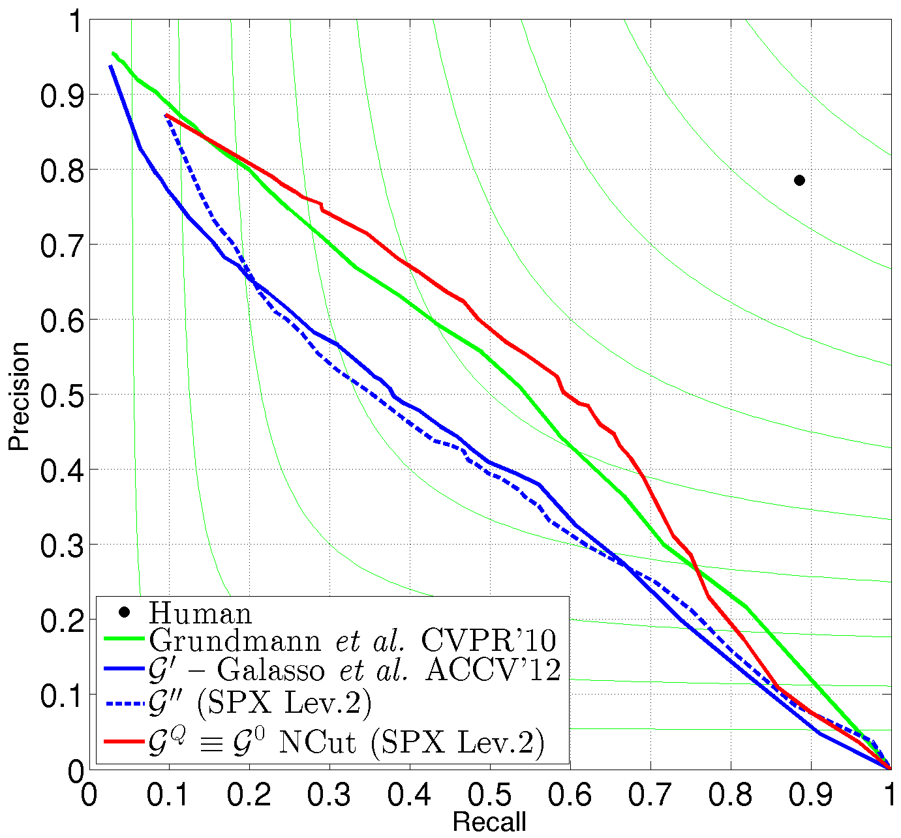
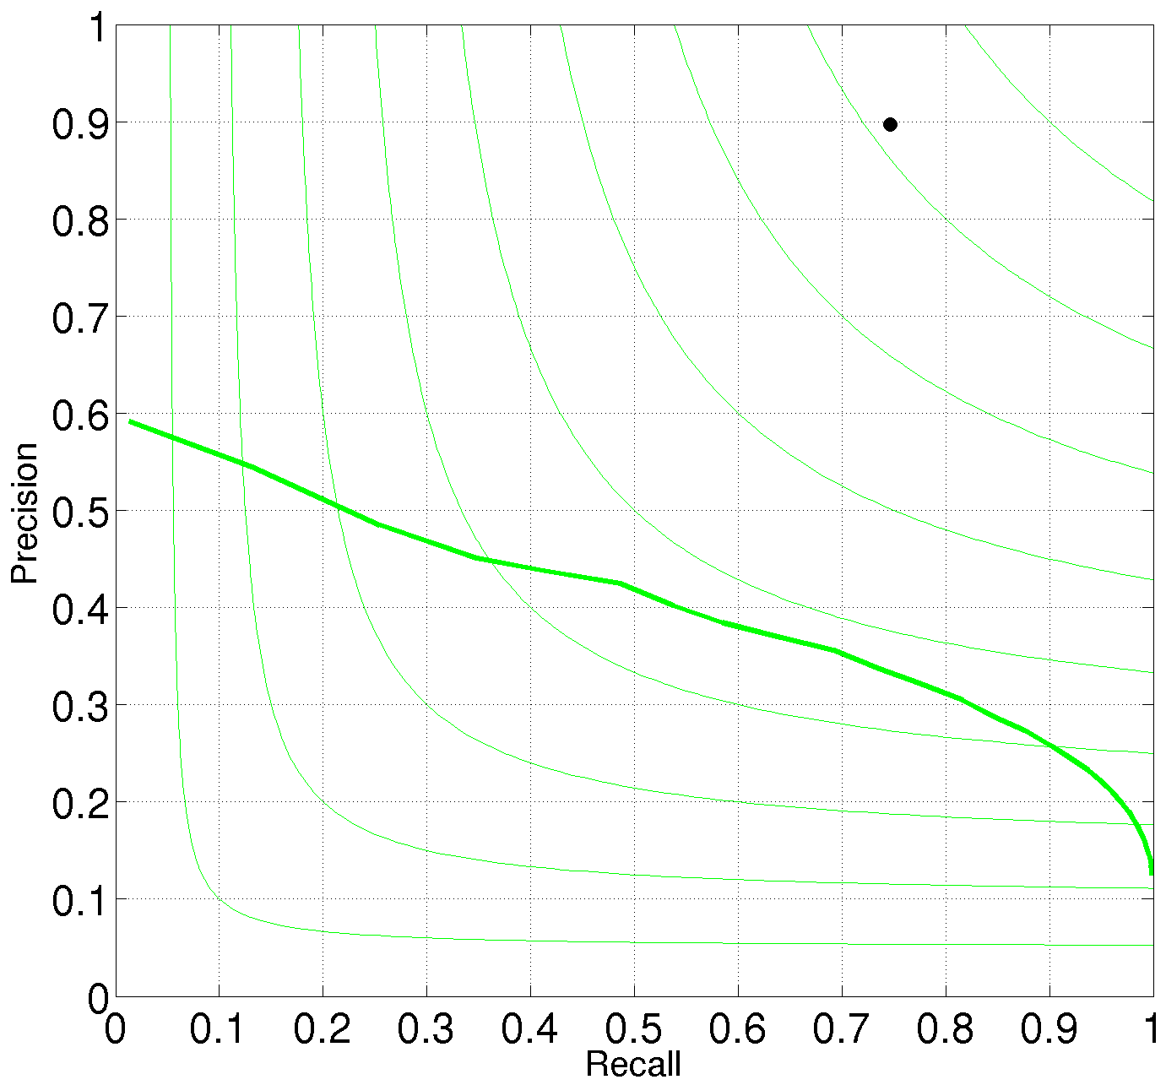
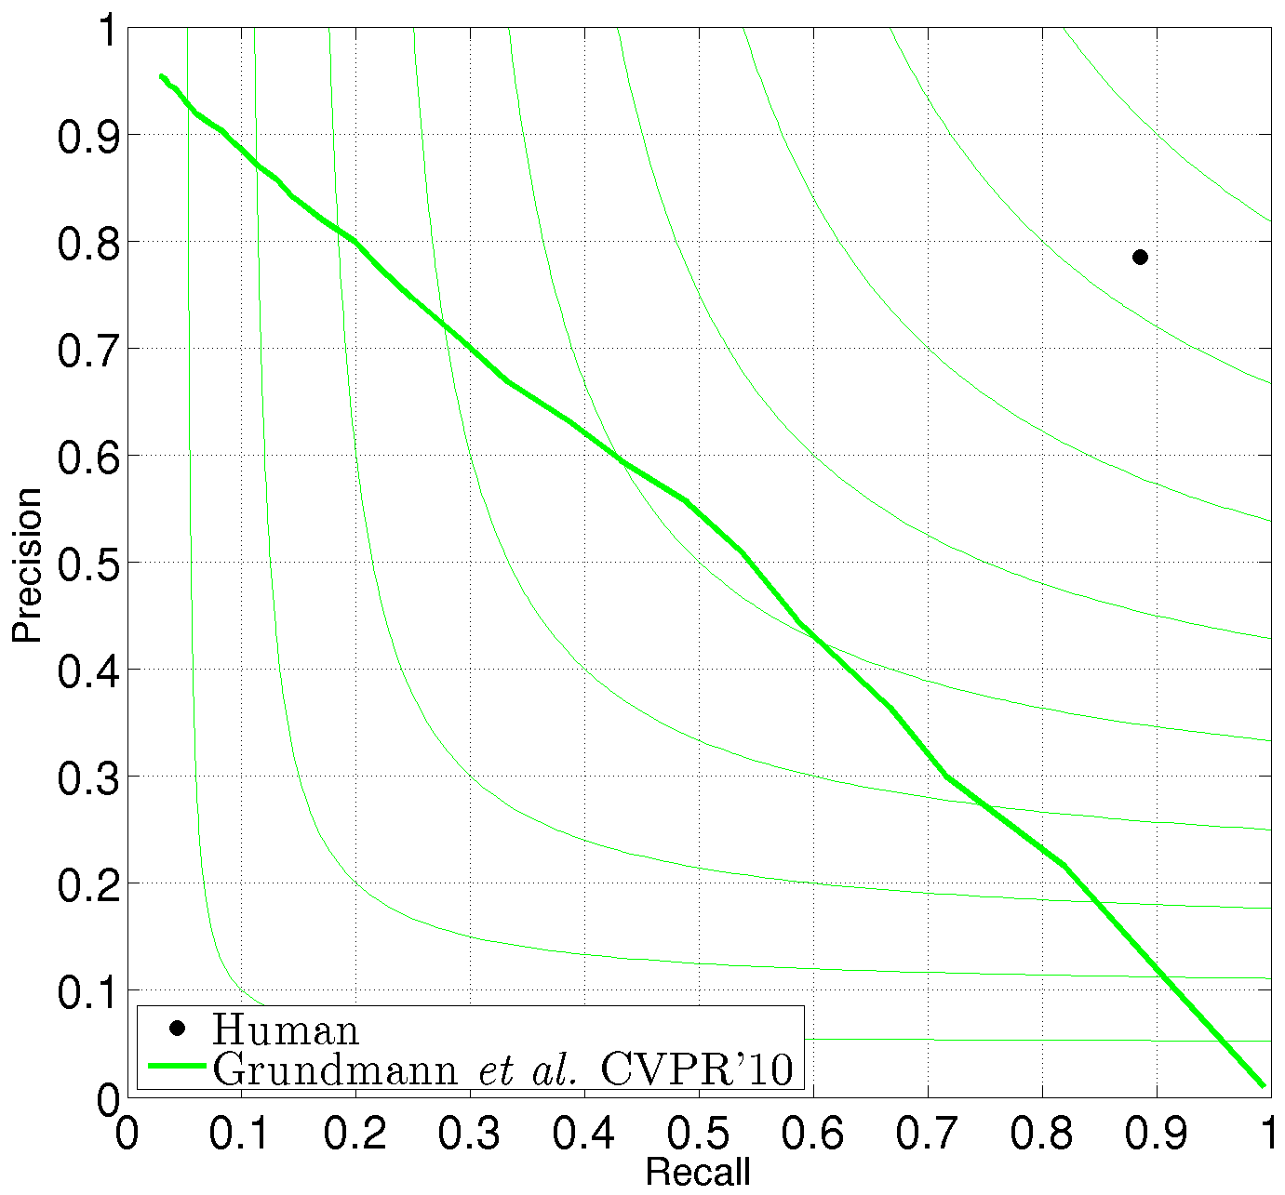
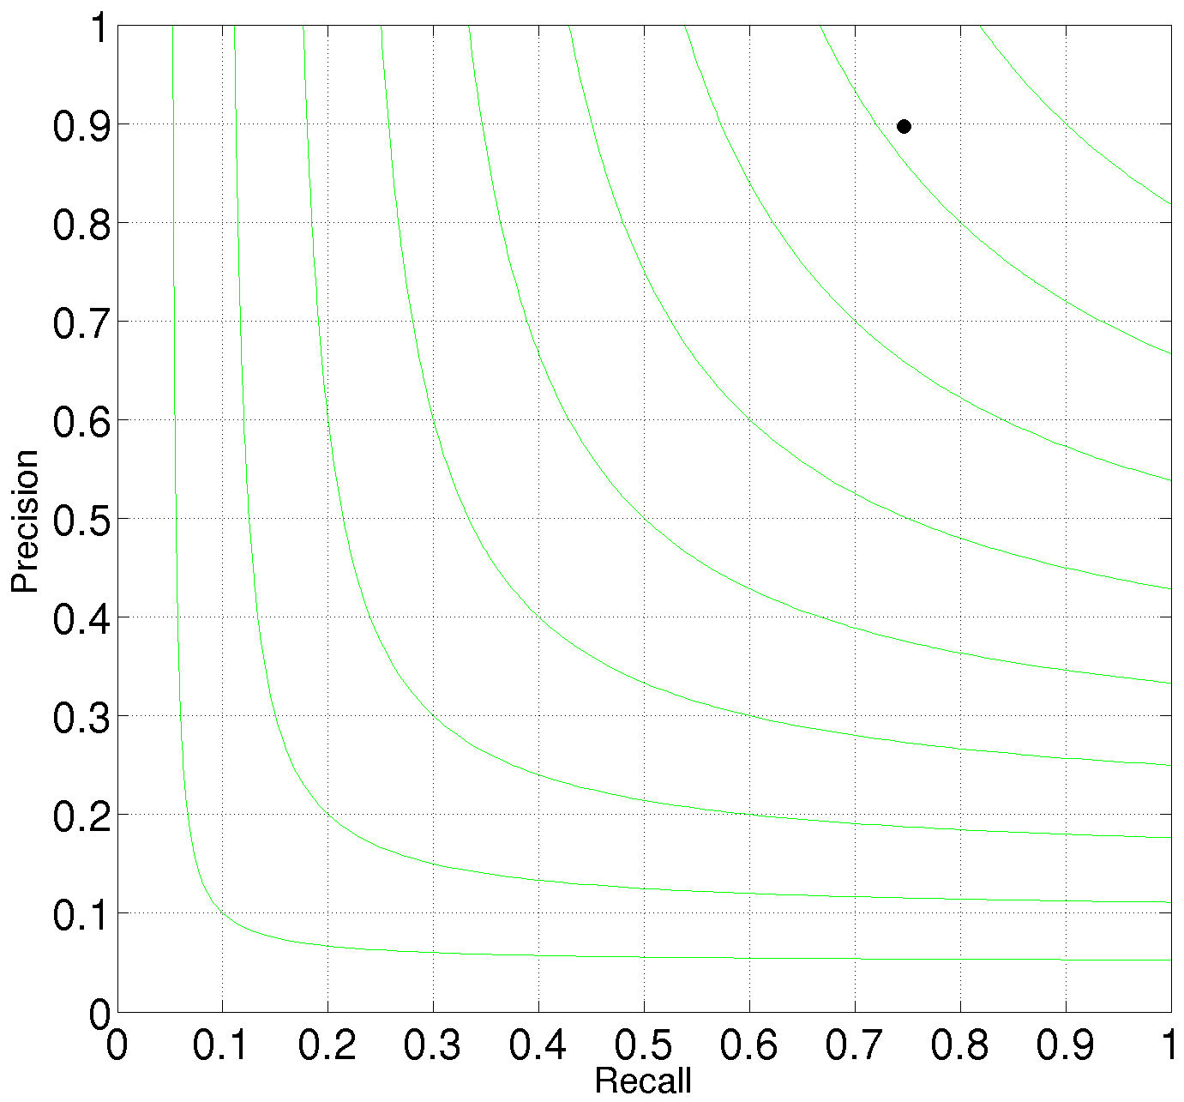
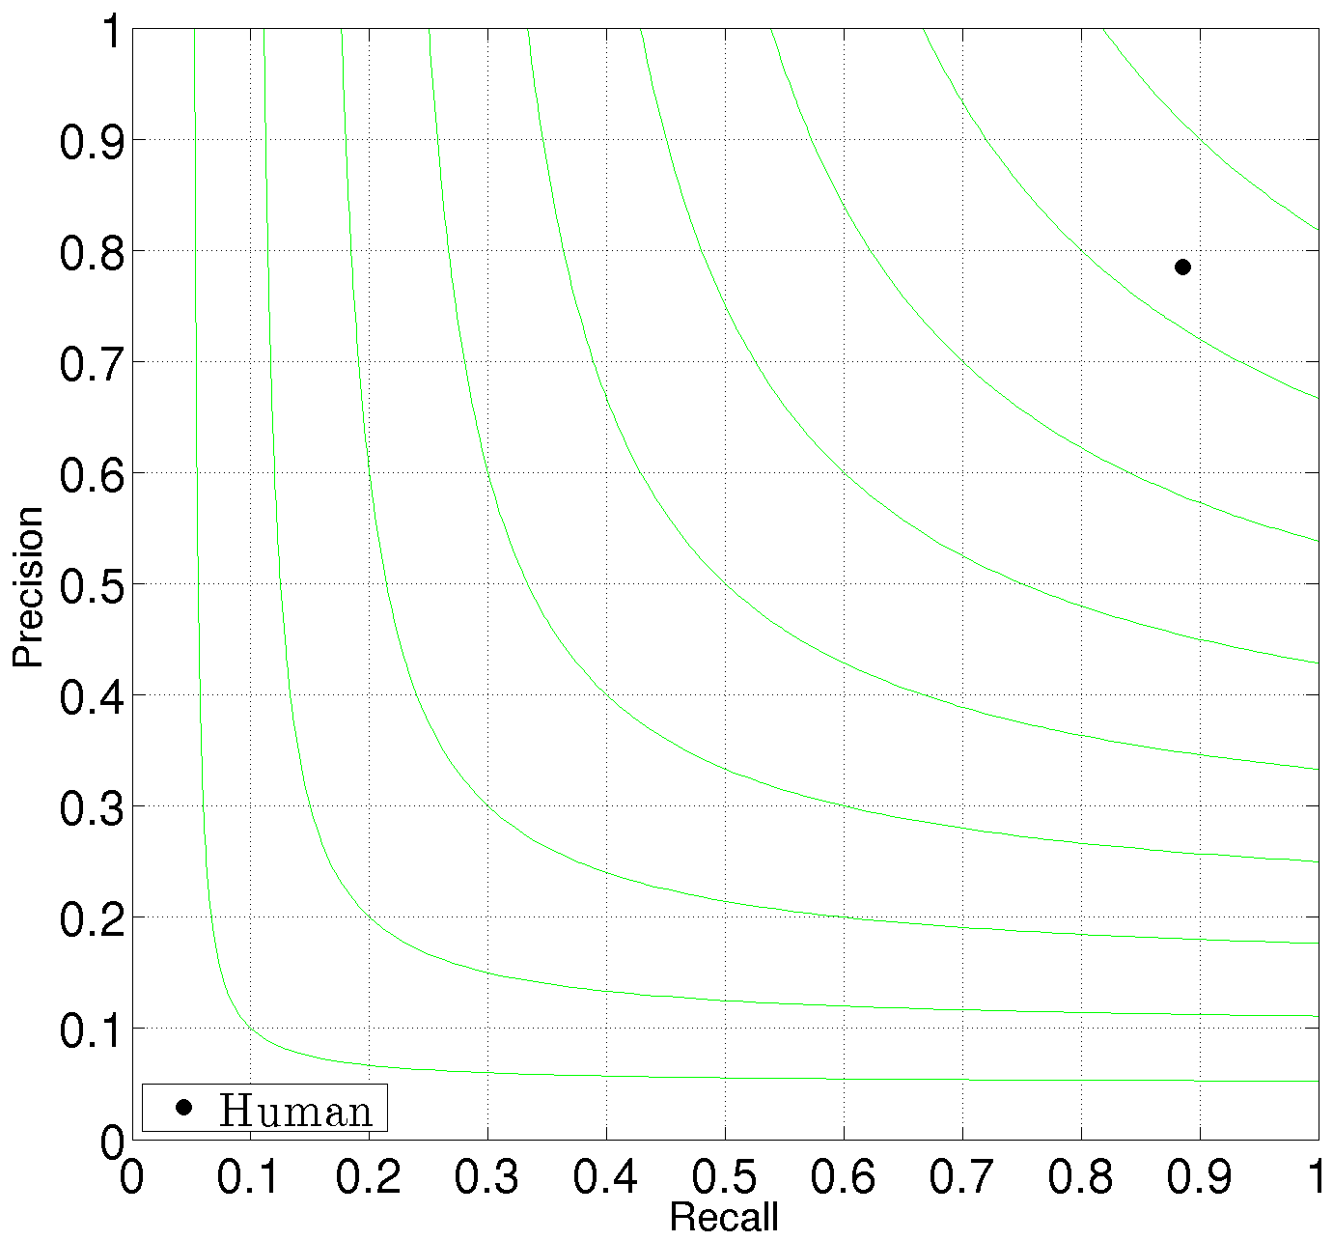
Application to video segmentation
Evaluate on VSB100
Prior information and higher-order features
10x runtime reduction, 5x memory load reduction
General benchmark
Boundary Precision-Recall
Volume Precision-Recall

Slide 24
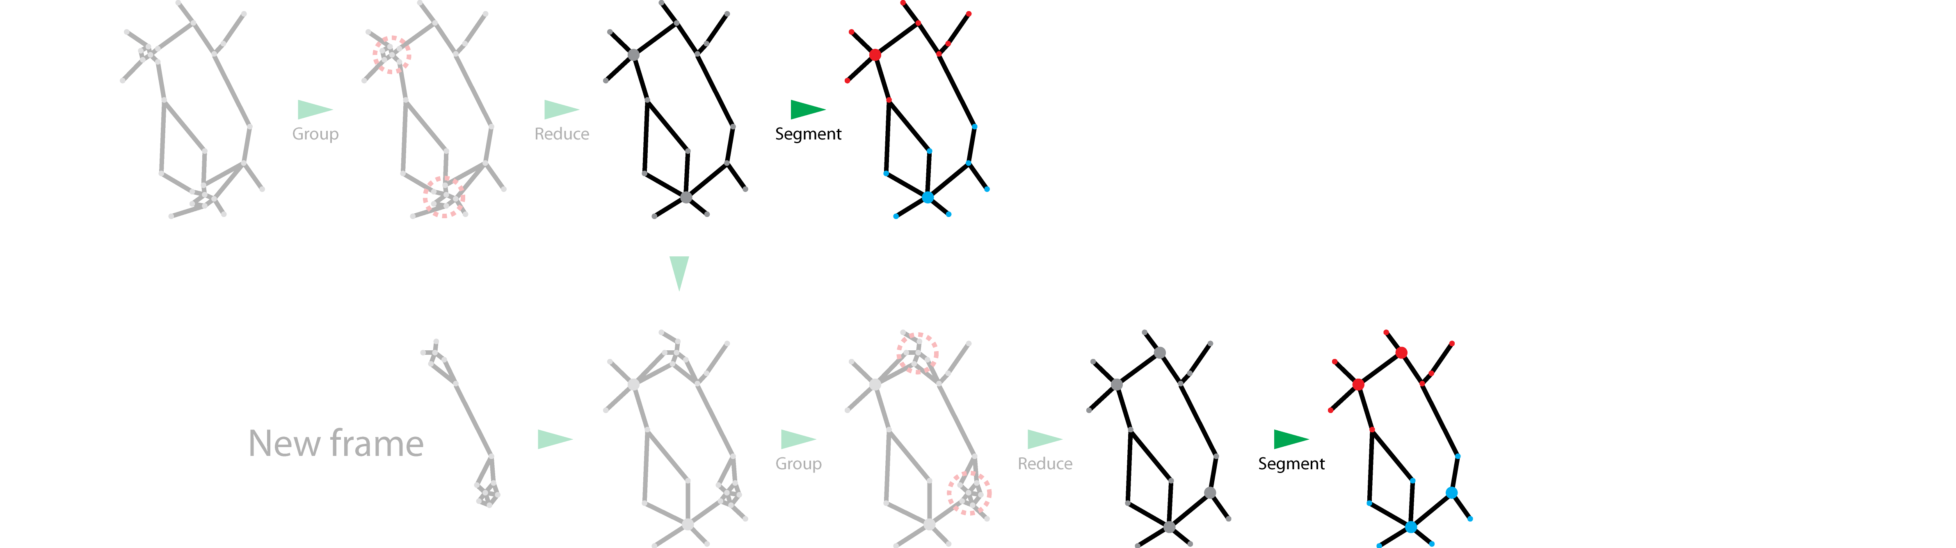
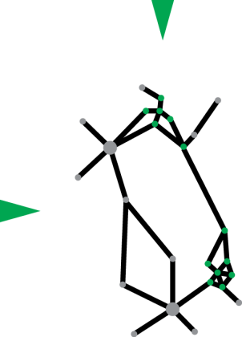
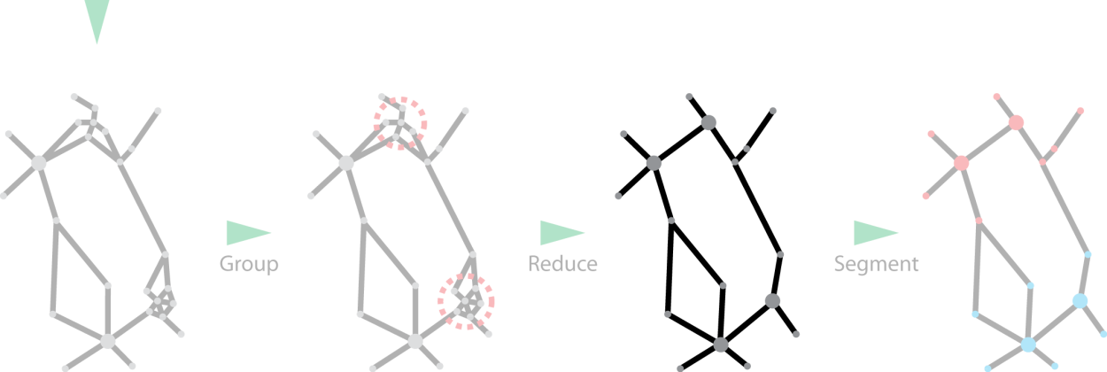
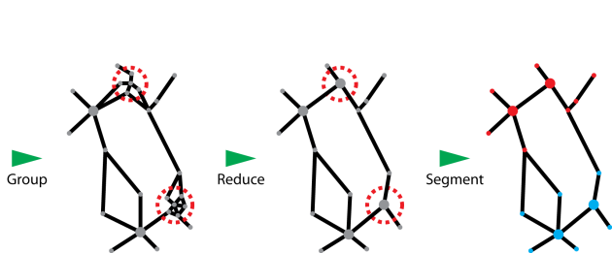
Application to streaming video segmentation
Streaming video segmentation
Future frames not available
Limited processing memory
Fix-sized equivalent representation up to time
Optimal segmentation at each time
…

Slide 25
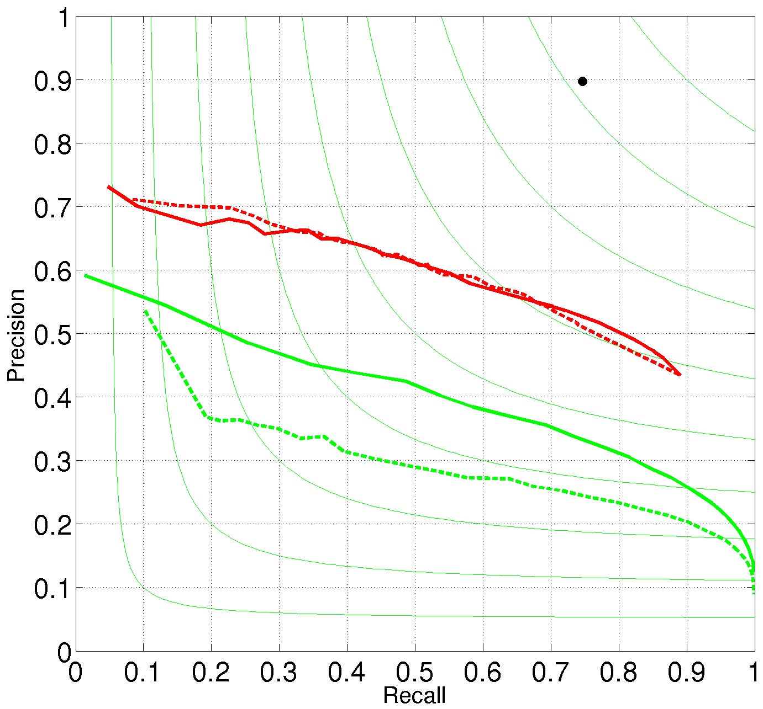
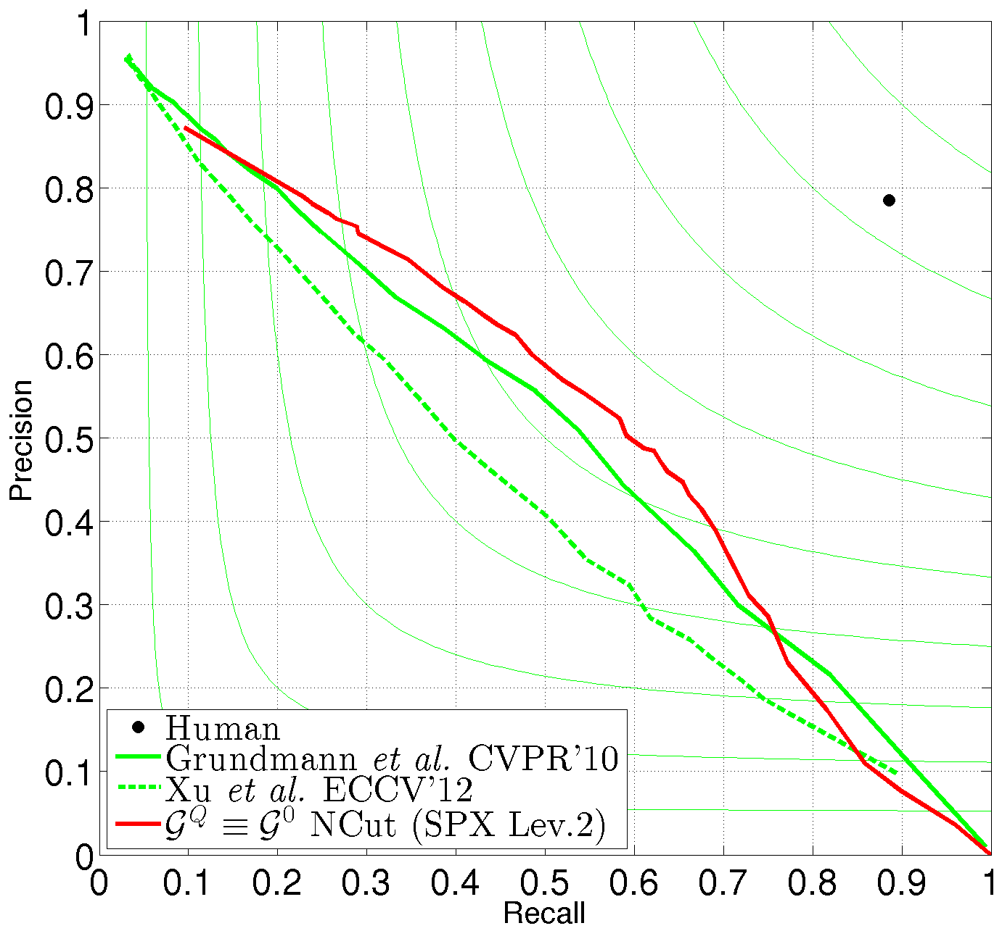
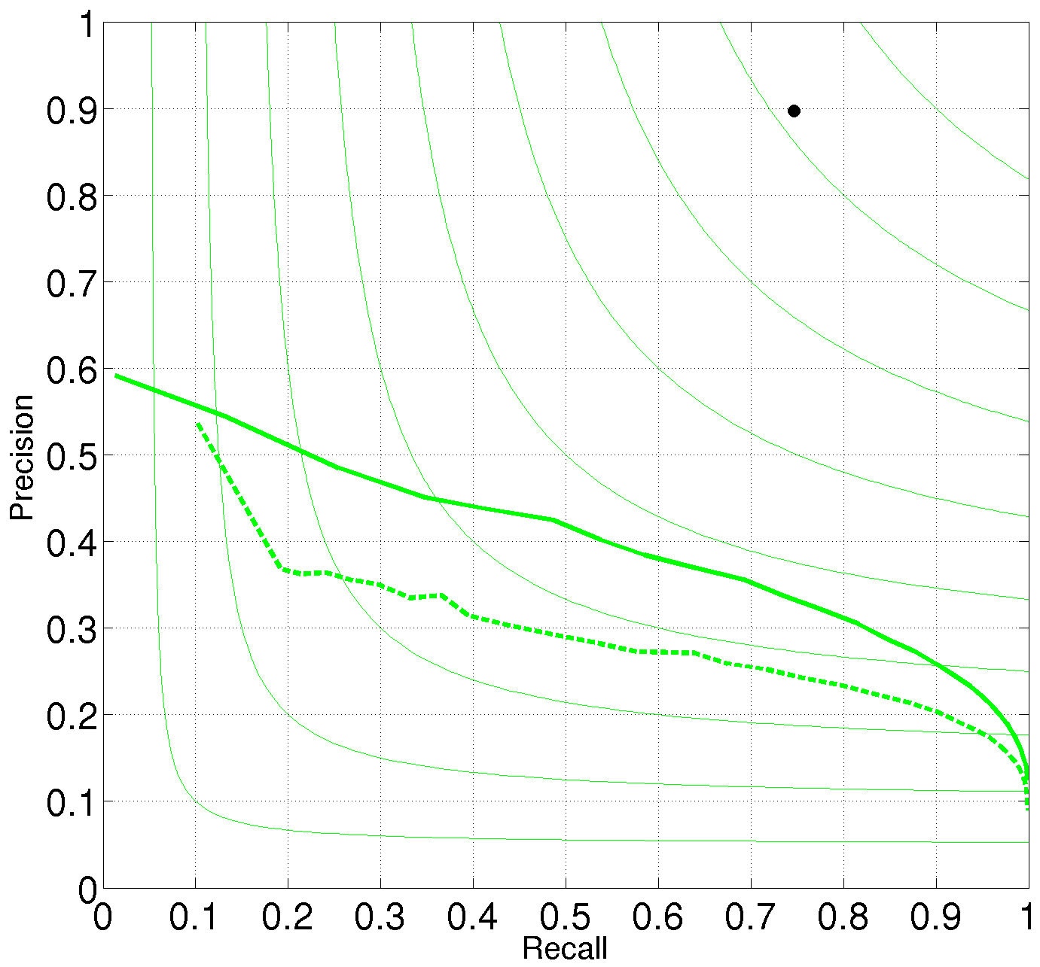
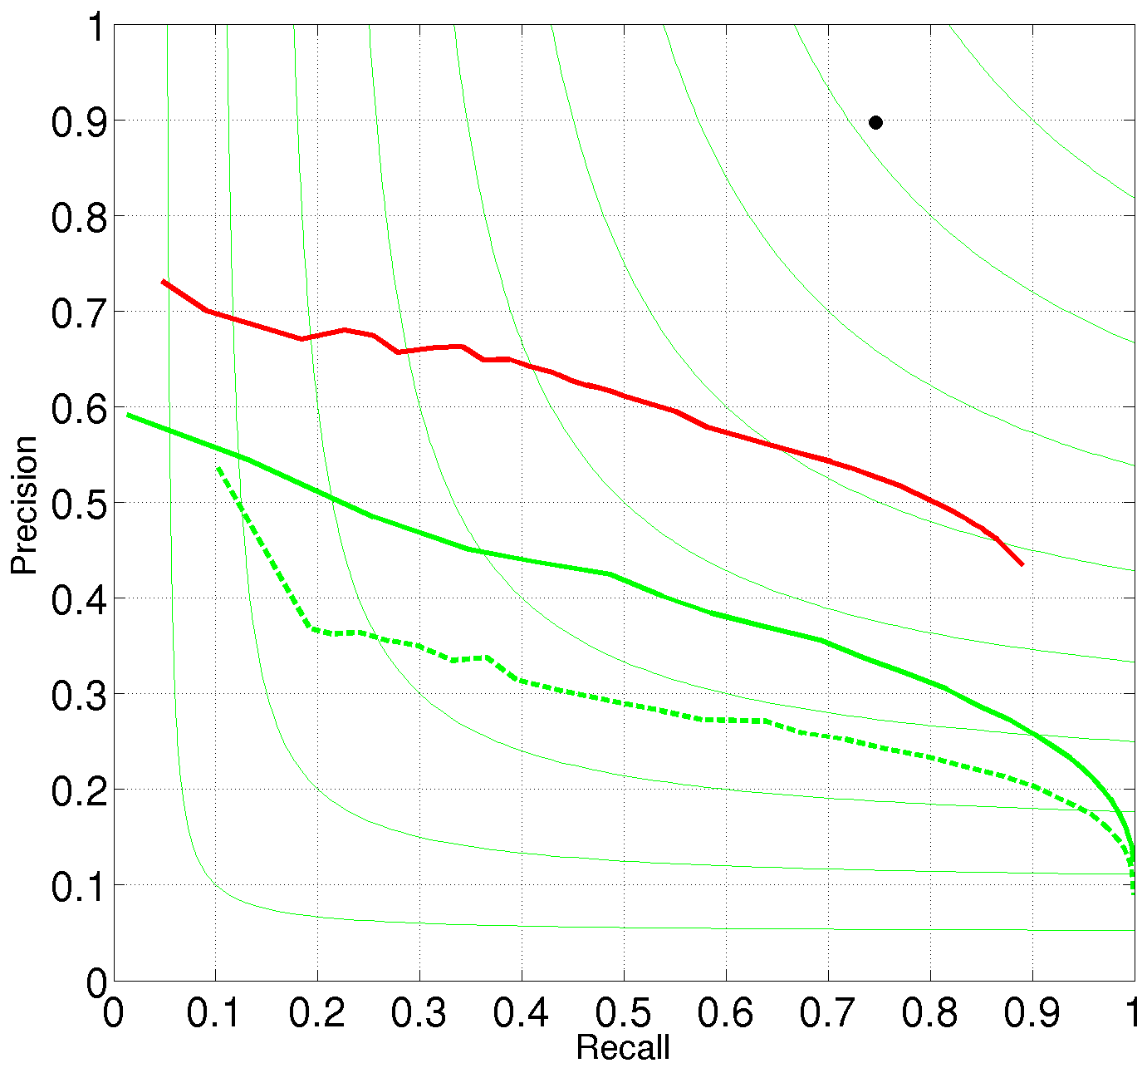
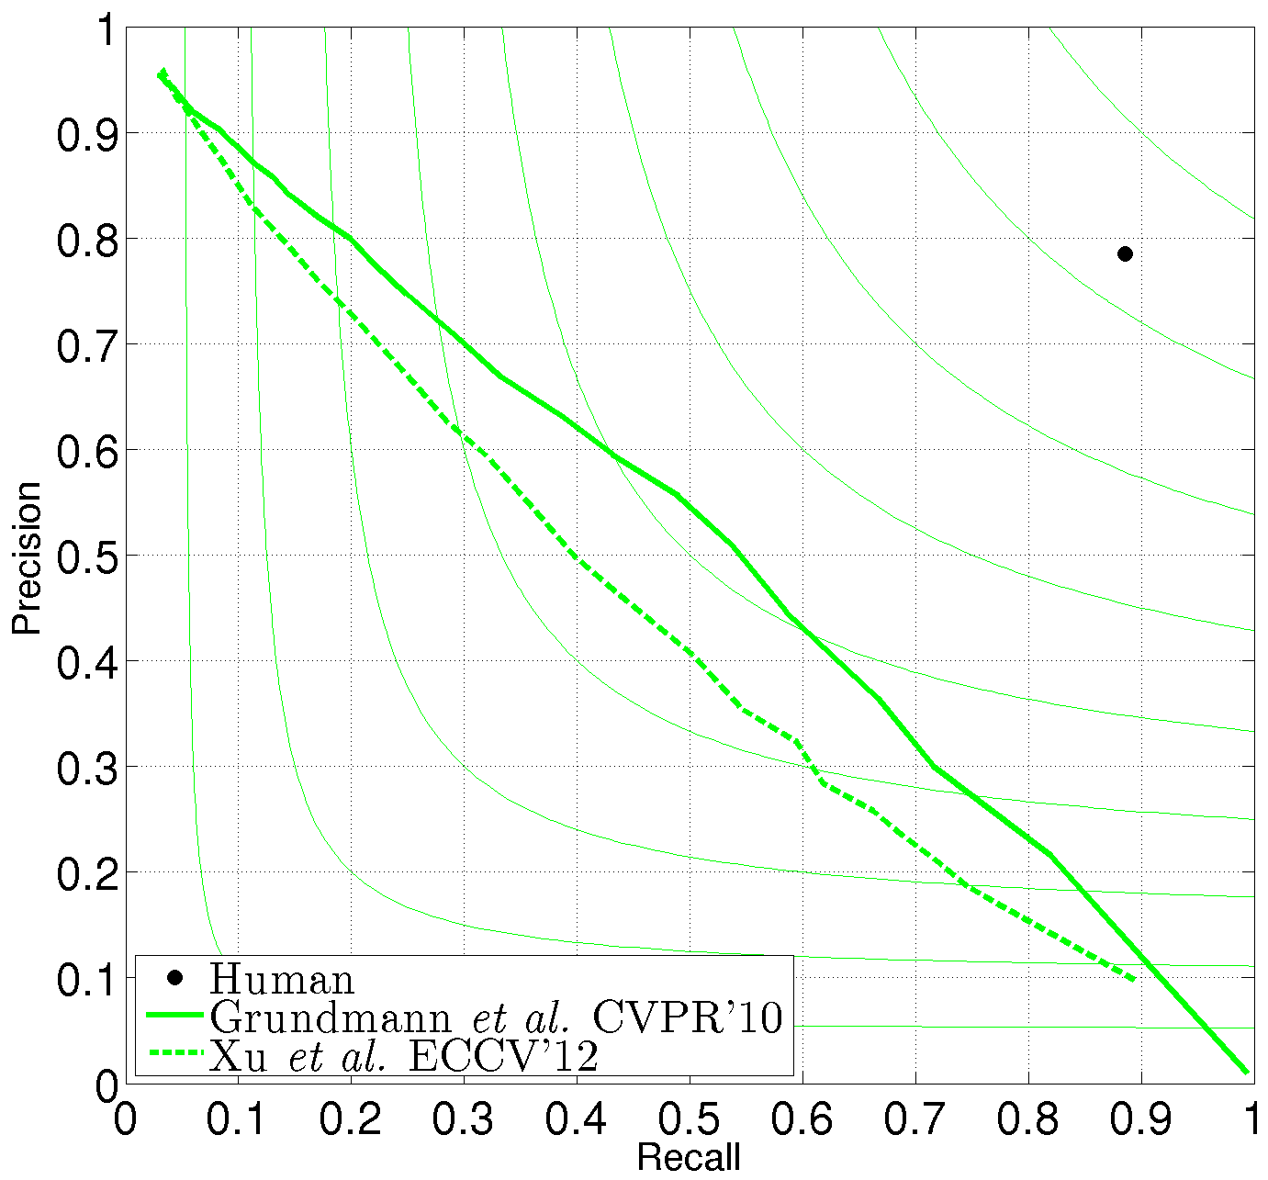
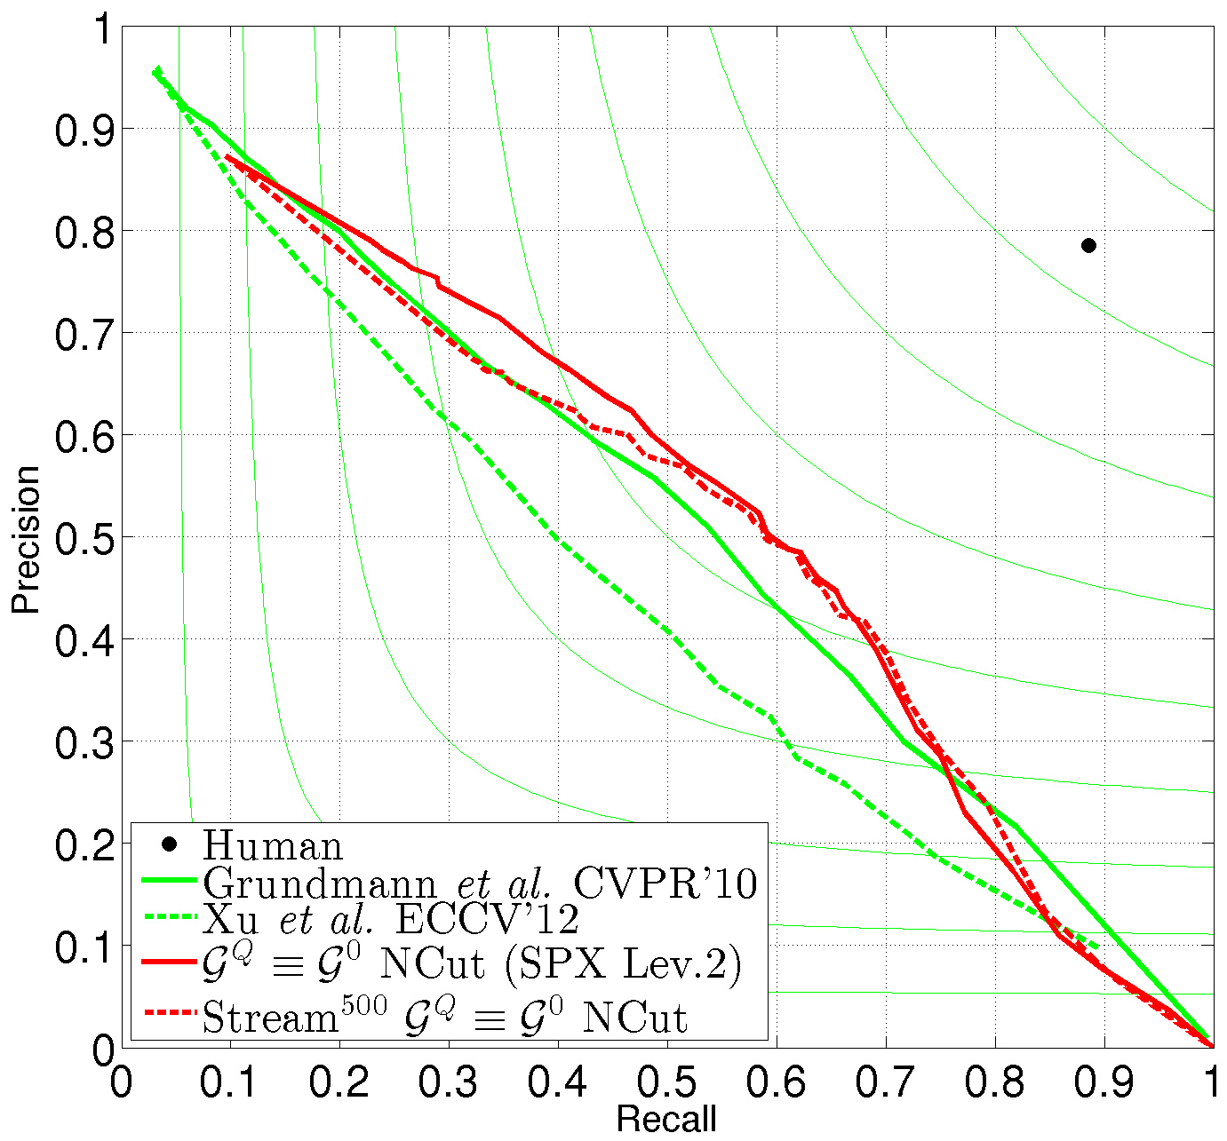
Application to streaming video segmentation
Evaluate on VSB100
20x runtime reduction, 50x memory load reduction
Best streaming method on VSB100
General benchmark
Boundary Precision-Recall
Volume Precision-Recall

Slide 26
Conclusions
Spectral graph reduction
Equivalent graph reduction
Efficiency
Re-balance with higher-order models
Performance
Several applications
superpixels
other clustering problems
Matlab code available
www.d2.mpi-inf.mpg.de/equivalence
Thanks for your attention

