Slide 1
Automated knowledge base construction
2. Design considerations, crawling and scraping
Simon Razniewski
Summer term 2022
Notes:
31: Look at robots.txt
46: Task XPath
47: Firefox add-in

Slide 2
Notes
Central communication: Mailing list
Assignment results
  Late submissions, format
Rooms
Survey
  Missed DSAI (57% other)? → MSc. mostly
  NLP 50/50
  ML: 75/25
  Semantic Web, Wikidata: 25/75
  80% Python
  Oral exam 50/50 → assignments, last tutorial test session
  Comments
    Recordings: Noted
    Rooms: see above
    Builds from core?

Slide 3
Outline
AKBC - Design considerations
Crawling
Scraping

Slide 4
AKBC design considerations
Fundamental questions:
What should be the output?
What is the best suited input?
How to get from 2. to 1.?

Slide 5
What should be the output?
Err, a KB?
What kind of KB?
  Canonicalized entities?
  Canonicalized relations?
  Importance of precision vs. recall?
Typically approached as several subtasks
  Entity extraction
  Entity canonicalization
  Entity set expansion
  Entity typing
  Relation extraction
  Relation canonicalization
  Constraint extraction
  Knowledge cleaning
  …
Each subtask may need different input, different method

Slide 6
Inputs
Semi-Structured Data
(Infoboxes, Tables, Lists …)
Text Documents
& Web Pages
Conversations
& Behavior
Premium Sources
(Wikipedia, IMDB, …)
Web collections
(Web crawls)
High-Quality Text
(News Articles, Wikipedia …)
Difficult Text
(Books,
Interviews …)
Online Forums
& Social Media
Queries & Clicks
Rules & Patterns
Logical
Inference
Statistical
Inference
NLP
Tools
Deep
Learning
Methods
Entity Names, Aliases & Classes
Entities in
Taxonomy
Rules &
Constraint
Relational
Statements
Canonicalized
Statements
Outputs
Notes:
Search engines: “the good the bad and the ugly movie”.
Term, which WP page is clicked -> entity disambiguation

Slide 7
Inputs
Semi-Structured Data
(Infoboxes, Tables, Lists …)
Text Documents
& Web Pages
Conversations
& Behavior
Crawling
Premium Sources
(Wikipedia, IMDB, …)
Web collections
(Web crawls)
High-Quality Text
(News Articles, Wikipedia …)
Difficult Text
(Books,
Interviews …)
Online Forums
& Social Media
Queries & Clicks
Rules & Patterns
Logical
Inference
Statistical
Inference
NLP
Tools
Deep
Learning
Methods
Entity names, aliases & classes
Entities in
Taxonomy
Rules &
Constraint
Relational
Statements
Canonicalized
Statements
Outputs

Slide 8
Inputs
Semi-Structured Data
(Infoboxes, Tables, Lists …)
Text Documents
& Web Pages
Conversations
& Behavior
Scraping
Premium Sources
(Wikipedia, IMDB, …)
Web collections
(Web crawls)
High-Quality Text
(News Articles, Wikipedia …)
Difficult Text
(Books,
Interviews …)
Online Forums
& Social Media
Queries & Clicks
Rules & Patterns
Logical
Inference
Statistical
Inference
NLP
Tools
Deep
Learning
Methods
Entity names, aliases & classes
Entities in
Taxonomy
Rules &
Constraint
Relational
Statements
Canonicalized
Statements
Outputs

Slide 9
Outline
AKBC design considerations
Crawling
Scraping

Slide 10
Acknowledgment
Material adapted from Fabian Suchanek and Antoine Amarilli

Slide 11
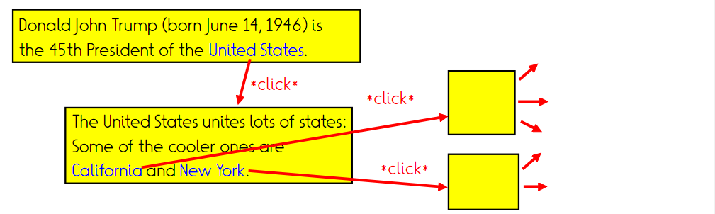
Crawling: Task
Given: One or several source URLs
Return: Document corpus obtained by transitive hyperlink closure (bounded)

Slide 12
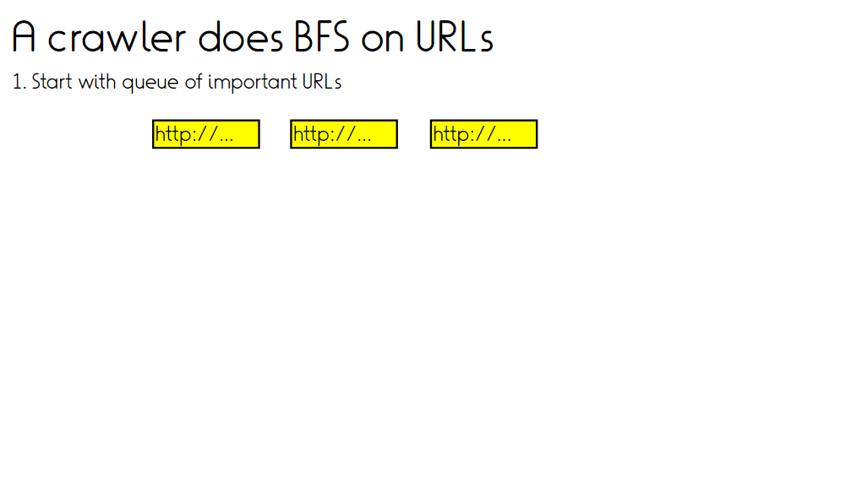

Slide 13
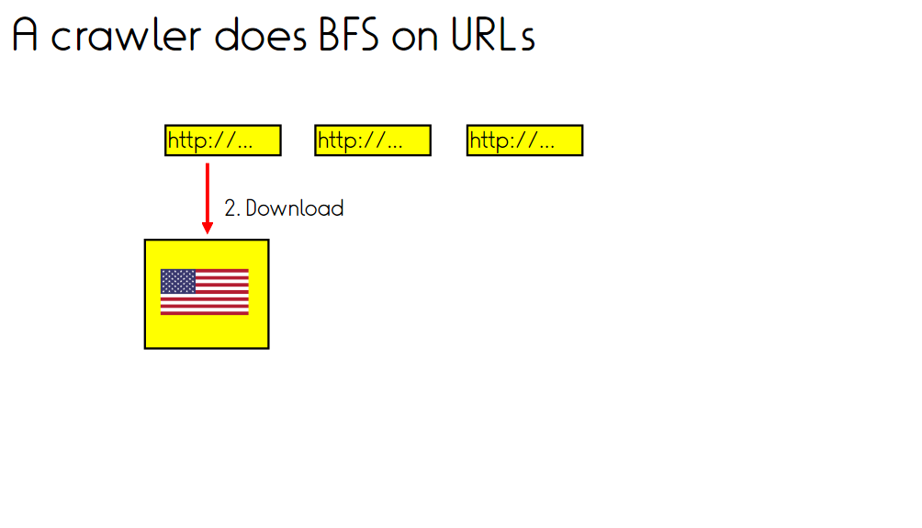

Slide 14
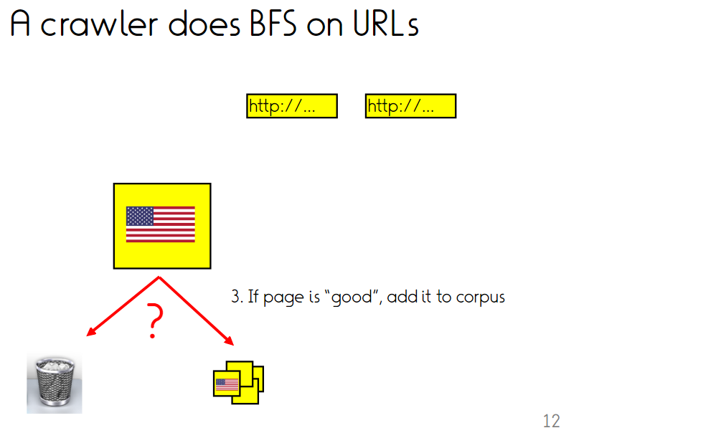

Slide 15
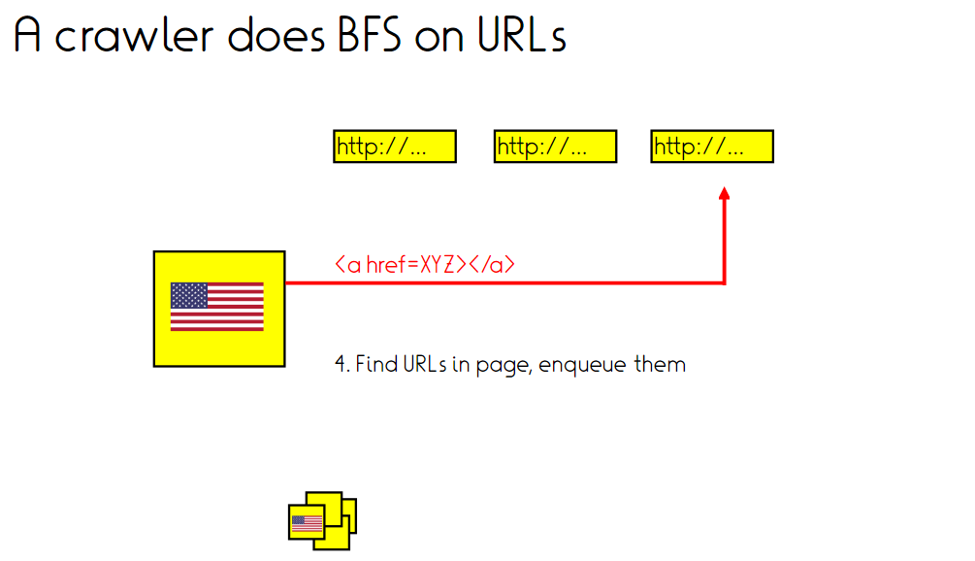

Slide 16
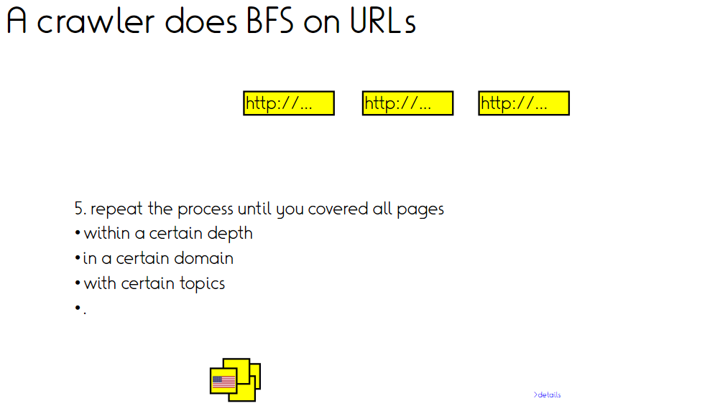

Slide 17
Crawling: The fine print
How to find hyperlinks?
How to decide when to revisit/how often to revisit?
Denial of service
Captchas
Deep web
Existing crawl corpora

Slide 18
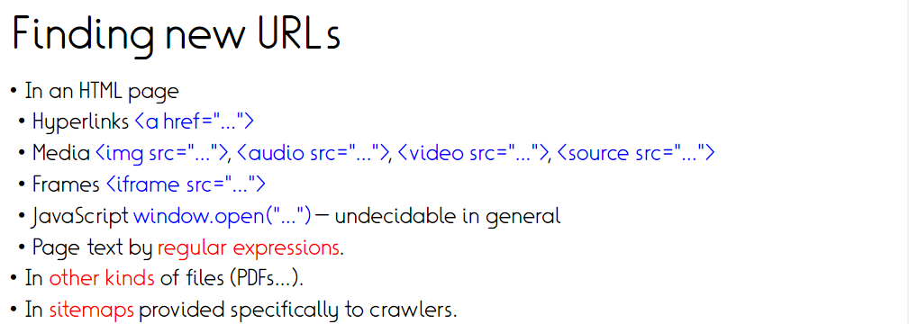

Slide 19
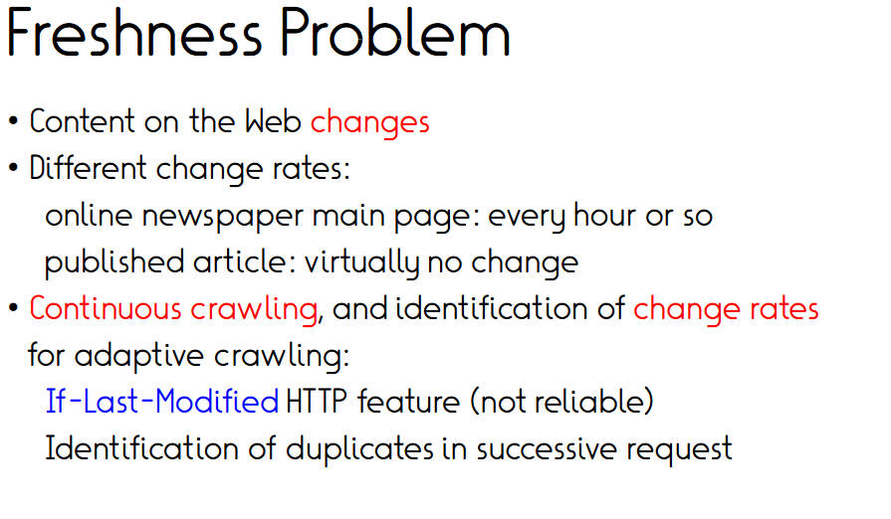
Firefox: Developer tools/Network/Response header
https://en.wikipedia.org/wiki/Max_Planck_Institute_for_Informatics
Notes:
If modified since is a feature to only get a website if modified since a certain date..

Slide 20
Freshness problem (2)
Prediction problem: Estimate page change frequency
  From previous change behavior
  Or from page content
Optimization problem: Decide crawl frequency
  Fixed budget → How to distribute them
  Flexible budget → Cost-benefit framework needed

Slide 21
Estimating change frequencies
Cho and Molina, TOIT 2003
  Model changes as Poisson processes (i.e., memoryless/
  statistically independent)
  Extrapolate change frequency from previous visits
    Daily visit for 10 days, 6 changes detected
    Change frequency: 0.6 changes/day?
  Extrapolation underestimates change frequency due to multiple change possibility
Wijaya et al., EMNLP 2015
  Wikipedia-specific
  Learn state-change-indicating terms
  E.g., engage, divorce
Notes:
How to Keep a Knowledge Base Synchronized with Its Encyclopedia Source

Slide 22
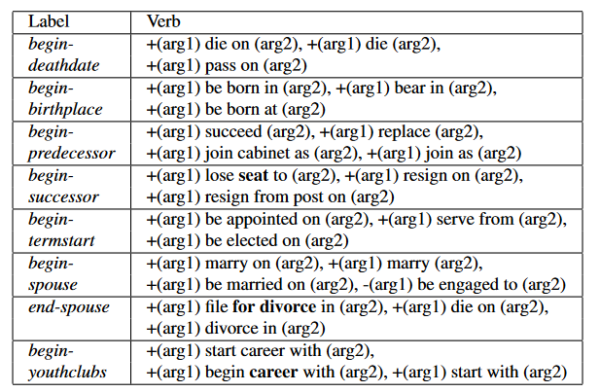
Wijaya et al., EMNLP 2015

Slide 23
Optimization problem
[Razniewski, 2016]
Resources flexible
Ingredients:
  Benefit of an up-to-date website
    Alternatively: cost of outdated website
  Cost of a crawl action
  Decay behavior
→ Page-specific recrawl frequency that maximizes benefit minus cost

Slide 24
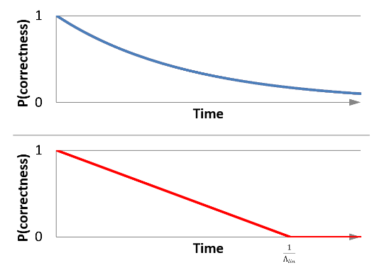


Decay behaviour

Slide 25
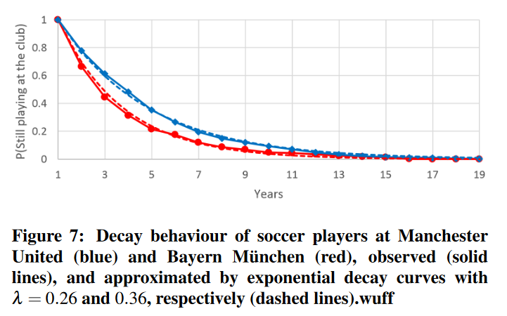
Observed decay behaviour

Slide 26
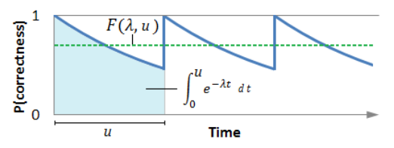

Average freshness F

Slide 27

Net income NI
B…Benefit/time unit
F…Average freshness
Λ… decay coefficient
u…update interval length
C…cost of an update
Standard algebra:
Finding function maximum

Slide 28
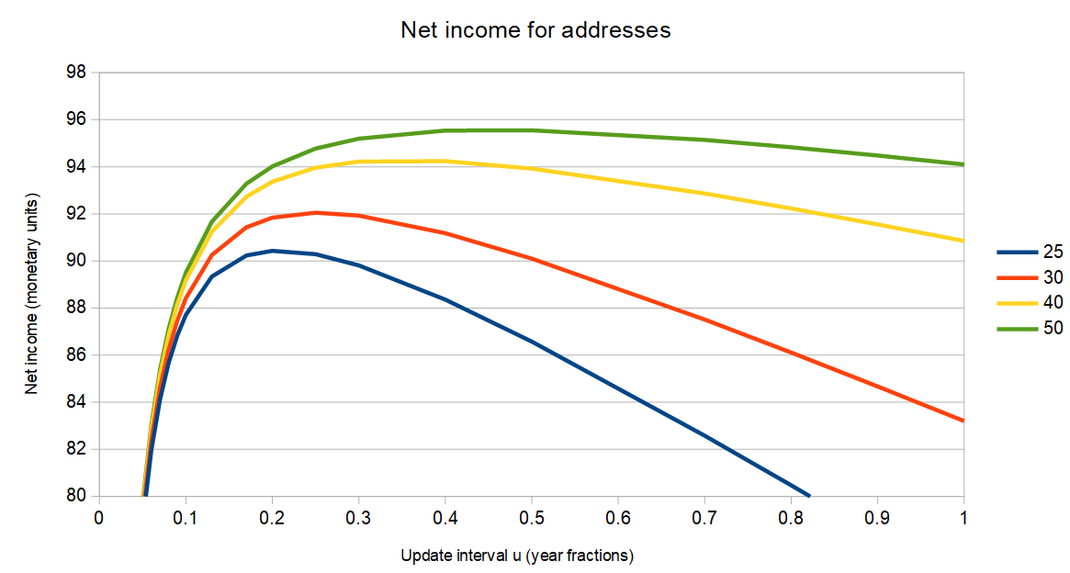
Examples for address updates:
NI over u
Λ
0.46
0.32
0.16
0.10
Assumption: benefit over one year = 100 x cost of single crawl
Actual ratio magnitudes lower, e.g., 0.003 Cents/crawl [http://www.michaelnielsen.org/ddi/how-to-crawl-a-quarter-billion-webpages-in-40-hours/]
(and for 580 $ on Amazon EC2)

Slide 29
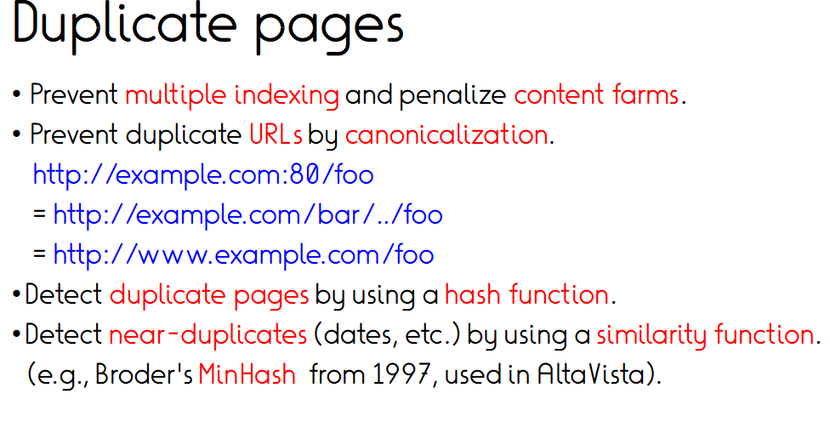
and later Google)

Slide 30
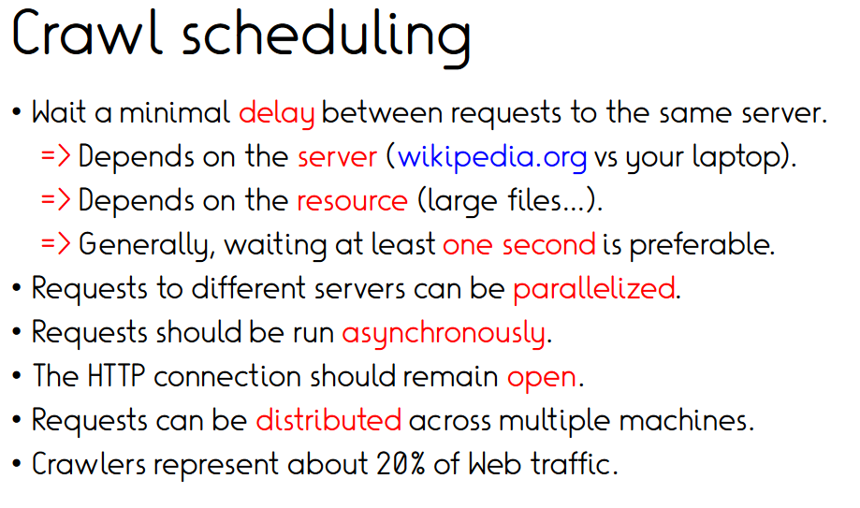

Slide 31
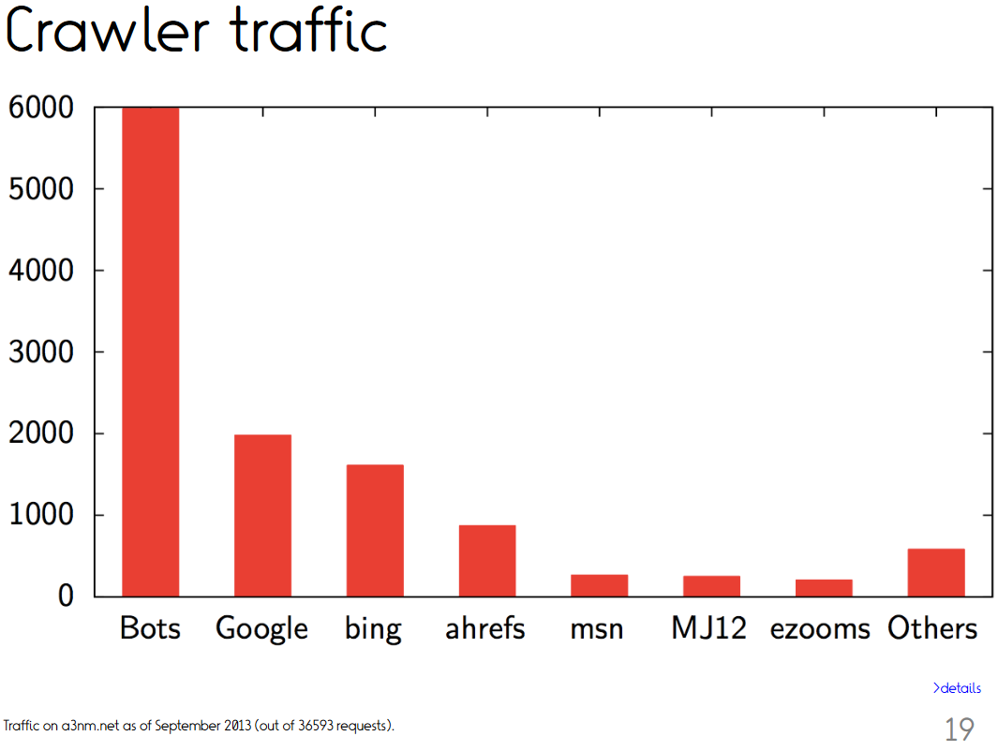
Crawler traffic
[Yuan et al., CCN 2002]
“We estimate that approximately 40% of Internet traffic is due to Web crawlers”

Slide 32
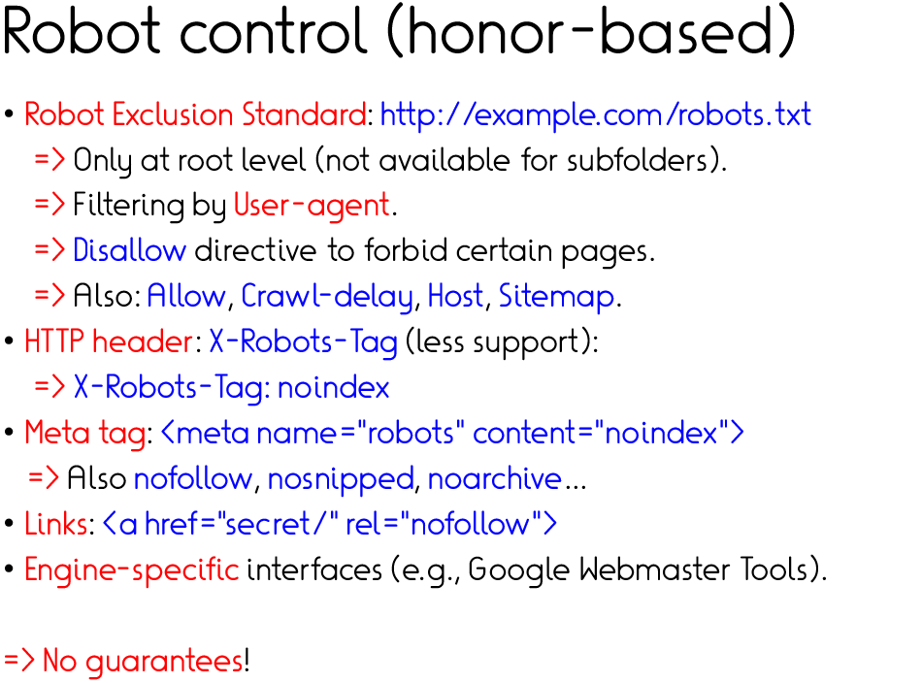
https://www.mpi-inf.mpg.de/robots.txt
https://www.google.de/robots.txt

Slide 33
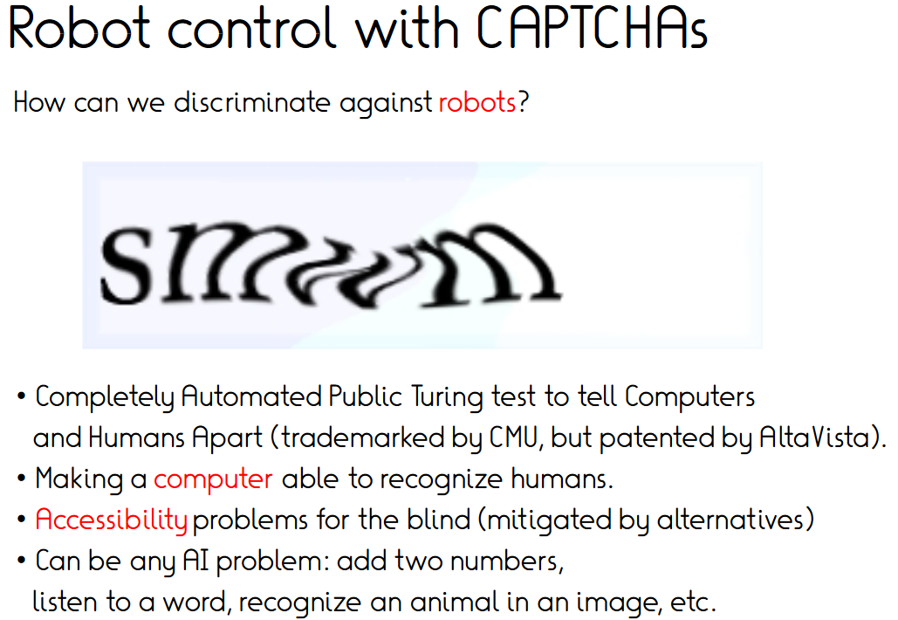

Slide 34
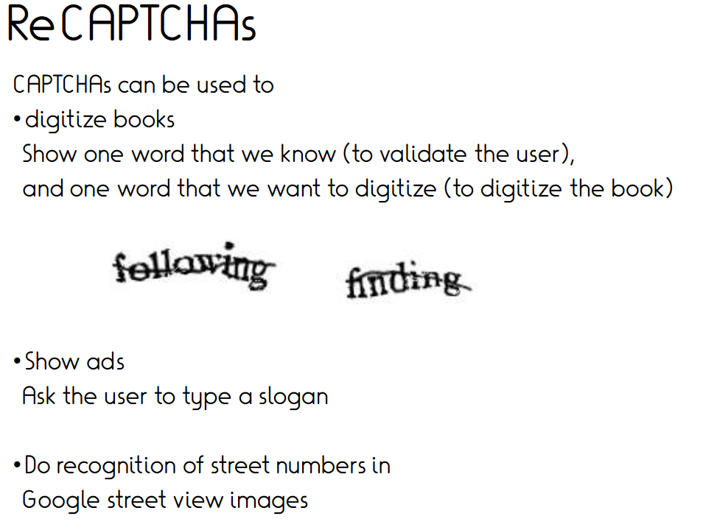

Slide 35
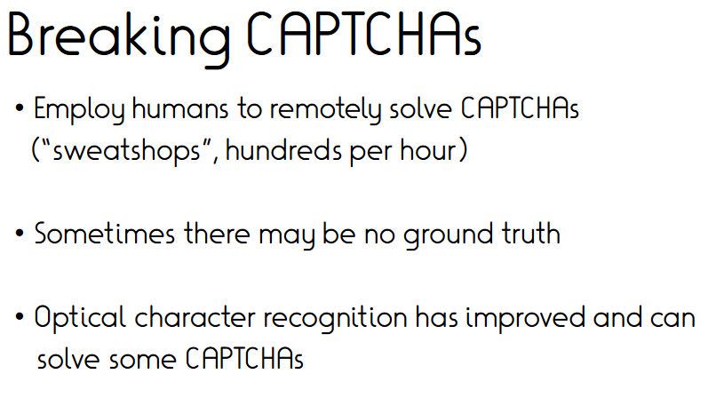
→ Try often enough

Slide 36
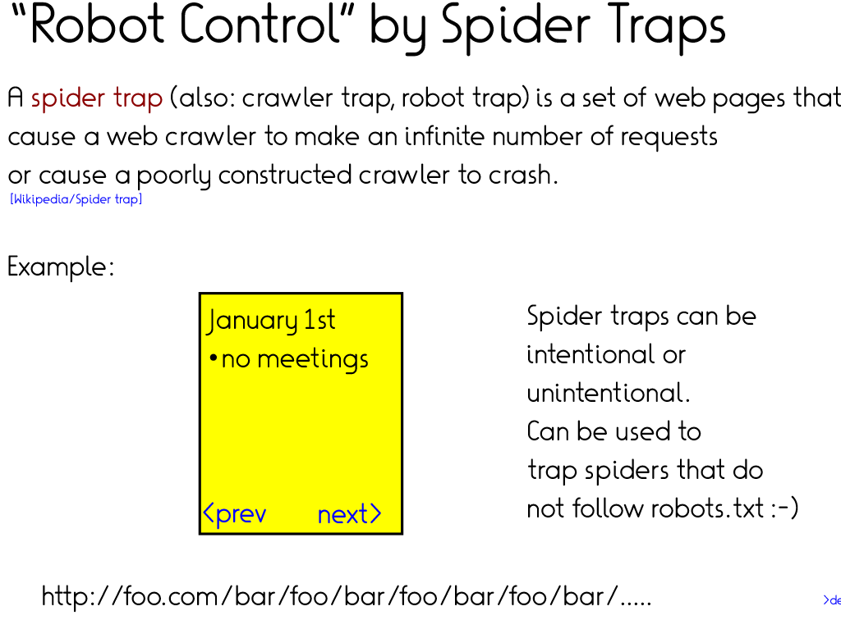

Slide 37
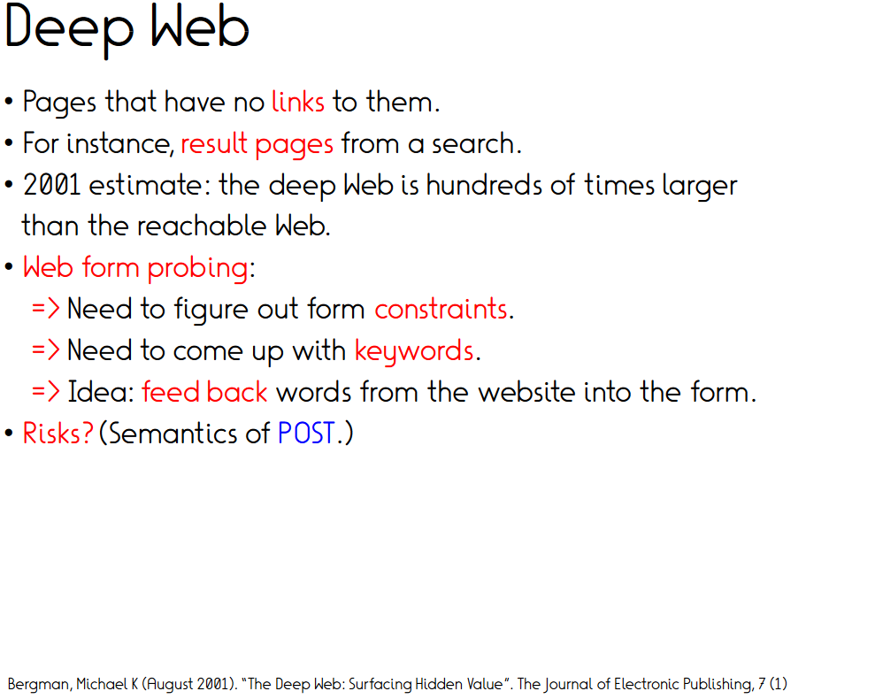
Deep web / dark web

Slide 38
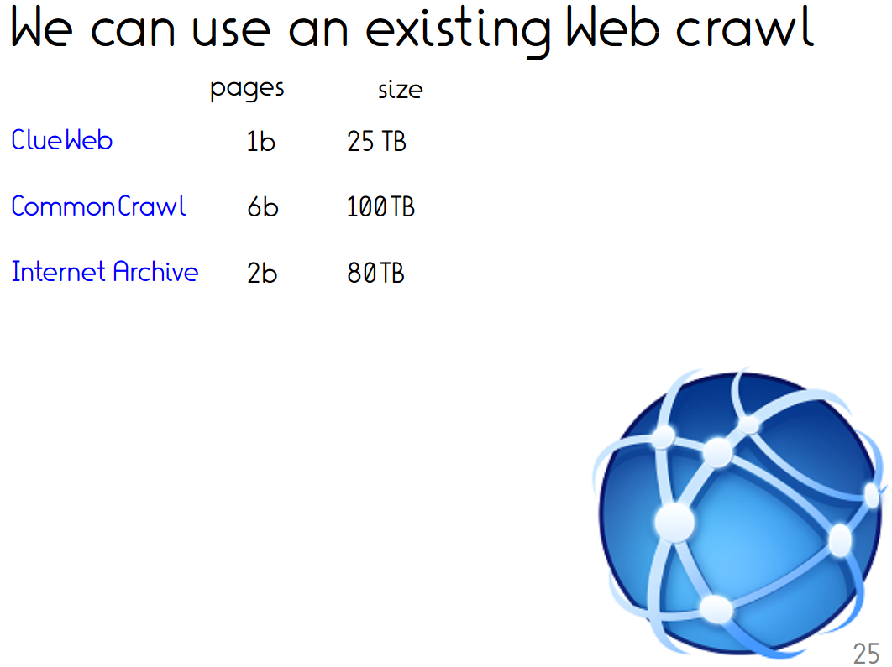
enWikipedia 5m 30 GB
Dresden web 125m
table corpus
Twitter dumps
2016 US election 280m
Reddit dumps …
Wikia dumps …
…

Slide 39
Insights from crawling mpi-inf.mpg.de
URL ending inclusion/exclusion criteria need thought
Long (machine-generated URLs) need exclusion
Beyond that no issues
35 lines in Python
Sequential runtime for 2000 pages: ~10 minutes
Completeness?

Slide 40
Outline
Design considerations
Crawling
Scraping

Slide 41
Inputs
Semi-Structured Data
(Infoboxes, Tables, Lists …)
Text Documents
& Web Pages
Conversations
& Behavior
Crawling
Premium Sources
(Wikipedia, IMDB, …)
Web collections
(Web crawls)
High-Quality Text
(News Articles, Wikipedia …)
Difficult Text
(Books,
Interviews …)
Online Forums
& Social Media
Queries & Clicks
Rules & Patterns
Logical
Inference
Statistical
Inference
NLP
Tools
Deep
Learning
Methods
Entity names, aliases & classes
Entities in
Taxonomy
Rules &
Constraint
Relational
Statements
Canonicalized
Statements
Outputs

Slide 42
Inputs
Semi-Structured Data
(Infoboxes, Tables, Lists …)
Text Documents
& Web Pages
Conversations
& Behavior
Scraping
Premium Sources
(Wikipedia, IMDB, …)
Web collections
(Web crawls)
High-Quality Text
(News Articles, Wikipedia …)
Difficult Text
(Books,
Interviews …)
Online Forums
& Social Media
Queries & Clicks
Rules & Patterns
Logical
Inference
Statistical
Inference
NLP
Tools
Deep
Learning
Methods
Entity names, aliases & classes
Entities in
Taxonomy
Rules &
Constraint
Relational
Statements
Canonicalized
Statements
Outputs

Slide 43
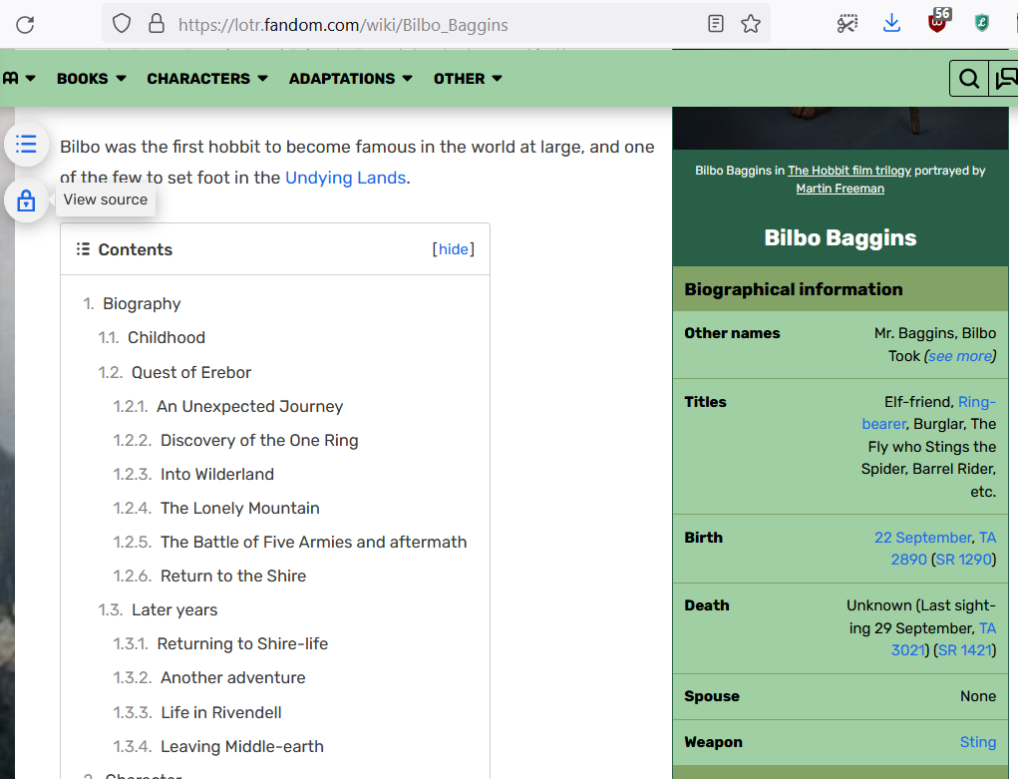
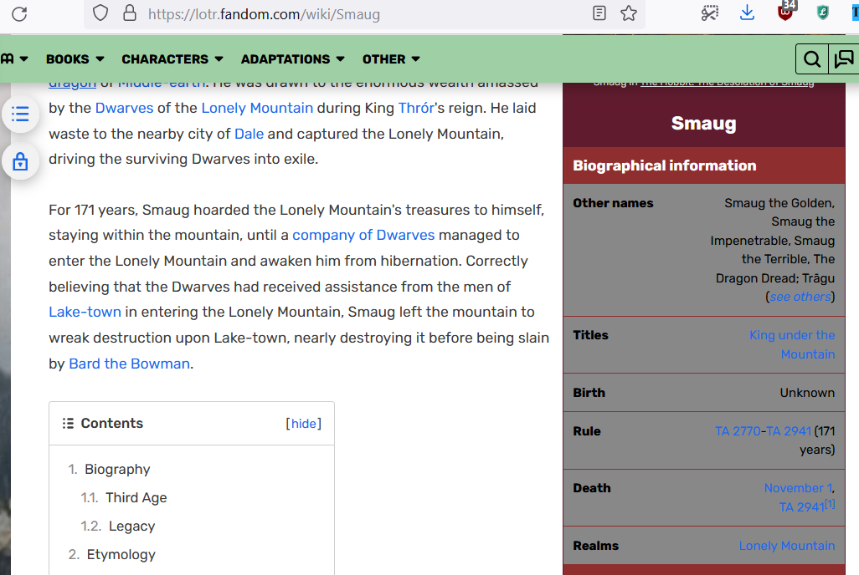
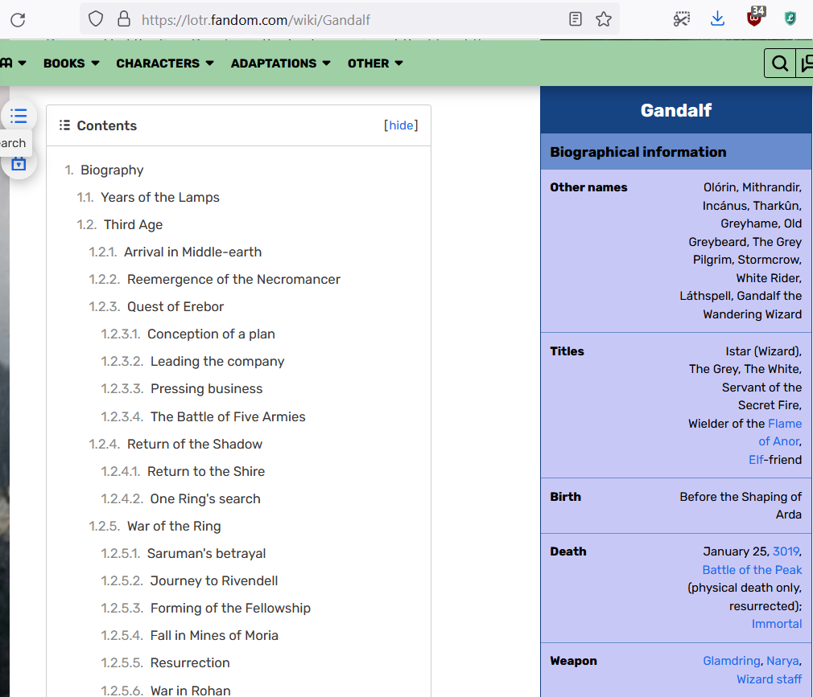

Slide 44
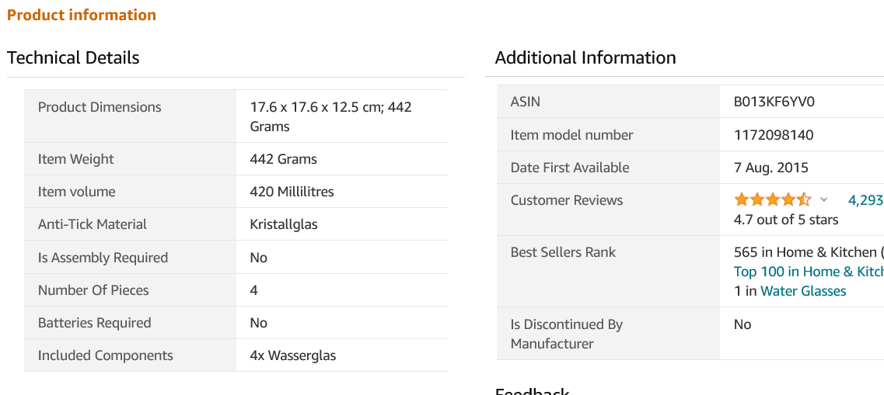
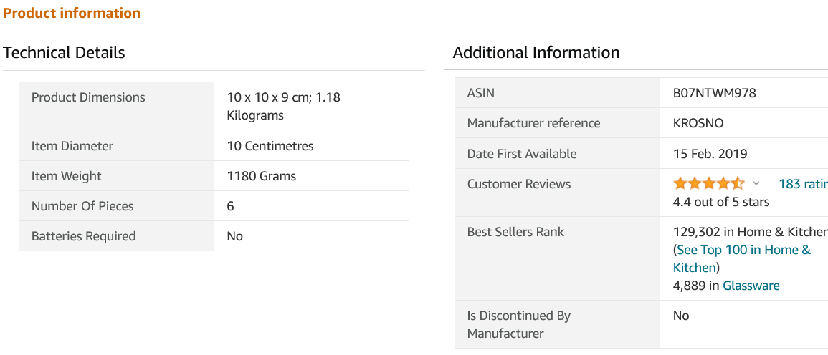

Slide 45
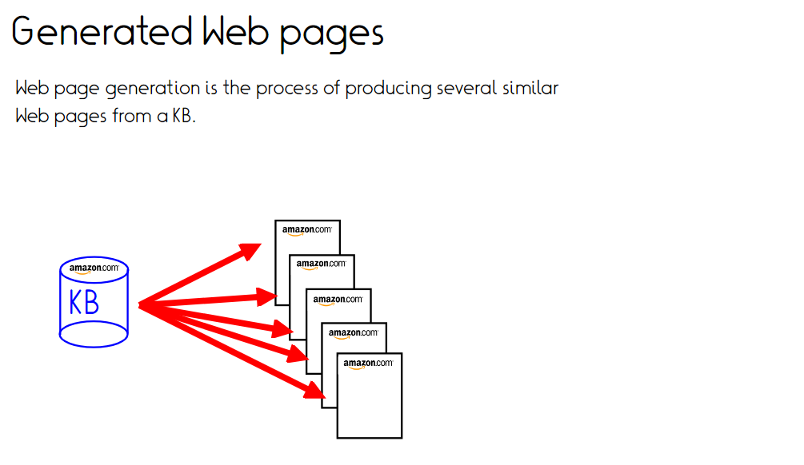

Slide 46
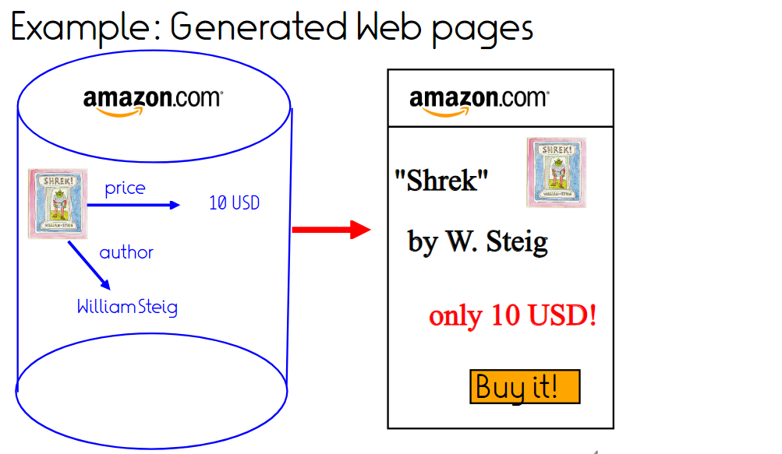

Slide 47
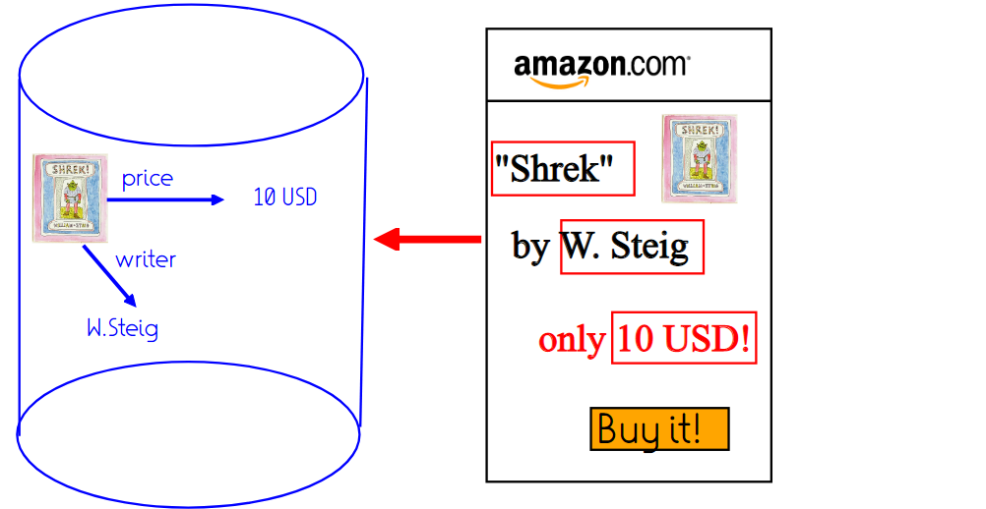
Scraping aims to reconstruct the KB

Slide 48
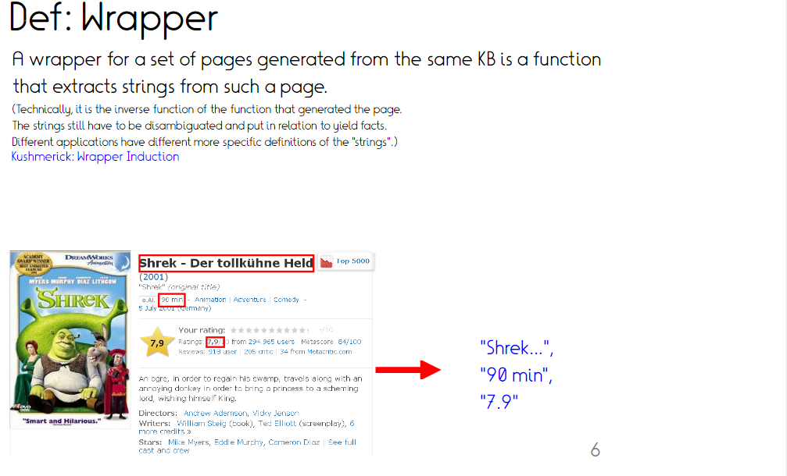

Slide 49
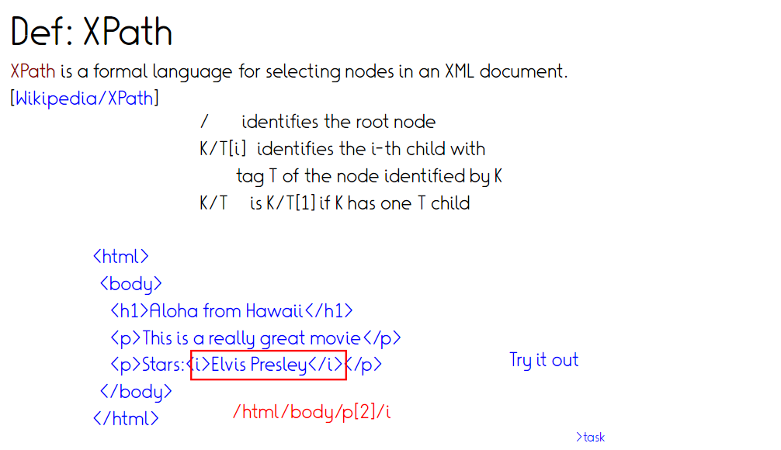
[https://www.w3schools.com/xml/xml_xpath.asp]
[https://devhints.io/xpath]

Slide 50
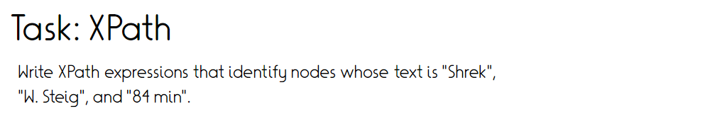
<html>
<body>
<b>Shrek</b>
<ul>
<li>Creator: <b>W. Steig</b></li>
<li>Duration: <i>84m</i></li>
</ul>
</body>
</html>
https://www.freeformatter.com/xpath-tester.html
Notes:
<html>
<body>
<b>Shrek</b>
<ul>
<li>Creator: <b>W. Steig</b></li>
<li>Duration: <i>84m</i></li>
</ul>
</body>
</html>
/html/body/b
/html/body/ul/li[1]/b
/html/body/ul/li[2]/I
/text()

Slide 51
Scraping: Browser
Website: https://lotr.fandom.com/wiki/Bilbo_Baggins
“Try XPath” Firefox addin
//h3[@class='pi-data-label pi-secondary-font']
Firefox console
  $x('//h3[@class=\'pi-data-label pi-secondary-font\']')
//h3[@class='pi-data-label pi-secondary-font'] | //div[@class='pi-data-value pi-font']
Notes:
Tools-> developer -> console – “allow pasting”. And use console window at bottom, not search field at top!
Website: https://lotr.fandom.com/wiki/Bilbo_Baggins
Try Xpath is nice because shows graphically what is caught

Slide 52
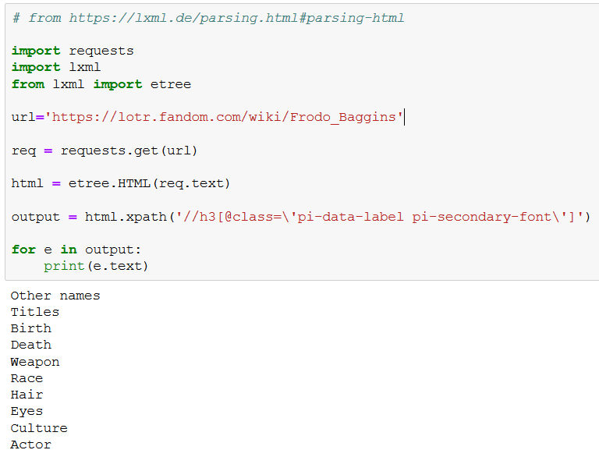
Scraping in Python - XPath

Slide 53
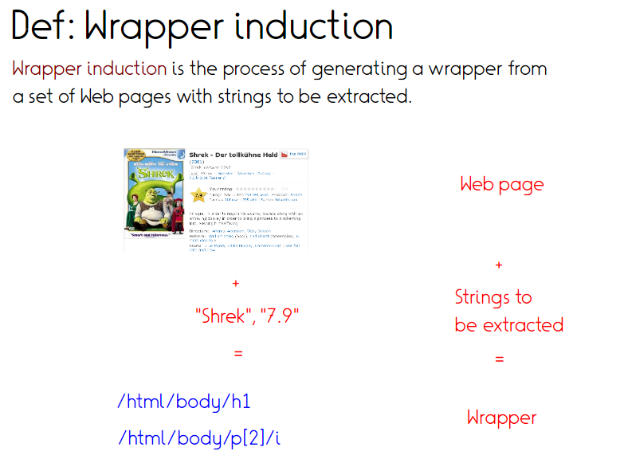

Slide 54
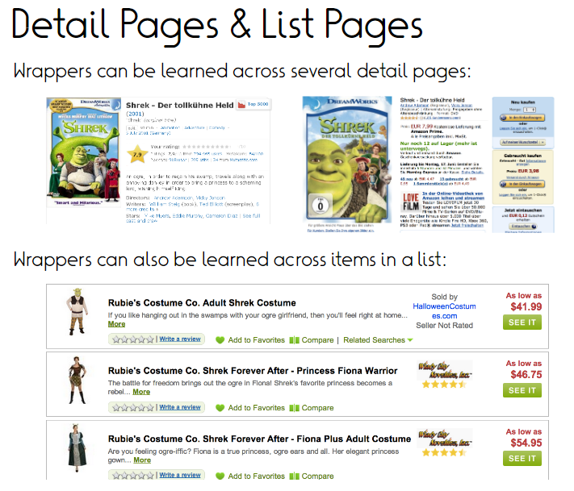

Slide 55
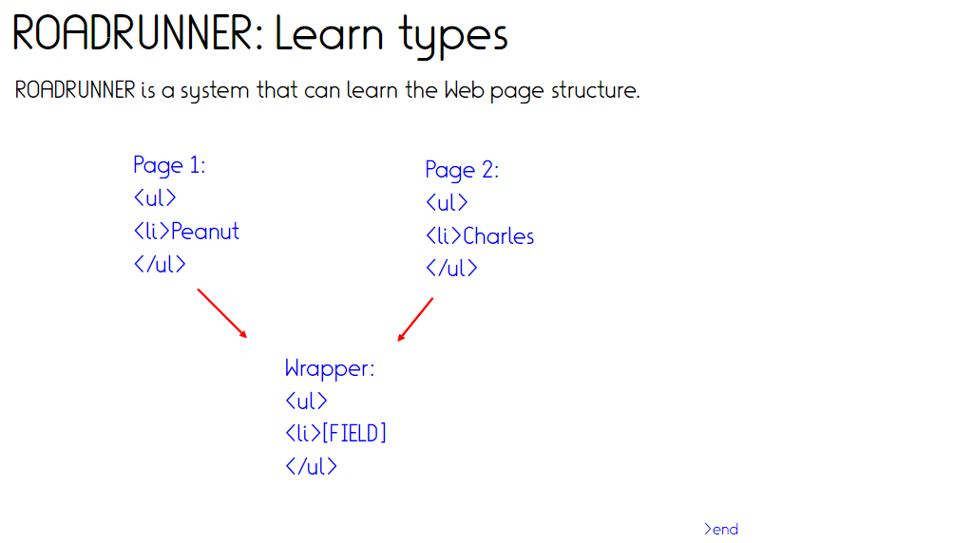
Finds least upper bounds in regex lattice
Crescenzi et al., VDLB 2001
http://www.vldb.org/conf/2001/P109.pdf

Slide 56
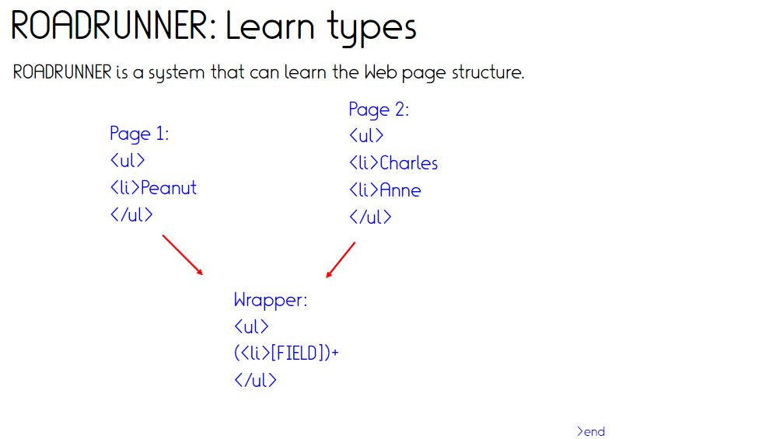
Crescenzi et al., VDLB 2001
http://www.vldb.org/conf/2001/P109.pdf

Slide 57
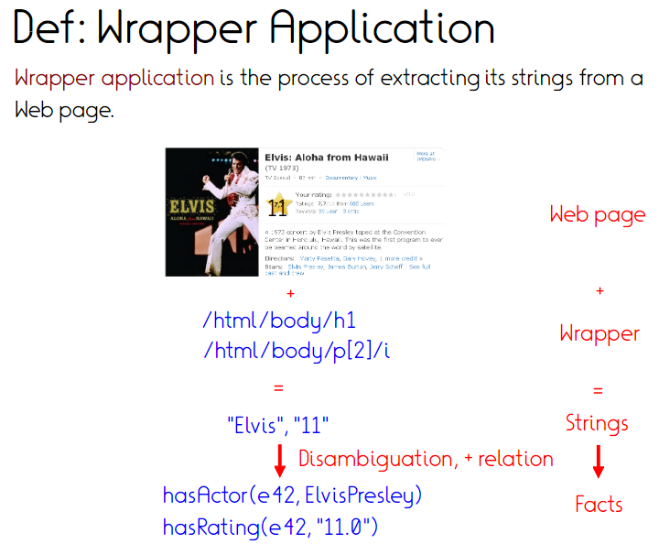

Slide 58
Alternative Scraping in Python – BeautifulSoup
Python library for
  Treating HTML structure as a Python object
  Effective search inside this object
soup.title
# <title>The Dormouse's story</title>
soup.title.string
# 'The Dormouse's story'
soup.title.parent.name
# ‘head'
soup.a
# <a class="sister" href="http://ex.com/elsie" id="link1">Elsie</a>
soup.find_all('a')
# [<a class="sister" href="http://ex.com/elsie" id="link1">Elsie</a>,
# <a class="sister" href="http://ex.com/lacie" id="link2">Lacie</a>
<html>
<head>
<title>
The Dormouse's story
</title>
</head>
<body>
Once upon a time there were three little sisters; and their names were <a class="sister" href="http://ex.com/elsie" id="link1">Elsie</a> , <a class="sister" href="http://ex.com/lacie" id="link2"> Lacie</a> and …

Slide 59
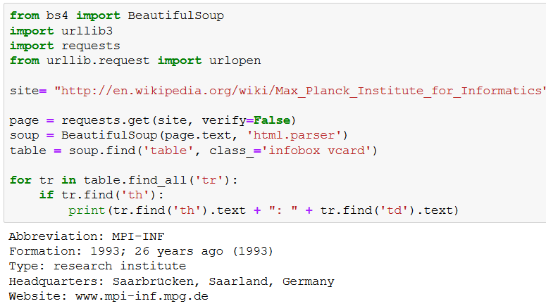
Alternative Scraping in Python – BeautifulSoup (2)

Slide 60
XPath vs. BeautifulSoup vs …
XPath: Generic query language to select nodes in XML (HTML) documents
  Queries can be issued from Python, Java, C, …
BeautifulSoup
  Python library to manipulate/search websites as Python objects
Scrapy
  Python library to crawl websites
Selenium
  Actual scripted browser interaction
  → To get around Javascript etc.
https://www.udemy.com/tutorial/scrapy-tutorial-web-scraping-with-python/scrapy-vs-beautiful-soup-vs-selenium/

Slide 61
Assignment 2
No crawling (practicality/ethics…)
1x Wikia infobox extraction
  XML format, but essential content not structured by XML tags → BeautifulSoup/pattern matching/regex
1x LSF-scraping
  XPath/BeautifulSoup should both work

Slide 62
Take home
Considerations about output, input, method go first
Crawling
  BFS to achieve coverage
  Challenges with captchas, traps, deep web
Scraping
  Reverse-engineering of template-based websites
Next week: (Textual) entity typing

