Slide 1
Automated knowledge base construction
4. Taxonomy induction + entity disambiguation
Simon Razniewski
Summer term 2022
Notes:
Interactive:
OpenTapioca demo

Slide 2
Recap
Assignment
Crawling and scraping
Entity types as first building block of KBs
Today:
  How to organize entity types
  How to distinguish entities

Slide 3
Outline
Taxonomy induction
Entity disambiguation

Slide 4
Recap: Entity types
Einstein: Physicist, Nobel prize winner, ETH alumni
Dudweiler: Village, municipality
RCH₂OH: chemical formula, psychoactive substance
Why organize them?
  Observations are usually sparse
  Upper classes may be needed for queries:
    German locations ending in –weiler
    Scientists born in 1879
  Class relations needed for constraint checking
    graduatedFrom(Person, educationalInstitution)
    UdS -> University -> OK?

Slide 5
Inputs
Semi-Structured Data
(Infoboxes, Tables, Lists …)
Text Documents
& Web Pages
Conversations
& Behavior
Premium Sources
(Wikipedia, IMDB, …)
Web collections
(Web crawls)
High-Quality Text
(News Articles, Wikipedia …)
Difficult Text
(Books,
Interviews …)
Online Forums
& Social Media
Queries & Clicks
Rules & Patterns
Logical
Inference
Statistical
Inference
NLP
Tools
Deep
Learning
Methods
Entity Names, Aliases & Classes
Entities in
Taxonomy
Rules &
Constraint
Relational
Statements
Canonicalized
Statements
Outputs

Slide 6
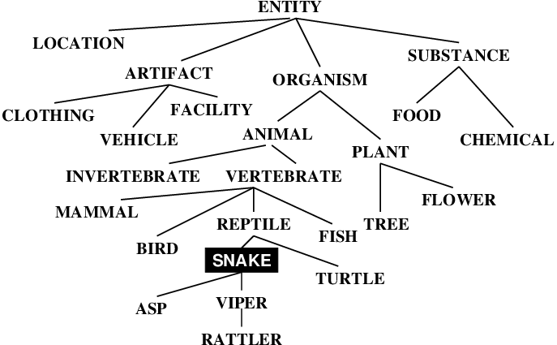
Taxonomy induction: Goal

Slide 7
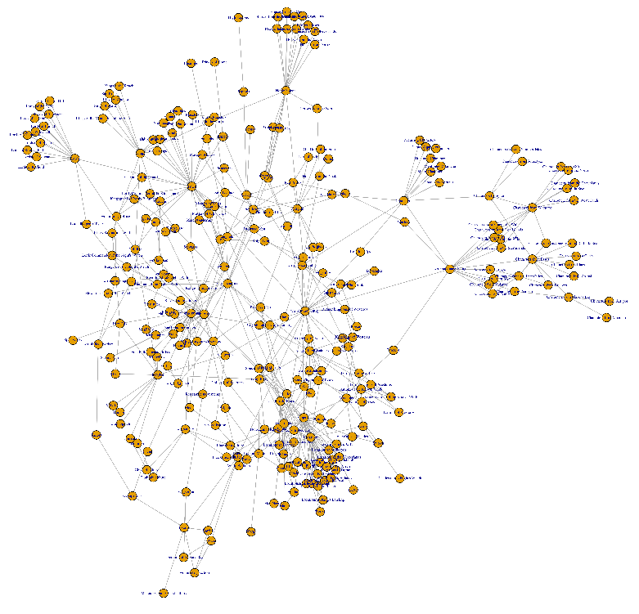
Taxonomy induction:
General approach
Hypernymy candidates are “cheap”
→ Start with large noisy candidate graph, clean it up

Slide 8
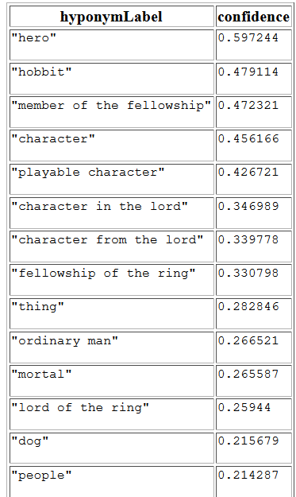
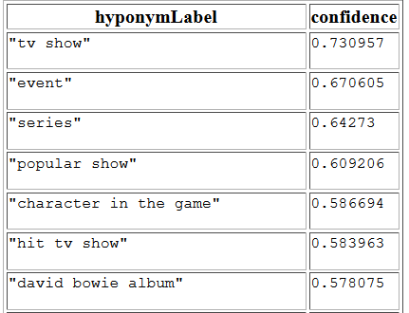
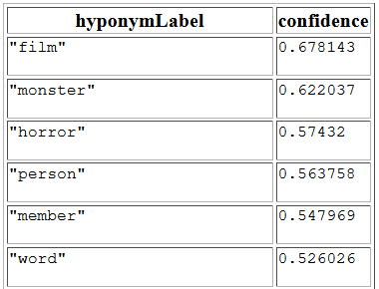
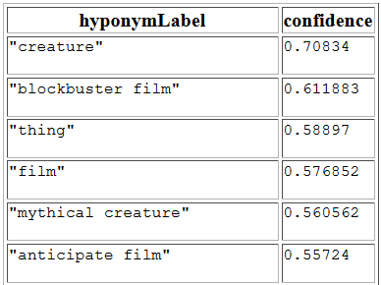
Candidates #1: Hearst-patterns
Hearst-style patterns (here: WebIsALOD for ``Frodo’’)

Slide 9
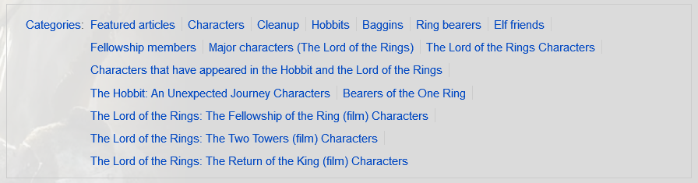
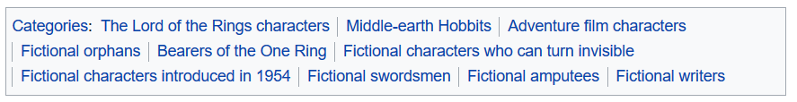


Candidates #2: Sub-category relations in Wiki systems

Slide 10
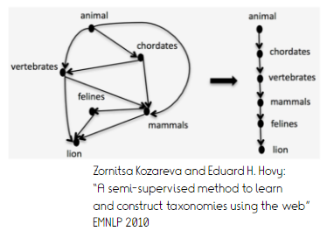
Challenges
Noise
  Extraction errors
  Instances
  Ambiguous terms
  Meta-categories
Structural oddities
  Cycles
  Upward branching
  Redundancy (transitive edges)
Imbalance in observations and scoring
  Naive thresholding discards entire regions

Slide 11
Text-based taxonomy induction challenge [Semeval 2016, Bordea et al.]
Input: Set of domain terms
  Tofu, pizza, garlic
  Computer, smartphone, printer
Task: Induce a taxonomy over these terms
Evaluation measures
  Recall w.r.t. gold standard
  Precision w.r.t. gold standard
  Connectedness (#connected components)
  Categorization (#intermediate nodes)
  Acyclicity
  #nodes
  #edges

Slide 12
Taxi [Panchenko et al., 2016]
Crawl domain-specific text corpora in addition to WP, Commoncrawl
Candidate hypernymy extraction
  Via substrings
    “biomedical science” isA “science”
    “microbiology” isA “biology”
    “toast with bacon” isA “toast”
    Lemmatization, simple modifier processing
    Scoring proportional to relative overlap
  Candidate hypernymy from 4 Hearst-Pattern extraction projects
Supervised pruning
  Positive examples: gold data
  Negative examples: inverted hypernyms + siblings
  Features: Substring overlap, Hearst confidence (more features did not help)

Slide 13
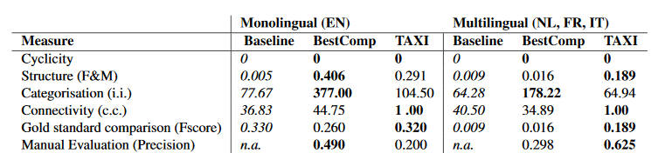
Taxi [Panchenko et al., 2016]
  4. Taxonomy induction
    Break cycles by random edge removal
    Fix disconnected components by attaching each node with zero out-degree to root
- too many hypernyms in English

Slide 14
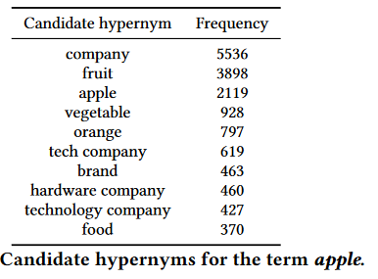
Taxonomy induction using hypernym subsequences [Gupta et al., 2017]
Looking at edges in isolation ignores important interactions
  Hypernym candidates typically contain higher-level terms that help in predicting whole sequence
  Crucial as abstract term hypernym extraction empirically harder (e.g., “company” → “group of friends”?)

Slide 15
Taxonomy induction using hypernym subsequences [Gupta et al., 2017]
Joint probabilistic model that estimates true hypernymy relations from skewed observations
Break cycles by removing edges with minimal weight
Induce tree from DAG by a min-cost-flow model

Slide 16
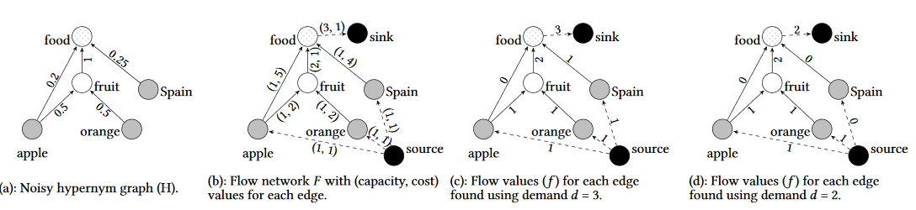
Taxonomy induction using hypernym subsequences [Gupta et al., 2017]
Method: Find cheapest way to send flow from leaves to root
Cost inversely proportional to edge weight
Notes:
DAG to tree -> retain all edges that are used in cheapest shipment.

Slide 17
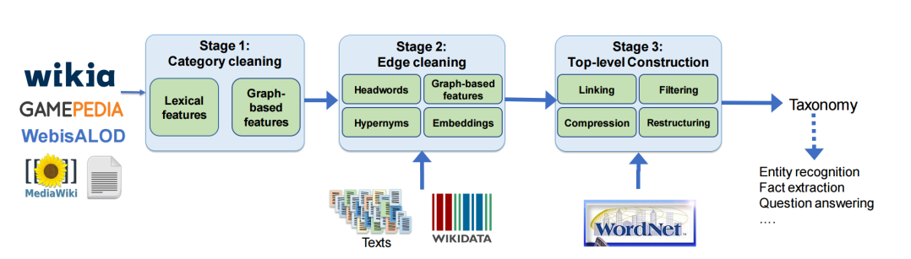
Wiki[pedia | a]- based taxonomy induction: TiFi [Chu et al., WWW 2019]
Observations:
  Wikia category systems are noisy
  Wikia category systems lack abstractions
Approach: Supervised filtering + WordNet reuse

Slide 18
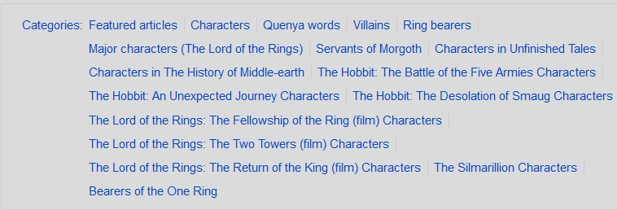
TiFi: Category cleaning
Challenge:
  Meta-categories (Meta, Administration, Article_Templates)
  Contextual categories (actors, awards, inspirations)
  Instances (Arda, Mordor)
  Extensions (Fan fiction)
Approach: Supervised classification
  “Featurizes” earlier rule-based category cleaning works, e.g., [Pasca, WWW 2018]
Features:
  Lexical
    Headword in plural? Dark Orcs, Ring of Power
    Capitalization? Quenya words, Ring bearers
  Graph-based
    #instances
    Supercategory/subcategory count
    Average depth
    Connected subgraph size

Slide 19
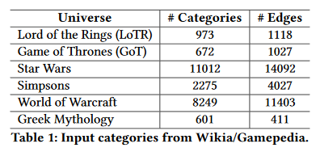
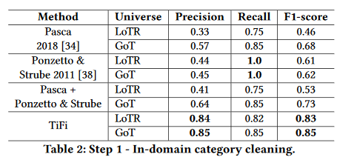
TiFi: Category cleaning - results
Most important feature: Plural
  Occasional errors (Food)

Slide 20
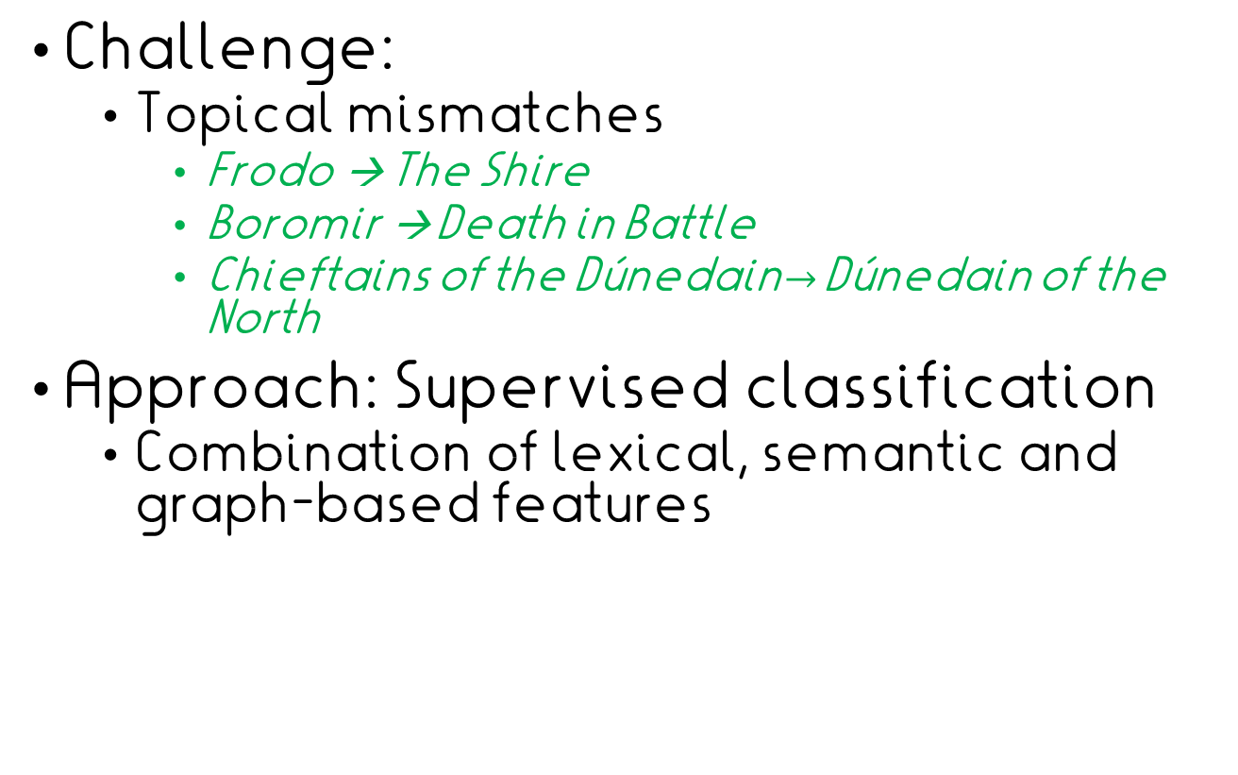
TiFi: Edge cleaning
Challenge:
  Topical mismatches
    Frodo → The Shire
    Boromir → Death in Battle
    Chieftains of the Dúnedain$→$Dúnedain of the North
Approach: Supervised classification
  Combination of lexical, semantic and graph-based features

Slide 21
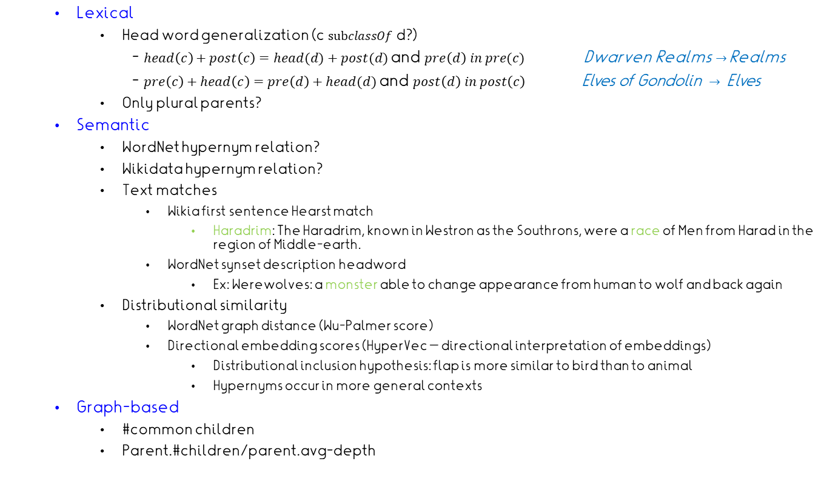
TiFi: Edge cleaning - features
  Lexical
    Head word generalization (c $subclassOf$d?)
  - $head\left(c\right)+post\left(c\right)=head(d)+post(d)$and $pre\left(d\right) in pre(c)$ Dwarven Realms $→$Realms
  - $pre\left(c\right)+head\left(c\right)=pre\left(d\right)+head(d)$ and $post\left(d\right) in post\left(c\right) \text{Elves} \text{of} \text{Gondolin} → \text{Elves}$
    Only plural parents?
  Semantic
    WordNet hypernym relation?
    Wikidata hypernym relation?
    Text matches
      Wikia first sentence Hearst match
        Haradrim: The Haradrim, known in Westron as the Southrons, were a race of Men from Harad in the region of Middle-earth.
      WordNet synset description headword
        Ex: Werewolves: a monster able to change appearance from human to wolf and back again
    Distributional similarity
      WordNet graph distance (Wu-Palmer score)
      Directional embedding scores (HyperVec – directional interpretation of embeddings)
        Distributional inclusion hypothesis: flap is more similar to bird than to animal
        Hypernyms occur in more general contexts
  Graph-based
    #common children
    Parent.#children/parent.avg-depth

Slide 22
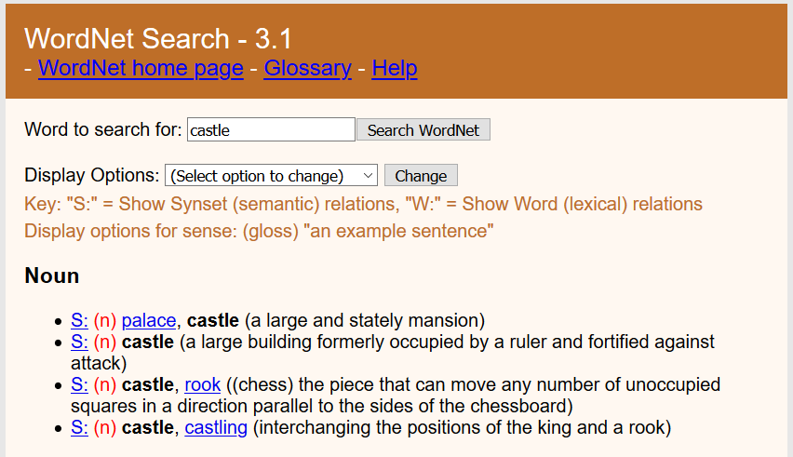
TiFi - WordNet synset description headword

Slide 23
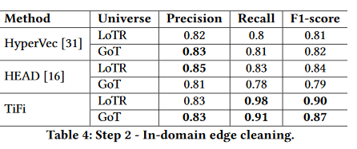
TiFi: Edge cleaning - results
Most important features:
  Only plural parent
  Lexical generalization
  Common child support
  Wikia first sentence Hearst match
← Embedding only
← Rules only

Slide 24
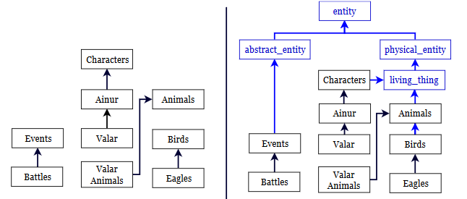
TiFi: Top-level construction
Problem: Wikia categories represent many disconnected components
Solution: Link sinks to WordNet taxonomy and import further top level
Notes:
Linking: WordNet lookup, then embedding similarity to obtain right sense

Slide 25
TiFi – Top-level construction
Using latent similarity based on description and parent/child names versus WordNet glosses
  Birds is mapped to bird%1:05:00::
  Subsequent hypernyms: wn_vertebrate → wn_chordate → wn_animal → wn_organism
  → wn_living_thing → wn_whole → wn_object → wn_physical_entity → wn_entity
  Removal of long paths (nodes with only one child and one parent)
  Dictionary-based filtering of ~100 too abstract classes (whole, sphere, imagination, …)

Slide 26
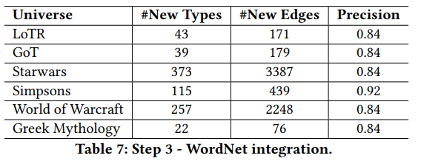
TiFi: Top-level construction - results

Slide 27
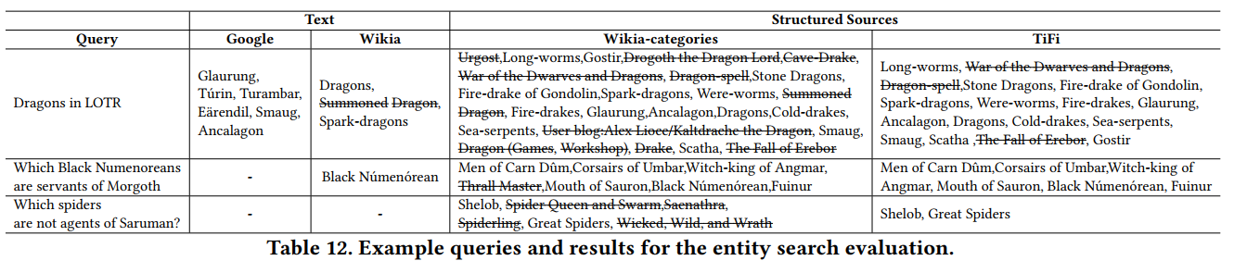
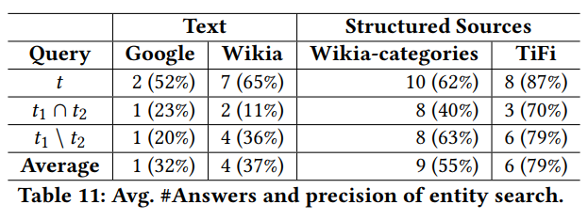
TiFi – Relevance for entity search

Slide 28
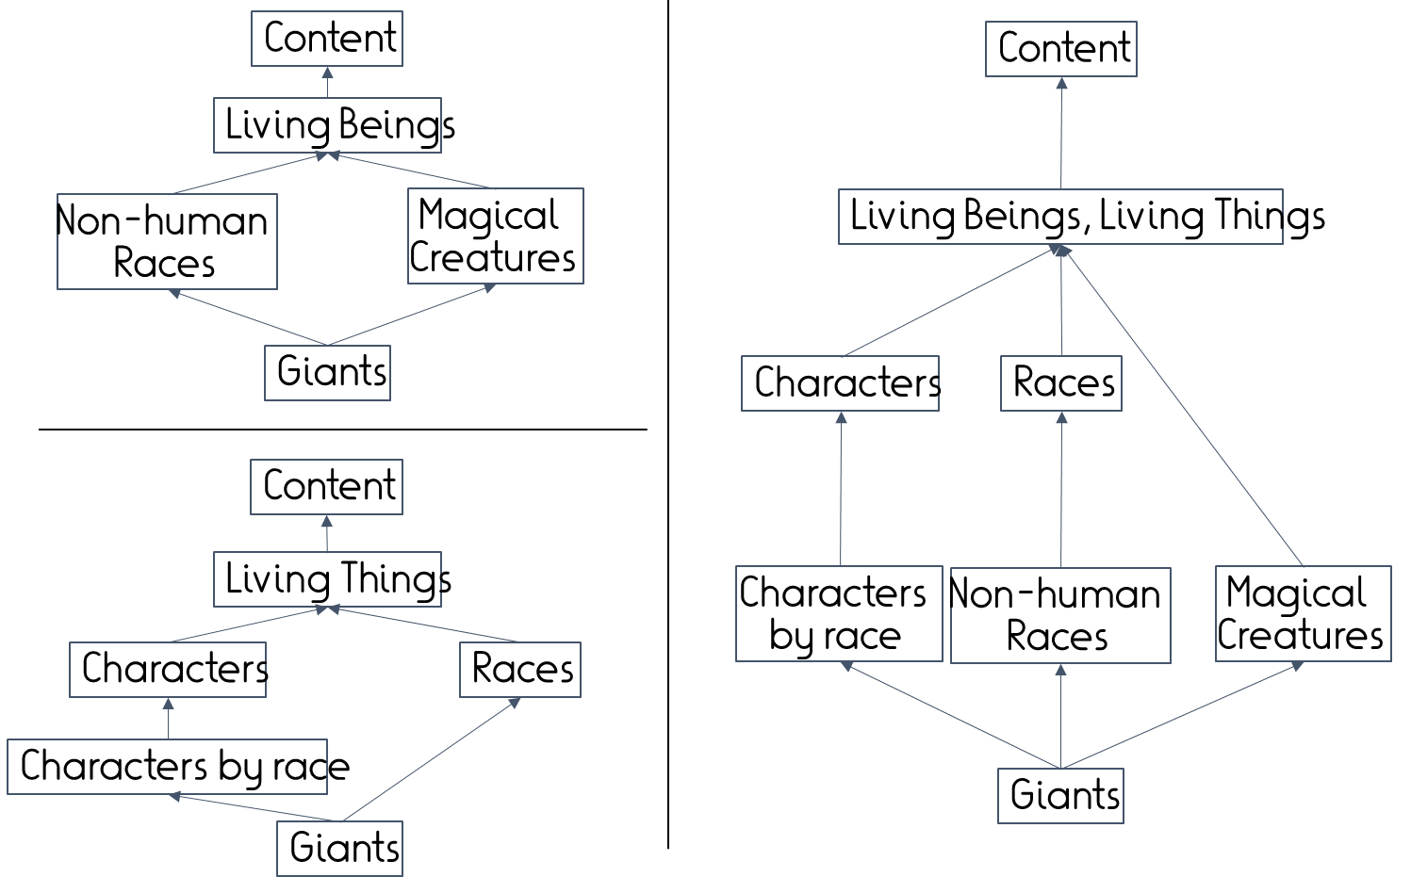
Open: Taxonomy Merging
~Complex alignment problem requiring joint optimization

Slide 29
Summary: Taxonomy induction
Usually a filtering process on larger candidate set
Structure matters for local decisions
  Local-only decision OK but not optimal
Top-level: Avoid reinventing wheel
  Sparse observations
  Generality makes reuse easier
Relevance for AKBC:
  Queries for type conditions not explicitly observed
  Constraints on relation arguments

Slide 30
Outline
Taxonomy induction
Entity disambiguation

Slide 31
Ready for fact extraction?
Homer is the main character of the TV series “Simpsons”.
Homer is the author of the Odyssey.
appearsIn(Homer, Simpsons)
wrote(Homer, Odyssey)?

Slide 32
Inputs
Semi-Structured Data
(Infoboxes, Tables, Lists …)
Text Documents
& Web Pages
Conversations
& Behavior
Premium Sources
(Wikipedia, IMDB, …)
Web collections
(Web crawls)
High-Quality Text
(News Articles, Wikipedia …)
Difficult Text
(Books,
Interviews …)
Online Forums
& Social Media
Queries & Clicks
Rules & Patterns
Logical
Inference
Statistical
Inference
NLP
Tools
Deep
Learning
Methods
Entity Names, Aliases & Classes
Entities in
Taxonomy
Rules &
Constraint
Relational
Statements
Canonicalized
Statements
Outputs

Slide 33
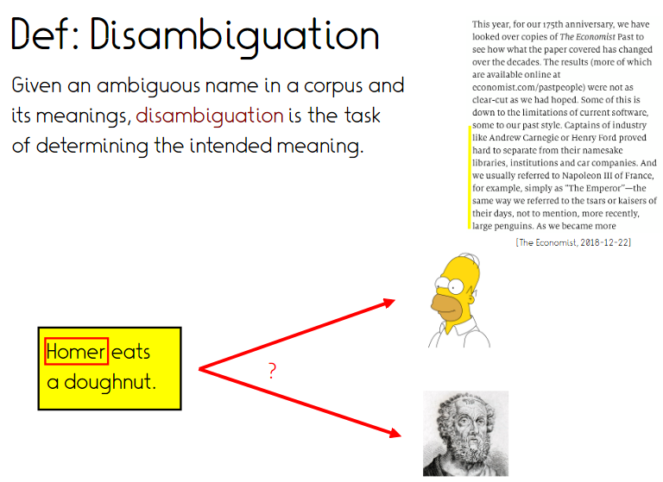

Slide 34
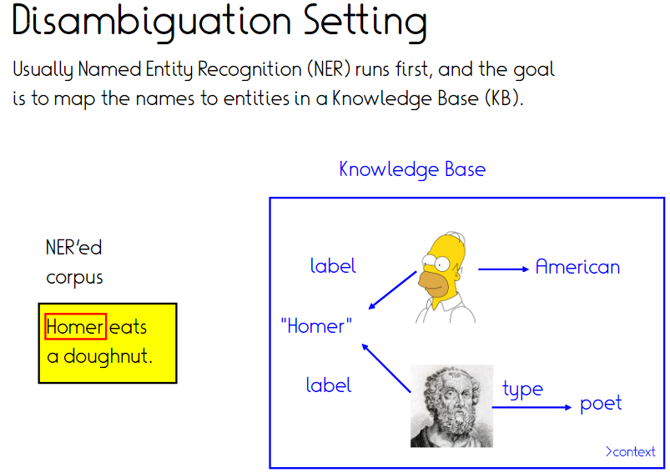
Also called “Wikification”, because everyone links to Wiki[pedia | data]

Slide 35
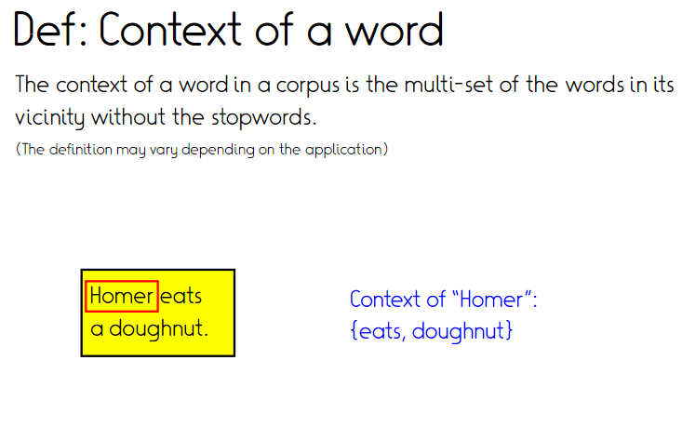

Slide 36
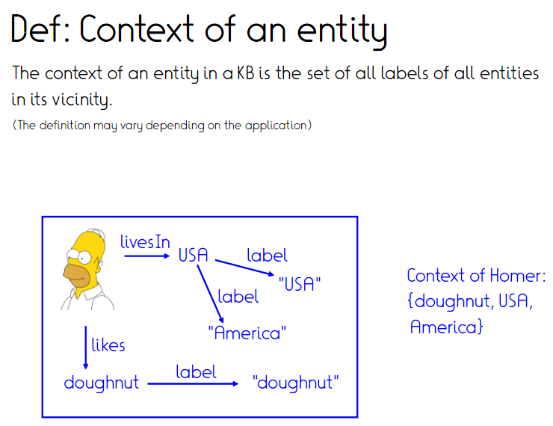

Slide 37
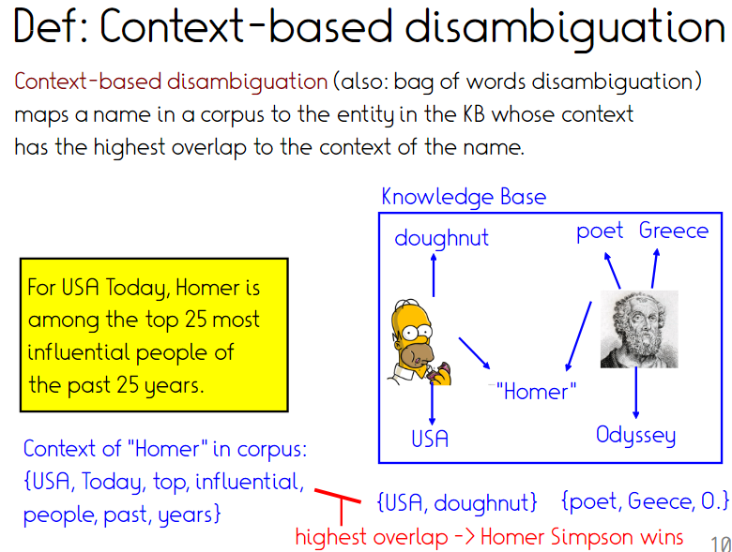
Who wins?

Slide 38
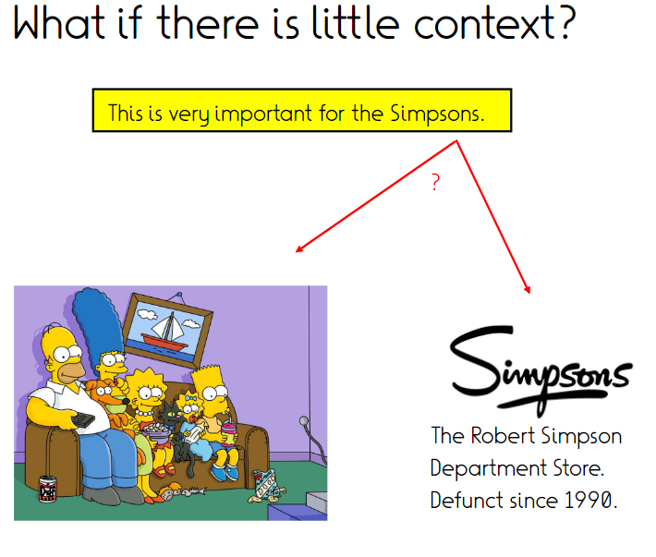

Slide 39
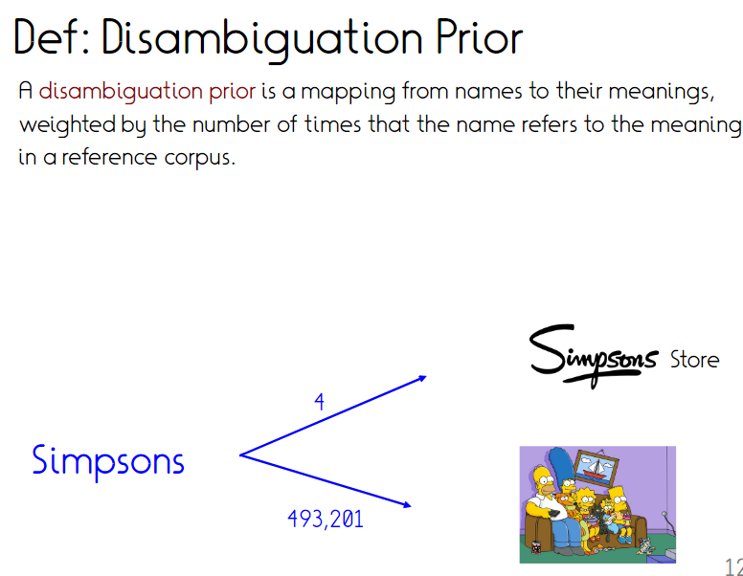
Can be computed e.g. from Wiki[pedia | a] by link disambiguation or page views

Slide 40
Local or global solution?
Features so far local
(one entity mention at a time)
  Context-similarity
  Disambiguation prior
Do disambiguations influence each other?

Slide 41
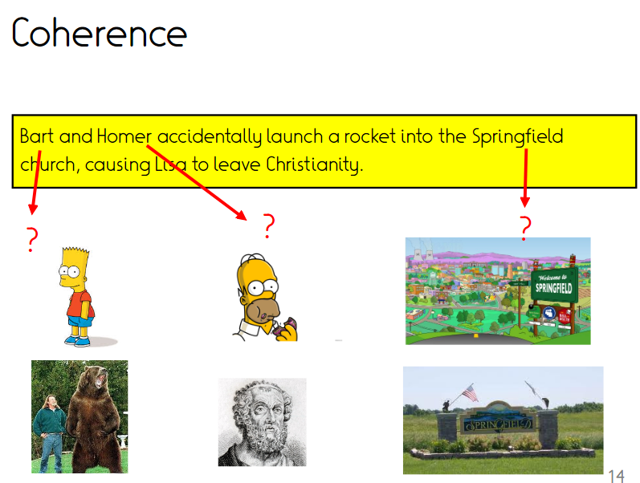
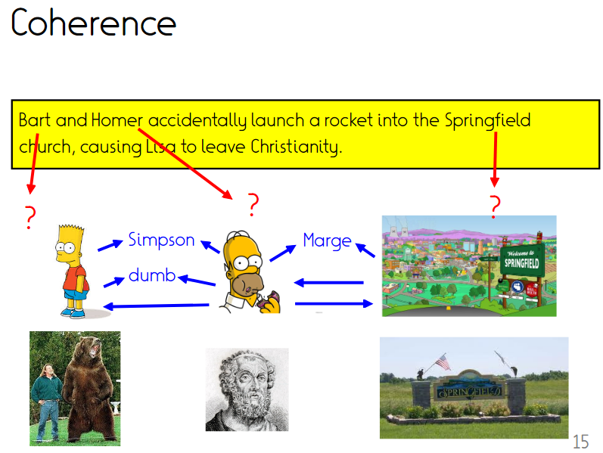
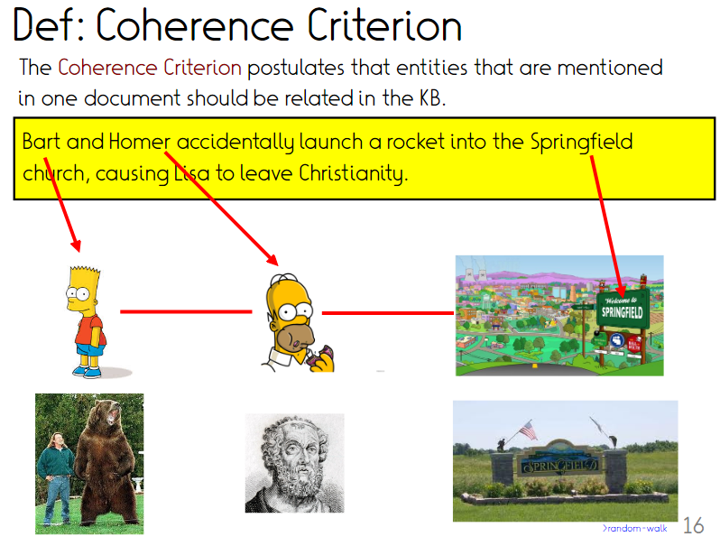

Slide 42
Possible implementation (2)
n entity mentions
Each with m candidate KB entities
→ Compute coherence scores for m^{n} combinations

Slide 43
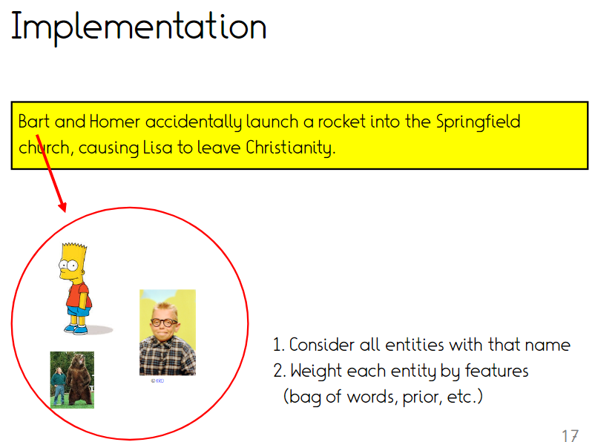
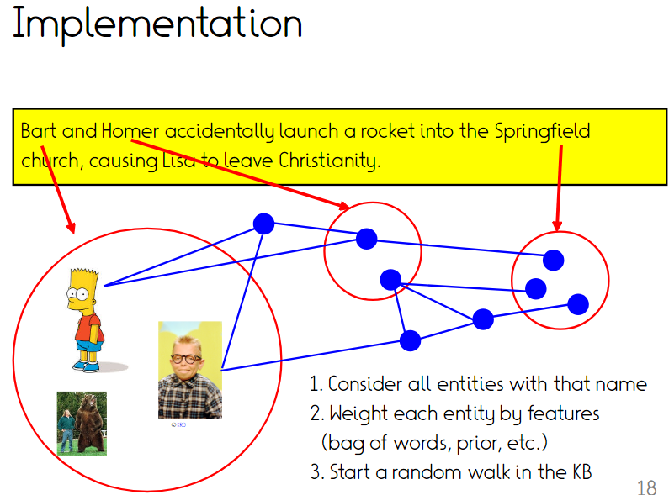
Possible implementation (2)
[Guo and Barbosa. Robust Named Entity Disambiguation with Random Walks, SWJ 2018]

Slide 44
State of the art
Pre-trained neural models for context match likelihood
  Encode KB context
  Encode text context
  Predict match likelihood
  …or, predict KB identifier directly
  (GENRE, de Cao, ICLR 2021)
Graph algorithm for global coherence
Automated training data:
Wikipedia-data text links

Slide 45
Example systems (1): Opentapioca
https://opentapioca.org/
https://arxiv.org/pdf/1904.09131.pdf
Notes:
[[Angela]] met [[Donald]] and together they discussed about [[Vladimir]]
Associated Press writer Julie Pace contributed from Washington. She knows Obama and lives in Berlin.

Slide 46
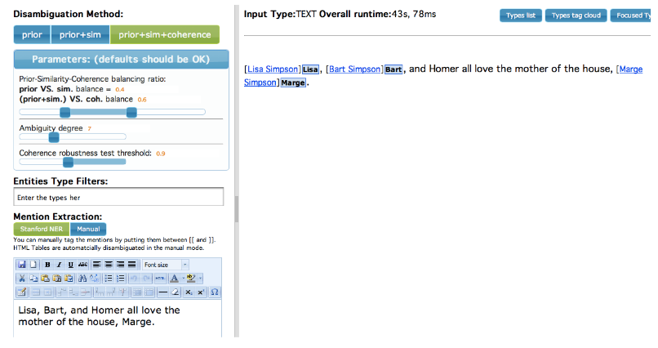
Example systems (2): AIDA
Explicit parameter tuning – no more functioning ☹
https://gate.d5.mpi-inf.mpg.de/webaida/

Slide 47
Further solutions
spaCy can do this
  https://spacy.io/usage/linguistic-features#entity-linking
  Though more complex setup, KB
Commercial APIs
  https://try.rosette.com/
  https://cloud.google.com/natural-language/docs/analyzing-entities
  https://azure.microsoft.com/en-us/services/cognitive-services/text-analytics/

Slide 48
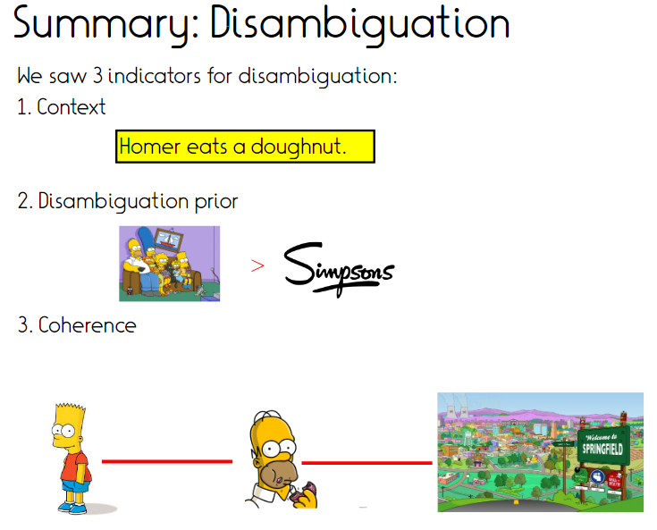

Slide 49
Disambiguation vs. typing
Like for typing, context is decisive
Unlike typing, no chance for supervised approach
  Can train classifiers that predict “Politician-ness” of a mention
  Cannot train classifier to predict “Einstein-ness”
Disambiguation is ranking problem (single solution), not multiclass classification
Type predictions can be used as intermediate features for context-based disambiguation
Type prediction can augment disambiguation, if KB has sparse content

Slide 50
References
Panchenko, Alexander, et al. Taxi at SEMEVAL-2016 Task 13: A taxonomy induction method based on lexico-syntactic patterns, substrings and focused crawling. SemEval 2016.
Gupta, Amit, et al. "Taxonomy induction using hypernym subsequences." CIKM 2017.
Chu, Cuong Xuan, et al. "TiFi: Taxonomy Induction for Fictional Domains." WWW 2019.
Yosef, Mohamed Amir, et al. Aida: An online tool for accurate disambiguation of named entities in text and tables. VLDB 2011.
Slides adapted from Fabian Suchanek, Gina-Anne Levow and Chris Manning

Slide 51
Assignment 5 – Taxonomy induction
Given: Set of terms
Task: Build a small taxonomy that organizes them
  Can become both leafs or inner nodes
Noisy input provided from WebIsALOD
  Cleaning, filtering, etc. highly recommended
  Other inputs allowed too
Evaluation:
  Two known term sets
  One unseen set (robustness)

Slide 52
Take home
Taxonomy induction:
  Structure matters
  Important features: Lexical/semantic matches, structural properties
Entity disambiguation
  Context seen already in typing
  Coherence as additional feature
Meta-observation:
  Both problems are better approached globally than locally
  Both problems are complementary

Slide 53
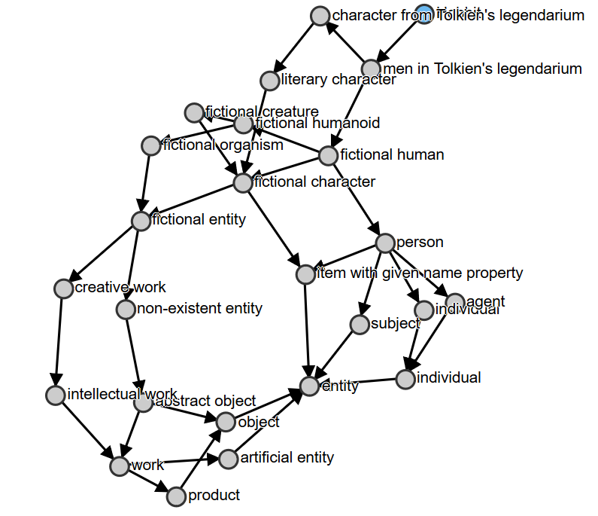
Playing with the Wikidata taxonomy
https://angryloki.github.io/wikidata-graph-builder/?property=P279&item=Q74359

