Slide 1
Automated knowledge base construction
5+6. Relation extraction
Simon Razniewski
Summer term 2022
Start of 6th lecture
Notes:
DIPRE one task
P/R several tasks, Nostradamus etc.

Slide 2
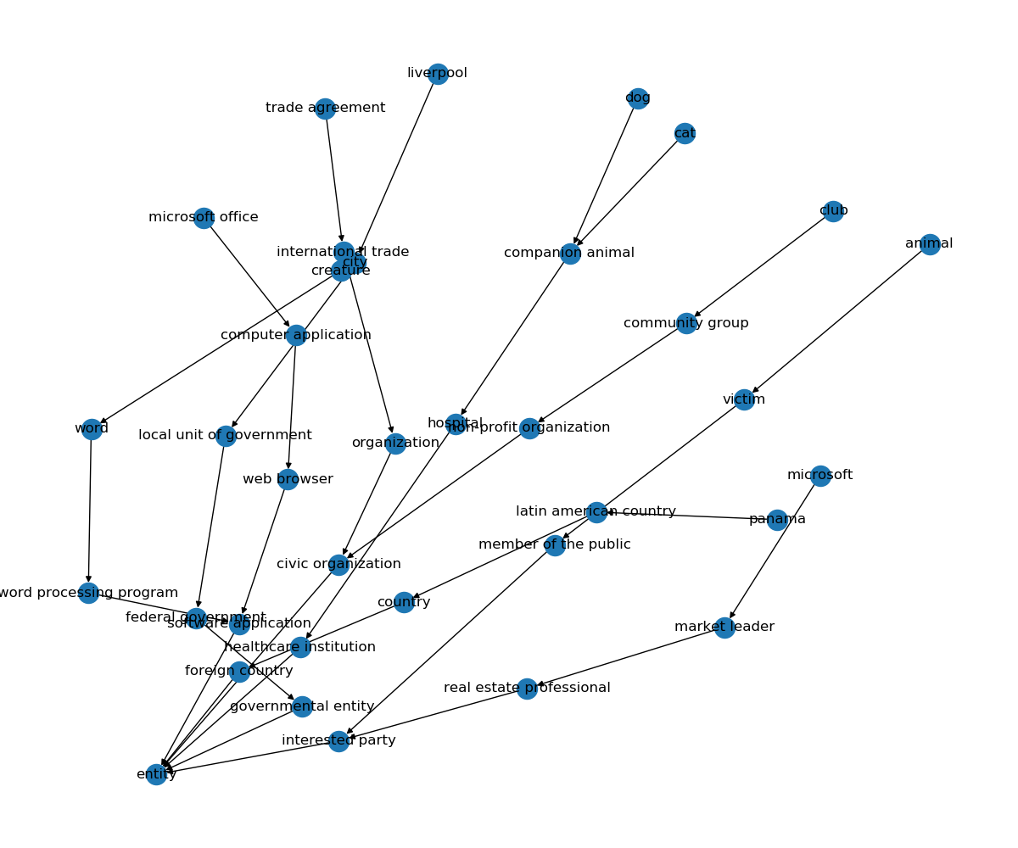
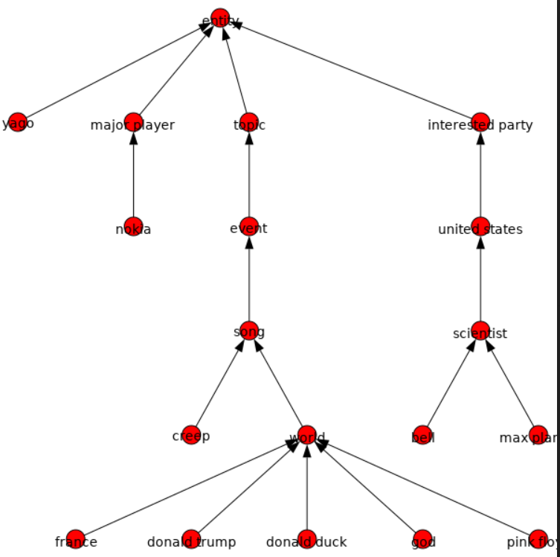
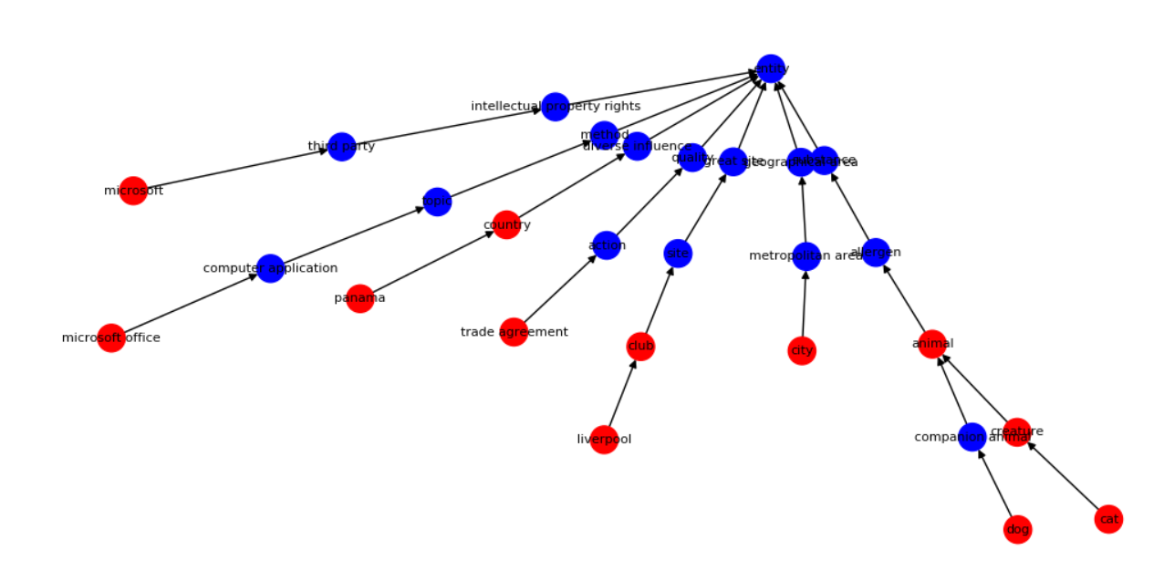

Slide 3
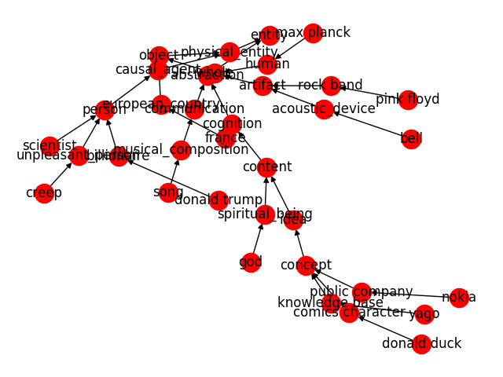

Slide 4
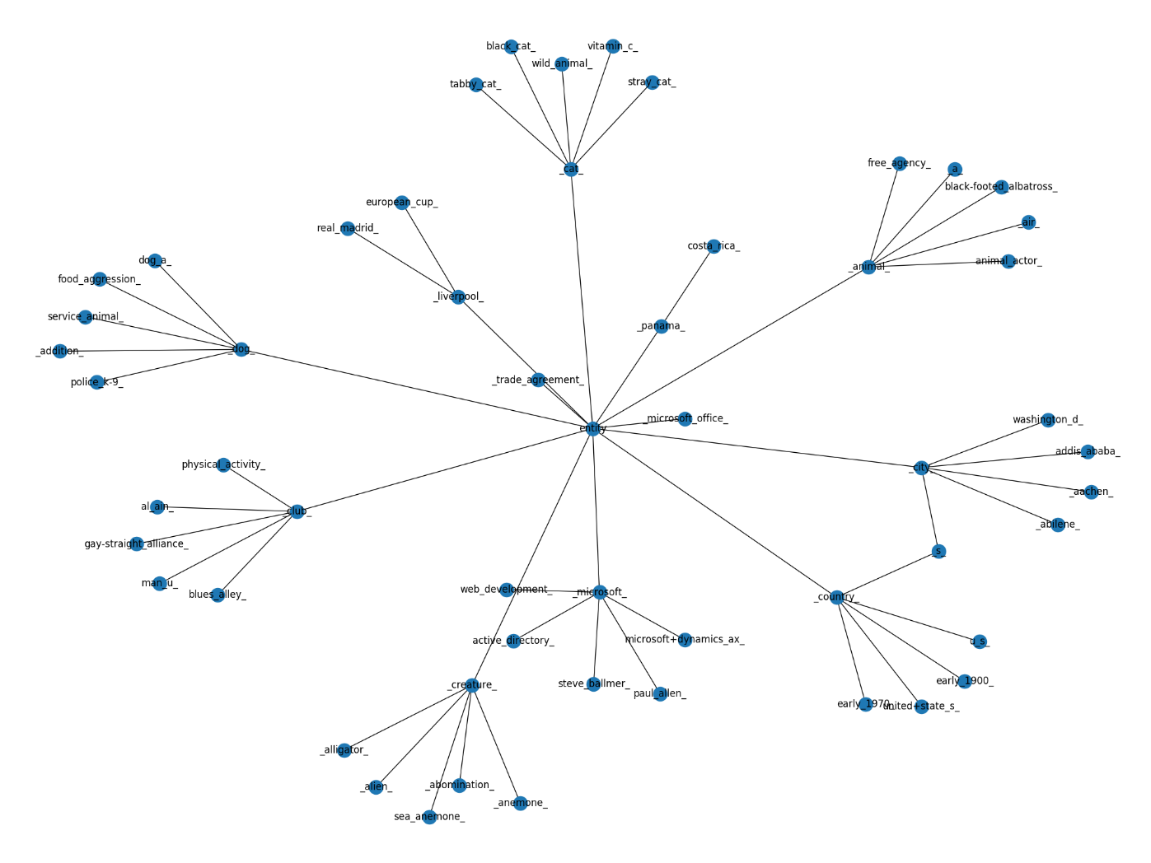

Slide 5
Outline
Fixed-target relation extraction
  Task
  Manual patterns
  Supervised learning
  Learning at scale
    Iterative pattern learning
    Distant supervision
  Case study: CINEX
Evaluation
Open information extraction (OIE)
  Idea
  Semantic role labeling and OIE
  Organizing open relations
Today
Next week

Slide 6
Inputs
Semi-Structured Data
(Infoboxes, Tables, Lists …)
Text Documents
& Web Pages
Conversations
& Behavior
Premium Sources
(Wikipedia, IMDB, …)
Web collections
(Web crawls)
High-Quality Text
(News Articles, Wikipedia …)
Difficult Text
(Books,
Interviews …)
Online Forums
& Social Media
Queries & Clicks
Rules & Patterns
Logical
Inference
Statistical
Inference
NLP
Tools
Deep
Learning
Methods
Entity Names, Aliases & Classes
Entities in
Taxonomy
Rules &
Constraint
Relational
Statements
Canonicalized
Statements
Outputs

Slide 7
Fixed-target relation extraction: Task
Given
  Text t
  Entities E in t
  Set of target relations R
Output:
  All relational triples (e₁, r, e₂) asserted in t
  (NER typically a preprocessing step to relation extraction)

Slide 8
Principal approaches
Extractive (patterns)
  If text contains “X is in Y”
  Then output tuple locatedIn(X, Y)
Classification
- Filtering: Only pairs within same sentence
- Perform sentence-for-sentence, union (avg) of results
sibling
coworker
 | e₁ | e₂ | e₃ | e₄ | e₅ | e₆ | e₇ | …
e₁ |  | T
e₂
e₃ |  |  |  | T
e₄
e₅ |  |  |  |  |  |  | T
e₆ |  |  |  | T
…
 | e₁ | e₂ | e₃ | e₄ | e₅ | e₆ | e₇ | e₈ | …
e₁ |  | T
e₂
e₃ | T
e₄ |  |  |  | T
e₅ |  |  |  |  |  |  | T
e₆ |  | T
…
Notes:
Reading comprehension
https://arxiv.org/pdf/1706.04115.pdf
QA similar to RE, models are classifiers
Predict which entities take part in a relation, then try to match them
- can extract relations without training data, if RC model is good.
- can benefit from large training data for RC.

Slide 9
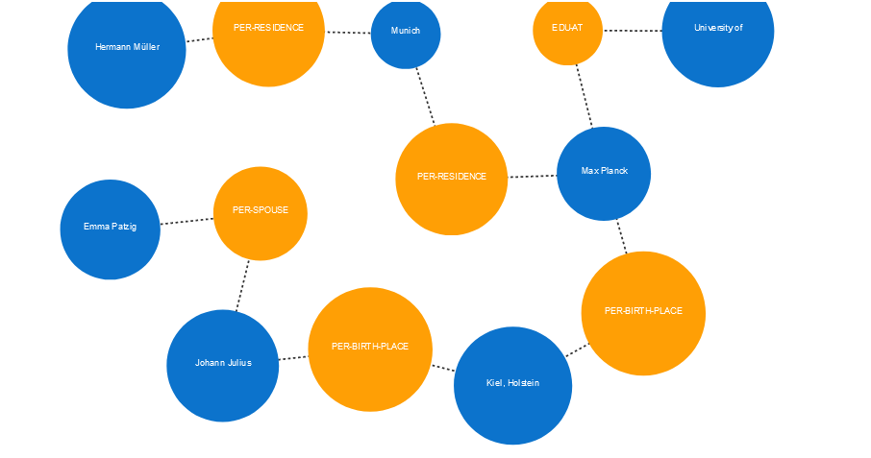
Output: Graph view

Slide 10
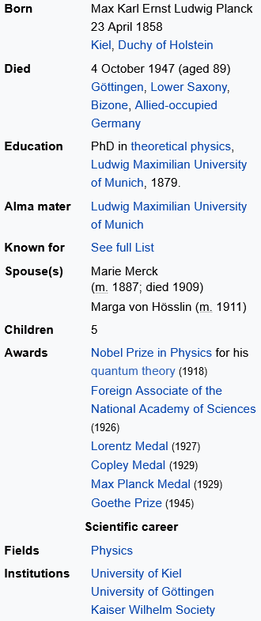
Output: Slot/list view

Slide 11
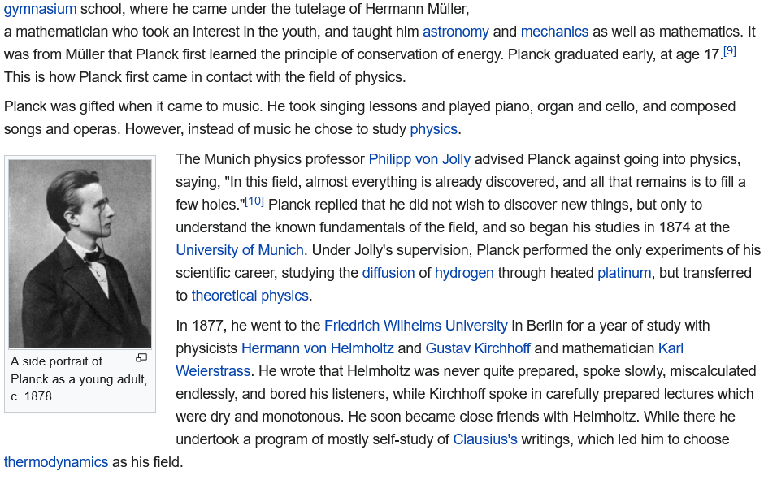
Extracting Relation Triples from Text
Which relations should we extract?

Slide 12
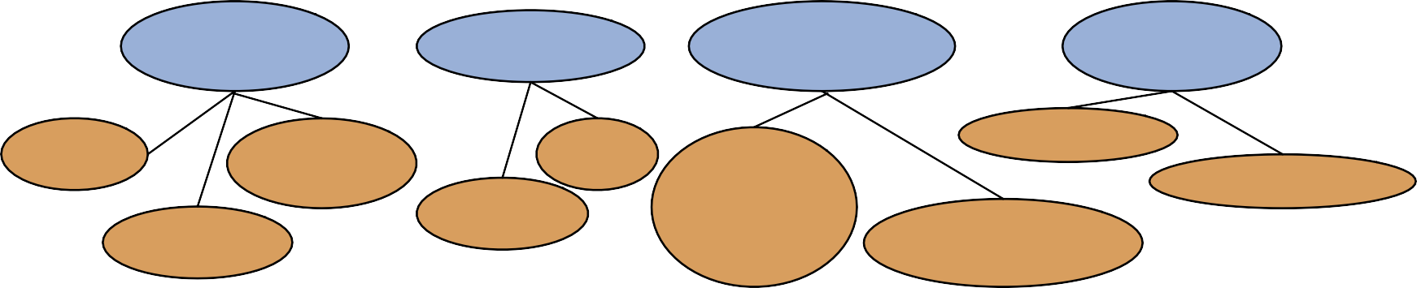
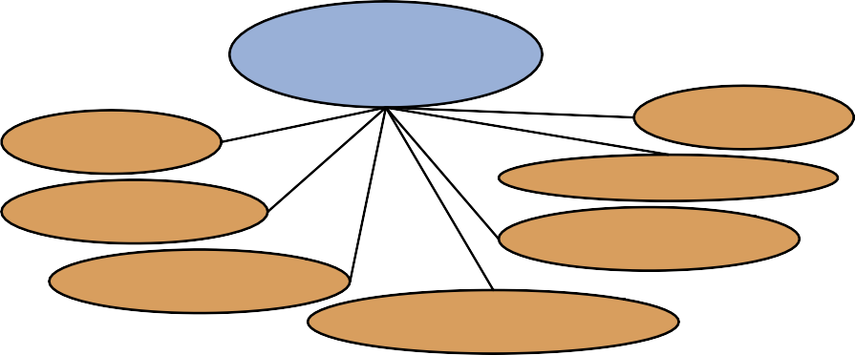
Automated Content Extraction (ACE)
17 relations from 2008 “Relation Extraction Task”
PERSON- SOCIAL
PHYSICAL
GENERAL AFFILIATION
PART- WHOLE
Family
Lasting Personal
Business
Near
Citizen- Resident- Ethnicity- Religion
Subsidiary
Geographical
Located
Org-Location- Origin
ORG AFFILIATION
ARTIFACT
Founder Ownership
Membership
Investor Student-Alum Employment
User-Owner-Inventor- Manufacturer
Sports-Affiliation

Slide 13
Automated Content Extraction (ACE)
Physical-Located
He was in
PER-GPE
Tennessee
Part-Whole-Subsidiary ORG-ORG
XYZ, the parent company of ABC
Person-Social-Family PER-PER
John’s wife
Org-AFF-Founder
Steve Jobs,
Yoko
PER-ORG
co-founder of Apple…

Slide 14
UMLS: Unified Medical Language System
134 entity types, 54 relations
Injury | disrupts | Physiological Function
Bodily Location | location-of | Biologic Function
Anatomical Structure | part-of | Organism
Pharmacologic Substance | causes | Pathological Function
Pharmacologic Substance | treats | Pathologic Function

Slide 15
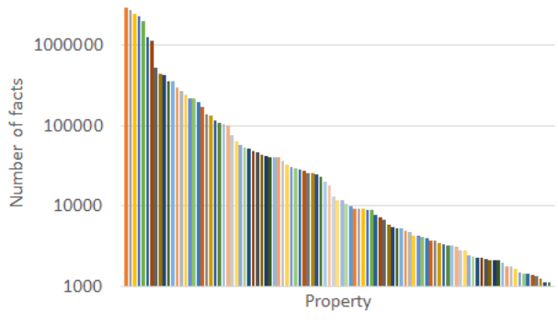
Wikidata relations
> 5000 relations
Most frequent relations for humans:
  Gender (89%)
  Occupation (77%)
  Date of birth ( 69%)
  Given name (59%)
  Citizenship (58%)
  …
  Languages spoke (13%)
  Position held (10%)
  …
11/2019: 67 human properties used at least 100k times

Slide 16
Ontological relations
Examples from WordNet
isA (hypernym): subsumption between classes
  Giraffe isA ruminant isA ungulate isA
mammal isA vertebrate isA animal…
instanceOf: relation between individual and class
  San Francisco instanceOf city
Synonym: Same meaning
Antonym: Opposite meaning
Meronym: Part of another concept
…

Slide 17
Outline
Fixed-target relation extraction
  Task
  Manual patterns
  Supervised learning
  Learning at scale
    Iterative pattern learning
    Distant supervision
  Case study: CINEX
Evaluation
Open information extraction (OIE)
  Idea
  Semantic role labeling and OIE
  Organizing open relations

Slide 18
Hearst Patterns++ for extracting relations
“such Y
“X was born in Y”
“Born in Y, X”
…
as X”
Y”
“X or other “X and other “Y
“Y,
Y”
including X”
especially X”

Slide 19
Extracting richer relations using rules and named entities
Intuition: relations oben hold between specific entities
  located-in (ORGANIZATION, LOCATION)
  founded (PERSON, ORGANIZATION)
  cures (DRUG, DISEASE)
Utilize NERC tags to help extract relation!
“X_{PERS} (Y_{LOC}, DATE-)”
“Born in Y_{LOC}, X_{PERS}”
…

Slide 20
Extracting richer relations using rules and named entities
Who holds what office in what organization?
PERSON, POSITION of ORG
George Marshall, Secretary of State of the United States
PERSON(named|appointed|chose|etc.) PERSON Prep? POSITION
Truman appointed Marshall Secretary of State
PERSON [be]? (named|appointed|etc.) Prep? ORG POSITION
George Marshall was named US Secretary of State

Slide 21
Hand-­built patterns for relations
Pro
  Human patterns tend to be high-precision
  Can be tailored to specific domains
Contra
  Human patterns are often low-recall
  A lot of work to think of all possible patterns!
  Don’t want to have to do this for every relation!

Slide 22
Outline
Fixed-target relation extraction
  Task
  Manual patterns
  Supervised learning
  Learning at scale
    Iterative pattern learning
    Distant supervision
  Case study: CINEX
Evaluation
Open information extraction (OIE)
  Idea
  Semantic role labeling and OIE
  Organizing open relations

Slide 23
Supervised ML for relation extraction
Choose a set of relations we’d like to extract
Choose a set of relevant named entities
Find and label data
  Choose a representative corpus
  Label the named entities in the corpus
  Hand-label the relations between these entities
  Break into training, development, and test
Design a set of features
Train a classifier on the training set

Slide 24

Relation Extraction via classification
Classify the relation between two entities
American Airlines, a unit of AMR, immediately matched
the move, spokesman Tim Wagner said.
EMPLOYMENT
FAMILY
CITIZEN
NIL
…
SUBSIDIARY
FOUNDER
INVENTOR

Slide 25
Word Features for Relation Extraction
American Airlines, a unit of AMR, immediately matched the move, spokesman Tim Wagner said
Mention 1 Mention 2
Headwords of M1 and M2
Airlines Wagner
Bag of words and bigrams in M1 and M2
{ American, Airlines, Tim, Wagner, American Airlines, Tim Wagner }
Words or bigrams in particular positions left and right of M1/M2
M2: -1 spokesman M2: +1 said
Bag of words or bigrams between the two entities
{ a, AMR, of, immediately, matched, move, spokesman, the, unit }

Slide 26
Named Entity Type and Mention Level Features for Relation Extraction
American Airlines, a unit of AMR, immediately matched the move, spokesman Tim Wagner said
Mention 1
Named-entity types
  M1: ORG
  M2: PERSON
Mention 2
Entity Level of M1 and M2 (NAME, NOMINAL, PRONOUN)
M1: NAME
M2: NAME
[it or he would be PRONOUN]
[the company would be NOMINAL]

Slide 27
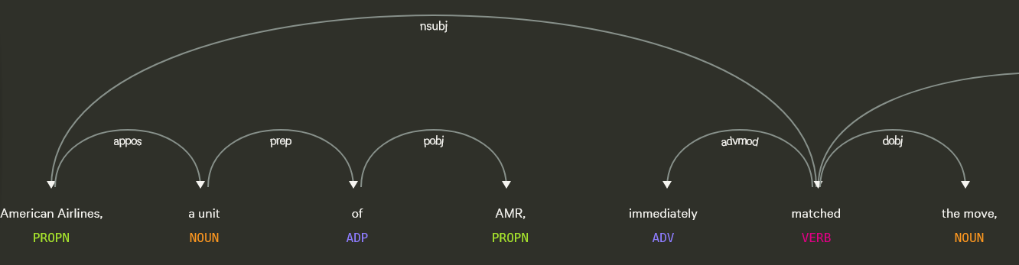
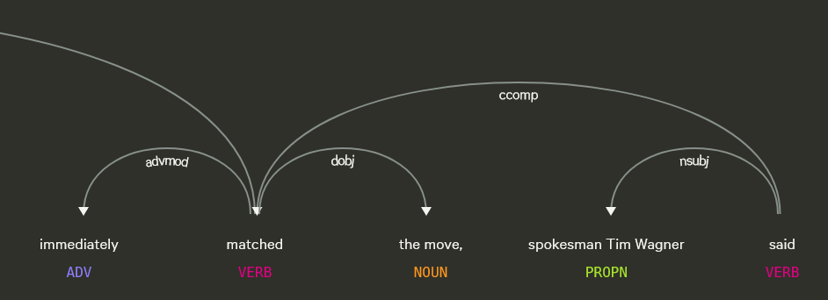
Parse Features for Relation Extraction
American Airlines, a unit of AMR, immediately matched the move, spokesman Tim Wagner said
Mention 1 Mention 2
Base syntactic chunk sequence from one to the other
NP NP PP VP NP NP
Constituent path through the tree from one to the other
NP ⬆⬆ NP ⬆⬆ S ⬆⬆ S ⬇⬇ NP
Dependency path
Airlines matched Wagner said
https://explosion.ai/demos/displacy?

Slide 28
Dictionaries and trigger word features for relation extraction
Trigger list for family: kinship terms
  parent, wife, husband, grandparent, etc.
Dictionaries:
  Lists of useful geo or geopolitical words
    Country name list
    Other sub-entities

Slide 29
Evaluation of supervised relation Extraction
Now you can use any standard supervised classifier
Evaluate on withheld annotated data
(more later)

Slide 30
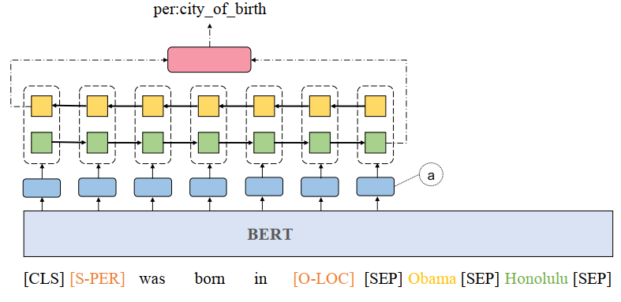
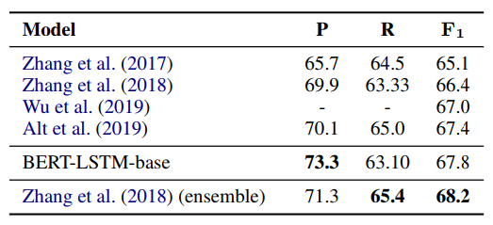
Relation extraction using BERT
Bi-LSTM (768 nodes) on top of BERT representation of masked sentence+ subject+object
MLP (300 nodes) for final prediction
[Simple BERT Models for Relation Extraction
and Semantic Role Labeling , Peng Shi and Jimmy Lin, ArXiv, 2019]

Slide 31
TACRED [Zhang et al., EMNLP 2017]
TAC: Text analysis conference, at national institute for standards (NIST), USA
Annual competitions around information extraction, retrieval, question answering, etc.
https://tac.nist.gov/
TACRED:
  Relation extraction dataset, competition since 2014
  106,264 human-labelled entity pairs in a sentence sampled from newswire and web forum discussions
  41 common relation types
  23 entity types
  no_relation if no defined relation holds

Slide 32
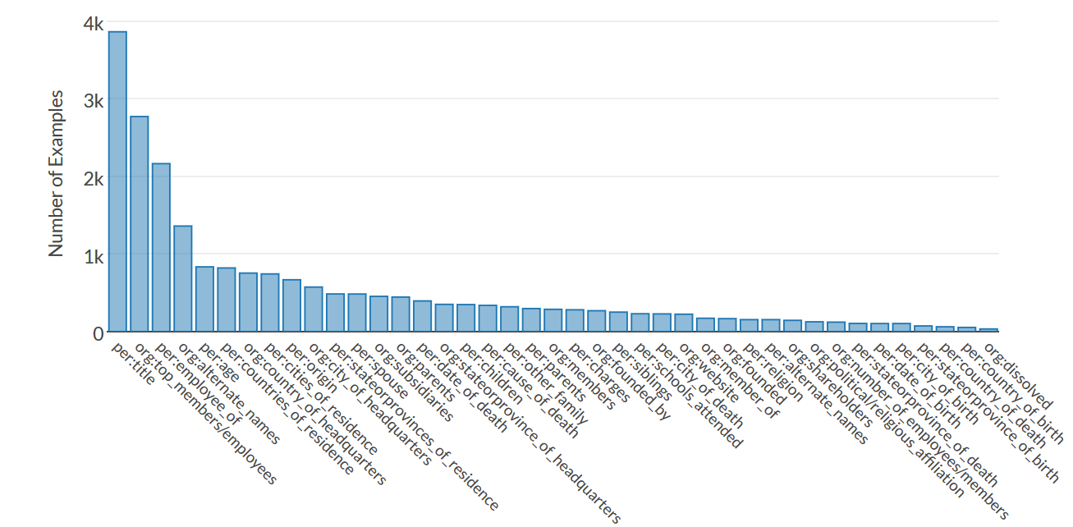
TACRED (2)

Slide 33
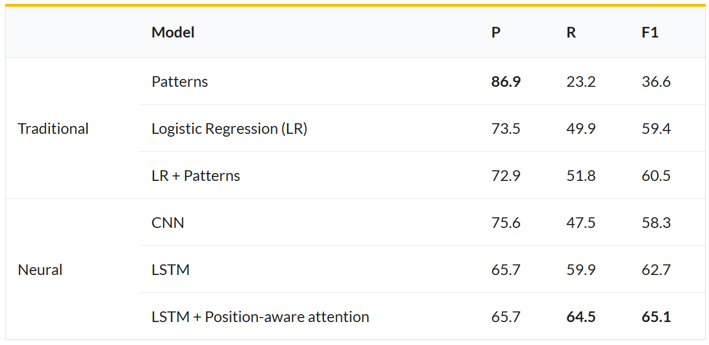
TACRED (3)
[TACRED website]

Slide 34
Summary: Supervised relation extraction
Pro
Can get high precision/recall with enough training data, if test similar enough to training
Contra
Labeling a large training set is expensive
Supervised models are still brittle, don’t generalize well to different genres

Slide 35
Outline
Fixed-target relation extraction
  Task
  Manual patterns
  Supervised learning
  Learning at scale
    Iterative pattern learning
    Distant supervision
  Case study: CINEX
Evaluation
Open information extraction (OIE)
  Idea
  Semantic role labeling and OIE
  Organizing open relations

Slide 36
Seed-based or bootstrapping approaches to relation extraction
No training set? Maybe you have:
  A few seed tuples
Can you use those seeds to do something useful?
  Bootstrapping: use the seeds to directly learn to populate a relation
Related to self-supervised learning, label propagation, etc.
Underlying assumption: High-confidence predictions/patterns are likely correct

Slide 37
Relation Bootstrapping (Hearst 1992)
Gather a set of seed pairs that have relation R
Iterate:
  Find sentences with these pairs
  Look at the context between or around the pair and generalize the context to create patterns
  Use the patterns for grep for more pairs

Slide 38
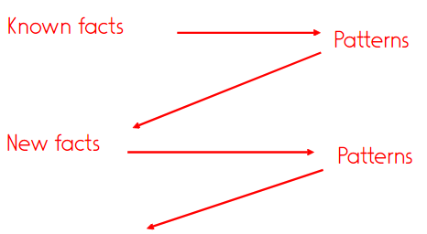
Bootstrapping/Pattern iteration
buriedIn(Mark Twain, Elmira) - Seed tuple
  Grep (google) for the environments of the seed tuple
  “Mark Twain is buried in Elmira, NY.”
X is buried in Y
“The grave of Mark Twain is in Elmira”
The grave of X is in Y
“Elmira is Mark Twain’s final resting place”
Y is X ’ s final resting place.
Use those patterns to grep for new tuples
Iterate

Slide 39
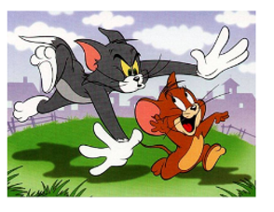
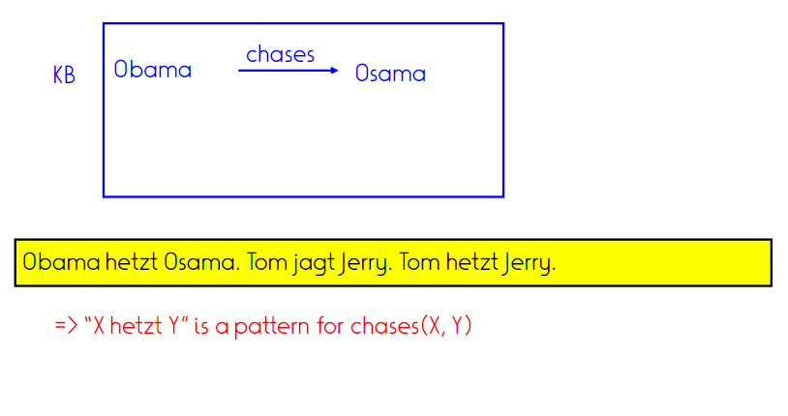


Example: Pattern iteration

Slide 40
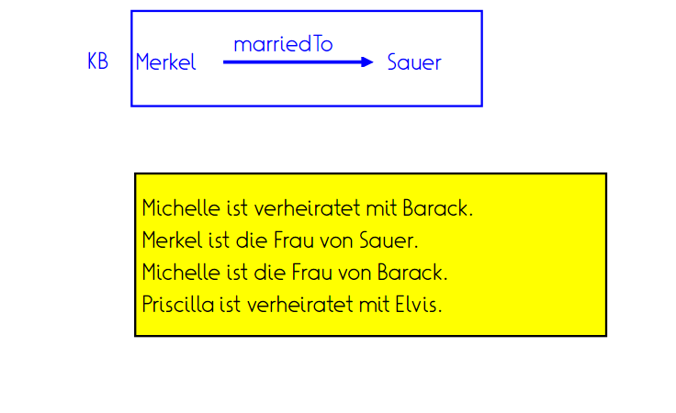
Task: Pattern iteration

Slide 41
DIPRE: Extracting <author,book> pairs
(=Dual iterative pattern relation extraction)
Brin, Sergei. 1998. Extracting Patterns and Relations from the World Wide Web.
Author | Book
Isaac Asimov | The Robots of Dawn
David Brin | Startide Rising
James Gleick | Chaos: Making a New Science
Charles Dickens | Great Expectations
William Shakespeare | The Comedy of Errors
Start with 5 seeds:
Find Instances:
Extract patterns (group by middle,
take longest common prefix/suffix)
?x , by ?y , ?x , one of ?y ‘s
Now iterate, finding new seeds that match the pattern
The Comedy of Errors, by William Shakespeare, was
The Comedy of Errors, by William Shakespeare, is
The Comedy of Errors, one of William Shakespeare's earliest attempts
The Comedy of Errors, one of William Shakespeare's most

Slide 42
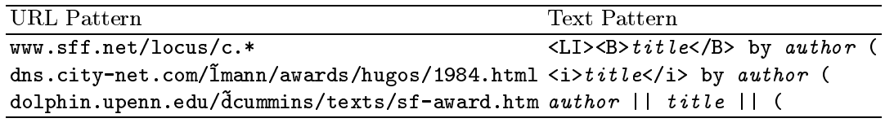
DIPRE
5 seeds
199 occurrences
3 patterns
→ 4047 pairs
3972 occurrences in first 5 million websites
25 patterns
→ 9369 pairs
9938 occurrences in documents containing “book” term
346 patterns
15k pairs
  Starting from 5!
  Precision 95% (n=20..)

Slide 43
Snowball
E. Agichtein and L. Gravano 2000. Snowball: Extracting Relations from Large Plain-Text Collections. ICDL
Similar iterative algorithm
Organization | Location of Headquarters
Microsoft | Redmond
Exxon | Irving
IBM | Armonk
Group instances w/similar prefix, middle, suffix, extract patterns
  But require that X and Y be named entities
  And compute a confidence for each pattern
.69
.75
ORGANIZATION {’s, in, headquarters} LOCATION
LOCATION
{in, based}
ORGANIZATION

Slide 44
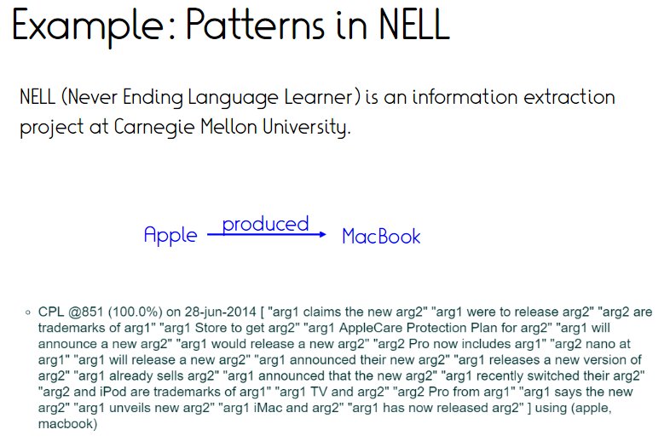

Slide 45
Outline
Fixed-target relation extraction
  Task
  Manual patterns
  Supervised learning
  Learning at scale
    Iterative pattern learning
    Distant supervision
  Case study: CINEX
Evaluation
Open information extraction (OIE)
  Idea
  Semantic role labeling and OIE
  Organizing open relations

Slide 46
Distant Supervision
Combine bootstrapping with supervised learning
  Instead of 5 seeds,
    Use a large database to get huge # of noisy seed examples
  Create lots of features from all these examples
  Combine in a supervised classifier

Slide 47









Distantly supervised learning of relation extraction patterns
1
For each relation
For each tuple in a KB
Find sentences in large corpus
with both entities
Born-In
<Edwin Hubble, Marshfield>
<Albert Einstein, Ulm>
Hubble was born in Marshfield Einstein, born (1879), Ulm Hubble’s birthplace in Marshfield
PER was born in LOC PER,
born (XXXX), LOC
PER’s birthplace in LOC
P(born-in | f1,f2,f3,…,f70000)
2
3
Extract frequent features (parse, words, etc)
Train supervised classifier using scores of instances
(negatives random entity pairs not in relation)
4
5

Slide 48
Distant supervision paradigm
Like supervised classification:
  Uses a classifier with lots of features
  Supervised by detailed hand-created knowledge
  Doesn’t require iteratively expanding patterns
Like unsupervised pattern iteration:
  Uses very large amounts of unlabeled data

Slide 49
Exercise: Distant supervision
KB (bornIn)
(Einstein, Ulm)
(Curie, Warsaw)
Text:
Einstein was born in Ulm.
Curie migrated from Warsaw.
Researchers claim: Was Einstein born in France?
Einstein and the Unified Modelling language (ULM).
Ulm was home to many famous people, including Hoeneß and Einstein.
Task: With distant supervision, what would be the positive training examples (sentences) for a bornIn relation classifier?
Notes:
1, 2, 4, 5

Slide 50
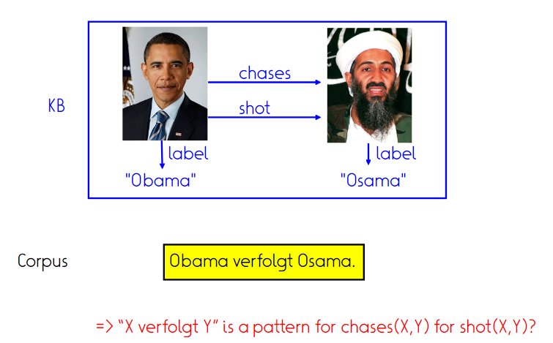
Challenge 1: Overlapping relations

Slide 51
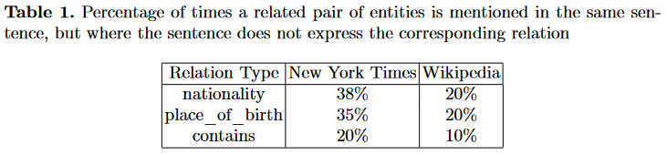
Challenge 2: Irrelevant contexts
capitalOf(Paris, France)
Paris is the capital of France.
French authorities tightened security measures after the Paris attacks.
Paris is a popular tourist destination in France.
May lead to learning of wrong patterns
May lead to not extracting relations if few relevant contexts are overshadowed by many irrelevant ones

Slide 52
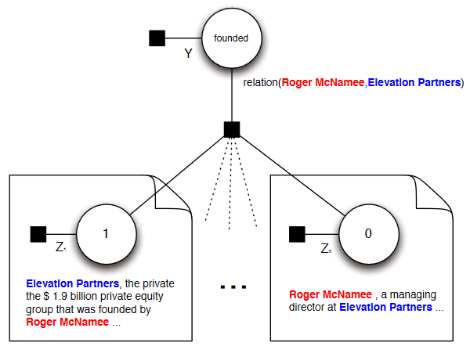
Fixing the naive assumption
→ At-least-one assumption
[Riedel et al., 2010]
  “If two entities participate in a relation, at least one sentence that mentions these two entities might express that relation.”
Probabilistic model that simultaneously estimates whether relations hold, and which sentences express them.
  Binary variables for contexts per entity pair
  Contexts grouped for relation prediction
Precision jumps from 87% to 91% (=31% reduction in error)

Slide 53
Outline
Fixed-target relation extraction
  Task
  Manual patterns
  Supervised learning
  Learning at scale
    Iterative pattern learning
    Distant supervision
  Case study: CINEX
Evaluation
Open information extraction (OIE)
  Idea
  Semantic role labeling and OIE
  Organizing open relations

Slide 54
CINEX [Mirza et al., 2018]
Instructive example of distant supervision with cleaning
Common twin of Wikipedia, Wikidata
Focused on relation between entities
and quantity expressions (counting quantifiers)

Slide 55

Counting Quantifiers (CQs)
Fully qualified facts: <S, P, O>
Counting information: <S, P, $∃$O>
“There exists a specific number of O for a given SP pair”
<California, hasCounty, Monterey> | <Donald Trump, hasSpouse, Melania Knauss>
<California, hasCounty, $∃58$> | <Donald Trump, hasSpouse, $∃3$>

Slide 56
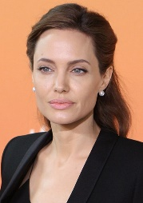

Problem: CQ Extraction
Given
Determine
S
P
hasChild
$∃$6

Slide 57
Problem hardness
Various expressions
    Explicit numerals (cardinal numbers) “has five children”
    Lower bounds (ordinal numbers) “his third wife”
    Number-related noun phrases ‘twins’ or ‘quartet’
    Existence-proving articles “has a brother”
    Non-existence adverbs ‘never’ or ‘without’
Compositionality
    In 2016, Jolie brought her twins, one daughter and three adopted children to the gala.

Slide 58

CINEX: Counting INformation EXtraction
Stage 1:
CQ Recognition
Stage 2:
CQ Consolidation
Seeds
CRF
LSTM
Composition
or
CQs
Input Text
Preferences
Thresholding
CQ Candidates

Slide 59

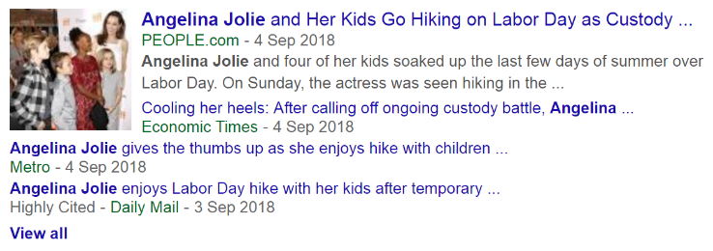
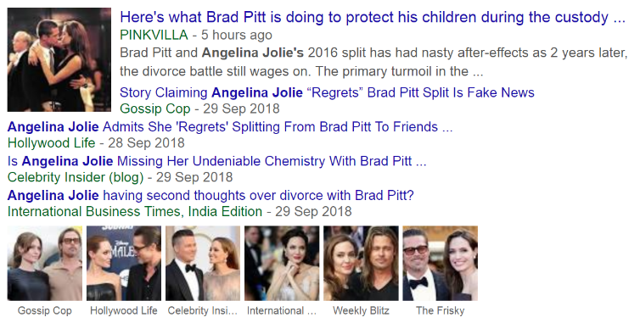
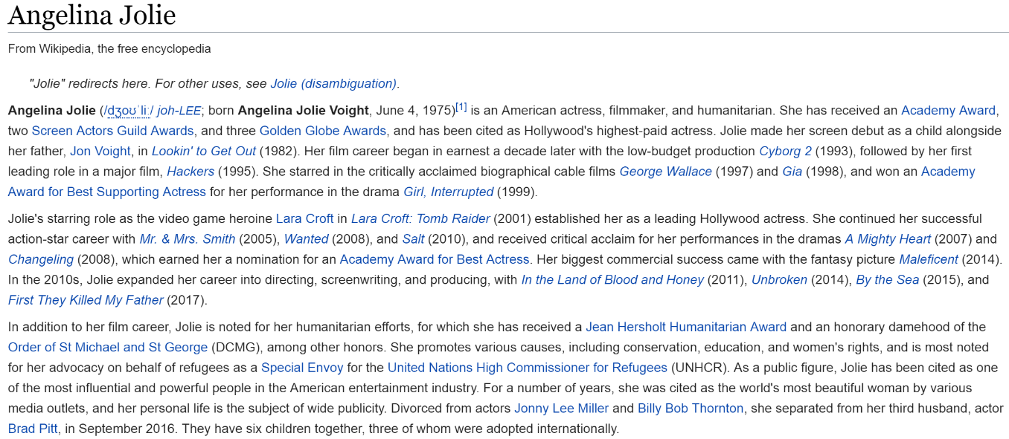
Stage 1: CQ Recognition
She has a grand total of six children together: three biological and three adopted.
Angelina Jolie and four of her kids soaked up the last few days of summer over Labor Day.
She has received an Academy Award, two Screen Actors Guild Awards, and three Golden Globe Awards, and has been cited as Hollywood’s highest-paid actress.
Divorced from actors Jonny Lee Miller and Billy Bob Thornton, she separated from her third husband, actor Brad Pitt, in September 2016.
The arrival of the first biological child Jolie and Pitt caused an excited flurry with fans.
On July 12, 2008, she gave birth to twins: a son, Knox Leon, and a daughter, Vivienne Marcheline.
In 2016, Jolie brought her twins, one daughter and three adopted children to the gala.
S
She has a grand total of six children together: three biological and three adopted.
Angelina Jolie and four of her kids soaked up the last few days of summer over Labor Day.
She has received an Academy Award, two Screen Actors Guild Awards, and three Golden Globe Awards, and has been cited as Hollywood’s highest-paid actress.
Divorced from actors Jonny Lee Miller and Billy Bob Thornton, she separated from her third husband, actor Brad Pitt, in September 2016.
The arrival of the first biological child Jolie and Pitt caused an excited flurry with fans.
On July 12, 2008, she gave birth to twins: a son, Knox Leon, and a daughter, Vivienne Marcheline.
In 2016, Jolie brought her twins, one daughter and three adopted children to the gala.
P
hasChild
cardinals
ordinals
numterms
articles

Slide 60
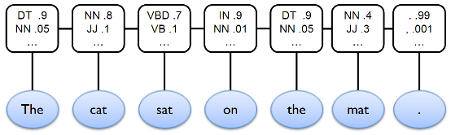
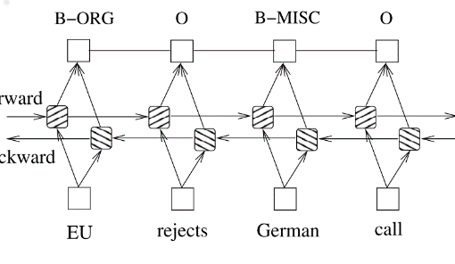
Stage 1: CQ Recognition
In 2016, Jolie brought her twins, one daughter and three adopted children to the gala.
Sequence labelling task
  One model learned per predicate
  Feature-based model (CRF) vs Neural model (bi-LSTM-CRF)
S
preprocessing
…her | twins | , | one | daughter | and | three | adopted | children | to…
…her | NUMTERM | , | CARDINAL | daughter | and | CARDINAL | adopted | children | to…
O | COUNT | COMP | COUNT | O | COMP | COUNT | O | O | O
P
hasChild

Slide 61
Stage 1: CQ Recognition
In 2016, Jolie brought her twins, one daughter and three adopted children to the gala.
Incompleteness-aware distant supervision
  COUNT DISTINCT <Angelina Jolie, hasChild, *> as seed counts
  Filtering training data based on subject popularity
  Ignoring higher counts, unless > upper bound (count at 99th percentile)
    e.g., 2016 cannot be number of children
  Ignoring counts with low entropy
    Count ‘1’ appears abundantly in the text
  Label the tokens with COUNT (and COMP) when
    the token itself, OR
    the sum of several tokens match the seed count
S
preprocessing
…her | twins | , | one | daughter | and | three | adopted | children | to…
…her | NUMTERM | , | CARDINAL | daughter | and | CARDINAL | adopted | children | to…
O | COUNT | COMP | COUNT | O | COMP | COUNT | O | O | O
P
hasChild

Slide 62

Stage 2: CQ Consolidation
S
She has a grand total of six_{0.4} children together: three_{0.5} biological [and] three_{0.3} adopted.
Angelina Jolie and four_{0.3} of her kids soaked up the last few days of summer over Labor Day.
The arrival of the first_{0.5} biological child Jolie and Pitt caused an excited flurry with fans.
On July 12, 2008, she gave birth to twins_{0.8}: a_{0.2} son, Knox Leon, [and] a_{0.1} daughter, Vivienne Marcheline.
 6_{0.4}, 6_{0.5}
 4_{0.3}
 1_{0.5}
 2_{0.8}, 2_{0.2}
P
hasChild
1. cardinals 6_{0.5}
2. numterms 2_{0.8}
3. ordinals 1_{0.5}
4. articles 2_{0.2}
$∃$6
1. cardinals 6_{0.5}
2. numterms
3. ordinals 1_{0.5}
4. articles
threshold = 0.5

Slide 63
Training data setup
Wikidata as source KB,
Wikipedia pages of subject S as input texts
5 relation/predicate P
Training set: Wikidata object counts as seed counts
Test set: manually annotated CQs
Train/Test data size
Wikidata Subject Class | Wikidata Property | Relation
series of creative works | has part | containsWork
musical ensemble | has part | hasMember
admin. territorial entity | contains admin… | containsAdmin
human | child | hasChild
human | spouse | hasSpouse
#Subjects | #Sentences
642 | 7,984
8,901 | 96,056
6,266 | 13,199
40,145 | 319,807
45,261 | 408,974
At least one object

Slide 64
Evaluation
Stage 1: CQ recognition
  CRF models more robust than bi-LSTMs (57% vs 40% avg F1-score)
    Neural models much more prone to overfitting to noisy training data
Stage 2: CQ consolidation
 | containsWork | hasMember | containsAdmin | hasChild | hasSpouse
CINEX-CRF | 39.8 | 56.1 | 77.3 | 49.0 | 62.4
F1-scores
 | containsWork | hasMember | containsAdmin | hasChild | hasSpouse
CINEX-CRF | 49.2 | 64.3 | 78.6 | 50.0 | 58.1
Precision
(Contribution)
CARDINAL | 55.0 (33.9) | 62.5 (28.6) | 85.7 (87.5) | 67.3 (70.5) | 75.0 (18.6)
NUMT.+ART. | 62.5 (40.7) | 65.0 (71.4) | 33.3 (10.7) | 6.3 (20.5) | 43.8 (37.2)
ORDINAL | 20.0 (25.4) | 0 (0) | 0 (1.8) | 14.3 (9.0) | 63.2 (44.2)
ORDINAL (as lower bound) | 86.7 (25.4) | 0 (0) | 0 (1.8) | 85.7 (9.0) | 89.5 (44.2)

Slide 65
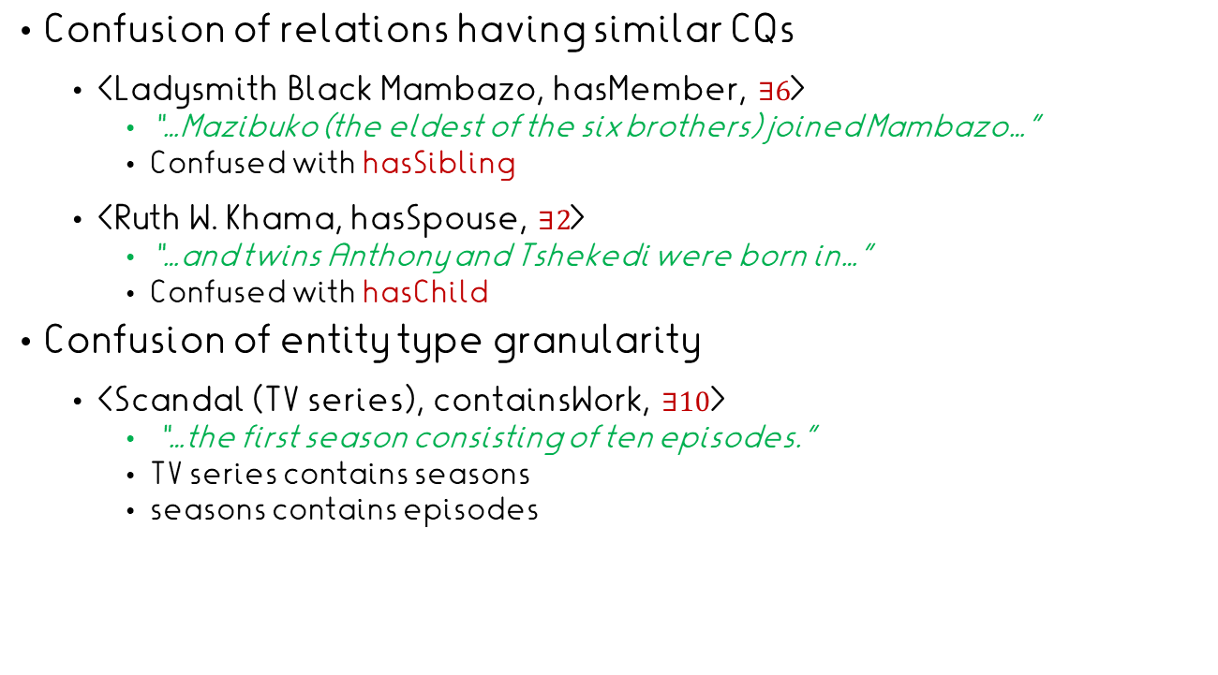
Evaluation: Error Analysis
Confusion of relations having similar CQs
  <Ladysmith Black Mambazo, hasMember, $∃6$>
    “…Mazibuko (the eldest of the six brothers) joined Mambazo…”
    Confused with hasSibling
  <Ruth W. Khama, hasSpouse, $∃2$>
    “…and twins Anthony and Tshekedi were born in…”
    Confused with hasChild
Confusion of entity type granularity
  <Scandal (TV series), containsWork, $∃10$>
    “…the first season consisting of ten episodes.”
    TV series contains seasons
    seasons contains episodes

Slide 66
KB Enrichment Potential
Enrich KB with knowledge that facts exist
Apply CINEX on all Wikidata relations:
  Filter out functional properties
  Relations  properties paired with 10 most frequent subject classes
  Per relation  Evaluate CINEX on 10% (up to 200) most popular subjects as test set
    CINEX yields >50% precision  110 relations  having good extracted CQs
  Apply 110 CINEX models on all subject entities of corresponding classes
CINEX enrich KB (for 110 relations) with existence of 28.3% more facts
property | class | KB facts | CQ facts
has part | rock band | 1,147 | 1,516 (+32.2%)

Slide 67
References
Papers:
  Sergey Brin, Extracting Patterns and Relations
  from the World Wide Web, WebDB 1998
  Mintz et al., Distant supervision for relation extraction without labeled data, 2009
  Riedel et al., Modeling Relations and Their Mentions without Labeled Text, ECML 2010
  Mirza et al., Enriching Knowledge Bases with Counting Quantifiers, ISWC 2018
Slides
  Fabian Suchanek, Paramita Mirza and Dan Jurafsky
Code/APIs
  No off-the shelf solutions (training needed)
  Extensive code on Github etc.
  Rosette API https://www.rosette.com/capability/relationship-extraction/#try-the-demo (commercial)

Slide 68
Assignment 5
Pattern-based relation extraction
Similar to type extraction, but now longer text
Suggestion: Pattern-based extraction using spaCy NER tags
Evaluation using micro F1

Slide 69
Take home
Approaches:
  Extraction
  Classification
Key methodological ingredients:
  Iterative pattern learning
    Repeat statement extraction and pattern learning with increasing sets (“snowballing”)
  Distant supervision
    Scale training data by skipping on hand-labelling of sentences
    Automatically label sentences from KB statements

Slide 70
Outline
Fixed-target relation extraction
  Task
  Manual patterns
  Supervised learning
  Learning at scale
    Iterative pattern learning
    Distant supervision
  Case study: CINEX
Evaluation
Open information extraction (OIE)
  Idea
  Semantic role labeling and OIE
  Organizing open relations

Slide 71
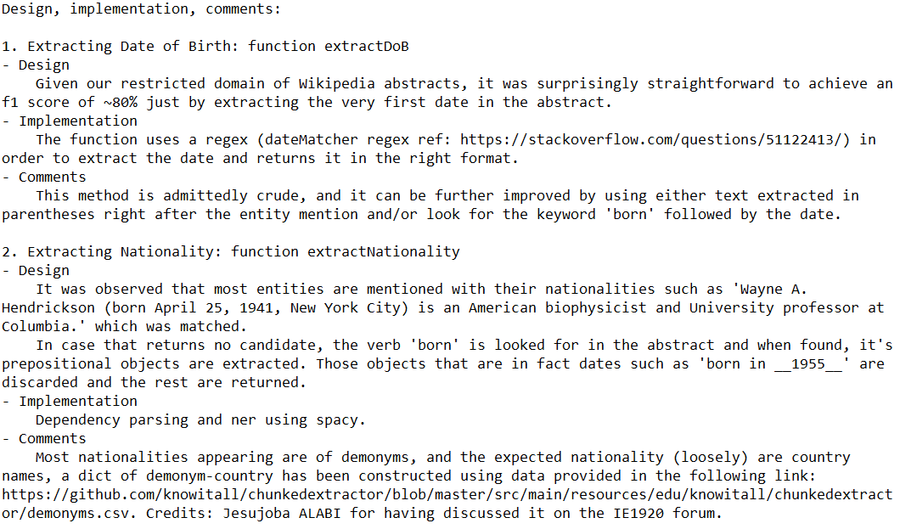

Slide 72
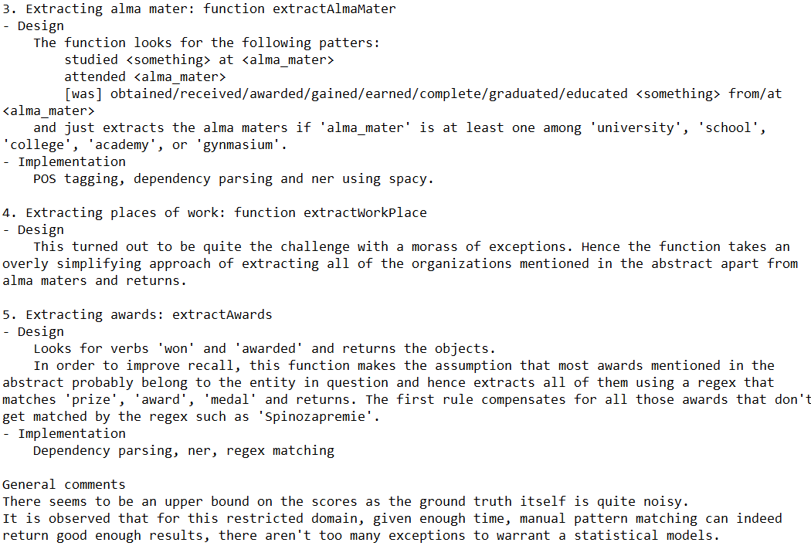

Slide 73
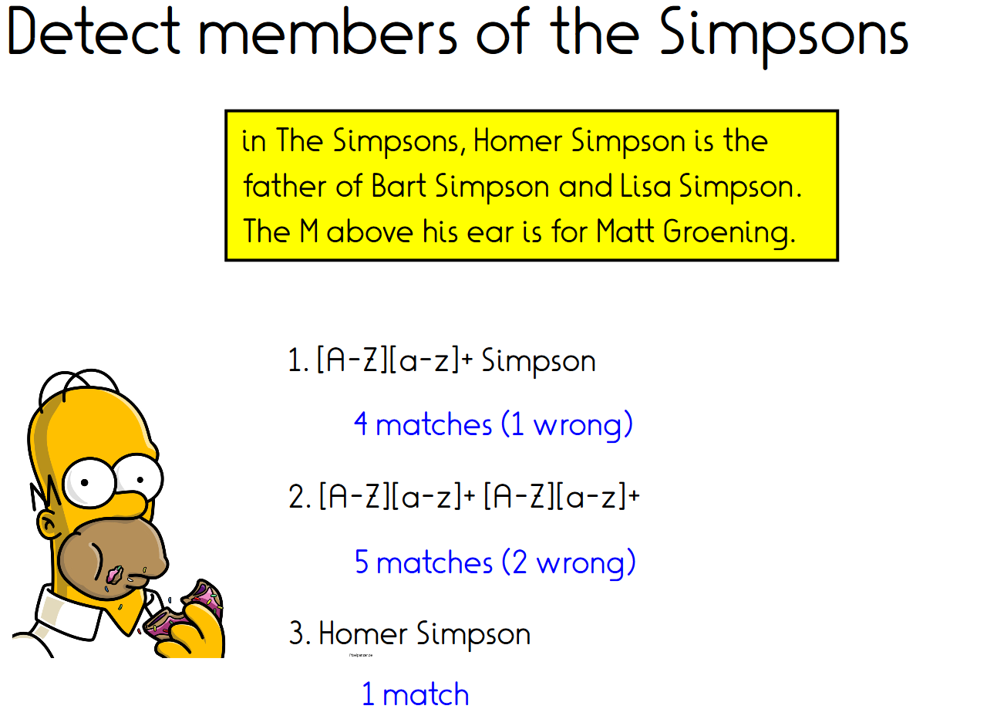
Notes:
Animations show different naive methods

Slide 74
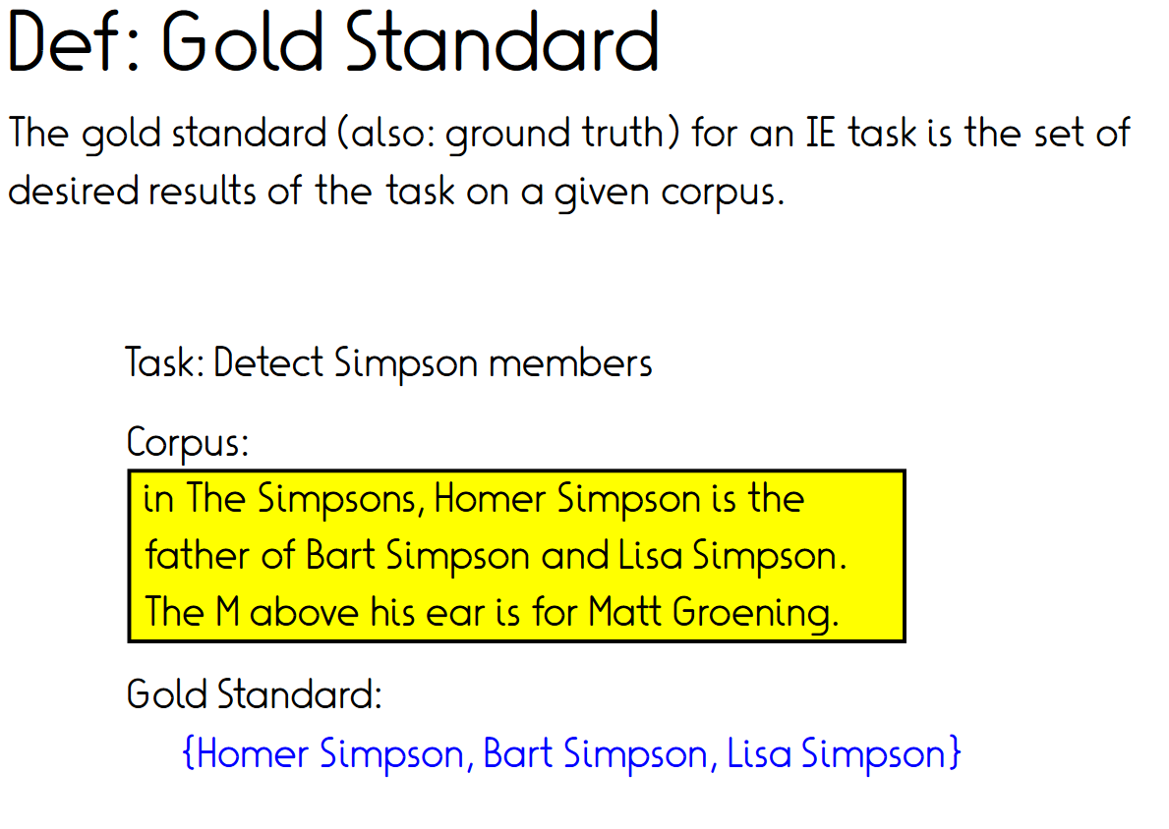

Slide 75
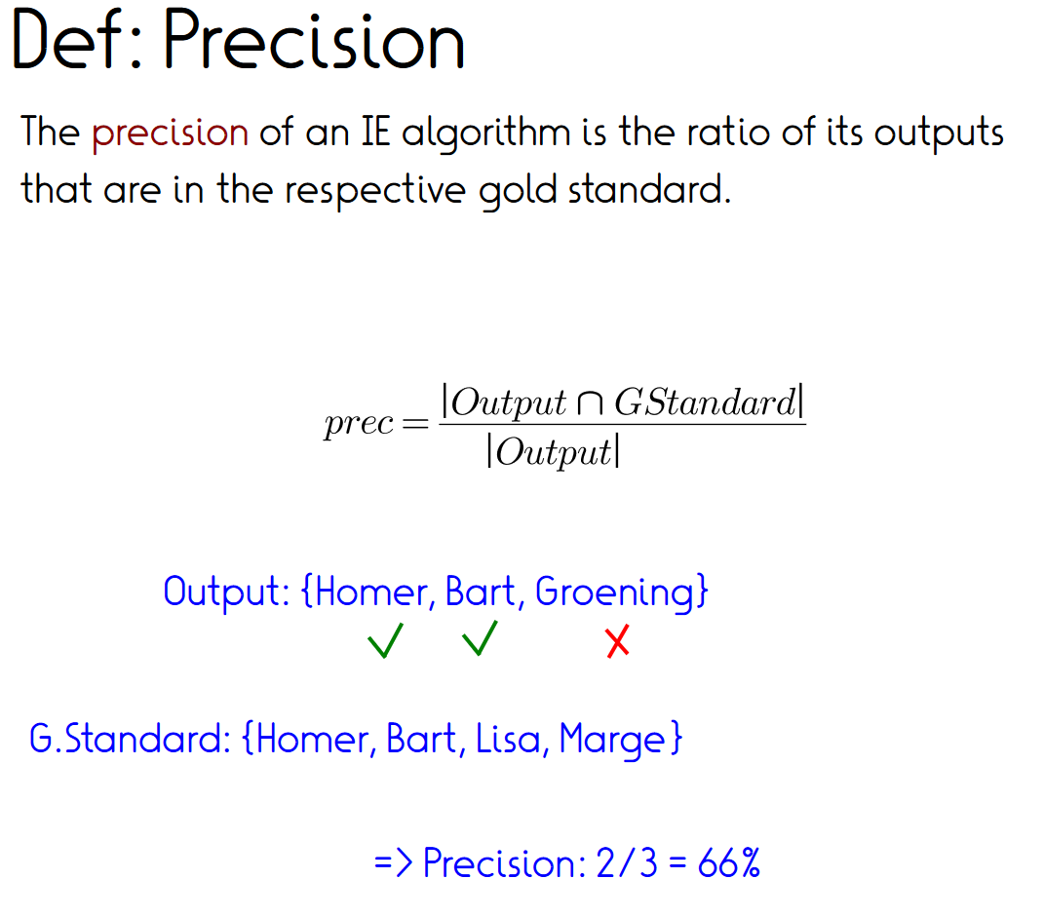
Method output: {Homer, Bart, Groening}
Gold standard: {Homer, Bart, Lisa}

Slide 76
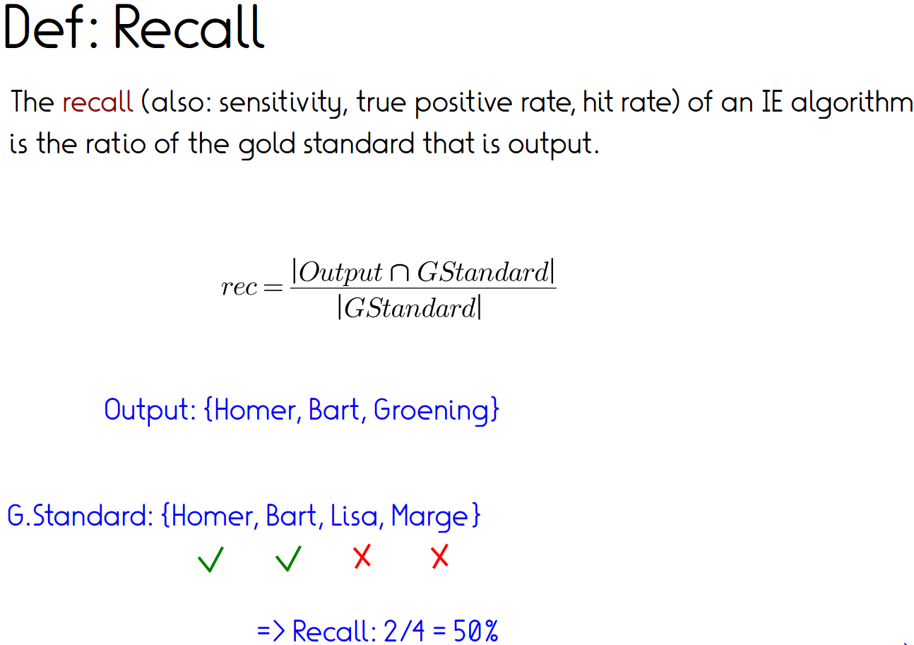
Gold standard: {Homer, Bart, Lisa}
=> Recall: 2/3 = 66%

Slide 77
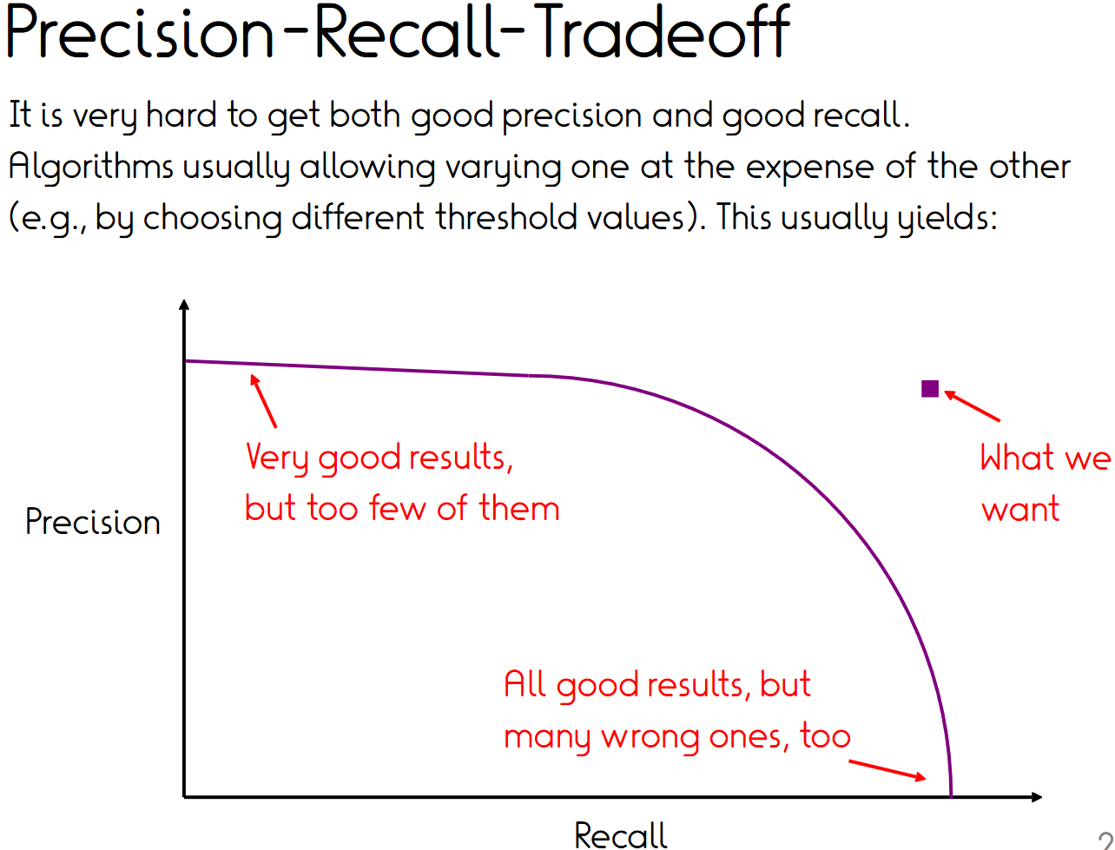
1
0
0
1

Slide 78
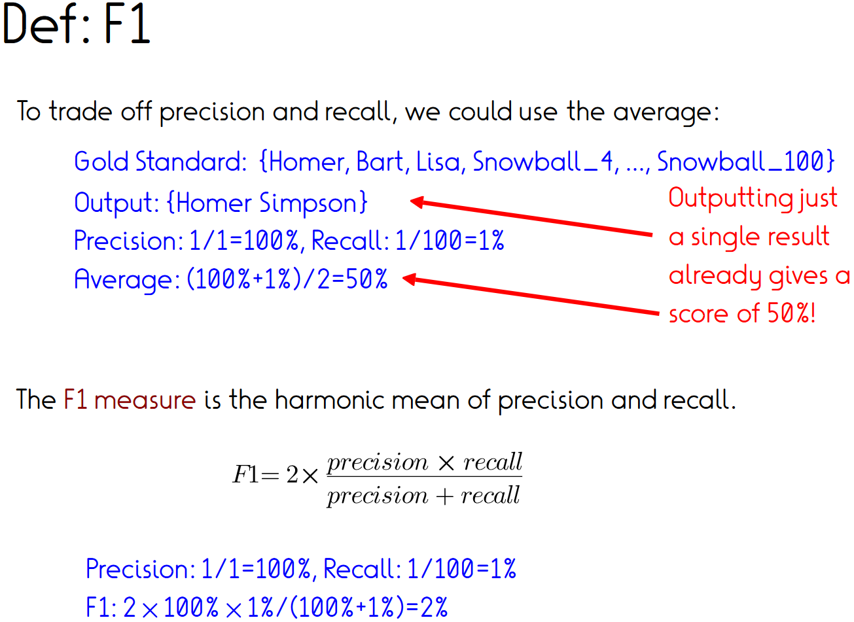
To obtain a single score for ranking systems, we could average:

Slide 79
F1 given P and R
 | 1 | 0 | 0.1 | 0.18 | 0.26 | 0.33 | 0.4 | 0.46 | 0.52 | 0.57 | 0.62 | 0.67 | 0.71 | 0.75 | 0.79 | 0.82 | 0.86 | 0.89 | 0.92 | 0.95 | 0.97 | 1
 | 0.95 | 0 | 0.1 | 0.18 | 0.26 | 0.33 | 0.4 | 0.46 | 0.51 | 0.56 | 0.61 | 0.66 | 0.7 | 0.74 | 0.77 | 0.81 | 0.84 | 0.87 | 0.9 | 0.92 | 0.95 | 0.97
 | 0.9 | 0 | 0.09 | 0.18 | 0.26 | 0.33 | 0.39 | 0.45 | 0.5 | 0.55 | 0.6 | 0.64 | 0.68 | 0.72 | 0.75 | 0.79 | 0.82 | 0.85 | 0.87 | 0.9 | 0.92 | 0.95
 | 0.85 | 0 | 0.09 | 0.18 | 0.26 | 0.32 | 0.39 | 0.44 | 0.5 | 0.54 | 0.59 | 0.63 | 0.67 | 0.7 | 0.74 | 0.77 | 0.8 | 0.82 | 0.85 | 0.87 | 0.9 | 0.92
 | 0.8 | 0 | 0.09 | 0.18 | 0.25 | 0.32 | 0.38 | 0.44 | 0.49 | 0.53 | 0.58 | 0.62 | 0.65 | 0.69 | 0.72 | 0.75 | 0.77 | 0.8 | 0.82 | 0.85 | 0.87 | 0.89
 | 0.75 | 0 | 0.09 | 0.18 | 0.25 | 0.32 | 0.38 | 0.43 | 0.48 | 0.52 | 0.56 | 0.6 | 0.63 | 0.67 | 0.7 | 0.72 | 0.75 | 0.77 | 0.8 | 0.82 | 0.84 | 0.86
 | 0.7 | 0 | 0.09 | 0.18 | 0.25 | 0.31 | 0.37 | 0.42 | 0.47 | 0.51 | 0.55 | 0.58 | 0.62 | 0.65 | 0.67 | 0.7 | 0.72 | 0.75 | 0.77 | 0.79 | 0.81 | 0.82
 | 0.65 | 0 | 0.09 | 0.17 | 0.24 | 0.31 | 0.36 | 0.41 | 0.46 | 0.5 | 0.53 | 0.57 | 0.6 | 0.62 | 0.65 | 0.67 | 0.7 | 0.72 | 0.74 | 0.75 | 0.77 | 0.79
 | 0.6 | 0 | 0.09 | 0.17 | 0.24 | 0.3 | 0.35 | 0.4 | 0.44 | 0.48 | 0.51 | 0.55 | 0.57 | 0.6 | 0.62 | 0.65 | 0.67 | 0.69 | 0.7 | 0.72 | 0.74 | 0.75
 | 0.55 | 0 | 0.09 | 0.17 | 0.24 | 0.29 | 0.34 | 0.39 | 0.43 | 0.46 | 0.5 | 0.52 | 0.55 | 0.57 | 0.6 | 0.62 | 0.63 | 0.65 | 0.67 | 0.68 | 0.7 | 0.71
 | 0.5 | 0 | 0.09 | 0.17 | 0.23 | 0.29 | 0.33 | 0.38 | 0.41 | 0.44 | 0.47 | 0.5 | 0.52 | 0.55 | 0.57 | 0.58 | 0.6 | 0.62 | 0.63 | 0.64 | 0.66 | 0.67
P | 0.45 | 0 | 0.09 | 0.16 | 0.23 | 0.28 | 0.32 | 0.36 | 0.39 | 0.42 | 0.45 | 0.47 | 0.5 | 0.51 | 0.53 | 0.55 | 0.56 | 0.58 | 0.59 | 0.6 | 0.61 | 0.62
 | 0.4 | 0 | 0.09 | 0.16 | 0.22 | 0.27 | 0.31 | 0.34 | 0.37 | 0.4 | 0.42 | 0.44 | 0.46 | 0.48 | 0.5 | 0.51 | 0.52 | 0.53 | 0.54 | 0.55 | 0.56 | 0.57
 | 0.35 | 0 | 0.09 | 0.16 | 0.21 | 0.25 | 0.29 | 0.32 | 0.35 | 0.37 | 0.39 | 0.41 | 0.43 | 0.44 | 0.45 | 0.47 | 0.48 | 0.49 | 0.5 | 0.5 | 0.51 | 0.52
 | 0.3 | 0 | 0.09 | 0.15 | 0.2 | 0.24 | 0.27 | 0.3 | 0.32 | 0.34 | 0.36 | 0.37 | 0.39 | 0.4 | 0.41 | 0.42 | 0.43 | 0.44 | 0.44 | 0.45 | 0.46 | 0.46
 | 0.25 | 0 | 0.08 | 0.14 | 0.19 | 0.22 | 0.25 | 0.27 | 0.29 | 0.31 | 0.32 | 0.33 | 0.34 | 0.35 | 0.36 | 0.37 | 0.37 | 0.38 | 0.39 | 0.39 | 0.4 | 0.4
 | 0.2 | 0 | 0.08 | 0.13 | 0.17 | 0.2 | 0.22 | 0.24 | 0.25 | 0.27 | 0.28 | 0.29 | 0.29 | 0.3 | 0.31 | 0.31 | 0.32 | 0.32 | 0.32 | 0.33 | 0.33 | 0.33
 | 0.15 | 0 | 0.07 | 0.12 | 0.15 | 0.17 | 0.19 | 0.2 | 0.21 | 0.22 | 0.22 | 0.23 | 0.24 | 0.24 | 0.24 | 0.25 | 0.25 | 0.25 | 0.25 | 0.26 | 0.26 | 0.26
 | 0.1 | 0 | 0.07 | 0.1 | 0.12 | 0.13 | 0.14 | 0.15 | 0.16 | 0.16 | 0.16 | 0.17 | 0.17 | 0.17 | 0.17 | 0.17 | 0.18 | 0.18 | 0.18 | 0.18 | 0.18 | 0.18
 | 0.05 | 0 | 0.05 | 0.07 | 0.07 | 0.08 | 0.08 | 0.09 | 0.09 | 0.09 | 0.09 | 0.09 | 0.09 | 0.09 | 0.09 | 0.09 | 0.09 | 0.09 | 0.09 | 0.09 | 0.09 | 0.1
 | 0 | 0 | 0 | 0 | 0 | 0 | 0 | 0 | 0 | 0 | 0 | 0 | 0 | 0 | 0 | 0 | 0 | 0 | 0 | 0 | 0 | 0
 |  | 0 | 0.05 | 0.1 | 0.15 | 0.2 | 0.25 | 0.3 | 0.35 | 0.4 | 0.45 | 0.5 | 0.55 | 0.6 | 0.65 | 0.7 | 0.75 | 0.8 | 0.85 | 0.9 | 0.95 | 1
 |  |  |  |  |  |  |  |  |  |  | R

Slide 80
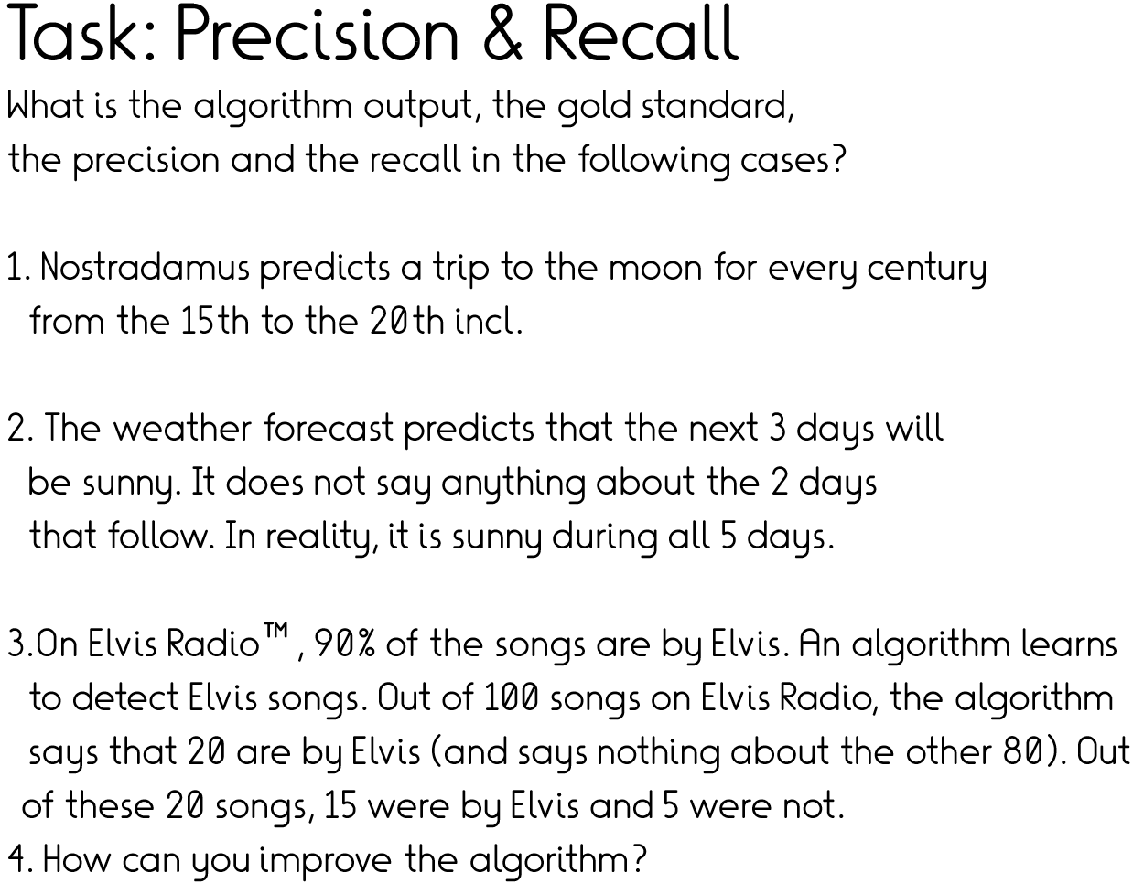
Notes:
1. P = 0.2, R=1
2. P=1, R = 0.6 What if it had said “rainy”? -> P=0, R=1
3. P=.75, R=.15 -> Better say always “Elvis” → P=0.9, R=1. Or toss a coin with 0.9 bias -> P=0.9, R=0.9 – same P follows because no matter which fraction at random is annotated, P will be 0.9 for any random instance to be correct…

Slide 81
Dive deeper at home
https://www.technologyreview.com/s/613508/ai-fairer-than-judge-criminal-risk-assessment-algorithm
Precision/recall tradeoff in automated courtroom decision making
Notes:
For at home

Slide 82
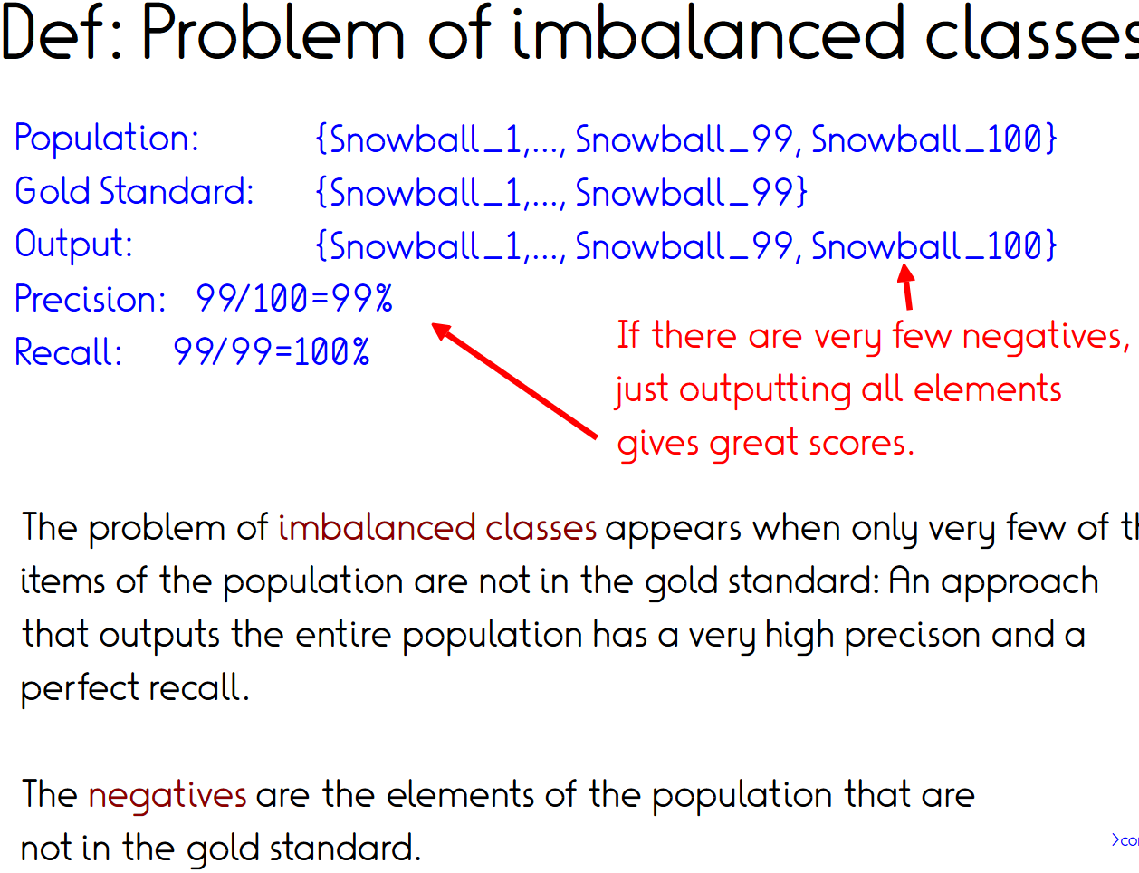
the
(Ex2: Citizenship on en-Wikipedia)

Slide 83
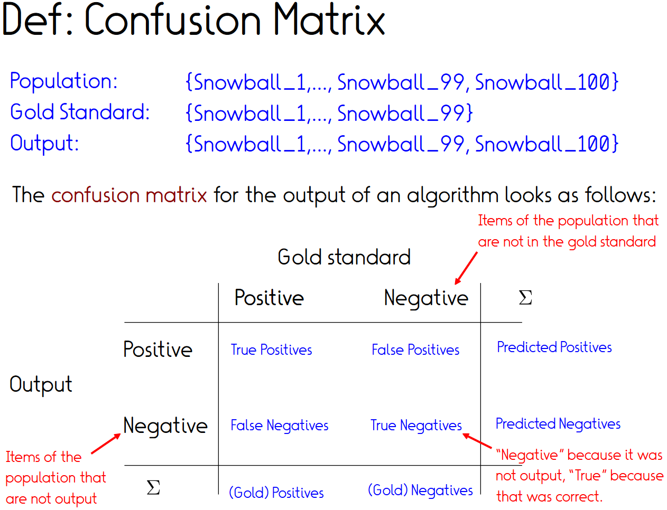

Slide 84
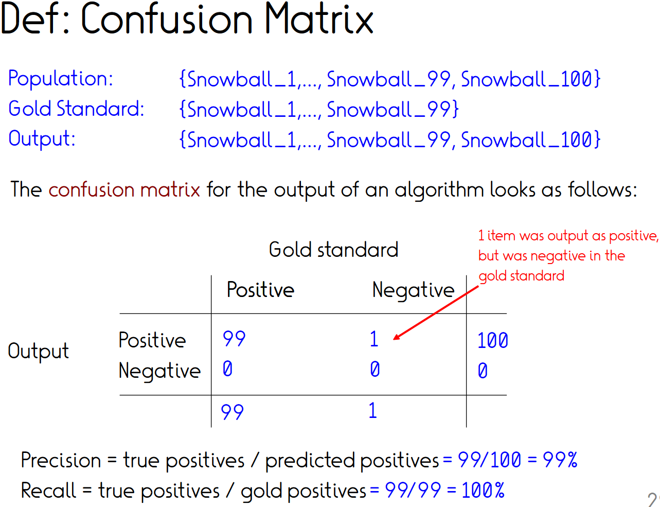

Slide 85
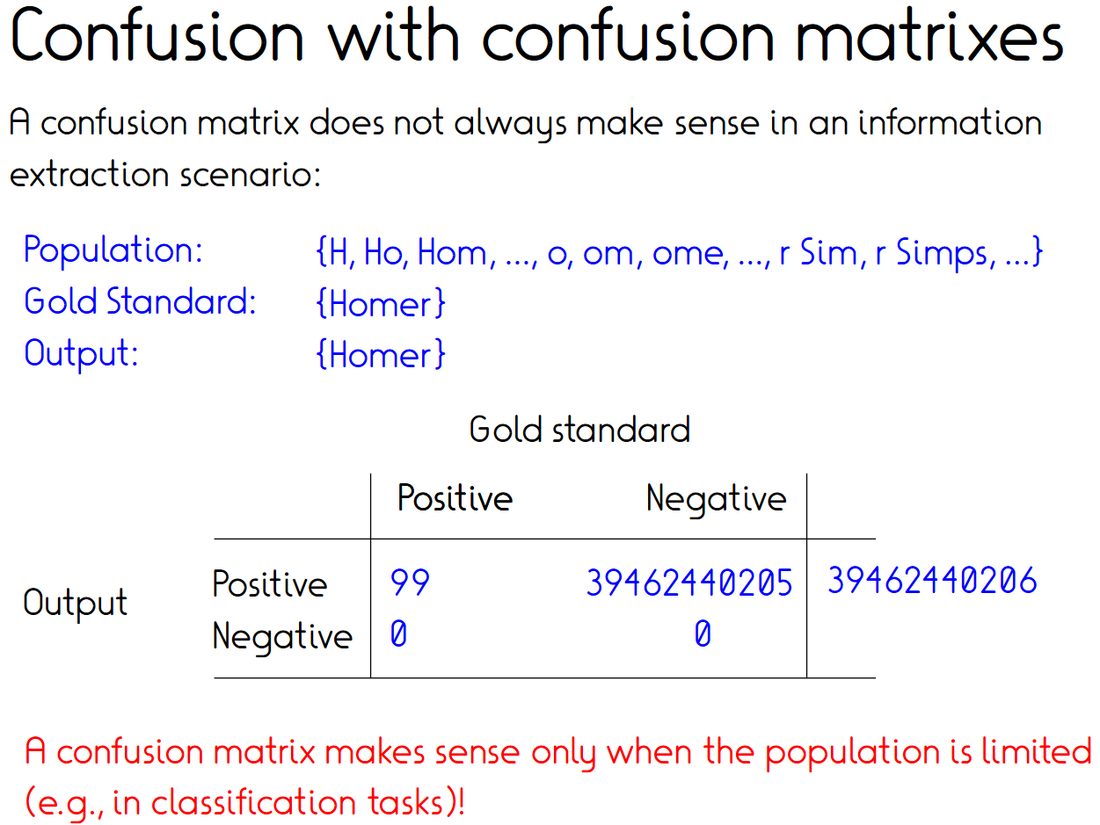
{A, B, …, Aa, Ab, …, Aaa, …}
1
0
0
39462440205
Notes:
This is a side note, will come back to issue of imbalance in next slide.

Slide 86
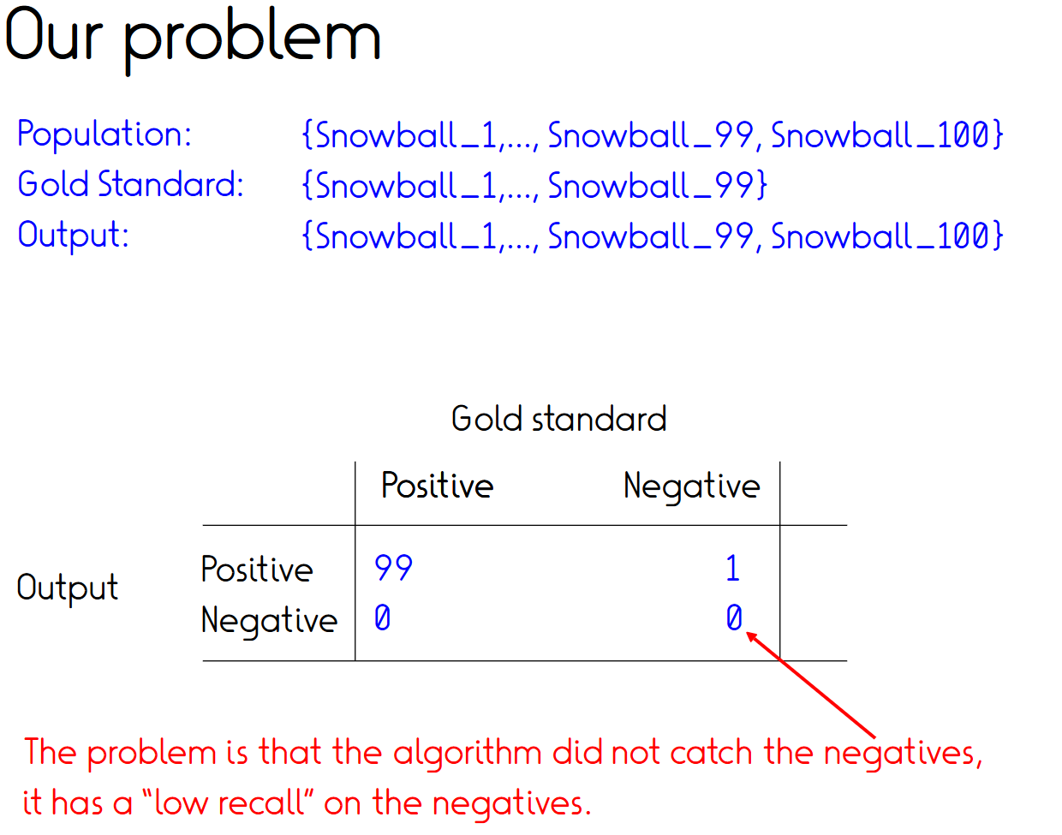

Slide 87
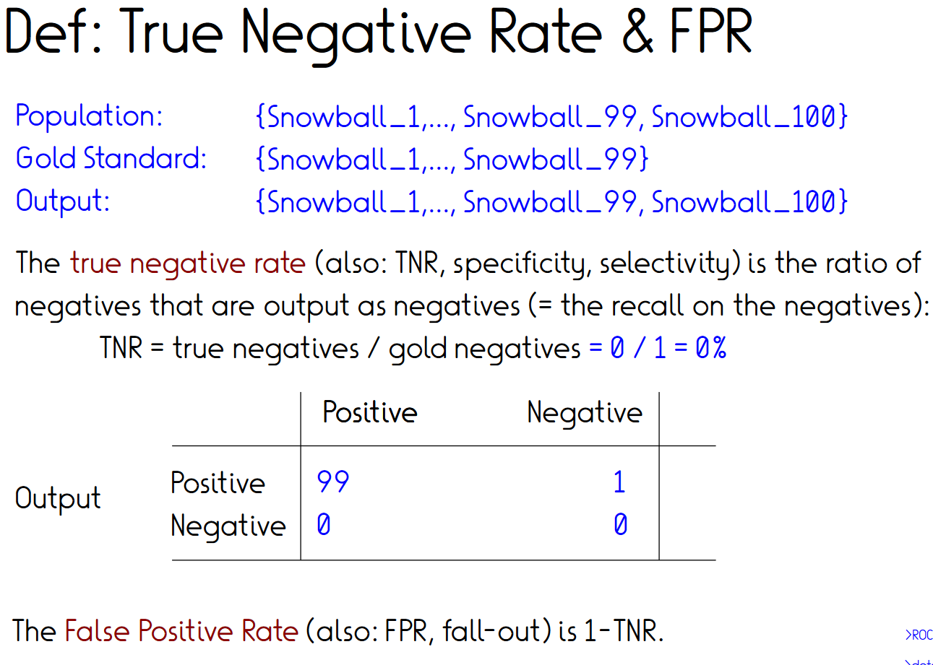
Notes:
FPR = which fraction of negs falsely labelled as positive

Slide 88
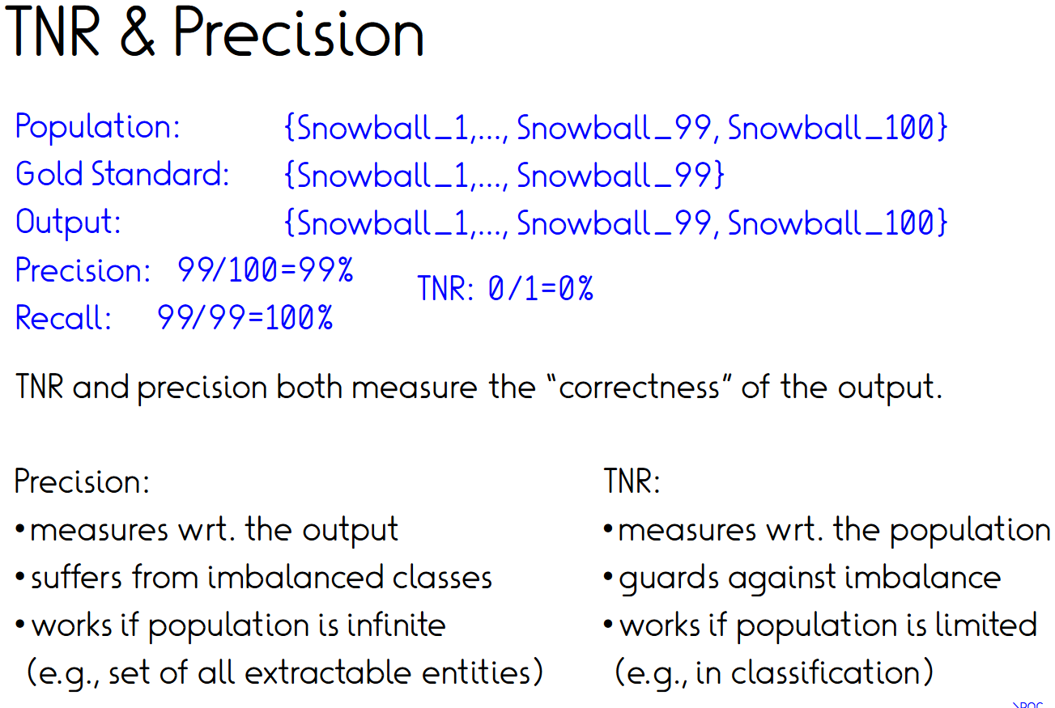

Slide 89

1
0
0
1

Slide 90

1
Random baseline
0
0
1

Slide 91

1
0
0
1
(AUC measure for PR curves also exists, but has
no corresponding probabilistic interpretation)

Slide 92

Def: Micro vs. Macro averaging
3 relations (A, B, C)
Predictions:
  10x A (90% correct)
  10x B (90% correct)
  100x C (10% correct)
Micro-avg. precision: $\frac{10x0.9+10x0.9+100x0.1}{10+10+100}=0.23$
Macro-avg. precision: $\frac{0.9+0.9+0.1}{3}=0.63$
Recall and F1 analogous
Micro – each instance counts same
Macro – each class counts same
Notes:
Micro – each instance counts
Macro – look at class level only

Slide 93
Interpreting scores:
Baselines and yardsticks
Method precision 0.63, recall 0.47
  Is this good?
Baselines
  Random!
  Most frequent class!
  Naive heuristics
    Trigger word lookup, first noun, 5th word, etc.
Yardsticks
  Existing systems
  Human performance (agreement)
    (in certain tasks e.g. in vision not a yardstick anymore)

Slide 94

Error analysis (1/3)
Method: P 0.63 R 0.47
Baseline: P 0.55 R 0.30
Humans: P 0.85 R0.90
What went wrong?
  Sample a few errors (false positives and false negatives)
  Define categories of errors
  Sample a larger set of errors
  Count frequencies of error categories
  Possibly iterate
Severity of errors?
Important for
  Pinpointing component in pipeline (NER, NED, RE, …)
  Yourself to improve
  The next one continuing your concrete work
  Others to understand potential and limits of your approach
Error meta-categories
  Limit of effort
    Effort-performance-derivation/extrapolation? Wrt. time or training data size
  Limits of methodology
  Limit of data/metric (next)

Slide 95
Task: Error analysis categories
Text | Ground truth | Extracted
Mary lives in Chicago | livesIn(Mary_Smith, Chicago_USA) | bornin(Mary_Smith, Chicago_USA)
 |  | livesIn(Chicago_USA, Mary_Smith)
 |  | livesIn(Mary_Smith, Chicago_Kenya)
John works for Procter and Gamble | worksFor(John, ProcterAndGamble_cpy) | worksFor(John, Procter_cpy)
 |  | affiliatedWith(John, ProcterAndGamble_cpy)
 |  | ceoOf(John, ProcterAndGamble_cpy)
Mary lives in Mannheim, right next to Ludwigshafen | livesIn(Mary, Mannheim) | livesIn(Mary, Ludwigshafen)

Slide 96

Error analysis (2/3) – Question the data
Data too often with issues
  Typing assignment: Vocabulary mismatch
  Relation extraction assignment: Nationalities that are not nationalities
Semiautomatic data:
  Systematic errors
Crowdsourced data:
  Difficult cases avoided
  Random noise
…
Notes:
Typing assignment: Painter → Human
RE assignment: Auckland, Minnesota instead of nationality

Slide 97

Error analysis (3/3) – Question the rules
Evaluation metric design not trivial
  Named entity recognition, OpenIE: Partial matches?
  Machine translation and summarization: BLEU
  Typing: Metrics aware of error severity?
  Disambiguation: Plausible vs. semantically impossible mismatches
(FIFA congress)

Slide 98
How to get gold data?
Self-annotation
  Alone or in a team of few researchers, colleagues
  Confirmation bias
  For final publication discouraged
Creative reuse of existing data
  E.g., Wikipedia text links for entity disambiguation
  Synchronous edits of Wikidata relation and texts
  Usually still shaky/biased
Paid annotators
  Can be known local personnel
  More often, anonymous online crowdsourcing
  De-facto standard nowadays

Slide 99
Crowdsourcing
Prominent platforms: Amazon Mechanical Turk, Prolific
Typical pay ~10$/hour
  In cases total spending 100k+€ for research datasets
Requires to-the-point instructions
  Traditional expert annotations guidelines sometimes >100 pages
  Complex or open-ended annotation tasks difficult
    Wherever possible, break into smaller tasks
Quality assurance:
  Worker education/background
  Worker reputation
  Honeypot/test question-based filtering
  Redundancy (majority opinion on task)
Creating good crowd tasks takes iterations and effort!

Slide 100
Example benchmark dataset: KnowledgeNet
[Mesquita et al., EMNLP 2019 https://www.aclweb.org/anthology/D19-1069.pdf]
Text: Wikipedia abstracts
15 common person relations
9000 exhaustively annotated sentences
Interannotator agreement
  Relation classification: 96%
  Entity disambiguation: 93%
In-house annotators
~2 minutes/annotator/sentence for one property
  22% mention detection, 40% relation classification, 28% entity disambiguation
2 annotators, in case of disagreement third annotator
→ Total effort ~ 600 annotator hours

Slide 101


Slide 102




Slide 103

Instructive pipeline implementations
Mention detection, coreference resolution, relation classification, entity linking
Human performance as comparison
Stanford TAC KBP
+ coreference
+entity types
+…
+BERT
Text spans of S and O match vs. KB links match

Slide 104
Takeaway: Evaluation
Choose metrics wisely
  Single metric desirable for ranking, but limited
    Simplifies complex picture of data distribution and error categories
    Thresholding behavior may matter
    Classification vs. extraction problem
  Goodhart’s law: Metrics cease to be good metrics once the become the prime target
Error analysis essential for learning sth.
  Error categorization
  Question ground truth and metrics

Slide 105
Outline
Fixed-target relation extraction
  Task
  Manual patterns
  Supervised learning
  Learning at scale
    Iterative pattern learning
    Distant supervision
  Case study: CINEX
Evaluation
Open information extraction (OIE)
  Verb-based
  SRL-based
  Organizing predicates
  Semistructured web: Openceres

Slide 106
Motivation: Open information extraction
So far assumed a fixed set of relations
Presumably designed by humans (“ontology engineers”)
Lessons from DB/KR Research
  Declarative KR is expensive & difficult
  Formal semantics is at odds with
    Broad scope
    Distributed authorship
  A “universal ontology” is wishful thinking

Slide 107
Coverage limitations of ontology engineering: Examples
Schema.org
  Industry standard for microformat in wepages
  800 entity types, 1300 properties
  CollegeOrUniversity: No numberOfStudents, nor degreesOffered
Wikidata
  Largest public crowd project on KBC
  >7000 properties
  Musicians: No performedAt, coveredArtist, songAbout
IMDB
  Most popular movie information website
  [Lockard et a., NAACL 2019]: Contains only about 10% of properties of 8 other domain-specific websites

Slide 108
Open vs. Traditional RE
OPEN VERSUS TRADITIONAL IE
 | Traditional RE | Open RE
Input: | Corpus + O(R) hand-labeled data | Corpus
Relations: | Specified in advance | Discovered automatically
Extractor: | Relation-specific | Relation-independent
How is Open RE Possible?

Slide 109


Semantic Tractability Hypothesis
$∃$ easy-to-understand subset of English
Characterized relations/arguments syntactically
[Banko et al. ACL ’08]
Characterization is compact, domain independent
Covers 80-95% of binary relations in sample corpus
(simplified!)

Slide 110

Reverb [Fader et al., 2011]

Slide 111
Sample Reverb relations
invented | acquired by | has a PhD in
denied | voted for | inhibits tumor growth in
inherited | born in | mastered the art of
downloaded | aspired to | is the patron saint of
expelled | Arrived from | wrote the book on

Slide 112
OpenIE: Demo
https://demo.allennlp.org/open-information-extraction
Einstein likes ice cream. Bus 105 is going to the zoo. The fox chased the rabbit that was hiding in the bush.
See BIO tagging

Slide 113

Challenges (1)
The great R. Feynman worked jointly with F. Dyson

Slide 114


Challenges (2)

Slide 115

System evolution
2007 Textrunner
  CRF and self-training
2010 ReVerb
  POS-based patterns
2012: OLLIE
  Dependency-parse based
2013: ClausIE
  Sentence restructuring before dependency parsing
2014 OpenIE 4.0
  SRL-based extraction
2016 OpenIE 5.0
  Compound noun phrases, numbers
2017 MinIE
  Minimizing extractions by removal of minor qualifiers etc.

Slide 116

OLLIE

Slide 117
Number of relation phrases
NUMBER OF RELATIONS
DARPA MR Domains | <50
NYU, Yago | <100
NELL | ~500
DBpedia 3.2 | 940
PropBank | 3,600
VerbNet | 5,000
Wikipedia Infoboxes, f > 10 | ~5,000
TextRunner | 100,000+
ReVerb | 1,000,000+

Slide 118
Demo: AKBC via OpenIE
https://openie.allenai.org/
Saarland
Einstein
Kangaroo
…

Slide 119
Outline
Fixed-target relation extraction
  Task
  Manual patterns
  Supervised learning
  Learning at scale
    Iterative pattern learning
    Distant supervision
  Case study: CINEX
Evaluation
Open information extraction (OIE)
  Verb-based
  SRL-based
  Organizing predicates
  Semistructured web: Openceres

Slide 120
Semantic role labelling
Can we figure out that these have the same meaning?
  XYZ corporation bought the stock.
  They sold the stock to XYZ corporation.
  The stock was bought by XYZ corporation.
  The purchase of the stock by XYZ corporation...
  The stock purchase by XYZ corporation...
How do we represent this commonality?

Slide 121
A Shallow Semantic Representation: Semantic Roles
Predicates (bought, sold, purchase) represent an event
Semantic roles express the abstract role that arguments of a predicate can take in the event
More specific More general
acquirer
buyer agent
thief
thrower mover
transporter

Slide 122
Thematic roles
Buyer and Thrower have something in common!
  Volitional actors
  Often animate
  Direct causal responsibility for their events
Thematic roles are a way to capture this semantic commonality between Buyers and Thrower.
They are both AGENTS.
The BoughtThing and ThrownThing, are THEMES.
• prototypically inanimate objects affected in some way by the action
One of the oldest linguistic models
  Indian grammarian Panini between the 7th and 4th centuries BCE

Slide 123
Thematic roles
A typical set:
Thematic Role | Definition | Example
AGENT | The volitional causer of an event | The waiter spilled the soup.
EXPERIENCER | The experiencer of an event | John has a headache.
FORCE | The non-volitional causer of the event | The wind blows debris from the mall into our yards.
THEME | The participant most directly affected by an event | Only after Benjamin Franklin broke the ice...
RESULT | The end product of an event | The city built a regulation-size baseball diamond...
CONTENT | The proposition or content of a propositional event | Mona asked “You met Mary Ann at a supermarket?”
INSTRUMENT | An instrument used in an event | He poached catfish, stunning them with a shocking device...
BENEFICIARY | The beneficiary of an event | Whenever Ann Callahan makes hotel reservations for her boss...
SOURCE | The origin of the object of a transfer event | I flew in from Boston.
GOAL | The destination of an object of a transfer event | I drove to Portland.
10

Slide 124

Roles can be naturally described by questions
→ Crowd annotators write intuitive¹ questions and answers
¹[Dagan et al.] The PropBank annotation guide is 89 pages (Bonial etal., 2010), and the FrameNet guide is 119 pages (Ruppen-hofer et al., 2006). Our QA-driven annotation instructions are 5 pages.

Slide 125
Supervised OpenIE
[Stanovsky et al., NAACL 2018 https://www.aclweb.org/anthology/N18-1081]
Uses SRL annotations as target and training data
  Idea: Every set of (head, arg0, arg1) corresponds to a statement
Trains a bi-LSTM to solve OpenIE via sequence labelling
  Verb identification
  Verb argument identification
  (head, arg0, arg1) as OIE output

Slide 126
Task: Formulate questions to elicit OpenIE triples
Einstein likes ice cream.
Bus 105 is going to the zoo.
The fox chased the rabbit that was hiding in the bush.

Slide 127
Outline
Fixed-target relation extraction
  Task
  Manual patterns
  Supervised learning
  Learning at scale
    Iterative pattern learning
    Distant supervision
  Case study: CINEX
Evaluation
Open information extraction (OIE)
  Verb-based
  SRL-based
  Organizing predicates
  Semistructured web: OpenCeres

Slide 128
Problem
Are there really 1 Million different relations?
  playedFor, wasOnTeam, appearedFor, playerOf, …
Sparsity makes it difficult to spot frequent trends and similarities across entities
Need to canonicalize and structure surface relations
  Canonicalize ~ NED for entities
  Structure ~ taxonomy construction for entity types

Slide 129
Key ingredient
Strong Co-Occurrence Principle:
If property name X frequently co-occurs with name Y in a context with cue Z (defined below), then Y is (likely) a synonym for X.
This principle can be instantiated in various ways, depending on what we consider as context cue Z:
  S-O context
  Multilingual context
  Search engine query-click logs
  …

Slide 130
Instance overlap as context: PATTY
Resource of 350k synsets of binary relations
Taxonomical organization
Key idea: exploit instance overlap/subsumption
Wikipedia-extractions between two named entities in sentence
Patterns combine terms, POS tags, types
Pattern accuracy: 85%
Subsumption accuracy: 75%
Played for | Was on the team of | Liked to eat
(Ronaldo, ManU) | (Ronaldo, ManU) | (Einstein, ice cream)
(Messi, Barca) | (Messi, Barca)

Slide 131



PATTY (2)
A=(Schwarzenegger, California), 80 occurrences

Slide 132

Efficient support set overlap comparison
n patterns → n² comparisons?
Prefix tree allows quick retrieval of subsumed patterns
Notes:
Tree construction: Put each instance into tree into each branch whose pattern it co-occurs.
So put F into both 2nd and third branch.
For a given pattern, find its leaf node, then go upward and collect all other patterns that appear along the nodes it contains as well.
E.g., for p3 start at H and also go sideward to notice that p4 contains G and F as well.

Slide 133

Multilingual context: PPDB
One of the largest paraphrase dictionaries, PPDB (Paraphrase Database), was constructed similarly
>100 million paraphrase pairs
Covering both unary predicates (types/classes and WordNet-style senses) and binary predicates (relations and attributes)

Slide 134

Query-click-log as context
Reformulations give first hints on synonyms/subproperties
Even stronger: Observe result interaction: Are overlapping sets of results clicked?
[He et al., “Automatic Discovery of
Attribute Synonyms Using Query Logs and Table Corpora”. WWW. 2016]

Slide 135
Outline
Fixed-target relation extraction
  Task
  Manual patterns
  Supervised learning
  Learning at scale
    Iterative pattern learning
    Distant supervision
  Case study: CINEX
Evaluation
Open information extraction (OIE)
  Verb-based
  SRL-based
  Organizing predicates
  Semistructured web: OpenCeres

Slide 136

Example: OpenCeres [Lockard et al., NAACL 2019]
Back from text to seminstructured content
Instructive OpenIE and distant supervision

Slide 137

OpenCeres

Slide 138
Take home: OpenIE
Open IE/RE is a powerful machinery
  Needs no labelled data
  No domain-specific adaptation
  Well suited for maximizing KB recall
  Can discover new predicates
Challenges
  Typically substantial noise
  Downstream applications that need clustering/canonicalization require additional processing steps
Open predicate organization
  Based on distributional similarity cues
    E.g., instance overlap, multilingual alignments, query-click-logs

Slide 139
References
Papers:
  Stanovsky and Dagan, Creating a Large Benchmark for Open Information Extraction, EMNLP 2016
  Nakashole et al., PATTY: A Taxonomy of Relational Patterns with Semantic Types, EMNLP 2012
Slides
  Adopted from Fabian Suchanek, Julien Romero and Oren Etzioni
Code/APIs
  OpenIE
    https://www.textrazor.com/demo
    https://gate.d5.mpi-inf.mpg.de/ClausIEGate/ClausIEGate/
    https://github.com/dair-iitd/OpenIE-standalone
Link collection on OpenIE
  https://github.com/gkiril/oie-resources

Slide 140
Assignment 6
Code your own open relation extraction
Evaluation on benchmark data from [Stanovsky and Dagan, EMNLP 2017]
F1 on extractions (head word match for predicate)

Slide 141
Take home
Fixed relations
  Supervised learning data bottleneck, but performant
  Iterative pattern learning and distant supervision as alternatives
  BERT allows to bypass feature engineering
Evaluation
  Right metric for right problem
  Error analysis
  Effort in data annotation, error analysis
Open information extraction
  Alternative requiring no decision on schema upfront
  But some effort pushed downstream (clustering/canonicalization)

