Slide 1
Automated knowledge base construction
7. Commonsense Knowledge (CSK)
Simon Razniewski
Summer term 2022

Slide 2
Interactive pattern matching with spaCy
Interactive tool for exploring pattern matches
  https://explosion.ai/demos/matcher
General documentation:
  https://spacy.io/usage/rule-based-matching

Slide 3
Background
So far largely (implicitly): Small data
  First sentence from an entity description, one Wikipedia article, one Fandom infobox, …
More often than not:
  Huge set of possible sources
  Precision-orientation may suggest filtering, selecting
    Semistructured content >> Wikipedia >> General web
  If no premium resources exist/high recall is desired
  → Leads to the topic of extraction consolidation

Slide 4
Consolidation need
bornIn(John, Paris) + bornIn(John, London)
(single-value conflict)
hasParent(Mary, John) + hasParent(John, Mary)
(antisymmetric relation violated)
hasParent(Mary, {John1, John2, … John377})
(implausible counts)
bornIn/raisedIn/livedIn/diedIn(John, Sydney) + positionHeld(John, Prime Minister of Canada)
(spatial implausibility)
… temporal implausibility
… topical implausibility
…

Slide 5
Extraction consolidation
Family of approaches
  Tresholding
  Constraint reasoning
  Multi-source validation
Details in
  Section 8.5 of course textbook (see website)
  Slides of lecture 8 of old course (link)
Today: Application domain of AKBC where multi-source extraction and consolidation is essential: Commonsense knowledge

Slide 6
Outline
Introduction to CSK
  What is CSK?
  Why is it important?
  How to represent it?
  What makes it challenging?
Crowdsourced CSKB construction
Text-extraction for ACSKB construction
CSKBs: Summary and Outlook

Slide 7
What is commonsense knowledge?
Definition 1 (by commonality):
Knowledge shared by most humans
Possible qualifications
  Across cultures
  From early in life (=children)
E.g., elementary school exam questions
  http://data.allenai.org/ai2-science-questions

Slide 8
What is commonsense knowledge?
Concepts: City, footballer, organization
Events: Football match, birthday party
Differentiation from encyclopedic knowledge on instances
  Instances: Saarbrücken, Ronaldo, Manchester United
Definition 2 (by knowledge type):
Knowledge about concepts and events

Slide 9
Definition Pro/Con
Definition 1 (by commonality):
  Popsicle, is, frozen – only known in North America
  Lion is dangerous/cute - depends whom you ask
  Inclusion/exclusion decision challenging
Definition 2 (by knowledge type):
  Apple MacBook, Ford Model T
  Class/instance not trivial to separate
  USA borders Pacific Ocean – excluded as instance knowledge
  Mitochondria, hasPart, inner membrane – not common knowledge
  Open-ended
    Can be somewhat mitigated by ranking-based evaluation

Slide 10
Definition: Merger
Knowledge
Class knowledge Instance knowledge
Shared by
- Virtually
everyone
- Many
- Some
- Few
Fire is hot
Basic CSK
Advanced CSK
Elephants have tusks
USA borders Pacific
Mitochondria have inner membrane
Newton born in Woolsthorpe

Slide 11
Examples of CSK
Taxonomical
  Elephant, isA, mammal
Properties
  Elephant, lives in, Savanna
Parts
  Elephants, hasPart, trunk
Measures
  Adult elephant, weight, ~2..5 tons
  Elephant, lifespan, ~60 years
Activities
  Seeing elephant, requires, go to zoo
  Go to zoo, subevent, buy ticket
  Go to zoo, typicalDuration, 2 hours

Slide 12
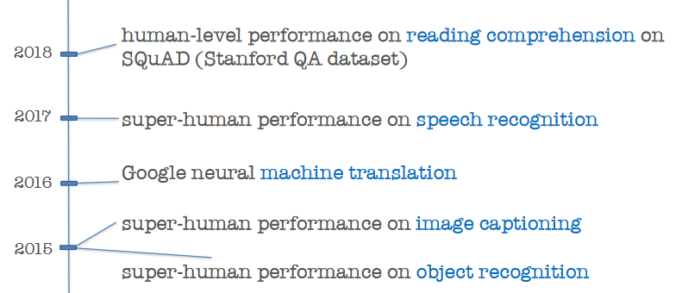
Why CSK? Amazing progress without
[From Yejin Choi, ACL 2020]

Slide 13
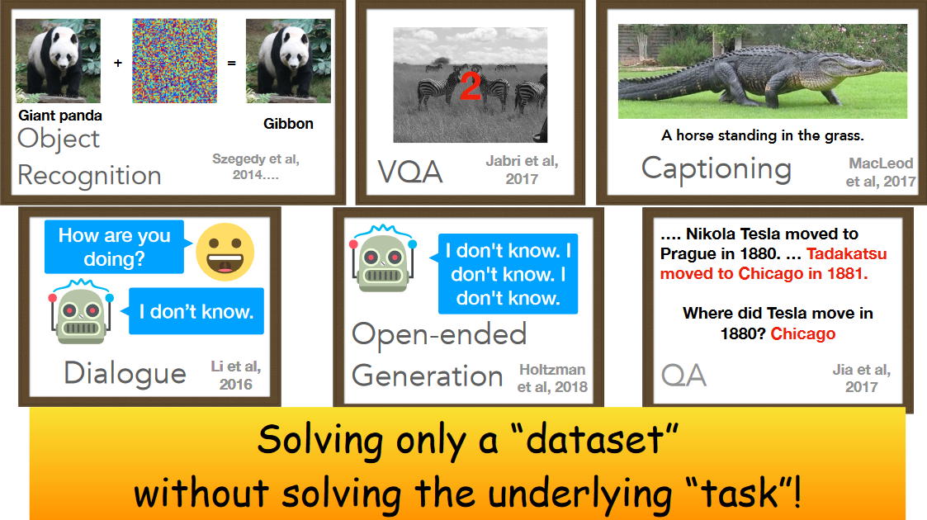
[From Yejin Choi, ACL 2020]
Notes:
For *any* “how many” question, SOTA models will say 2

Slide 14
Importance of CSK
Reusable and scrutable asset for a range of AI tasks
Reusable:
  CSK can be plugged into a range of tasks, e.g., QA, dialogue, object recognition, text generation, …
  Contrasts with typical end-to-end learning
Scrutable:
  Humans can inspect, add and remove content
    Relevant in applications where errors are costly
    Relevant in applications at risk of bias/discrimination
  Humans can inspect discrete statements used for reasoning
    Relevant for debugging complex downstream use cases
  Contrasts with end-to-end learning and pretrained language models
Notes:
Examples Microsoft Tay
Man/woman/doctor/nurse

Slide 15
Knowledge representation challenges
Encyclopedic KBs: Typically binary truth notion
  Trump, born in, NY
  House of Cards, producer, Netflix
  New York, mayor, Bloomberg, [2002-2013]
CSK: Generalizes across subjects
  Lions, have, manes - percentage?
Fuzzy time notion
  Lions, drink, milk - when?
Spatial and cultural context
  Lion, is, cute
  Elk, usedFor, transport

Slide 16
Linguistics - Generics
It is complicated
  Ducks lay eggs >> Ducks are female
    Even though former set is a subset of latter
  Dinosaurs are extinct/Elephants are biggest land animals
    Not applicable to individuals
[Generics oversimplified, Leslie, 2013]

Slide 17
Epistemic logics
“Zoo visitors believe lions are cute”
“Rural dwellers believe lions are dangerous”
Used in CycL
  Reification
  Modals for belief and desires
[CYC: Towards programs with common sense, Lenat et al., 1990]
[Kriepke 1963], and others

Slide 18
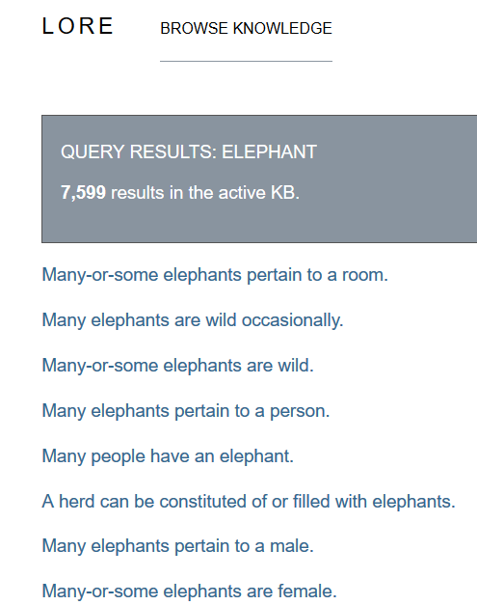
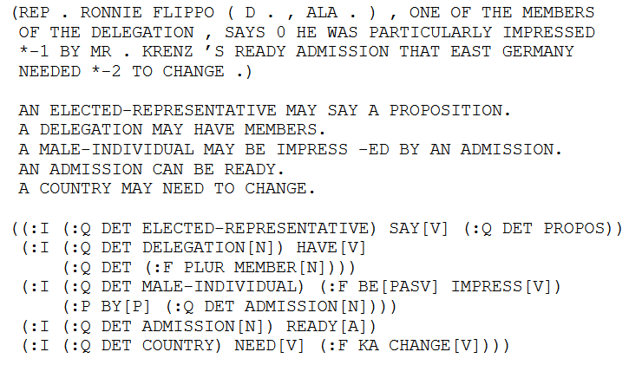
Episodic logics
KNext, Lore projects in early 2000s
Schubert, Lenhart. "Can we derive general world knowledge from texts.“ HLT 2002
Notes:
Turn every instance assertion into a class assertion with existential quantification

Slide 19
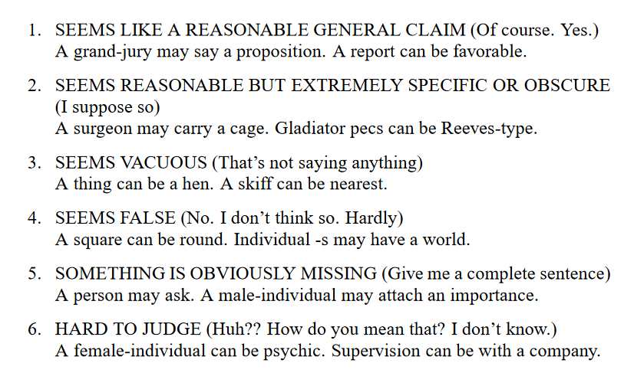
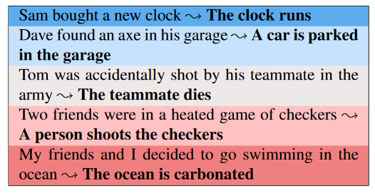
Graded formalisms
Heuristic level in CycL
  True, default true, unknown, default false and false as statement labels
Ordinal grades
[Schubert and Tong, NAACL 2003]
Simplified
[Zhang et al., TACL 2017]
  Very likely
  Likely
  Plausible
  Technically possible
  Impossible
Notes:
Ordinal Common-sense Inference – Durme 2017

Slide 20
Graded formalisms (2)
Dice [Chalier et al., AKBC 2020]
  4 dimensions
 | Plausible | Typical | Salient | Remarkable
Lions; eat; chicken | ✓
Lions; attack; humans | ✓ |  | ✓ | ✓
Lions; drink; water | ✓ | ✓

Slide 21
KR - state of the art
Expressive proposals exist
  Modal, epistemic, episodic logic
Instantiation hard
  Sparse realization in natural language
  Correct extraction nontrivial
Most projects:
Pragmatic choice of (subject, predicate, object) triples with a single score
Lion, hunts, zebra – 0.73
Lion, drinks, milk – 0.45

Slide 22
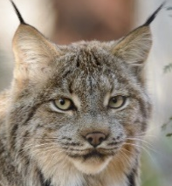


Triples and done?
Still major design decisions left!
  Fixed or open set of predicates
  Subject range
  Object range
Fixed vs. open predicates
  E.g., ConceptNet: ~25 predicates (isCapableOf, requires, isA) vs. TupleKB ~1000 textual phrases
Subjects: Strings or disambiguated terms?
  Lynx vs. lynx vs. lynx
Granularity and modifiers
  Elephant, Foraging elephant? Newborn elephant?
Objects: Entities or open phrases?
  Politician, isCapableOf, promise that impossible things will happen

Slide 23
Outline
Introduction to CSK
Crowdsourced CSKB construction
Text-extraction for ACSKB construction
CSKBs: Summary and Outlook

Slide 24
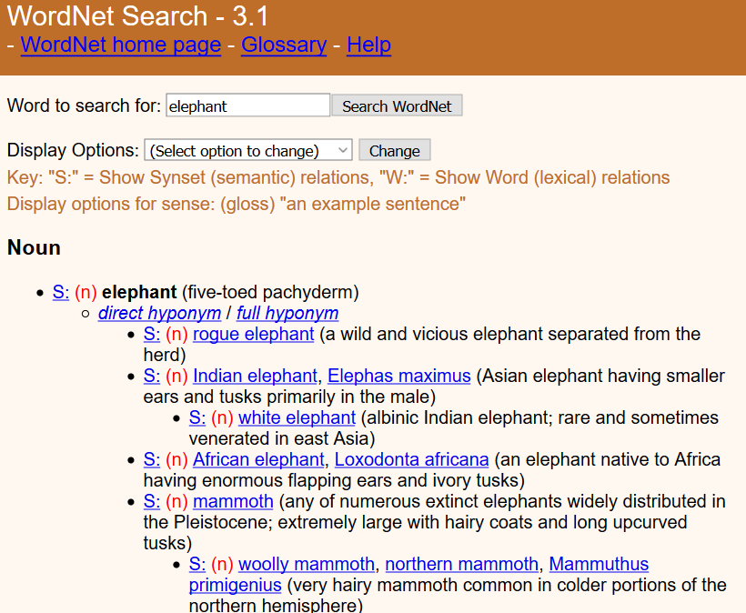
Crowdsourcing Expert annotation
WordNet [Miller and Fellbaum, ~80s]
  Lexical resource still popular today
  Is-A, synonym, partOf
  ~200k word senses
  2 expert annotators (=authors)
  Limitations: Imbalance, idiosyncrasies,
  lack of scores/ranking
Cyc [Lenat, ~80s]
  CSK, world knowledge, rules
  Hired experts on specific domains
  >1000 person-years of effort estimated
Next projects: Harness power of laypeople

Slide 25
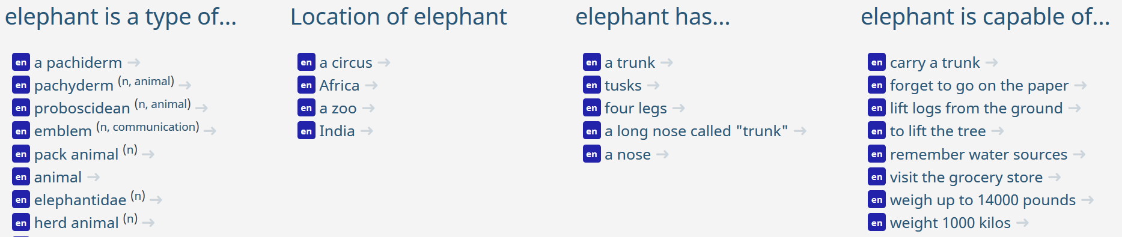
Open Mind Common Sense / ConceptNet
Havasi et al., MIT ~1999 [http://conceptnet.io/]
CSK for ~25 relations
  Construction statistics
    ~14k volunteers filled in sentences with blanks
    ~700 000 English sentences
    NLP tools: 300 000 concepts and 1.6 million assertions
[ConceptNet — a practical commonsense reasoning tool-kit, Liu and Singh, 2004]

Slide 26
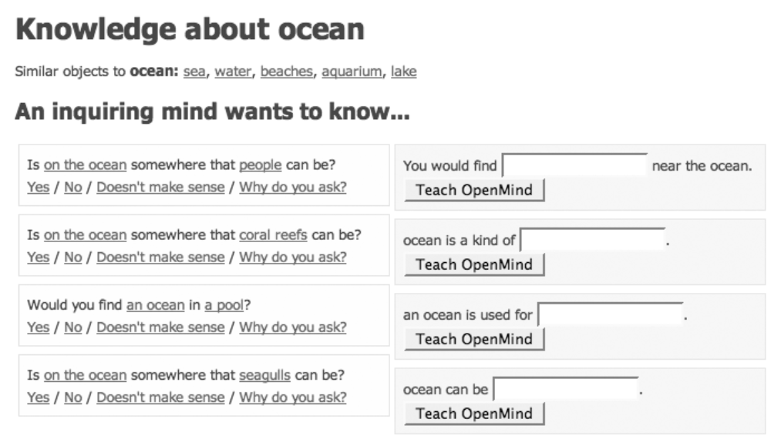
Open Mind Common Sense / ConceptNet

Slide 27
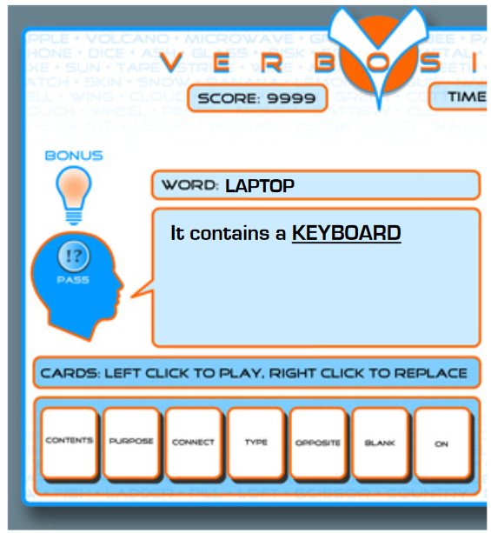
Verbosity
2-player game inspired by Taboo
Narrator must describe a word by filling blanks in templates
  ___ is a kind of ___. Allows for hierarchical categorization.
  ___ is used for ___. Provides information about the purpose of a word.
  ___ is typically near/in/on ___ (three templates). Provide spatial data.
  ___ is the opposite of ___ / ___ is related to ___(two templates). Provide data about basic relations between words.
Templates give rise to CSK assertions
Verification via automated narrator that replays human assertions
Used to feed ConceptNet
High-quality: 85% of sentences rated as correct by 6/6 annotators
[Ahn et al., 2006]
Notes:
van Ahn famous for human computation, captchas

Slide 28
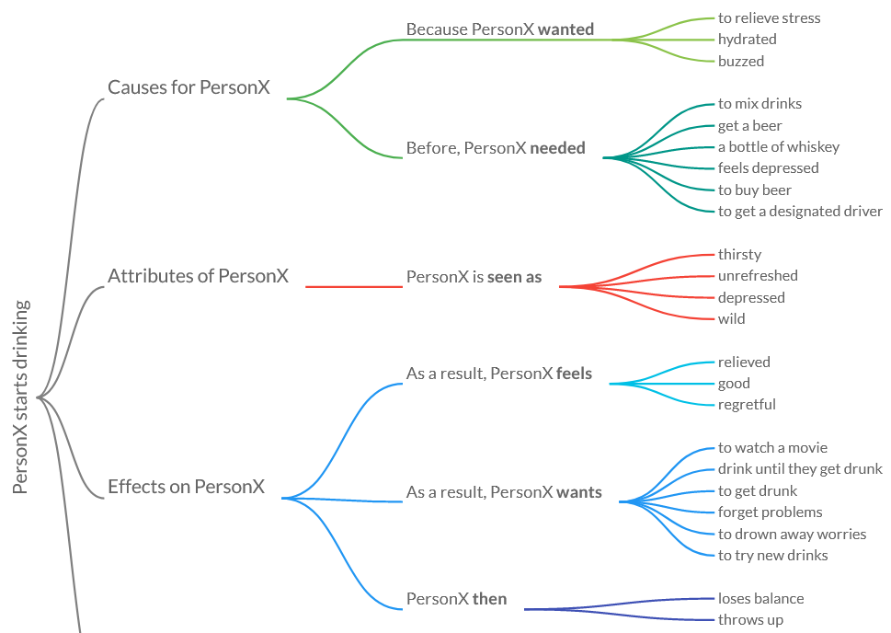
Atomic
Targets event knowledge
https://mosaickg.apps.allenai.org/kg_atomic
Redundancies!
[Sap et al., AAAI 2019]

Slide 29
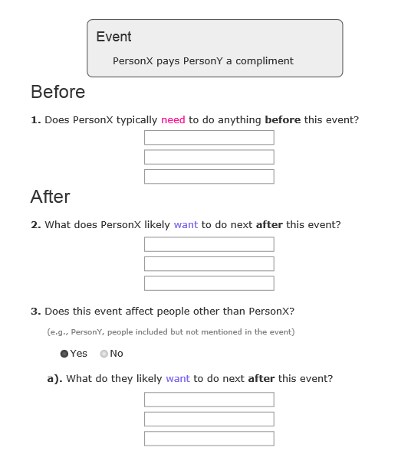
Atomic
Archetype of large-scale paid crowdsourcing
Subjects from text extraction (24k event phrases)
Statement creation
  3 workers per subject
  Free-form interface
  ~12$/hour
  300k statements
  3*5 minute/subject (?) → ~$100k cost

Slide 30
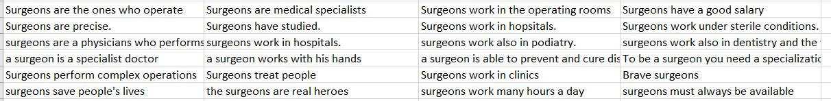
Quasimodo evaluation data
Not a KB construction effort!
Only tiny slice of humans data for evaluation
https://www.mpi-inf.mpg.de/fileadmin/inf/d5/research/quasimodo/CSK-crowd-for-recall.xlsx
2400 statements
[Romero et al., CIKM 2019]

Slide 31
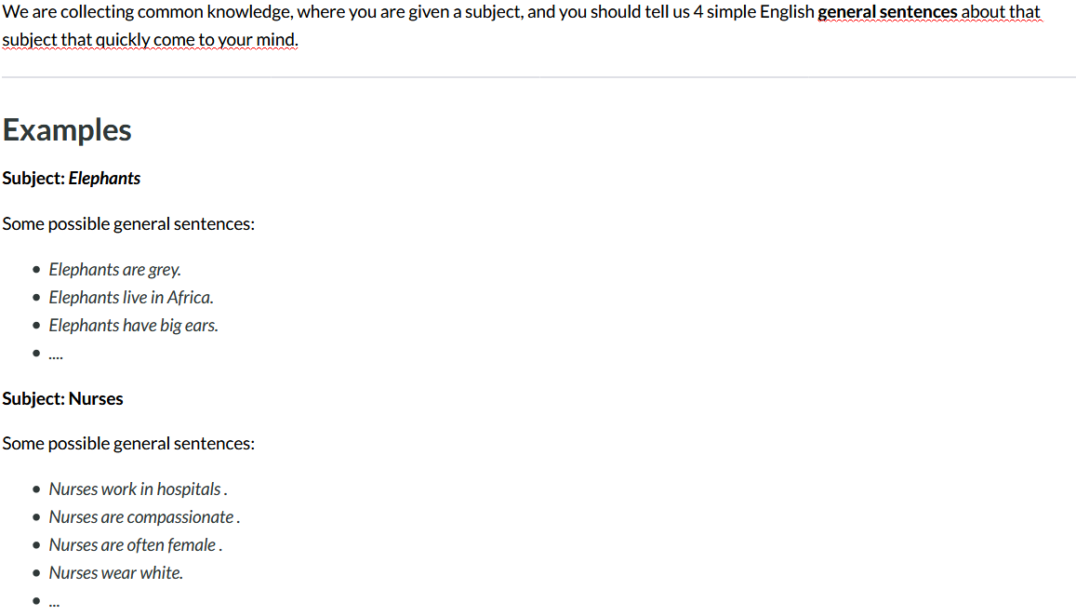
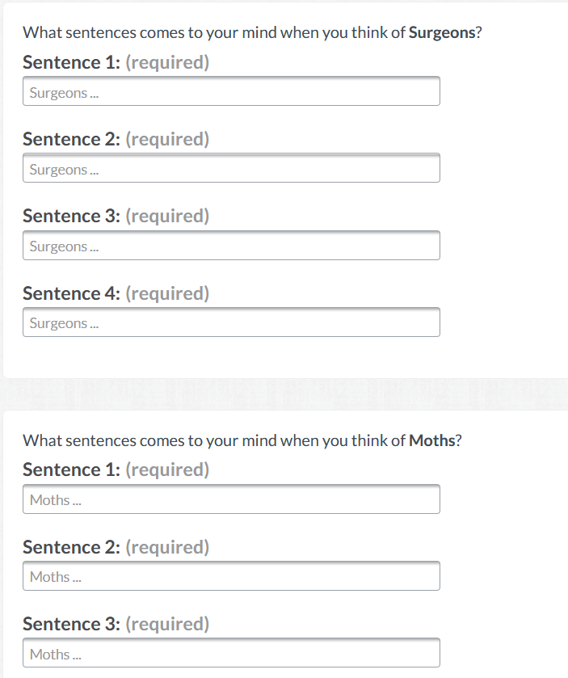
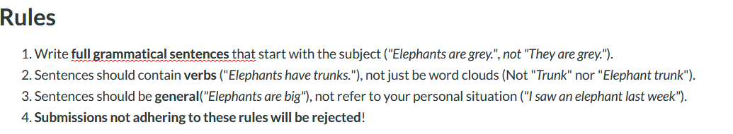
Still lots of misunderstandings
“I know a surgeon”
“Un cirujano es un gran hombre”
“The heart surgeon”
→ Second round of peer filtering might help
Notes:
We paid 15 cents per row -> assuming about 1 minute per subject

Slide 32
Wikidata
Collaborative knowledge base construction effort
Under umbrella of Wikimedia foundation
Best public source on encyclopedic knowledge today
Commonsense:
  Comparably lower coverage
  Roughly comparable to ConceptNet
  Growing…to be monitored
  [Ilievski et al, Arxiv 2020]

Slide 33
Crowdsourcing - Summary
Project | Focus | #statements | Notes
WordNet | Taxonomical relations | 175k synsets | Expert-built
Cyc | General statements and rules | OpenCyc: ~2 M statements | Expert-built, closed source
ConceptNet | Object properties | 1.6 M statements
Atomic | Events | 877k statements
Wikidata | Object properties | 100k CSK statements | Editable
Limited by volunteer effort/money
Targeted domains in reach for industrial efforts
Quality assurance important

Slide 34
Outline
Introduction to CSK
Crowdsourced CSKB construction
Text-extraction for ACSKB construction
  Overview
  Recipe
  Example projects
CSKBs: Summary and Outlook

Slide 35
Overview
Earliest projects on CSKB construction were manually authored (Cyc, ConceptNet)
Challenges in scale
  Atomic: ~100k$ annotator expenses
Automated information extraction and KB construction field with long history
  Focus traditionally on crisp ``encyclopedic’’ knowledge
  (cf. DBpedia, YAGO, NELL, DeepDive, …)
Can we use automated IE and KBC for CSK?

Slide 36
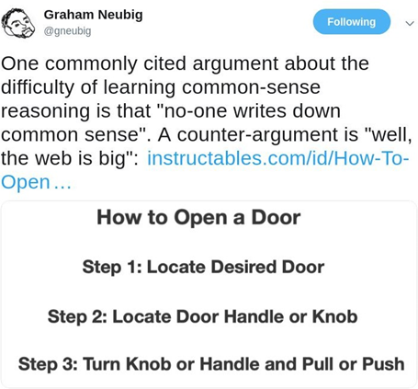

Slide 37
Challenges of automated CSKB construction
Underspecified text semantics
  “Lions attack humans” – all/some/all the time/once/..?
Reporting bias
  “woman kills” vs. ”woman breathes” – 1.5M vs. 0.1M web search results
  “pink elephant” vs. “grey elephant” – 6.9M vs. 1.9M web search results
Sparse observations of quadratic+ space of possible statements
  Do computer programmers drink water?
Noise and polysemy
  Pigs can fly - idiom
  Lynx: Constellation, web browser, animal

Slide 38
Outline
Introduction to CSK
Crowdsourced CSKB construction
Text-extraction for ACSKB construction
  Overview
  Recipe
  Example projects
CSKBs: Summary and Outlook

Slide 39
Recipe – Generic design points
Sources
Extraction method
Type of contextualization
Consolidation method

Slide 40
Design point 1 – Source choices
“Where to extract from?”
  Wikipedia
  Books and other dedicated sources
    ARC science corpus
    Project Gutenberg
  Web search
  Forums
    Reddit
    Quora
    Yahoo Answers
  Search engine query logs
  Web crawls
    ClueWeb
    CommonCrawl
  …
Precision
Coherence
Recall
Redundancy

Slide 41
Extraction source - considerations
(CS)KB projects stand and fall with source selection
Precision: Topic-specific sources >> random web
  Event knowledge – Wikihow [HowToKB, WWW 2017]
  Cultural knowledge – Movie scripts [Knowlywood, CIKM 2015]
  Science knowledge – Science textbooks [GenericsKB, Arxiv 2020]
Frequency signals may be stronger from general web dumps, but considerable noise
Intermediate setting: Targeted web search [TupleKB, Ascent]

Slide 42
Design point 2 – Extraction method options
“How to extract”
  Manual patterns [WebChild, WSDM 2014]
    Hearst patterns etc.
  Co-occurrence [DoQ, ACL 2019]
    Window, same sentence, …
  Open information extraction [TupleKB, Quasimodo, Ascent]
    Any verb phrase
  Relation-specific supervised learning

Slide 43
Extraction method - considerations
Preferred method depends on desired knowledge representation
  E.g.,
    Few non-overlapping relation → Co-occurrence
    Moderate relations → Supervised extractors
    Many relations → OpenIE
Has implications downstream
  Extraction confidences (supervised extractors) for quantitative contextualization
  Text context for qualitative contextualization
  OpenIE with many unspecific extractions

Slide 44
Design point 3 – Contextualization
“What do we annotate statements with?”
  Observation frequency [WebChild 2.0, DoQ]
    Elephant, has, tusks, 155
    Elephant, has, tail, 84
  Quantitative [0,1] truth labels [TupleKB, Quasimodo]
    Elephant, lives in, group, 0.87
  Qualitative truth labels [Ascent]
    Elephant, lives in, group, temp: during wet season
    Subgroup: Female elephant, lives in, group

Slide 45
Contextualization - considerations
Frequencies trivial to interpret, but do not qualify degree of truth
Quantitative truth labels nontrivial semantics
Qualitative labels easier to interpret, but harder to compare
Expressive proposals from KR exist (e.g., modal logics)
  Actual implementation not easy
    Sparse realization in natural language
    Correct extraction nontrivial

Slide 46
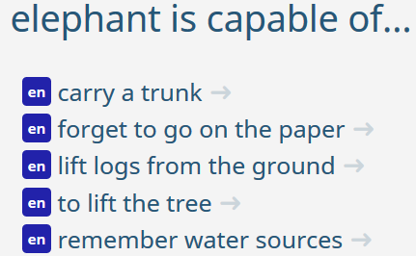
Design point 4 – Consolidation
“What do we do with redundant and competing extractions?”
Similar statements may be seen several times
Redundancy and contradictions may require additional inference
Common consolidation methods
  Keep all [DoQ]
  Frequency cutoff [Ascent]
    E.g., at least seen 5 times
  Per-statement consolidation [TupleKB, Quasimodo]
    Feature-based classification/ranking
  Joint consolidation [WebChild, Dice, Ascent]
    E.g., BERT-based clustering, MaxSAT, …
Cats, are, solitary
Lions, live in, groups
Lions, are, cats

Slide 47
Consolidation - considerations
Redundancy challenge and blessing
Exploiting redundancy requires strong text similarity/entailment modules
Previous projects often stuck to per-statement consolidation due to lack of strong similarity/entailment modules
Recent advances on pretrained LMs give hope for joint consolidation (see e.g., Dice, Ascent)

Slide 48
Outline
Introduction to CSK
Crowdsourced CSKB construction
Text-extraction for ACSKB construction
  Overview
  Recipe
  Example projects
CSKBs: Summary and Outlook

Slide 49
Example projects
Webchild [Tandon et al., WSDM 2014]
  Disambiguated noun-adjective pairs
Quasimodo [Romero et al., CIKM 2019]
  Salient general triples
DoQ [Elazar et al., ACL 2019]
  Quantitative knowledge
Dice [Chalier et al., AKBC 2020]
  Multifaceted quantitative contextualization and joint consolidation

Slide 50
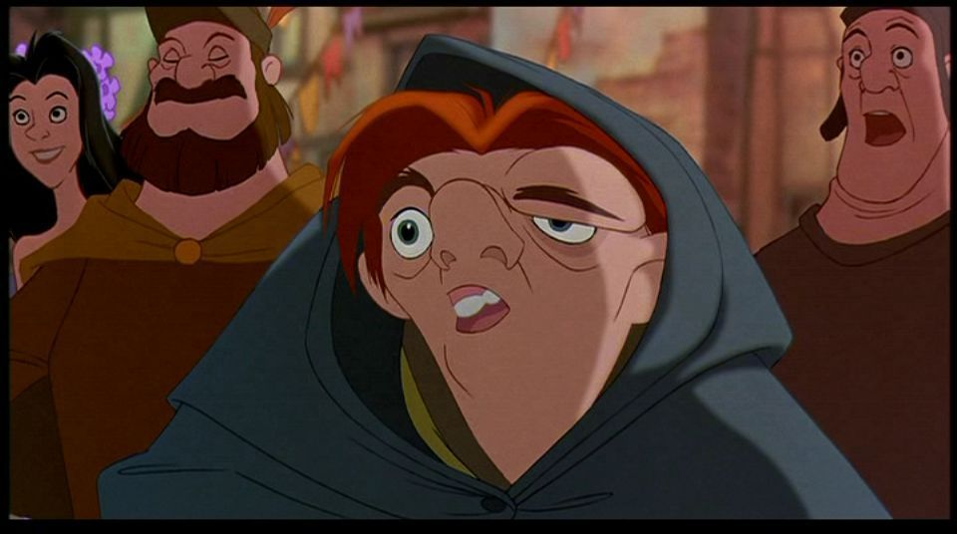
Quasimodo
= Query Logs and QA Forums for
Salient Commonsense Definitions
Focus on salient knowledge
  Human associations, curiosity
Source: Query logs and QA forum questions
Extraction method: OpenIE
Contextualization: Supervised precision + IDF
Consolidation: Largely per-statement regression
(The Hunchback of Notre Dame)
[Romero et al., CIKM 2019], builds on [TupleKB - Mishra et al., TACL 2017]

Slide 51
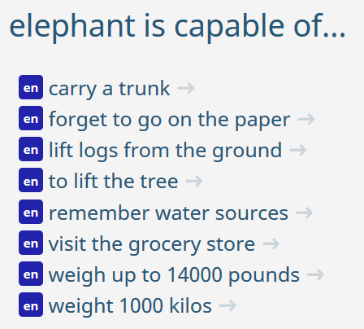
Starting point:
Humans vs. automated IE
Manual constructions:
Salient but few
Automated construction:
Many but boring
[ConceptNet]
[TupleKB]
Elephant:
- require, ground
- inhabit, region
- (95 more)
(6 more)
How to reconcile the two?

Slide 52
Salient knowledge: Utterance context
Key idea: Questions convey salient knowledge
Why do cats purr?
Why do Americans love guns?
Why are airplanes white?
  So someone knows these!
  That someone cares enough to ask!

Slide 53
Salient knowledge: Premier sources
QA forums:
  Reddit
  Quora
  Yahoo answers
  Ask.com
Search engine query logs
  Bing
  Google

Slide 54
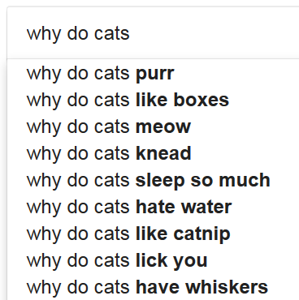
Tapping search engine query logs
Autocomplete gives only 10 suggestions/query
→ Exhaustive suffix probing
  Why do cats a
  Why do cats b
  Why do cats …
  Why do cats aa
  Why do cats ab
  …

Slide 55
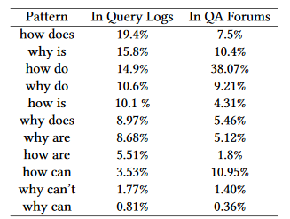
Question templates

Slide 56
Statement extraction
Questions → statements → tuples using OpenIE
Why are lions hunting zebras?
Transform
Lions are hunting zebras
OpenIE
(lions, are hunting, zebras)
Normalize
(lion, hunt, zebras)
Score
(lion, hunt, zebras), 0.73
Une école de l’IMT

Slide 57
Anecdotal Examples
Practical human knowledge | (car, slip on, ice)
Problems linked to a subject | (pen, can, leak)
Emotions linked to events | (divorce, can, hurt)
Human behaviors | (ghost, scare, people)
Visual facts | (road, has_color, black)
Cultural knowledge (USA) | (school, have, locker)
Comparative knowledge | (light, faster than, sound)
Une école de l’IMT

Slide 58
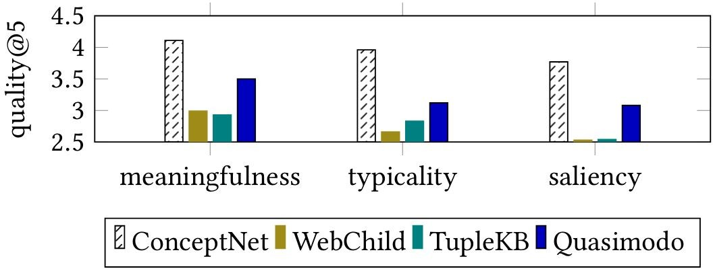
Results – Precision
Sample from a list of common subjects (popular animals and occupations)
5 = best, 1 = worst

Slide 59
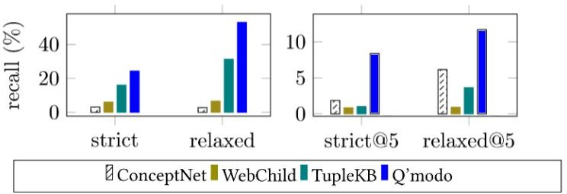
Results – Recall
Crowd task:
Tell us 3 things that come to your
mind when thinking of lions.
1. Lions …
2. Lions …
3. Lions …
Full KB Top-5

Slide 60
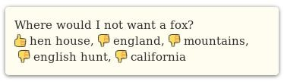
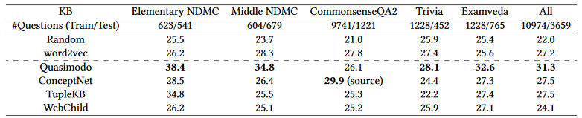
Extrinsic evaluation
Accuracy in multiple-choice question answering.
(Simple question-answer connectedness scheme)

Slide 61
Example projects
Webchild 1.0 [Tandon et al., WSDM 2014]
  Disambiguated noun-adjective pairs
Quasimodo [Romero et al., CIKM 2019]
  Salient general triples
DoQ [Elazar et al., ACL 2019]
  Quantitative knowledge
Dice [Chalier et al., AKBC 2020]
  Multifaceted quantitative contextualization and joint consolidation

Slide 62

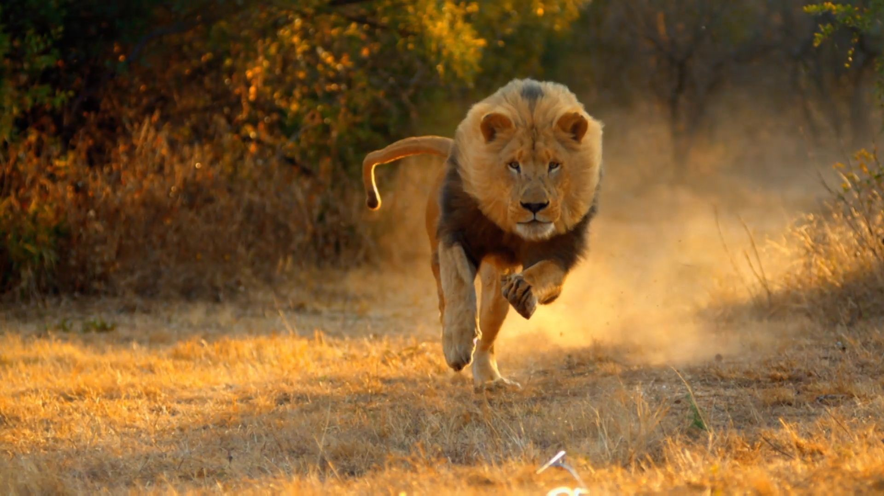
Distribution over quantities (DoQ)
P
roprietary + Conﬁdential
Understanding numerical properties and the way they relate to words.
Lion
Focus on items which can be measured objectively
speed
weight
...
size
Physical attributes
[Elazar et al., ACL 2019]

Slide 63
Distribution over quantities (DoQ)
P
roprietary + Conﬁdential
Source: Google search engine document index
Extraction scheme: Text window co-occurrence of subject, quantity and dimension keyword
Contextualization: Frequency
Consolidation: none/distribution

Slide 64
Example - Measurement Detection
P
roprietary + Conﬁdential
“These breeds can vary in weight from a
0.46 kg teacup poodle ...”
Detect numerical measurements using rules: kg/kgs/kilogram -> Mass
Normalize (kg -> g)

Slide 65

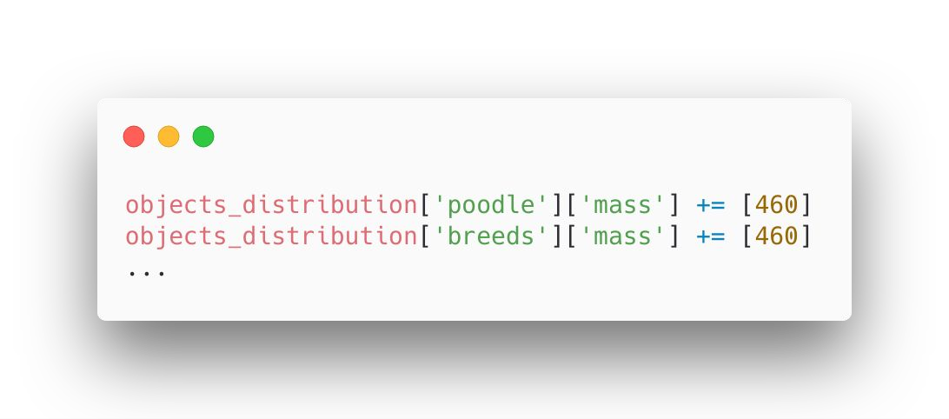
Example - Co-Occurring objects
Proprietary + Conﬁdential
Noun Noun
“These breeds can vary in weight from a
0.46 kg teacup poodle ...”
NP
460 gram
Detect objects of interest (Nouns, Adjectives and Verbs) using a POS tagger.

Slide 66
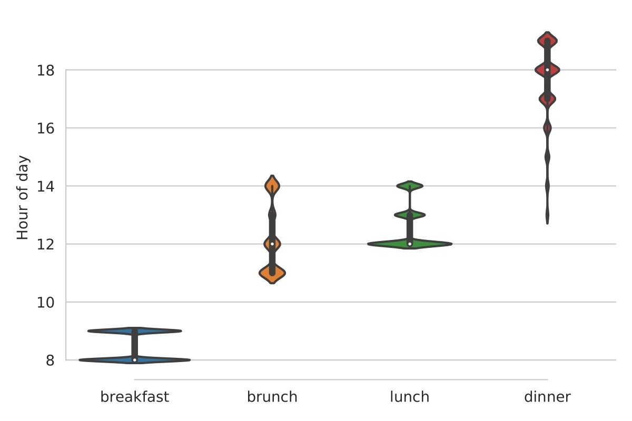
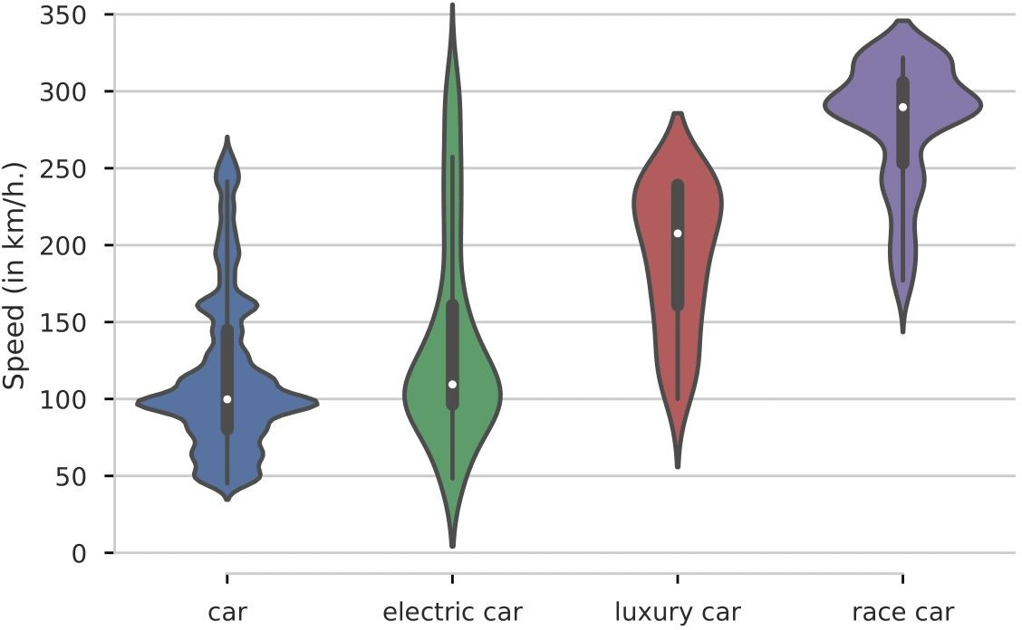
Example - Aggregating Measurements

Slide 67
Resource Statistics - DoQ
Proprietary + Conﬁdential
Distributions over Quantities (DoQ)
A very large and diverse resource
~120M Unique tuples (object, measurement)
  ~350K with >= 1000 occurrences
Measurement types:
  Length, mass, currency, temperature, …
27 In total

Slide 68
Intrinsic Evaluation
P
roprietary + Conﬁdential
Extract the median of “popular” noun distributions
Expand to a range
  20 mm 10-100 mm
Ask annotators if the item fits the range
  “Is the usual length of a screw between 10-100mm?”
69% agreement with predictions
Not perfect, but a reasonable start for acquiring such knowledge

Slide 69
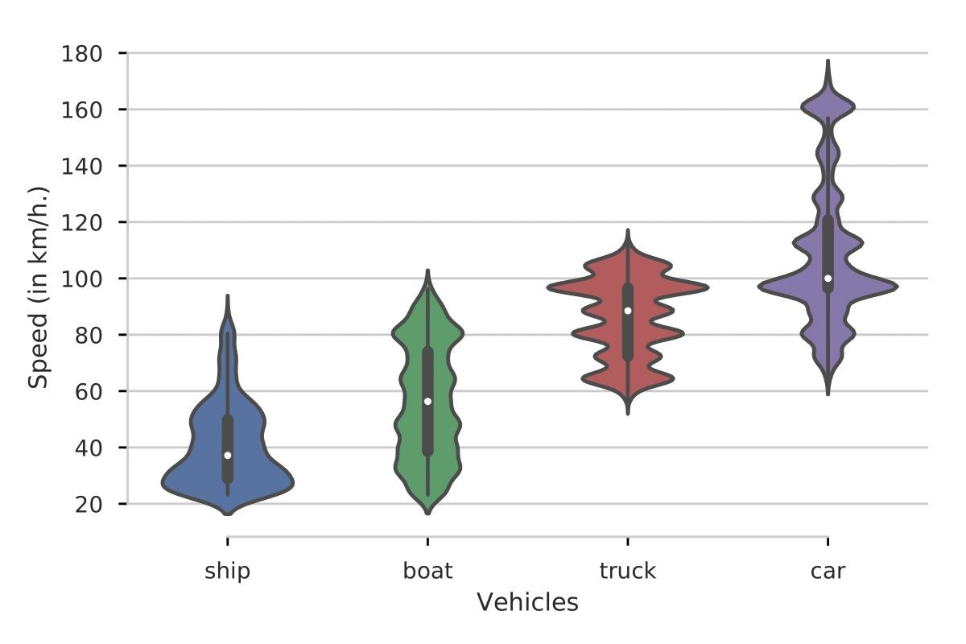

Comparable Objects - Cool Results
Proprietary + Conﬁdential

Slide 70
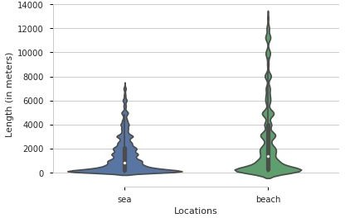
Comparable Objects - Some Issues
Proprietary + Conﬁdential
“Elevation ranges from 3,000 feet
... above sea level.”
That’s a small sea!

Slide 71
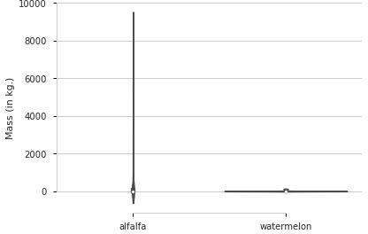
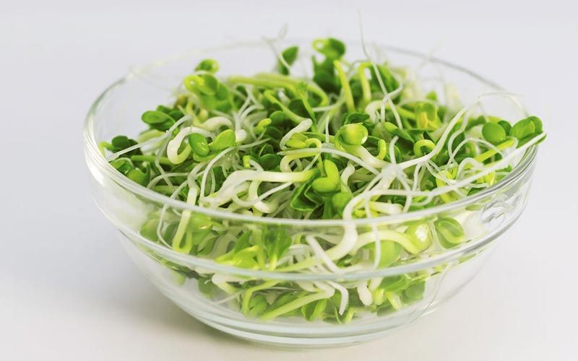
Comparable Objects - Some Issues
Proprietary + Conﬁdential
“Alfalfa is the most cultivated legume ... reaching around 454 million tons ...”
That’s a heavy alfalfa
https://alivebynature.com/the-right-way-to-eat-alfalfa-sprouts/

Slide 72
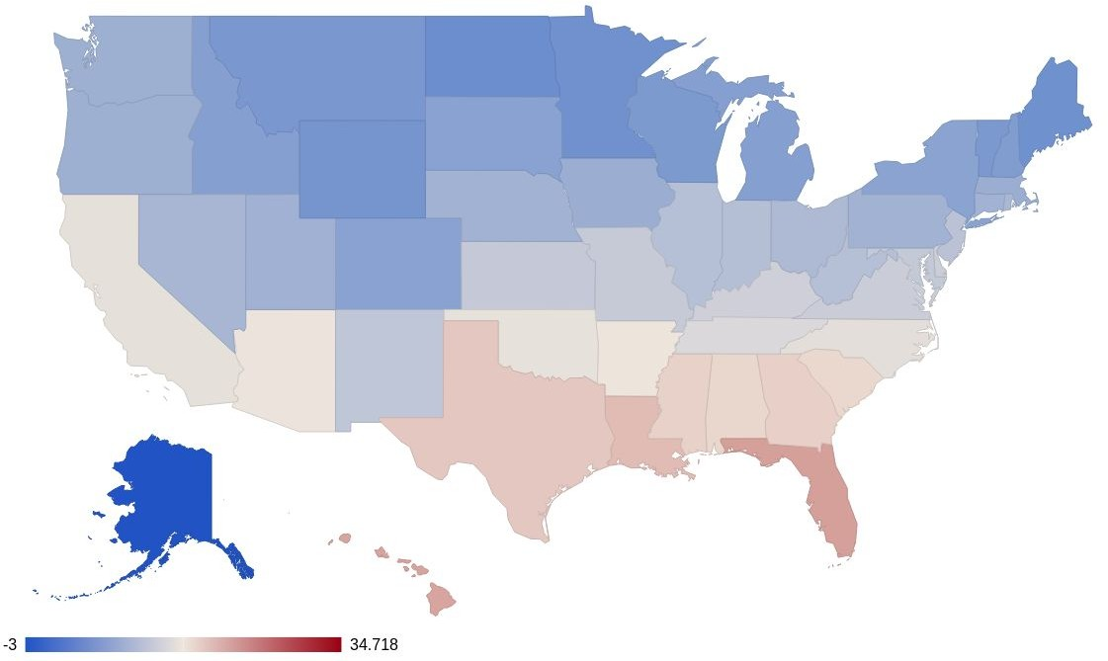
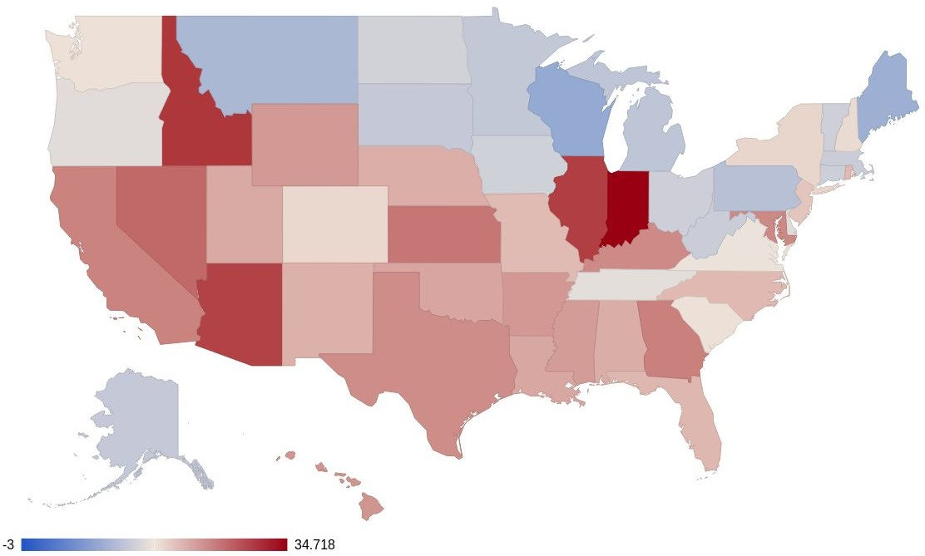
Comparable Objects - Case Study
Proprietary + Conﬁdential
Collected temperatures of US States
“Real” average
Predicted median

Slide 73
Summary
Sources
  Domain-specific selection pays off
Extraction method
  OpenIE vs. trained extractors
Contextualization
  Expressivity-extractability tradeoff
  Quantitative vs. qualitative
Consolidation
  Advances in text similarity detection enable joint consolidation
State of the art
Automatically extracted CSKBs competitive with manually-built projects
  Usually huge gains in recall, moderate loss in precision

Slide 74
Overview – major projects
 | Domain | 1. Sources | 2. Extraction | 3. Contextualization | 4. Consolidation | Size (#statements)
WebChild | General noun-adjective pairs | Books | Manual patterns | Single precision | Joint ILP | 4.6 M
TupleKB | Science triples | Targeted web search | OpenIE | Single precision | Supervised per-statement | 0.3 M
Quasimodo | General triples | User questions | OpenIE | Single precision | Supervised per-statement | 4 M (v1.3)
DoQ | Quantity triples | Web crawls | Co-occurrence | Frequency | - | (120 M)
Dice | General triples | Existing structured CSKBs | - | Four quantitative facets | Joint MaxSAT | -
Ascent | General triples | Targeted web search | Facet-based OpenIE | Qualitative facets, subject constraints, frequency | Similarity clustering | 8.6 M

Slide 75
Outline
Introduction to CSK
Crowdsourced CSKB construction
Text-extraction for ACSKB construction
  Overview
  Recipe
  Example projects
CSKBs: Summary and Outlook

Slide 76
Evaluation
Intrinsic evaluation
  Size
  Precision
  Salience
  Recall
  → Based on user judgments/input
Extrinsic evaluation
  Wide set of academic benchmarks available
    AllenAI science challenge perhaps most prominent
  Often focus on reasoning, not just knowledge

Slide 77
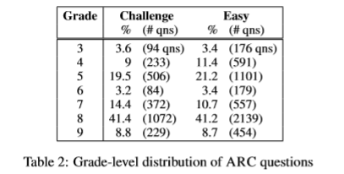
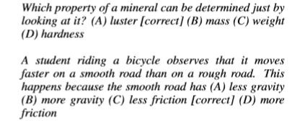
AllenAI challenge
~8000 real school questions

Slide 78
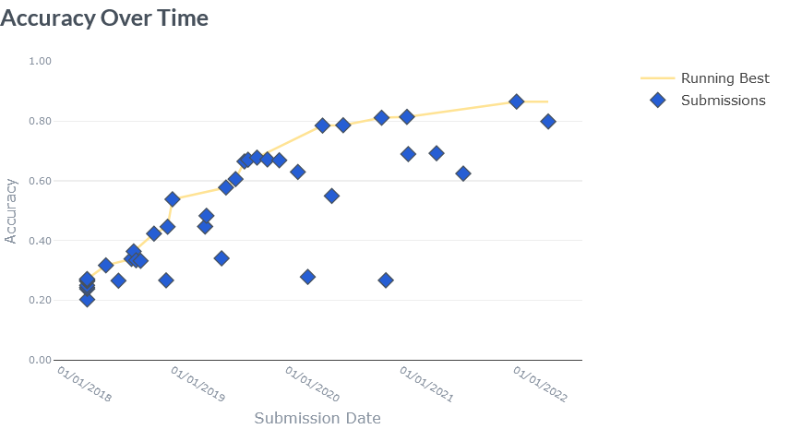

Slide 79
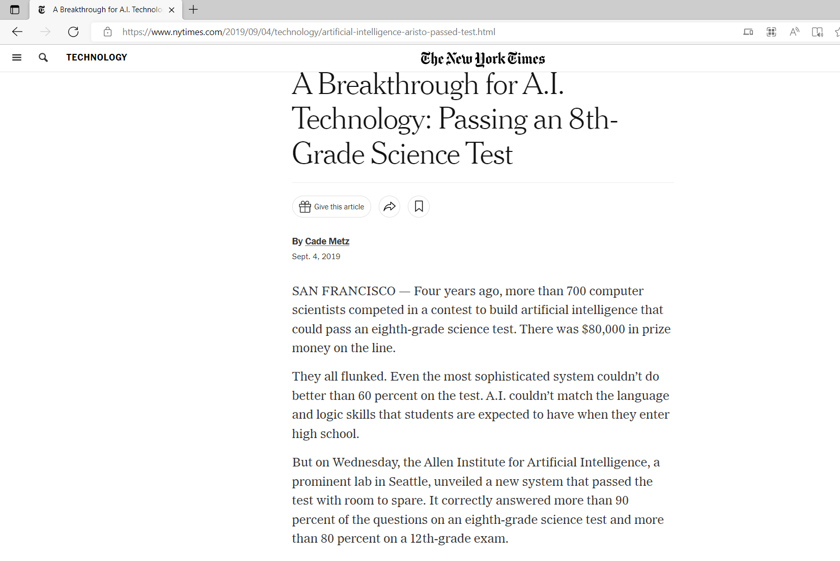

Slide 80
Benchmarks on commonsense reasoning
CommonsenseQA
  https://www.tau-nlp.org/commonsenseqa
  Talmor et al. NAACL, 2019
CommonGen
  Lin et al., Arxiv, 2020
  https://arxiv.org/abs/1911.03705
MC-TACO
  Zhou et al., EMNLP 2019
  https://arxiv.org/pdf/1909.03065.pdf
Semeval 2020 Task 4
  https://competitions.codalab.org/competitions/21080
Further listings:
  https://leaderboard.allenai.org/

Slide 81
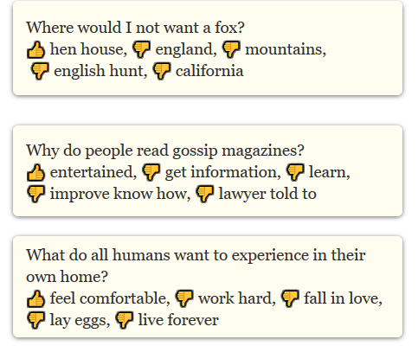
CommonsenseQA

Slide 82
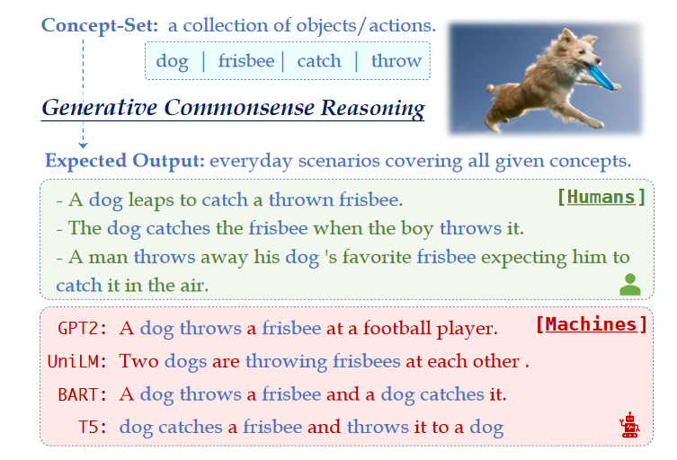
CommonGen

Slide 83
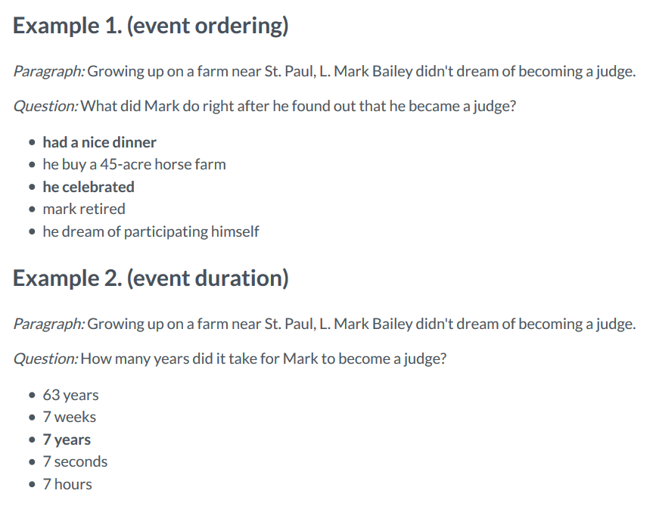
MC-TACO

Slide 84
References
Based on tutorial @ KI 2020
Related tutorials
  Commonsense Reasoning for Natural Language Processing,Sap et al., ACL 2020 (NLP)
  Common Sense Knowledge Graphs (CSKGs), Ilievski et al, ISWC2020 (Semantic Web)

Slide 85
References – Major projects
1. Tandon, Niket, et al. "Webchild: Harvesting and organizing commonsense knowledge from the web." WSDM. 2014.
2. Mishra, Bhavana Dalvi, Niket Tandon, and Peter Clark. "Domain-targeted, high precision knowledge extraction." TACL. 2017
3. Romero, Julien, et al. "Commonsense properties from query logs and question answering forums." CIKM. 2019.
4. Elazar, Yanai, et al. "How large are lions? inducing distributions over quantitative attributes." ACL. 2019
5. Chalier, Yohan, et al. "Dice: A Joint Reasoning Framework for Multi-Faceted Commonsense Knowledge“ AKBC. 2020
6. Nguyen, Tuan-Phong, Simon Razniewski, and Gerhard Weikum. "Advanced Semantics for Commonsense Knowledge Extraction.“WWW 2021.

Slide 86
Further references
Omeliyanenko, Janna, et al. "LM4KG: Improving Common Sense Knowledge Graphs with Language Models." ISWC, 2020.
Bhakthavatsalam, Sumithra, Chloe Anastasiades, and Peter Clark. "GenericsKB: A Knowledge Base of Generic Statements." arXiv preprint arXiv:2005.00660 (2020).
Bhakthavatsalam, Sumithra, et al. "Do dogs have whiskers? a new knowledge base of haspart relations." arXiv preprint arXiv:2006.07510 (2020).
Tandon, Niket, et al. "Knowlywood: Mining activity knowledge from hollywood narratives." Proceedings of the 24th ACM International on Conference on Information and Knowledge Management. 2015.
Chu, Cuong Xuan, Niket Tandon, and Gerhard Weikum. "Distilling task knowledge from how-to communities." Proceedings of the 26th International Conference on World Wide Web. 2017.
Schubert, Lenhart. "Can we derive general world knowledge from texts." Proc. HLT. 2002
Schubert, Lenhart, and Matthew Tong. "Extracting and evaluating general world knowledge from the Brown corpus." Proceedings of the HLT-NAACL 2003 workshop on Text meaning. 2003.

Slide 87
Take home
Structured CSK important interpretable and scrutable building block for trustworthy AI
Coherence and density require consolidation
  Multi-source validation
  Constraint-based reasoning
Semantics of CSK still with gaps
  Opportunity for deliberate KR
Advance of neural models suggest hybrid architectures
  Neural model for bridging language gaps
  (see also next lecture)

