Slide 1
Automated knowledge base construction
8. Language models and knowledge bases
Simon Razniewski
Summer term 2022

Slide 2
Outline
Sub-symbolic models
  Knowledge graph embeddings
  Language models
Language models as knowledge bases?
  LAMA
  Prompt engineering
  Context for LMs
  Entities
  Autoregressive models
Analysis and comparison
  Knowledge or correlation?
  Curation and provenance
  Probabilities, bounds and benchmarks
  Language models AND knowledge bases?

Slide 3
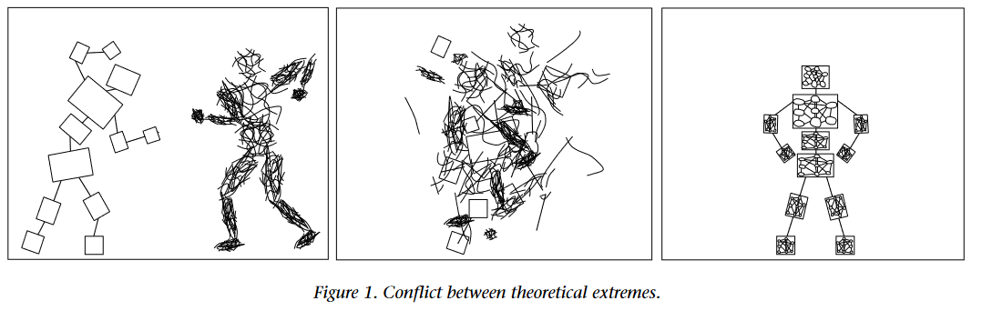
Symbolic vs. neural approaches in AI
Logic/computationalism vs. connectionism
Symbolic vs. subsymbolic
… old debate
see, e.g., [Logical vs. Analogical or Symbolic vs. Connectionist or Neat vs. Scruffy, Minsky 1991]

Slide 4
A subsymbolic view of knowledge:
KG embeddings
Idea: Turn complex KG objects into uniform real-valued vectors
Einstein
bornIn Ulm
knownFor Relativity
almaMater ETH Zürich
…
Yesterday
performer Beatles
composer Lennon-McCartney
chartRank 1
…
[0.32 0.02 0.93]
[0.01 0.95 0.07]

Slide 5
Demo/Links
https://wikipedia2vec.github.io/wikipedia2vec/usage/
https://github.com/pykeen/pykeen

Slide 6
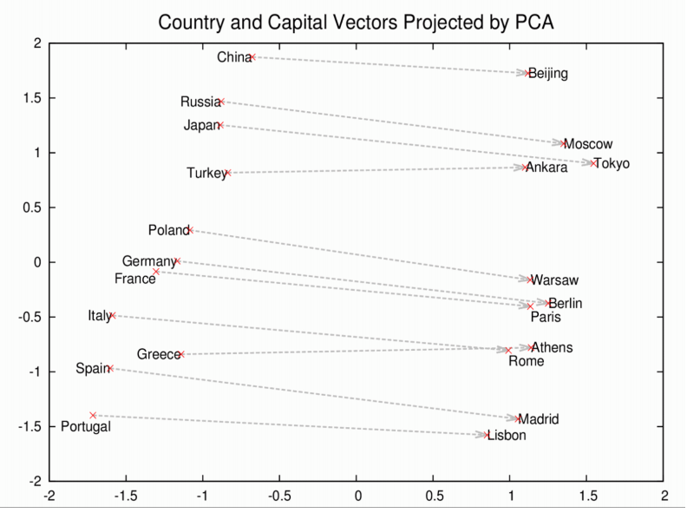
KG embeddings (2)
Numeric vectors great for tasks like similarity search
  Idea stems from NLP – word embeddings
Rescal (2011),
TransE (2013) et al:
Topology allows to
recover relations
Germany-Berlin ≈ France-Paris
→
Mozambique’s capital?
Germany-Berlin ≈ Mozambique-X
X ≈ Mozambique-Germany+Berlin
(Illustration from word2vec)

Slide 7
KG embeddings for predicting knowledge
Intellectually interesting
Did not significantly impact real use cases
Major limitation:
  Embeddings are computed from KG itself
  No real “new insights”
  Latent rehash of knowledge that is also accessible to interpretable methods (e.g., rule mining)
But language models are built from text
Real chance for complementary perspective

Slide 8
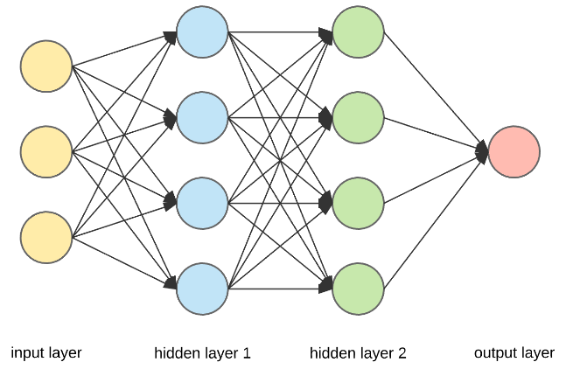
Pre-trained neural language models (LMs)
Huge multi-layer neural networks self-trained on large corpora, later fine-tuned to a variety of tasks
  Huge: Only recently became trainable
  (e.g., GPT-3: 175B parameters)
  Self-training: Require no further human labels - predict randomly masked words, or sentence order on existing texts
  Fine-tuning to applications: Can be transferred to a range of text-related tasks with relatively few labelled samples
Popular instances: ELMo, BERT, GPT, T5
The lion chased the zebra.
The lion chased the [?].
[?] = zebra

Slide 9
Main variants
Masked language modelling (BERT, RoBERTa, et al.)
  Can predict a single token at arbitrary position
  Saarbrücken is located at the [MASK] ocean.
Autoregressive models (GPT-2/3, T5, et al.)
  Can predict an open-ended sequence to the right
  Saarbrücken is located at ….
Differences in pre-training objectives

Slide 10
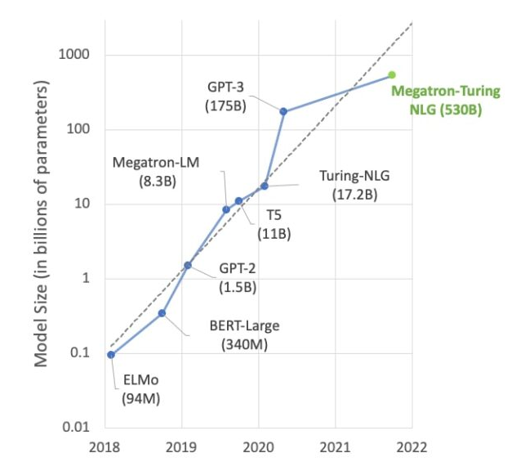

Slide 11
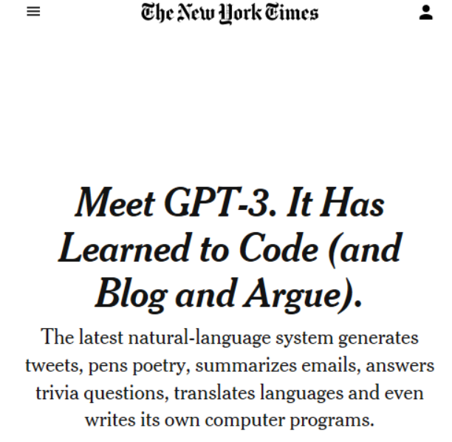
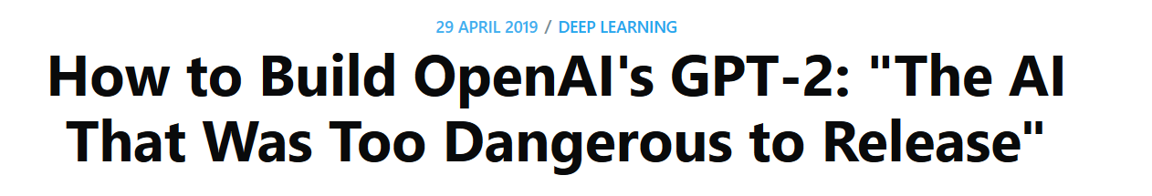

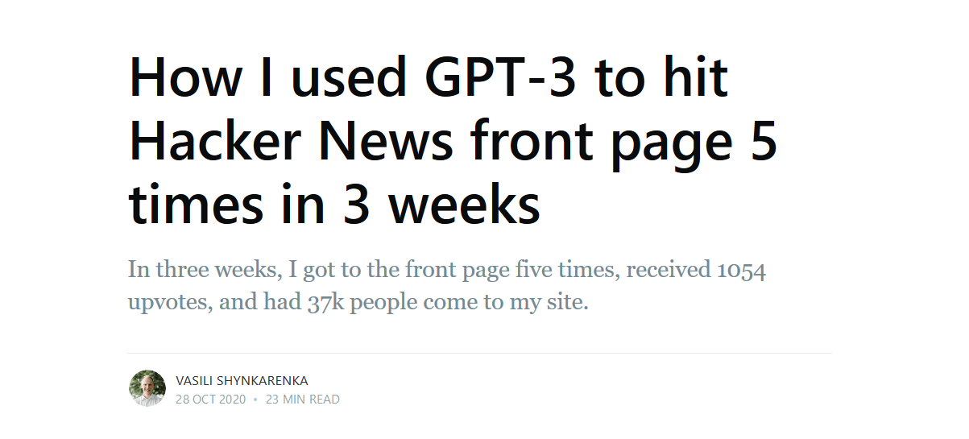

Slide 12
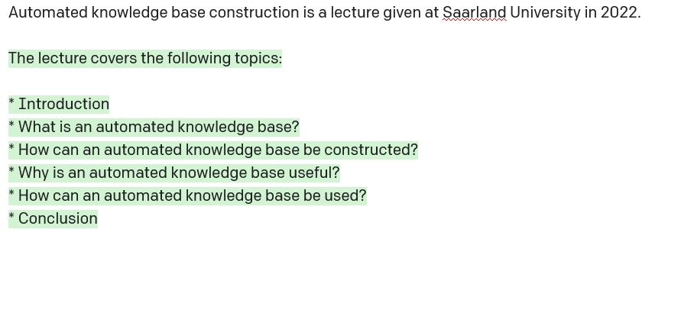

Slide 13
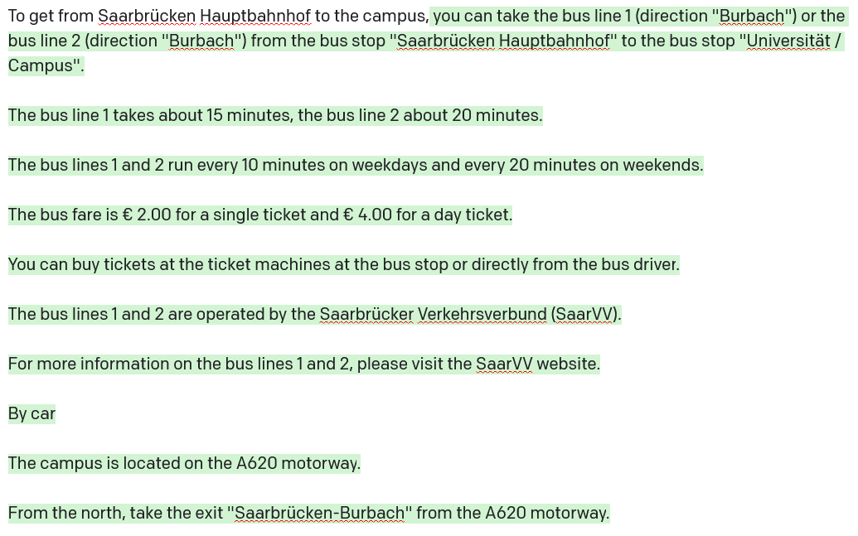

Slide 14
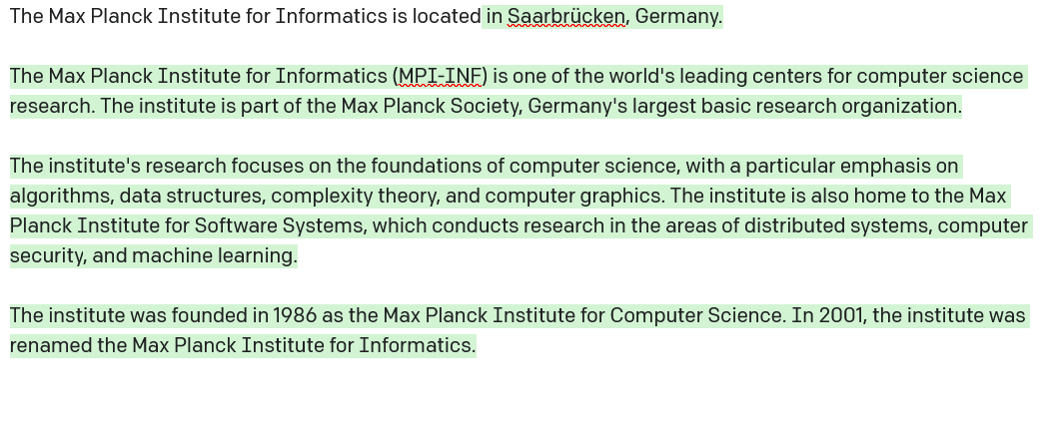
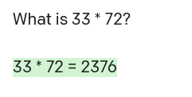

Slide 15
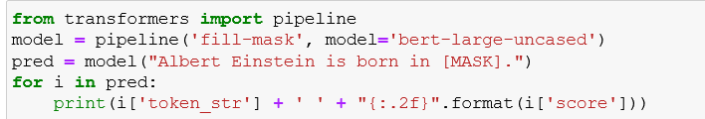
Try it
Autoregressive
  https://transformer.huggingface.co/doc/distil-gpt2
  https://demo.allennlp.org/next-token-lm
Masked token prediction
  https://demo.allennlp.org/masked-lm
  http://localhost:8888/notebooks/bert-predict.ipynb
Notes:
Sample prompts:
- Einstein born in, merkel born in
- capital of
Albert Einstein received the [MASK] price

Slide 16
Outline
Sub-symbolic models
  Knowledge graph embeddings
  Language models
Language models as knowledge bases?
  LAMA
  Prompt engineering
  Context for LMs
  Entities
  Autoregressive models
Analysis and comparison
  Knowledge, probabilities and correlations
  Curation and provenance
  Bounds and benchmarks
  Language models AND knowledge bases?

Slide 17
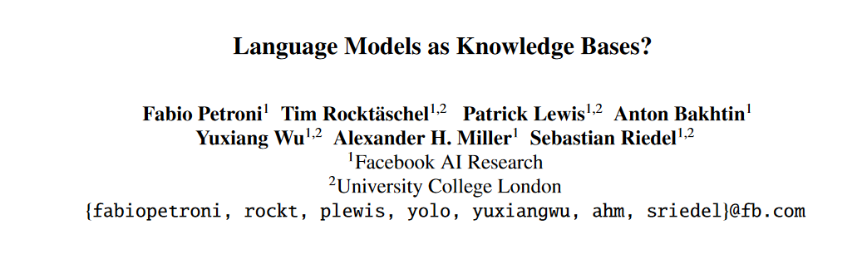
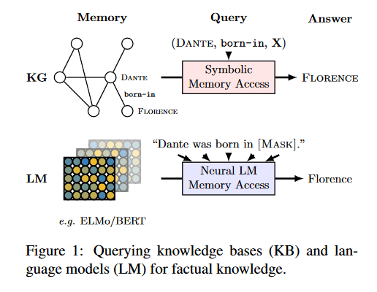
730 citations in 3 years

Slide 18
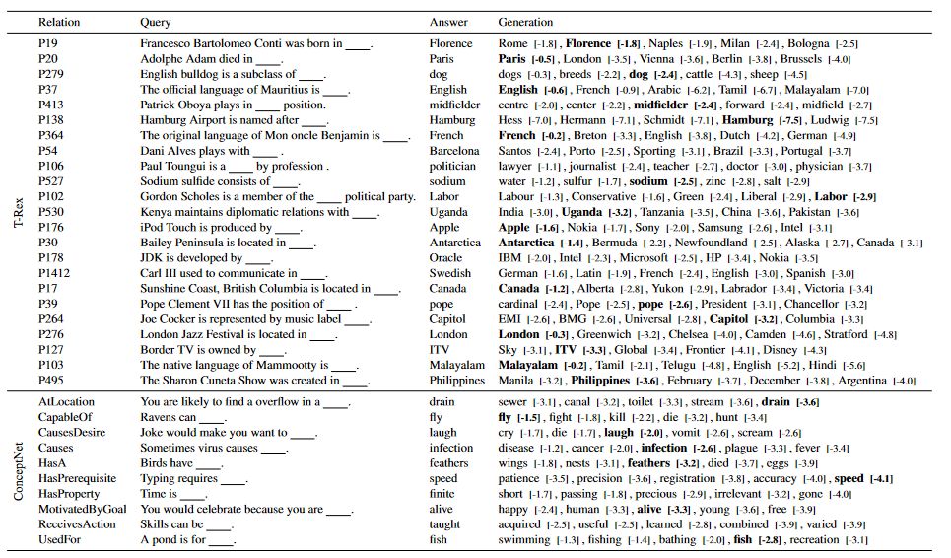

Slide 19
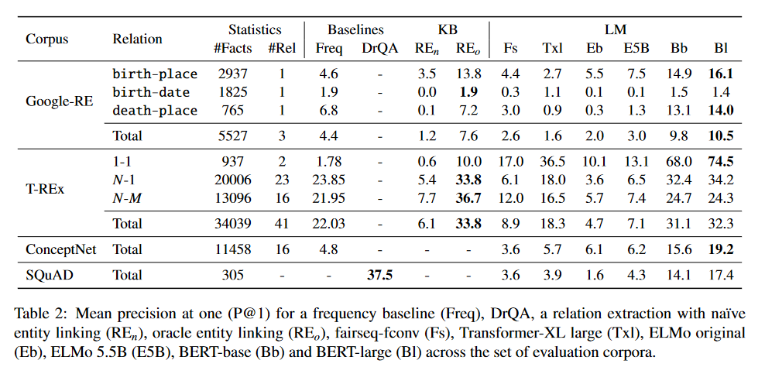
LM
Mean precision at one (P@1) for a frequency baseline, DrQA, a relation extraction with naive entity linking, oracle entity linking and BERT-base and BERT-large.
Performance on par with naive RE model
Either performances far from practical
Still noteworthy for such a simple start
Performance increases with model size

Slide 20
LAMA – paper conclusion
“We suspected BERT might have an advantage due to the larger amount of data it has processed, so we added Wikitext-103 as additional data to the relation extraction system and observed no significant change in performance. This suggests that while relation extraction performance might be difficult to improve with more data, language models trained on ever growing corpora might become a viable alternative to traditional knowledge bases extracted from text in the future.”

Slide 21
Outline
Sub-symbolic models
  Knowledge graph embeddings
  Language models
Language models as knowledge bases?
  LAMA
  Prompt engineering
  Context for LMs
  Entities
  Autoregressive models
Analysis and comparison
  Knowledge, probabilities and correlations
  Curation and provenance
  Bounds and benchmarks
  Language models AND knowledge bases?

Slide 22
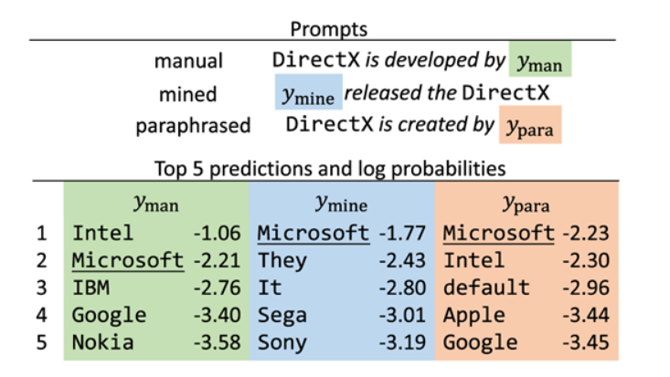
Problems with prompts
What is the best prompt?
Shares similarity with problem of pattern-based extraction
But now we (implicitly) need a single (general) prompt

Slide 23
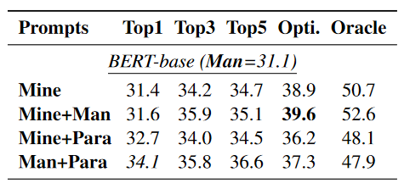
Approaches
Mining-based (distant supervision)
  Middle-words
  Dependency-path
Paraphrasing-based
  Back-translation
Notes:
Top = ensembling majority
Opti – learning optimized weights
Oracle – did any of the prompts return the correct result

Slide 24
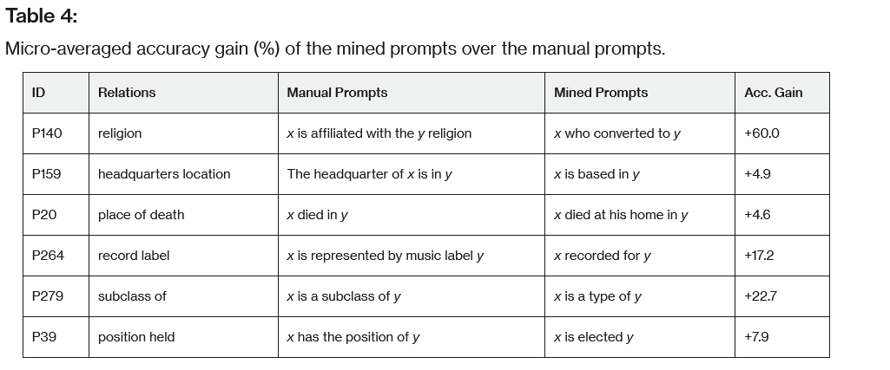
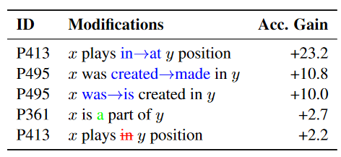
(LAMA)
Notes:
brittle

Slide 25
Outline
Sub-symbolic models
  Knowledge graph embeddings
  Language models
Language models as knowledge bases?
  LAMA
  Prompt engineering
  Context for LMs
  Entities
  Autoregressive models
Analysis and comparison
  Knowledge, probabilities and correlations
  Curation and provenance
  Bounds and benchmarks
  Language models AND knowledge bases?

Slide 26
Demo
Einstein was born in [MASK].
Manchester is a great city. Einstein was born in [MASK]
The birth place of Einstein is Ulm. Einstein was born in [MASK].
Notes:
Notably, fails on the last one!!

Slide 27
Context comparison
Text retrieval model (DrQA, based on TF-IDF), on Wikipedia
Quasi best possible context (called “Oracle”), manually or automatically aligned to Wikipedia
Adversarial context: A context very similar to the oracle one, but for a subject with different object value
(Bert generating its own context)
Notes:
Automatic alignment of fact much better than text retrieval, since this ground truth can exploit the object also for alignment

Slide 28
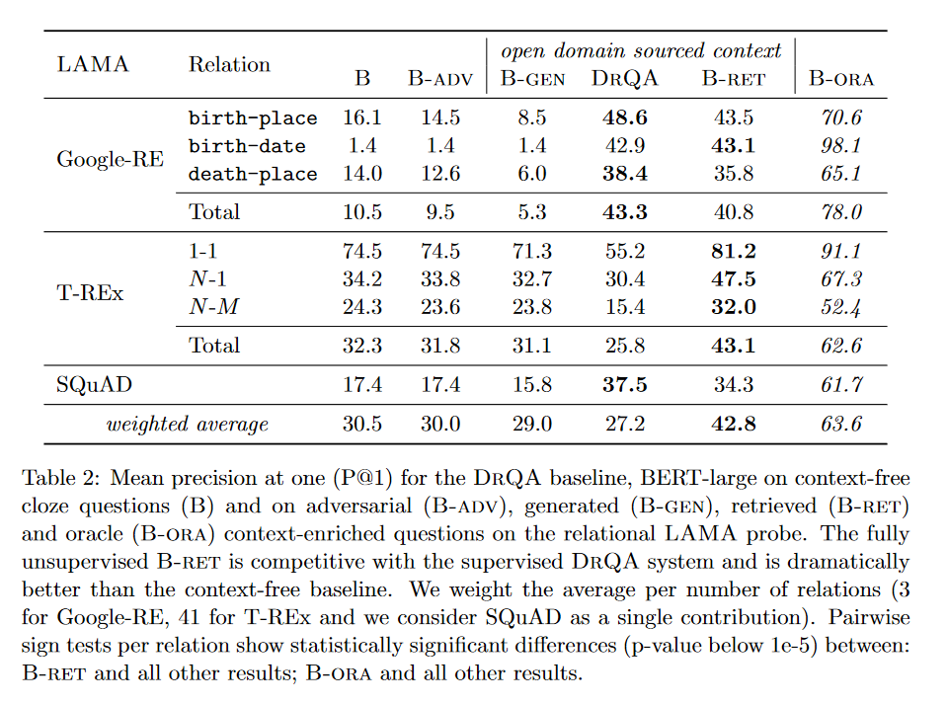
Notes:
DrQA – is the QA system alone

Slide 29
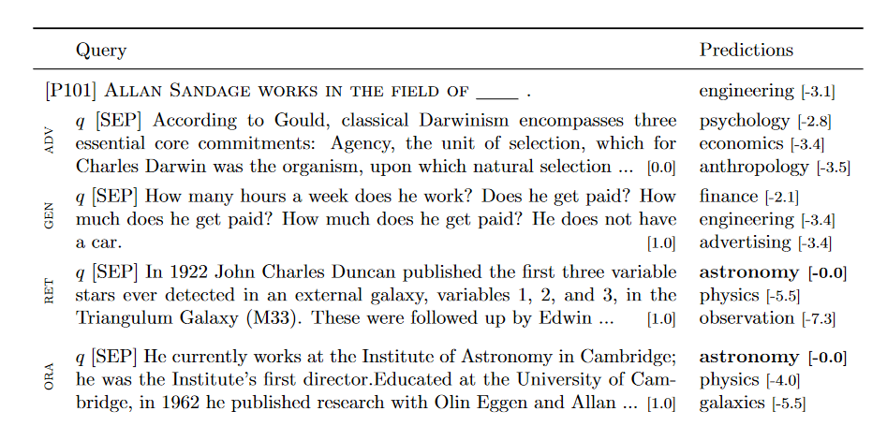

Slide 30


Context in commonsense QA
(Not knowledge extraction, but illustrates sensitivity of LM outputs to context)
Commonsense questions from Google search log
Context: Statements from different commonsense KBs (see previous lecture)
No KB
They eat a variety of plants, including the leaves of the elephant's horn.
ConceptNet
Elephants are big.
Q: What do elephants eat?
With KB context
IR
Ascent
Elephants eat grass.
+19% correctness
+21% informativeness
Demo: https://ascent.mpi-inf.mpg.de/qa

Slide 31
Outline
Sub-symbolic models
  Knowledge graph embeddings
  Language models
Language models as knowledge bases?
  LAMA
  Prompt engineering
  Context for LMs
  Autoregressive models
  Entities
Analysis and comparison
  Knowledge, probabilities and correlations
  Curation and provenance
  Bounds and benchmarks
  Language models AND knowledge bases?

Slide 32
Autoregressive models
BERT et al. struggle with multi-token prediction
  Johnson and Johnson?
  Albert Einstein vs. Hans Einstein
Can have multiple masks, but unclear how these interact, and how to decide on #masks
Autoregressive models allow variable-length predictions
Notes:
GenIE – generative information extraction – uses GPT for IE on text..
The name of the company is [MASK] and [MASK].

Slide 33
Demo: GPT-3

Slide 34
Tradeoff
No right-side context possible
  Albert Einstein speaks the [MASK] language.
Autoregressive models can blabber on and on – where to stop?
  → Entities next

Slide 35
Outline
Sub-symbolic models
  Knowledge graph embeddings
  Language models
Language models as knowledge bases?
  LAMA
  Prompt engineering
  Context for LMs
  Autoregressive models
  Entities
Analysis and comparison
  Knowledge or correlation?
  Curation and provenance
  Probabilities, bounds and benchmarks
  Language models AND knowledge bases?

Slide 36
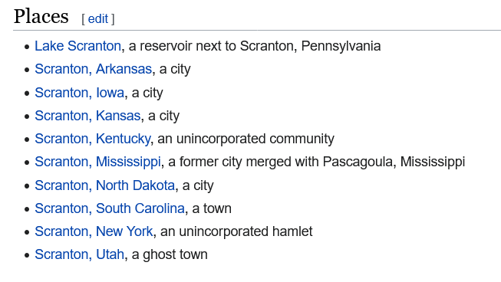

Problems with entities
Multi-token
  https://demo.allennlp.org/masked-lm
  Seoul is the capital of [MASK] [MASK].
Ambiguous entities
  Output:
    Joe Biden is born in [MASK].
    [MASK] = Scranton ???
  Input:
    John Smith was a famous [MASK].
(hundreds more)

Slide 37
Solution 1: Introduce entities into the vocabulary of BERT
E-BERT [Poerner et al., EMNLP’20]
  Enlarge the vocabulary of BERT with tokens specific for each entity
  Vocab_{E-BERT} = {a, the, house, tree, red, blue, Scranton_Pennsylvania, John_Smith_botanist, Saarland_University, …}
  Assign word vectors to entity tokens based on linear fit of another word-entity aligned corpus: Wikipedia2vec
  Wikipedia2vec: Computes embeddings for words and entities such that:
    Words and entities appearing in similar context have similar embeddings (skip-gram model)
  Runtime: Can now feed entities in input, or restrict [MASK] predictions to entities

Slide 38
Solution 2: Let autoregressive models generate unambiguous entity identifiers
Wikipedia entity identifiers:
    John_Smith_(astronomer)
    Frederick_Smith_(British_Army_officer,_born_1790)
    Scranton,_North_Dakota
  Are not arbitrary G7A3kg89g4GWSKW identifiers!
  Carry structure that LMs might exploit
GENRE language model [De Cao et al., ICLR 2021]:
  Train autoregressive model to directly predict textual identifiers
  Ensure validity by constraining generation using a trie of entity name components
Advantages
  Allows LM to exploit textual structure of IDs
  No need to externally compute and store entity embeddings

Slide 39
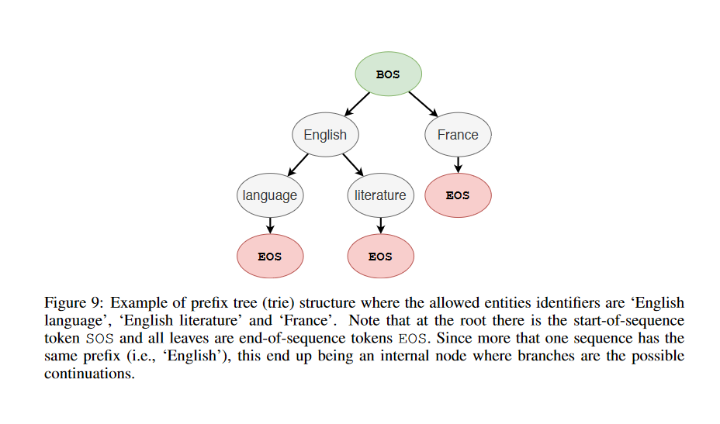

Slide 40
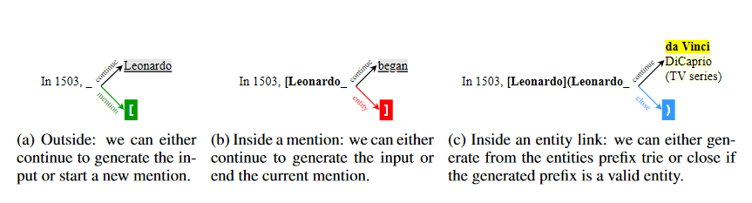

Slide 41
Entities - summary
Entities are at the core of KBs
LMs natively just create text tokens
Entities into text input and output?
  Approaches:
    Add entities to LM vocabulary
    Train autoregressive model to generate surface IDs
Questions open
  Incremental maintenance (new entities emerging)
  Sparse-text performance
    Entities may very succinctly be described by structured properties (e.g., coordinates or birth date) – how much text is needed to match this (especially for long-tail entities?)

Slide 42
Outline
Sub-symbolic models
  Knowledge graph embeddings
  Language models
Language models as knowledge bases?
  LAMA
  Prompt engineering
  Context for LMs
  Entities
  Autoregressive models
Analysis and comparison
  Knowledge or correlation?
  Curation and provenance
  Probabilities, bounds and benchmarks
  Language models AND knowledge bases?

Slide 43
Preface
Be careful saying “an LM knows/believes statement X”
Antrophomorphizing them is problematic anyway
  Deflects blame from developers/(ab)users
But importantly, they are not trained to hold beliefs
  They are trained on task to predict masked/next tokens, based on input corpus
  Using them for predicting relational assertions is worth a try, but not what they are trained on!
    Do LMs know the birth place of Biden?
    → Can we use LM, trained for the task of masked-token prediction on Wikipedia and web text, to predict the birth place of Biden?

Slide 44
Challenges (1/3)
  Does the LM output come from textual assertions, or is it derived from vague correlations?

Slide 45
Correlation vs. “knowledge”
Imagine a person who claims to know a lot of facts.
During a quiz, you ask them about the native language of actor Jean Marais. They correctly answer “French.” For a moment you are impressed, until you realize that Jean is a typical French name. So you ask the same question about Daniel Ceccaldi (a French actor with an Italian-sounding name). This time, the person says “Italian.”
If this quiz were a QA benchmark, the person would have achieved a respectable Hits@1 score of 50%. Yet, you doubt that they really knew the first answer.

Slide 46
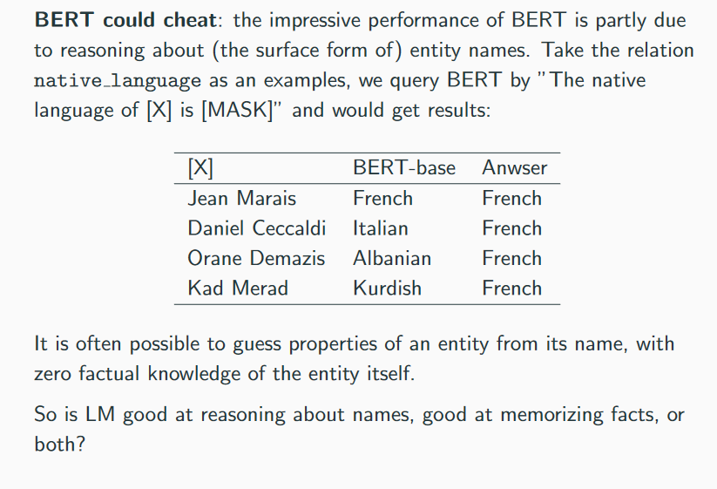

Slide 47
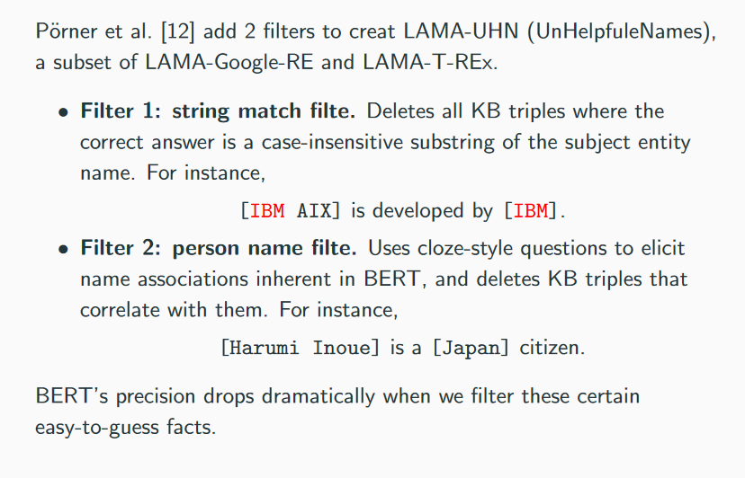
Investigating correlations
Jean is a common name in [MASK]
French is in top-3 predictions
Jean Marais speaks French in ground truth → Drop row from benchmark

Slide 48
Result
P@1 drops by about 33%

Slide 49
Outline
Sub-symbolic models
  Knowledge graph embeddings
  Language models
Language models as knowledge bases?
  LAMA
  Prompt engineering
  Context for LMs
  Entities
  Autoregressive models
Analysis and comparison
  Knowledge or correlation?
  Curation and provenance
  Probabilities, bounds and benchmarks
  Language models AND knowledge bases?

Slide 50
Challenges (2/3)
  Curatability
    Addition is nonmonotonic
    Update/deletion is ???
  Provenance
    Joe Biden is a strong advocate of … 2nd amendment?
  4. Context helps but adds confusion
    Did the LM observe it in pre-training/predict it via correlation, or does it predict it based on the context?

Slide 51
Outline
Sub-symbolic models
  Knowledge graph embeddings
  Language models
Language models as knowledge bases?
  LAMA
  Prompt engineering
  Context for LMs
  Entities
  Autoregressive models
Analysis and comparison
  Knowledge or correlation?
  Curation and provenance
  Probabilities, bounds and benchmarks
  Language models AND knowledge bases?

Slide 52
Challenges (3/3)
  Epistemic: Probabilities ≠ knowledge
    Birthplace(Biden) – Scranton (83%), New Castle (0.2%)
    Birth country (Bengio) – France (3.5%), Canada (3.2%)
  Probabilities do not reflect truth, but probabilities of likelihood over other tokens!
    First woman on moon is [MASK]
    Saarbrücken is the mayor of [MASK].
    The Saarland borders the [MASK] ocean.
  Know your limits/abstain from answering
    Microsoft was acquired by … Novell (84%)
    Sun Microsystems was acquired by … Oracle (84%)

Slide 53
Probabilities
Traditional IE: Pattern-based
  “was born in” – 95% precision on test data
  → For 100 instances of this pattern in a text, 95 of the subject-object pairs really stand in that relation
  TheLM-KBC
  color of elephants is … yellow – 37%
  ~ In 37 of 100 cases where the prefix was observed, the next token was yellow
    Similarity-enriched/extrapolated/…
    The sandwich of the gnu ate the umbrella in … silence – 14%

Slide 54
Abstaining from answering
Know when a subject-predicate pair has no value
Angela Merkel, children, none
Switzerland, capital, none
Iceland, landBorder, none
Nontrivial for structured KBs too
  Open-world vs. closed-world semantics
But structured KBs do not make up statements

Slide 55
Meta-problem: Existing benchmarks
LAMA and its variants
  Sample (s,p,o) triples from a KB
  Hide the object o
  Let the LM predict o
For any s-p-pair in the benchmark, it is guaranteed that there is an object
Evaluation metric P@1 just looks how often that object is in top-1 predictions (across s-p-pairs)
Reality: There can be more than one object
  → Can the LM decide how many of its predictions are true?
Advertisement: LM-KB challenge @ ISWC 2022

Slide 56

Knowledge Base Construction from Pre-trained Language Models (LM-KBC)
Challenge at ISWC 2022 (virtual conference)
Task:
Use LMs to predict objects
for given subject-predicate pairs
  There may be 0, 1, or several
Materialize output
  → predict a concrete object set,
  not just rank candidates)
Participation by July 14
Submit system
Write a description of the approach as an academic paper
Outcome
Global leaderboard
System descriptions published in online proceedings
Approaches presented at virtual conference (last year registration $50)
Assignment 8 is a subset of this challenge
https://lm-kbc.github.io/
https://lm-kbc.github.io/

Slide 57
Outline
Sub-symbolic models
  Knowledge graph embeddings
  Language models
Language models as knowledge bases?
  LAMA
  Prompt engineering
  Context for LMs
  Entities
  Autoregressive models
Analysis and comparison
  Knowledge or correlation?
  Curation and provenance
  Probabilities, bounds and benchmarks
  Language models AND knowledge bases?

Slide 58
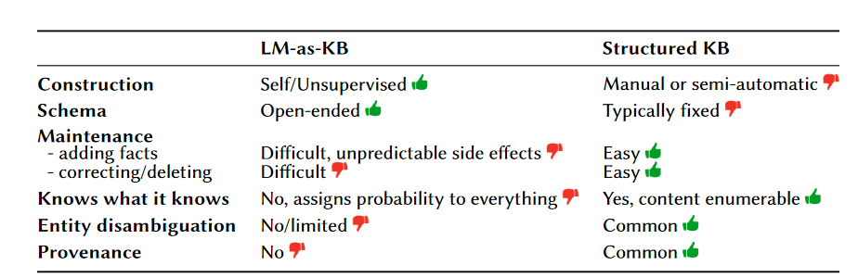
Comparison
Truth probabilities No Typically

Slide 59
Application view
Many KB applications: Precision matters way more than recall
  Google KV project: Not adopted because it did not reach 99% precision
  Lack of reliability for critical applications
Powerful exception: Similarity search
Areas where unreliable LM extractions may be useful:
  Vague relations (“field of work”, “known for”)
  General concepts (“airplane”, “elephant”, “pizza”)

Slide 60
LMs and KBs?
LMs find their way into AKBC via subtasks: POS/dependency parsing, NER(C), RE, …
Area of specific noteworthiness: Relation extraction via span-prediction
  E.g., spanBERT family of models
  Unlike context-enriched LM prompting, this ensures that answer is grounded in text
  https://huggingface.co/deepset/roberta-base-squad2
Other view: LMs for validation
  LMs are a lossy compression of huge corpora
  LM prompting provides noisy views into these corpora
  → useful as corroboration signal in multi-source extraction validation

Slide 61
Take home
LM: a lossy compression of huge text corpora
Prompting convenient way to glimpse into these
Fundamental limitations for AKBC:
  Relation to source lost – spotted vs. correlation
  Probabilities are not truth probabilities, but token likelihoods relative to each other
  Negation/limits unclear
  Maintenance unclear
Possible ways forward
  LMs in many subtasks of AKBC
  LMs in text-based QA for RE
  LMs as corroboration signals in multi-source validation

Slide 62
References
KG embeddings
  Bordes, Antoine, et al. "Translating embeddings for modeling multi-relational data." NeurIPS (2013).
LAMA
  Petroni, Fabio, et al. "Language Models as Knowledge Bases?." EMNLP 2019.
Prompt tuning
  Jiang, Zhengbao, et al. "How can we know what language models know?." TACL 2020.
Context for LMs
  Petroni, Fabio, et al. "How Context Affects Language Models' Factual Predictions." AKBC. 2020.
Entities
  De Cao. “Autoregressive Entity Retrieval”, ICLR 2021
  E-BERT: Efficient-Yet-Effective Entity Embeddings for BERT, Poerner et al., EMNLP-Findings 2020
Overfitting to correlations
  E-BERT: Efficient-Yet-Effective Entity Embeddings for BERT, Poerner et al., EMNLP-Findings 2020
  Knowledgeable or Educated Guess? Revisiting Language Models as Knowledge Bases, Cao et al., ACL 2021
Critical analysis
  Razniewski et al. Language Models As or For Knowledge Bases, DL4KG@ISWC, 2021

