Slide 1
Advanced Topics in Knowledge Bases
Simon Razniewski
Winter semester 2018/19
<number>
Notes:
<number>

Slide 2
Outline
Introducing each other
Organization of the seminar
Introduction to Knowledge Bases
Topic presentation
Seminar survival skills
Topic assignment
<number>
Notes:
<number>

Slide 3
Outline
Introducing each other
Organization of the seminar
Introduction to Knowledge Bases
Topic presentation
Seminar survival skills
Topic assignment
<number>
Notes:
<number>

Slide 4
Simon Razniewski
Senior Researcher at MPII, Department 5
Heading “Knowledge Base Construction and Quality” area
Background
Assistant professor at FU Bozen-Bolzano, Italy, 2014-2017
Research stays at AT&T Labs-Research, University of Queensland, UC San Diego
PhD FU Bozen-Bolzano, 2014
Diplom at TU Dresden, 2010
Expertise:
Logics, databases, Semantic Web
More recently IR, (applied) NLP, ML, …
Research focus:
Analyzing what knowledge bases know, and what they don’t
<number>
Notes:
<number>

Slide 5
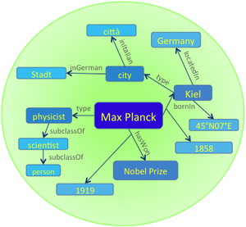
Department 5
Department 5: Database and information systems, ~35 members
Knowledge discovery: extracting, organizing, searching, exploring and ranking facts from structured, semi-structured, textual and multimodal information sources
Knowledge Base
Earliest prominent machine-generated knowledge base (2007)
Contains more than 10 million entities and more than 120 million facts
Gerhard Weikum 259th most cited computer scientist worldwide
<number>
Notes:
Source: http://www.guide2research.com/scientists/
<number>

Slide 6
And you?
Name
Course of study
Specialization (thesis topic?)
Why interested in KBs?
…
<number>
Notes:
<number>

Slide 7
Outline
Introducing each other
Organization of the seminar
Introduction to Knowledge Bases
Topic presentation
Seminar survival skills
Topic assignment
<number>
Notes:
<number>

Slide 8
Formal organization
Credit points: 7, hours: 210 (!)
Registration
Register in HISPOS (till 2 weeks after topic assignment)
What to do?
Attend the lectures and block seminar days
Write a seminar report
Give a presentation
Block seminar days
2 days seminar, 8 presentations per day (~25 min talk, ~10 min discussion each)
Dates: TBD by Doodle (https://doodle.com/poll/pmze6yum6stxu5nc)
<number>
Notes:
<number>

Slide 9
What is expected?
Research and presentation of a topic
Independent literature research
~2 seed references provided
In-depth and in-breadth discussion of the topic in the seminar report
Typically carefully chosen components in depth
Less deep broader overview
→ Talk to me if unsure
Seminar presentation more narrow than the report
High quality content organization, visual design and presentation
Grading based on
Seminar paper (50%)
Depth
Breadth
Presentation quality
Presentation and discussion (50%)
Presentation quality
Knowledge (ability to answer questions)
Ability to stick to deadlines
<number>
Notes:
<number>

Slide 10
Schedule
23.10.18
Introduction to KBs
25.10.18
Introduction to KBs (2)
Topic presentation
7.11.18
“How to research, write and present” lecture
Topic assignment (preference-based lottery)
30.11.18
Students send extended outline of their seminar paper
5./6.12.
Individual meetings to discuss extended outline/draft
31.01.19
Students submit final seminar reports
Two weeks before the first block seminar
Students send preliminary slides
Two days before the first block seminar
Students send final slides
Extended outline
…
2. Methodology
2.1 KB Representation
Discussion on how to represent knowledge
Comparison with other representations
Benefits and limitations of such representations
…
<number>
Notes:
<number>

Slide 11
Learning outcomes
Knowledge
What is a knowledge base
How are they constructed, evaluated, used, …
Skills
Learn to research a topic
Learn to read scientific papers
Learn to structure and write up a scientific paper
Learn to give high-quality scientific presentations
→ Almost a thesis!
Only missing the own original technical contribution
<number>
Notes:
<number>

Slide 12
Outline
Introducing each other
Organization of the seminar
Introduction to Knowledge Bases
Topic presentation
Seminar survival skills
Topic assignment
<number>
Notes:
<number>

Slide 13
3. Introduction to Knowledge Bases
Motivation
Definition and topics
Formal foundations
Construction and maintenance
Technologies
Applications
Past, present and future
<number>
Notes:
<number>

Slide 14
3. Introduction to Knowledge Bases
Motivation
Definition and topics
Formal foundations
Construction and maintenance
Technologies
Applications
Past, present and future
<number>
Notes:
<number>

Slide 15
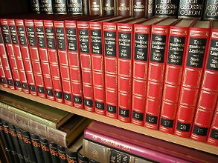
I. Motivation
<number>
Notes:
<number>

Slide 16
https://www.wikidata.org/wiki/Q565400
<number>
Notes:
<number>

Slide 17
What structured data enables…
Who discovered the most planets: http://tinyurl.com/y7rldyqc
Distribution of places ending with “-weiler” in Germany: http://tinyurl.com/y7tfko57
Number of women vs. persons named “John” in the British parliament: http://tinyurl.com/y7mu3qqp
<number>
Notes:
Most common male first names in Germany
http://tinyurl.com/ya9mro69
Ancestors of Charlemagne
http://tinyurl.com/ycagf28s
<number>

Slide 18
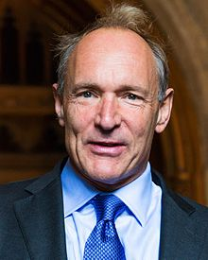
The Semantic Web
Term coined by Tim Berners-Lee for a machine-readable Web
Requirement for intelligent agents
Web content originally from humans for humans
→ Make machines read human language, or make humans write machine-readable structured data?
<number>
Notes:
<number>

Slide 19
<number>
Notes:
<number>

Slide 20
3. Introduction to Knowledge Bases
Motivation
Definition and topics
Formal foundations
Construction and maintenance
Technologies
Applications
Past, present and future
<number>
Notes:
<number>

Slide 21
Definition
A knowledge base is a machine-readable collection of knowledge about the general world
Machine-readable: Structured format, not just text
General world: Unlike e.g. a company database
Remainder of the discussion focus on open KBs
<number>
Notes:
<number>

Slide 22
Topics
KBs to some extent be divided by their focus:
Lexical knowledge
<shout, isA, verb>
<shout, subformOf, communicate>
Instance knowledge (“Encyclopedic KBs”):
<Paris, capitalOf, France>
<MPII, foundedIn, 1988>
<Angela Merkel, major, Physics>
Class knowledge (“common sense”):
<Pizza, is, tasty>
<Elephant, color, grey>
<turnOnPC, requires, power>
<number>
Notes:
<number>

Slide 23
Lexical KBs
WordNet (1995)
FrameNet (1998)
(Wiktionary (2002))
SenticNet (2010)
…
<number>
Notes:
<number>

Slide 24
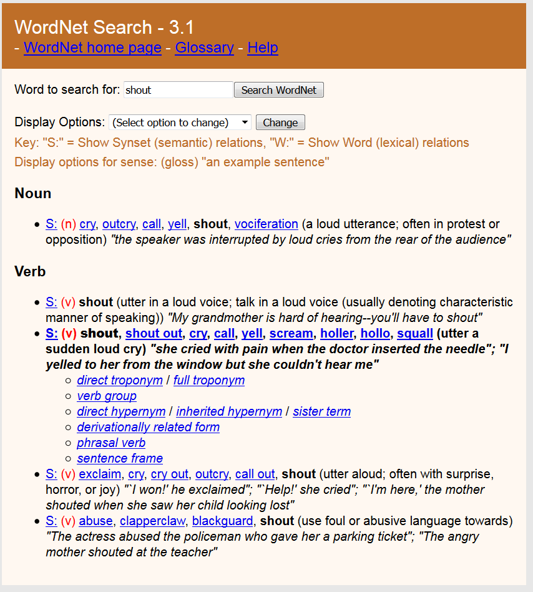
<number>
Notes:
<number>

Slide 25
FrameNet
Example Frame – “Revenge”: Because of some injury to something-or-someone important to an avenger (maybe himself), the avenger inflicts a punishment on the offender. The offender is the person responsible for the injury.
Frame elements:
avenger, offender, injury, injured_party, punishment.
Invoking terms:
Nouns: revenge, vengeance, reprisal, retaliation
Verbs: avenge, revenge, retaliate (against), get back (at), get even (with), pay back
Adjectives: vengeful, vindictive
<number>
Notes:
<number>

Slide 26
Encyclopedic KBs (“Instance-oriented KBs”)
Cyc (1984)
YAGO (2007)
DBpedia (2007)
Wikidata (2012)
<number>
Notes:
<number>

Slide 27
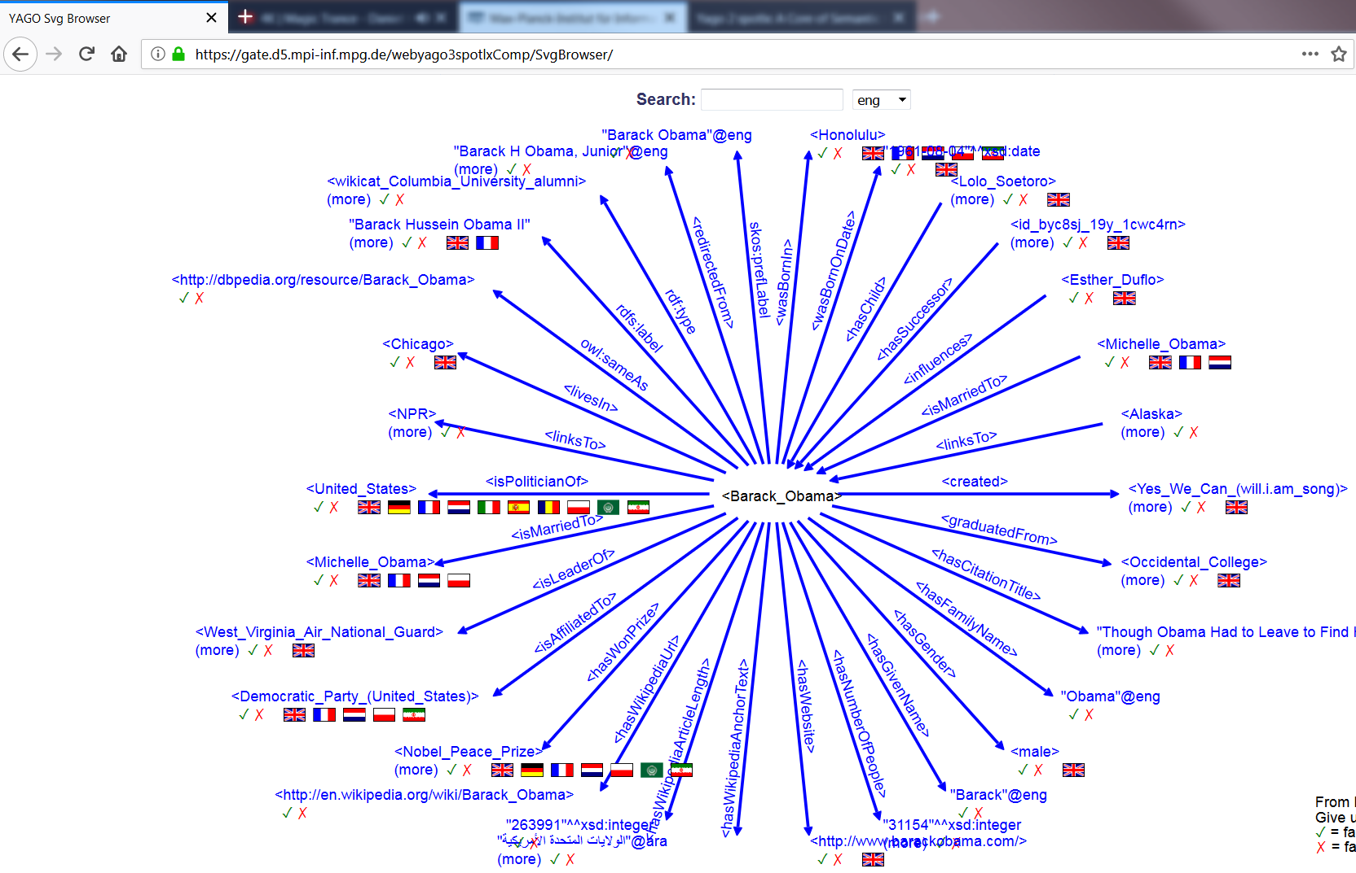
<number>
Notes:
<number>

Slide 28
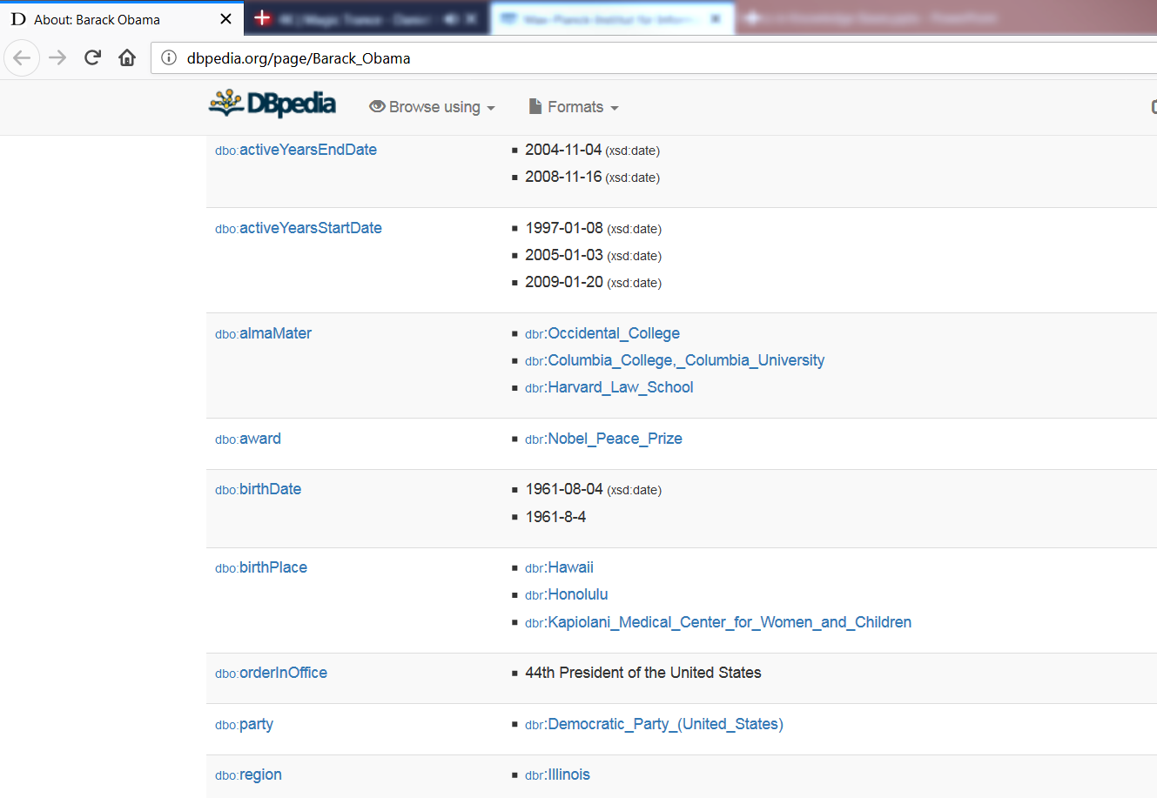
<number>
Notes:
<number>

Slide 29
Common-sense KBs (class-oriented)
Cyc (1984)
ConceptNet (1999)
WebChild (2014)
MS Coco (2014), VisualGenome (2016)
ActivityKB, Knowlywood (2015)
TupleKB (2017)
<number>
Notes:
<number>

Slide 30
ConceptNet
<number>
Notes:
<number>

Slide 31
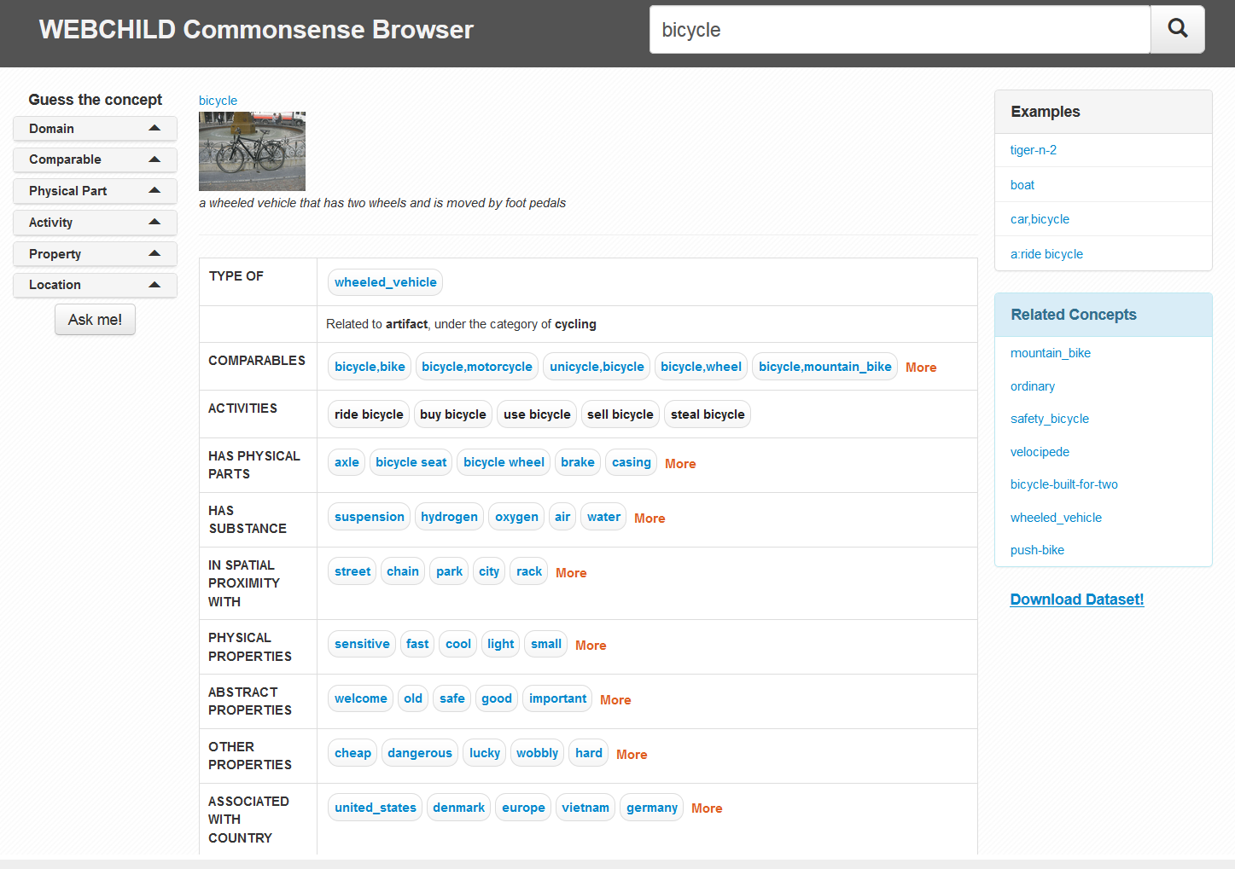
<number>
Notes:
<number>

Slide 32
3. Introduction to Knowledge Bases
Motivation
Definition and topics
Formal foundations
Construction and maintenance
Technologies
Applications
Past, present and future
<number>
Notes:
<number>

Slide 33
Knowledge base or knowledge graph?
Used largely interchangeably
<number>
Notes:
<number>

Slide 34
Facts (triples) and their constituents
Entities: Objects about which statements can be made Paris; Trump; Irony
Property/predicate/relation/attribute: What can be said locatedIn, worksAt, antonymOf
Fact/statement/claim/triple: Core building block of KBs <Paris, locatedIn, France>
General form:
<subject, predicate, object>
<s, p, o>
<number>
Notes:
<number>

Slide 35
Subjects and objects
Machine-generated identifiers
Wikidata: Q4262, Q67245
Canonical name strings
DBpedia, YAGO: “John_Smith_(politician)”
Internationalized resource identifier (IRI)
Semantic web: http://dbpedia.org/resource/Max_Planck
General phrases
TupleKB: <industry, grow over, past few decade>
Literals: Attribute values that are no entities
www.mpi-inf.mpg.de
Often with units: 1.63m; 54.85° N
Same for predicates, sometimes canonicalized, sometimes just text
<number>
Notes:
<number>

Slide 36
Classes and class hierarchies
Classes/types: Allow to group similar entities Presidents, nouns, Greek gods
Type/property hierarchy: Tree-like hierarchy among types/properties (cf. inheritance in object-oriented programming) <Town, subclassOf, Administrative_unit>
<number>
Notes:
<number>

Slide 37
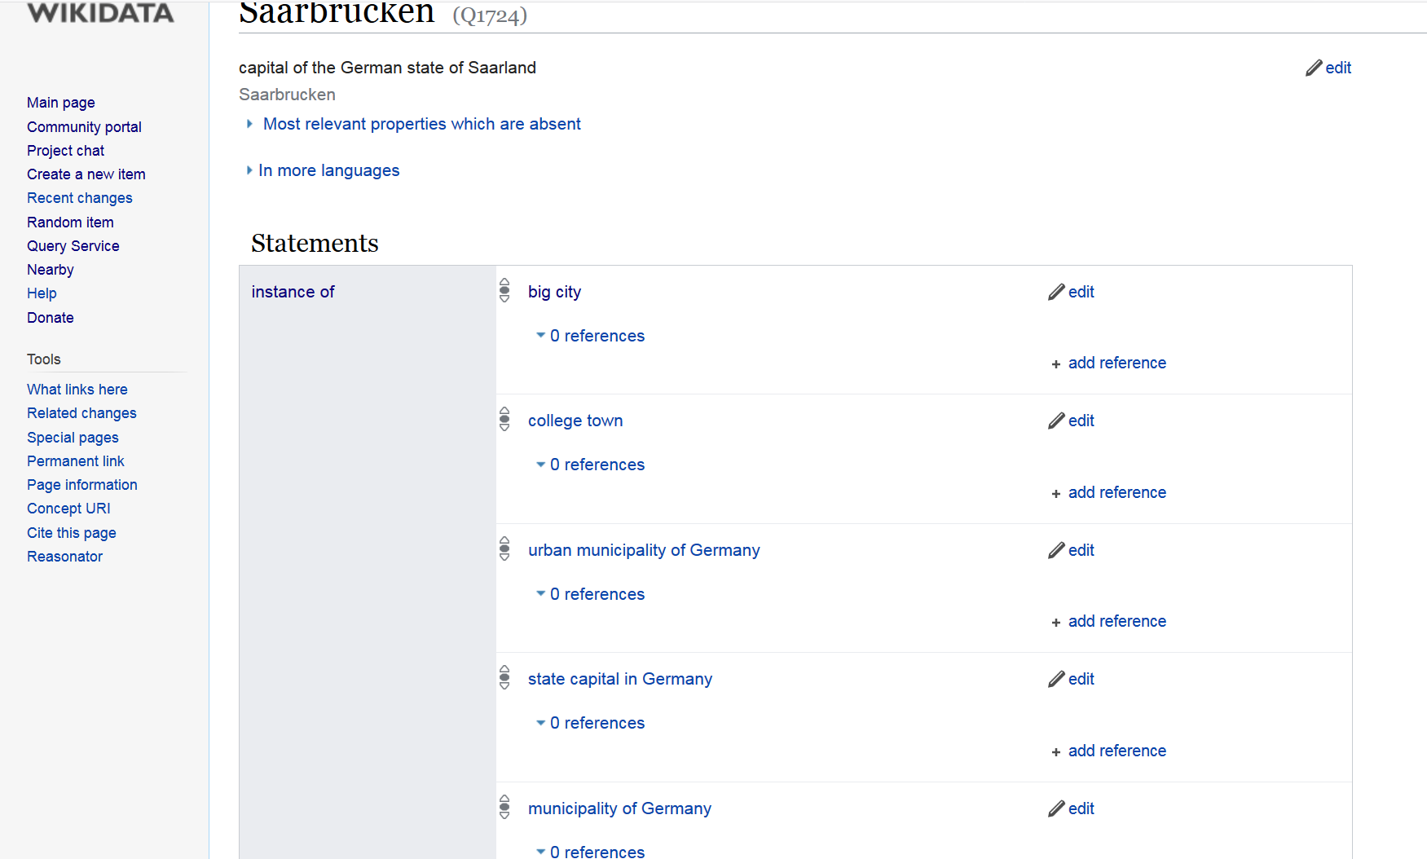
Classes
<number>
Notes:
<number>

Slide 38
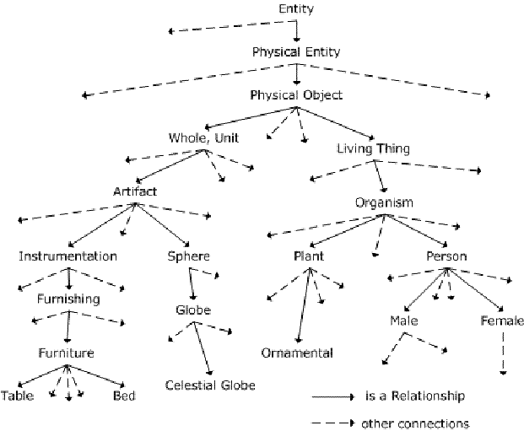
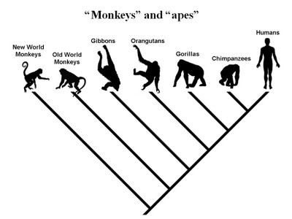
Taxonomies
<number>
Notes:
<number>

Slide 39
Data format
Most commonly triples
Some statements have more arguments
Wedding(Angelina_Jolie, Brad_Pitt, 2014, Chateau_Miraval)
Role(Gran_Torino, Kowalski, Clint Eastwood)
Additional qualifiers for triples
Reification (solution from logics, introduce new object)
<number>
Notes:
<number>

Slide 40
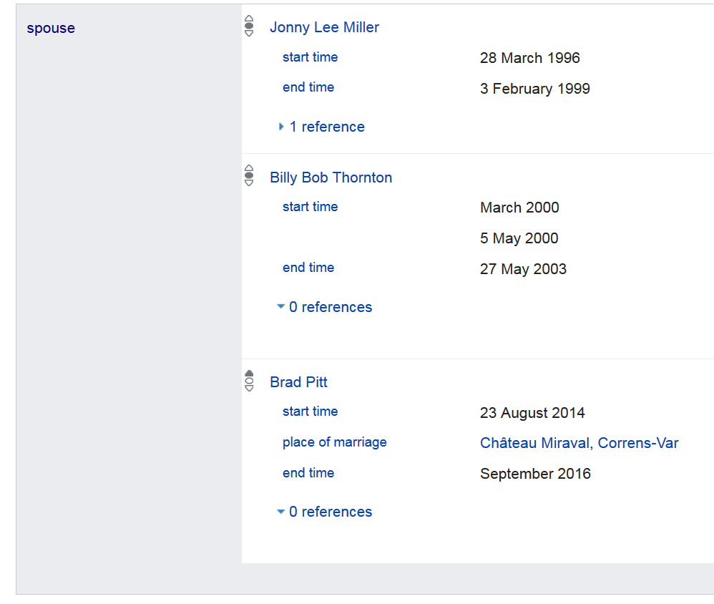
<number>
Notes:
<number>

Slide 41
Embedding-based knowledge
Apple (0.72 0.35 0.91)
Pear (0.80 0.33 0.55)
Penguin (0.12 0.58 0.27)
Not human-readable
Limited machine-readable (meaning of dim. 2?)
Often impressive performance (e.g., analogies)
<number>
Notes:
<number>

Slide 42
Discussion
Page length: 12 content pages
Doodle: https://doodle.com/poll/pmze6yum6stxu5nc
<number>
Notes:
<number>

Slide 43
Introduction to Knowledge Bases
Motivation
Definition and topics
Formal foundations
Construction and maintenance
Technologies
Applications
Past, present and future
<number>
Notes:
<number>

Slide 44
How would you construct the next great knowledge base?
<number>

Slide 45
Construction and maintenance
Humans (CYC, ConceptNet, Wikidata)
Structured extraction (YAGO, DBpedia)
Text extraction (NELL, Textrunner)
Constraints
Semantics and coverage
<number>
Notes:
<number>

Slide 46
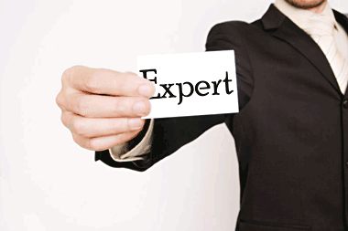
A. Humans: Experts
Potentially best quality
Difficult to scale
CYC: “In 1986, Doug Lenat estimated the effort to complete the KB to be 250,000 rules and 350 man-years of effort.”
<number>
Notes:
<number>

Slide 47
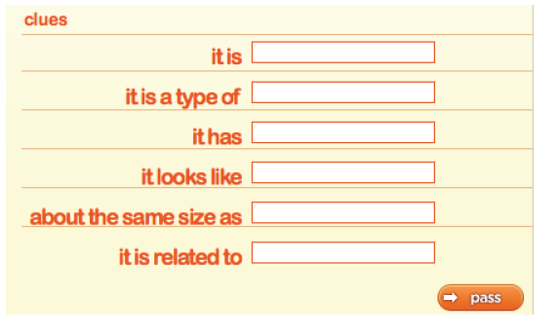
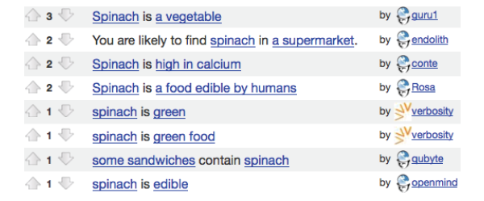
Humans: Crowdsourcing/Gamification
Make work fun ☺
<number>
Notes:
<number>

Slide 48
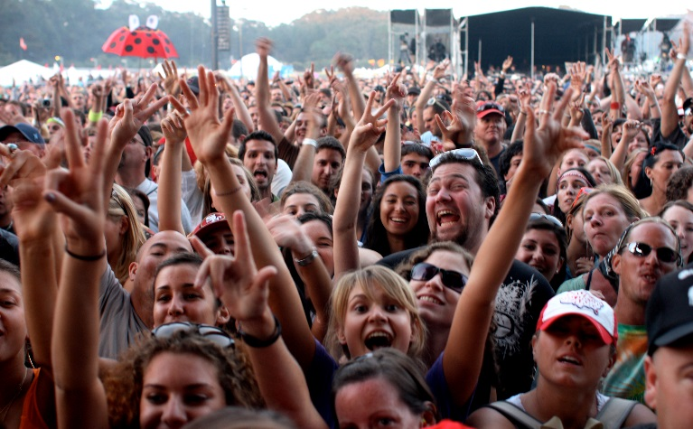
Humans: Volunteers
Wikidata: 18k active users
Intrinsic motivation achieves great things
Targeted expertise, compared with experts/crowdsourcing
https://www.wikidata.org/wiki/Wikidata:Database_reports/List_of_properties/all
Live edits good for motivation
<number>
Notes:
<number>

Slide 49
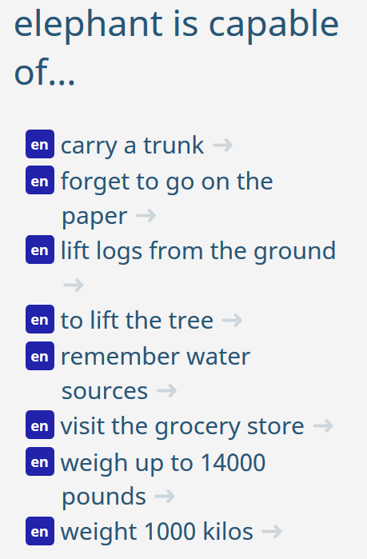
Humans: Challenges
ConceptNet:
Common knowledge, normalization
Crowdsourcing: Quality assurance
Wikidata: Modelling issues
E.g., gender, nationality, notable_work, …
Multilingual concept alignment
<number>
Notes:
<number>

Slide 50
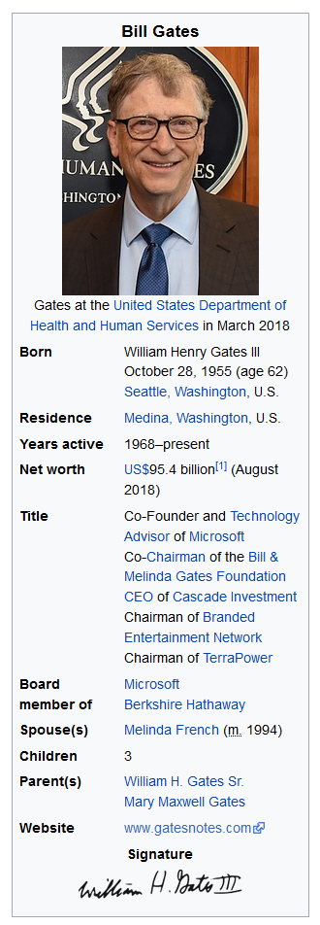
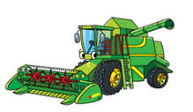
B. Structured extraction
Wikipedia already provides structured data
All we need to do is harvest…
<number>
Notes:
<number>

Slide 51
Work done?
Noise
Canonicalization of entities and predicates
Usage of category system
Examples: YAGO, DBpedia
<number>
Notes:
<number>

Slide 52
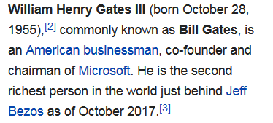
C. Text extraction
In principle most powerful
No need for humans
No restriction to Wikipedia
In practice very noisy
No canonicalization
Inconsistencies
…
Examples: NELL, Textrunner
<number>
Notes:
<number>

Slide 53
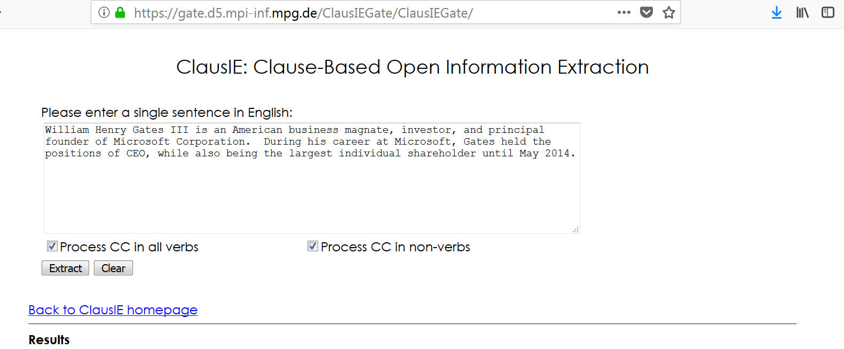
<number>
Notes:
<number>

Slide 54
Challenges
Entity identification
Entity disambiguation [Babelfy]
Relation identification
Relation normalization
…
End-to-end models can alleviate these to some extent, but are specific to their training data
E.g., DeepDive
<number>
Notes:
Babelfy fails at: The Hilton Hotel in Paris is owned by Paris Hilton.
<number>

Slide 55
D. Constraints
Databases
Key, foreign key, range, …
Knowledge bases:
Events start earlier than they end
Every human must have two parents
Mayors of cities must be humans
Humans must have a nationality
The parent of a person’s sibling is the person’s parent
Can be used to…
… reject KB modifications
… indicate missing information
… infer new facts
But reality is messy..
<number>
Notes:
<number>

Slide 56
E. Semantics and coverage (1)
won
name | award
John | Oscar
Mary | FieldsMedal
Bob | DijkstraAward
Closed-world
assumption
Open-world
assumption
won(John, Oscar)?
won(Ellen, DijkstraAward)?
→ Yes
→ Yes
→ No
→ Maybe
(Relational) databases traditionally employ the closed-world assumption
KBs necessarily operate under the open-world assumption
<number>
Notes:
<number>

Slide 57
E. Semantics and coverage (2)
Q: Hamlet written by Goethe?
KB: Maybe
Q: Schwarzenegger lives in Dudweiler?
KB: Maybe
Q: Trump brother of Kim Jong Un?
KB: Maybe
Open-world assumption often too cautious
<number>
Notes:
<number>

Slide 58
E. Semantics and coverage (3)
Which data should be there?
Birth date for humans?
Which data should not be there?
Nationality for dogs?
Which data is complete?
Languages spoken by Merkel, but not by myself
Is yesterday’s data still valid tomorrow?
Date of birth yes, employer maybe not
→ My research
<number>
Notes:
<number>

Slide 59
E. Semantics and coverage (4)
https://www.wikidata.org/wiki/Wikidata:Recoin
[Recoin: Relative Completeness in Wikidata, Vevake Balaraman, Simon Razniewski and Werner Nutt, Wiki workshop at The Web Conference, 2018]
<number>
Notes:
<number>

Slide 60
Introduction to Knowledge Bases
Motivation
Definition and topics
Formal foundations
Construction techniques
Technologies
Applications
Past, present and future
<number>
Notes:
<number>

Slide 61
Which technologies every KB engineer should know about?
<number>
Notes:
<number>

Slide 62
Technologies (1)
RDF for representing data
Resource description framework
Turtle syntax for triples and data types:
<Mark_Twain> <author> <Huckleberry_Finn>.
<Huckleberry_Finn> <description> “A 19th century classic novel”.
IRIs for unique identification of entities:
<http://yago-knowledge.org/resource/Mark_Twain>
Prefixes for shorthand notation:
@prefix yago: <http://yago-knowledge.org/resource>
yago:Mark_Twain yago:dateOfBirth 30.11.1835
<number>
Notes:
<number>

Slide 63
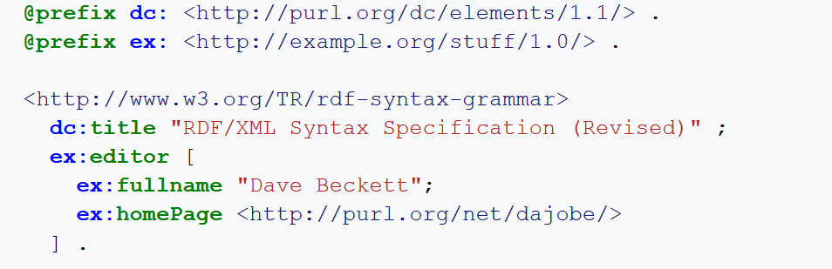
<number>
Notes:
Blank node/reification
<number>

Slide 64
Technologies (2)
SPARQL for posing queries
Query language inspired by SQL
Cats: query.wikidata.org
British parliament: http://tinyurl.com/y7mu3qqp
<number>
Notes:
<number>

Slide 65
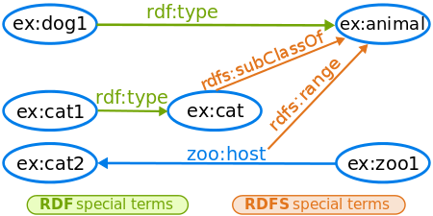
Technologies (3)
RDFS/OWL for constraint checking and inference
Animals?
<number>
Notes:
Query for animals -> dog1, cat1, cat2
<number>

Slide 66
Introduction to Knowledge Bases
Motivation
Definition and topics
Formal foundations
Construction techniques
Technologies
Applications
History and future
<number>
Notes:
<number>

Slide 67
Sample applications
Master data
Data mining
Search enhancements
Question answering
Language generation
Entity linking
Learning more knowledge
<number>
Notes:
<number>

Slide 68
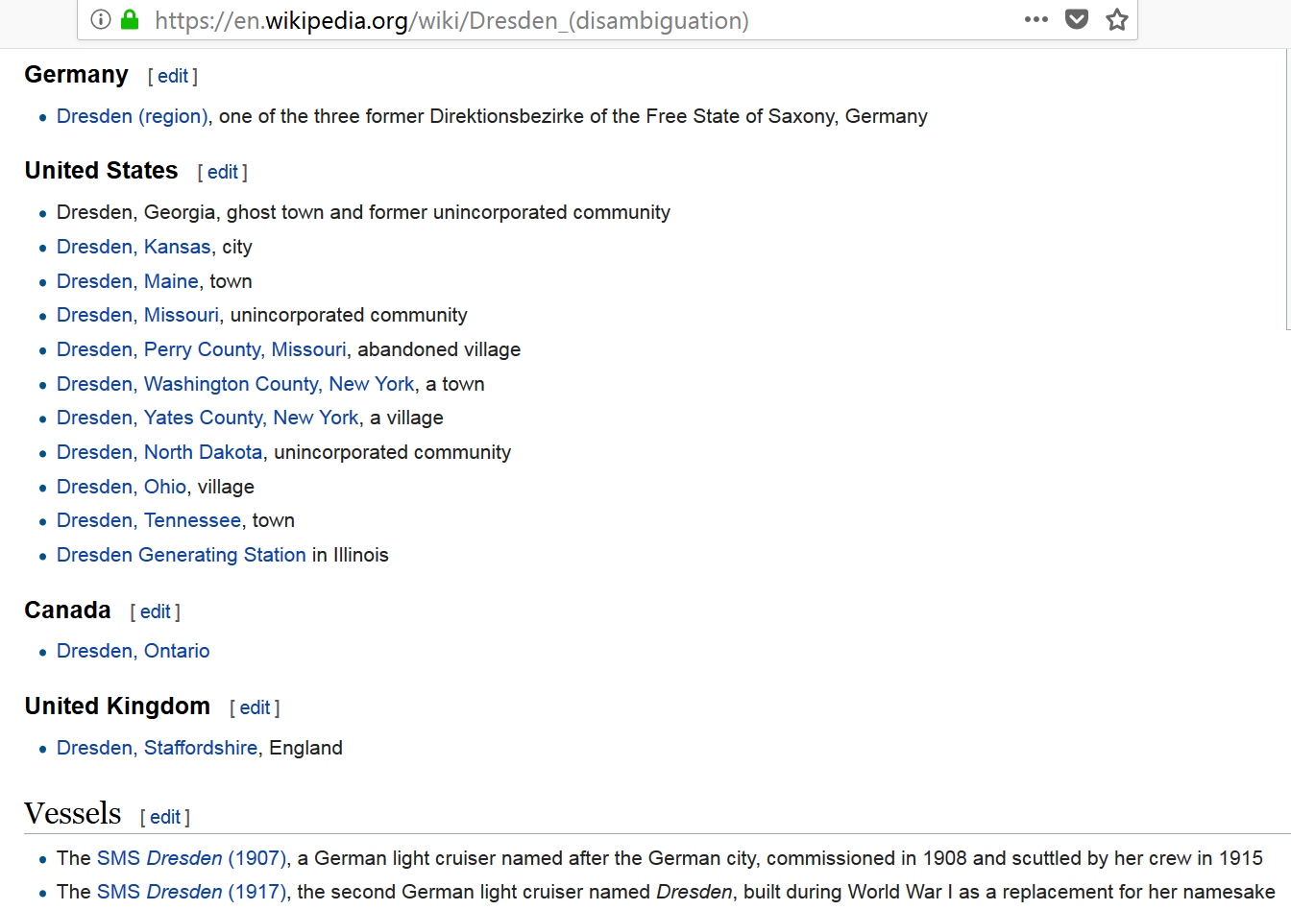
Master data (1)
<number>
Notes:
<number>

Slide 69
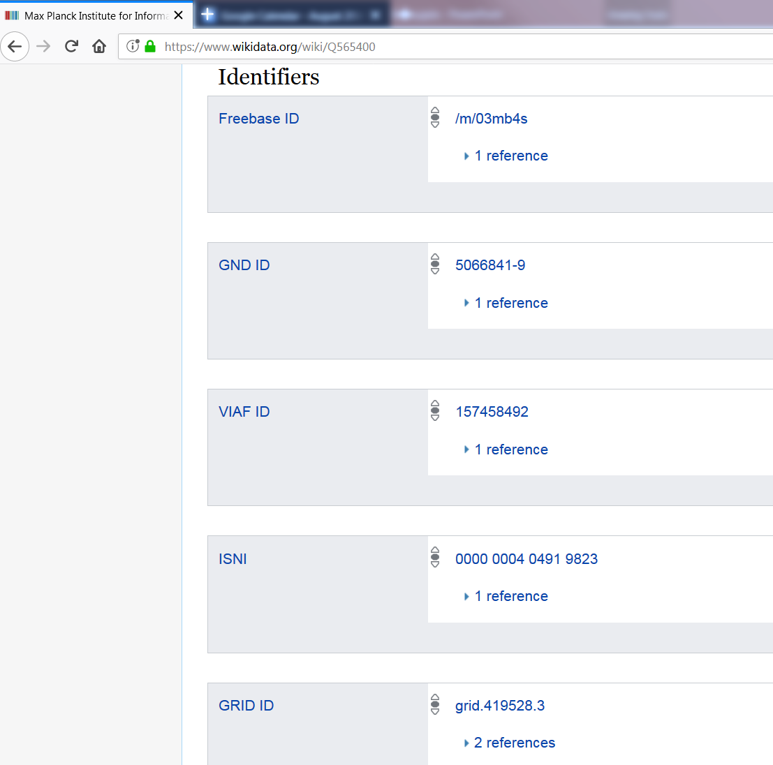
Master data (2)
Relevant for:
- Museums
- Libraries
- Scientific publications
….
<number>
Notes:
John Smith – which John Smith – author disambiguation e.g. real problem…
<number>

Slide 70
Data mining
Use input facts to extract patterns that allow to predict new facts
isCitizenOf(John, France) → livesIn(John, France)
Various approaches based on association rule mining and latent models
<number>
Notes:
<number>

Slide 71
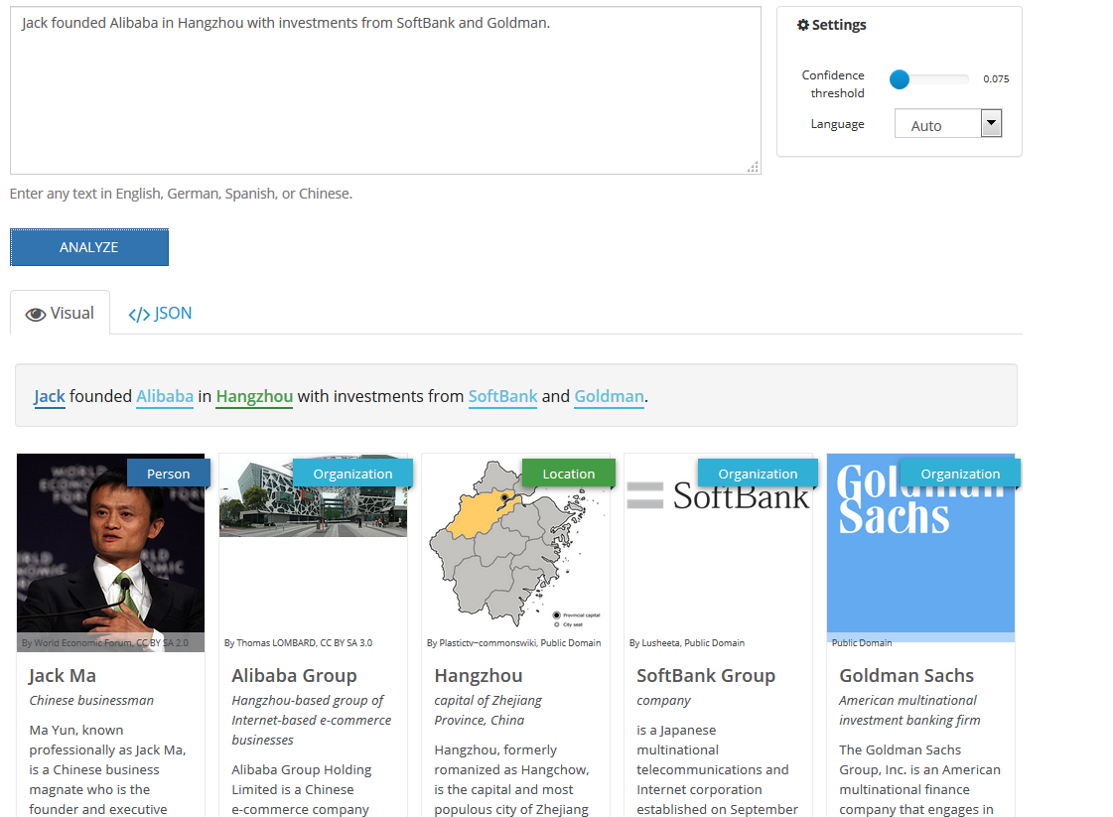
Entity linking
<number>
Notes:
<number>

Slide 72
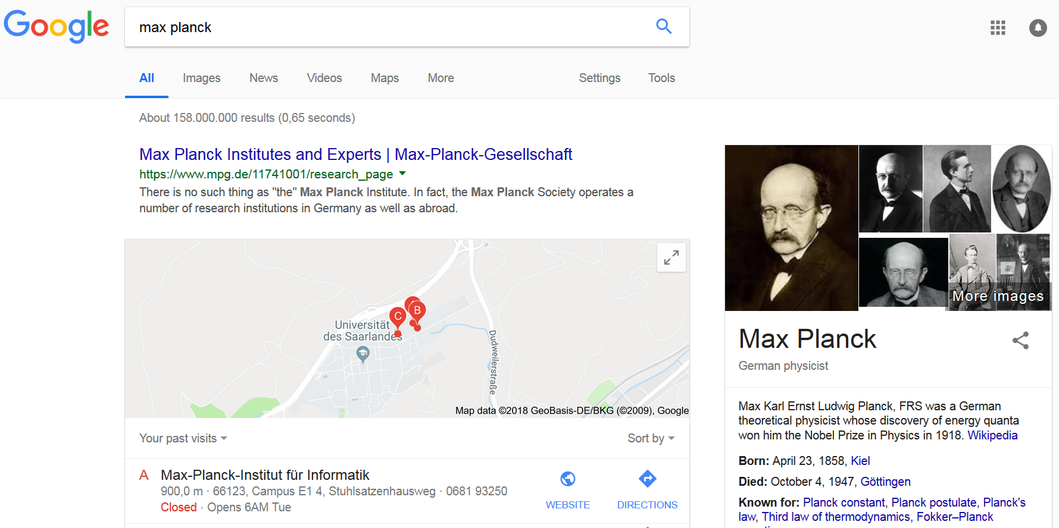
Search enhancements
<number>
Notes:
<number>

Slide 73
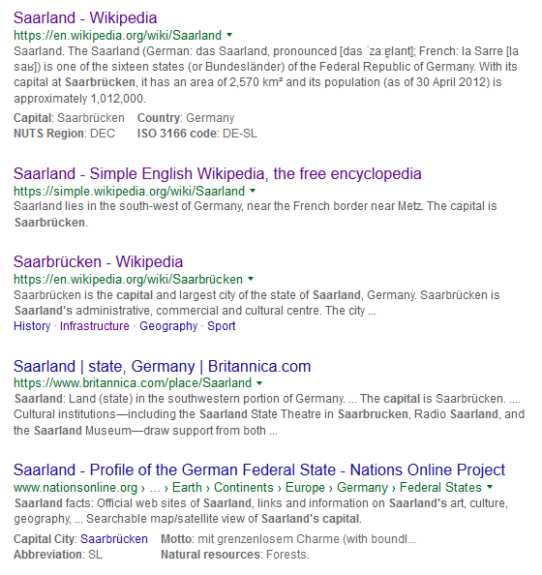
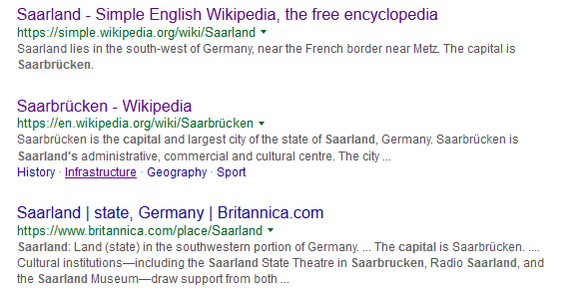
Question answering
What is the capital of the Saarland?
Try yourself:
When was Trump born?
What is the nickname of Ronaldo?
Who invented the light bulb?
<number>
Notes:
Google launched 1998 (1995 other name)
<number>

Slide 74
Question answering (2)
Knowledge bases key component in question answering systems
E.g., IBM Watson
AllenAI science challenge: Computers currently in 8th grade
Knowledge acquisition still major bottleneck
<number>
Notes:
<number>

Slide 75
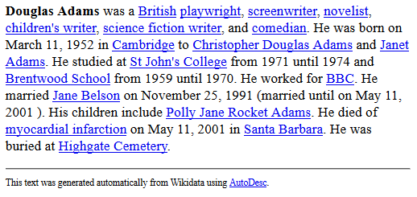
Language generation
Wikipedia in world’s most spoken language: 1/10 as many articles as English Wikipedia
World’s fourth most spoken language: 1/100
→ Wikidata intended to help resource-poor languages
<number>
https://tools.wmflabs.org/autodesc?q=9021&lang=&mode=long&links=reasonator&redlinks=reasonator&format=html
Notes:
First Chinese, fourth Hindi
<number>

Slide 76
Introduction to Knowledge Bases
Motivation
Definition and topics
Formal foundations
Construction and maintenance
Technologies
Applications
Past, present and future
<number>
Notes:
<number>

Slide 77
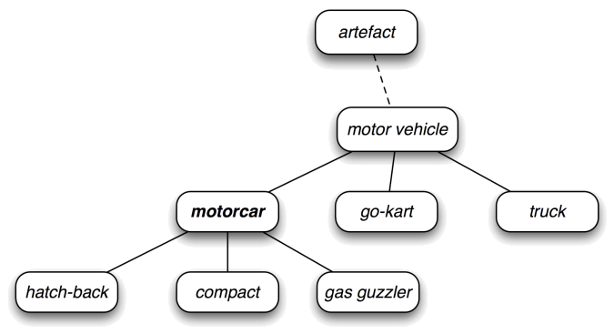
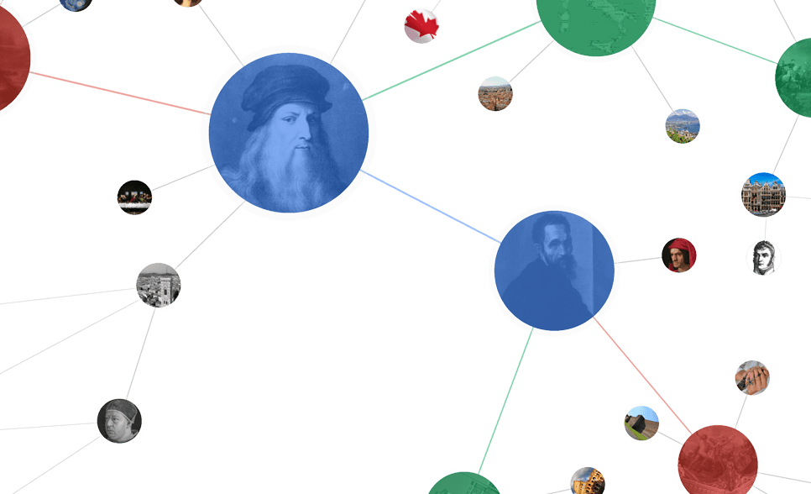
Past
Cyc
(#$relationAllExists
#$biologicalMother
#$ChordataPhylum
#$FemaleAnimal)
Knowledge Graph
(collaborative)
1984
2001
2007
2012
2018
<number>
Notes:
<number>

Slide 78
Present
KBs deployed at most major tech companies and beyond
Google, Microsoft, Alibaba, Bloomberg, …
Industry challenges: Metonymy, modelling, consistency, ..
Feb 2018: $125 million investment by Microsoft cofounder Paul Allen into non-profit research on common sense knowledge
Research: Major part of NLP conferences taken up by KB research
<number>
Notes:
Cuba and trump vs. president (role), Baseball teams moving cities, Sushi fastfood or not
<number>

Slide 79
Future
Combination of explicit and latent formalisms?
Better construction, cleaning and refinement using distant supervision, self-training, deep learning, …?
You?
<number>
Notes:
<number>

Slide 80
Outline
Introducing each other
Organization of the seminar
Introduction to Knowledge Bases
Topic presentation
Seminar survival skills
Topic assignment
<number>
Notes:
<number>

Slide 81
4. Topic presentation
https://www.mpi-inf.mpg.de/departments/databases-and-information-systems/teaching/ws1819/advanced-topics-in-knowledge-bases/
<number>
Notes:
<number>

Slide 82
Doodle result: 12./13.3.19
10:00-13:00 each day?

Slide 83
Outline
Introducing each other
Organization of the seminar
Introduction to Knowledge Bases
Topic presentation
Seminar survival skills
Topic assignment
<number>
Notes:
<number>

Slide 84
5. Survival skills for seminar attendants
<number>
Notes:
<number>

Slide 85
Outline
How to…
Research a topic
Read a paper
Write a report
Give a seminar talk
<number>
Notes:
<number>

Slide 86
Topic research: Foundations
Goal: Find relevant literature
Input: One or two reference papers
Idea: Greedy traversal of a relatedness graph (“snowballing”)
What gives related papers?
Papers that are cited
Papers that cite the work
Sources: Google Scholar, digital libraries (ACM digital library, Springer, Elsevier)
Other work of same authors
Sources: Institute/personal webpages, DBLP
Tool or project websites (e.g., AMIE)
Conference/journal/workshop webpages
Keyword-based search (Google Scholar)
<number>
Notes:
<number>

Slide 87
Greedy search heuristics
How to judge importance of a paper?
#citations
Venue
A*, A, (B), …
http://portal.core.edu.au/conf-ranks/
Paper type and length
Full/short/poster/Arxiv
Authors
<number>
Notes:
<number>

Slide 88
Keeping track
Method
Mendeley
Google Scholar “My library”
Text file
Take note of narrative patterns
“The classic rule mining”, “The Semantic Web community”, “The Paris group”, “The AI winter”
Humans love narratives
Helps to remember
<number>
Notes:
<number>

Slide 89
Demo
Google “AMIE: association rule mining under incomplete evidence in ontological knowledge bases”
Google Scholar
See in and outgoing citations
See author’s DBLP
CORE
<number>
Notes:
<number>

Slide 90
Outline
How to…
Research a topic
Read a paper
Write a report
Give a seminar talk
<number>
Notes:
<number>

Slide 91
Research paper: Common structure
Abstract
Introduction
Related Work
Background/Formalization
Methodology (often specific name)
Experimental Setup
Evaluation
Discussion
Conclusion
<number>
Notes:
<number>

Slide 92
What to find where
Abstract contains everything ☺
Introduction contains more of everything ☺
Both mention what is novel
Related work great to discover what to read next
Background/formalization may contain surprising assumptions/simplifications
“for the remainder of the paper, we assume that all text sources only contain true statements”
Experimental setup says how method was evaluated
Discussion/conclusion contain limitations and open questions
<number>
Notes:
<number>

Slide 93
How to read a paper
Read abstract
Read introduction
Skim rest, especially methodology and results
Read introduction again
Decide further process
Continue reading
Read previous work
Discard
If you don’t understand something
Read a similar paper: Might explain better
Take pen&paper and simulate a scenario
Look for theses/journal articles
<number>
Notes:
<number>

Slide 94
Outline
How to…
Research a topic
Read a paper
Write a report
Give a seminar talk
<number>
Notes:
<number>

Slide 95
General writing
Follow the Latex template (course website)
Miktex and other Latex distributions
Lyx (Word-style editing)
Overleaf/Sharelatex (Google-docs-like online editing)
At least 12 pages content
Do not plagiarize
<number>
Notes:
<number>

Slide 96
Structure
Use a standard outline
Introduction
Wider area/history of the topic
Foundations/assumptions/specific scenario the work looks at
Technical parts
Method 1, Method 2, Other methods
Critical evaluation and discussion
Conclusion
→ Helps the standard reader in retrieval
<number>
Notes:
<number>

Slide 97
Watch your writing
Does only the content matter?
Surface features like appearance highly influence other dimensions of evaluation
Known as the Halo effect since almost 100 years (Thorndike, 1920)
Academic publishing: 3 typos in the abstract = rejection
<number>
Notes:
<number>

Slide 98
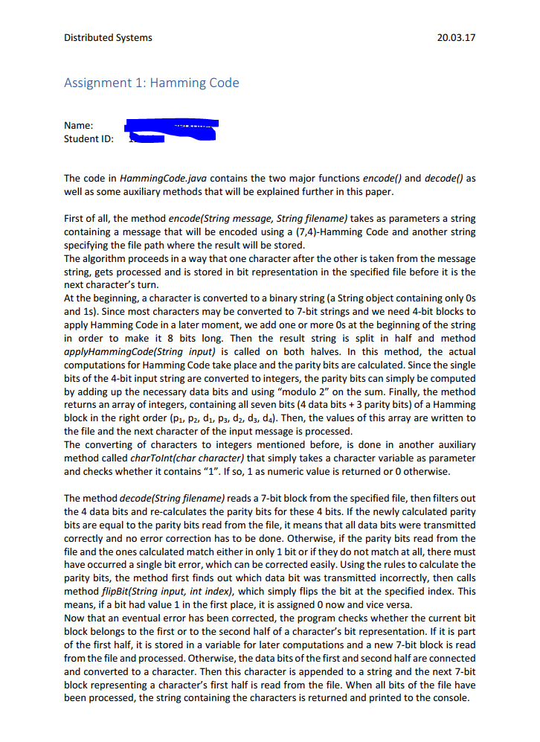
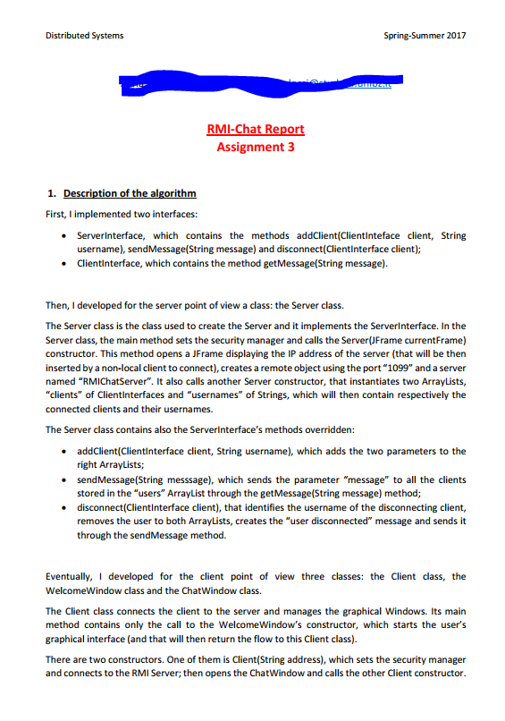
<number>
Notes:
<number>

Slide 99
Good presentation
Structure!
No typos!
Examples!
Pictures!
Correct and concise language!
<number>
Notes:
<number>

Slide 100
Specific hints
Explain the background of the work
Who are the authors?
Is this part of a bigger effort?
See what else the authors published
Be subjective only in discussion/conclusion
There: What seems good, what seems bad, what did you like, what has promise for future?
Elsewhere, avoid noncomparative judgements (“good”, “fast” – “more robust than”, “faster than”)
Avoid wiggle language
“around 800”, “a lot of works”, “2 experienced annotators”
Be consistent
Subsections numbered or not
Capitalization of headings
Tense
Typesetting, e.g., of entities and predicates
References format (page numbers, conference names)
Check use of articles
Especially if your mother language has none
<number>
Notes:
<number>

Slide 101
How to write a good paper
Iterate…
<number>
Notes:
<number>

Slide 102
Outline
How to…
Research a topic
Read a paper
Write a report
Give a seminar talk
<number>
Notes:
<number>

Slide 103
How to give a seminar talk
General:
Presentations are the 15-minute fame of researchers
Utmost important
Good presenting is no God-given skill but a hard-learned craft
Important points
Talks live or die with the example(s) used
Do not try to say everything
Less content per slide
Avoid being a tool-fool
<number>
Notes:
<number>

Slide 104
A. Examples
Think about them carefully
Funny and/or interesting case
Bonus: References to local/current situation/joint background
Talk in Paris: Eiffel tower, talk in Germany now: Diesel crisis, …
Need to be consistently used
Not: on Slide 3 “Mary lives in Munich”, on Slide 10 “Mary lives in Berlin”
Ideal: Same examples for the whole presentation (extended piece by piece)
If possible: 1 use of blackboard per presentation
<number>
Notes:
<number>

Slide 105
B. Do not say everything you know
Most situations: Talk is a teaser
“This is an interesting problem”
“I have a solution for …”
“I can significantly improve over the state of the art”
…
Main goal is not to convey the technical content
That’s what papers/reports are for
Often: Overview + explain one favorite module of the approach in detail
<number>
Notes:
<number>

Slide 106
B. Adjust to the audience
Adjust talk to audience knowledge
Audience rarely have same technical background
→ Don’t outdistance them
But don’t bore them either
E.g. in the context of this seminar, don’t repeatedly elaborate “a knowledge base is a set of triples (s,p,o), …”
Adjust to context
We have just seen …, now we …
Look what other talks might cover – talk to these presenters!
<number>
Notes:
<number>

Slide 107
C. Less content per slide (1/2)
Most slides contain too much content
1-2 minutes per slide
Whenever looks like too much
Split in two
Use animation effects to remove content not needed anymore (e.g. in examples)
Font size not below 20 (PPT)
This is 28, quite big
This is 24, reasonably OK
This is 20, which should be your limit
This is 16, what do you think people in the last row see?
<number>
Notes:
<number>

Slide 108
C. Less content per slide (2/2)
But this is not only about font size
Even though I use font size 28/20 for all text on this slide, you may get the impression that something is wrong with this slide
Is this possibly related to the amount of information conveyed?
Well, actually, what I am saying is not very deep. You already know very well that the human brain has only a limited attention span. So by the time you are reading this you certainly have forgotten what was written at the top of this slide.
More structure does not help either
Because too much is simply too much. So really pay attention both to font size and to amount of information conveyed
<number>
Notes:
<number>

Slide 109
D. Avoid being a tool-fool
Latex vs. Powerpoint
Redraw diagrams
Edit images
<number>
Notes:
<number>

Slide 110
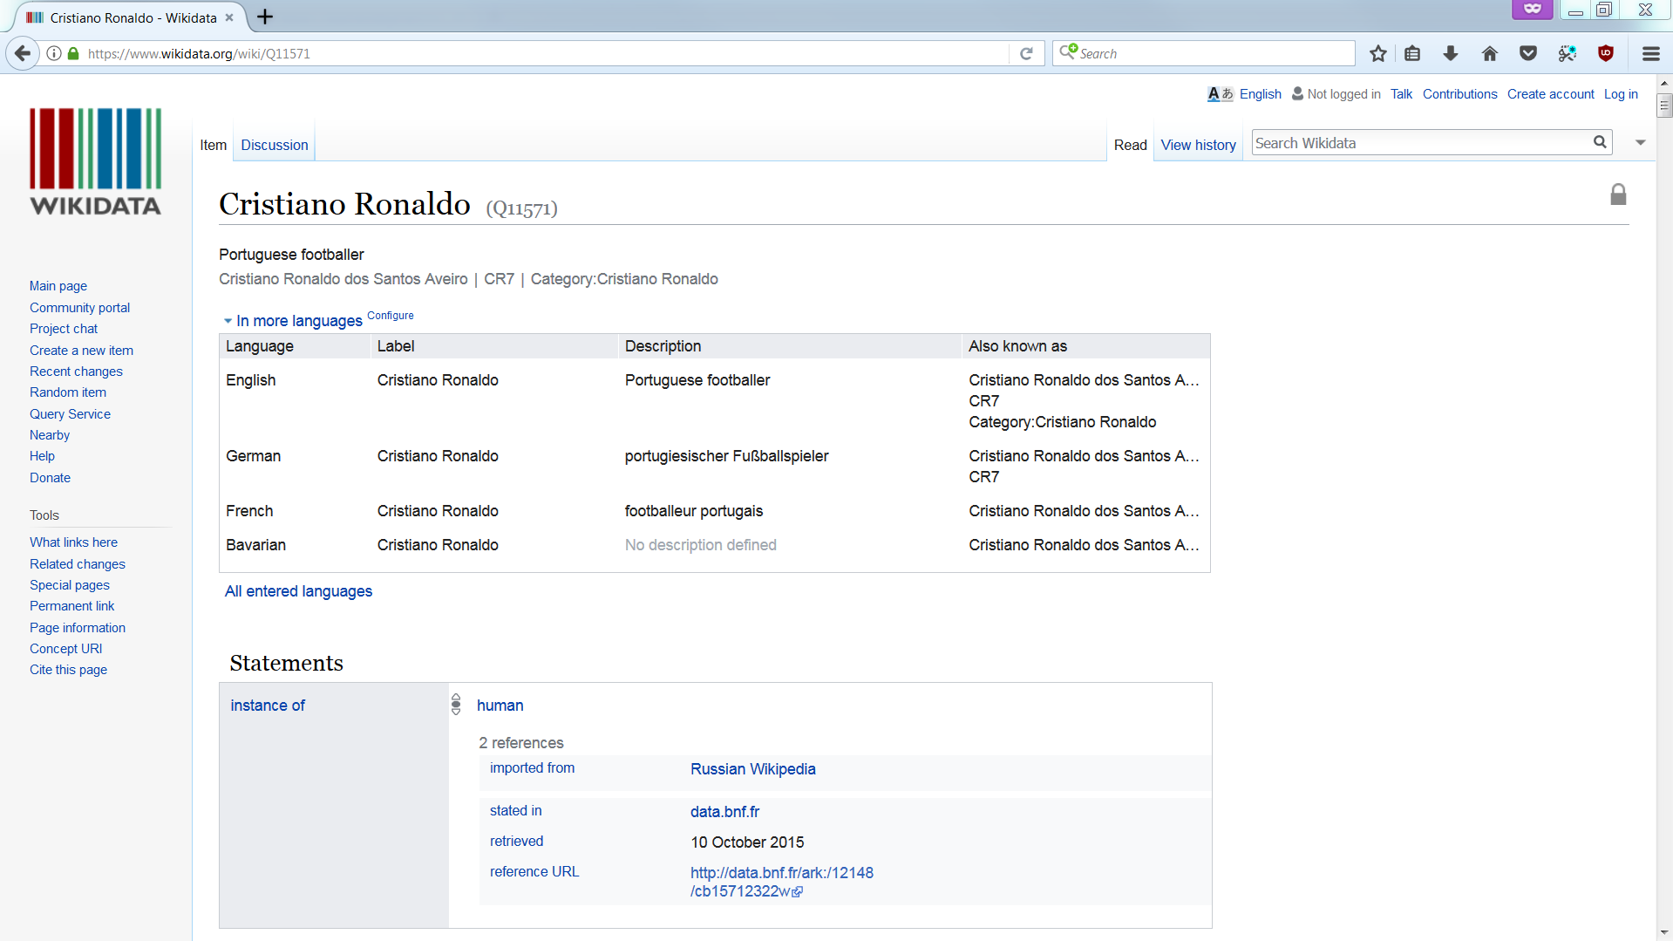
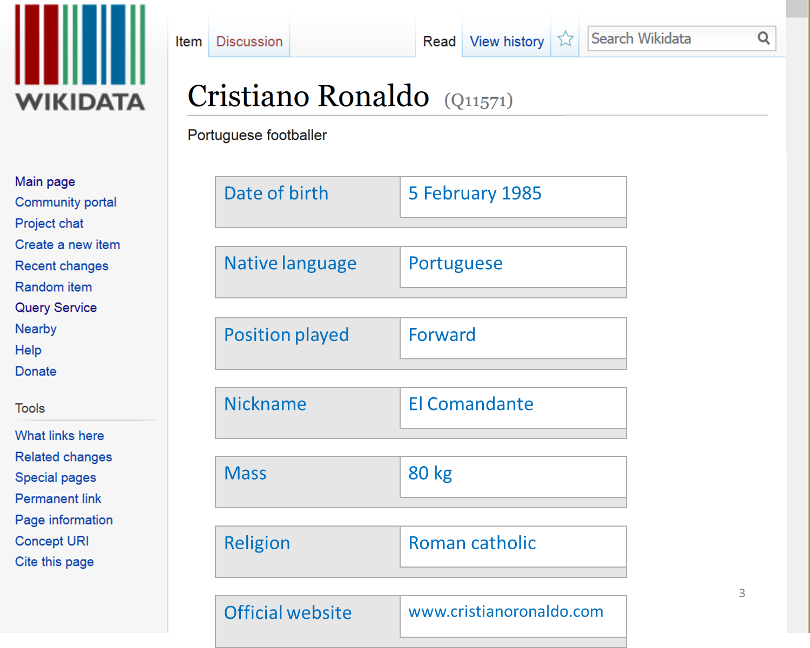
Modify figures where needed
<number>
Notes:
<number>

Slide 111
Seminar “Advanced Topics in Knowledge Bases” Lesson 3: How to give a talk XX.YY.2018
Varia (1/3)
Avoid useless generic information
Page numbers
No empty last slide “questions”,
Rather overlay over conclusion
→ Gives audience an anchor
<number>
Dr. Simon Razniewski Max Planck Institute for Informatics www.simonrazniewski.com
Notes:
<number>

Slide 112
Questions?
<number>
Notes:
<number>

Slide 113
Summary
Questions?
How to…
Research a topic
Use multiple means
Read a paper
Read, read, read
Write a report
Watch the simple things
Give a seminar talk
Less is more
Spend a lot of effort on good examples
<number>
Notes:
<number>

Slide 114
Varia (2/3)
Tell three times
Tell what you are going to tell
Tell it
Tell what you told
Easy way: Repeat outline throughout talk
Good point to breathe in deeply, take a sip of water, look at your watch, ask “everything clear so far?”
<number>
Notes:
<number>

Slide 115
Outline
How to…
Research a topic
Read a paper
Write a report
Give a seminar talk
<number>
Notes:
<number>

Slide 116
Varia (3/3)
One slide: “Not in this talk”
<number>
Notes:
<number>

Slide 117
Not in this talk
How to typeset math formulas
See e.g. “Mathematical writing” by Donald Knuth
How to write proper language
Search online
Rhetorical hints
Take a course at the Center for Key Competencies and University Didactics
<number>
Notes:
<number>

Slide 118
Practice (1/3)
John Wooden’s 8Ps of Success
Plan
Prepare
Practice
Practice
Practice
Practice
Practice, and
Practice
<number>
Notes:
<number>

Slide 119
Practice (2/3)
Everybody is nervous
Enjoy your presentation, and your audience will enjoy
Keep visual contact
Take questions
Acknowledge gaps, take issues offline
Audience: Help answering questions
<number>
Notes:
<number>

Slide 120
Practice (3/3)
Same setting is not required
Explain over lunch to a colleague
Your parents are OK too
Helps to get more familiar
Watch for flow, consistency, odd steps
<number>
Notes:
<number>

Slide 121
Summary
Questions?
How to…
Research a topic
Use multiple means
Read a paper
Read, read, read
Write a report
Watch the simple things
Give a seminar talk
Less is more
Spend a lot of effort on good examples
<number>
Notes:
<number>

Slide 122
Outline
Introducing each other
Organization of the seminar
Introduction to Knowledge Bases
Topic presentation
Seminar survival skills
Topic assignment
<number>
Notes:
<number>

Slide 123
1.
2.
3.
4.
5.
6.
7.
8.
9.
10.
11.
12.
13.
14.
<number>
Notes:
<number>

Slide 124
Questions?
Summary
Introducing each other
Organization of the seminar
Introduction to Knowledge Bases
Topic presentation
Seminar survival skills
Topic assignment
Next steps
Enroll in HISPOS
Do literature research
Prepare extended outline until 30.11.
<number>
Notes:
<number>

