Slide 1
Commonsense knowledge extraction and curation
Simon Razniewski
Winter semester 2020/21

Slide 2
Outline
Introducing each other
Organization of the seminar
Introduction to commonsense knowledge
Topic presentation
Seminar survival skills
Topic assignment

Slide 3
Outline
Introducing each other
Organization of the seminar
Introduction to commonsense knowledge
Topic presentation
Seminar survival skills
Topic assignment

Slide 4
Simon Razniewski
Senior Researcher at MPII, Department 5
Heading “Knowledge Base Construction and Quality” area
Background
  Assistant professor at FU Bozen-Bolzano, Italy, 2014-2017
  Extended visits at AT&T Labs-Research, University of Queensland, UC San Diego
  PhD FU Bozen-Bolzano, 2014
  Diplom at TU Dresden, 2010
Background:
  Logics, databases, Semantic Web
  More recently IR, (applied) NLP, ML, …
Research interests:
  Information extraction, knowledge base construction, data quality, …

Slide 5
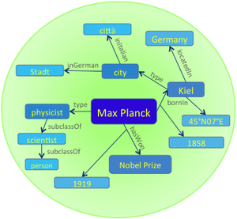

Department 5
Department 5: Database and information systems, ~25 members
Knowledge discovery: extracting, organizing, searching, exploring and ranking facts from structured, semi-structured, textual and multimodal information sources
Knowledge Base
  Earliest prominent machine-generated
  knowledge base (2007)
  Contains more than 10 million entities
  and more than 120 million facts
Gerhard Weikum 259th most cited
computer scientist worldwide
Notes:
Source: http://www.guide2research.com/scientists/

Slide 6
And you?
Name
Course of study
Specialization (thesis topic?)
…
Notes:
Who wrote BSc. already could mention topic.

Slide 7
Outline
Introducing each other
Organization of the seminar
Introduction to commonsense knowledge
Topic presentation
Seminar survival skills
Topic assignment
Notes:
Who wrote BSc. already could mention topic.

Slide 8
Formal organization
Credit points: 7, hours: 210 (!)
Registration
  HISPOS
    Till 2 weeks after topic assignment
    So max. 3 weeks from now
What to do?
  Attend the introductory lectures and block seminar days
  Produce 5 deliverables
    Short writeup on open questions (November 12 – 5%)
    Report extended outline (December 12 – 5%)
    Report 1st revision (January 14 - 0%)*
    Reviews on two other reports (January 28 - 10%)
    Reports 2nd revision (February 11 - 40%)
  Give a presentation (March 4 - 40%)
Extended outline
…
2. Methodology
2.1 KB Representation
Discussion on how to represent knowledge
Comparison with other representations
Benefits and limitations of such representations
…

Slide 9
What is expected?
Research and presentation of a topic
  Independent literature research
    ~2 seed references provided
  In-depth and in-breadth discussion of the topic in the seminar report
    Typically carefully chosen components in depth
    Less deep broader overview
    → Talk to me if unsure
  Seminar presentation more narrow than the report
    Careful content selection and organization, visual design and presentation
Main grading basis:
  Seminar paper:
    Depth
    Breadth
    Presentation quality
  Presentation and discussion:
    Didactic value
    Presentation quality
    Knowledge (ability to answer questions)

Slide 10
Learning outcomes
Knowledge
  What is a commonsense knowledge
  How is such knowledge collected, consolidated, exploited, …
Skills
  Learn to research a topic
  Learn to read scientific papers
  Learn to structure and write up a scientific paper
  Learn to give high-quality scientific presentations
→ Almost a thesis!
  Only missing the own original technical contribution

Slide 11
Outline
Introducing each other
Organization of the seminar
Introduction to commonsense knowledge
Topic presentation
Seminar survival skills
Topic assignment

Slide 12
Outline
Motivation
Knowledge representation
Crowdsourcing
Text Extraction
Transformer-based techniques
Consolidation
Summary and Outlook
Based on a tutorial at KI 2020
http://simonrazniewski.com/commonsense-tutorial-ki-2020

Slide 13
Outline
Motivation
  What is CSK?
  Why is it important?
  What makes it challenging?
Knowledge representation
Crowdsourcing
Text Extraction
Transformer-based techniques
Consolidation
Summary and Outlook

Slide 14
What is commonsense knowledge?
Definition 1 (by commonality):
Knowledge shared by most humans
Possible qualifications
  Across cultures
  From early in life (=children)
E.g., elementary school exam questions
  http://data.allenai.org/ai2-science-questions

Slide 15
What is commonsense knowledge?
Definition 2 (by knowledge type):
Knowledge about concepts and events
  Concepts: Person, party, newspaper
  Events: Election, election party
Differentiation from encyclopedic knowledge on instances
  Instances: Joe Biden, Republican Party, New York Times
What to know about concepts and events?
  Properties
  Relations
    Taxonomical
    Subparts
    Temporal and causal relationships
    …

Slide 16
Definition Pro/Con
Definition 1 (by commonality):
  Popsicle, is, frozen – only known in North America
  Lion is dangerous/cute - depends whom you ask
  → Inclusion/exclusion decision challenging
Definition 2 (by knowledge type):
  Germany, locatedIn, Europe – excluded as instance knowledge
  Mitochondria, hasPart, inner membrane – not common knowledge
  → Class knowledge limitless

Slide 17
Examples of CSK
Taxonomical
  Elephant, isA, mammal
Properties
  Elephant, lives in, Savanna
Parts
  Elephants, hasPart, trunk
Measures
  Adult elephant, weight, ~2..5 tons
  Elephant, lifespan, ~60 years
Activities
  Seeing elephant, requires, go to zoo
  Go to zoo, subevent, buy ticket
  Go to zoo, typicalDuration, 2 hours
Example KB: Ascent: https://ascentkb.herokuapp.com/

Slide 18
Out of scope for remainder
Lexical knowledge
  Word senses, synonymy, …
  WordNet as prime example: https://wordnet.princeton.edu
Taxonomic knowledge lion is a mammal is a vertebrate is a …
  Good coverage in lexical projects
    WordNet, WebIsADB, …
Encyclopedic KBs
  Wikidata
    Structured sister project of Wikipedia, mostly focused on encyclopedic knowledge
    Knowledge on concepts slowly growing, though limited set of useful predicates
    Recent analysis: [Commonsense Knowledge in Wikidata, Ilievski et al., Arxiv, 2020]
  NELL, DBpedia, YAGO, …
    Similar encyclopedic focus

Slide 19
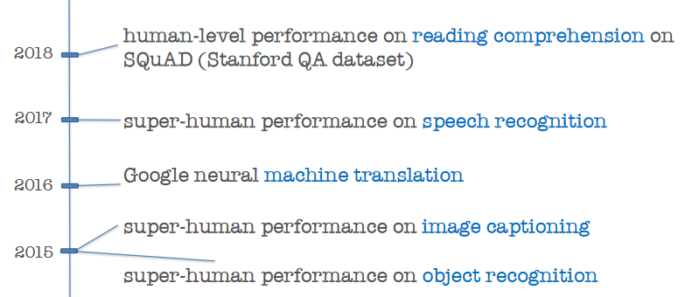
Why CSK? Amazing progress without
[From Yejin Choi, ACL 2020]

Slide 20
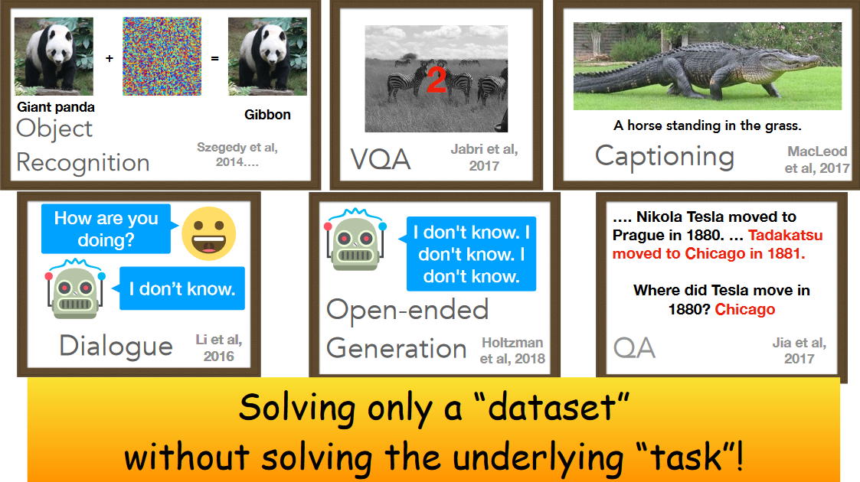
[From Yejin Choi, ACL 2020]
Notes:
For *any* “how many” question, SOTA models will say 2

Slide 21
Importance of CSK
Reusable and scrutable asset for a range of AI tasks
Reusable:
  CSK can be plugged into a range of tasks, e.g., QA, dialogue, object recognition, text generation, …
  Contrasts with typical end-to-end learning
Scrutable:
  Humans can inspect, add and remove content
    Relevant in applications where errors are costly
    Relevant in applications at risk of bias/discrimination
  Humans can inspect discrete statements used for reasoning
    Relevant for debugging complex downstream use cases
  Contrasts with end-to-end learning and pretrained language models
Notes:
Examples Microsoft Tay
Man/woman/doctor/nurse

Slide 22
Challenges of compiling CSK knowledge
Semantics
  “Lions, attack, humans” – all/some/all the time/once/..?
Salience
  “Elephant has trunk” vs. “Elephant has tibia bone”
Reporting bias
  “woman kills” vs. ”woman breathes” – 1.5M vs. 0.1M
  “pink elephant” vs. “grey elephant” – 6.9M vs. 1.9M
Sparsity in sources
  Do Python programmers drink water?
Noise and polysemy
  Pigs can fly - idiom
  Lynx: Constellation, web browser, animal

Slide 23
Outline
Motivation
Knowledge representation
Crowdsourcing
Text Extraction
Transformer-based techniques
Consolidation
Summary and Outlook

Slide 24
Knowledge representation challenges
Encyclopedic KBs: Typically binary truth notion
  Trump, born in, NY
  House of Cards, producer, Netflix
  Bamberg, mayor, Herbert Lauer, [1994-2006]
CSK: Generalizes across subjects
  Lions, have, manes - percentage?
Fuzzy time notion
  Lions, drink, milk - when?
Spatial and cultural context
  Lion, is, cute
  Grashopper, is, tasty

Slide 25
Linguistics - Generics
It is complicated
  Ducks lay eggs >> Ducks are female
    Even though former set is a subset of latter
  Dinosaurs are extinct
    Not applicable to individuals
[Generics oversimplified, Leslie, 2013]

Slide 26
Epistemic logics
“Zoo visitors believe lions are cute”
“Rural dwellers believe lions are dangerous”
Used in CycL
  Reification
  Modals for belief and desires
[CYC: Towards programs with common sense, Lenat et al., 1990]
[Kriepke 1963], and others

Slide 27
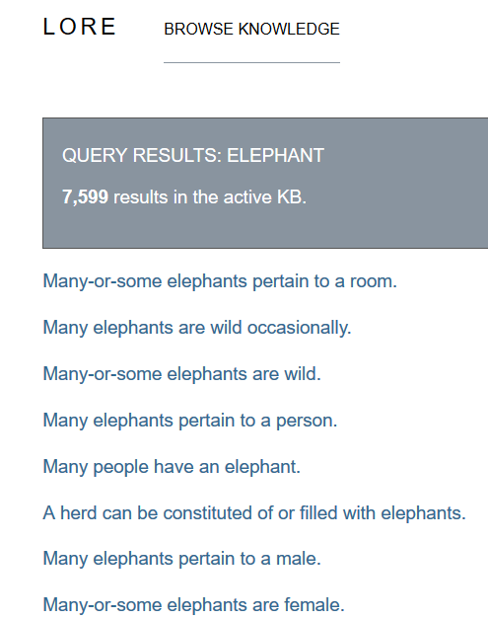
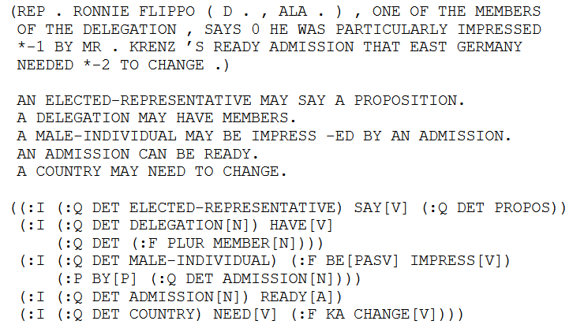
Episodic logics
KNext, Lore projects in early 2000s
Schubert, Lenhart. "Can we derive general world knowledge from texts.“ HLT 2002

Slide 28
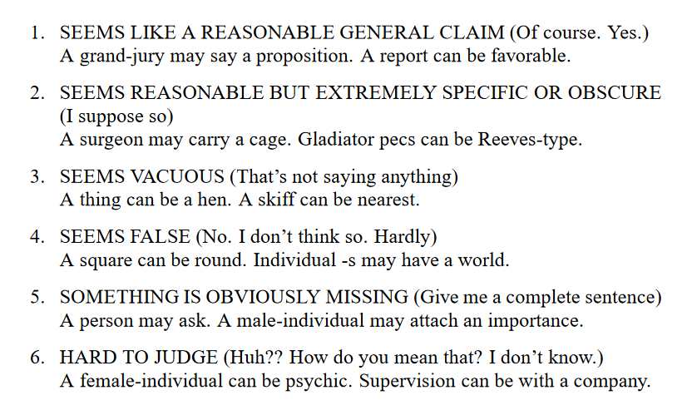
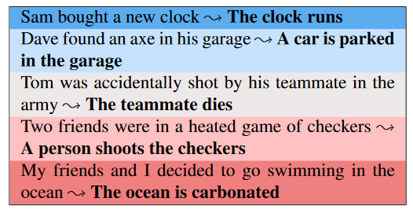
Graded formalisms
Heuristic level in CycL
  True, default true, unknown, default false and false as statement labels
Ordinal grades
[Schubert and Tong, NAACL 2003]
Simplified
[Zhang et al., TACL 2017]
  Very likely
  Likely
  Plausible
  Technically possible
  impossible
Notes:
Ordinal Common-sense Inference – durme 2017

Slide 29
Graded formalisms (2)
Dice [Chalier et al., AKBC 2020]
  4 dimensions
 | Plausible | Typical | Salient | Remarkable
Lions; eat; chicken | ✓
Lions; attack; humans | ✓ |  | ✓ | ✓
Lions; drink; water | ✓ | ✓

Slide 30
Chat bot examples
Plausibility
  Avoid blunders, detect irony (lion enjoyed taking selfies)
Typicality
  Infer missing context (user saw hyenas → likely a pack)
Remarkability
  Infer concepts (spotted laughing animal → hyena)
Salience
  Move conversation (user saw lion → was it roaring?)

Slide 31
KR – (Pre)Summary
Expressive proposals exist
Instantiation hard
  Sparse realization in natural language
  Correct extraction nontrivial
Most projects:
Pragmatic choice of (subject, predicate, object) triples with a single score
Lion, hunts, zebra – 0.73
Lion, drinks, milk – 0.45

Slide 32
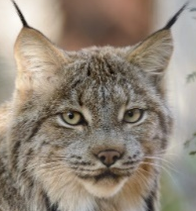
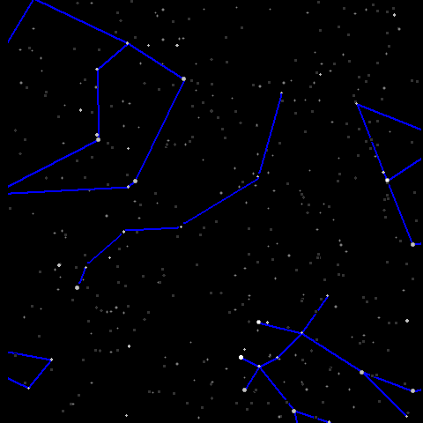

Triples and done?
Still major design decisions left!
  Fixed or open set of predicates
  Subject range
  Object range
Fixed vs. open predicates
  E.g., ConceptNet: ~25 predicates (isCapableOf, requires, isA) vs. TupleKB ~1000 textual phrases
Subjects: Strings or disambiguated terms?
  Lynx vs. lynx vs. lynx
Granularity and modifiers
  Elephant, Foraging elephant? Newborn elephant?
Objects: Entities or open phrases?
  Politician, isCapableOf, promise that impossible things will happen

Slide 33
Knowledge representation – Summary
Balance between expressivity and extractive tractability
Use cases impact choice of formalism
  Dialogue/QA: Textual phrases help matches
  Entity comparison: Stricter predicates help matching

Slide 34
Outline
Motivation
Knowledge representation
Crowdsourcing
Text Extraction
Transformer-based techniques
Consolidation
Summary and Outlook

Slide 35
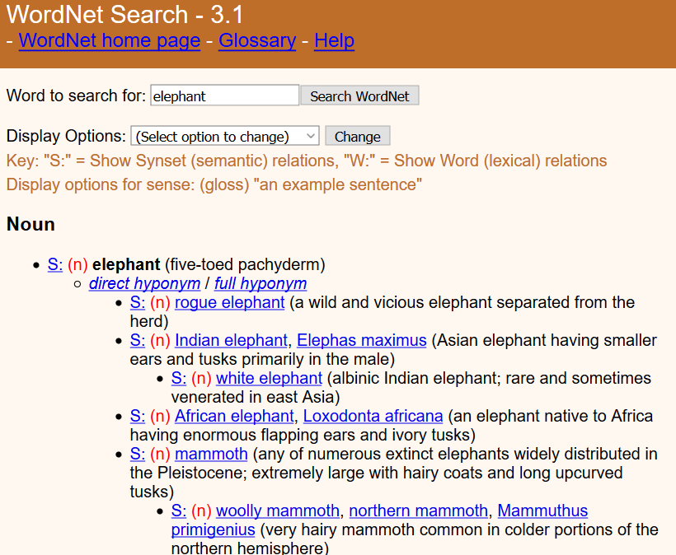
Crowdsourcing Expert annotation
WordNet [Miller and Fellbaum, ~80s]
  Lexical resource still popular today
  Is-A, synonym, partOf
  ~200k word senses
  2 expert annotators (=authors)
  Limitations: Imbalance, idiosyncrasies,
  lack of scores/ranking
Cyc [Lenat, ~80s]
  CSK, world knowledge, rules
  Hired experts on specific domains
  >1000 person-years of effort estimated
Next projects: Harness power of laypeople

Slide 36
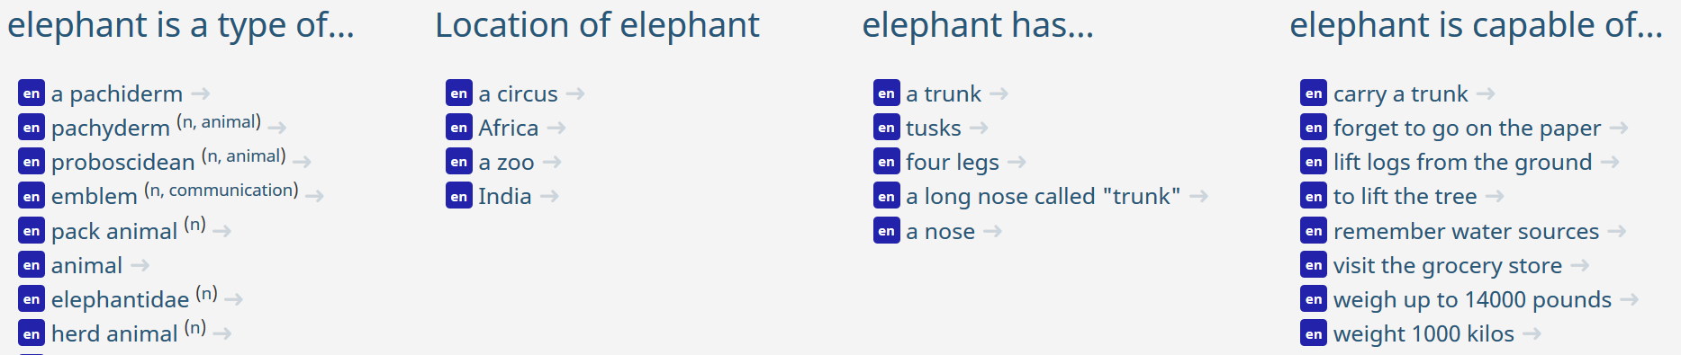
Open Mind Common Sense / ConceptNet
Havasi et al., MIT ~1999 [http://conceptnet.io/]
CSK for ~25 relations
  Construction statistics
    ~14k volunteers filled in sentences with blanks
    ~700 000 English sentences
    NLP tools: 300 000 concepts and 1.6 million assertions
[ConceptNet — a practical commonsense reasoning tool-kit, Liu and Singh, 2004]

Slide 37
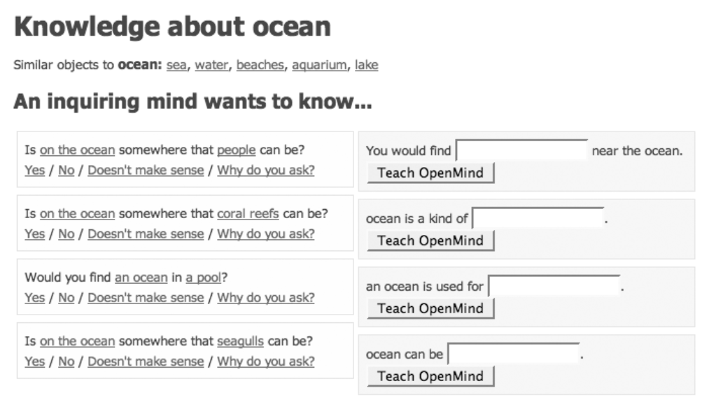
Open Mind Common Sense / ConceptNet

Slide 38
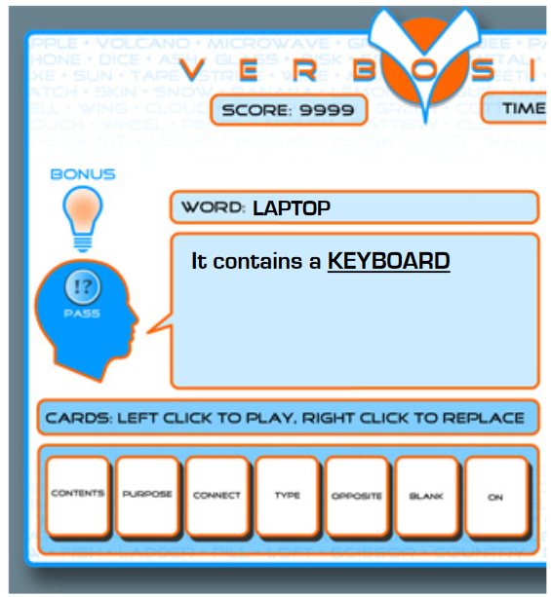
Verbosity
2-player game inspired by Taboo
Narrator must describe a word by fillig blanks in templates
  ___ is a kind of ___. Allows for hierarchical categorization.
  ___ is used for ___. Provides information about the purpose of a word.
  ___ is typically near/in/on ___ (three templates). Provide spatial data.
  ___ is the opposite of ___ / ___ is related to ___(two templates). Provide data about basic relations between words.
Templates give rise to CSK assertions
Verification via automated narrator that replays human assertions
Used to feed ConceptNet
High-quality: 85% of sentences rated as correct by 6/6 annotators
[Ahn et al., 2006]
Notes:
Van ahn famous for human computation, captchas

Slide 39
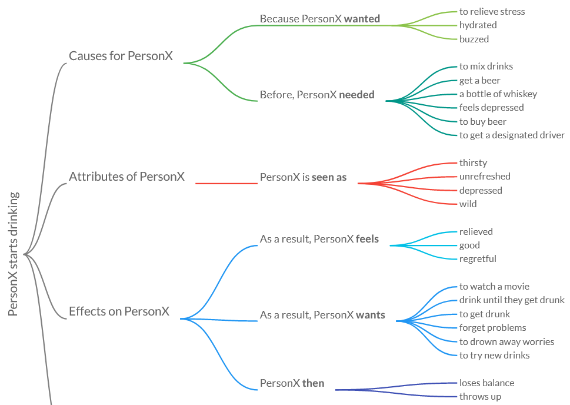
Atomic
Targets event knowledge
https://mosaickg.apps.allenai.org/kg_atomic
Redundancies!
[Sap et al., AAAI 2019]

Slide 40
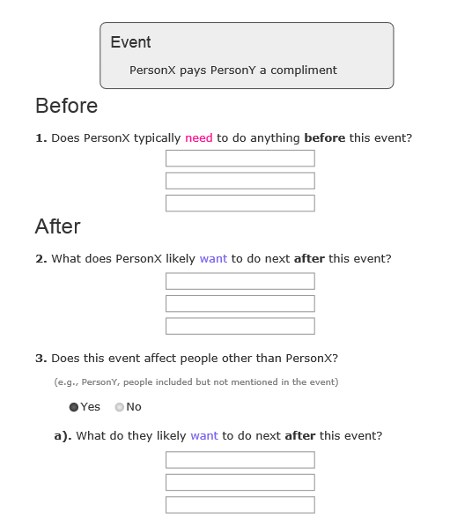
Atomic
Archetype of large-scale paid crowdsourcing
Subjects from text extraction (24k event phrases)
Statement creation
  3 workers per subject
  Free-form interface
  ~12$/hour
  300k statements
  3*5 minute/subject (?) → ~$100k cost

Slide 41
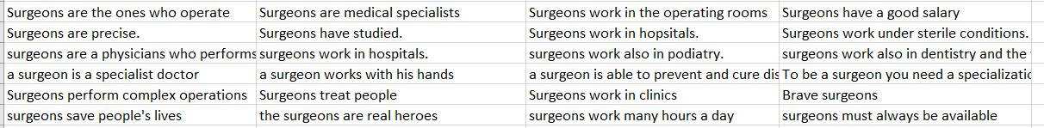
Quasimodo evaluation data
Not a KB construction effort!
Only tiny slice of humans data for evaluation
https://www.mpi-inf.mpg.de/fileadmin/inf/d5/research/quasimodo/CSK-crowd-for-recall.xlsx
2400 statements
[Romero et al., CIKM 2019]

Slide 42
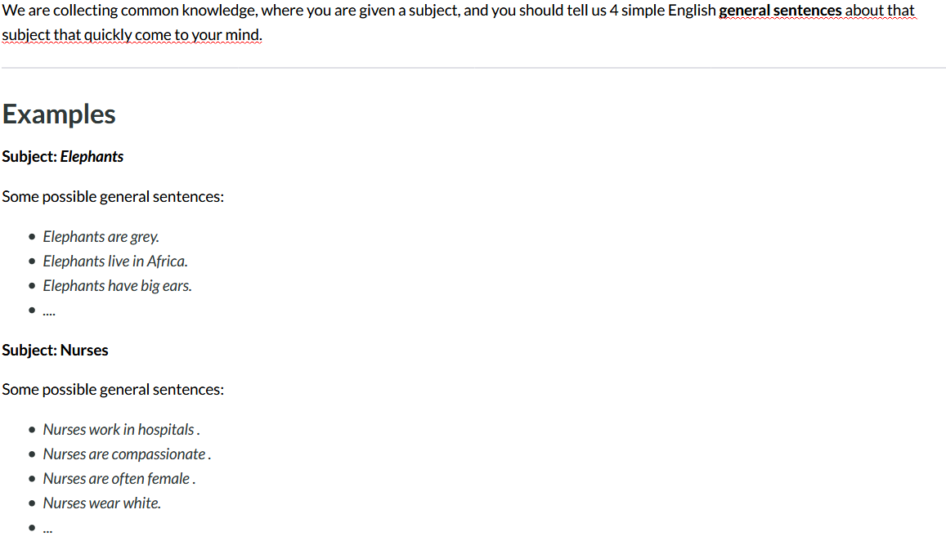
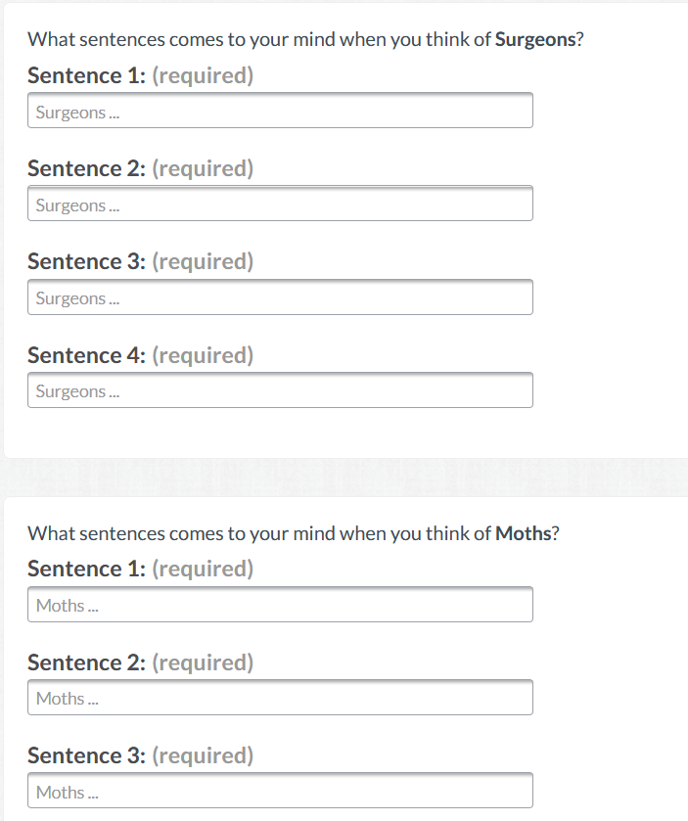
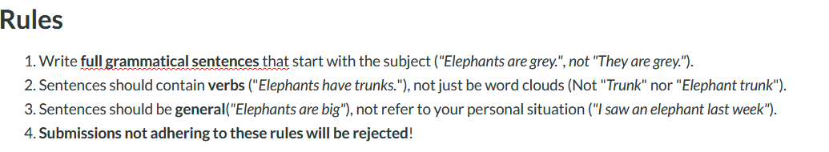
Still lots of misunderstandings
“I know a surgeon”
“Un cirujano es un gran hombre”
“The heart surgeon”
→ Second round of peer filtering might help
Notes:
We paid 15 cents per row -> assuming about 1 minute per subject

Slide 43
Wikidata
Collaborative knowledge base construction effort
Under umbrella of Wikimedia foundation
Best public source on encyclopedic knowledge today
Commonsense:
  Comparably lower coverage
  Roughly comparable to ConceptNet
  Growing…to be monitored
  [Ilievski et al, Arxiv 2020]

Slide 44
Crowdsourcing - Summary
Project | Focus | #statements | Notes
WordNet | Taxonomical relations | 175k synsets | Expert-built
Cyc | General statements and rules | OpenCyc: ~2 M statements | Expert-built, closed source
ConceptNet | Object properties | 1.6 M statements
Atomic | Events | 877k statements
Wikidata | Object properties | 100k CSK statements | Editable
Limited by volunteer effort/money
Targeted domains in reach for industrial efforts
Quality assurance important

Slide 45
Outline
Motivation
Knowledge representation
Crowdsourcing
Text Extraction
Transformer-based techniques
Consolidation
Summary and Outlook

Slide 46
Text extraction
Text extraction topic of long attention in KBC/NLP
Idea: Exploit patterns/commonalities in natural language in order to extract commonsense knowledge
  Lynx eat hares
  Elephants eat grass
  _ eats _
Design points
  Choice of sources
  Choice of extraction method
  Choice of consolidation
Prominent projects:
  WebChild
  TupleKB
  Quasimodo
  DoQ

Slide 47
Design point 1 – Extraction source
Wikipedia
Books and other dedicated sources
  ARC science corpus
Web crawls
  ClueWeb
  CommonCrawl
Web search
Forums
  Reddit
  Yahoo Answers
Search engine query logs
…

Slide 48
Design point 2 – Extraction scheme
Manual patterns
  Hearst patterns etc.
Co-occurrence
  Window, same sentence, …
Open information extraction
  Any verb phrase
Relation-specific supervised learning

Slide 49
Design point 3 – Consolidation
Keep all
Frequency cutoff
  E.g., at least seen 5 times
Per-statement consolidation
Joint consolidation
See section 6

Slide 50
WebChild
Among the first large-scale attempts at text extraction
Named for getting children’s knowledge from the web
Original focus: Linking nouns with adjectives
Text source: Google web search 5-gram corpus
Patterns: ~20 copula verbs (be, look, feel, …)
[Tandon et al., WSDM 2014]

Slide 51
TupleKB
Knowledge about science topics
Main ideas:
  Direct web extraction via search engine queries (keywords)
  Open predicate set by retaining predicate phrases “as is” (OpenIE)
    Partially consolidated using clustering
  Supervised scoring
[Mishra et al., TACL 2017]

Slide 52
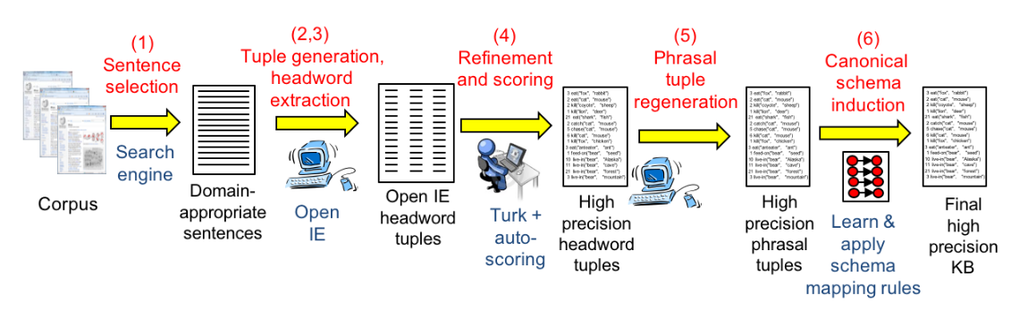
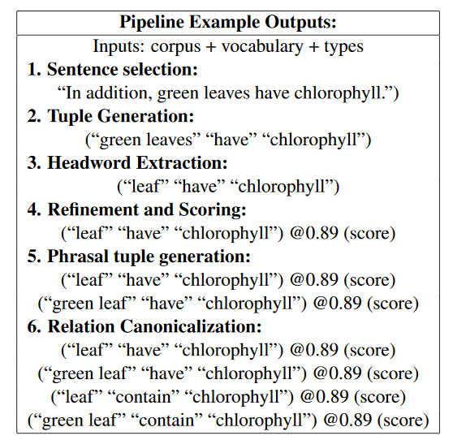
TupleKB

Slide 53
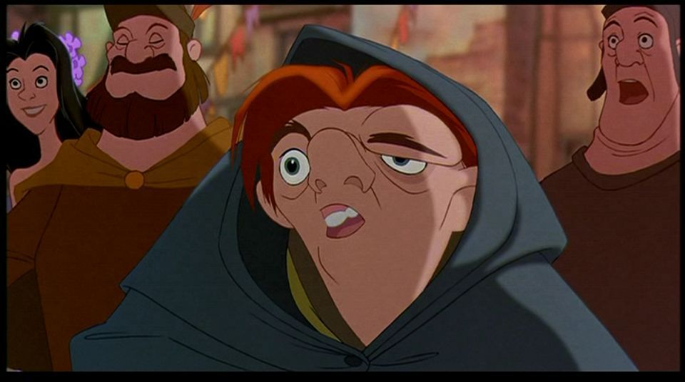
Quasimodo
= Query Logs and QA Forums for
Salient Commonsense Definitions
Focus on salient knowledge
  Human associations, curiosity
Characteristics
  Adopts open(IE) schema (like TupleKB)
  Salient assertions via careful choice of utterance context and sources
  Corroboration stage for candidate verification
(The Hunchback of Notre Dame)
[Romero et al., CIKM 2019]

Slide 54
Salient knowledge: Utterance context
Key idea: Questions convey salient knowledge
Why do cats purr?
Why do Americans love guns?
Why are airplanes white?
  So someone knows these!
  That someone cares enough to ask!

Slide 55
Salient knowledge: Premier sources
QA forums:
  Reddit
  Quora
  Yahoo answers
  Ask.com
Search engine query logs
  Bing
  Google

Slide 56
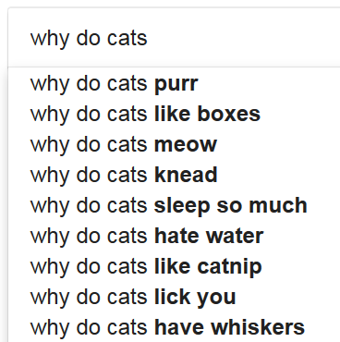
Tapping search engine query logs
Autocomplete gives only 10 suggestions/query
→ Exhaustive suffix probing
  Why do cats a
  Why do cats b
  Why do cats …
  Why do cats aa
  Why do cats ab
  …

Slide 57
Anecdotal Examples
Practical human knowledge | (car, slip on, ice)
Problems linked to a subject | (pen, can, leak)
Emotions linked to events | (divorce, can, hurt)
Human behaviors | (ghost, scare, people)
Visual facts | (road, has_color, black)
Cultural knowledge (USA) | (school, have, locker)
Comparative knowledge | (light, faster than, sound)
Une école de l’IMT

Slide 58
Quasimodo – Open issues
Questions sometimes go towards the odd
  Why does car leak oil, catch fire, not start …
  Not: Car transports people, consumes fuel, …
How to fit phrases into triples?
  Lawyers, can make, the world a better place?
  Lawyers, are, good for a fair judicial system?

Slide 59

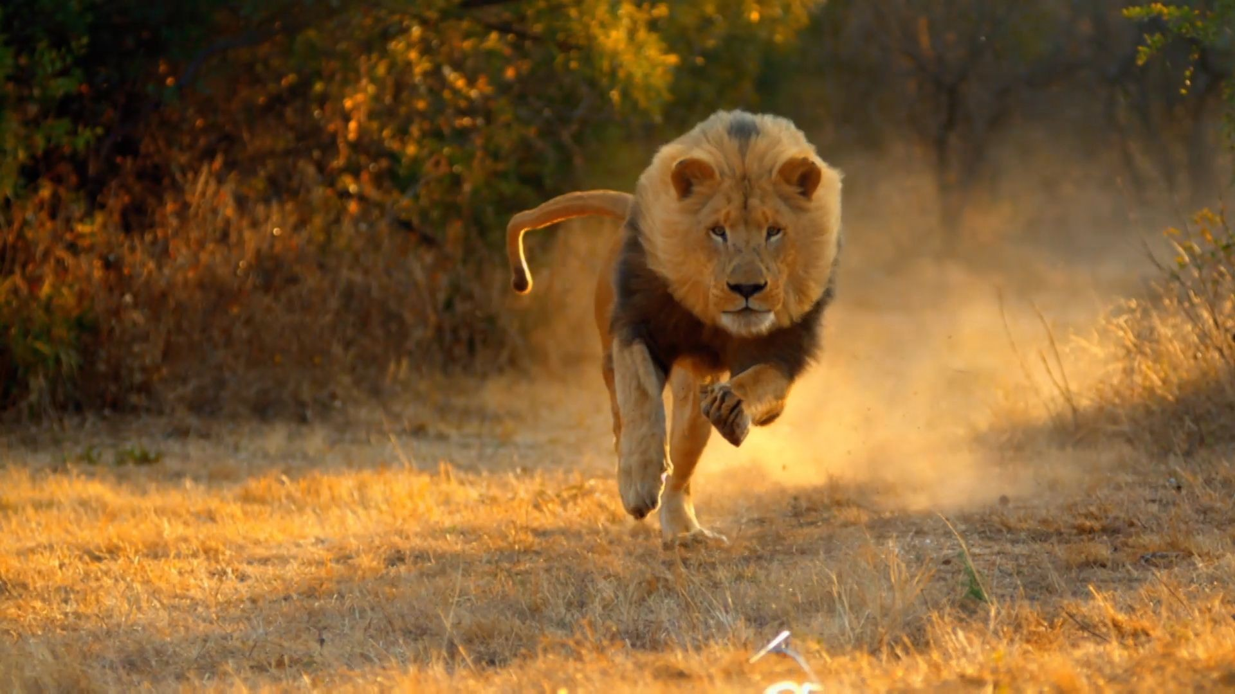
Distribution over quantities (DoQ)
P
roprietary + Conﬁdential
Understanding numerical properties and the way they relate to words.
Lion
speed
weight
...
size
Physical attributes
[Elazar et al., ACL 2019]

Slide 60
Approach
P
roprietary + Conﬁdential
Count co-occurrences of measurements with the words that appear in their context
By using a large text corpora

Slide 61
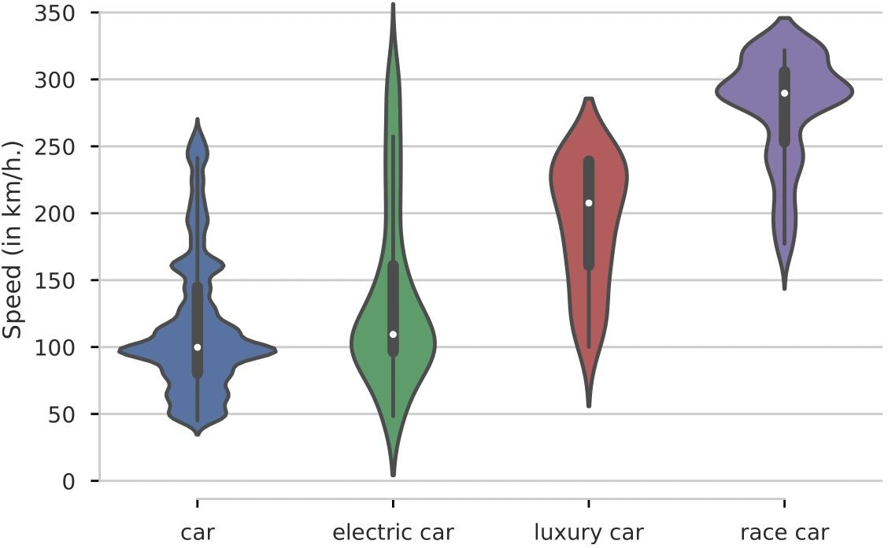
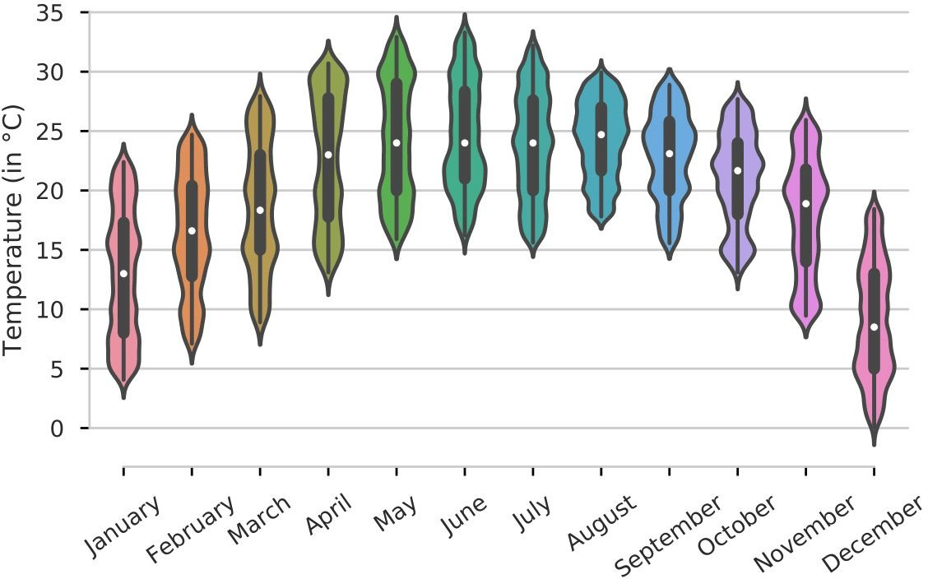
Example - Aggregating Measurements

Slide 62
Resource Statistics - DoQ
Proprietary + Conﬁdential
Distributions over Quantities (DoQ)
A very large and diverse resource
~120M Unique tuples (object, measurement)
  ~350K with >= 1000 occurrences
Measurement types:
  Length, mass, currency, temperature, …
27 In total

Slide 63
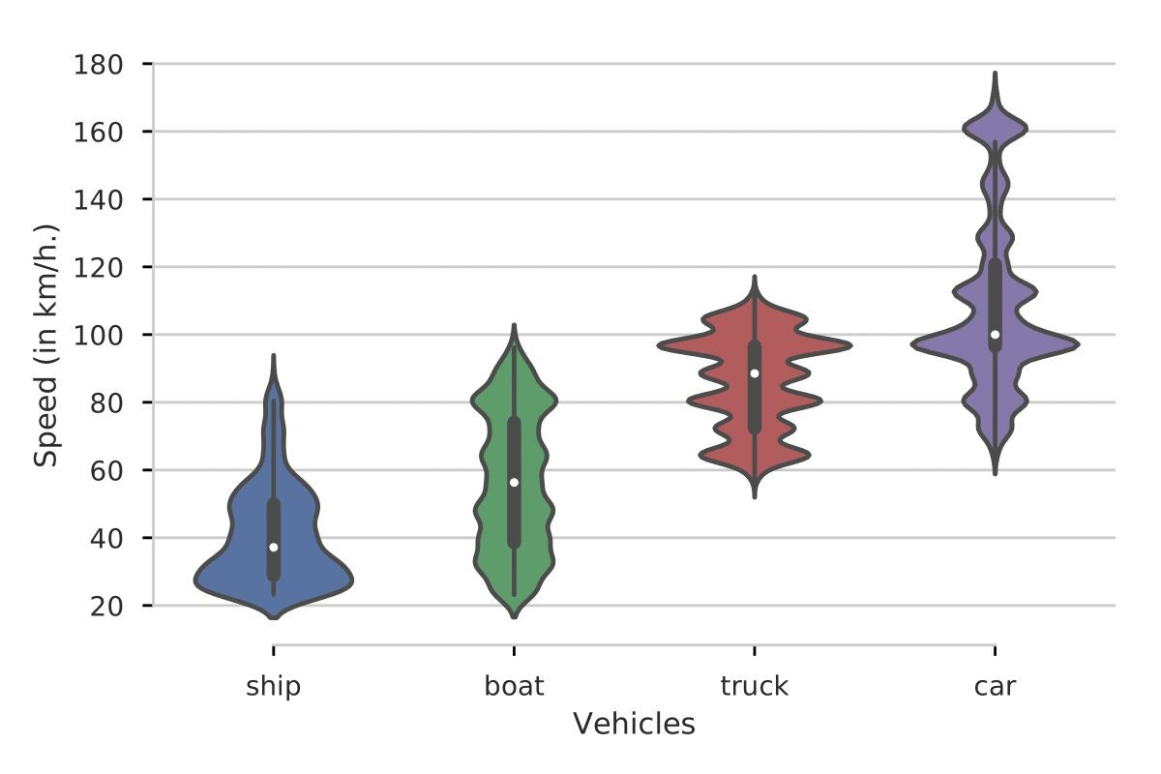
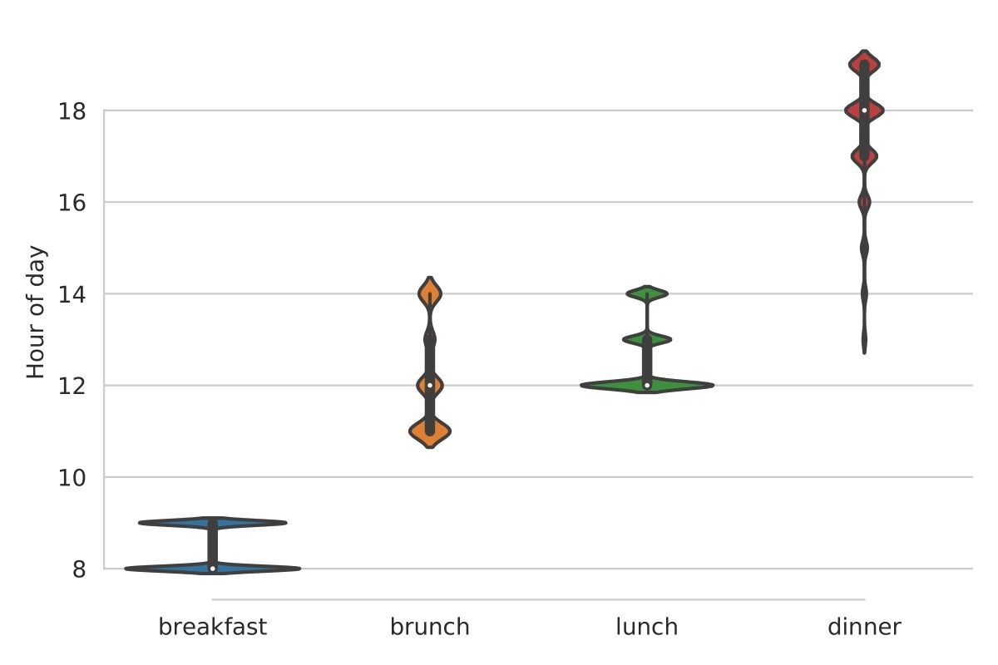

Comparable Objects - Cool Results
Proprietary + Conﬁdential

Slide 64
Summary – Text extraction
Design choice of
Resource
Data model
Extraction scheme
Project | Focus | Comments
Knext [2002] | Plausible assertions
XLore [2010] | Quantified assertions | Episodic logic
WebChild [2014] | Adjectives | Plausibility as inclusion criterion
TupleKB [2017] | Science knowledge
Quasimodo [2019] | General knowledge | Saliency instead of correctness as prime goal
DoQ [2019] | Quantities

Slide 65
Outline
Motivation
Knowledge representation
Crowdsourcing
Text Extraction
Transformer-based techniques
Consolidation
Summary and Outlook

Slide 66
Pretrained language models
BERT, ELMO, GPT, …
Major recent trend in NLP
  Deep neural networks (Transformer networks)
  Trained to fill gaps in text corpora, predict next sentences
  Unsupervised training on huge corpora (~web crawls)
Able to generate plausible continuations for given input
Encode basic linguistic and world knowledge (?) that benefits many downstream tasks (fine-tuning)
Can we use them to generate CSK?

Slide 67
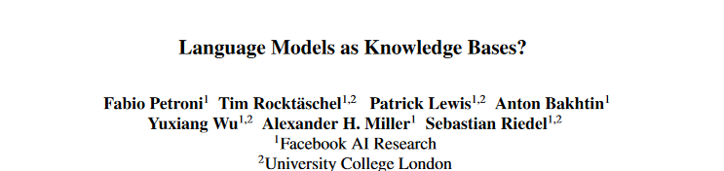
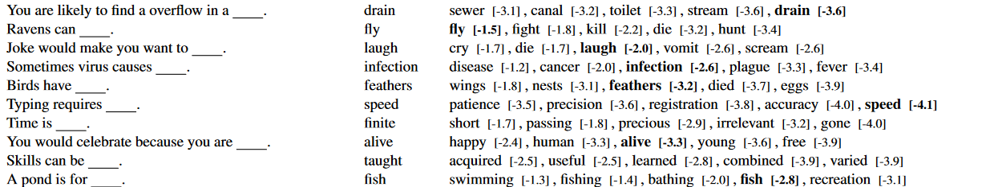
EMNLP’19
Query Answer Language model
Encouraging, but closer look
Limited vocabulary
Single token only

Slide 68
Own experiments
GPT2 from https://demo.allennlp.org/next-token-lm
My prefix GPT2’s prediction
Pandas eat bamboo in … the forest.
Pandas like to eat … the food they eat.
Lions like to eat … meat, but they are not carnivores.
Rabbits like to eat … and drink.
Cows mostly eat … the same food as cows, but they also eat a lot of other animals.
Lawyers wear black because … they are not allowed to wear black.

Slide 69
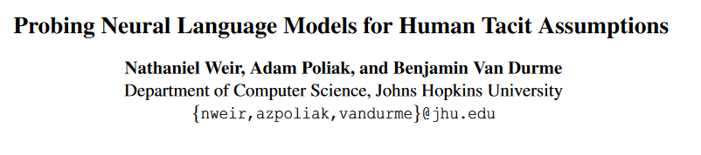
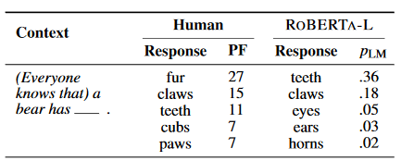
LMs struggle with proposing salient parts

Slide 70
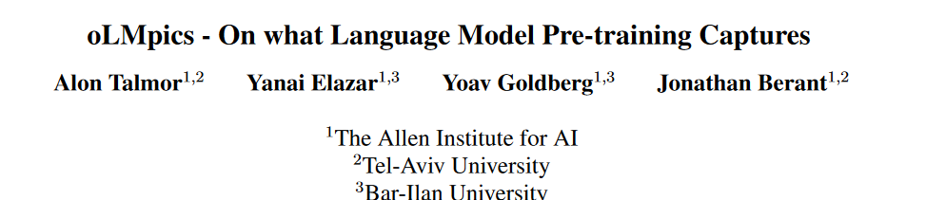
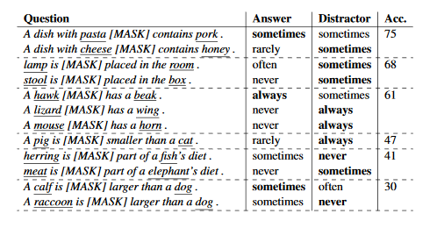
Can LMs understand the degree to which statements are true?
Overall find that models do not perform well.
Reporting bias may play a role in LMs in-ability to correctly determine cases such as “A rhinoceros NEVER has fur.”
Notes:
Groups in rows are by template type

Slide 71
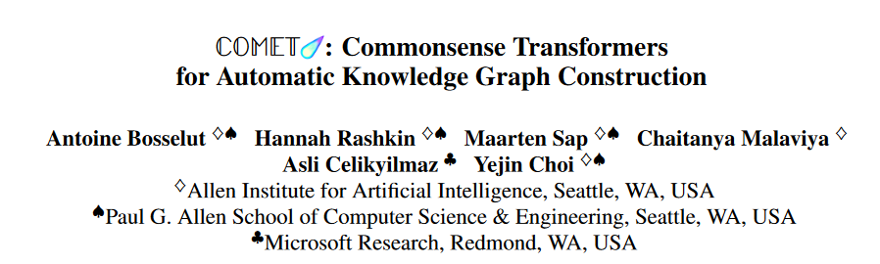
[ACL’19]
  Combine general LMs and CSK data to predict new CSK
  Initialized with pretrained GPT model
  Trained on ConceptNet and Atomic triples
https://mosaickg.apps.allenai.org/comet_atomic/?l=holding%20a%20videoconference

Slide 72
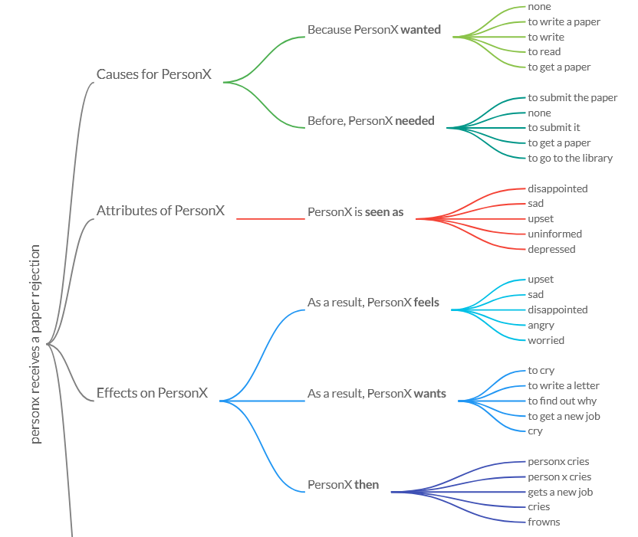

Slide 73
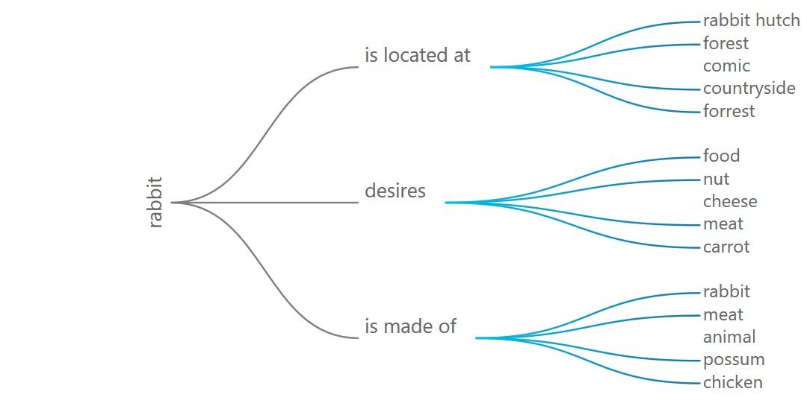

Slide 74
Summary – Transformer-based techniques
Pretrained language models come with a considerable set of statistical language knowledge
Can apply this to some extend to predict CSK
Struggle with deeper semantics (degree, negation)
Can fine-tune them on existing CSK collections for better performance (COMET)

Slide 75
Outline
Motivation
Knowledge representation
Crowdsourcing
Text Extraction
Transformer-based techniques
Consolidation
Summary and Outlook

Slide 76
Consolidation
Merge resources
Per-statement consolidation
  Feature-based classification/reranking
Joint consolidation
  Explore statement and facet interaction

Slide 77
Resource merging
ConceptNet
  OpenMind Commonsense, WordNet, Wiktionary, Verbosity, …?
CSKG [Ilievski et al., Arxiv 2020]
  ConceptNet, VisualGenome, Atomic, Wikidata, WordNet, Rogenet, FrameNet
  4.7 million nodes, 17.2 million edges

Slide 78
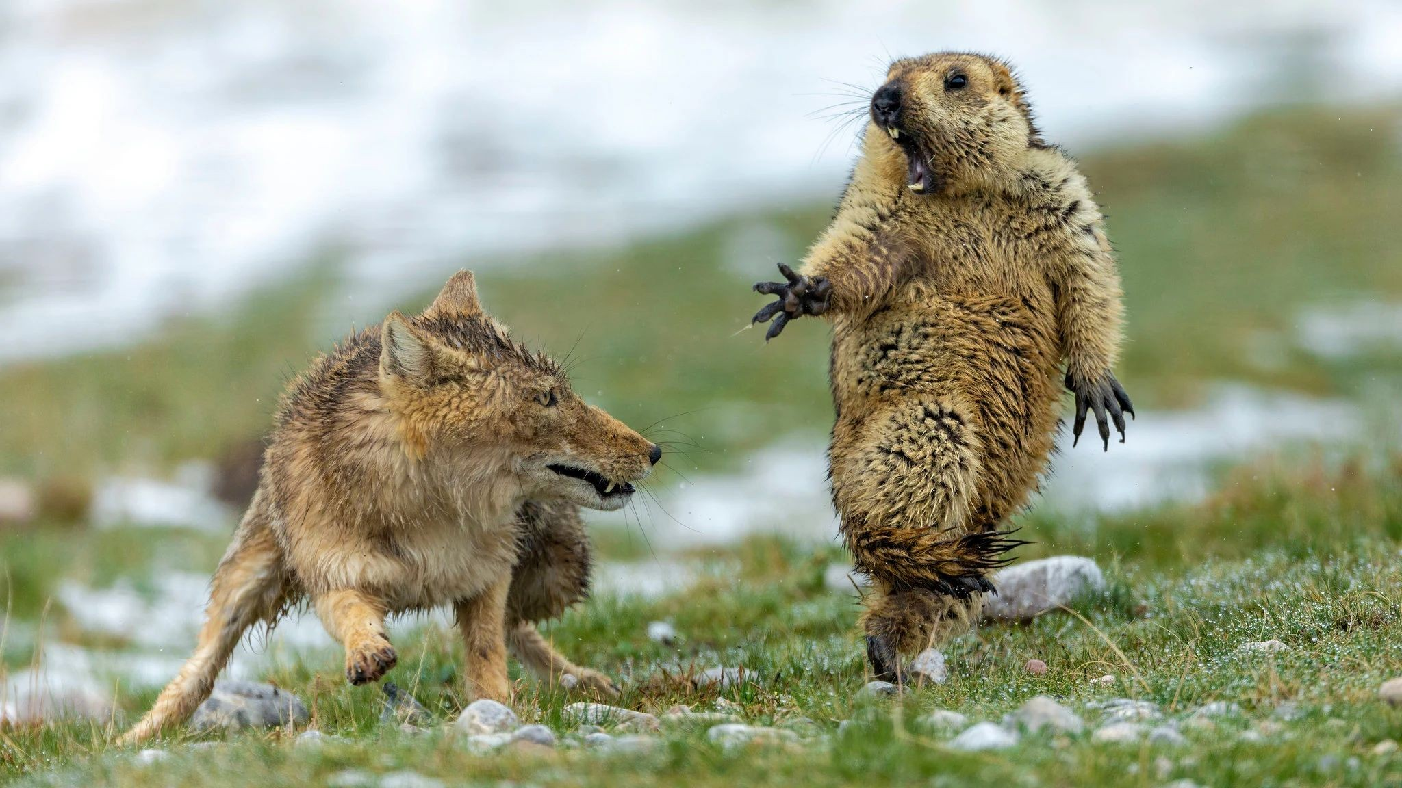
Per-statement consolidation
Quasimodo: Corroborate initial extractions using additional signals from :
Wikipedia and Simple Wikipedia
Answer snippets from search engines
Google Books
Image Tags from OpenImages and Flickr
Google’s Conceptual Captions dataset
Wildlife Photographer of the Year award goes to Yongqing Bao for image of Tibetan fox attacking marmot
Train classifier from all signals in 700 manually annotated triples
TupleKB similar from lexical features
Une école de l’IMT

Slide 79
Joint consolidation
A step back – CSK semantics
Lions, attack, humans

Slide 80

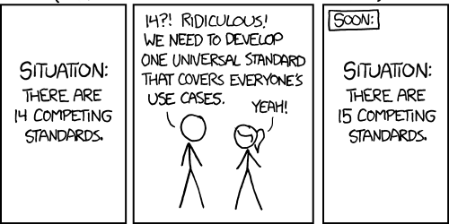
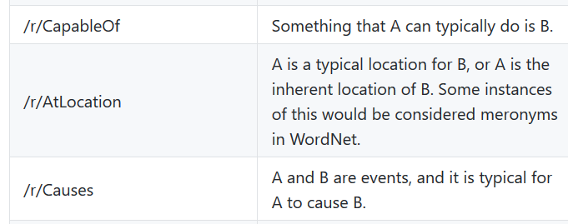

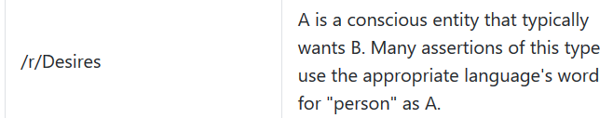
A step back – CSK semantics
In WebChild’s evaluations
we asked for plausibility
[WebChild coauthor,
personal communication]
[TupleKB]
Key observation 3: Disagreement about meaning of CSK
The goal of this paper is to advance the automatic acquisition of salient commonsense properties from online content of the Internet.
[Quasimodo]
Remarkability of terms is captured via inverse document frequency (IDF) [Information theory 101]
[ConceptNet]

Slide 81
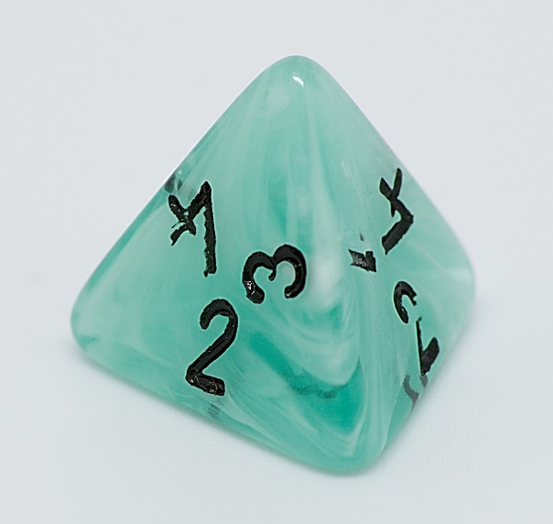
Multi-faceted CSK: Dice
Each statement (s, p) has four facets:
  Plausibility
  Typicality
  Remarkability
  Salience
Lions drink milk – Plausible, not typical
Lions eat meat – Typical, not salient
Lions attack humans – Salient, not typical

Slide 82
Joint reasoning
Consolidation in TupleKB, Quasimodo:
Each statement in isolation
In traditional DBs: Joint constraints
  Functionality, single-value constraints, disjointness, (a)symmetry, …
In KBs expert knowledge
  Humans two parents, marriage temporally functional, birth before death, …
  Prominent frameworks: PSL (DeepDive), MaxSAT (SOFIE)
  Not suited for open KBs
  → No hope for CSK consolidation?
Key observation: Generic soft constraints apply to CSK

Slide 83
Generic soft constraints for CSK
Taxonomical relations give dependencies
  Penguins not flying remarkable when most taxonomical siblings do fly
  Macaques eating bananas makes it likely that also stump-tailed macaques eat bananas
Similar statements reinforce each other
  Being able to swim correlates with being able to dive
  Lifting logs from the ground correlates with carrying trees
Facets of statements influence each other
  Being salient requires being plausible
  Being remarkable and typical implies being salient
Can combat sparsity!
Can encode coherence expectations!

Slide 84
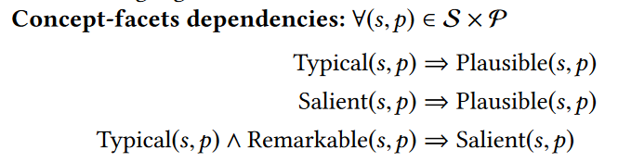
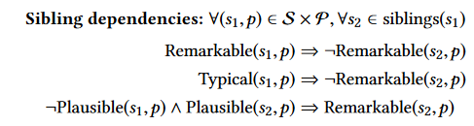
Joint reasoning framework
… parent-child dependencies, similar statement reinforcement
17 kinds of soft constraints in total

Slide 85
Implementation
How to bootstrap constraint system?
Taxonomy from Hearst-based web extraction [Hertling&Paulheim 2017]
Prior scores from
  Precision/frequency scores in existing CSKBs,
  Text entailment models,
  Statement entropy w.r.t. neighbourhood
How to ground it?
→ Active domain per subject (+neighbors)
→ Huge constraint system
→ Approximation via taxonomy-based slicing
How to solve it?
  Weighted maxSAT
  Encoded into ILP, ranking via reduced costs

Slide 86
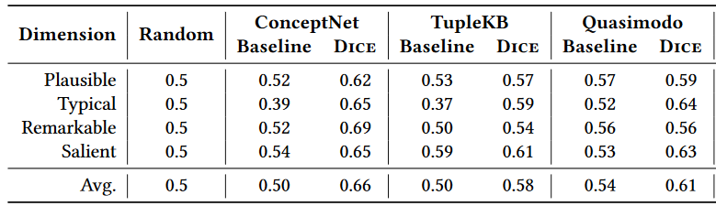
Evaluation
Crowd task:
Which of the following is more typical?
1. Lion roars.
2. Lion kills human.
Precision in pairwise statement ranking (ppref)
Baseline = existing single score in CSKB

Slide 87
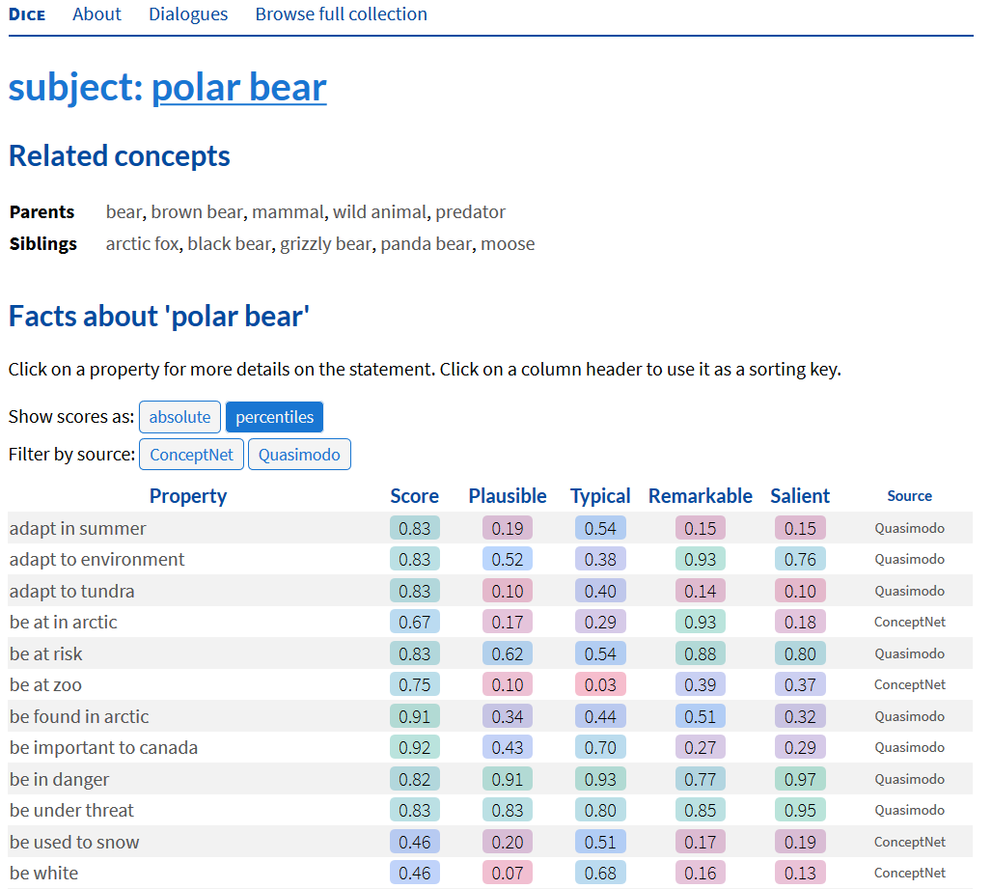
https://dice.mpi-inf.mpg.de/subject/polar-bear

Slide 88
Challenges
Task is hard
  0.58..0.69 ppref
Stronger priors difficult to identify
Model still with expressivity limitations
  Typicality ranking
  “lions hunt in packs vs. lions have manes”?

Slide 89
Consolidation
Merge resources
  Targets recall only
Per-statement consolidation
  Feature-based classification/reranking
  Helps to a significant degree, though with limits
Joint consolidation
  In principle most powerful
  Joint inference problems not easy to formulate and solve
Notes:
Maybe webchild graph-based, tuple KB clustering

Slide 90
Outline
Motivation
Knowledge representation
Crowdsourcing
Text Extraction
Transformer-based techniques
Consolidation
Summary and Outlook

Slide 91
Methodology
Crowdsourcing
  Costly, but in reach for industry
Text extraction
  Source, data model and extraction scheme selection
Language models
  Contain some CSK implicitly, can output explicit CSK with limitations
Consolidation
  Utilize frequency, linguistic features, and statement interrelations for higher quality

Slide 92
Evaluation
Intrinsic evaluation
  Size
  Precision
  Salience
  Recall
  → Based on user judgments/input
Extrinsic evaluation
  Wide set of academic benchmarks available
    AllenAI science challenge perhaps most prominent
  Often focus on reasoning, not just knowledge

Slide 93
Benchmarks on commonsense reasoning
CommonsenseQA
  https://www.tau-nlp.org/commonsenseqa
  Talmor et al. NAACL, 2019
CommonGen
  Lin et al., Arxiv, 2020
  https://arxiv.org/abs/1911.03705
MC-TACO
  Zhou et al., EMNLP 2019
  https://arxiv.org/pdf/1909.03065.pdf
Semeval 2020 Task 4
  https://competitions.codalab.org/competitions/21080
Further listings:
  https://leaderboard.allenai.org/

Slide 94
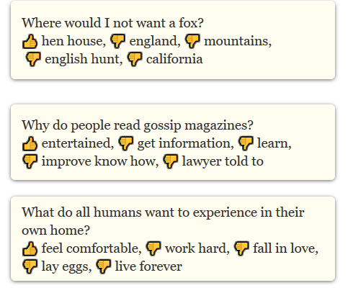
CommonsenseQA

Slide 95
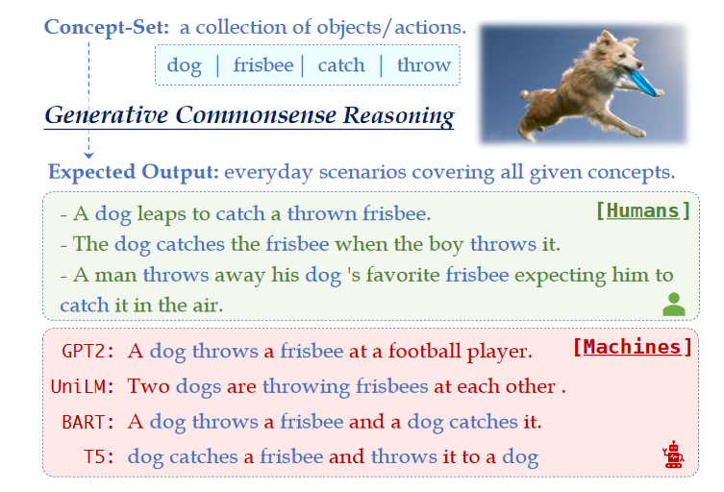
CommonGen

Slide 96
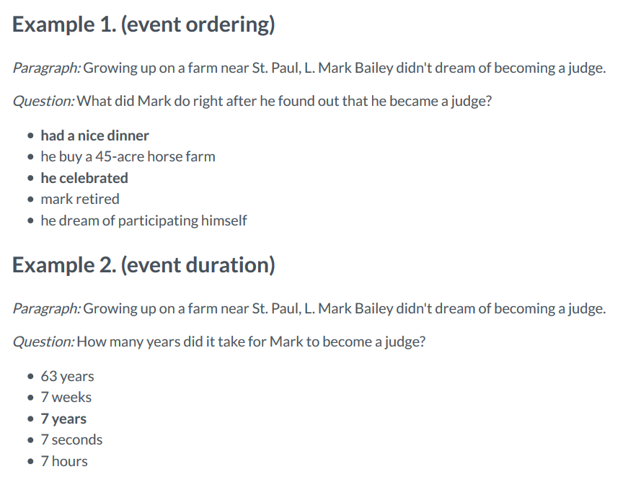
MC-TACO

Slide 97

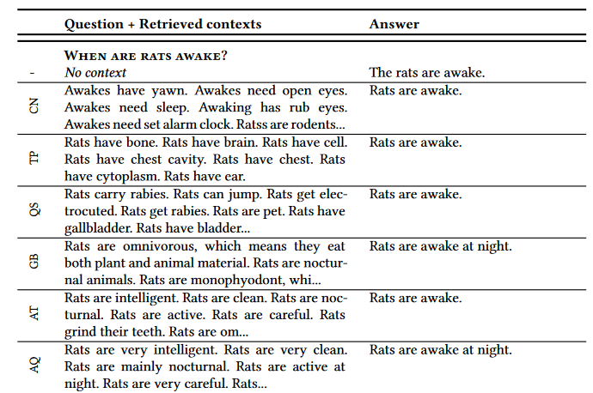

Context for language-model-based QA

Slide 98
Major resources
 | Domain | Relations
WordNet | Lexical knowledge | Synonymy, hypernymy, ..
ConceptNet | Concept properties | capableOf, UsedFor, … (~25)
WebChild | Concept-adjective relations, subparts | ~10
Atomic | Events | Open text
Quasimodo | Salient concept properties | Open text
Wikidata | Encyclopedic knowledge | ~50 relevant for CSK
DoQ | Quantities | ~20
Dice | Refined semantics | Addon for any resource
CSKG | Merger of 7 repositories | ConceptNet + subrelations

Slide 99
Summary
Structured CSK important interpretable and scrutable building block for trustworthy AI
Scope from taxonomical knowledge to properties and event orderings
Paradigms towards construction
  Human engineering
  Text extraction
  Language models
Coherence and density require reasoning on top
  Multi-source validation
  Constraint-based reasoning
Extrinsic evaluations often require complex systems
  LM-based completion provides novel clean scheme

Slide 100
Outline
Introducing each other
Organization of the seminar
Introduction to Knowledge Bases
Topic presentation
Seminar survival skills
Topic assignment
Notes:
Who wrote BSc. already could mention topic.

Slide 101
4. Topic presentation
https://www.mpi-inf.mpg.de/departments/databases-and-information-systems/teaching/ws2021/commonsense-knowledge-extraction-and-consolidation

Slide 102
Outline
Introducing each other
Organization of the seminar
Introduction to Knowledge Bases
Topic presentation
Seminar survival skills
Topic assignment
Notes:
Who wrote BSc. already could mention topic.

Slide 103
Report length
Latex template on course website
Last seminar: 21-38 pages (median 25.5)
  Includes 3+ pages title+outline, 2+ pages references
  → 16..31 pages content
So 20 pages content sensible target
  But moderate under/overshooting not an issue
  (Hard minimum 12 pages)
  Reviews will give insights where detail is lacking or elaboration is too long
  “If I Had More Time, I Would Have Written a Shorter Letter”

Slide 104
5. Survival skills for seminar attendants

Slide 105
Outline
How to…
  Research a topic
  Read a paper
  Write a report
  Write a review
  Give a seminar talk

Slide 106
Topic research: Foundations
Goal: Find relevant literature
Input: One or two reference papers
Idea: Greedy traversal of a relatedness graph (“snowballing”)
What gives related papers?
  Papers that are cited
  Papers that cite the work
    Sources: Google Scholar, digital libraries (ACM digital library, Springer, Elsevier)
  Other work of same authors
    Sources: Institute/personal webpages, DBLP
  Tool or project websites (e.g., AMIE)
  Conference/journal/workshop webpages
  Keyword-based search (Google Scholar)

Slide 107
Greedy search heuristics
How to judge importance of a paper?
  #citations
  Venue
    A*, A, (B), …
    http://portal.core.edu.au/conf-ranks/
  Paper type and length
    Full/short/poster/Arxiv
  (Authors)

Slide 108
Keeping track
Method
  Mendeley
  Google Scholar “My library”
  Text file
Mnemonic tricks
  Narrative patterns: “The classic rule mining”, “The Semantic Web community”, “The Paris people”, A trio of papers
    Brains love narratives, truth secondary (e.g., AI winter)
  Draw a graph

Slide 109
Demo
Google “AMIE: association rule mining under incomplete evidence in ontological knowledge bases”
Google Scholar
See in and outgoing citations
See author’s DBLP
CORE

Slide 110
Outline
How to…
  Research a topic
  Read a paper
  Write a report
  Write a review
  Give a seminar talk

Slide 111
Research paper: Common structure
Abstract
Introduction
Related Work
Background/Formalization
1..n times Methodology (often more specific names)
Experimental Setup
Evaluation
Discussion
Conclusion

Slide 112
What to find where
Abstract contains everything ☺
  Introduction contains more of everything ☺
    Both mention what is novel
Related work great to discover what to read next
Background/formalization may contain surprising assumptions/simplifications
  “for the remainder of the paper, we assume that all sentences have no more than 3 words”
Experimental setup says how method was evaluated
Discussion/conclusion contain limitations and open questions

Slide 113
How to read a paper
Read abstract
Read introduction
Skim rest, especially methodology and results
Read introduction again
Decide further process
  Continue reading
  Read previous work
  Discard
If something is hard to understand
  Read a related paper: Might explain better
  Take pen&paper and simulate a scenario
  Look for theses/journal articles

Slide 114
Outline
How to…
  Research a topic
  Read a paper
  Write a report
  Write a review
  Give a seminar talk

Slide 115
General writing
Follow the Latex template (course website)
  Miktex and other Latex distributions
  Lyx (Word-style editing)
  Overleaf/Sharelatex (Google-docs-like online editing)
At least 12 pages content
Do not plagiarize
  Style reveals
  Tool support
  As academic, reputation irrevocably destroyed
  As student, notification of study dean

Slide 116
Structure
Use a standard outline
  Introduction
  Wider area/history of the topic
  Foundations/assumptions/specific scenario the works look at
  Technical parts
    Method 1, Method 2, Other methods
  Critical evaluation and discussion
  Conclusion
→ Helps the standard reader in retrieval

Slide 117
Watch your writing
Does only the content matter?
Surface features like appearance highly influence other dimensions of evaluation
Known as the Halo effect since 100 years (Thorndike, 1920)
Academic publishing:
3 typos in the abstract = rejection

Slide 118



Slide 119
Good presentation
Structure
Examples
Pictures
No typos
Correct and concise language

Slide 120
Specific hints
Explain the background of the work
  Who are the authors?
  Is this part of a bigger effort?
  See what else the authors published
Be subjective only in discussion/conclusion
  There: What seems good, what seems bad, what did you like, what has promise for future?
  Elsewhere, avoid noncomparative judgements (“good”, “fast” – “more robust than”, “faster than”)
Avoid wiggle language
  “around 800”, “a lot of works”, “2 experienced annotators”
Be consistent
  Subsections numbered or not
  Capitalization style for headings
  Tense
  Typesetting, e.g., of entities and predicates
  References format (page numbers, conference names)
Check use of articles

Slide 121
How to write a good paper
Get feedback
Iterate

Slide 122
Outline
How to…
  Research a topic
  Read a paper
  Write a report
  Write a review
  Give a seminar talk

Slide 123
Writing a review
Peer review crucial for trust in scientific method
Binary/ternary outcomes: Accept/reject/revise and resubmit
Controversial topic with much to say
Recommended reads:
  “The task of the referee”
  Further links:
    https://2020.emnlp.org/blog/2020-05-26-instructions-for-reviewers
    https://www.openresearch.org/wiki/ESWC_2019#Review_Criteria
    https://www.elsevier.com/reviewers/role
    https://acl2017.wordpress.com/2017/02/23/last-minute-reviewing-advice/

Slide 124
Major points
Be specific
  Illustrate points with examples
    “The paper requires extensive proofreading” -> Give three examples of odd formulations/typos
    “The methodology in Section … is unclear” -> Say which specific part is unclear: In Section …, after the paragraph on options for source identification, it remains unclear to me which of the three option is followed through”
Be fair
  “Do to others what you would have them do to you”
Be constructive
  “Algorithm for source discovery is hard to follow through” -> “I’d suggest to expand the theoretical discussion with a running example

Slide 125
How far is our paper style from “real” papers?
“Real” papers mostly have a novel methodological and/or experimental contribution
Novelty (and its significance) thus major criteria
But there’s an exception: Survey papers
  E.g., Semantic Web Journal:
  “Survey articles – full-length papers surveying the state of the art of topics central to the journal's scope. [..]Survey articles should have the potential to become well-known, highest quality introductory and overview texts. These submissions will be reviewed along the following dimensions: (1) Suitability as introductory text, targeted at researchers, PhD students, or practitioners, to get started on the covered topic. (2) How comprehensive and how balanced is the presentation and coverage. (3) Readability and clarity of the presentation. (4) Importance of the covered material to the broader Semantic Web community.”

Slide 126
Possible review structure
1 paragraph summarizing report in your own words
  Helpful to authors to see possible different interpretations/misunderstandings
Listing of 3 positive points (I like about this report 1. …, 2. …, 3. …)
3 critical points (may be aggregate point)
Paragraphs elaborating each critical point with details and suggestions for improvement
Listing of minor points (typos, odd wordings, etc.)
~500-800 words

Slide 127
Technical setup
Easychair submission system
https://easychair.org/conferences/?conf=csksem2020
  Enter metadata of their report till December 12
  Submit bids on other reports till January 14
  Submit PDF drafts till January 14
  Review assignment is done January 14/15
  Reviews due January 28
  (will send reminders)

Slide 128
Outline
How to…
  Research a topic
  Read a paper
  Write a report
  Write a review
  Give a seminar talk

Slide 129
How to give a seminar talk
General:
  Presentations are the 15-minute fame of researchers
  Utmost important
  Good presenting is no God-given skill but a hard-learned craft
Important points
  Talks live or die with the example(s) used
  Do not try to say everything
  Less content per slide
  Avoid being a tool-fool

Slide 130
A. Examples
Think about them carefully
  Funny and/or interesting case
  Bonus: References to local/current situation/joint background
    Talk anywhere in the world now: Covid, talk in Paris: Eiffel tower, …
Need to be consistently used
  Not: on Slide 3 “Mary lives in Munich”, on Slide 10 “Mary lives in Berlin”
  Ideal: Same examples for the whole presentation (extended piece by piece)
If possible: 1 use of blackboard per presentation

Slide 131
B. Do not say everything you know
Most situations: Talk is a teaser
  “This is an interesting problem”
  “I have a solution for …”
  “I can significantly improve over the state of the art”
  …
Main goal is not to convey full technical content
  That’s what papers/reports are for
Often: Overview + explain one favorite module
of the approach in detail

Slide 132
B. Adjust to the audience
Adjust talk to audience knowledge
Audience rarely have same technical background
→ Don’t outdistance them
But don’t bore them either
  E.g. in the context of this seminar, don’t repeatedly elaborate
  “a knowledge base is a set of triples (s,p,o), …”
Adjust to context
  We have just seen …, now we …
  Look what other talks might cover – talk to these presenters!

Slide 133
C. Less content per slide (1/2)
Most slides contain too much content
  1-2 minutes per slide
Whenever looks like too much
  Split in two
  Use animation effects to remove content not needed anymore (e.g. in examples)
Font size not below 20 (PPT)
  This is 28, quite big
  This is 24, reasonably OK
  This is 20, which should be your limit
  This is 16, what do you think people in the last row see?

Slide 134
C. Less content per slide (2/2)
But this is not only about font size
Even though I use font size 28/20 for all text on this slide, you may get the impression that something is wrong with this slide
  Is this possibly related to the amount of information conveyed?
  Well, actually, what I am saying is not very deep. You already know very well that the human brain has only a limited attention span. So by the time you are reading this you certainly have forgotten what was written at the top of this slide.
More structure does not help either
  Because too much is simply too much. So really pay attention both to font size and to amount of information conveyed

Slide 135
D. Avoid being a tool-fool
Latex vs. Powerpoint
Redraw diagrams
Edit images

Slide 136


Modify screenshots for legibility

Slide 137

Varia (1/3)
Seminar “Advanced Topics in Knowledge Bases” Lesson 3: How to give a talk XX.YY.2018
Avoid useless generic information
Page numbers
No empty last slide “questions”,
  Rather overlay over conclusion
→ Gives audience an anchor
Dr. Simon Razniewski Max Planck Institute for Informatics www.simonrazniewski.com

Slide 138
Questions?

Slide 139
Summary
Questions?
How to…
  Research a topic
    Use multiple means
  Read a paper
    Read, read, read
  Write a report
    Watch the simple things
  Write a review
    Be specific
  Give a seminar talk
    Less is more
    Spend a lot of effort on good examples

Slide 140
Varia (2/3)
Tell three times
  Tell what you are going to tell
  Tell it
  Tell what you told
Easy way: Repeat outline throughout talk
  Good point to breathe in deeply, take a sip of water, look at your watch, ask “everything clear so far?”

Slide 141
Outline
How to…
  Research a topic
  Read a paper
  Write a report
  Give a seminar talk

Slide 142
Varia (3/3)
Helpful slide: “Not in this talk”

Slide 143
Not in this talk
How to typeset math formulas
  See e.g. “Mathematical writing” by Donald Knuth
How to write in good language
  Search online
Rhetorical hints
  Take a course at the Center for Key Competencies and University Didactics

Slide 144
Practice (1/3)
John Wooden’s 8Ps of Success
  Plan
  Prepare
  Practice
  Practice
  Practice
  Practice
  Practice, and
  Practice

Slide 145
Practice (2/3)
Everybody is nervous
Positive psychology: Enjoy your presentation, and your audience will enjoy
Keep visual contact
  Camera on
Taking questions
  Be thankful for questions
  Acknowledge gaps, forward questions, take issues offline

Slide 146
Practice (3/3)
Same setting is not required
  Explain over lunch to a colleague
  Your parents are OK too
Helps to get more familiar
Watch for flow, consistency, odd transitions

Slide 147
Summary
Questions?
How to…
  Research a topic
    Use multiple means
  Read a paper
    Read, read, read
  Write a report
    Watch the simple things
  IV. Write a review
    Be specific
  V. Give a seminar talk
    Less is more
    Spend a lot of effort on good examples

Slide 148
Outline
Introducing each other
Organization of the seminar
Introduction to Knowledge Bases
Topic presentation
Seminar survival skills
Topic assignment

Slide 149
5 - Social stereotypes and biases | Priyanka Das
2 – Modelling CSK and generics | Priyanka Upadhyay
8 – noun compounds | Quynh Trang Hoang
3- Time and causality | Sushmita Nair
7 – Pysical CSK | Awantee Deshpande
1- A psychological view on CSK | Tanja Christine Bäumel
4- Quantitative and comparative knowledge | Syed Taqi Abbas Rizvi
6- Commonsense explanations | Maximilian Wagner

Slide 150
Summary
Questions?
Introducing each other
Organization of the seminar
Introduction to Knowledge Bases
Topic presentation
Seminar survival skills
Topic assignment
Next steps
  Enroll in HISPOS
  Do literature research
  Prepare second deliverable
Notes:
Who wrote BSc. already could mention topic.

