Slide 1
Commonsense knowledge extraction and curation
Simon Razniewski
Winter semester 2020/21

Slide 2
Outline
Introducing each other
Organization of the seminar
Introduction to commonsense knowledge
Topic presentation
Seminar survival skills
Topic assignment

Slide 3
Outline
Introducing each other
Organization of the seminar
Introduction to commonsense knowledge
Topic presentation
Seminar survival skills
Topic assignment

Slide 4
Simon Razniewski
Senior Researcher at MPII, Department 5
Heading “Knowledge Base Construction and Quality” area
Background
Assistant professor at FU Bozen-Bolzano, Italy, 2014-2017
Extended visits at AT&T Labs-Research, University of Queensland, UC San Diego
PhD FU Bozen-Bolzano, 2014
Diplom at TU Dresden, 2010
Background:
Logics, databases, Semantic Web
More recently IR, (applied) NLP, ML, …
Research interests:
Information extraction, knowledge base construction, data quality, …

Slide 5
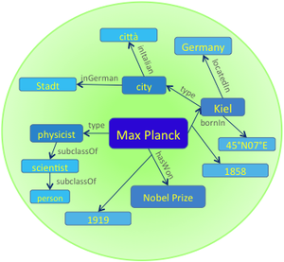
Department 5
Department 5: Database and information systems, ~25 members
Knowledge discovery: extracting, organizing, searching, exploring and ranking facts from structured, semi-structured, textual and multimodal information sources
Knowledge Base
Earliest prominent machine-generated knowledge base (2007)
Contains more than 10 million entities and more than 120 million facts
Gerhard Weikum 259th most cited computer scientist worldwide
Notes:
Source: http://www.guide2research.com/scientists/

Slide 6
And you?
Name
Course of study
Specialization (thesis topic?)
…
Notes:
Who wrote BSc. already could mention topic.

Slide 7
Outline
Introducing each other
Organization of the seminar
Introduction to commonsense knowledge
Topic presentation
Seminar survival skills
Topic assignment
Notes:
Who wrote BSc. already could mention topic.

Slide 8
Formal organization
Credit points: 7, hours: 210 (!)
Registration
HISPOS
Till 2 weeks after topic assignment
So max. 3 weeks from now
What to do?
Attend the introductory lectures and block seminar days
Produce 5 deliverables
Short writeup on open questions (November 12 – 5%)
Report extended outline (December 12 – 5%)
Report 1st revision (January 14 - 0%)*
Reviews on two other reports (January 28 - 10%)
Reports 2nd revision (February 11 - 40%)
Give a presentation (March 4 - 40%)
Extended outline
…
2. Methodology
2.1 KB Representation
Discussion on how to represent knowledge
Comparison with other representations
Benefits and limitations of such representations
…

Slide 9
What is expected?
Research and presentation of a topic
Independent literature research
~2 seed references provided
In-depth and in-breadth discussion of the topic in the seminar report
Typically carefully chosen components in depth
Less deep broader overview
→ Talk to me if unsure
Seminar presentation more narrow than the report
Careful content selection and organization, visual design and presentation
Main grading basis:
Seminar paper:
Depth
Breadth
Presentation quality
Presentation and discussion:
Didactic value
Presentation quality
Knowledge (ability to answer questions)

Slide 10
Learning outcomes
Knowledge
What is a commonsense knowledge
How is such knowledge collected, consolidated, exploited, …
Skills
Learn to research a topic
Learn to read scientific papers
Learn to structure and write up a scientific paper
Learn to give high-quality scientific presentations
→ Almost a thesis!
Only missing the own original technical contribution

Slide 11
Outline
Introducing each other
Organization of the seminar
Introduction to commonsense knowledge
Topic presentation
Seminar survival skills
Topic assignment

Slide 12
Outline
Motivation
Knowledge representation
Crowdsourcing
Text Extraction
Transformer-based techniques
Consolidation
Summary and Outlook
Based on a tutorial at KI 2020
http://simonrazniewski.com/commonsense-tutorial-ki-2020

Slide 13
Outline
Motivation
What is CSK?
Why is it important?
What makes it challenging?
Knowledge representation
Crowdsourcing
Text Extraction
Transformer-based techniques
Consolidation
Summary and Outlook

Slide 14
What is commonsense knowledge?
Definition 1 (by commonality): Knowledge shared by most humans
Possible qualifications
Across cultures
From early in life (=children)
E.g., elementary school exam questions
http://data.allenai.org/ai2-science-questions

Slide 15
What is commonsense knowledge?
Definition 2 (by knowledge type): Knowledge about concepts and events
Concepts: Person, party, newspaper
Events: Election, election party
Differentiation from encyclopedic knowledge on instances
Instances: Joe Biden, Republican Party, New York Times
What to know about concepts and events?
Properties
Relations
Taxonomical
Subparts
Temporal and causal relationships
…

Slide 16
Definition Pro/Con
Definition 1 (by commonality):
Popsicle, is, frozen – only known in North America
Lion is dangerous/cute - depends whom you ask
→ Inclusion/exclusion decision challenging
Definition 2 (by knowledge type):
Germany, locatedIn, Europe – excluded as instance knowledge
Mitochondria, hasPart, inner membrane – not common knowledge
→ Class knowledge limitless

Slide 17
Examples of CSK
Taxonomical
Elephant, isA, mammal
Properties
Elephant, lives in, Savanna
Parts
Elephants, hasPart, trunk
Measures
Adult elephant, weight, ~2..5 tons
Elephant, lifespan, ~60 years
Activities
Seeing elephant, requires, go to zoo
Go to zoo, subevent, buy ticket
Go to zoo, typicalDuration, 2 hours
Example KB: Ascent: https://ascentkb.herokuapp.com/

Slide 18
Out of scope for remainder
Lexical knowledge
Word senses, synonymy, …
WordNet as prime example: https://wordnet.princeton.edu
Taxonomic knowledge lion is a mammal is a vertebrate is a …
Good coverage in lexical projects
WordNet, WebIsADB, …
Encyclopedic KBs
Wikidata
Structured sister project of Wikipedia, mostly focused on encyclopedic knowledge
Knowledge on concepts slowly growing, though limited set of useful predicates
Recent analysis: [Commonsense Knowledge in Wikidata, Ilievski et al., Arxiv, 2020]
NELL, DBpedia, YAGO, …
Similar encyclopedic focus

Slide 19
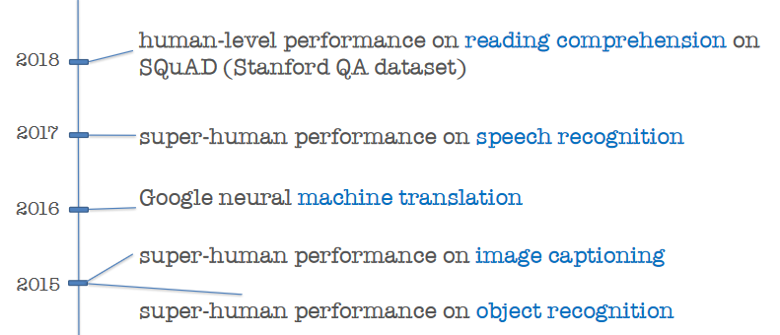
Why CSK? Amazing progress without
[From Yejin Choi, ACL 2020]

Slide 20
[From Yejin Choi, ACL 2020]
Notes:
For *any* “how many” question, SOTA models will say 2

Slide 21
Importance of CSK
Reusable and scrutable asset for a range of AI tasks
Reusable:
CSK can be plugged into a range of tasks, e.g., QA, dialogue, object recognition, text generation, …
Contrasts with typical end-to-end learning
Scrutable:
Humans can inspect, add and remove content
Relevant in applications where errors are costly
Relevant in applications at risk of bias/discrimination
Humans can inspect discrete statements used for reasoning
Relevant for debugging complex downstream use cases
Contrasts with end-to-end learning and pretrained language models
Notes:
Examples Microsoft Tay
Man/woman/doctor/nurse

Slide 22
Challenges of compiling CSK knowledge
Semantics
“Lions, attack, humans” – all/some/all the time/once/..?
Salience
“Elephant has trunk” vs. “Elephant has tibia bone”
Reporting bias
“woman kills” vs. ”woman breathes” – 1.5M vs. 0.1M
“pink elephant” vs. “grey elephant” – 6.9M vs. 1.9M
Sparsity in sources
Do Python programmers drink water?
Noise and polysemy
Pigs can fly - idiom
Lynx: Constellation, web browser, animal

Slide 23
Outline
Motivation
Knowledge representation
Crowdsourcing
Text Extraction
Transformer-based techniques
Consolidation
Summary and Outlook

Slide 24
Knowledge representation challenges
Encyclopedic KBs: Typically binary truth notion
Trump, born in, NY
House of Cards, producer, Netflix
Bamberg, mayor, Herbert Lauer, [1994-2006]
CSK: Generalizes across subjects
Lions, have, manes - percentage?
Fuzzy time notion
Lions, drink, milk - when?
Spatial and cultural context
Lion, is, cute
Grashopper, is, tasty

Slide 25
Linguistics - Generics
It is complicated
Ducks lay eggs >> Ducks are female
Even though former set is a subset of latter
Dinosaurs are extinct
Not applicable to individuals
[Generics oversimplified, Leslie, 2013]

Slide 26
Epistemic logics
“Zoo visitors believe lions are cute”
“Rural dwellers believe lions are dangerous”
Used in CycL
Reification
Modals for belief and desires
[CYC: Towards programs with common sense, Lenat et al., 1990]
[Kriepke 1963], and others

Slide 27
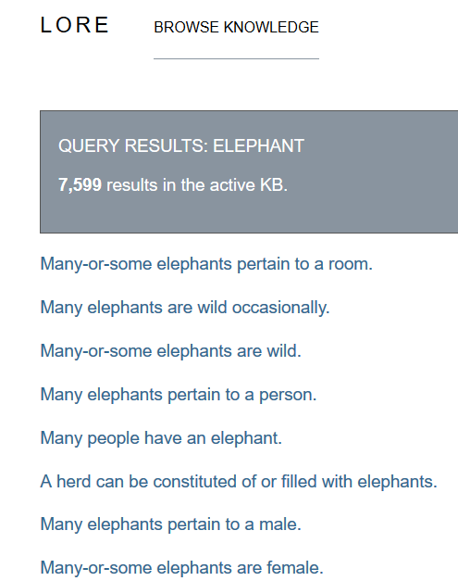
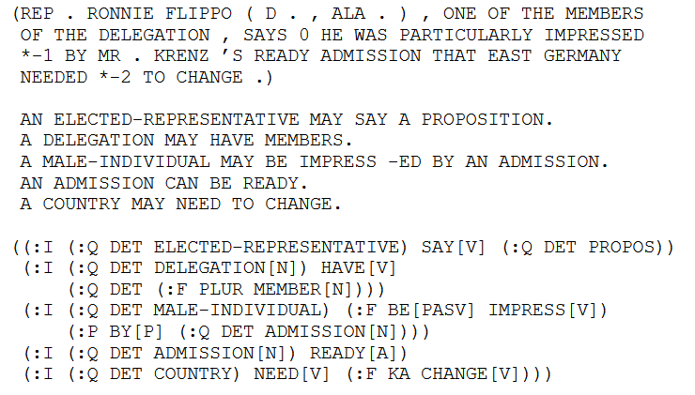
Episodic logics
KNext, Lore projects in early 2000s
Schubert, Lenhart. "Can we derive general world knowledge from texts.“ HLT 2002

Slide 28
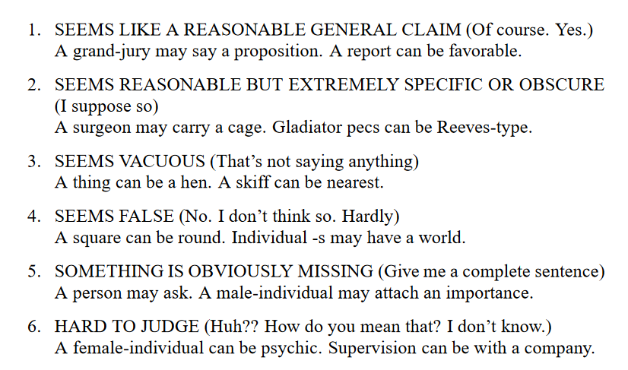
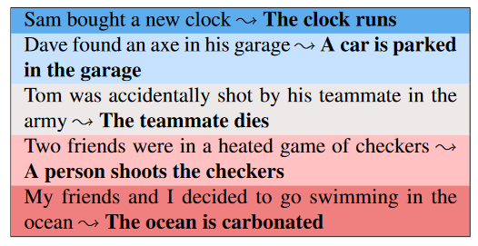
Graded formalisms
Heuristic level in CycL
True, default true, unknown, default false and false as statement labels
Ordinal grades [Schubert and Tong, NAACL 2003]
Simplified [Zhang et al., TACL 2017]
Very likely
Likely
Plausible
Technically possible
impossible
Notes:
Ordinal Common-sense Inference – durme 2017

Slide 29
Graded formalisms (2)
Dice [Chalier et al., AKBC 2020]
4 dimensions
 | Plausible | Typical | Salient | Remarkable
Lions; eat; chicken | ✓
Lions; attack; humans | ✓ |  | ✓ | ✓
Lions; drink; water | ✓ | ✓

Slide 30
Chat bot examples
Plausibility
Avoid blunders, detect irony (lion enjoyed taking selfies)
Typicality
Infer missing context (user saw hyenas → likely a pack)
Remarkability
Infer concepts (spotted laughing animal → hyena)
Salience
Move conversation (user saw lion → was it roaring?)

Slide 31
KR – (Pre)Summary
Expressive proposals exist
Instantiation hard
Sparse realization in natural language
Correct extraction nontrivial
Most projects: Pragmatic choice of (subject, predicate, object) triples with a single score
Lion, hunts, zebra – 0.73
Lion, drinks, milk – 0.45

Slide 32
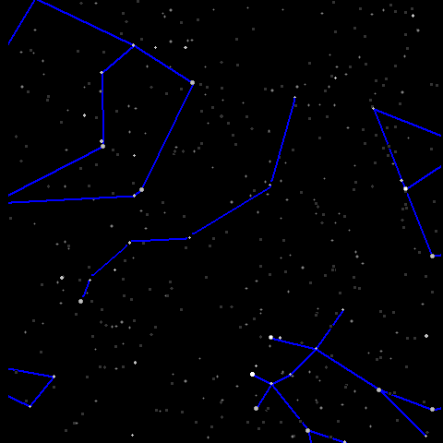
Triples and done?
Still major design decisions left!
Fixed or open set of predicates
Subject range
Object range
Fixed vs. open predicates
E.g., ConceptNet: ~25 predicates (isCapableOf, requires, isA) vs. TupleKB ~1000 textual phrases
Subjects: Strings or disambiguated terms?
Lynx vs. lynx vs. lynx
Granularity and modifiers
Elephant, Foraging elephant? Newborn elephant?
Objects: Entities or open phrases?
Politician, isCapableOf, promise that impossible things will happen

Slide 33
Knowledge representation – Summary
Balance between expressivity and extractive tractability
Use cases impact choice of formalism
Dialogue/QA: Textual phrases help matches
Entity comparison: Stricter predicates help matching

Slide 34
Outline
Motivation
Knowledge representation
Crowdsourcing
Text Extraction
Transformer-based techniques
Consolidation
Summary and Outlook

Slide 35
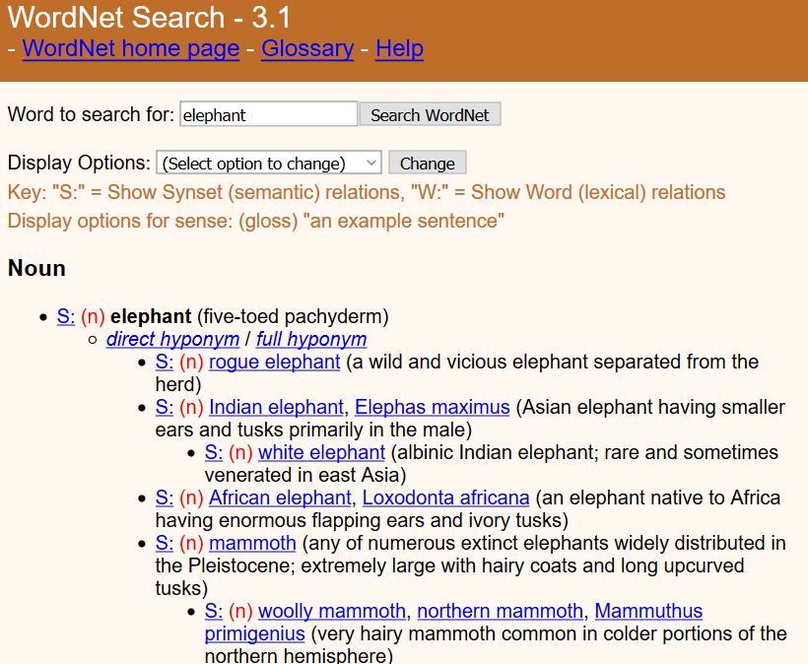
Crowdsourcing Expert annotation
WordNet [Miller and Fellbaum, ~80s]
Lexical resource still popular today
Is-A, synonym, partOf
~200k word senses
2 expert annotators (=authors)
Limitations: Imbalance, idiosyncrasies, lack of scores/ranking
Cyc [Lenat, ~80s]
CSK, world knowledge, rules
Hired experts on specific domains
>1000 person-years of effort estimated
Next projects: Harness power of laypeople

Slide 36
Open Mind Common Sense / ConceptNet
Havasi et al., MIT ~1999 [http://conceptnet.io/]
CSK for ~25 relations
Construction statistics
~14k volunteers filled in sentences with blanks
~700 000 English sentences
NLP tools: 300 000 concepts and 1.6 million assertions
[ConceptNet — a practical commonsense reasoning tool-kit, Liu and Singh, 2004]

Slide 37
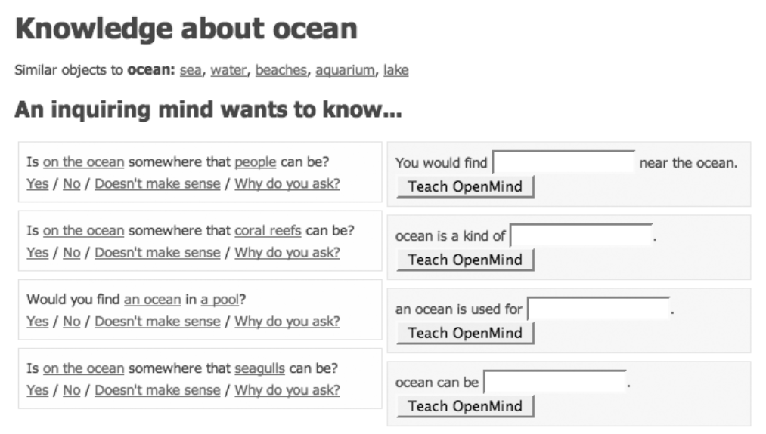
Open Mind Common Sense / ConceptNet

Slide 38
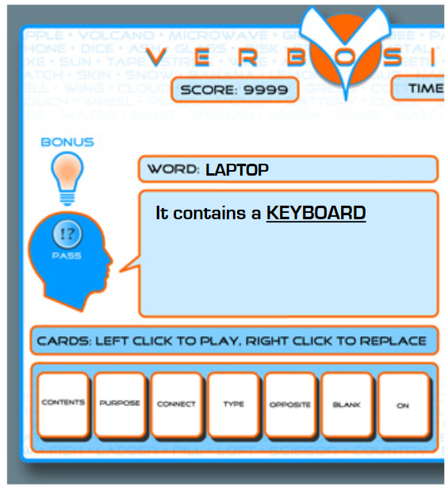
Verbosity
2-player game inspired by Taboo
Narrator must describe a word by fillig blanks in templates
___ is a kind of ___. Allows for hierarchical categorization.
___ is used for ___. Provides information about the purpose of a word.
___ is typically near/in/on ___ (three templates). Provide spatial data.
___ is the opposite of ___ / ___ is related to ___(two templates). Provide data about basic relations between words.
Templates give rise to CSK assertions
Verification via automated narrator that replays human assertions
Used to feed ConceptNet
High-quality: 85% of sentences rated as correct by 6/6 annotators
[Ahn et al., 2006]
Notes:
Van ahn famous for human computation, captchas

Slide 39
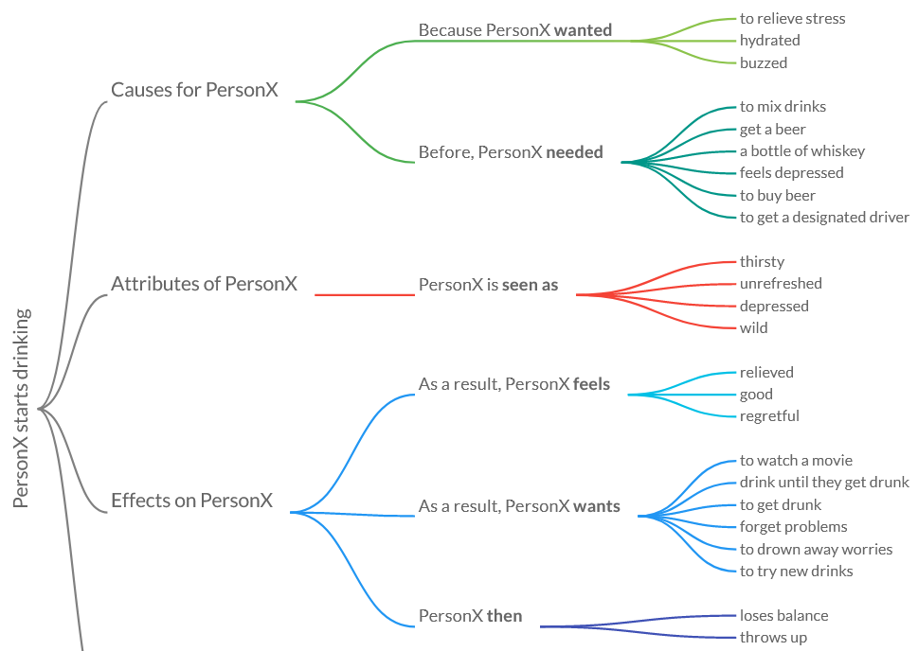
Atomic
Targets event knowledge
https://mosaickg.apps.allenai.org/kg_atomic
Redundancies!
[Sap et al., AAAI 2019]

Slide 40
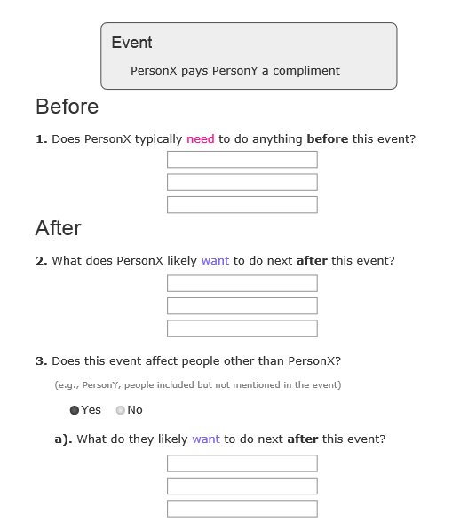
Atomic
Archetype of large-scale paid crowdsourcing
Subjects from text extraction (24k event phrases)
Statement creation
3 workers per subject
Free-form interface
~12$/hour
300k statements
3*5 minute/subject (?) → ~$100k cost

Slide 41
Quasimodo evaluation data
Not a KB construction effort!
Only tiny slice of humans data for evaluation
https://www.mpi-inf.mpg.de/fileadmin/inf/d5/research/quasimodo/CSK-crowd-for-recall.xlsx
2400 statements
[Romero et al., CIKM 2019]

Slide 42
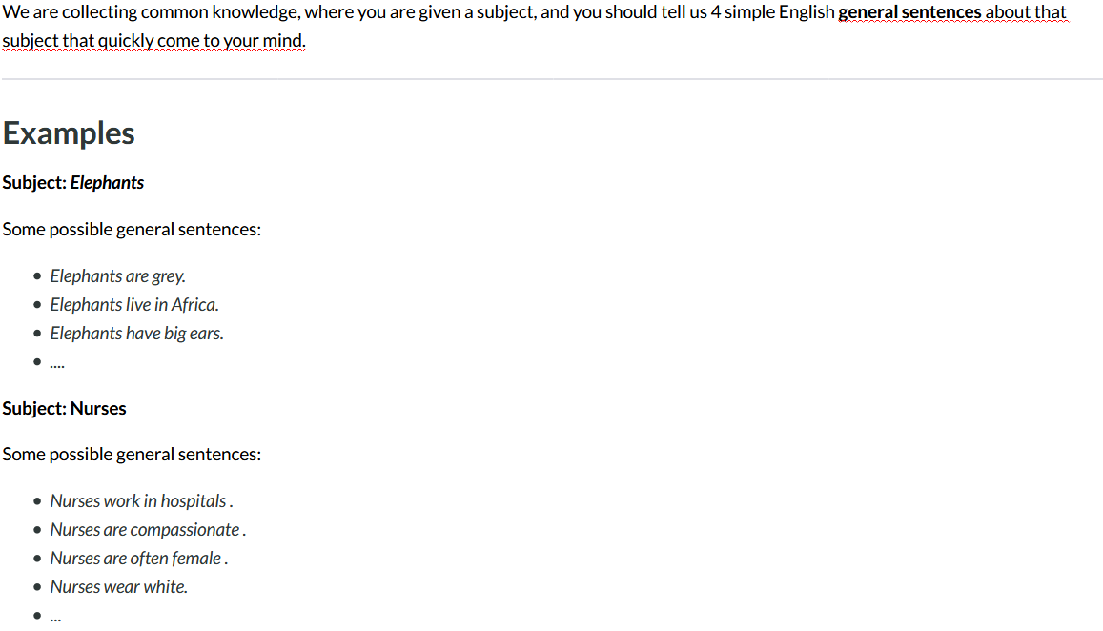
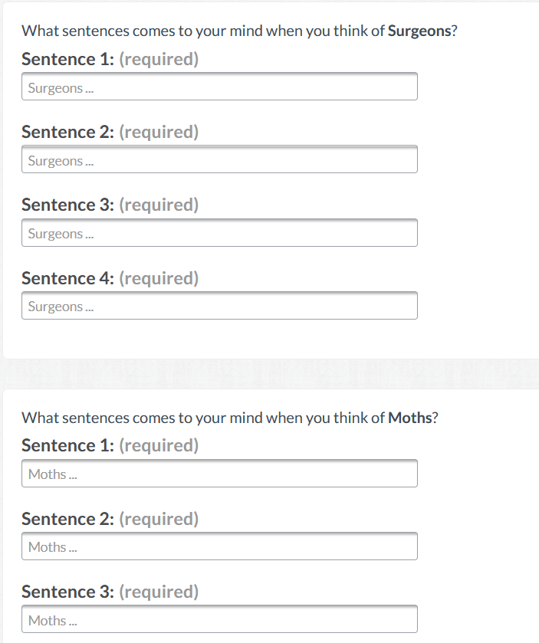
Still lots of misunderstandings
“I know a surgeon”
“Un cirujano es un gran hombre”
“The heart surgeon”
→ Second round of peer filtering might help
Notes:
We paid 15 cents per row -> assuming about 1 minute per subject

Slide 43
Wikidata
Collaborative knowledge base construction effort
Under umbrella of Wikimedia foundation
Best public source on encyclopedic knowledge today
Commonsense:
Comparably lower coverage
Roughly comparable to ConceptNet
Growing…to be monitored
[Ilievski et al, Arxiv 2020]

Slide 44
Crowdsourcing - Summary
Project | Focus | #statements | Notes
WordNet | Taxonomical relations | 175k synsets | Expert-built
Cyc | General statements and rules | OpenCyc: ~2 M statements | Expert-built, closed source
ConceptNet | Object properties | 1.6 M statements
Atomic | Events | 877k statements
Wikidata | Object properties | 100k CSK statements | Editable
Limited by volunteer effort/money
Targeted domains in reach for industrial efforts
Quality assurance important

Slide 45
Outline
Motivation
Knowledge representation
Crowdsourcing
Text Extraction
Transformer-based techniques
Consolidation
Summary and Outlook

Slide 46
Text extraction
Text extraction topic of long attention in KBC/NLP
Idea: Exploit patterns/commonalities in natural language in order to extract commonsense knowledge
Lynx eat hares
Elephants eat grass
_ eats _
Design points
Choice of sources
Choice of extraction method
Choice of consolidation
Prominent projects:
WebChild
TupleKB
Quasimodo
DoQ

Slide 47
Design point 1 – Extraction source
Wikipedia
Books and other dedicated sources
ARC science corpus
Web crawls
ClueWeb
CommonCrawl
Web search
Forums
Reddit
Yahoo Answers
Search engine query logs
…

Slide 48
Design point 2 – Extraction scheme
Manual patterns
Hearst patterns etc.
Co-occurrence
Window, same sentence, …
Open information extraction
Any verb phrase
Relation-specific supervised learning

Slide 49
Design point 3 – Consolidation
Keep all
Frequency cutoff
E.g., at least seen 5 times
Per-statement consolidation
Joint consolidation
See section 6

Slide 50
WebChild
Among the first large-scale attempts at text extraction
Named for getting children’s knowledge from the web
Original focus: Linking nouns with adjectives
Text source: Google web search 5-gram corpus
Patterns: ~20 copula verbs (be, look, feel, …)
[Tandon et al., WSDM 2014]

Slide 51
TupleKB
Knowledge about science topics
Main ideas:
Direct web extraction via search engine queries (keywords)
Open predicate set by retaining predicate phrases “as is” (OpenIE)
Partially consolidated using clustering
Supervised scoring
[Mishra et al., TACL 2017]

Slide 52
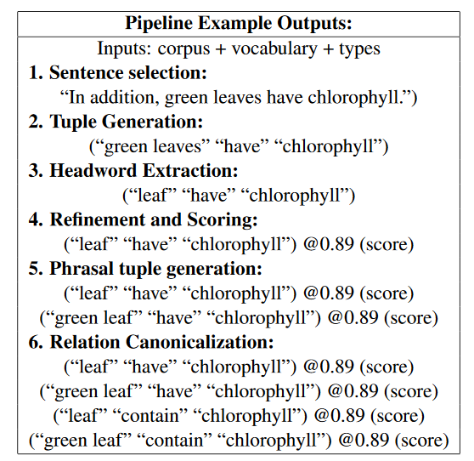
TupleKB

Slide 53
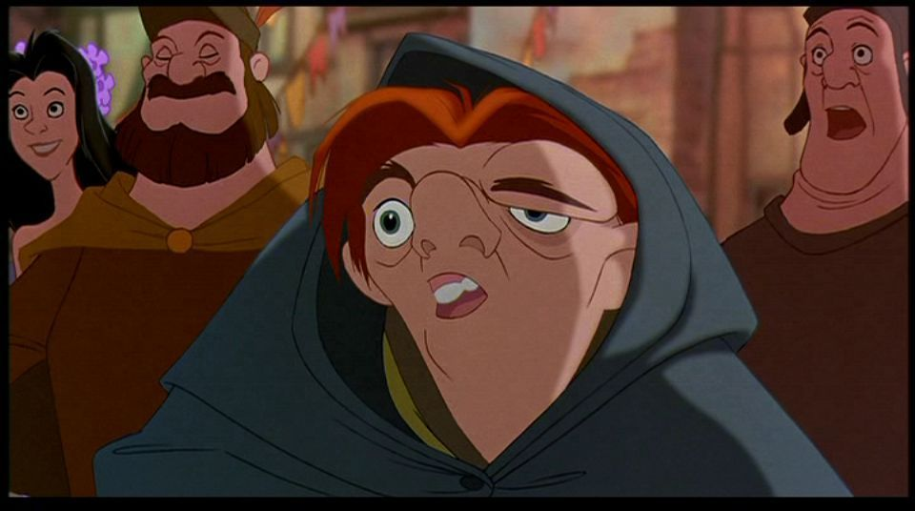
Quasimodo
= Query Logs and QA Forums for Salient Commonsense Definitions
Focus on salient knowledge
Human associations, curiosity
Characteristics
Adopts open(IE) schema (like TupleKB)
Salient assertions via careful choice of utterance context and sources
Corroboration stage for candidate verification
(The Hunchback of Notre Dame)
[Romero et al., CIKM 2019]

Slide 54
Salient knowledge: Utterance context
Key idea: Questions convey salient knowledge
Why do cats purr?
Why do Americans love guns?
Why are airplanes white?
So someone knows these!
That someone cares enough to ask!

Slide 55
Salient knowledge: Premier sources
QA forums:
Reddit
Quora
Yahoo answers
Ask.com
Search engine query logs
Bing
Google

Slide 56
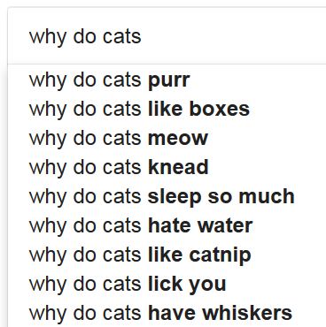
Tapping search engine query logs
Autocomplete gives only 10 suggestions/query → Exhaustive suffix probing
Why do cats a
Why do cats b
Why do cats …
Why do cats aa
Why do cats ab
…

Slide 57
Anecdotal Examples
Practical human knowledge | (car, slip on, ice)
Problems linked to a subject | (pen, can, leak)
Emotions linked to events | (divorce, can, hurt)
Human behaviors | (ghost, scare, people)
Visual facts | (road, has_color, black)
Cultural knowledge (USA) | (school, have, locker)
Comparative knowledge | (light, faster than, sound)
Une école de l’IMT

Slide 58
Quasimodo – Open issues
Questions sometimes go towards the odd
Why does car leak oil, catch fire, not start …
Not: Car transports people, consumes fuel, …
How to fit phrases into triples?
Lawyers, can make, the world a better place?
Lawyers, are, good for a fair judicial system?

Slide 59
Distribution over quantities (DoQ)
P
roprietary + Conﬁdential
Understanding numerical properties and the way they relate to words.
Lion
speed
weight
...
size
Physical attributes
[Elazar et al., ACL 2019]

Slide 60
Approach
P
roprietary + Conﬁdential
Count co-occurrences of measurements with the words that appear in their context
By using a large text corpora

Slide 61
Example - Aggregating Measurements

Slide 62
Resource Statistics - DoQ
Proprietary + Conﬁdential
Distributions over Quantities (DoQ)
A very large and diverse resource
~120M Unique tuples (object, measurement)
~350K with >= 1000 occurrences
Measurement types:
Length, mass, currency, temperature, …
27 In total

Slide 63
Comparable Objects - Cool Results
Proprietary + Conﬁdential

Slide 64
Summary – Text extraction
Design choice of
Resource
Data model
Extraction scheme
Project | Focus | Comments
Knext [2002] | Plausible assertions
XLore [2010] | Quantified assertions | Episodic logic
WebChild [2014] | Adjectives | Plausibility as inclusion criterion
TupleKB [2017] | Science knowledge
Quasimodo [2019] | General knowledge | Saliency instead of correctness as prime goal
DoQ [2019] | Quantities

Slide 65
Outline
Motivation
Knowledge representation
Crowdsourcing
Text Extraction
Transformer-based techniques
Consolidation
Summary and Outlook

Slide 66
Pretrained language models
BERT, ELMO, GPT, …
Major recent trend in NLP
Deep neural networks (Transformer networks)
Trained to fill gaps in text corpora, predict next sentences
Unsupervised training on huge corpora (~web crawls)
Able to generate plausible continuations for given input
Encode basic linguistic and world knowledge (?) that benefits many downstream tasks (fine-tuning)
Can we use them to generate CSK?

Slide 67
EMNLP’19
Query Answer Language model
Encouraging, but closer look
Limited vocabulary
Single token only

Slide 68
Own experiments
GPT2 from https://demo.allennlp.org/next-token-lm
My prefix GPT2’s prediction
Pandas eat bamboo in … the forest.
Pandas like to eat … the food they eat.
Lions like to eat … meat, but they are not carnivores.
Rabbits like to eat … and drink.
Cows mostly eat … the same food as cows, but they also eat a lot of other animals.
Lawyers wear black because … they are not allowed to wear black.

Slide 69
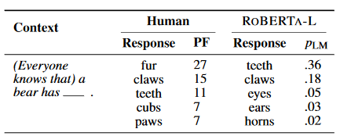
LMs struggle with proposing salient parts

Slide 70
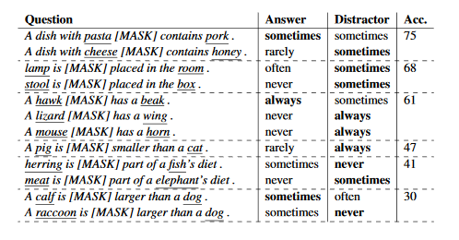
Can LMs understand the degree to which statements are true?
Overall find that models do not perform well.
Reporting bias may play a role in LMs in-ability to correctly determine cases such as “A rhinoceros NEVER has fur.”
Notes:
Groups in rows are by template type

Slide 71
[ACL’19]
Combine general LMs and CSK data to predict new CSK
Initialized with pretrained GPT model
Trained on ConceptNet and Atomic triples
https://mosaickg.apps.allenai.org/comet_atomic/?l=holding%20a%20videoconference

Slide 72
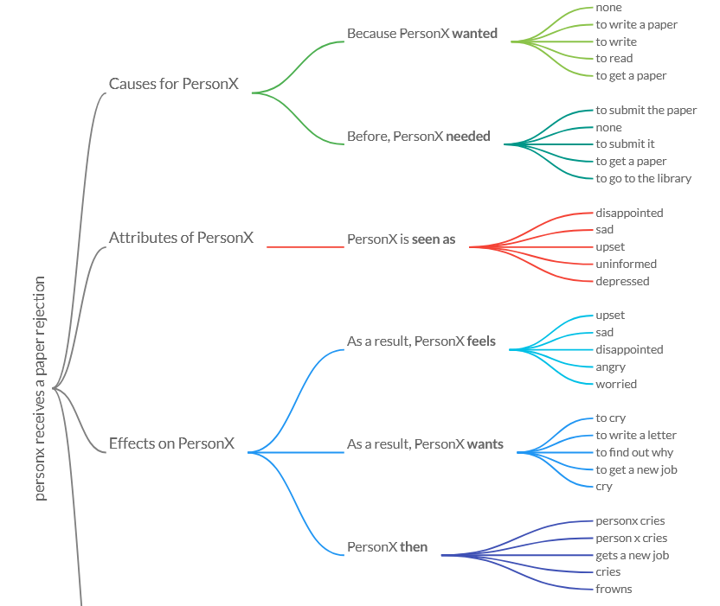

Slide 73
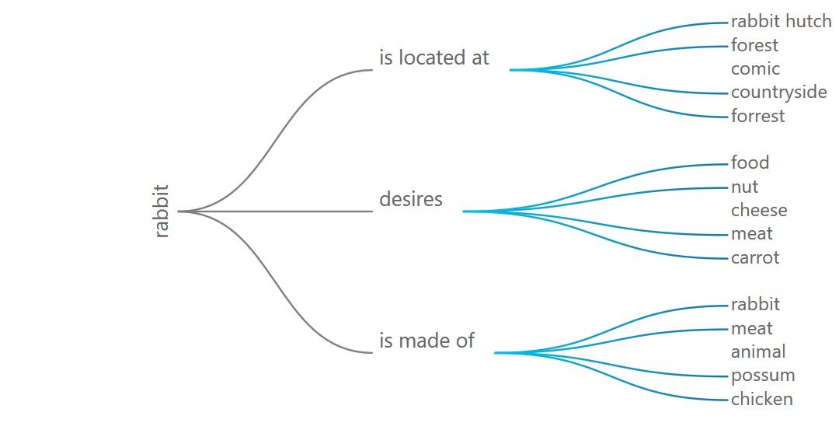

Slide 74
Summary – Transformer-based techniques
Pretrained language models come with a considerable set of statistical language knowledge
Can apply this to some extend to predict CSK
Struggle with deeper semantics (degree, negation)
Can fine-tune them on existing CSK collections for better performance (COMET)

Slide 75
Outline
Motivation
Knowledge representation
Crowdsourcing
Text Extraction
Transformer-based techniques
Consolidation
Summary and Outlook

Slide 76
Consolidation
Merge resources
Per-statement consolidation
Feature-based classification/reranking
Joint consolidation
Explore statement and facet interaction

Slide 77
Resource merging
ConceptNet
OpenMind Commonsense, WordNet, Wiktionary, Verbosity, …?
CSKG [Ilievski et al., Arxiv 2020]
ConceptNet, VisualGenome, Atomic, Wikidata, WordNet, Rogenet, FrameNet
4.7 million nodes, 17.2 million edges

Slide 78
Per-statement consolidation
Quasimodo: Corroborate initial extractions using additional signals from :
Wikipedia and Simple Wikipedia
Answer snippets from search engines
Google Books
Image Tags from OpenImages and Flickr
Google’s Conceptual Captions dataset
Wildlife Photographer of the Year award goes to Yongqing Bao for image of Tibetan fox attacking marmot
Train classifier from all signals in 700 manually annotated triples
TupleKB similar from lexical features
Une école de l’IMT

Slide 79
Joint consolidation A step back – CSK semantics
Lions, attack, humans

Slide 80
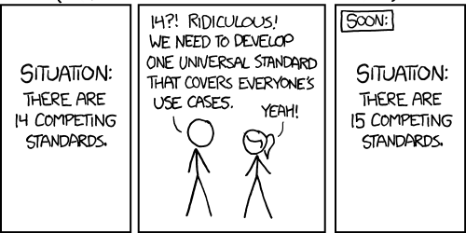
A step back – CSK semantics
In WebChild’s evaluations we asked for plausibility
[WebChild coauthor, personal communication]
[TupleKB]
Key observation 3: Disagreement about meaning of CSK
The goal of this paper is to advance the automatic acquisition of salient commonsense properties from online content of the Internet.
[Quasimodo]
Remarkability of terms is captured via inverse document frequency (IDF) [Information theory 101]
[ConceptNet]

Slide 81
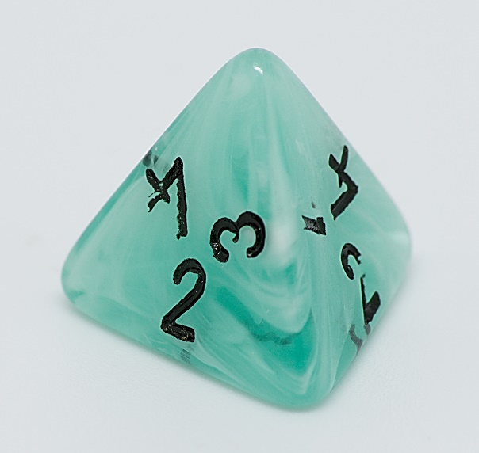
Multi-faceted CSK: Dice
Each statement (s, p) has four facets:
Plausibility
Typicality
Remarkability
Salience
Lions drink milk – Plausible, not typical
Lions eat meat – Typical, not salient
Lions attack humans – Salient, not typical

Slide 82
Joint reasoning
Consolidation in TupleKB, Quasimodo: Each statement in isolation
In traditional DBs: Joint constraints
Functionality, single-value constraints, disjointness, (a)symmetry, …
In KBs expert knowledge
Humans two parents, marriage temporally functional, birth before death, …
Prominent frameworks: PSL (DeepDive), MaxSAT (SOFIE)
Not suited for open KBs
→ No hope for CSK consolidation?
Key observation: Generic soft constraints apply to CSK

Slide 83
Generic soft constraints for CSK
Taxonomical relations give dependencies
Penguins not flying remarkable when most taxonomical siblings do fly
Macaques eating bananas makes it likely that also stump-tailed macaques eat bananas
Similar statements reinforce each other
Being able to swim correlates with being able to dive
Lifting logs from the ground correlates with carrying trees
Facets of statements influence each other
Being salient requires being plausible
Being remarkable and typical implies being salient
Can combat sparsity!
Can encode coherence expectations!

Slide 84
Joint reasoning framework
… parent-child dependencies, similar statement reinforcement
17 kinds of soft constraints in total

Slide 85
Implementation
How to bootstrap constraint system?
Taxonomy from Hearst-based web extraction [Hertling&Paulheim 2017]
Prior scores from
Precision/frequency scores in existing CSKBs,
Text entailment models,
Statement entropy w.r.t. neighbourhood
How to ground it?
→ Active domain per subject (+neighbors)
→ Huge constraint system
→ Approximation via taxonomy-based slicing
How to solve it?
Weighted maxSAT
Encoded into ILP, ranking via reduced costs

Slide 86
Evaluation
Crowd task:
Which of the following is more typical?
1. Lion roars.
2. Lion kills human.
Precision in pairwise statement ranking (ppref)
Baseline = existing single score in CSKB

Slide 87
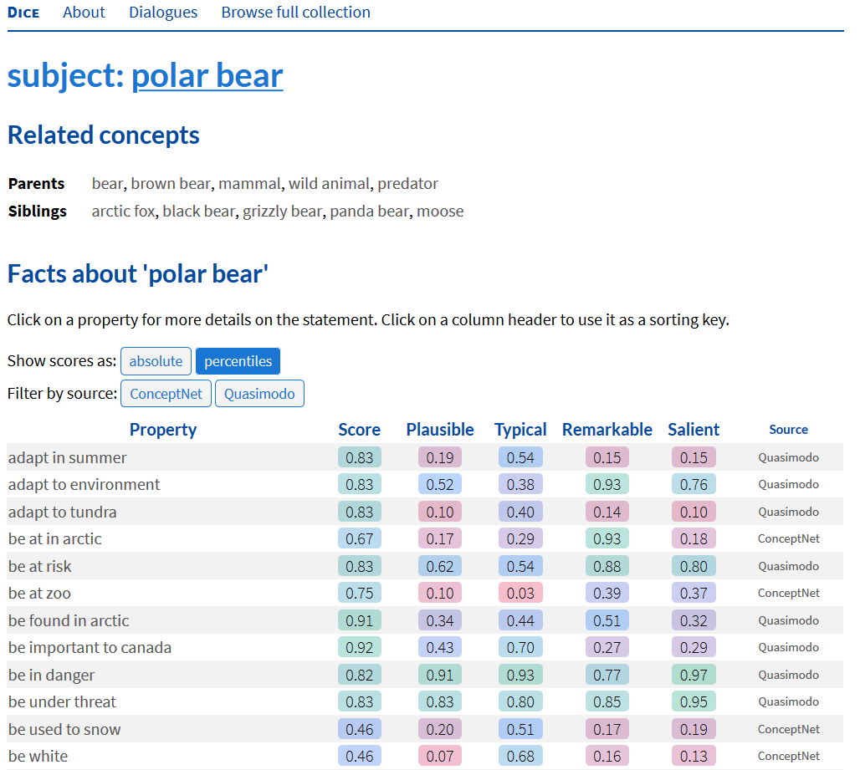
https://dice.mpi-inf.mpg.de/subject/polar-bear

Slide 88
Challenges
Task is hard
0.58..0.69 ppref
Stronger priors difficult to identify
Model still with expressivity limitations
Typicality ranking “lions hunt in packs vs. lions have manes”?

Slide 89
Consolidation
Merge resources
Targets recall only
Per-statement consolidation
Feature-based classification/reranking
Helps to a significant degree, though with limits
Joint consolidation
In principle most powerful
Joint inference problems not easy to formulate and solve
Notes:
Maybe webchild graph-based, tuple KB clustering

Slide 90
Outline
Motivation
Knowledge representation
Crowdsourcing
Text Extraction
Transformer-based techniques
Consolidation
Summary and Outlook

Slide 91
Methodology
Crowdsourcing
Costly, but in reach for industry
Text extraction
Source, data model and extraction scheme selection
Language models
Contain some CSK implicitly, can output explicit CSK with limitations
Consolidation
Utilize frequency, linguistic features, and statement interrelations for higher quality

Slide 92
Evaluation
Intrinsic evaluation
Size
Precision
Salience
Recall
→ Based on user judgments/input
Extrinsic evaluation
Wide set of academic benchmarks available
AllenAI science challenge perhaps most prominent
Often focus on reasoning, not just knowledge

Slide 93
Benchmarks on commonsense reasoning
CommonsenseQA
https://www.tau-nlp.org/commonsenseqa
Talmor et al. NAACL, 2019
CommonGen
Lin et al., Arxiv, 2020
https://arxiv.org/abs/1911.03705
MC-TACO
Zhou et al., EMNLP 2019
https://arxiv.org/pdf/1909.03065.pdf
Semeval 2020 Task 4
https://competitions.codalab.org/competitions/21080
Further listings:
https://leaderboard.allenai.org/

Slide 94
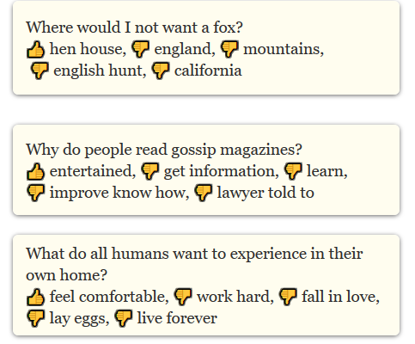
CommonsenseQA

Slide 95
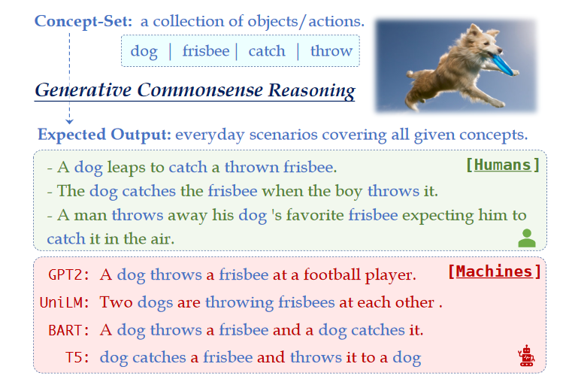
CommonGen

Slide 96
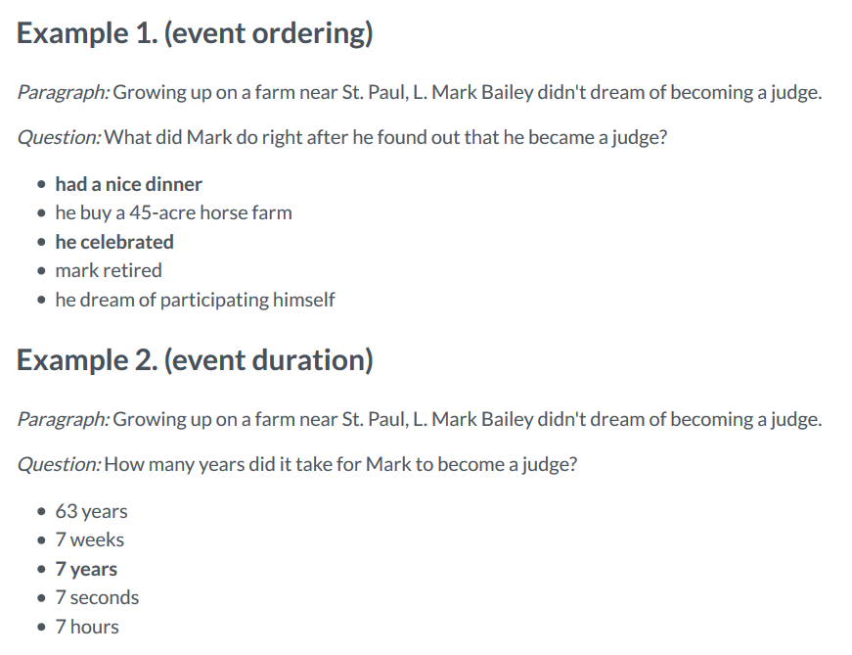
MC-TACO

Slide 97
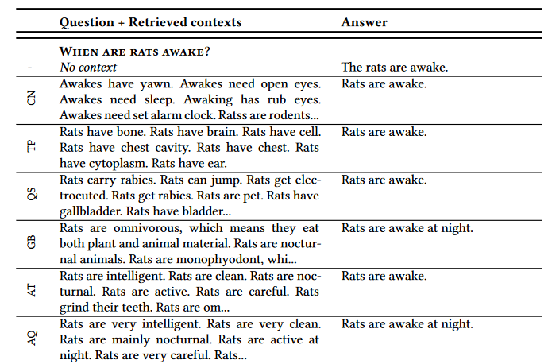
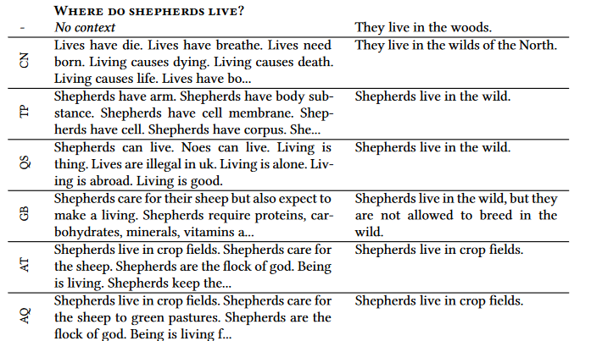
Context for language-model-based QA

Slide 98
Major resources
 | Domain | Relations
WordNet | Lexical knowledge | Synonymy, hypernymy, ..
ConceptNet | Concept properties | capableOf, UsedFor, … (~25)
WebChild | Concept-adjective relations, subparts | ~10
Atomic | Events | Open text
Quasimodo | Salient concept properties | Open text
Wikidata | Encyclopedic knowledge | ~50 relevant for CSK
DoQ | Quantities | ~20
Dice | Refined semantics | Addon for any resource
CSKG | Merger of 7 repositories | ConceptNet + subrelations

Slide 99
Summary
Structured CSK important interpretable and scrutable building block for trustworthy AI
Scope from taxonomical knowledge to properties and event orderings
Paradigms towards construction
Human engineering
Text extraction
Language models
Coherence and density require reasoning on top
Multi-source validation
Constraint-based reasoning
Extrinsic evaluations often require complex systems
LM-based completion provides novel clean scheme

Slide 100
Outline
Introducing each other
Organization of the seminar
Introduction to Knowledge Bases
Topic presentation
Seminar survival skills
Topic assignment
Notes:
Who wrote BSc. already could mention topic.

Slide 101
4. Topic presentation
https://www.mpi-inf.mpg.de/departments/databases-and-information-systems/teaching/ws2021/commonsense-knowledge-extraction-and-consolidation

